Slide 1
“Performance & Evaluation” (cont)

Slide 2
Outline
Techniques to increase speedup
Performance evaluation tools
Well-known performance models

Slide 3
Factors that Determine Speedup
Amount of sequential code (Amdahl’s law)
Amount of critical section code
Characteristics of parallel code
granularity
load balance
locality
communication and synchronization

Slide 4
Critical Section Code
Not quite sequential
– ?
But still only one processor at a time in critical section
Can result in contention for critical section lock

Slide 5
Approach 1
Minimize number of critical section accesses
Goal: reduce contention
General approach:
replace/approximate shared by local accesses
no need for critical section on local accesses

Slide 6
Approach 1 cont.
computepi()
{
h=1.0/n; sum =0.0;
for (i=0;i<n;i++) {
x=h*(i+0.5); sum=sum+4.0/(1+x*x);
}
pi=h*sum;
}
sum=0.0;
for(i=id;i<n;i=i+nprocs) {
x=h*(i+0.5); sum=sum+4.0/(1+x*x);
}
localpi=sum*h; use_tree_based_combining_for_critical_section();
pi=pi+localpi; end_critical_section();

Slide 7
Approach 2
Access shared data without critical section
Dangerous, because of possible incorrectness
Sometimes done to reduce overhead

Slide 8
Approach 3
Minimize amount of execution time inside critical section.
Minimize number of instructions.
Minimize number of data accesses, especially remote ones

Slide 9
Approach 4
Stagger accesses to critical sections in time
Example: each process executes:
Critical section A Critical section B Critical section C Critical section D
…
Solution?

Slide 10
Factors that Determine Speedup
Amount of sequential code (Amdahl’s law)
Amount of critical section code
Characteristics of parallel code
granularity
load balance
locality
communication and synchronization

Slide 11
Granularity
Granularity = size of the program unit that is executed by a single processor
May be a single loop iteration, a set of loop iterations, etc.
Fine granularity pros & cons?

Slide 12
Load Balance
Load imbalance = different in execution time between processors between barriers.
Static: done once before computation
block, cyclic, etc.
fine for regular data parallel
Dynamic: done at runtime
Centralized vs. distributed
fine for unpredictable execution
Usually high overhead

Slide 13
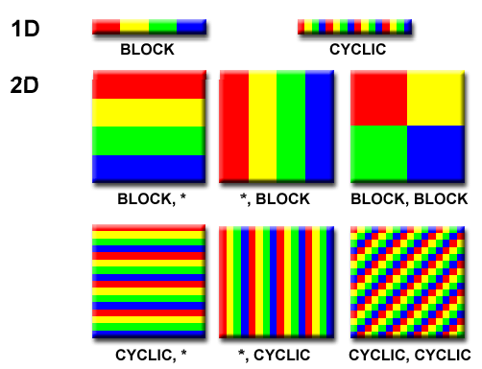
Static Load Balancing
Block
Pro & Con?
Cyclic
Pro & Con?
Block-cyclic
Pro & Con?

Slide 14
Dynamic Load Balancing
Centralized: single task queue.
Easy to program
Excellent load balance
Distributed: task queue per processor.
Less communication/synchronization
Task stealing:
Processes normally remove and insert tasks from their own queue
When queue is empty, remove task(s) from other queues
Discussion?

Slide 15
Locality
Locality (or re-use) = the extent to which a processor continues to use the same data or “close” data.
Temporal locality: re-accessing a particular word before it gets replaced
Spatial locality: accessing other words in a cache line before the line gets replaced

Slide 16
Example 1
for( i=0; i<n; i++ ) for( j=0; j<n; j++ )
grid[i][j] = temp[i][j];
Any locality?

Slide 17
Example 2
for( j=0; j<n; j++ ) for( i=0; i<n; i++ )
grid[i][j] = temp[i][j];
Locality?

Slide 18
Example 3
for( i=1; i<n; i++ ) for( j=1; j<n; j++ )
temp[i][j] = 0.25 *
(grid[i+1][j]+grid[i+1][j]+
grid[i][j-1]+grid[i][j+1]);
Locality?

Slide 19
Access to grid[i][j]
First time grid[i][j] is used: temp[i-1,j]
Second time grid[i][j] is used: temp[i,j-1]
Between those times, 3 rows go through the cache
If 3 rows > cache size, cache miss on second access

Slide 20
Traverse the array in blocks, rather than row- wise sweep
Fix
Make sure grid[i][j] still in cache on second access

Slide 21
Locality in Parallel Programming
View parallel machine
not only as a multi-CPU system
but also as a multi-memory system
Is even more important than in sequential programming, because the memory latencies are longer

Slide 22
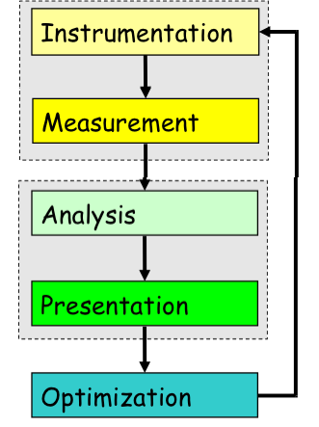
Performance Optimization
Expose factors
Collect performance data
Calculate metrics
Analyze results
Visualize results
Identify problems
Turn performance
This is an “art”

Slide 23
Performance Questions
How can we tell if a program is performing well?
Or isn’t?
If performance is not “good,” how can we pinpoint why?
How can we identify the causes?
What can we do about it?

Slide 24
Performance Tuning
The most important goal of performance tuning is to reduce a program’s wall clock time
Reducing resource usage in other areas, e.g., memory or disk requirements or energy consumption, may also be a goal
Performance tuning is an interactive process
Often involves finding your program’s hot spots and eliminating bottlenecks
Performance tuning usually involves profiling/tracing
Measure a program’s runtime characteristics and resource utilization
Use profiling/tracing tools to learn which areas of your code offer the greatest potential performance increase BEFORE you start the tuning

Slide 25
Profiling
Timing an entire program
UNIX time command outputs
user time
System time
Elapsed time
User time + system time = CPU time
Additional time output
Percent utilization
Average memory utilization
Blocked I/O operations
Page faults and swaps

Slide 26
Timing a Portion of a Program
Record the time before you start doing x
Do x
Record the time at completion of x
Subtract the start time from the completion time

Slide 27
Types of Profiling
Time-based
Based on other metrics such as
Operation counts
Cache and memory event counts
Types of Profile
Sharp profile
Flat profile

Slide 28
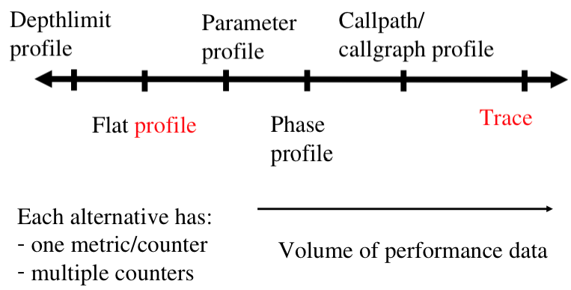
Profiling & Tracing

Slide 29
Subroutine Profiling
Most compilers provide a facility to automatically insert timing calls into your program at the entry and exit of each routine at compile time
A separate utility (e.g. prof, gprof) produces a report showing the percentage of time spent in each routine
Many performance analysis tools also provide this capability

Slide 30
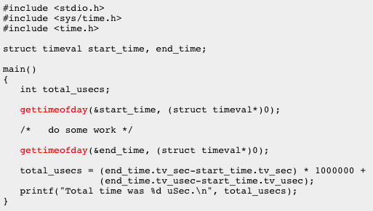
Gettimeofday()
Part of the standard C library (libc.a) on most Unix/Linux systems
Can be inserted anywhere within a C program and used to determine the start and end time of code fragments
Timer resolution is hardware dependent

Slide 31
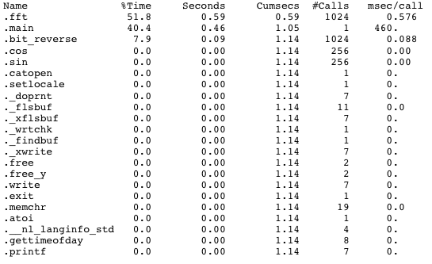
Profilers - prof
Included in most Unix/Linux systems
Can profile program execution at the procedure level

Slide 32
Hardware Performance Counters
Specialized registers to measure the performance of various aspects of a microprocessor
Can be used to profile:
Whole program timing
Cache behaviors
Branch behaviors
Memory and resource contention and access patterns
Pipeline stalls
Floating point efficiency
Instructions per cycle
Subroutine resolution
Process or thread attribution
CS546

Slide 33
PAPI
PAPI (Performance API) provides a programming interface for accessing performance counters
http://icl.cs.utk.edu/papi/
Countable events are defined in two ways
Platform-neural Preset Events
Standard set of over 100 events
Use papi_avail to see what preset events are available on a given platform
Platform-dependent Native Events
Any event countable by the CPU
Use papi_native_avail to see alll available native events
Use papi_event_chooser to select a set of events
CS546

Slide 34
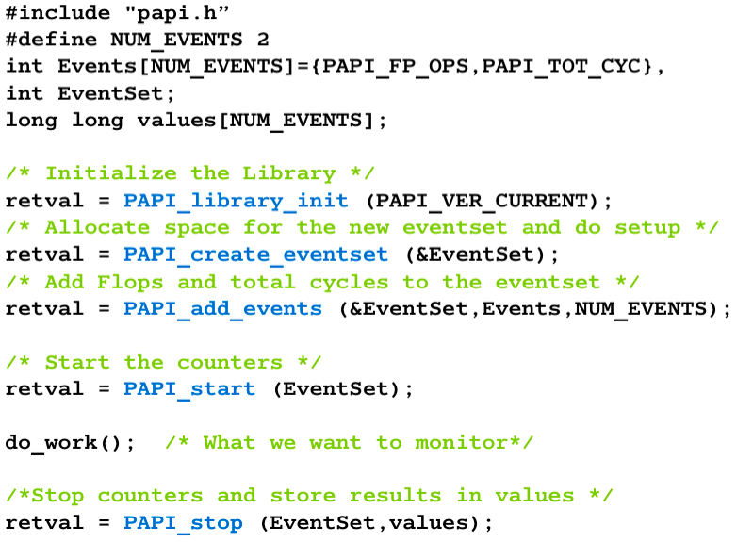
PAPI Example
CS546

Slide 35
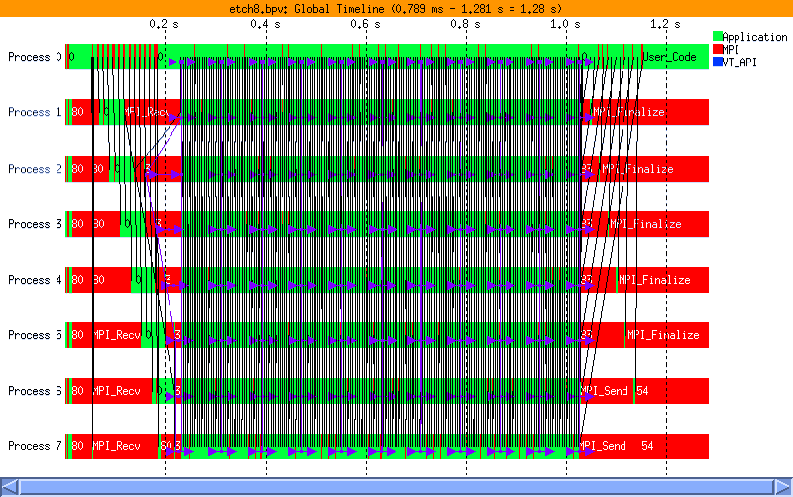
Tracing Tools
The program is monitored while it is executed
Monitoring produces performance data (TRACE) that is interpreted in order to reveal areas of poor performance
Tracing tools
Vampir
Paraver
CS546

Slide 36
Tuning and analysis utilities
TAU
– http://www.cs.uoregon.edu/research/tau/home.php
Integrated toolkit for performance tuning
Portable performance profiling and tracing
Instrumentation, measurement, analysis, and visualization
Supports several measurement options (profiling, tracing, profiling with hardware counters, etc.)
Can show how much time was spent in each routine
Can automatically instrument your source code
To use it, you need to set a couple of environment variables and substitute the name of your compiler with a TAU shell script
CS546

Slide 37
Well-Known Performance Models
PRAM
BSP
AB
LogP
CS546

Slide 38
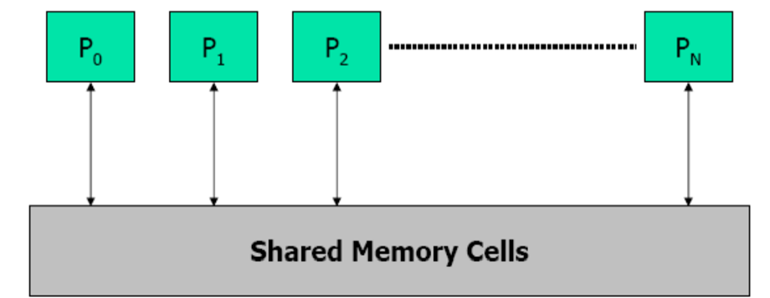
PRAM
Parallel Random Access Memory
Idealized abstraction of parallel systems
Properties
SIMD (all processors perform the same op in a cycle)
Polynomial no. of processors
Polynomial amount of shared memory
Uniform latency op: read, write, compute
Drawbacks?
CS546

Slide 39
PRAM Variants
Exclusive Read Exclusive Write (EREW)
At most one processor can read or write any memory cell in a step
Concurrent Read Exclusive Write (CREW)
Any processor can read any location
Only one processor may write any one memory cell in a step
Admits a large class of algorithms
Concurrent Read Concurrent Write (CRCW)
Each processor can read or write any one memory cell in a step
No consideration of memory contention
Variants depend on handling of write collisions
Common: assumes that all competing processor write the same value
Arbitrary: one arbitrary processor’s write succeeds; all others fail
Priority: write by highest priority processor succeeds; all others fail
Queue Read Queue Write (QRQW)
Permits concurrent reads and writes to shared memory locations
CS546

Slide 40
BSP Model
Bulk Synchronous Parallel Model
Execution as series of supersteps
– In one superstep, a processor
Sends limited no. of messages
Performs local computation
Receives all messages
Performs a global barrier
Efficient BSP algorithms
Overlap comm and comp
Comm bandwidth and latency can be ignored
Strengths
Simple enough to be used for design of portable algs
Enable designer to address key performance issues for algs
Evaluate algs using machine performance characteristics
CS546

Slide 41
Latency and Bandwidth Model
Time to send message of length n is roughly
Time = latency + n*cost_per_word
= latency + n/bandwidth
Topology is assumed irrelevant
Often called “α -β model” and written
Time = α + n*β
Usually α >> β >> time per flop
One long message is cheaper than many short ones
α + n∗β << n∗(α + 1∗β)
Can do hundreds or thousands of flops for cost of one message
Useful lesson from the model?
CS546

Slide 42
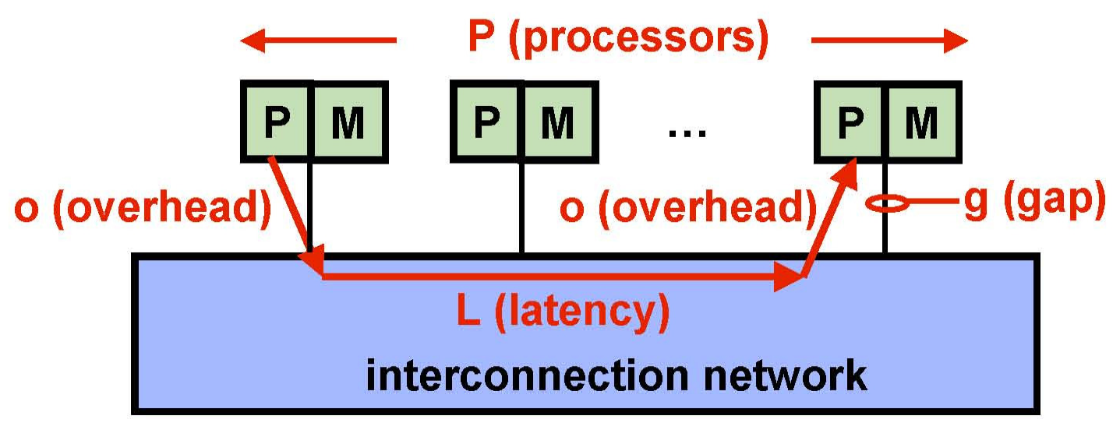
LogP Model
Abstract machine model
Four parameters
L: latency experienced in each comm event
Time to communicate word or small # of words
o: send/recv overhead experienced by processor
Time processor fully engaged in transmission or reception
g: gap between successive sends or recvs by a processor
1/g = comm BW
P: no. of processor/memory modules

Slide 43
Characteristics of LogP
Asynchronous processors that work independently
Messaging assumptions
All messages of small fixed size
Network has finite capacity
≤ ceiling(L/g) messages in transit from p to q at once
Attempting to transmit more causes processor to stall
No topology considerations
Assumes a fully connected network
Unpredictable msg latency
Bounded from above by L in absence of stalls
Notable missing aspect: local computation
Does not model local computation
Ignores cache size, pipeline structure

Slide 44
LogGP: Account for Long Msgs
Motivation
LogP: predicts performance for fixed-size short msgs only
Modern machines support long msgs with higher BW
Goal: model performance with both short and long msgs
Modeling long msgs:
Transmission time: t=t_{o}+t_{B}*n
Insufficiently detailed for short msgs
LogGP
Extend LogP with additional parameter G
G=gap per byte for long msg – time per byte for long msg
1/G=BW for long msg

Slide 45
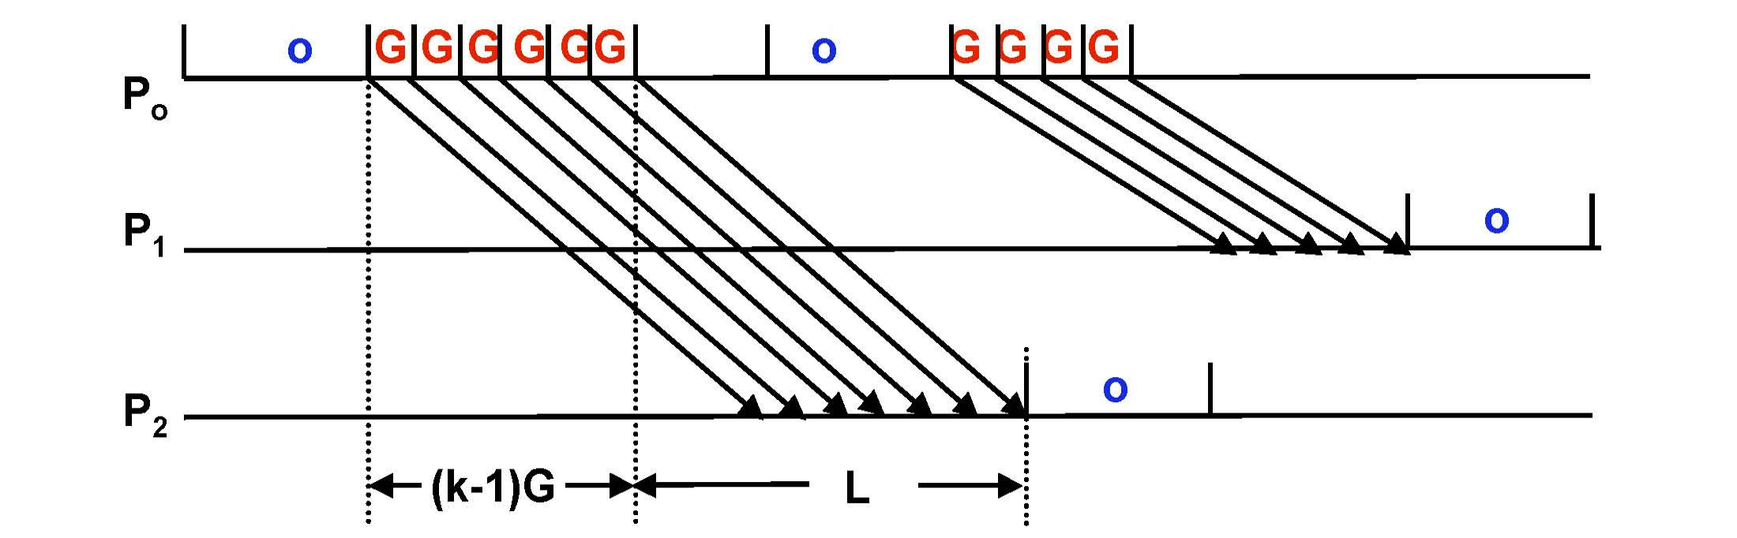
LogGP
Sending a small msg: 2o+L cycles
– o cycles on sender + L cycles in network + o cycles in recv
Under LogP, sending k bytes msg requires
time=o+ ⎢⎡(k-1)/w ⎥⎤ × max(g, o) + L + o cycles
Under LogGP
time=o+(k-1)*G + L + o cycles

Slide 46
Discussion of LogGP
o captures time main processor is involved in sending/recving
G reflects network BW for long msgs
g captures startup bottleneck of network
E.g., time for comm co-proc to open comm channel
Simplified models
For short msgs only: LogGP reduces to LogP
For very long msgs only: approximate xfer-time as kG
Impact on algorithm design
Aggregate short msgs into long msgs for higher BW

Slide 47
References
D.E. Culler, R.M. Karp, D. Patterson, A. Sahay, E.E. Santos, K.
E. Schauser, R. Subramonian, T. von Eicken. LogP: A practical model of parallel computation. Communications of the ACM, 39(11):78 - 85, November 1996.
A. Alexandrov, M. F. Ionescu, K. E. Schauser, and C. Scheiman. LogGP: Incorporating long messages into the LogP model. JPDC, 44(1):71–79, 1997.
P.B. Gibbons, Y. Matias, V. Ramachandran. The Queue-Read Queue-Write PRAM Model: Accounting for Contention in Parallel Algorithms. SIAM J. Computing 28(2):733-769, 1998.
Bell et al. An evaluation of current high-performanc networks, IPDPS, Nice, France, April 2003.

Slide 48
Summary
Techniques to increase speedup
Performance evaluation tools
Well-known performance models

