Slide 1
Shared Memory Architecture and Cache Coherency

Slide 2
Outline
Overview of shared memory architectures
Interconnects
Memory hierarchy
Cache coherence
Update vs. invalidate
Snoopy vs. directory
Reading:
Chpt2 of Kumar’s book

Slide 3
Shared Address Space Machines
All processors share a single global address space
Single address space facilitates a simple programming model
Processors P
P
P
P
P
P Processors
Caches
C
C
C
C
C
C Caches
Interconnect
I
M M
M Memory
Memory M M
M
I
Interconnect
(a) UMA
(b) NUMA

Slide 4
Example: Shared Address Space Machines
name | Maximum # of procs | Processor name | Processor clock rate
Compaq ProLiant 5000 | 4 | Pentiium Pro | 200MHz
Digital AlphaServer 8400 | 12 | Alpha 21164 | 440MHz
HP 9000 K460 | 4 | PA-8000 | 180MHz
IBM RS/6000 R40 | 8 | PowerPC 640 | 112MHz
SGI Power Challenge | 36 | MIPS R10000 | 195MHz
Sun Enterprise 6000 | 30 | UltraSPARC 1 | 167MHz
name | Maximum # of procs | Processor name | Processor clock rate
Cray T3E | 2048 | Alpha 21164 | 450MHz
HP/Convex Exemplar | 64 | PA-8000 | 180MHz
Sequent NUMA-Q | 32 | Pentium Pro | 200MHz
SGI Origin2000 | 128 | MIPS R10000 | 195MHz
Sun Enterprise 10000 | 64 | UltraSPARC 1 | 250MHz
(a) Characteristics of single-bus multiprocessor for sale in 1997
(b) Characteristics of network-connected Multiprocessor for sale in 1997

Slide 5
Shared Address Space Machines
Important aspects are:
Memory organization
Interconnect
Cache coherence mechanism
These aspects determine:
Performance: programming techniques
Scalability
Cost

Slide 6
Shared Memory Interconnects
Bus interconnect
A collection of parallel communication wires together with some hardware that controls acess to the bus
Communication wires are shared by the devices that are connected to it
As the number of devices connected to the bus increases, contention for use of the bus increases, and performance decreases

Slide 7
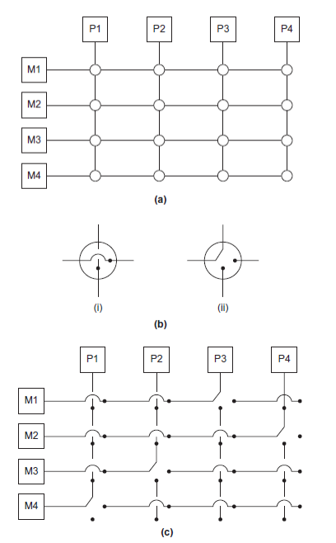
Shared Memory Interconnects
Switched interconnect
Uses switches to control the routing of data among the connected devices
Crossbar
Allows simultaneous communication among different devices
Faster than buses
But the cost of the switches and links is relatively high
Figure (a) a 4*4 crossbar
Figure (b) configuration of internal switches
Figure (c ) simultaneous memory accesses by the processors

Slide 8
Memory Organization
Single memory shared among processors causes sequentialization of accesses
Memory interleaving
Non-overlapping regions of address space mapped to banks
Banks service read/write requests independently

Slide 9
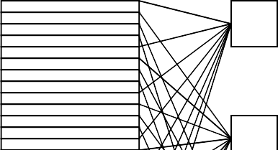
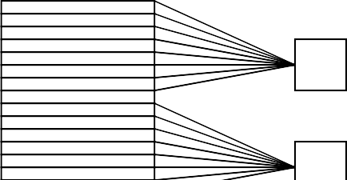
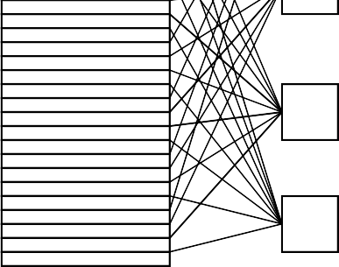
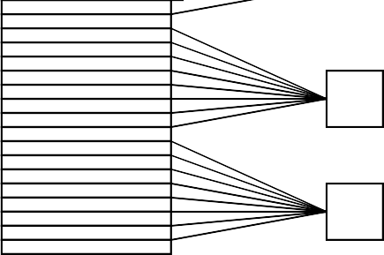
Memory Organization
00
00000
00001
00010
00011
00000
00001
00010
00011
00
01
01
10
10
11
11
Low Order Interleaving
High Order Interleaving

Slide 10
Memory Organization
Typically, which interleaving is used? Why?
Programming issues:
Must spread accesses across banks to avoid bank conflicts
Involves data placement as well as code restructuring

Slide 11
Memory Hierarchy
Most programs have a high degree of locality in their accesses
spatial locality
temporal locality
Memory hierarchy tries to exploit locality
processor control
Tertiary storage
(Disk/Tape)
Main memory
(DRAM)
Secondary storage (Disk)
Second level cache (SRAM)
datapath registers
on-chip
cache
Speed | 1ns | 10ns | 100ns | 10ms | 10sec
Size | KB | MB | GB | TB | PB

Slide 12
Processor-DRAM Gap (latency)
Memory hierarchies are getting deeper
– Processors get faster more quickly than memory
1000
µ Proc 60%/yr.
CPU
“Moore’s Law”
Performance
100
Processor-Memory
Performance Gap: (grows 50% / year)
DRAM
10
DRAM
7%/yr.
1
Time
1980
1981
1982
1983
1984
1985
1986
1987
1988
1989
1990
1991
1992
1993
1994
1995
1996
1997
1998
1999
2000

Slide 13
Handling Memory Latency
Bandwidth has improved more than latency
23% per year vs 7% per year
Approach to address the memory latency problem
Eliminate memory operations by saving values in small, fast memory (cache) and reusing them
Which locality is needed?
Take advantage of better bandwidth by getting a chunk of memory and saving it in small fast memory (cache) and using whole chunk
Which locality is needed?
Take advantage of better bandwidth by allowing processor to issue multiple reads to the memory system at once
concurrency in the instruction stream, e.g. load whole array, as in vector processors; or prefetching
Overlap computation & memory operations

Slide 14
Little’s Law
Latency vs. Bandwidth
Latency is physics (wire length)
e.g., the network latency on the Earth Simulation is only about 2x times the speed of light across the machine room
Bandwidth is cost:
add more wires to increase bandwidth (over-simplification)
Principle (Little's Law): the relationship of a production system in steady state is:
Inventory = Throughput × Flow Time
For parallel computing, Little’s Law is about the required concurrency to be limited by bandwidth rather than latency
Required concurrency = Bandwidth * Latency
For parallel computing, this means: Concurrency = bandwidth x latency

Slide 15
Little’s Law
Example 1: a single processor:
If the latency is to memory is 50ns, and the bandwidth is 5 GB/s (.2ns
/ Bytes = 12.8 ns / 64-byte cache line)
What does Little’s Law tell us?
Example 2: 1000 processor system
1 GHz clock, 100 ns memory latency, 100 words of memory in data paths between CPU and memory.
What does Little’s Law tell us?

Slide 16
Cache Basics
Cache is fast (expensive) memory which keeps copy of data in main memory; it is hidden from software
Cache hit
In-cache memory access, cheap!
Cache miss
Non-cached memory access, expensive!
Cache line length
Associativity
direct-mapped
n-way

Slide 17
Why Multiple Levels of Cache?
On-chip vs. off-chip
On-chip caches are faster, but limited in size
A large cache has delays
Hardware to check longer addresses in cache takes more time
Associativity, which gives a more general set of data in cache, also takes more time
Some examples:
Cray T3E eliminated one cache to speed up misses
IBM uses a level of cache as a “victim cache” which is cheaper
There are other levels of the memory hierarchy
Register, pages (TLB, virtual memory), …
And it isn’t always a hierarchy

Slide 18
Cache Coherence
A significant issue with shared memory
Processors may cache the same location
If one processor writes to the location, all others must eventually see the write
X:=1
Memory

Slide 19
Cache Coherence
P1 loads X from main memory into its cache
X:=1
Memory
P1
X:=1
Cache
Load X

Slide 20
Cache Coherence
P1 loads X from main memory into its cache
P2 loads X from main memory into its cache
X:=1
Memory
P1
P2
X:=1
X:=1
Load X
Load X

Slide 21
Cache Coherence
P1 stores 2 into X
We don’t have consistent values for X across the memory hierarchy
X:=1
Memory
P1
P2
X:=1
X:=2
X:=2

Slide 22
Cache Coherence
Ensure that all processors eventually see the same value for x
Cache coherence mechanisms:
Update vs. invalidate
Snoopy based vs. directory based
X:=2
Memory
P1
P2
X:=2
X:=2
X:=2

Slide 23
Approaches to Cache Coherence
Hardware
Caches implement coherence protocols to ensure that data appears globally consistent
Common in hardware today
Software
May or may not have help from the hardware
Must be conservative to be safe
Assume the worst about potential memory aliases
Of increasing interest
Concerns about cost of coherence in joules
Scales well for microprocessor based on “tiled” designs

Slide 24
Cache Coherence Protocols
When changing variable’s value: invalidate or update all copies
P
P
P
P
P
P
processors
x
x
x’
I
x’ x’
cache
bus
x
I
Write-Invalidate
x’ Write-Update
memory

Slide 25
Update and Invalidate Protocols
Cost-benefit tradeoff depends upon traffic pattern
Invalidate is worse when
• ??
Update is worse when
• ?
Both protocols suffer from false sharing overheads
What is false sharing?
Modern machines use invalidate protocols as the default

Slide 26
Using Invalidate Protocols
Each copy of a data item is associated with a state
Example set of states: shared, invalid, or dirty
Shared: multiple valid copies of the data item
A write needs to generate an invalidate
Dirty: only one copy exists
A write need not generate any invalidates
Invalidate: data copy is invalid
A read generates a data request and updates the state

Slide 27
Snoopy Cache Coherence
How are invalidates sent to the right processors?
Broadcast all invalidates and read requests
Snoopy cache listens and performs appropriate coherence operations locally
Processor Processor Processor
Snoop H/W
Snoop H/W
Snoop H/W
Tags
Cache
Tags
Cache
Tags
Cache
Dirty
Address/data
Memory
A simple snoopy bus based cache coherence system

Slide 28
Operation of Snoopy Caches
Once a datum is tagged dirty
All subsequent operations can be performed locally in cache
No external traffic needed
If a data item is read by a number of processors
Transitions to the shared state in all caches
All subsequent read operations become local
If multiple processors read and update data
Generate coherence requests on the bus
Bus is BW limited: imposes a limit on updates per second

Slide 29
The Cost of Coherence
Snoopy caches
Each coherence op is sent to all processors
What is the problem?
Why not send coherence requests to only those processors that need to be notified?

Slide 30
Directory-based Cache Coherence
Directory-based: the sharing status is kept in directory
Processor
Processor
Cache
Cache
Processor
Memory
Cache
Presence
bits / State
Interconnection Network
Interconnection Network
Processor
Presence Bits
Cache
Data
Processor
State
Directory
Presence
bits / State
Cache
Memory
(a)
(b)

Slide 31
Directory Implementations
Bit vector
Presence bit for each cache line along with its global state
Pointer set
Limited set of pointers (node IDs)
Less overhead than full map
Issue?

Slide 32
Performance of Directory-based Schemes
Bits to store the directory may add significant overhead
Think about scaling to many processors
Data bits per cache block vs. presence bits per cache block
Underlying network must carry all coherence requests
Directory becomes a point of contention
Distributed directory schemes are necessary

Slide 33
Shared Memory Programming
In shared memory programs
Start a single process and fork threads
Threads carry out tasks
Dynamic threads
Master thread waits for work, forks new threads, and when threads are done, they terminate
Pro vs con?
Static threads
Pool of threads created and are allocated work, but do not terminate until clean up
Pro vs con?

Slide 34
Summary
Overview of shared memory architectures
Interconnects
Memory hierarchy
Cache coherence
Update vs. invalidate
Snoopy vs. directory
Reading:
Chpt2 of Kumar’s book

