Slide 1
“Distributed Address Space: Network Topologies”

Slide 2
Outline
Overview of distributed address space
Performance Metrics
Topologies
Routing

Slide 3
Distributed Address Space
Each processor has its own local address space
Processors share data via explicit message passing
MEM
MEM
CPU
CPU
MEM CPU
CPU MEM
CPU
CPU
MEM
MEM

Slide 4
Distributed Address Space
Important aspects are:
Interconnect
Message routing mechanism
These aspects determine:
Performance
Scalability
cost

Slide 5
Interconnect Networks
Carry data between processors
Interconnect components
Switches
Links(wires, fiber)
Interconnect network flavors
Static network: point-to-point comm links
Direct networks
Dynamic networks: switches and comm links
Indirect network

Slide 6
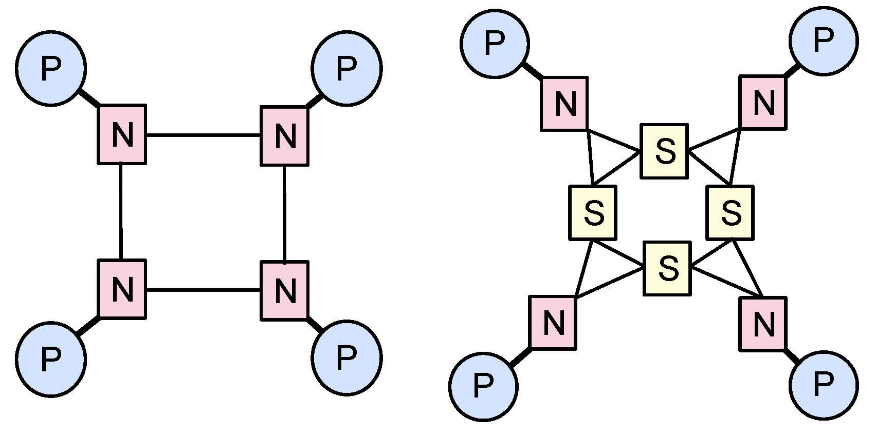
Static vs. Dynamic Networks
Static/direct network
Dynamic/indirect network

Slide 7
Performance Metrics
Degree: number of links per node
Diameter: maximum distance between any two processors.
Connectivity: the multiplicity of paths between processors.
– Arc connectivity: the minimum number of links that need to be removed in order to bread the network into two disjoint parts
Bisection width: the minimum number of links that need to be removed in a network to separate the processor into two halves
Cost:
~ # links and switches

Slide 8
Network Topologies: Bus
All processors access a common bus for exchanging data
Used in simples and earliest parallel machines
Advantages
– ?
Disadvantages
– ?

Slide 9
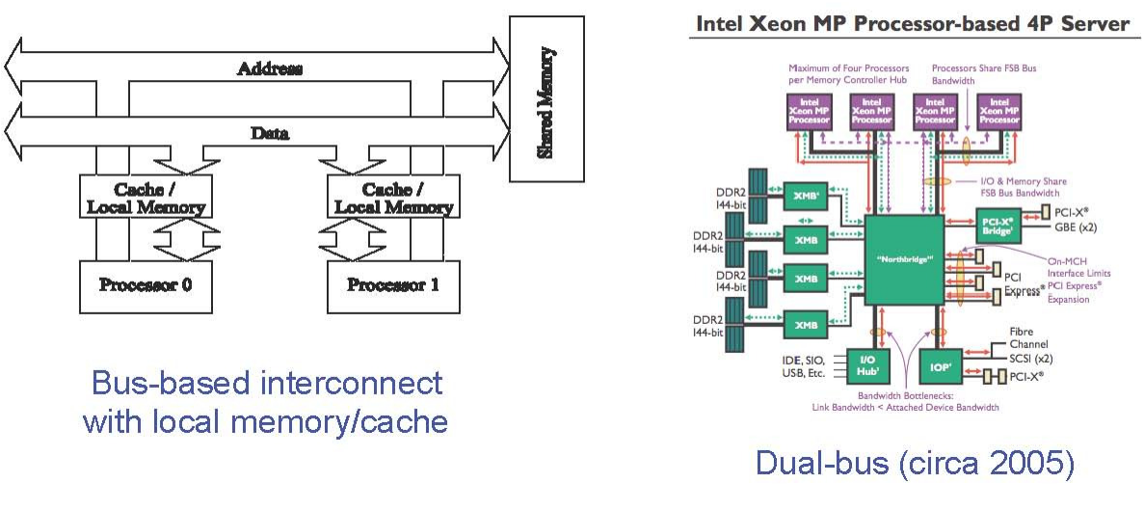
Bus
Since much of the data accessed by processors is local to the processor, a local memory can improve the performance of bus-based machines

Slide 10
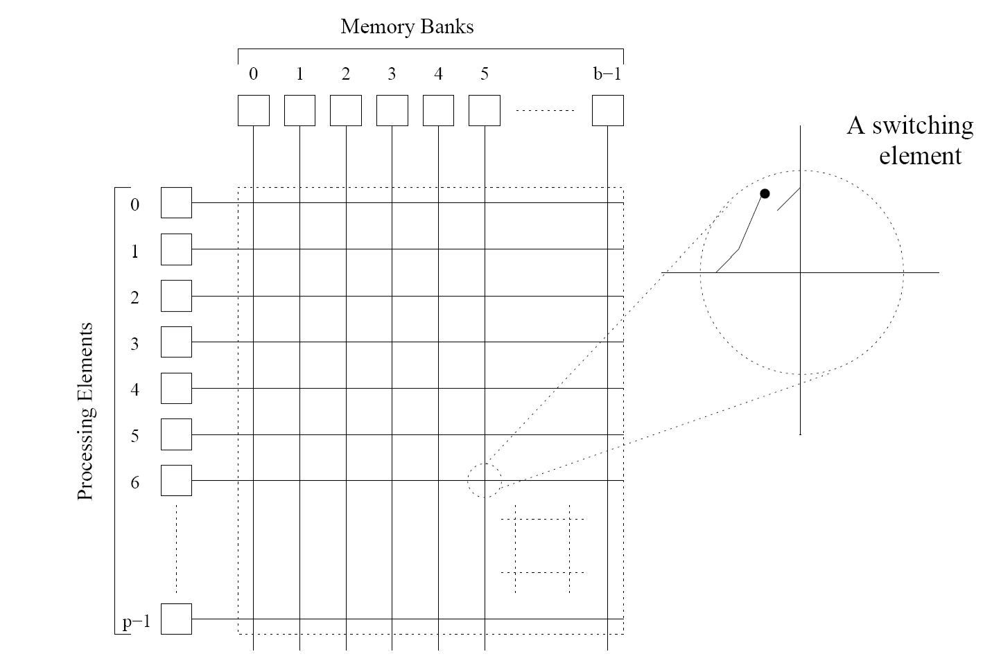
Crossbar Network
A crossbar network uses an p××××m grid of switches to connect p inputs to m outputs in a non-blocking manner

Slide 11
Crossbar Network
Suppose a p×p crossbar, its cost = ?
Examples:
Full crossbar
Earth simulator: custom 640-way single-stage crossbar
Crossbar as building block
Rice RTC (retired in 2008): 16-way crossbar switches in 128- way Clos network

Slide 12
Multistage Interconnect
Buses
Excellent cost scalability
Poor performance scalability
Crossbars
Excellent performance scalability
Poor cost scalability
Multistage interconnects
Compromise between these extremes

Slide 13
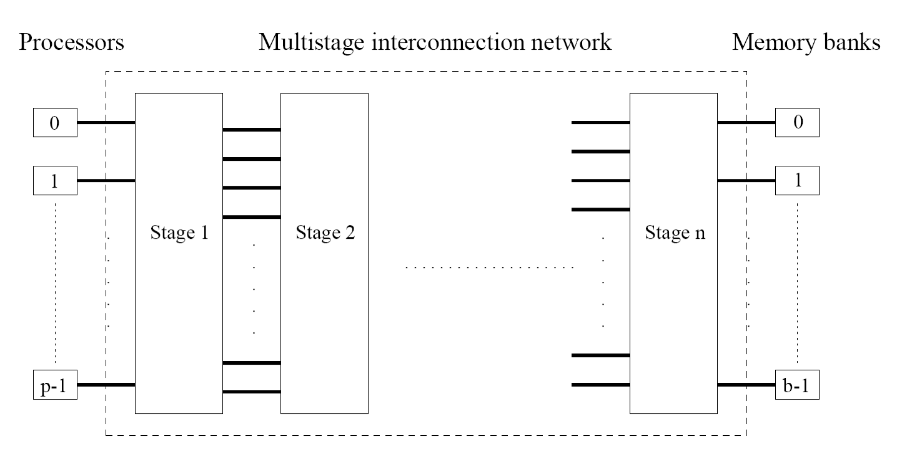
Multistage Network
Schematic of a typical multistage interconnection network (processor-to-memory, e.g., BBN Monarch)

Slide 14


Multistage Omega Network
One of the most commonly used multistage interconnects
Organization
log p stages
p number of inputs/outputs
At each stage, input i is connected to output j if:
If p=2^{k}, then j=?

Slide 15
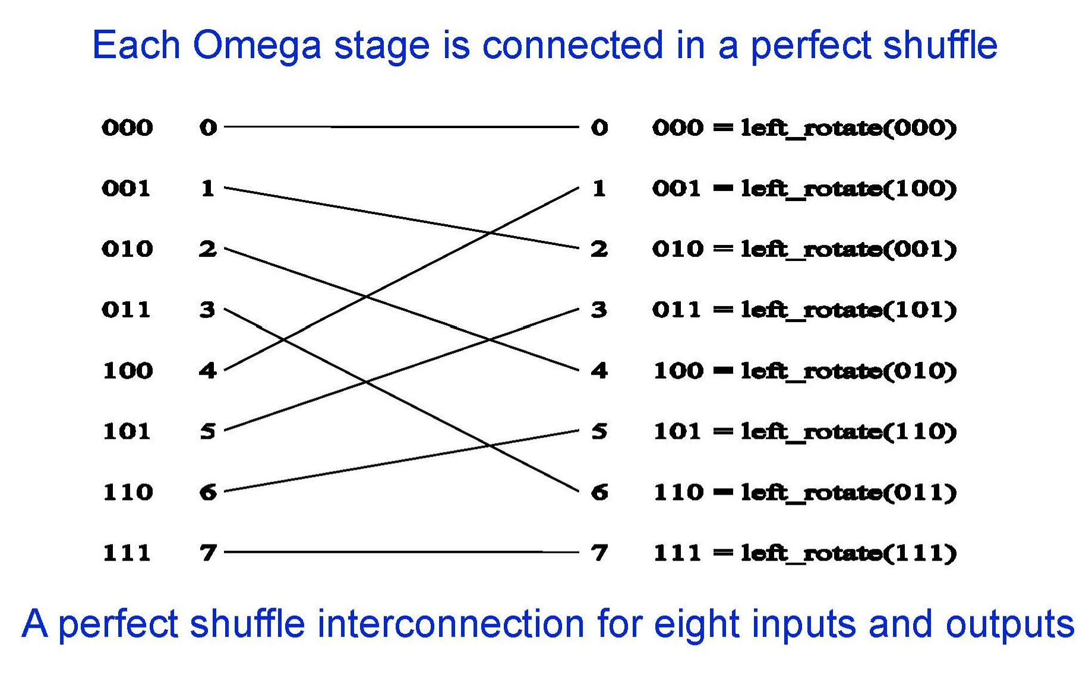
Omega Network Stage

Slide 16
Omega Network Switches
The perfect shuffle patterns are connected using 2×2 switches
The switches operate in two modes:
– Cross-over vs. pass-through.
0 |  | 0 | 0 | 0
1 |  | 1 | 1 | 1
(a) pass-through
(b) cross-over

Slide 17
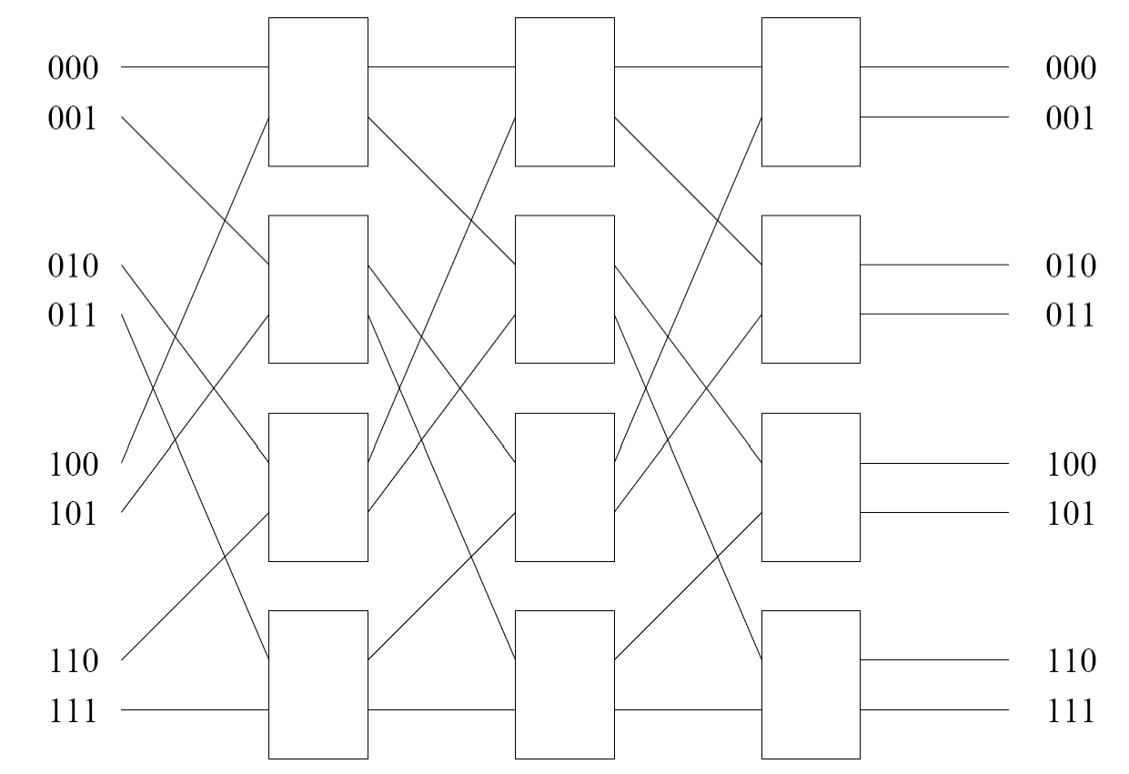
Multistage Omega Network
A complete omega network connecting eight inputs and eight outputs.
Cost: ??

Slide 18
Omega Network Routing
Let
s= binary representation of the source processor
d= binary representation of the destination processor or memory
The data traverses the link to the first switching node
if the most significant bit of s and d are the same pass-through
else
cross-over
Strip off leftmost bit of s and d
Repeat for each of the log(p) switching stages

Slide 19
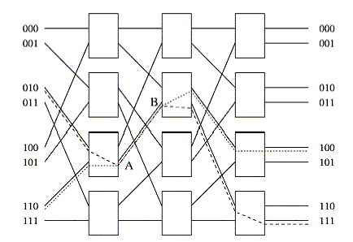
Omega Network Routing
An example of blocking in omega network: one of the messages (010 to 111 or 110 to 100) is blocked at link AB

Slide 20
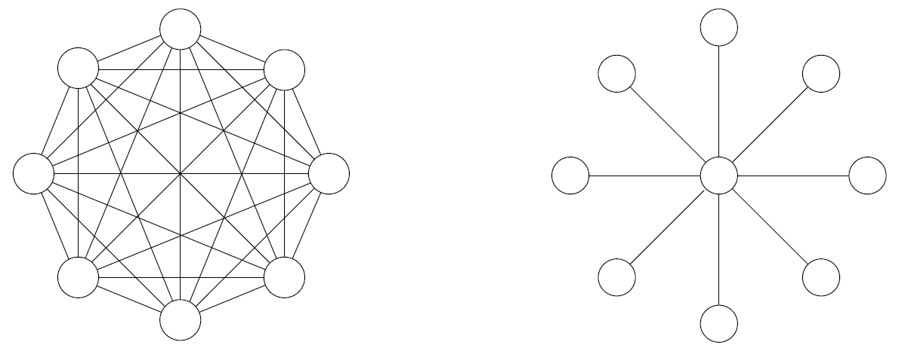
Star & Complete Connected Network
Star
Static counterpart of bus
Every node connected only to a common node at the center
Distance between any pair of nodes is O(1)
Complete connected network
Static counterpart of crossbar
Each processor is connected to every other processor.
The number of links in the network scales as O(p²)

Slide 21
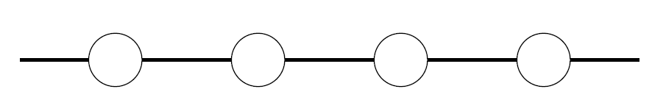
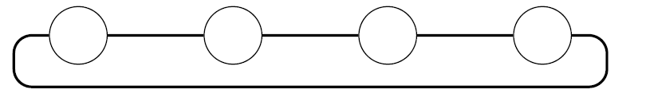
Linear Array
Each node has two neighbors: left & right
If connection between nodes at ends: 1D torus (ring)
Diameter of a ring is ?
Arc connectivity of a ring is ?
Bisection width of a ring is ?

Slide 22
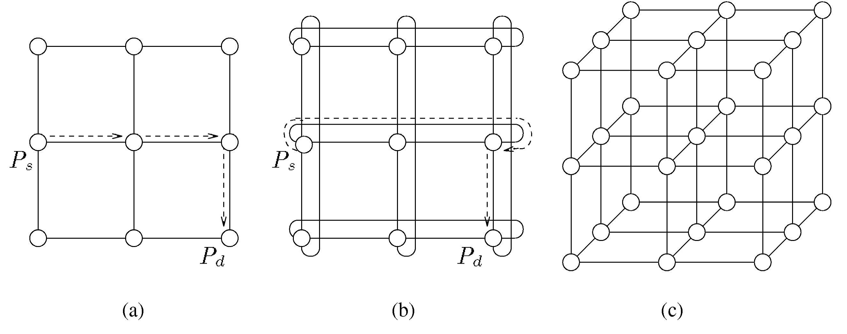
Multidimensional Meshes
Mesh: generalization of linear array to 2D or 3D
Mesh with wrap around: torus
K-dimensional mesh
– Node has 2k neighbors

Slide 23
Multidimensional Meshes
Diameter of a 2D mesh is
? ; for torus it is ?
Arc connectivity of a 2D mesh is ?; for torus it is ?
Bisection width of a 2D mesh is
? ; for torus it is ?

Slide 24
Hypercube
A hypercube is a multidimensional mesh with exactly two processors in each dimension
In a d-dimensional hypercube, each processor is connected with d other processors

Slide 25
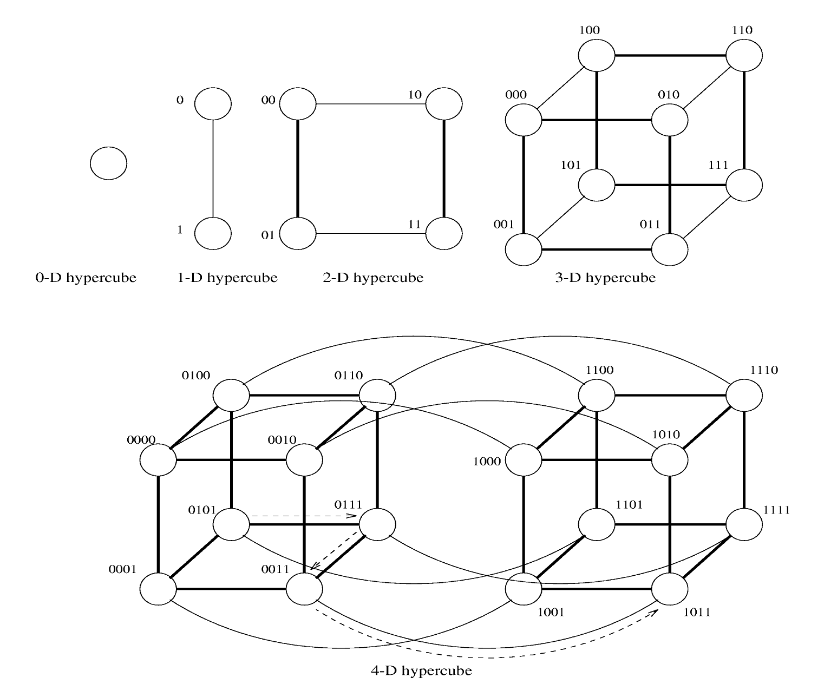
Hypercube

Slide 26
Hypercube
Hypercubes can be constructed recursively
Two processors are connected if ?
Consider two processors with labels s and t, what is the Hamming distance for the two processors?

Slide 27
Hypercube
Diameter of a hypercube is ?
Arc connectivity of a hypercube is ?
Bisection width of a hypercube is ?

Slide 28
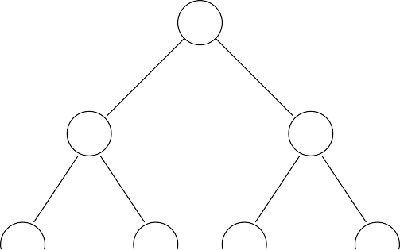
Trees
Processing nodes
Switching nodes
(a)
(b)
(a) Static tree network
(b) dynamic tree network

Slide 29
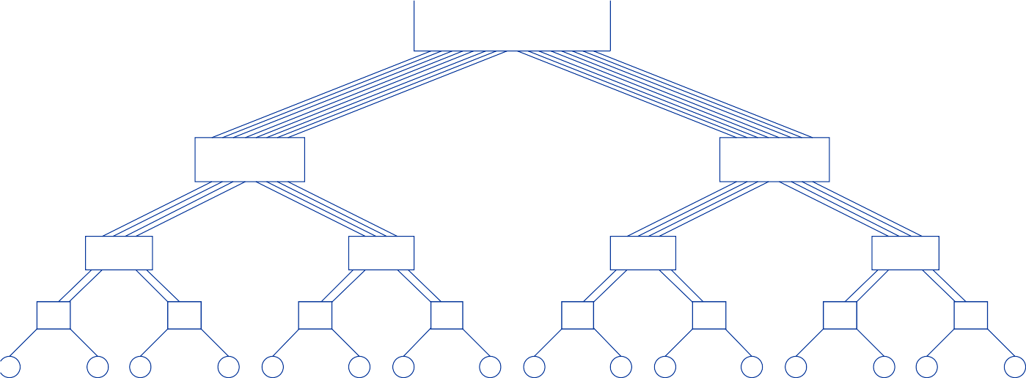
Tree Properties
Distance between any two nodes is no more than 2logp
Problem:
Links higher up the tree potentially carry more traffic than those at the lower levels
Solution: fat tree
Using wider links at higher levels in the tree
Fat tree network for 16 processors

Slide 30
Tree
Diameter of a tree is ?
Arc connectivity is ?
Bisection width is ?

Slide 31






















Metrics for Static Interconnects
Network
Diameter
Bisection Width
Arc Connectivity
Cost
(No. of links)
Completely-connected
Star
Complete binary tree
Linear array
2-D mesh, no wraparound
2-D wraparound mesh
Hypercube
Wraparound k-ary d-cube

Slide 32



Metrics for Dynamic Interconnects
Network
Diameter
Bisection Width
Arc Connectivity
Cost
(No. of links)
Crossbar
Omega Network
Dynamic Tree

Slide 33
Message Passing Costs
Startup time (t_{s})
Time spent at sending and receiving nodes
Including?
Per-hop time (t_{h})
A function of number of hops
Including?
Per-word transfer time (t_{w})
Including?

Slide 34



Store-and-Forward Routing
Definition:
– Message traversing multiple hops is completely received at an intermediate hop before being forwarded to the next hop
The total communication cost for a message of size
m words to traverse l communication links is
Typically, t_{h} is small
Thus, approximate store-and-forward message cost

Slide 35
Routing Techniques
time
P₀ P₁ P₂ P₃
(1) A single message sent over A store-and-forward network
time
P₀ P₁ P₂ P₃
(2) The same message broken into two parts and send over the network
time
P₀ P₁ P₂ P₃
(3) The same message broken into four parts and sent over the network

Slide 36
Packet Routing
Store-and-forward makes poor use of comm resources
Packet routing
Break messages into packets
Pipeline them through the network
Packets may take different paths, thus each packet must carry
Routing information
Error checking
Sequencing information
The total communication time for packet routing is
t_{w} accounts for overheads in packet headers

Slide 37
Cut-Through Routing
Packet routing in the extreme
Divide messages into basic units called flits
Flits are typically small -> header info must be small
What are the differences between cut-through and packet routing?
Used in today’s infiniband networks

Slide 38
Cut-Through Routing
Communication time for cut-through routing is
This is identical to packet routing; however, t_{w} is typically much smaller
Typically, t_{h} smaller than t_{s} and t_{w}
Approximate communication time using cut-through routing is

Slide 39
Simplified Cost Model for Messages
Valid for only uncongested networks
If a link takes multiple messages
corresponding t_{w} term must be scaled up by # messages
Network congestion varies by
Communication pattern
Match between pattern and network topology
Communication models must account for congestion

Slide 40
Routing Variants
Routing mechanism determines the path a message takes through the network when going from a source to a destination processor
Minimal or non-minimal routing
Deterministic or adaptive

Slide 41
Routing Challenges
Routing must prevent deadlocks
Use dimension-ordered or e-cube routing
Routing must avoid hot-spts
Can use two-step routing
Message from s to d: first sent to a randomly chosen intermediate processor i; then forward from i to destination d

Slide 42
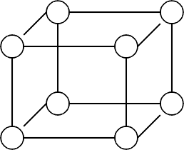
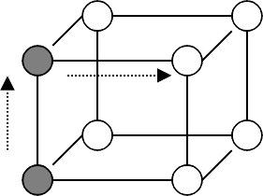
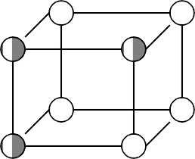
Example: E-cube Routing in Hypercube
If the message is at processor P_{i} and needs to go to P_{d}, compute s = P_{i} ⊕ P_{d} Send message along dimension k from P_{i} where k is the least significant non-zero bit in s
Continues this process at each successive processor until P_{d} is reached
100
110
100
110
100
110
000
010
000
010
000
010
101
111
101
111
101
111
001
011
001
011
001
011

Slide 43
Example: XY Routing in 2D Mesh
Message sent along X dimension until destination’s X coordinate is reached
Then message is sent along Y dimension until it reaches destination processor
Called dimension-order routing

Slide 44
Summary
Overview of distributed address space
Performance Metrics
Topologies
Routing
Reading material: Kumar – Chpt 2

