Slide 1
Digit Recognizer Algorithm in R
Mohammad AL-Amar

Slide 2
Outline
Digit Recognizer Algorithm
KNN
R programing
R code

Slide 3
Digit Recognizer Algorithm
https://www.kaggle.com/c/digit-recognizer
image of a handwritten single digit
determine what that digit is

Slide 4
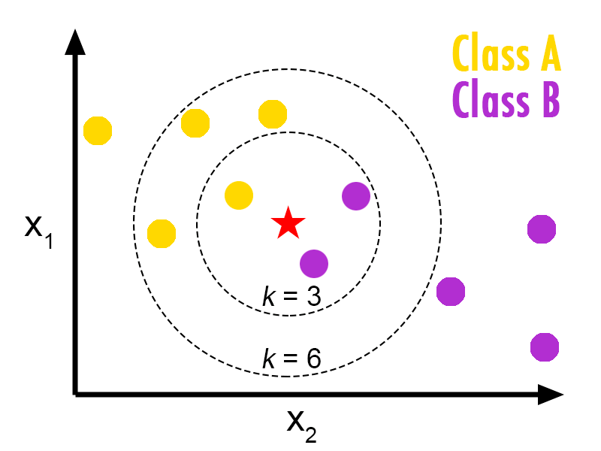
KNN
K Nearest Neighbor
https://www.youtube.com/watch?v=SQOdBjjA2y8

Slide 5
R programing
R is a language and environment for statistical computing and graphics
Download R
https://cran.r-project.org/
Download R studio https://www.rstudio.com/products/rstudio/download3/

