Slide 1
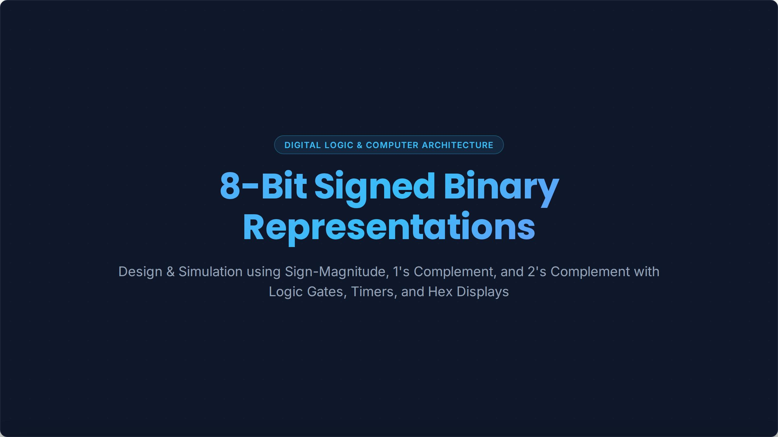

Slide 2
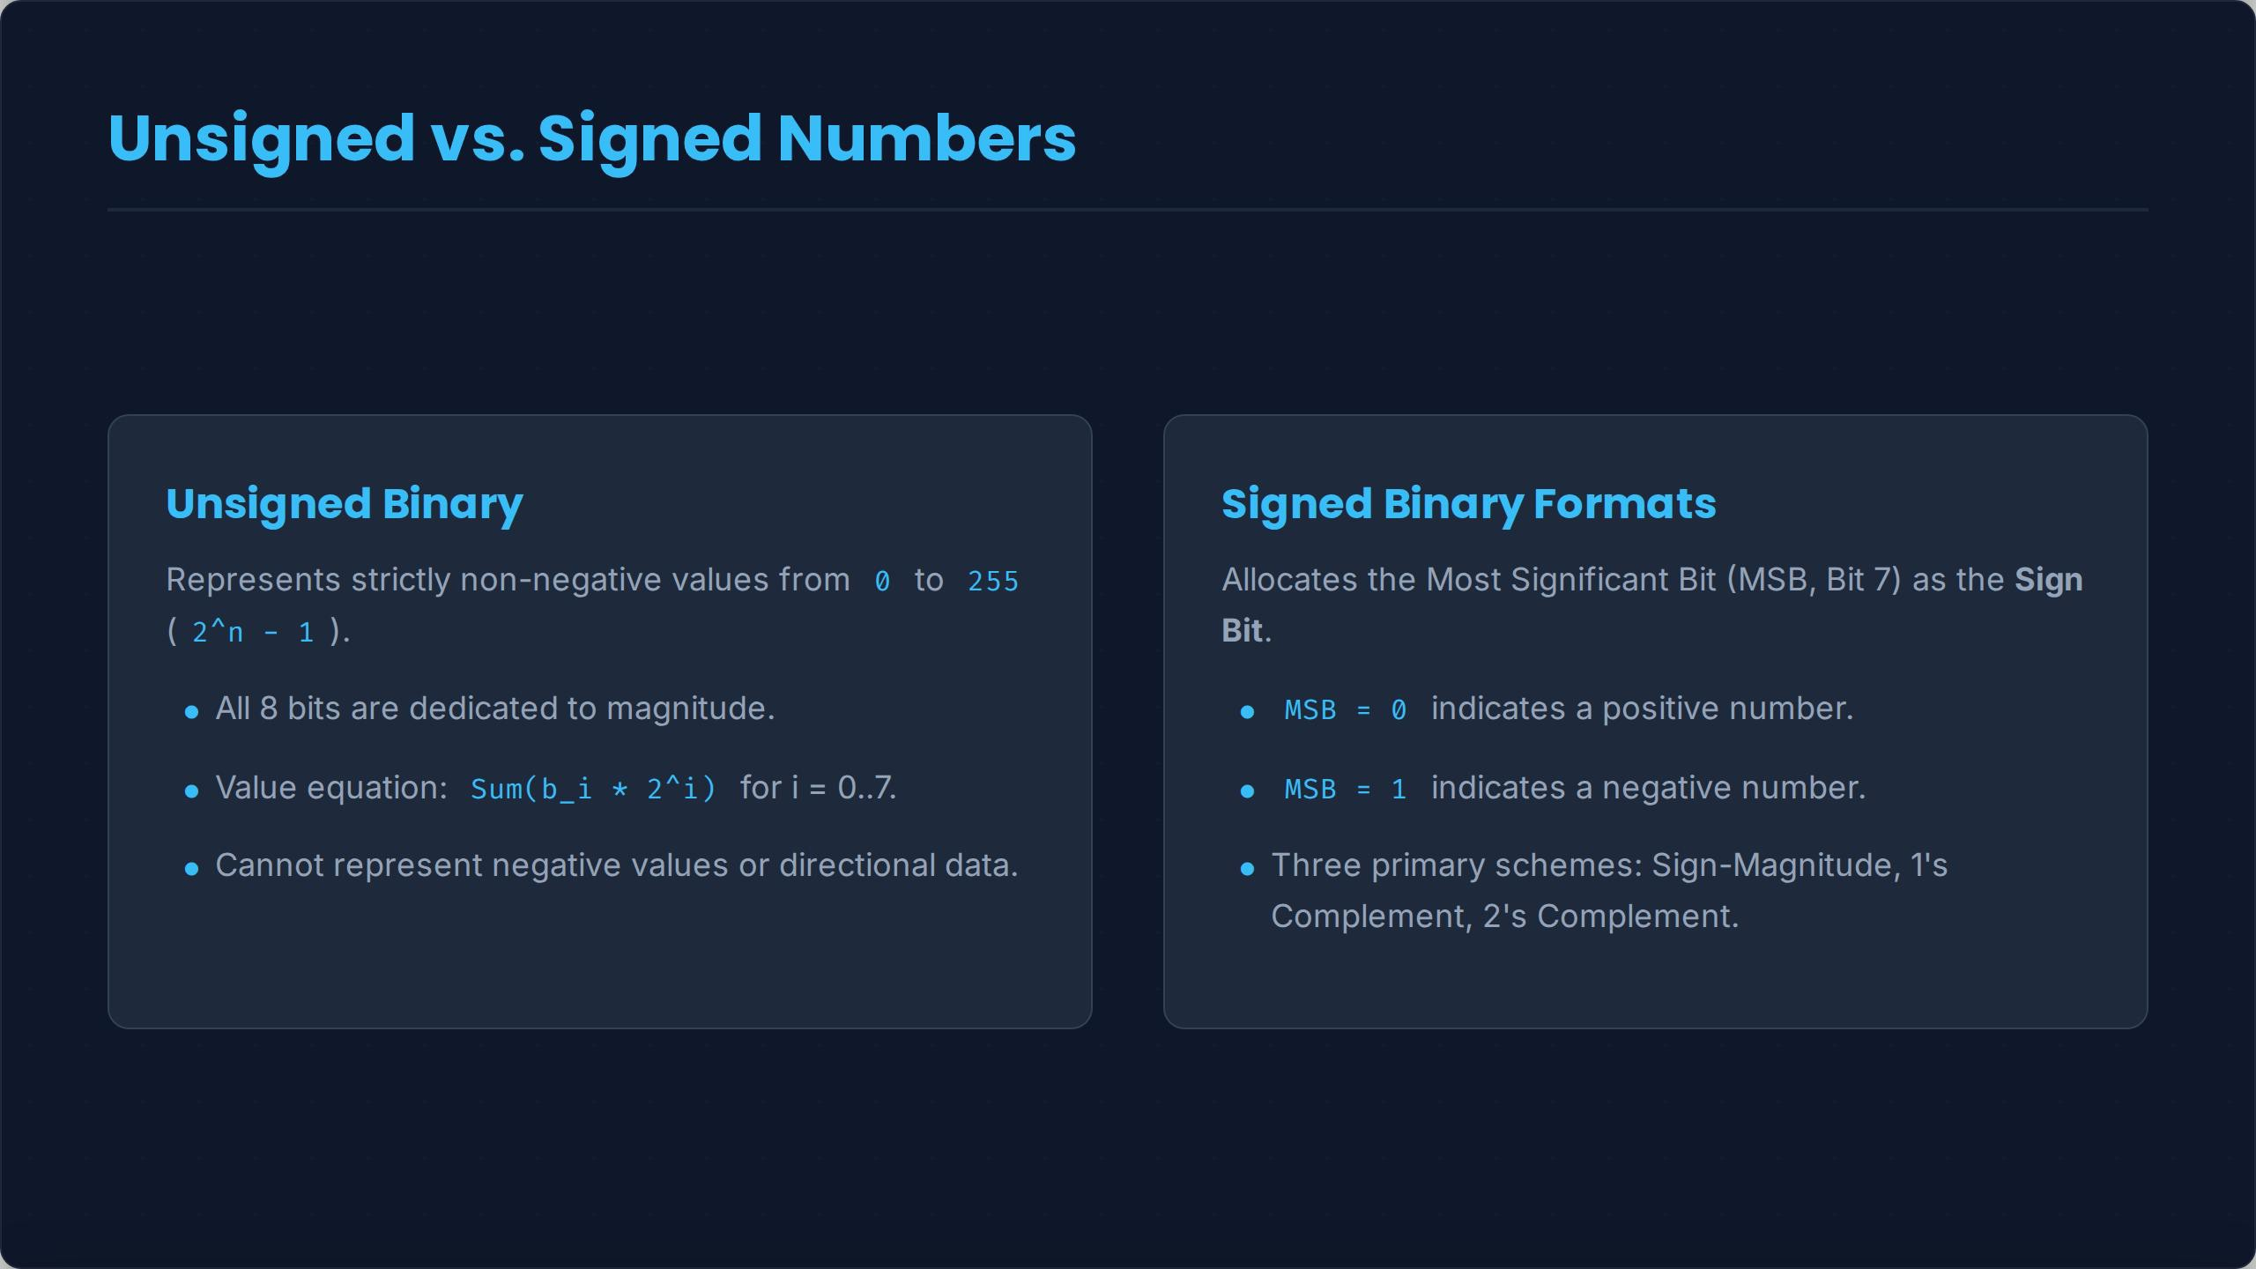

Slide 3
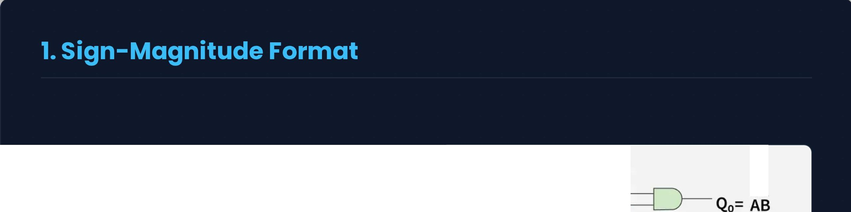
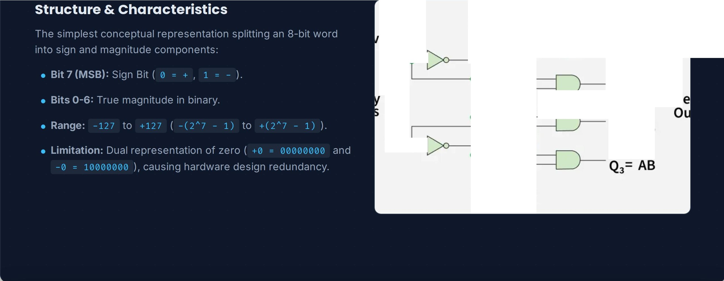
A B A B
- -
erter
A - , ,
--
-
Q1= AB
AND Gates
Q2= AB
D
-
B - , --t
Data Lines

Slide 4
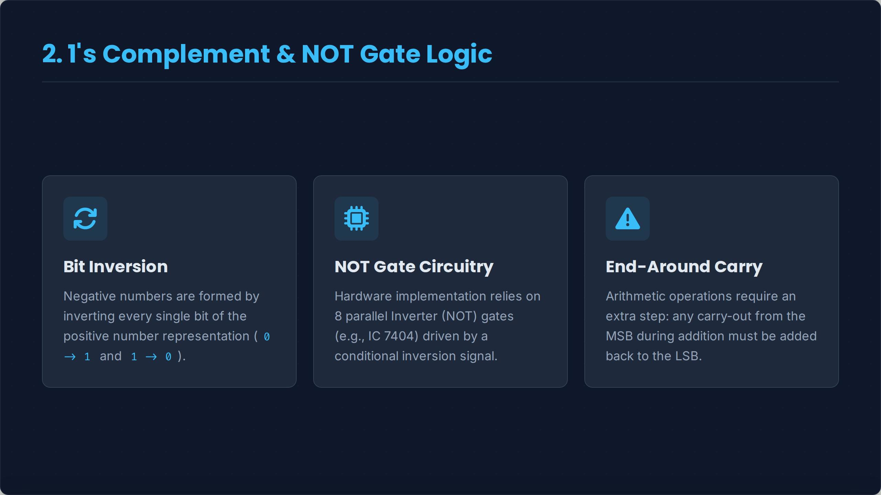

Slide 5
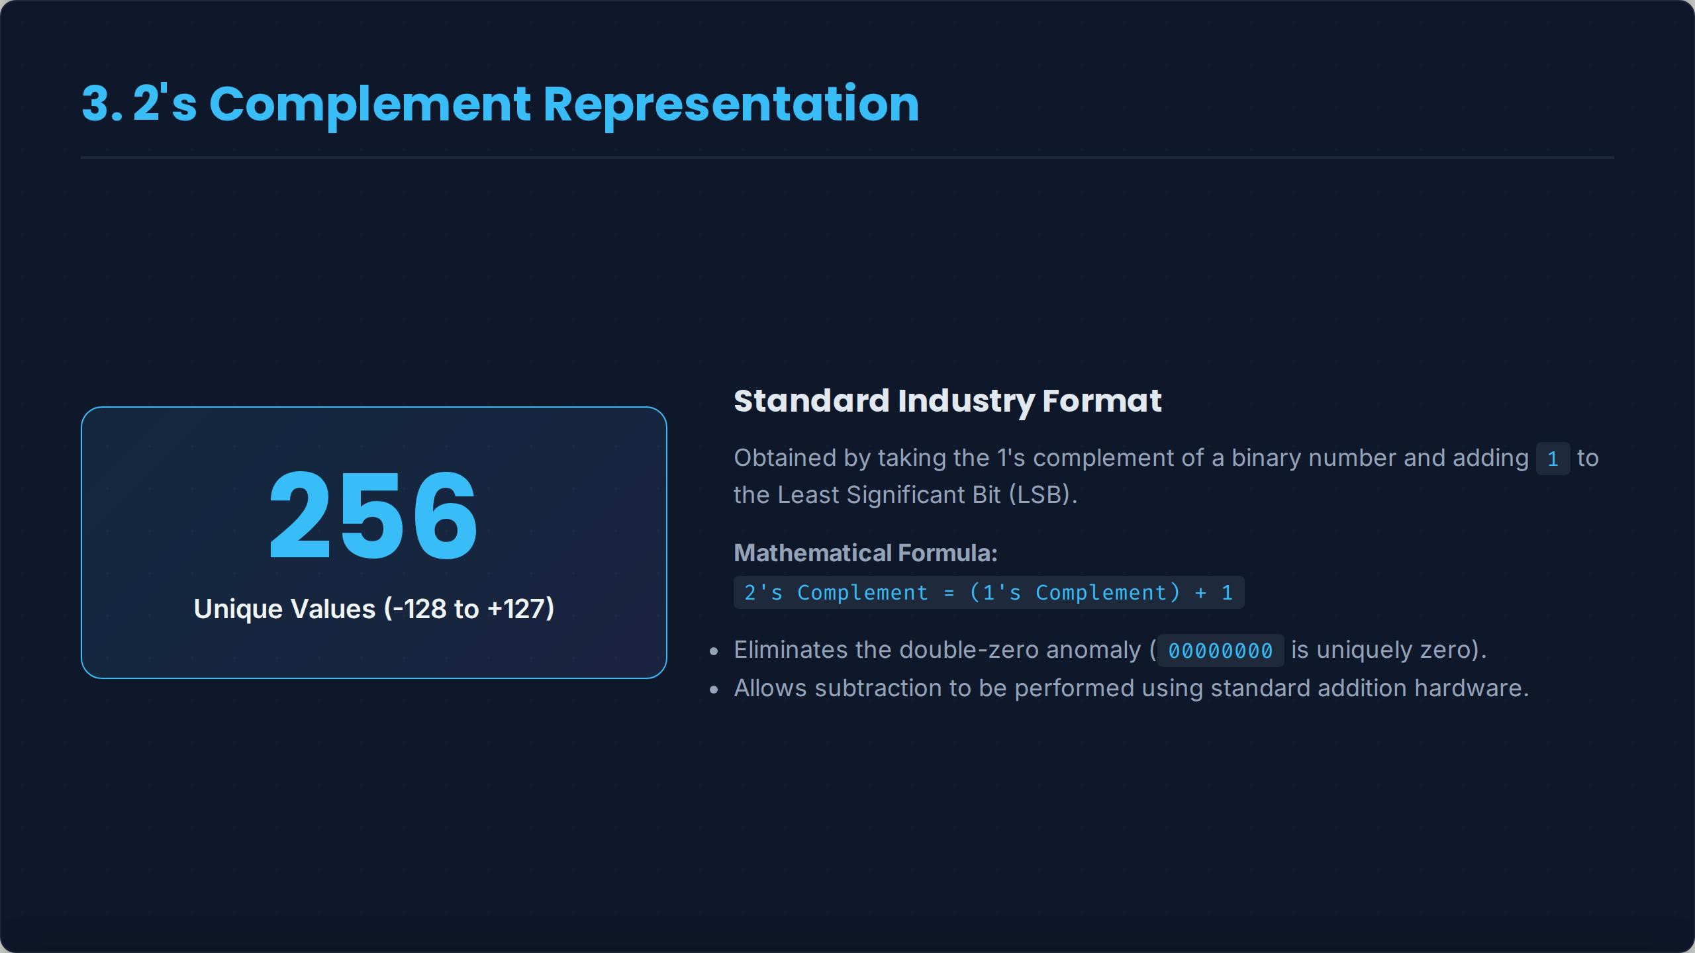

Slide 6
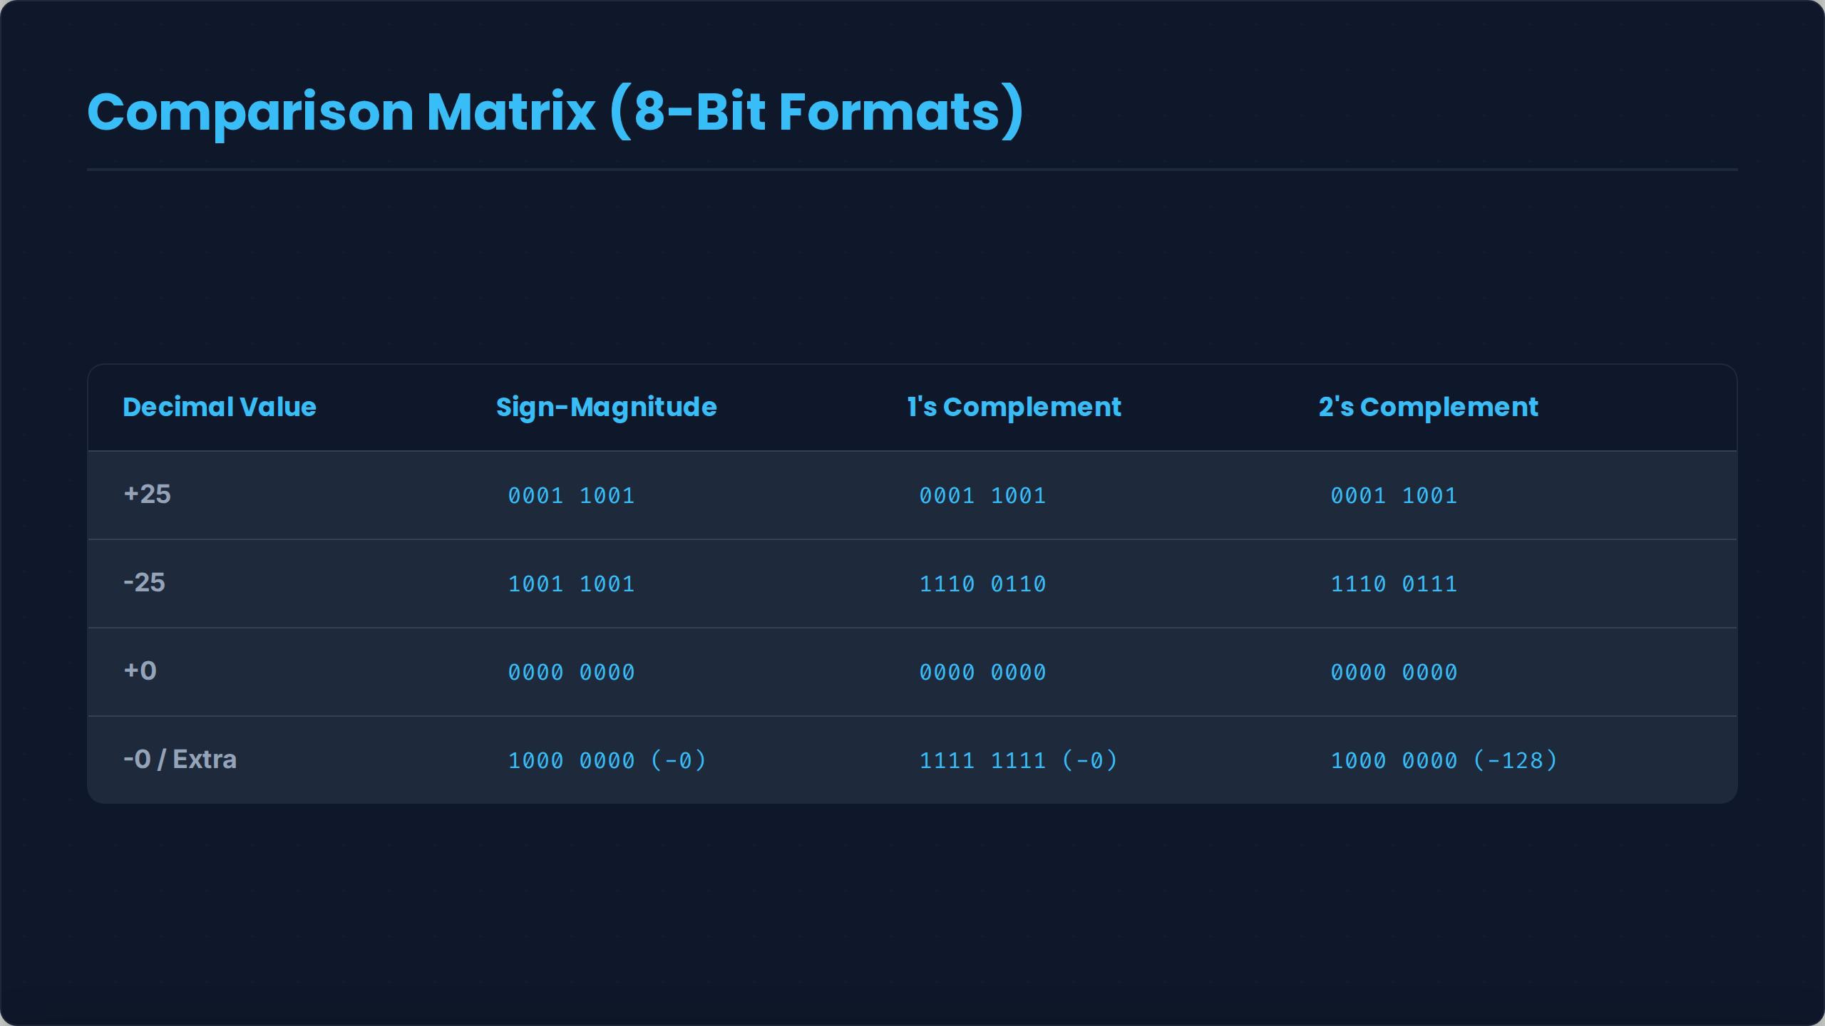

Slide 7
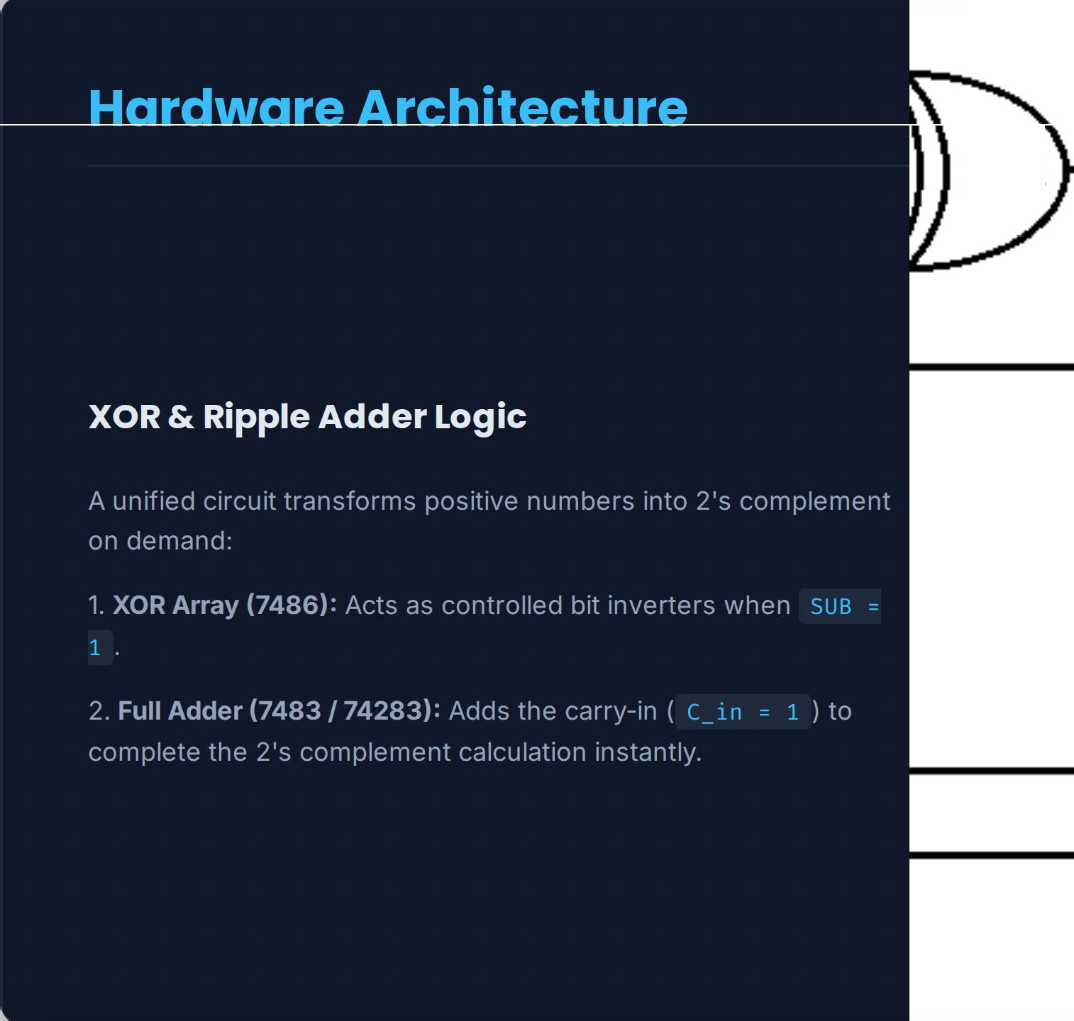


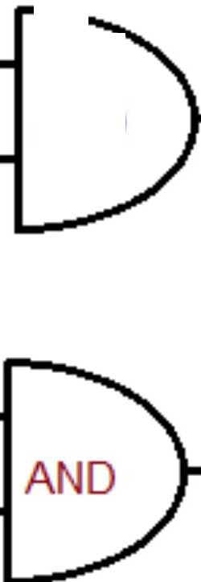
XOR
XOR
AND

Slide 8
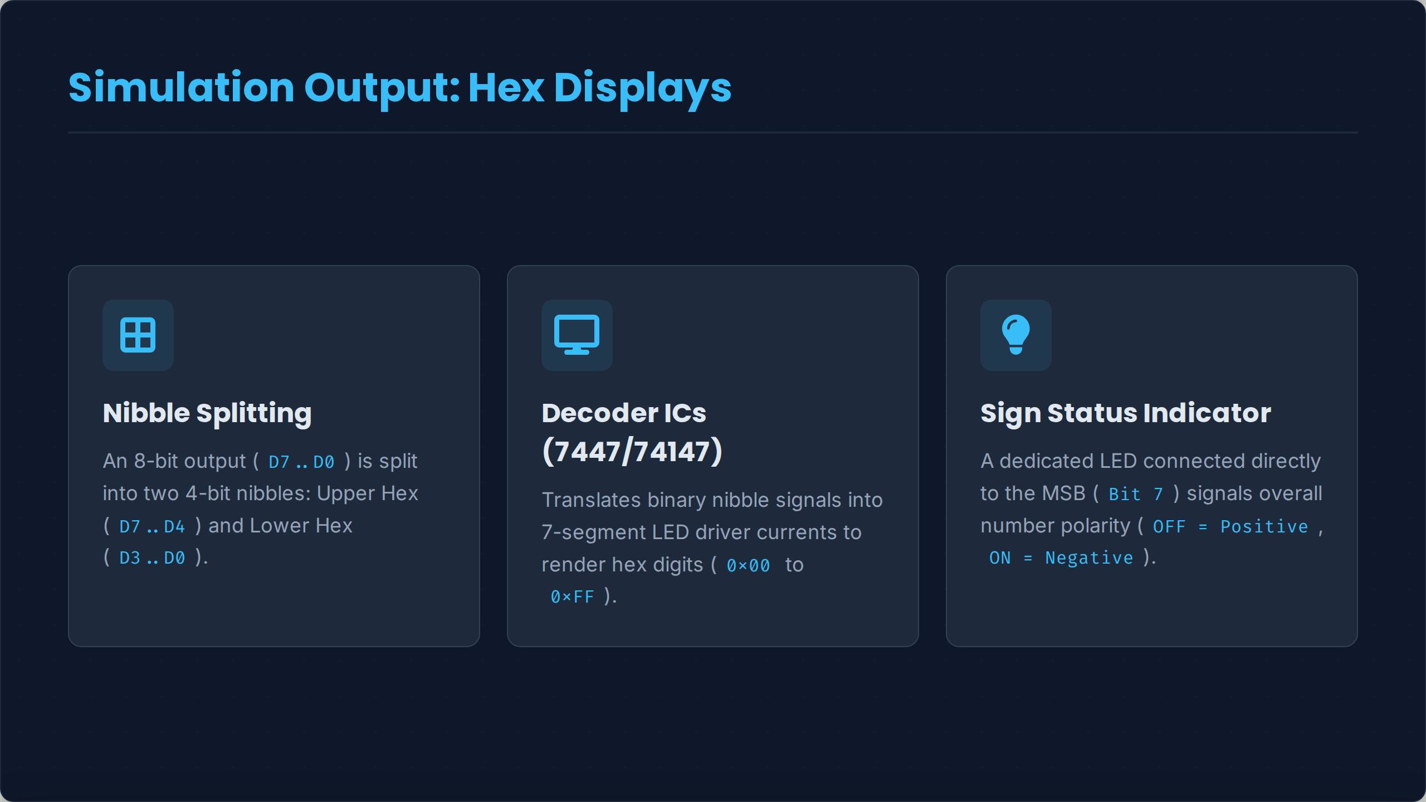

Slide 9
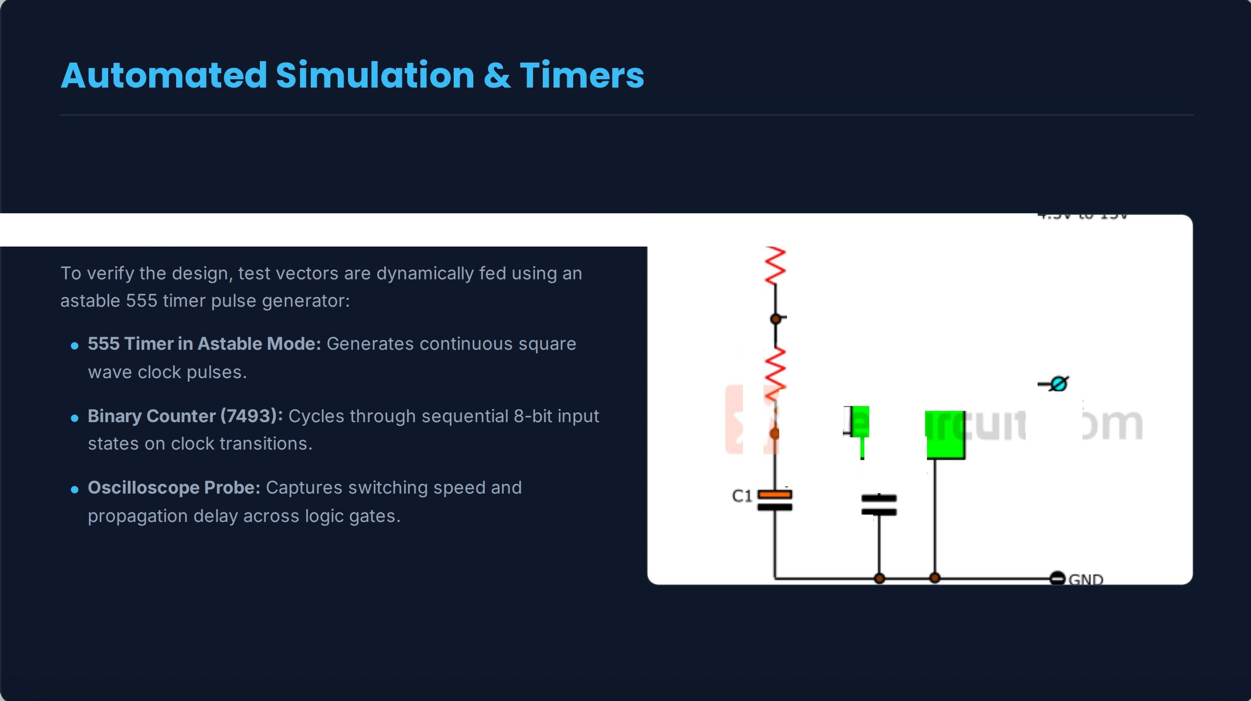
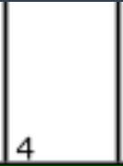


Clocking with 555 Timer IC
8
7
R2
ICl
555
3
OLJtput
6
�2
-
+
5
1
C2
0.01�F

Slide 10
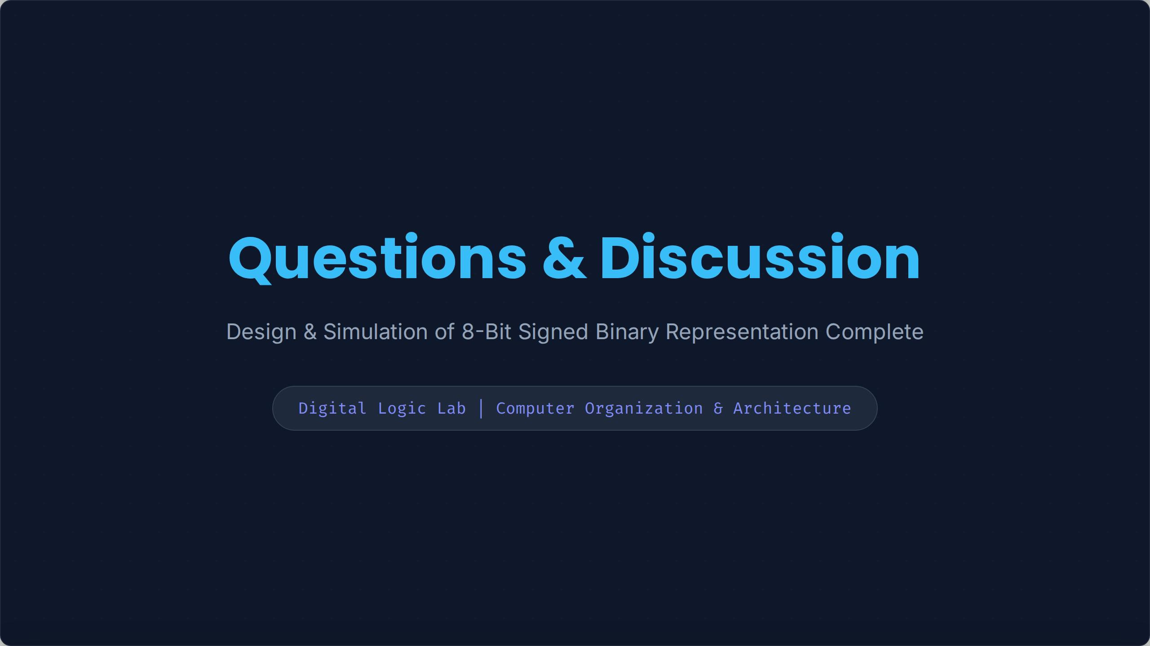

Slide 11

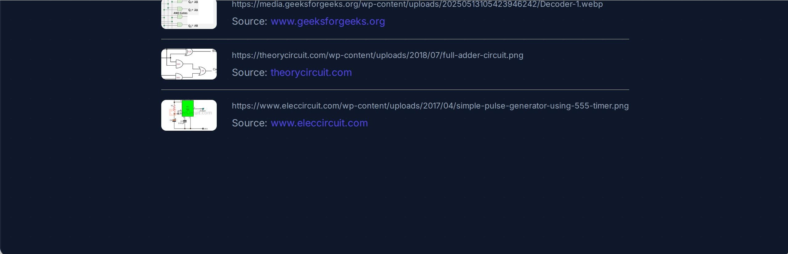
Decodec
Q,• _{AO} ""''"'

