Slide 1
Gesture-based Affective and Cognitive States Recognition using Kinect for Effective Feedback during E-learning
Kartik Vermun, Mohit Senapaty, Anindhya Sankhla
Dr. Priyadarshi Patnaik,
Dr. Aurobinda Routray

Slide 2
We address the issue of a Monitoring System for E-Learning.
3 Step Process
The system should:
Take input from the user
Identify the user’s state of mind
Provide appropriate feedback

Slide 3
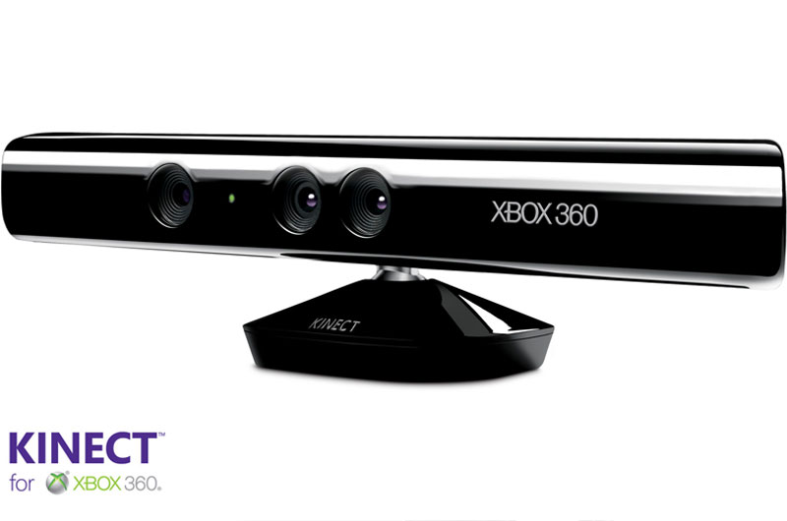
Kinect Device: The heart of our System

Slide 4
Features Exploited
Depth Sensor
Face Tracking
Kinect Skeleton

Slide 5
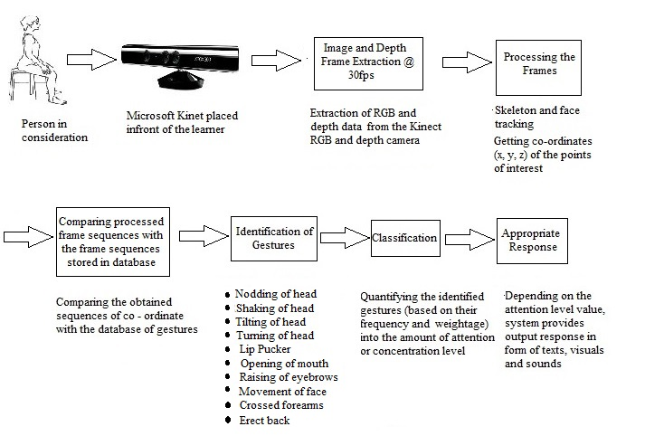
The System Representation

Slide 6
The Classification Table
Emotion/expression | Face | Body | Response
POSITIVE
Neutral | lips closed, eyes open, | Seated, figure erect | Encouraging response, positive words
Focused | Eyes focused, head straight | Head and body leaning towards the screen
NEGATIVE
Uncertainty & Puzzlement | lip suck, eyes closed, eyes turn right/left/up/down | head tilt left/right/up/down, | Trying to relax the person, clam him down, ask him to keep his cool and not panic.
Bored | Yawning, face not focused on the computer screen | hands behind the head; body motion; | Trying to tell the person that he is not focusing, should get focused.

Slide 7
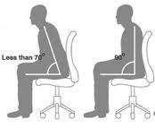
The Algorithm-Body Gestures
The angle between the user’s Shoulder Centre, Hip Centre and Knee Centre was considered and the following states were decoded.
180: Standing
90: Neutral
70: Focused
Similarly various angles can be computed to decode various other states.

Slide 8
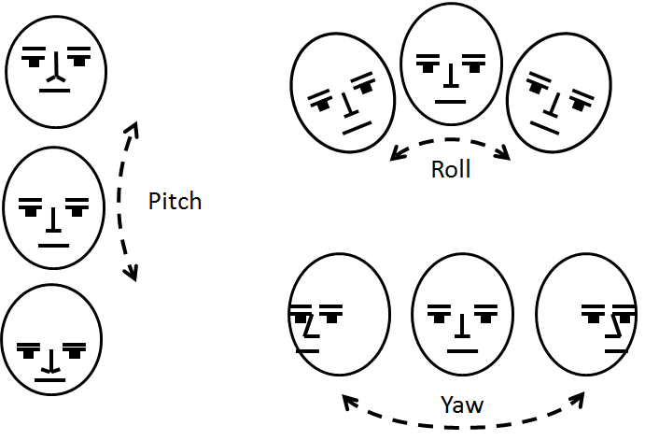
The Algorithm: Facial Gestures
Three values namely: Roll, Pitch and Yaw values were considered
in order to decode various facial gestures
such as head tilt, head shaking, nodding.

Slide 9
Future Work
Database Of Gestures
Gestures can be read from a distance, when expressions are not visible
The database to contain various gestures
Can be used in any E learning model
Database Of Expressions
Facial Expressions add to the confidence level of Gestures

Slide 10
It’s time for a DEMO!!

