Slide 1
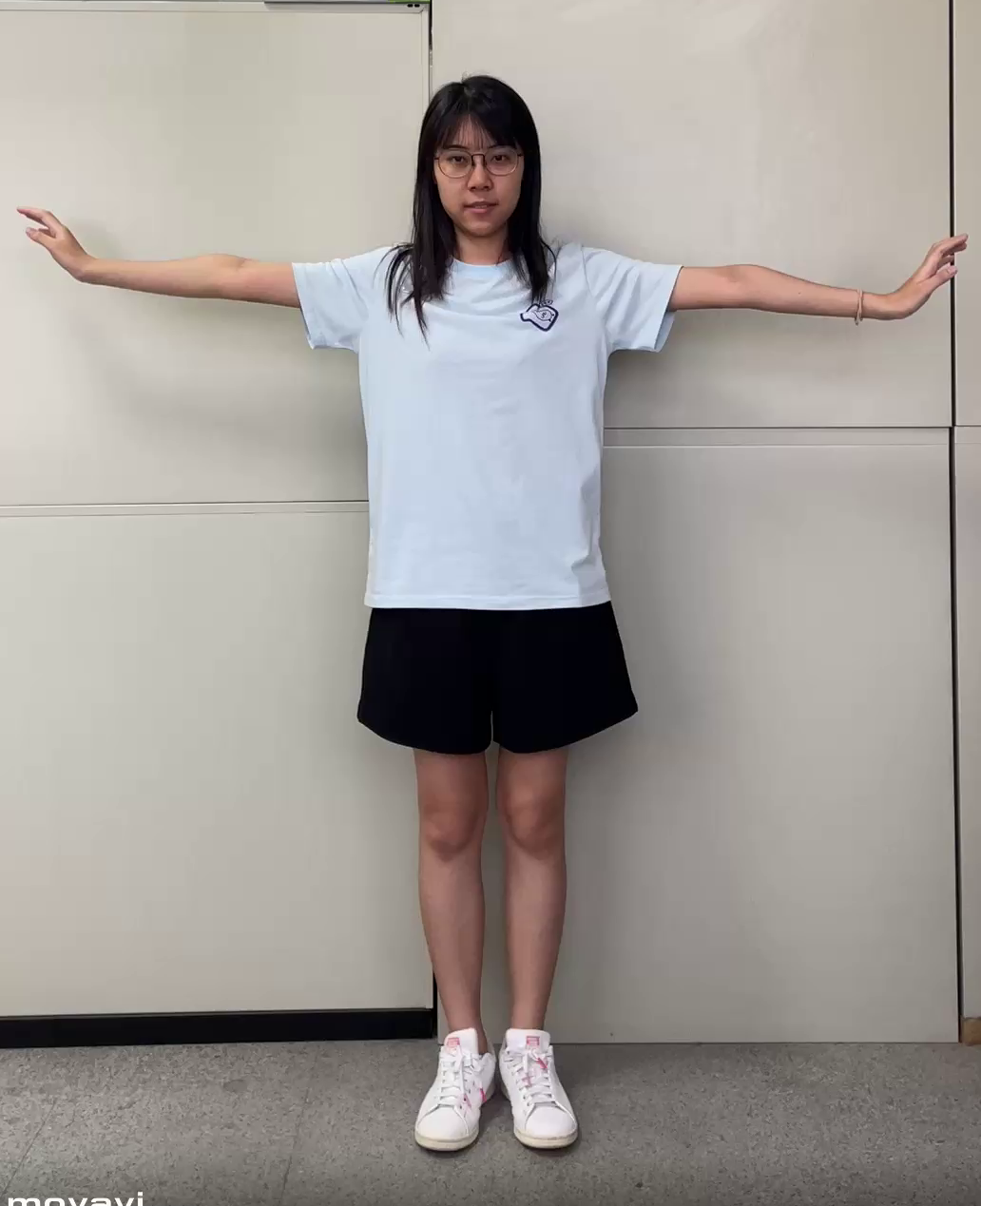
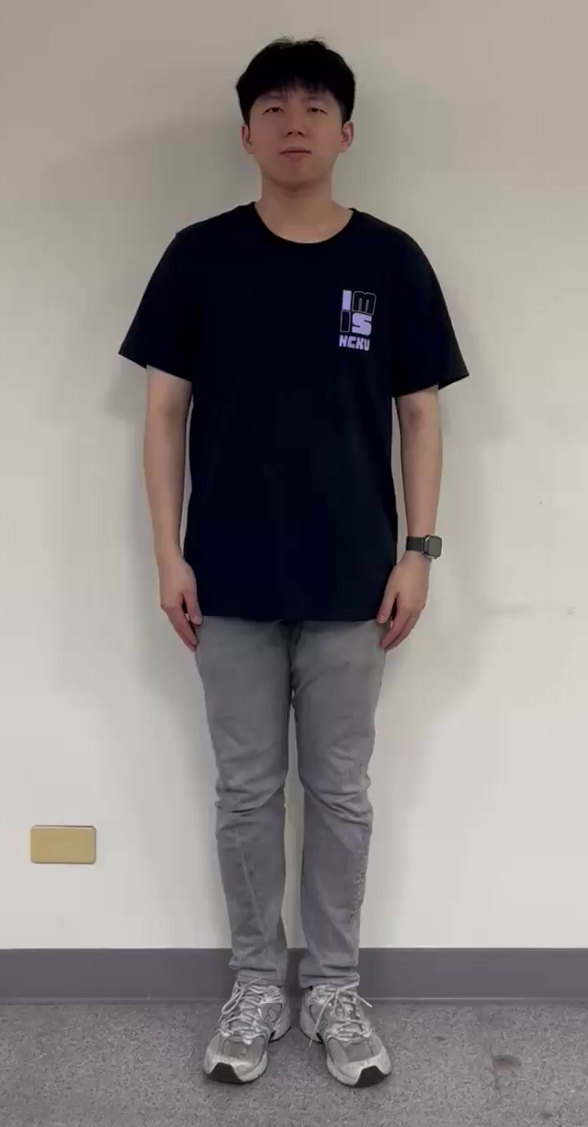
Part1
Cameras of mentor and convalescent are placed in SAME angle of view.
Mentor
Convalescent
Camera’s Position
Mentor : Front
Convalescent : Front
Video Spec: 30 FPS
Duration : 20 seconds
(freeze time excluded)

Slide 2
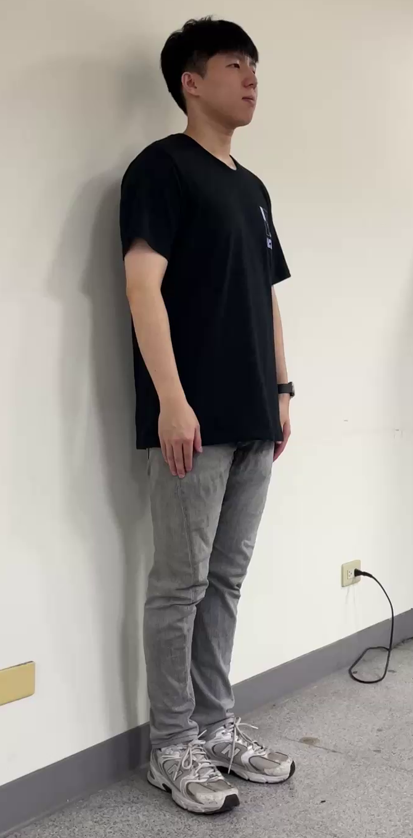
Part2
Cameras of mentor and convalescent are placed in DIFFERENT angle of view.
Mentor
Convalescent
Camera’s Position
Mentor : Front
Convalescent : Right
Video Spec: 30 FPS
Duration : 20 seconds
(freeze time excluded)

Slide 3
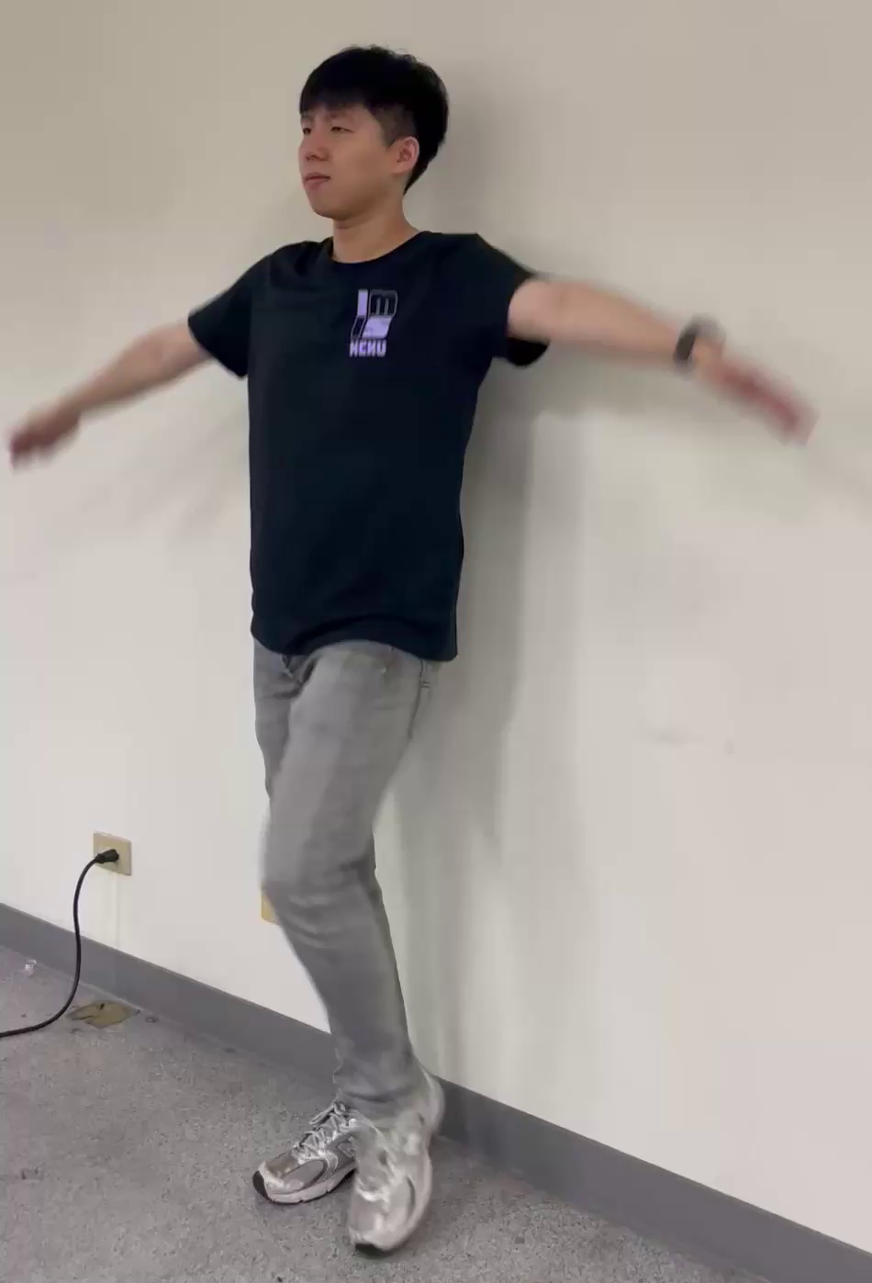
Part3
Cameras of mentor and convalescent are placed in DIFFERENT angle of view.
Mentor
Convalescent
Camera’s Position
Mentor : Front
Convalescent : Left
Video Spec: 30 FPS
Duration : 20 seconds
(freeze time excluded)

Slide 4
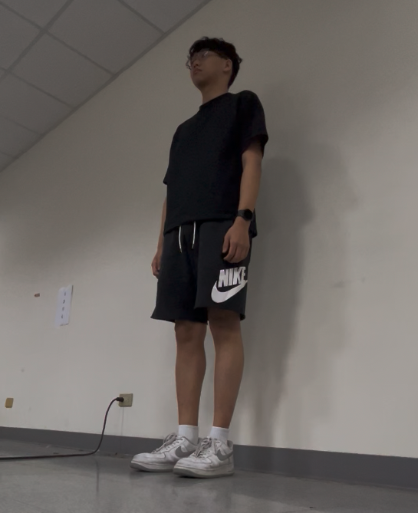
Part4: Robustness Study Under Challenging Conditions
Cameras of convalescent is placed in FLOOR angle of view.
Mentor
Convalescent
Camera’s Position
Mentor : Front
Convalescent : Left
Video Spec: 30 FPS
Duration :
Mentor: 20 seconds
Convalescent: 38 seconds
(freeze time excluded)
Simulate abnormal convalescent behavior: slow-paced execution
( The convalescent performs every movement at half the mentor’s speed. )

Slide 5
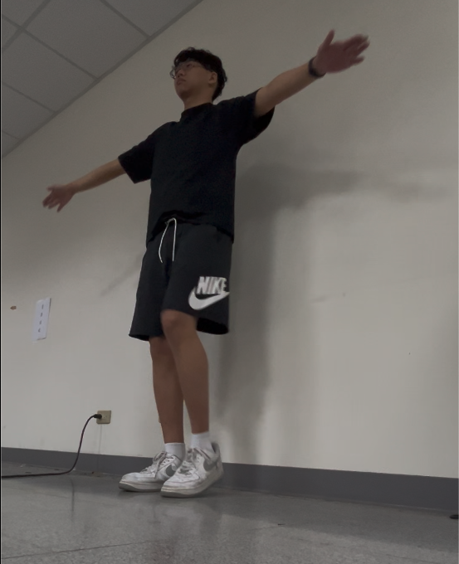
Part5: Robustness Study Under Challenging Conditions
Cameras of convalescent is placed in FLOOR angle of view.
Mentor
Convalescent
Camera’s Position
Mentor : Front
Convalescent : Left
Video Spec: 30 FPS
Duration : 20 seconds
(freeze time excluded)
Simulate abnormal convalescent behavior: lack of actions
( The convalescent lacks 1 action in each set of movements. )

Slide 6
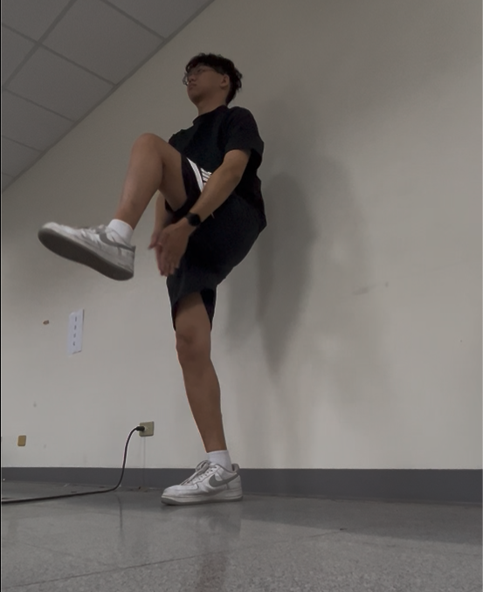
Part6: Robustness Study Under Challenging Conditions
Cameras of convalescent is placed in FLOOR angle of view.
Mentor
Convalescent
Camera’s Position
Mentor : Front
Convalescent : Left
Video Spec: 30 FPS
Duration :
Mentor: 20 seconds
Convalescent: 35 seconds
(freeze time excluded)
Simulate abnormal convalescent behavior: redundant actions
( The convalescent performs 1 extra action in the first two sets of movements. )

Slide 7
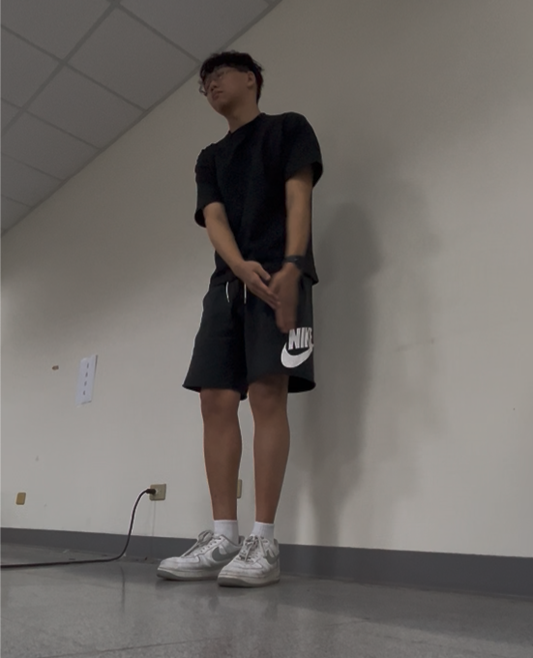
Part7: Robustness Study Under Challenging Conditions
Cameras of convalescent is placed in FLOOR angle of view.
Mentor
Convalescent
Camera’s Position
Mentor : Front
Convalescent : Left
Video Spec: 30 FPS
Duration : 20 seconds
(freeze time excluded)
Simulate abnormal convalescent behavior: incorrect execution
( The convalescent performs 2 incorrect action in each set of movements. )

Slide 8
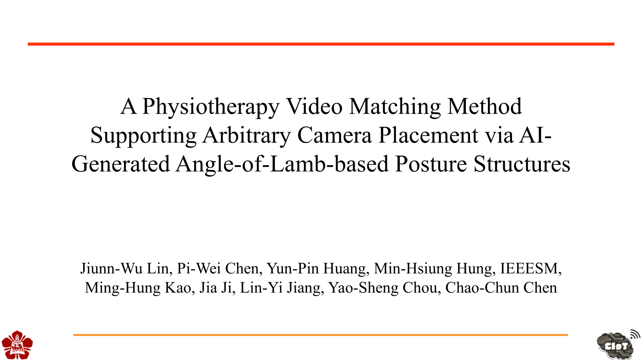
A Physiotherapy Video Matching Method Supporting Arbitrary Camera Placement via AI-Generated Angle-of-Lamb-based Posture Structures
Jiunn-Wu Lin, Pi-Wei Chen, Yun-Pin Huang, Min-Hsiung Hung, IEEESM, Ming-Hung Kao, Jia Ji, Lin-Yi Jiang, Yao-Sheng Chou, Chao-Chun Chen

Slide 9

Part1
Cameras of mentor and convalescent are placed in SAME angle of view.
Mentor
Convalescent
Camera’s Position
Mentor : Front
Convalescent : Front
Video Spec: 30 FPS
Duration : 20 seconds
(freeze time excluded)

Slide 10
Part2
Cameras of mentor and convalescent are placed in DIFFERENT angle of view.
Mentor
Convalescent
Camera’s Position
Mentor : Front
Convalescent : Right
Video Spec: 30 FPS
Duration : 20 seconds
(freeze time excluded)

Slide 11
Part3
Cameras of mentor and convalescent are placed in DIFFERENT angle of view.
Mentor
Convalescent
Camera’s Position
Mentor : Front
Convalescent : Left
Video Spec: 30 FPS
Duration : 20 seconds
(freeze time excluded)

Slide 12

Part4: Robustness Study Under Challenging Conditions
Cameras of convalescent is placed in FLOOR angle of view.
Mentor
Convalescent
Camera’s Position
Mentor : Front
Convalescent : Left
Video Spec: 30 FPS
Duration :
Mentor: 20 seconds
Convalescent: 38 seconds
(freeze time excluded)
Simulate abnormal convalescent behavior: slow-paced execution
( The convalescent performs every movement at half the mentor’s speed. )

Slide 13
Part5: Robustness Study Under Challenging Conditions
Cameras of convalescent is placed in FLOOR angle of view.
Mentor
Convalescent
Camera’s Position
Mentor : Front
Convalescent : Left
Video Spec: 30 FPS
Duration : 20 seconds
(freeze time excluded)
Simulate abnormal convalescent behavior: lack of actions
( The convalescent lacks 1 action in each set of movements. )

Slide 14
Part6: Robustness Study Under Challenging Conditions
Cameras of convalescent is placed in FLOOR angle of view.
Mentor
Convalescent
Camera’s Position
Mentor : Front
Convalescent : Left
Video Spec: 30 FPS
Duration :
Mentor: 20 seconds
Convalescent: 35 seconds
(freeze time excluded)
Simulate abnormal convalescent behavior: redundant actions
( The convalescent performs 1 extra action in the first two sets of movements. )

Slide 15
Part7: Robustness Study Under Challenging Conditions
Cameras of convalescent is placed in FLOOR angle of view.
Mentor
Convalescent
Camera’s Position
Mentor : Front
Convalescent : Left
Video Spec: 30 FPS
Duration : 20 seconds
(freeze time excluded)
Simulate abnormal convalescent behavior: incorrect execution
( The convalescent performs 2 incorrect action in each set of movements. )

