Slide 1
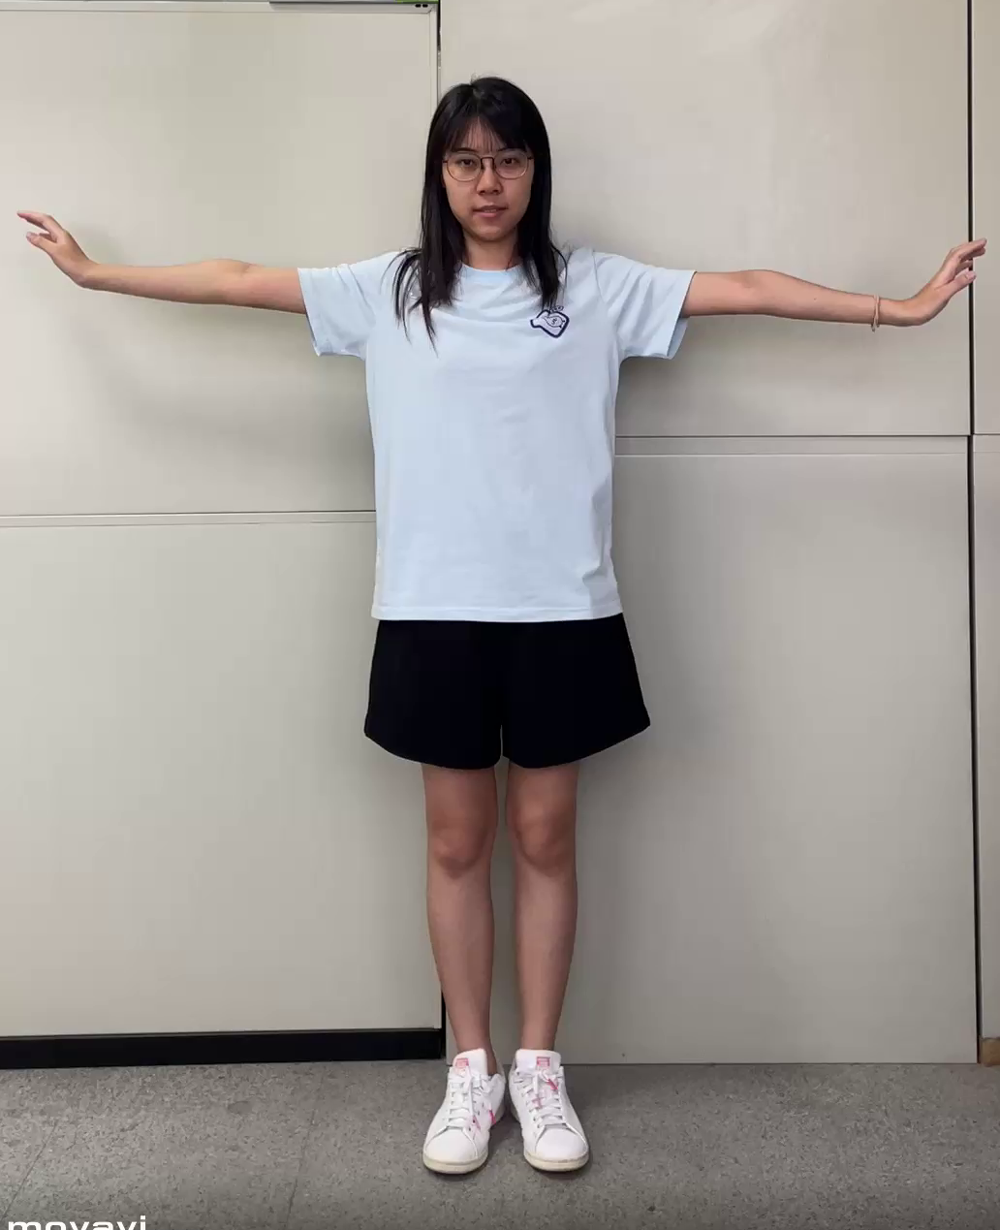
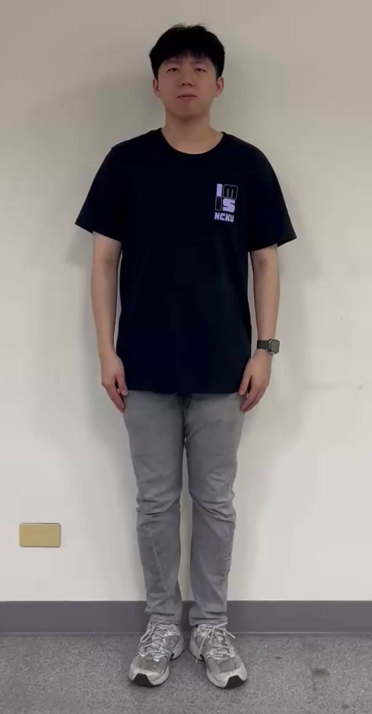
Part1
Cameras of mentor and convalescent are placed in SAME angle of view.
Mentor
Convalescent
Camera’s Position
Mentor : Front
Convalescent : Front
Video Spec: 30 FPS
Duration : 20 seconds
(freeze time excluded)

Slide 2
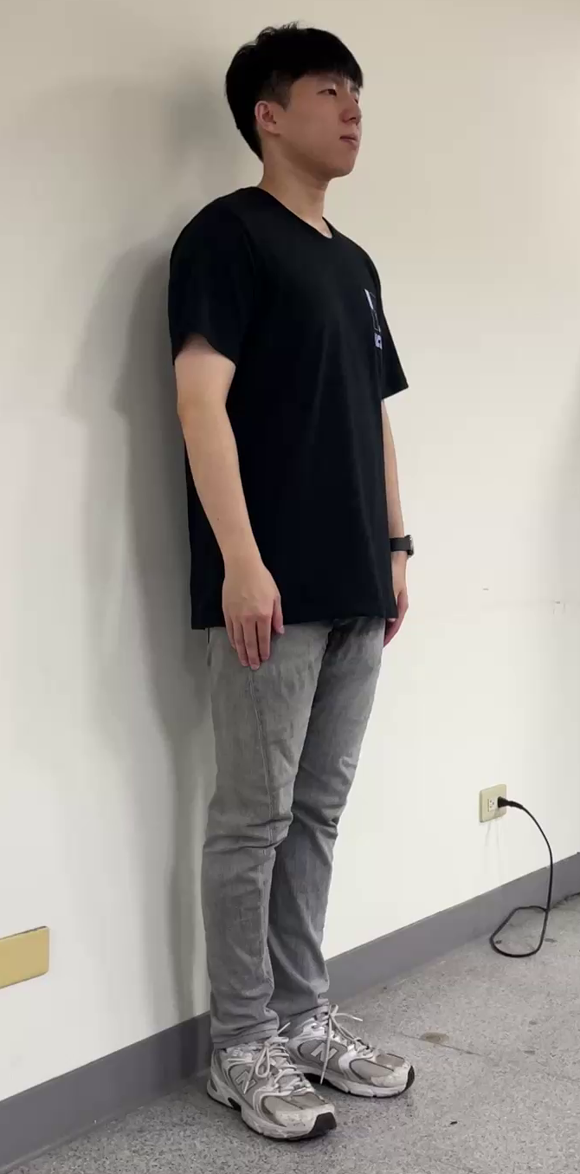
Part2
Cameras of mentor and convalescent are placed in DIFFERENT angle of view.
Mentor
Convalescent
Camera’s Position
Mentor : Front
Convalescent : Right
Video Spec: 30 FPS
Duration : 20 seconds
(freeze time excluded)

Slide 3
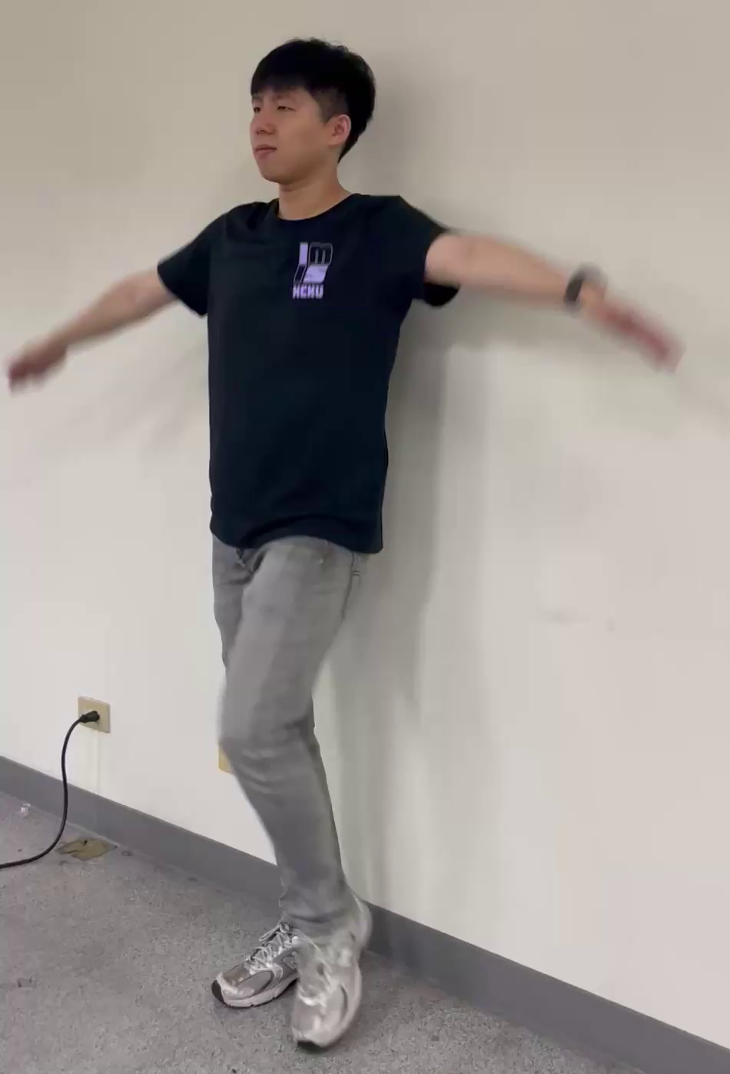
Part3
Cameras of mentor and convalescent are placed in DIFFERENT angle of view.
Mentor
Convalescent
Camera’s Position
Mentor : Front
Convalescent : Left
Video Spec: 30 FPS
Duration : 20 seconds
(freeze time excluded)

Slide 4
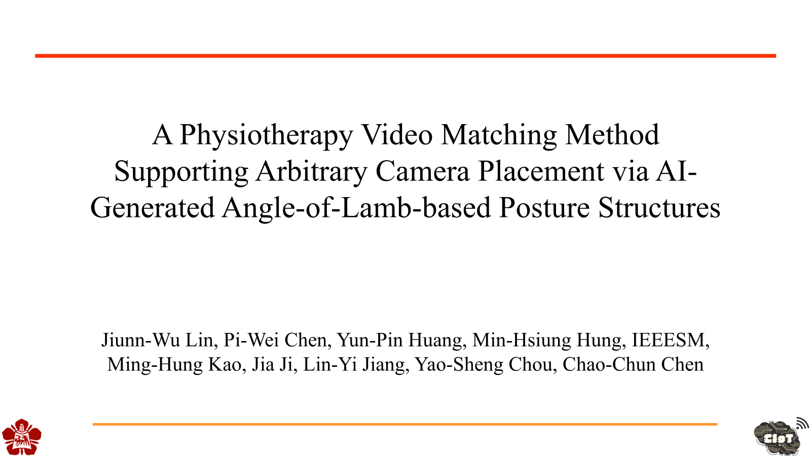
A Physiotherapy Video Matching Method Supporting Arbitrary Camera Placement via AI-Generated Angle-of-Lamb-based Posture Structures
Jiunn-Wu Lin, Pi-Wei Chen, Yun-Pin Huang, Min-Hsiung Hung, IEEESM, Ming-Hung Kao, Jia Ji, Lin-Yi Jiang, Yao-Sheng Chou, Chao-Chun Chen

Slide 5

Part1
Cameras of mentor and convalescent are placed in SAME angle of view.
Mentor
Convalescent
Camera’s Position
Mentor : Front
Convalescent : Front
Video Spec: 30 FPS
Duration : 20 seconds
(freeze time excluded)

Slide 6
Part2
Cameras of mentor and convalescent are placed in DIFFERENT angle of view.
Mentor
Convalescent
Camera’s Position
Mentor : Front
Convalescent : Right
Video Spec: 30 FPS
Duration : 20 seconds
(freeze time excluded)

Slide 7
Part3
Cameras of mentor and convalescent are placed in DIFFERENT angle of view.
Mentor
Convalescent
Camera’s Position
Mentor : Front
Convalescent : Left
Video Spec: 30 FPS
Duration : 20 seconds
(freeze time excluded)

