Slide 1
Python For Computational Problem Solving Project Topic : WhatsApp Bot
Group
Gambhir Shetty, Gaurav M, Harsha K V, Harshith G

Slide 2
Problem Statement
To build a WhatsApp bot which makes use of web scraping and gathers solutions for the user request

Slide 3
Modules/API used
Twilio(API): Twilio is a customer engagement functionality provider used by developers worldwide to build unique communication features and capabilities like voice, text, chat, video, and email into their applications.
Flask: Flask is a web framework. This means flask provides you with tools, libraries and technologies that allow you to build a web application.
Requests: is a library for making HTTP requests. It provides an easy-to-use interface that makes working with HTTP very simple, which means it simplifies the process of sending and receiving data from websites by providing a uniform interface for both GET and POST methods.
Ngrok: ngrok is a cross-platform application that enables developers to expose a local development server to the Internet with minimal effort. The software makes your locally-hosted web server appear to be hosted on a subdomain of ngrok.com, meaning that no public IP or domain name on the local machine is needed.
Googlesearch (library): is a Python library for searching Google, easily.

Slide 4
How it works
First, A Twilio account and a smartphone with an active phone number and WhatsApp installed.
Then, We use flask to create a web application that responds to incoming WhatsApp messages with twilio.
A request is made by the user.
We use the libraries requests and googlesearch to scrape the web.
The results (urls) are sent back to the user in url form

Slide 5
About
The WhatsApp bot takes certain words to be its parameter and searches the word or a certain topic in a specified website or websites which makes it easy for the user as the user gets many results instead of spending time on the internet searching for the same.

Slide 6
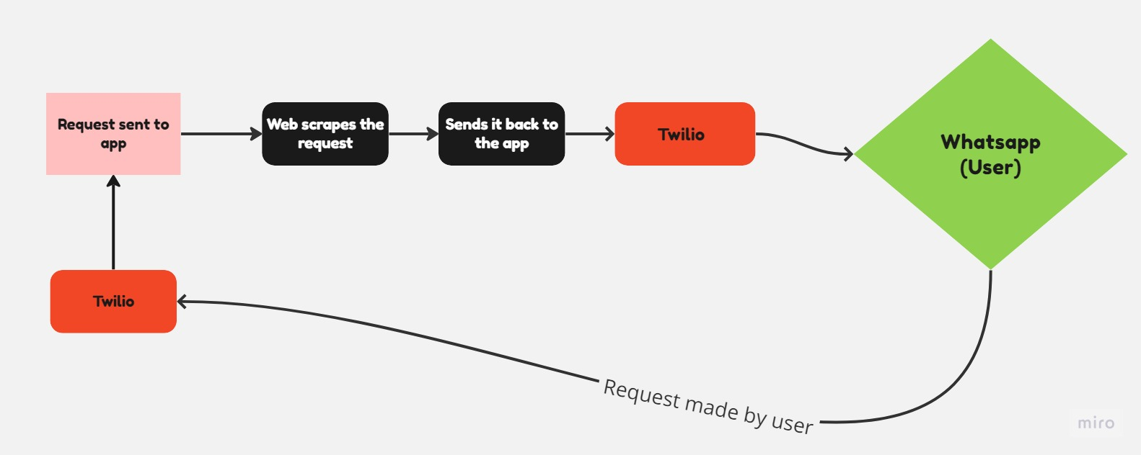
Flow of program

Slide 7
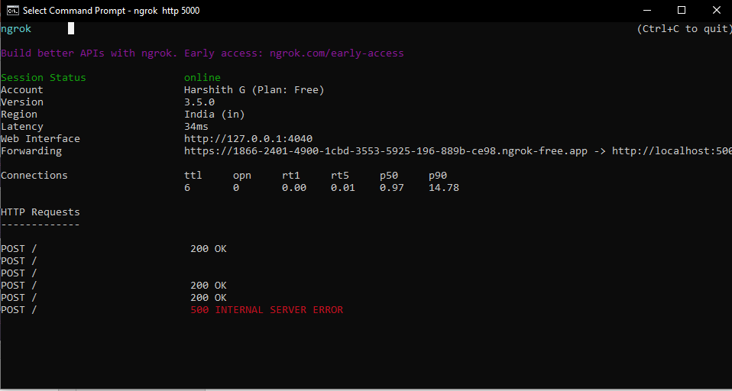

Slide 8
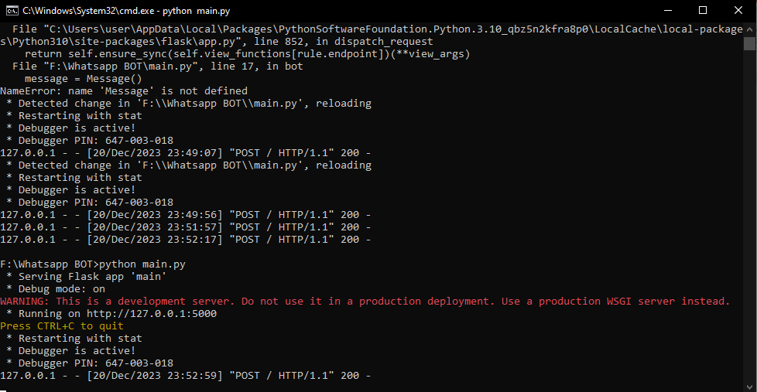

Slide 9
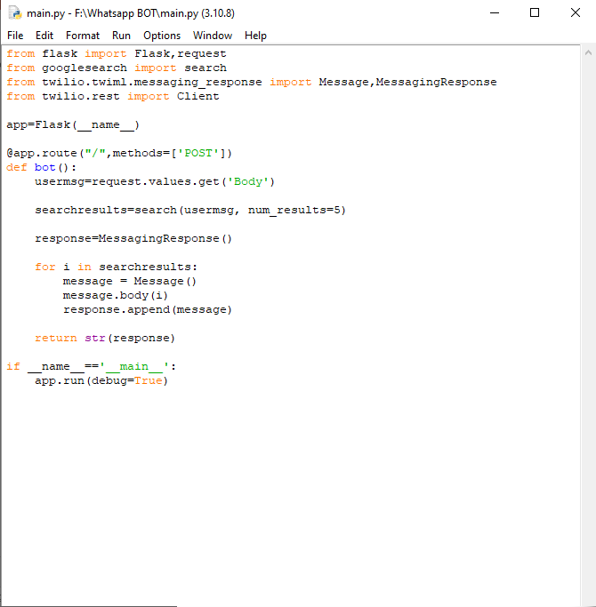

Slide 10
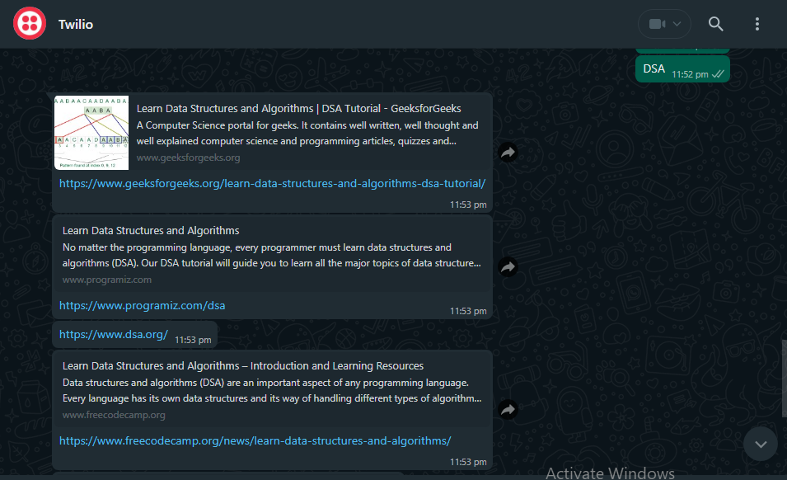
Output

Slide 11
System requirements
Ram: 2GB Ram processor: intel i3 6th gen and higher
Operating system: windows 10/Mac-os/linux
Python version: version 3.9 or higher

