Slide 1
Fixation-stimulus channel (FiSt)
Assembly instructions
v1.0

Slide 2
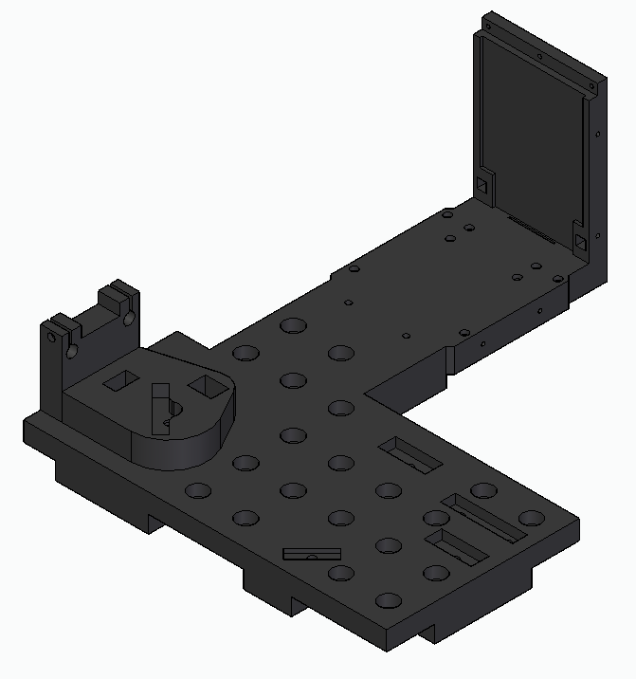
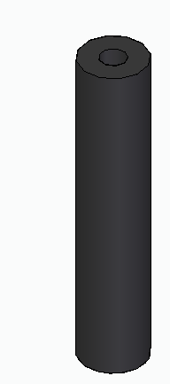
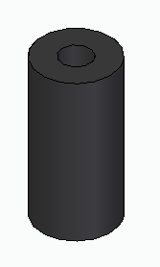
1 × 01_FDML_stimfix_mainboard
4 × 02_FDML_stimfix_electronics_post_24mm
4 × 03_FDML_stimfix_electronics_post_10mm

Slide 3
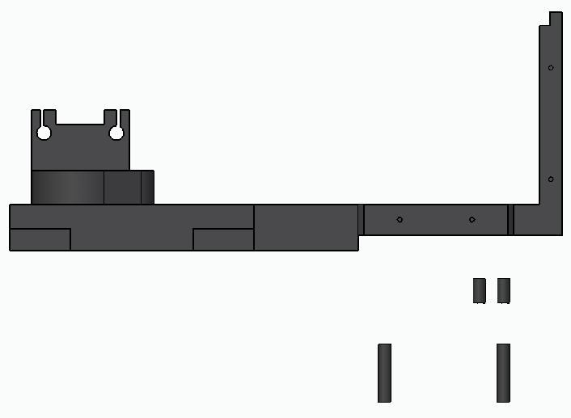
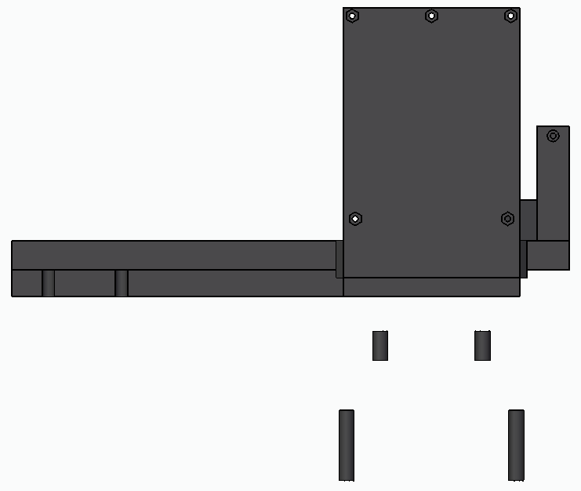
Use 8 × M2 cap screws to fix the posts

Slide 4
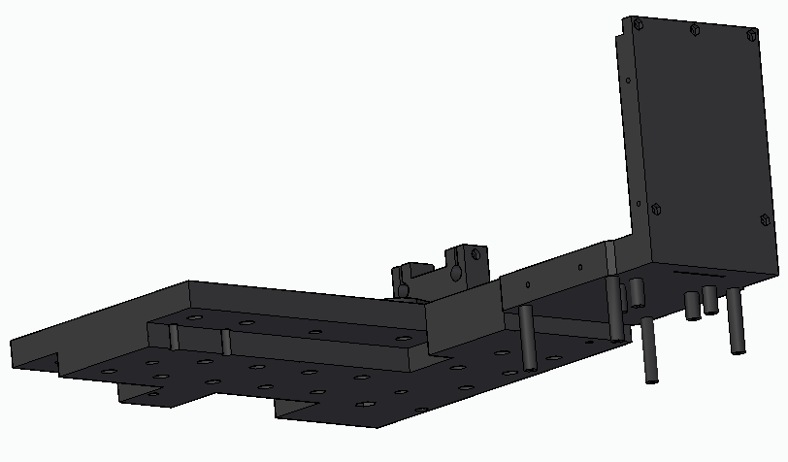

Slide 5
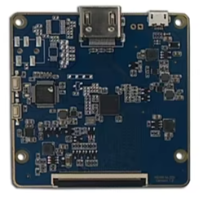
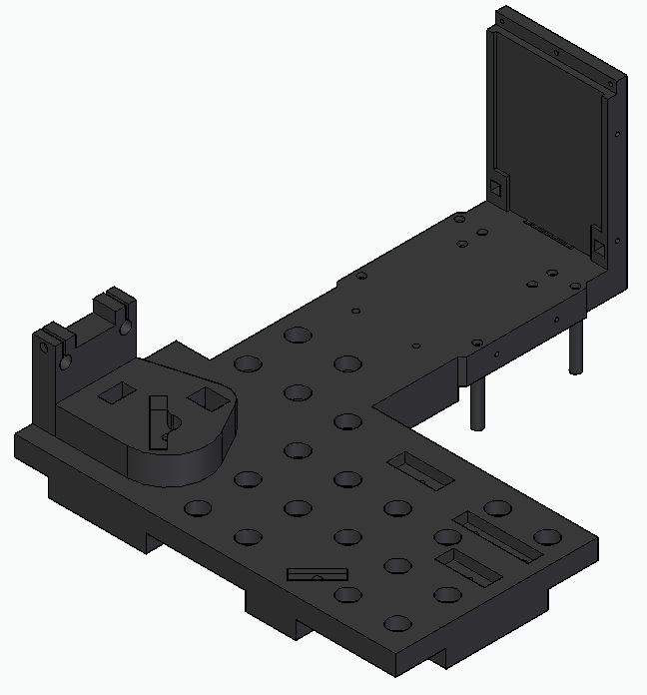
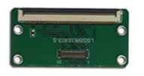
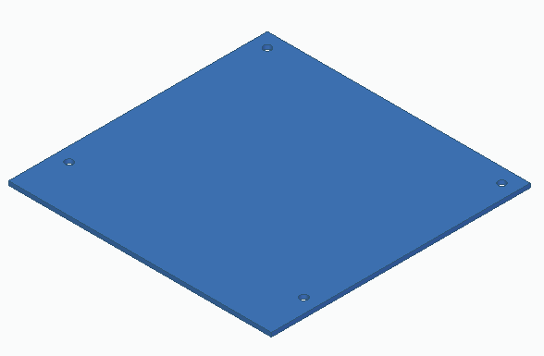
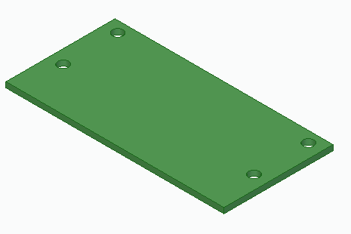
1 × PCB drive board small (comes with LCD screen)
1 × PCB drive board (comes with LCD screen)

Slide 6
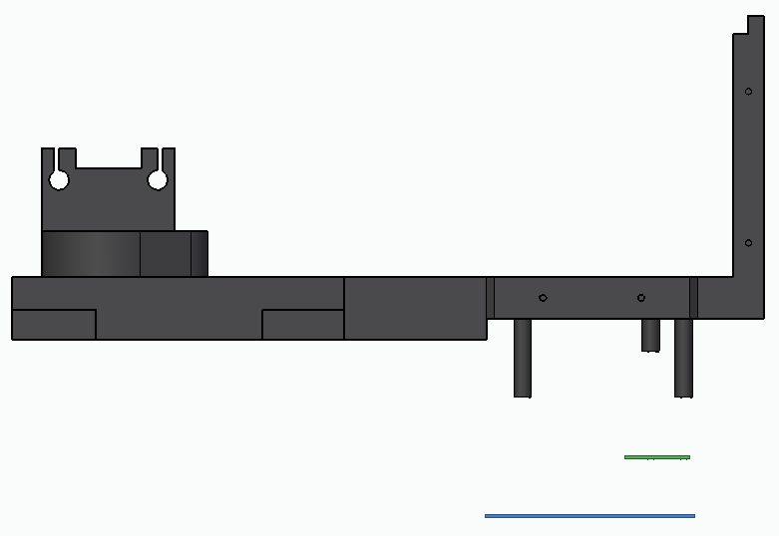
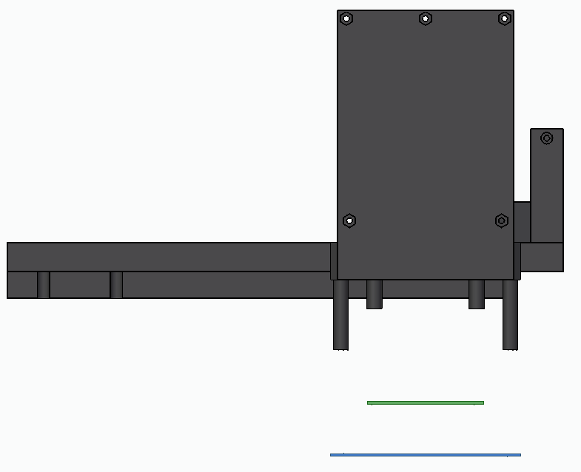
Use 8 × M2 cap screws to fix both PCB boards to the posts

Slide 7
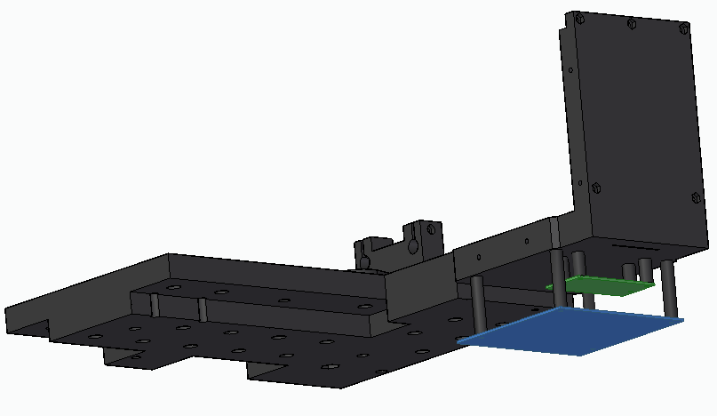

Slide 8
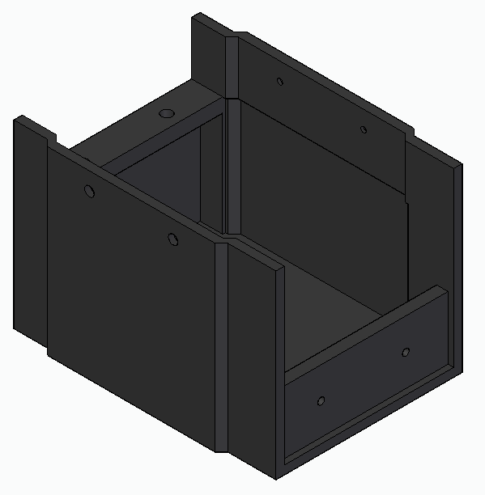
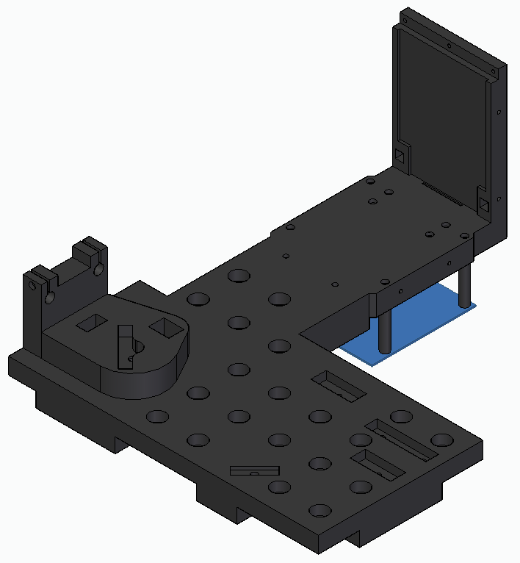
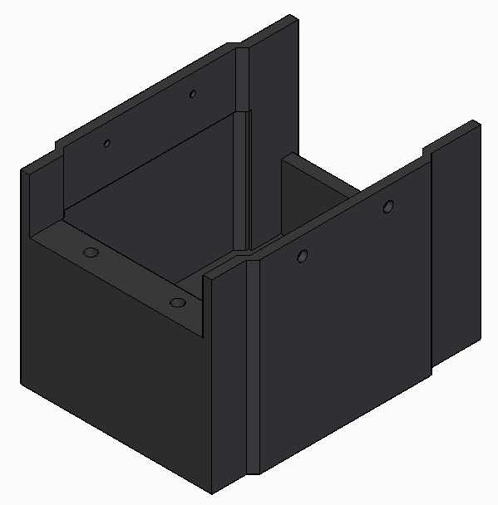
1 × 04_FDML_stimfix_PCB_boards_housing
Side notes:
The surface indicated by the blue arrow aligns with the bottom of the main board. Its purpose is to secure the enclosure, preventing light leakage from the PCB board LEDs.
The spacing between the holes should be increased to create a slot for routing the pitch flexible flat cable from the PCB blue board. The current spacing is too tight, making it difficult to install this component without risking damage or disconnection of the cable.
Additionally, counterbores need to be added to the main board. These should be applied to the holes designed as inserts for the cap screws that secure the section indicated by the blue arrow.
Securing the housing at the locations indicated by the red arrows prevents its removal once the Badal system is installed. Consider an alternative mounting solution to allow easier disassembly or access without interference from the installed system.

Slide 9
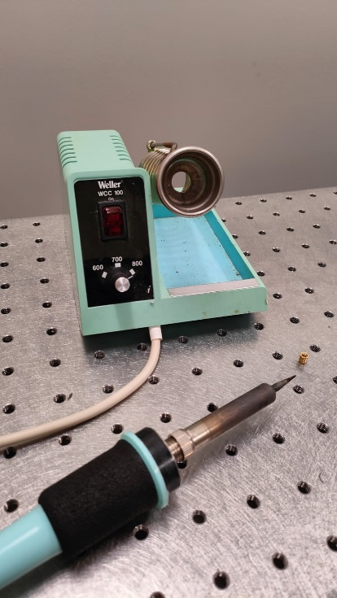
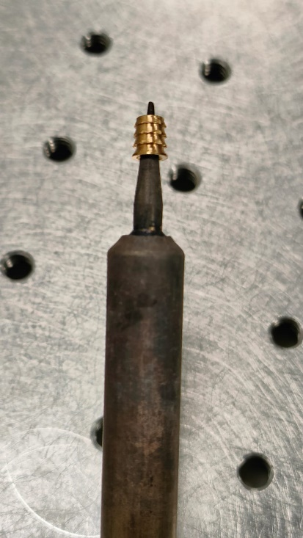
1 × 04_FDML_stimfix_PCB_boards_housing
Mold the M3 threaded inserts into the designated holes on both sides using a soldering tool.

Slide 10
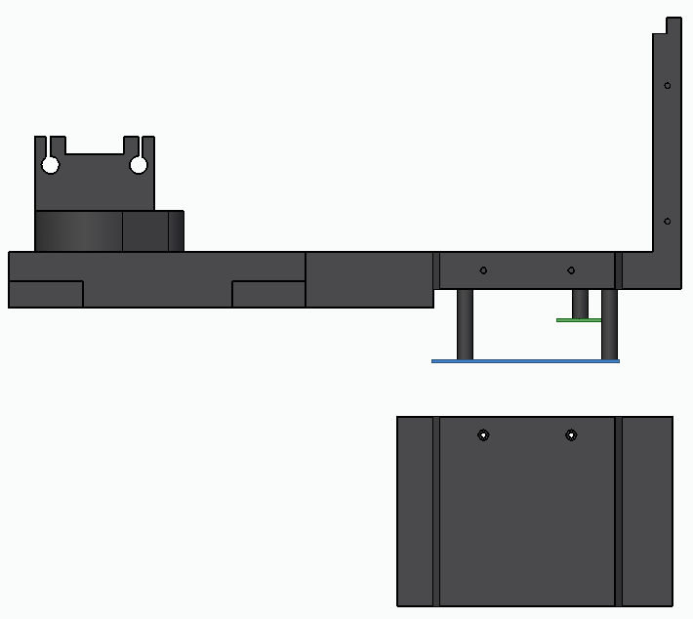
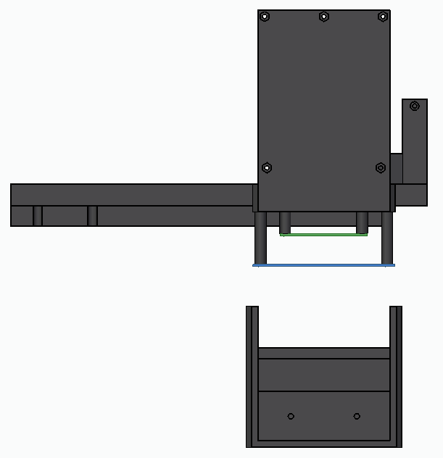
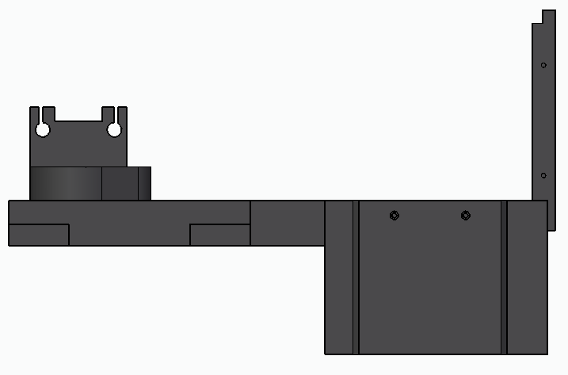
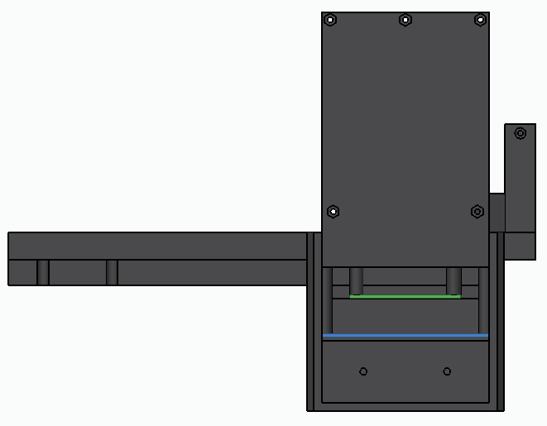
1
Mold the M2 threaded inserts into the designated holes on both sides using a soldering tool.
Insert M2 nuts into designated holes
2
Secure with
4 × M2 cap screws

Slide 11
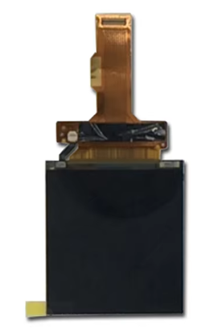
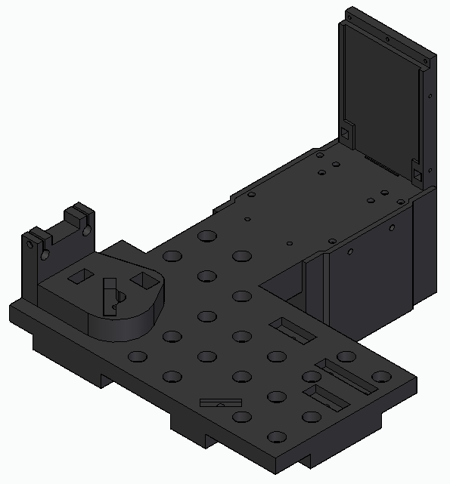
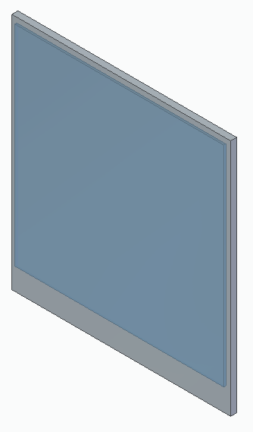
1 × LCD screen

Slide 12
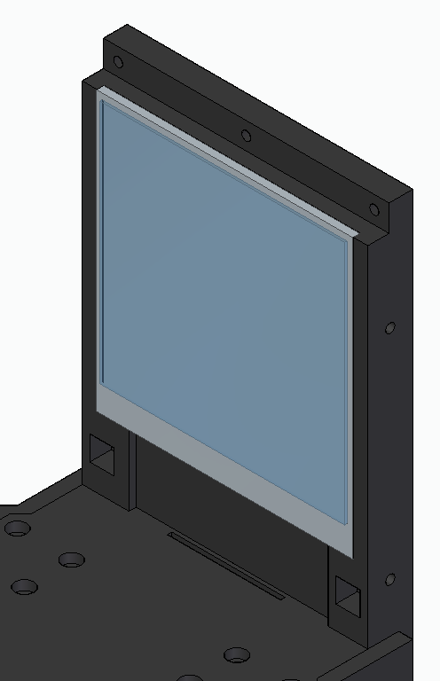
1 × LCD screen
Insert the screen into designated slot.
Pass the flat cable (not shown in the model) through the designated slot as indicated by green arrows.
Connect the cable to the green PCB board

Slide 13
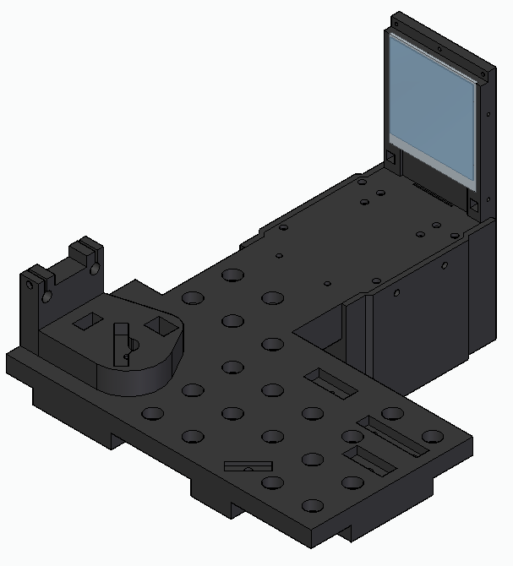
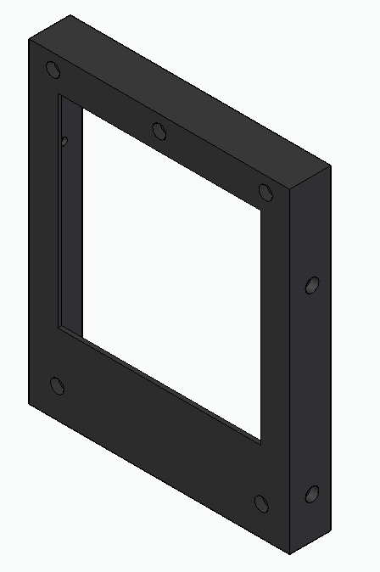
1 × 05_FDML_stimfix_LCD_screen_front_panel

Slide 14
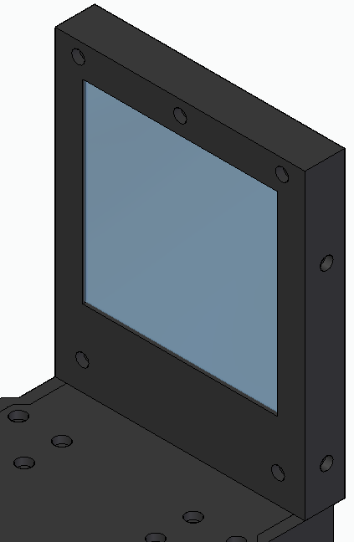
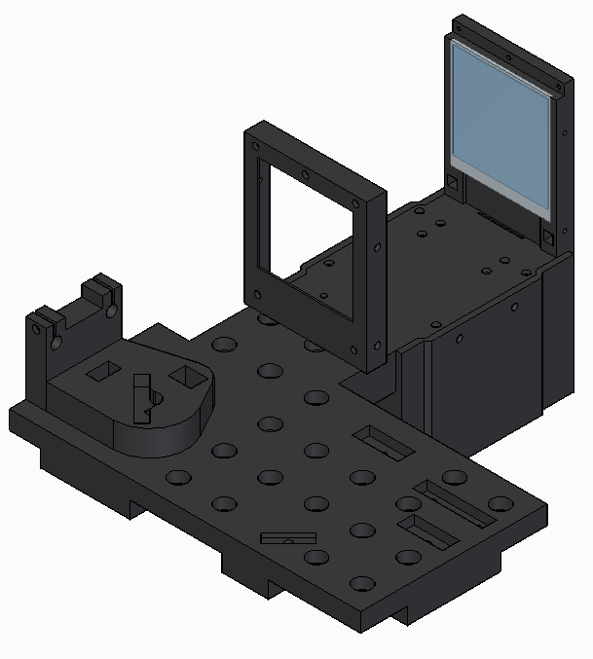
Secure with
12 × M2 cap screws

Slide 15
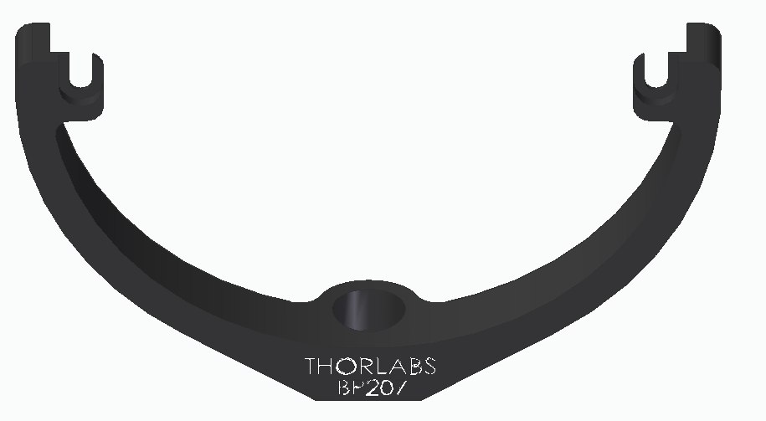
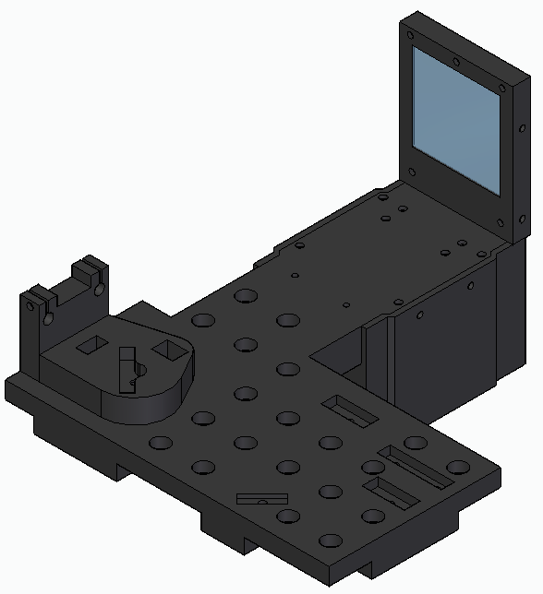
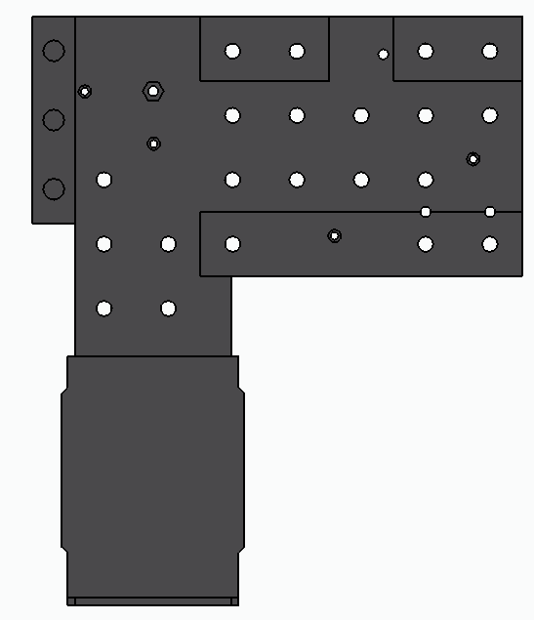

1 × Thorlabs_BP207 (a 3D printed alternative holder could also be used)
https://www.thorlabs.com/thorproduct.cfm?partnumber=BP207
Insert an M4 nut into designated hole
Plate bottom

Slide 16
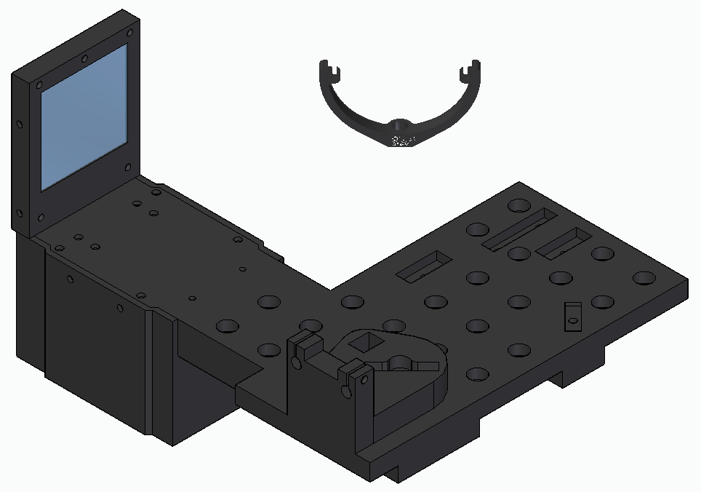
Secure with an M4 cap screw
Insert the pellicle holder part into the designated slot.

Slide 17
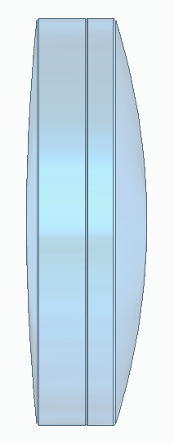
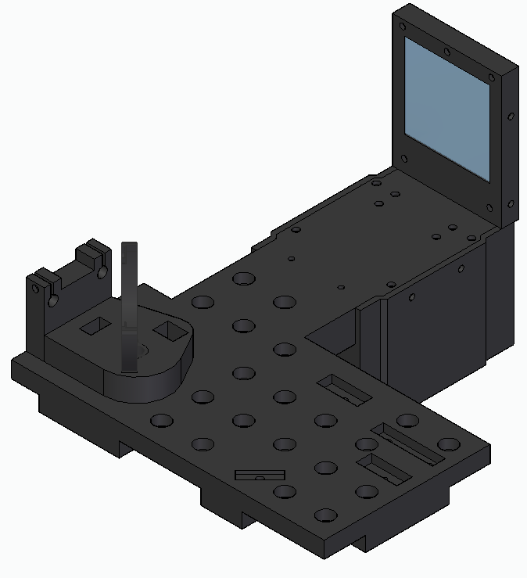
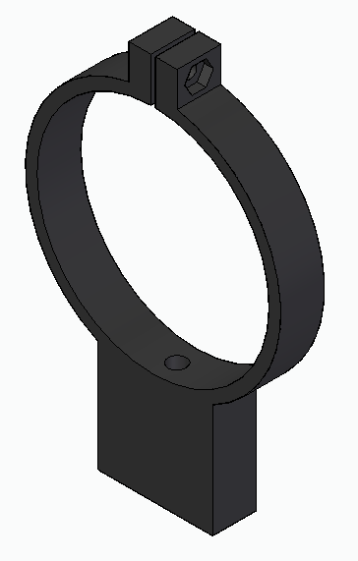
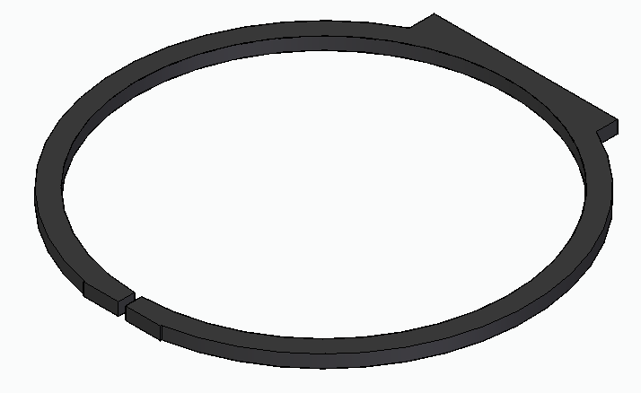
2 × 06_FDML_stimfix_2in_lens_clamp_holder
2 × Thorlabs_AC508-150-A
1 × extra_stimfix_2in_lens_clamp_holder_mounting_tool (optional)
https://www.thorlabs.com/thorproduct.cfm?partnumber=AC508-150-A
Insert M3 nuts into the designated slots indicated by the green arrows
Mold M3 threaded inserts into the designated holes indicated by the red arrows

Slide 18
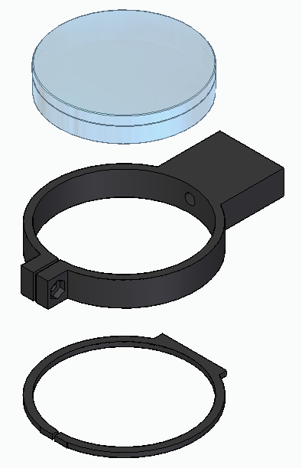
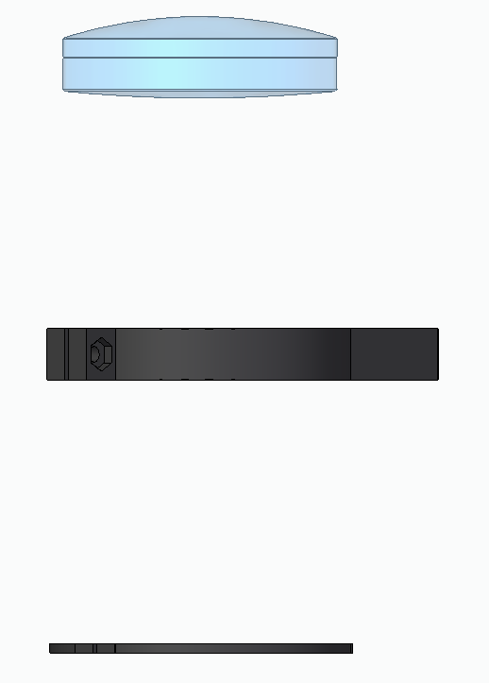
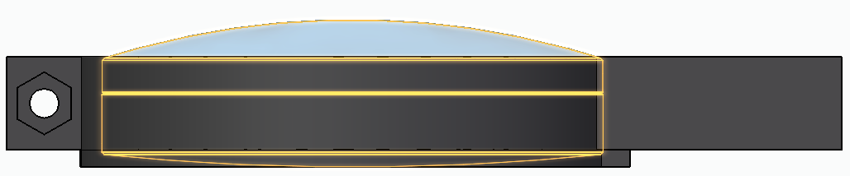
2 ×
Once in the proper position, secure the lens using an M3 cap screw

Slide 19
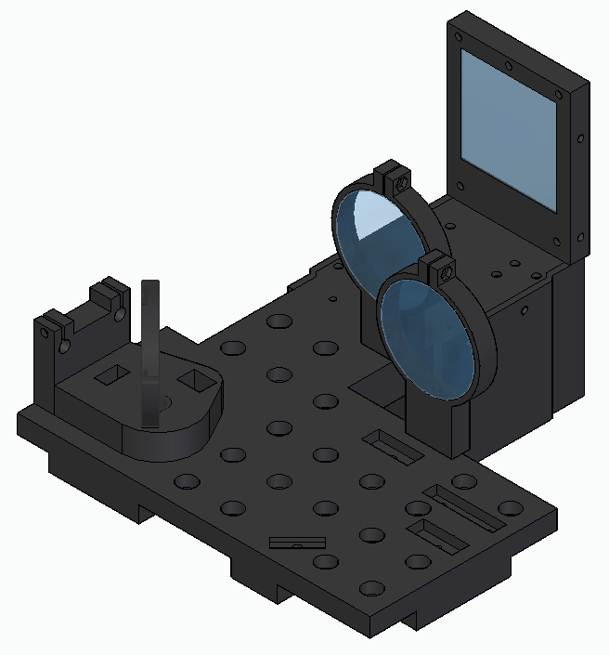
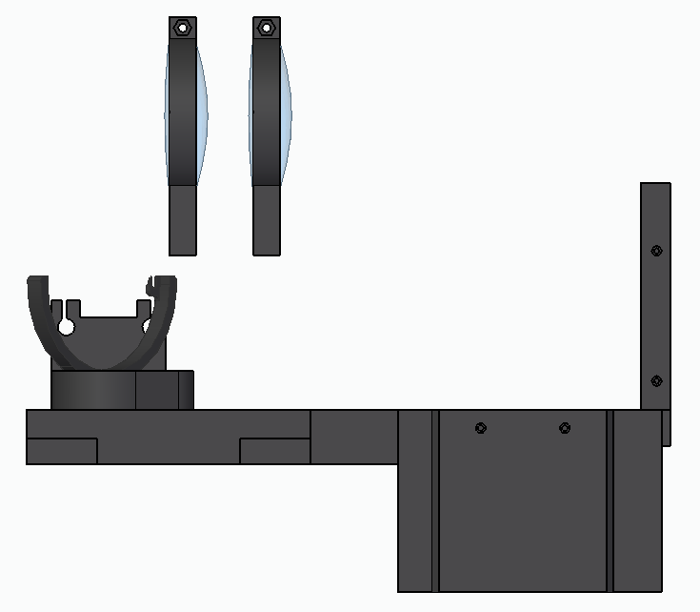
Ensure the convex sides of the lenses are oriented toward the plane pararell to the LCD screen
Secure using M3 cap screws inserted from the bottom side. Ensure the screws are not too long to avoid drilling into the lens

Slide 20
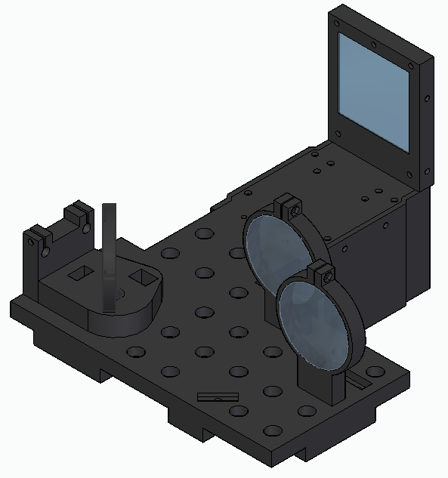
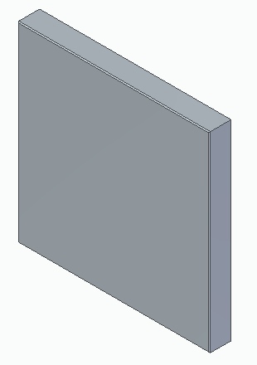
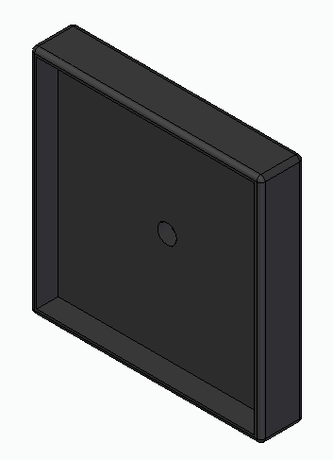
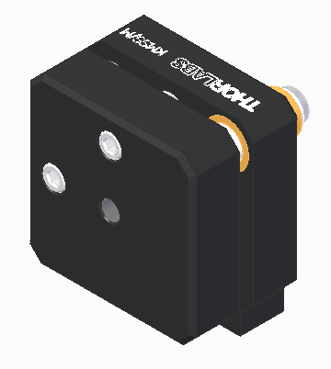
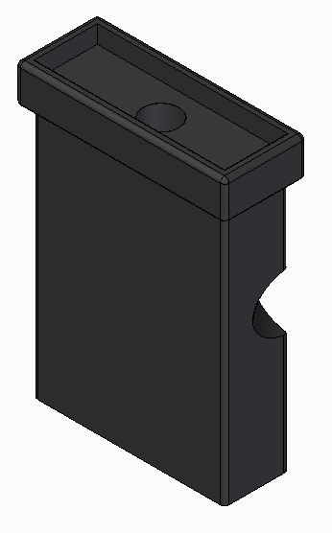
1 × Thorlabs_PFSQ20-03-P01 (https://www.thorlabs.com/thorproduct.cfm?partnumber=PFSQ20-03-P01)
1 × 07_FDML_stimfix_square_mirror_holder_small
1 × Thorlabs_KMSS_M (https://www.thorlabs.com/thorproduct.cfm?partnumber=KMSS/M)
1 × 08_FDML_stimfix_square_mirror_support_with_6mm_rod_cutout

Slide 21
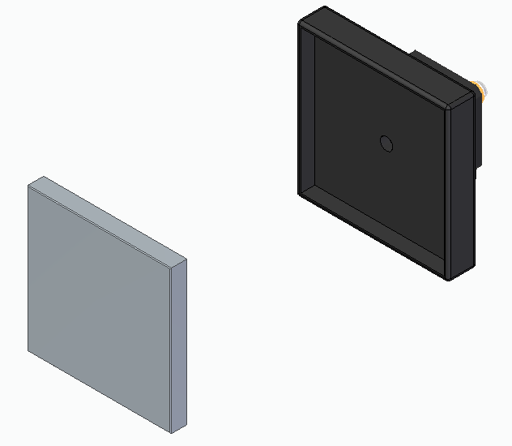




1
Ensure the corresponding surfaces are as paralell as possible
2
4
Insert the mirror into the holder with a tight fit
Secure using 4-40 cap screws
Ensure the position of the cutout is as indicated
3
Slide the kinematic mount into the post holder as tight as possible. Be careful as it may fall off – final fixing is with the M4 cap screw in the next step
Fit the support post into the slot indicated by the small green arrow. Secure the assembly using an M4 cap screw, as indicated by the large green arrow. The screw should pass through from the bottom of the main board to the kinematic mount.

Slide 22








1 × Thorlabs_BP208
1 × 09_FDML_stimfix_1in_lens_clamp_holder_stim
1 × 10_FDML_stimfix_1in_lens_clamp_holder_fix
1 × Thorlabs_AC254-075-A (https://www.thorlabs.com/thorproduct.cfm?partnumber=AC254-075-A)
1 × Thorlabs_CP20D (https://www.thorlabs.com/thorproduct.cfm?partnumber=CP20D)
1 × Thorlabs_LB1294-A (https://www.thorlabs.com/thorproduct.cfm?partnumber=LB1294-A)
2 × 11_FDML_stimfix_iris_mounting_rod
Mold M3 threaded inserts into the designated holes indicated by the red arrows
Insert M2 nuts into the designated slots indicated by the green arrows

Slide 23


Carefully insert the pellicle into the mounting fork. Head screws should be facing the direction indicated by the blue arrows and fitting the clearance slots
Secure with #2-56 button head screws as indicated by the red arrows

Slide 24







1
2
3
4
Tighten with an M2 cap screw
Tighten with an M2 cap screw
Insert until the rim indicated by the blue arrows
Insert until the rim indicated by the blue arrows
Convex side
5
6
Tighten with an M2 cap screws as indicated by the red arrows
Insert both holders tightly into dedicated slots, paying attention to the orientation of the holder.
Secure with M3 cap screws inserted from the bottom as indicated by the blue arrows.
Tighten with 5/64in locking screws as indicated by the blue arrows

Slide 25


STAGE 1 COMPLETE

Slide 26


STAGE 1 COMPLETE

Slide 27



1 × 12_FDML_stimfix_Badal_stage_bottom
2 × model_04_stimfix_Badal_stage_sliding_rod_200mm
Mold the M2 threaded inserts into the designated holes on both sides using a soldering tool.
Mold the M3 threaded inserts into the designated holes using a soldering tool.
Mold the M6 threaded inserts into the designated holes using a soldering tool.

Slide 28



1
2
Slide the rods into the designated slots for a tight fit.
Ensure the end tips of the rods are flush with the encasing

Slide 29








1 × 13_FDML_stimfix_Badal_stage_top
2 × 14_FDML_stimfix_square_mirror_support_Badal_stage
2 × Thorlabs_KMSS_M (https://www.thorlabs.com/thorproduct.cfm?partnumber=KMSS/M)
1 × 15_FDML_stimfix_square_mirror_holder_large
1 × 16_FDML_stimfix_square_mirror_holder_large_cut_corner
2 × EdmundOptics_88541 (https://www.edmundoptics.com/p/75-x-75mm-protected-silver-lambda4-mirror/30799/)
1 × model_05_hex_coupling_nut
2 × model_06_linear_ball_bearing_6mm

Slide 30





1
2
3
Ensure the corresponding surfaces are as paralell as possible
Insert the ball bearings and the hex coupling nut into the designated slots, ensuring a tight fit.
Secure using 4-40 cap screws
4
Ensure the corresponding surfaces are as paralell as possible
Insert the mirrors into the holders with a tight fit

Slide 31





1
Slide the kinematic mounts into the post holders as tight as possible. Be careful as it may fall off – final fixing is with the M4 cap screw in the next step
2
3
Insert both holders tightly into the designated slots, ensuring proper alignment with the slot orientation and the correct positioning of the holder with the cut corner. Secure the assembly using M3 cap screws inserted from the bottom, as indicated by the blue arrows.

Slide 32







1 × 17_FDML_stimfix_Badal_screw_8mm_end_cap
1 × 18_FDML_stimfix_Badal_screw_8mm_front_cap
1 × 19_FDML_stimfix_Badal_screw_8mm_rotating_handle
2 × 20_FDML_stimfix_Badal_screw_handle_fixing_bolt
1 × 21_FDML_stimfix_Badal_stage_cover_rear
1 × 22_FDML_stimfix_Badal_stage_cover_top
1 × model_07_stimfix_Badal_threaded_rod_M8

Slide 33






1
2
Insert the threaded rod into the central assembly through the designated slot with hex coupling. Attach end and front caps by rotating as indicated by the blue arrows until the fit is tight.
Slide the handle part of the rod (the one with the two holes) into the slot on the rear stage holder. Ensure it fits snugly and aligns with the holder.
4
3
Align with the top stage cover
Attach the rotating handle and secure with the two fixing bolts

Slide 34


Secure the stage top cover with M2 cap screws × 8 as indicated by the red arrows (not all shown)
Secure the stage rear cover with M3 cap screws × 4 as indicated by the blue arrows
Insert and secure deep grove ball bearings (inner diameter 8mm, outer diameter 12mm)

Slide 35


STAGE 2 COMPLETE

Slide 36


STAGE 2 COMPLETE

Slide 37
1 × STAGE 1 assembly
1 × STAGE 2 assembly

Slide 38



Slide 39


Slide 40

STAGE 1 + STAGE 2 COMPLETE

Slide 41




1 × 23_FDML_stimfix_dichroic_board
1 × 24_FDML_stimfix_dichroic_holder
1 × 25_FDML_rods_guiding_addon
4 × model_06_linear_ball_bearing_6mm
1 × EdmundOptics_54996
Attach element 23 to the STAGE 1 + STAGE 2 assembly first. Then proceed as the instructions indicate.
Mold from the bottom M6 threaded inserts into the designated holes indicated by the red arrows

Slide 42






1
2
3
Mold the M2 threaded inserts into the holes designated by the red arrows
Mold the M2 threaded inserts into the holes designated by the red arrows
Insert the ball bearings into the designated slots, ensuring a tight fit
Mold M3 threaded insert into the designated hole indicated by the blue arrow
Insert the ball bearings into the designated slots, ensuring a tight fit
4
5
6
Secure with an M6 cap screw from the bottom. Element 24 will be sandwiched between the board and the EdmundOptics_54996
element

Slide 43

STAGE 1 + STAGE 2 + STAGE 3 COMPLETE

Slide 44

STAGE 1 + STAGE 2 + STAGE 3 COMPLETE
Before proceeding to STAGE 4 ensure to mold M6 threaded inserts into the holes designated by the red arrows

Slide 45






1 × 26_FDML_stimfix_stimulus_board
1 × 28_FDML_stimfix_stimulus_cage_system_insert
1 × Thorlabs_AC254-075-A (https://www.thorlabs.com/thorproduct.cfm?partnumber=AC254-075-A)
1 × Thorlabs_SM1RR (https://www.thorlabs.com/thorproduct.cfm?partnumber=SM1RR)
1 × 27_FDML_stimfix_cage_system_insert_iris_holder
1 × Thorlabs_CP20D (https://www.thorlabs.com/thorproduct.cfm?partnumber=CP20D)
2 × 11_FDML_stimfix_iris_mounting_rod

Slide 46







1
2
3
Insert the lens into the tube until you feel resistance from the retaining ledge.
Secure the lens using the retaining ring.
Mold M2 and M3 threaded inserts into the designated holes indicated by red arrows (M2) and blue arrows (M3).
4
Insert both cage inserts firmly into the dedicated slots, ensuring correct orientation.
Secure them with M3 cap screws inserted from the bottom, as indicated by the blue arrows.
5
Insert iris mounting rods so that their ends are flush with the front cage insert surface. Secure them with M2 cap screws, as shown by the red arrows. Slide the iris onto the protruding rods as indicated.
6
Tighten the cage rod locking set screws, as indicated by the red arrows.

Slide 47






4 × Thorlabs_ER3 (https://www.thorlabs.com/thorproduct.cfm?partnumber=ER3-P4)
1 × EdmundOptics_49656 (https://www.meetoptics.com/lenses/achromatic/aspherized-achromat/s/edmund-optics/p/49-656)
1 × 29_FDML_collimator_lens_holder_tube
1 × Thorlabs_CP1XY (https://www.thorlabs.com/thorproduct.cfm?partnumber=CP1XY#ad-image-0)
1 × Thorlabs_SM05SMA (https://www.thorlabs.com/thorproduct.cfm?partnumber=SM05SMA#ad-image-0)
1 × Thorlabs_SM1ZA (https://www.thorlabs.com/thorproduct.cfm?partnumber=SM1ZA)

Slide 48








1
2
3
4
Insert the collimating lens into the holder until you feel resistance by the retaining ledge. The flat side of the lens should face the ledge.
Screw Thorlabs_SM05SMA fiber adapter onto the Thorlabs_CP1XY flex plate
Confirm the lens is fully seated.
5
6
7
Insert four ER3 rods into the cage insert as shown, and secure them with M2 screws at the positions marked by red arrows.
Screw the adapter-lens assembly onto the Thorlabs_SM1ZA z-translation cage mount.

Slide 49


1
2
Mount the Z-translation cage with the collimation lens onto the previously secured ER3 rods.
Then do the same with the flex plate containing the mounted fiber adapter.

Slide 50


STAGE 4 COMPLETE

Slide 51

1 × STAGE 1 + STAGE 2 + STAGE 3 assembly
1 × STAGE 4 assembly

Slide 52

Slide the STAGE 4 assembly into the rest of the setup, aligning it with the matching slots as indicated.

Slide 53

Tightly secure with M6 cap screws as indicated with the green arrows

Slide 54

STAGE 1 + STAGE 2 + STAGE 3 + STAGE 4 COMPLETE

Slide 55


STAGE 1 + STAGE 2 + STAGE 3 + STAGE 4
30_FDML_stimfix_mounting_post_long
31_FDML_stimfix_mounting_post_short
Mold M6 threaded inserts into each hole at the top of each post (insert from the top side).

Slide 56

The full assembly is supported by three longer posts and one shorter post (supporting the Badal stage). Posts can be secured to the optical table using standard optical forks. Secure the assembly to the posts using M6 cap screws inserted through the holes in the assembly, threading into the molded inserts at the top of each post.
Suggested post positions are shown on the next slide, which presents a bottom view of the assembly with precise post placement labeled (L = long, S = short).

Slide 57

L = long post
S = short post
S
L
L
L

Slide 58

STAGE 1 + STAGE 2 + STAGE 3 + STAGE 4 + STAGE 5 COMPLETE

Slide 59


STAGE 1 + STAGE 2 + STAGE 3 + STAGE 4 + STAGE 5 assembly
1 × Thorlabs_M45L01 (https://www.thorlabs.com/thorproduct.cfm?partnumber=M45L01)
1 × Chroma_dichroic_mirror (PART NUMBER MISSING)

Slide 60

Insert the multimode fiber tip into the entry of the stimulus channel. Tighten the screw to the fiber adapter.
Insert the dichroic mirror into designated holder and secure using the screws in the holder.
After inserting the fiber and the dichroic mirror you may proceed to final alignment of the optics. The stimulus-fixation channel is now ready.

Slide 61

FULL ASSEMBLY COMPLETE

Slide 62

FULL ASSEMBLY COMPLETE

Slide 63

FULL ASSEMBLY COMPLETE

Slide 64

FULL ASSEMBLY COMPLETE

