Slide 1
Unsupervised Learning

Slide 2
Unsupervised learning
There is only unlabeled data. The goal is to find meaningful structure in it.
Example: A child learning a first language.
An infant learning its way around the world.
The scientific community exploring the world.

Slide 3
Clustering
Given a collection of data points, divide them into clusters.
Applications:
Document retrieval/web search: Divide results into categories.
Product presentation on online shopping
Investigate alternative causes. E.g. you have a collection of medical record; clusters may correspond to diseases. Clusters of similar biota may correspond to a branch in evolutionary tree.

Slide 4
Variations
Clusters may be:
Exhaustive (every point belongs to a cluster) vs. non-exhaustive (only some)
Disjoint vs. overlapping
Hard vs. soft
Single level vs. hierarchical
One dimension vs. multiple dimensions
Points may be vectors or there may just be a distance measure.

Slide 5
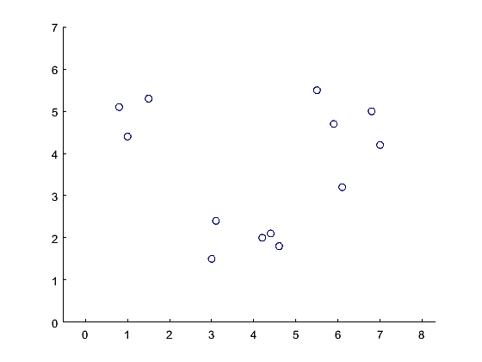
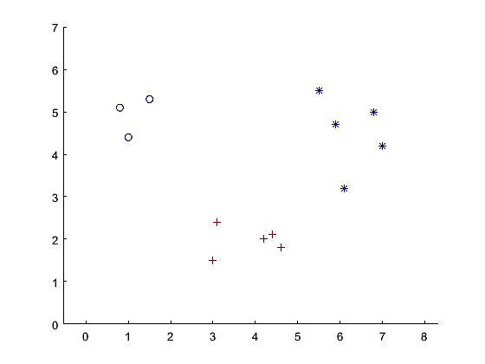
K-means algorithm
Input: Data points are vectors. K = number of clusters is specified.
Output: Exhaustive, disjoint, hard, flat clustering.

Slide 6
K-means algorithm
kMeans(point[n] Data, int k) {
centers = array of k random points;
int[n] clusterOf; % clusterOf[j] is the cluster assigned to Data[j]
repeat {
for (j=1..n) clusterOf[j] = argmin_{i} dist(Data[j],centers[i]);
for (i=1..k) centers[i] = mean({Data[j] | clusterOf[j] == i});
}
until (nothing changed in the previous iteration)
}

Slide 7
K-Means example
See David Rosenberg's Slides for example

Slide 8
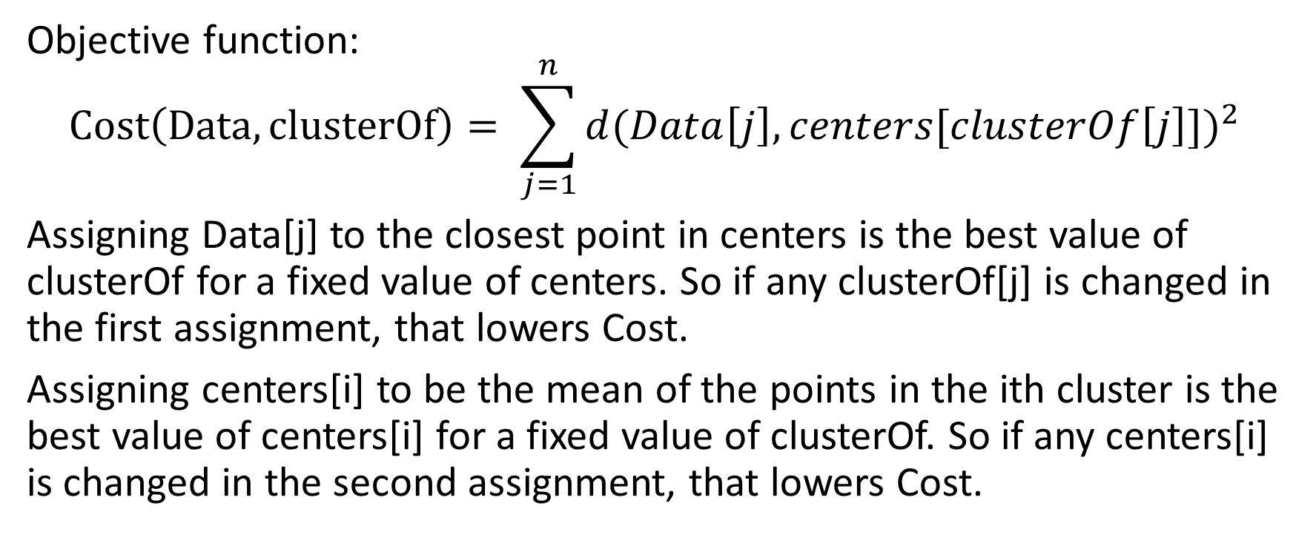
K-means as hill climbing
Objective function:
$$Cost\left(Data,clusterOf\right)= \sum_{j=1}^{n}{d(Data\left[j\right],centers[clusterOf\left[j\right]{])}^{2}}$$
Assigning Data[j] to the closest point in centers is the best value of clusterOf for a fixed value of centers. So if any clusterOf[j] is changed in the first assignment, that lowers Cost.
Assigning centers[i] to be the mean of the points in the ith cluster is the best value of centers[i] for a fixed value of clusterOf. So if any centers[i] is changed in the second assignment, that lowers Cost.

Slide 9
K-means terminates at a local minimum
Terminates: Every step lowers the cost function, so it cannot repeat a value of clusterOf. And there are only finitely many clusterings (at most k^{n}). So the loop terminates.
Local minimum: In the following sense:
  A state is a pair <clusterOf, centers>.
  State N is a neighbor of state S if either:
  N.centers = S.centers; or
  N.clusterOf = S.clusterOf
Then the state returned by K-means is a local minimum of Cost (almost always a strict local minimum, unless two centers are equidistant from a data point.)

Slide 10
Worst case running time
Andrea Vanatti (2011) showed that in pathological cases it takes time Ω(2^{cn}) even for points in 2 dimensional space. However, this doesn’t actually matter because these are pathological cases with a lot of points just on the border. In such cases, there is no actual value in getting the theoretically best clustering in any case.
In practice it tends to converge quickly.

Slide 11
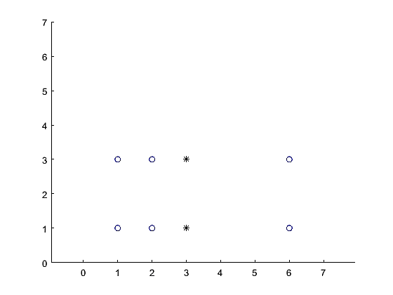
Local minima
A more serious problem is that one can reach poor local minima
Clustering with the top points in one cluster and the bottom in the other is a local minimum. (Asterisks are center points).
A fix for this is random restart.

Slide 12
Starvation
In some cases, a cluster can end up with no data points, so the result is fewer than k clusters.
In an extreme version, the result is a single cluster with all the data points.
Again, random restart will fix it. (This is never the true optimal solution.)
Alternatively, when one cluster is starved, pick a new center randomly. That will always lower the cost function, so it doesn’t risk non-terminology.

Slide 13
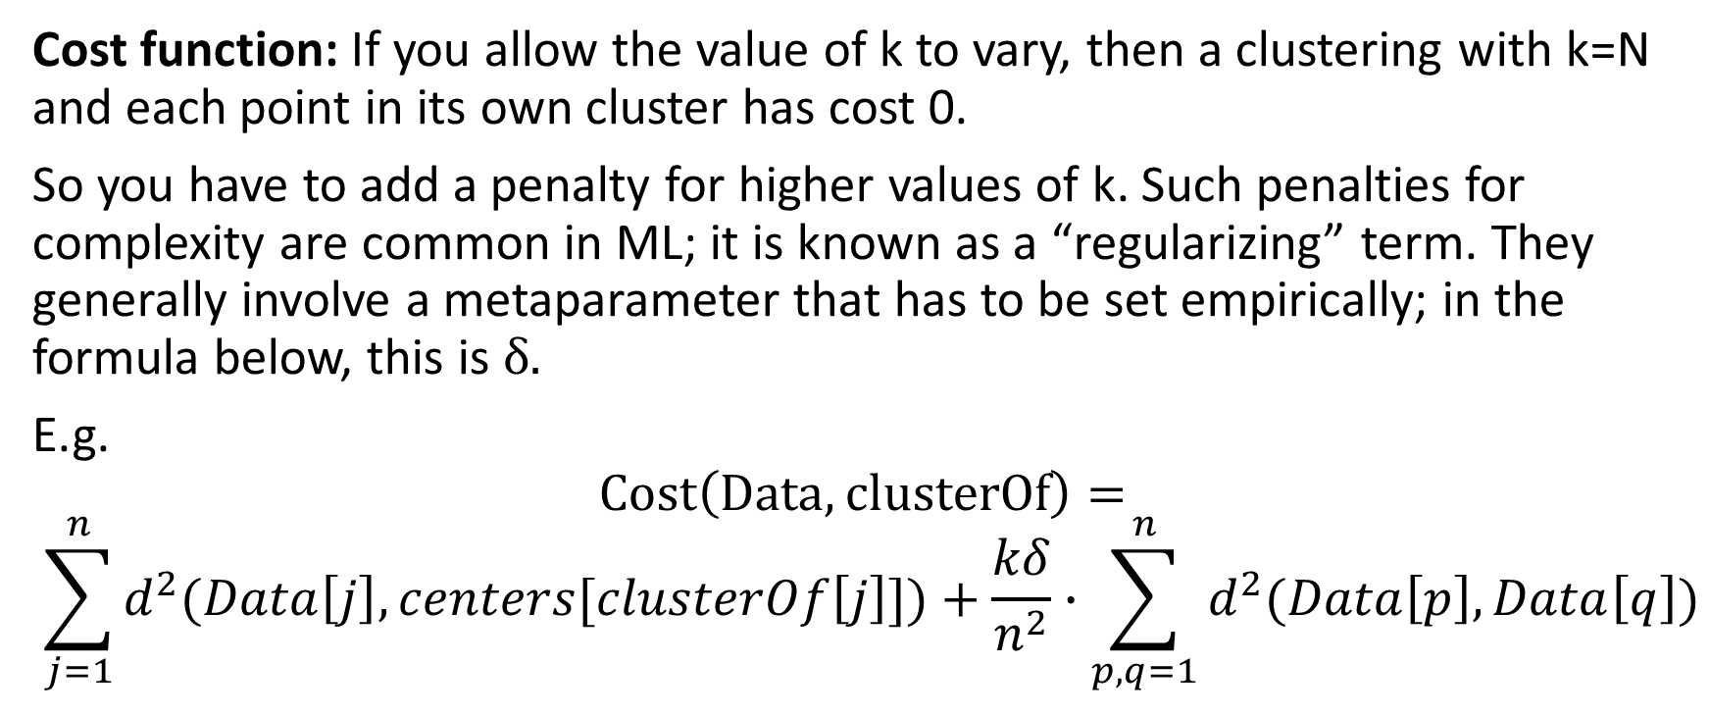
Choosing the value of k
Cost function: If you allow the value of k to vary, then a clustering with k=N and each point in its own cluster has cost 0.
So you have to add a penalty for higher values of k. Such penalties for complexity are common in ML; it is known as a “regularizing” term. They generally involve a metaparameter that has to be set empirically; in the formula below, this is δ.
E.g.
$$Cost\left(Data,clusterOf\right)=$$
$$\sum_{j=1}^{n}{d^{2}(Data\left[j\right],centers[clusterOf\left[j\right]])+\frac{kδ}{n^{2}}∙\sum_{p,q=1}^{n}{d^{2}(Data\left[p\right],Data\left[q\right])}}$$

Slide 14
Choosing the value of k
Start with k=2 and increase until the regularized cost function starts to increase.
Alternative:
Define a measure of the quality of a clustering: e.g. the largest diameter of a cluster. This (essentially) always decreases as a function of k. But if the improvement from k and k+1 is much less than the improvement from k−1 to k, then that suggests that k might be a good value.

Slide 15
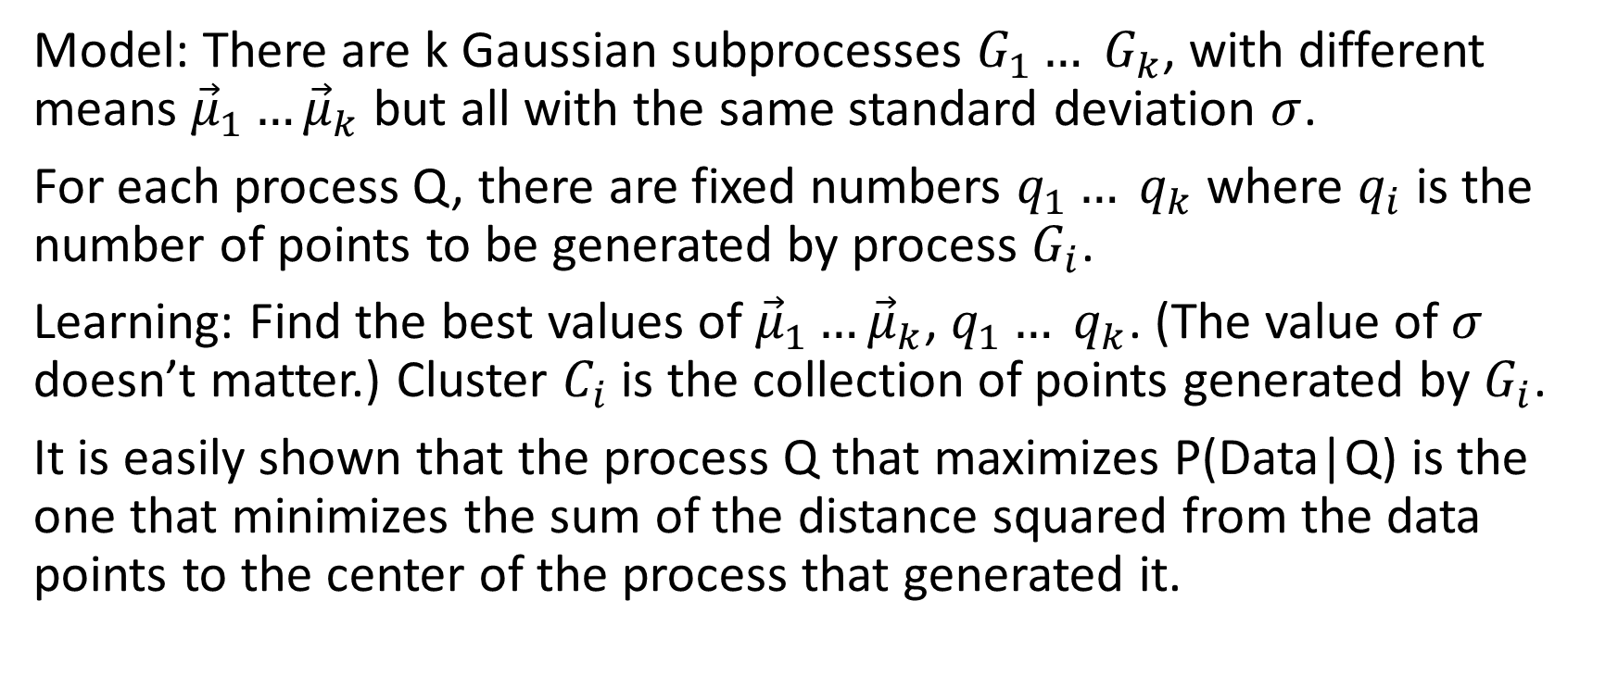
Stochastic Generative Model for Cost function
Model: There are k Gaussian subprocesses $G_{1}… G_{k}$, with different means ${\vec{μ}}_{1}…{\vec{μ}}_{k}$ but all with the same standard deviation $σ$.
For each process Q, there are fixed numbers $q_{1}… q_{k}$ where $q_{i}$ is the number of points to be generated by process $G_{i}$.
Learning: Find the best values of ${\vec{μ}}_{1}…{\vec{μ}}_{k}$, $q_{1}… q_{k}$. (The value of $σ$ doesn’t matter.) Cluster $C_{i}$ is the collection of points generated by $G_{i}$.
It is easily shown that the process Q that maximizes P(Data|Q) is the one that minimizes the sum of the distance squared from the data points to the center of the process that generated it.

Slide 16
Expectation maximization (EM) algorithm
Another method for dividing n data points that are vectors in R^{m} into k clusters. (As in k-means, k is fixed.)
Exhaustive. Soft clustering --- a point can belong to cluster A with one probability and to cluster B with another probability. (In fact, all points belong to all clusters with non-zero probability, though that probability can be very small.)
Clusters can be any size. In the full version, they can be ellipsoids of any aspect, but I will simplify things and present a model where they are spheres. Clusters can spatially overlap.

Slide 17
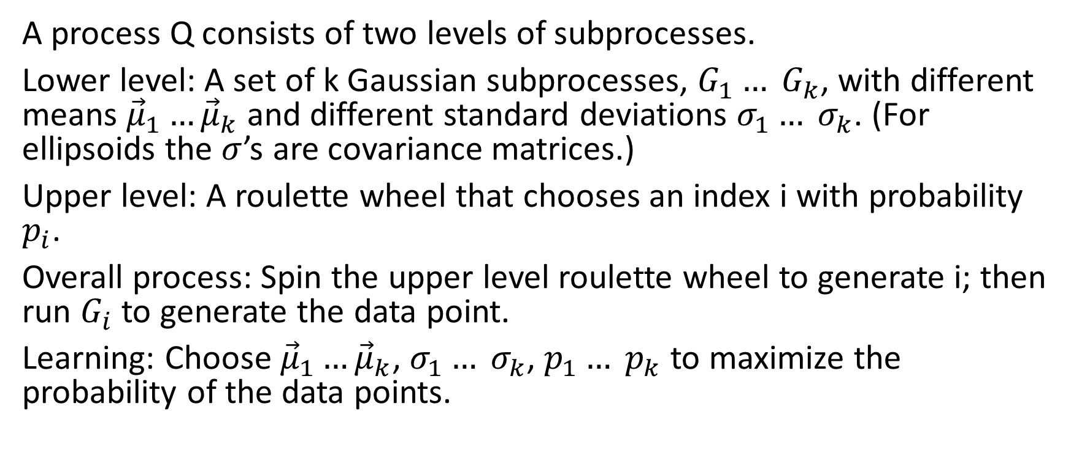
EM: Stochastic generative model:
Mixture model
A process Q consists of two levels of subprocesses.
Lower level: A set of k Gaussian subprocesses, $G_{1}… G_{k}$, with different means ${\vec{μ}}_{1}…{\vec{μ}}_{k}$ and different standard deviations $σ_{1}… σ_{k}$. (For ellipsoids the $σ$’s are covariance matrices.)
Upper level: A roulette wheel that chooses an index i with probability $p_{i}$.
Overall process: Spin the upper level roulette wheel to generate i; then run $G_{i}$ to generate the data point.
Learning: Choose ${\vec{μ}}_{1}…{\vec{μ}}_{k}$, $σ_{1}… σ_{k}$, $p_{1}… p_{k}$ to maximize the probability of the data points.

Slide 18
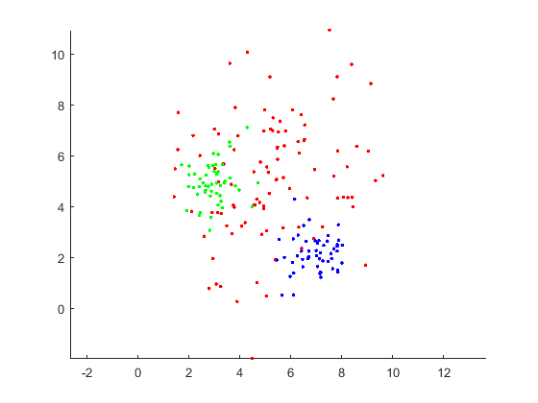
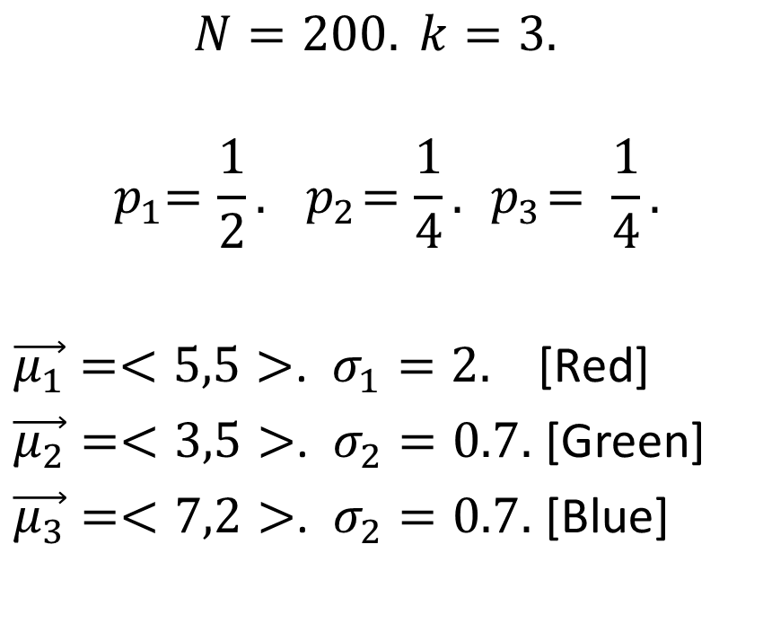
EM: Example
$$N=200. k=3.$$
$${ p}_{1}=\frac{1}{2}. { p}_{2}=\frac{1}{4}. { p}_{3}= \frac{1}{4}.$$
$\vec{μ_{1}}=<5,5>$. $σ_{1}=2.$ [Red]
$\vec{μ_{2}}=<3,5>$. $σ_{2}=0.7.$ [Green]
$\vec{μ_{3}}=<7,2>$. $σ_{2}=0.7.$ [Blue]

Slide 19
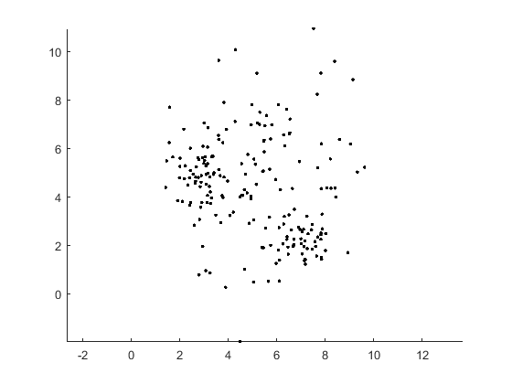
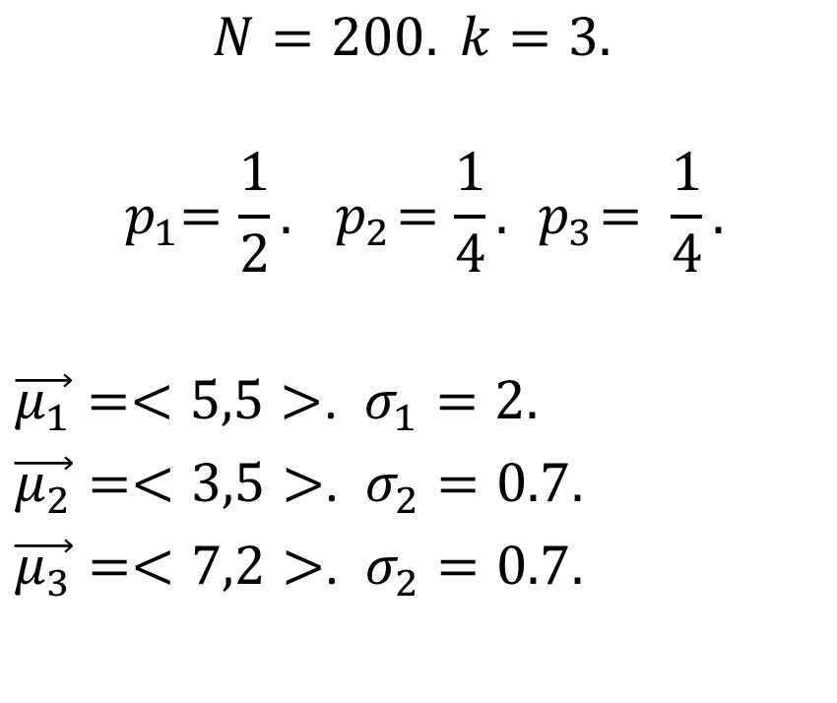
EM: Example
Given the points, recover the processes
$$N=200. k=3.$$
$${ p}_{1}=\frac{1}{2}. { p}_{2}=\frac{1}{4}. { p}_{3}= \frac{1}{4}.$$
$\vec{μ_{1}}=<5,5>$. $σ_{1}=2.$
$\vec{μ_{2}}=<3,5>$. $σ_{2}=0.7.$
$\vec{μ_{3}}=<7,2>$. $σ_{2}=0.7.$

Slide 20
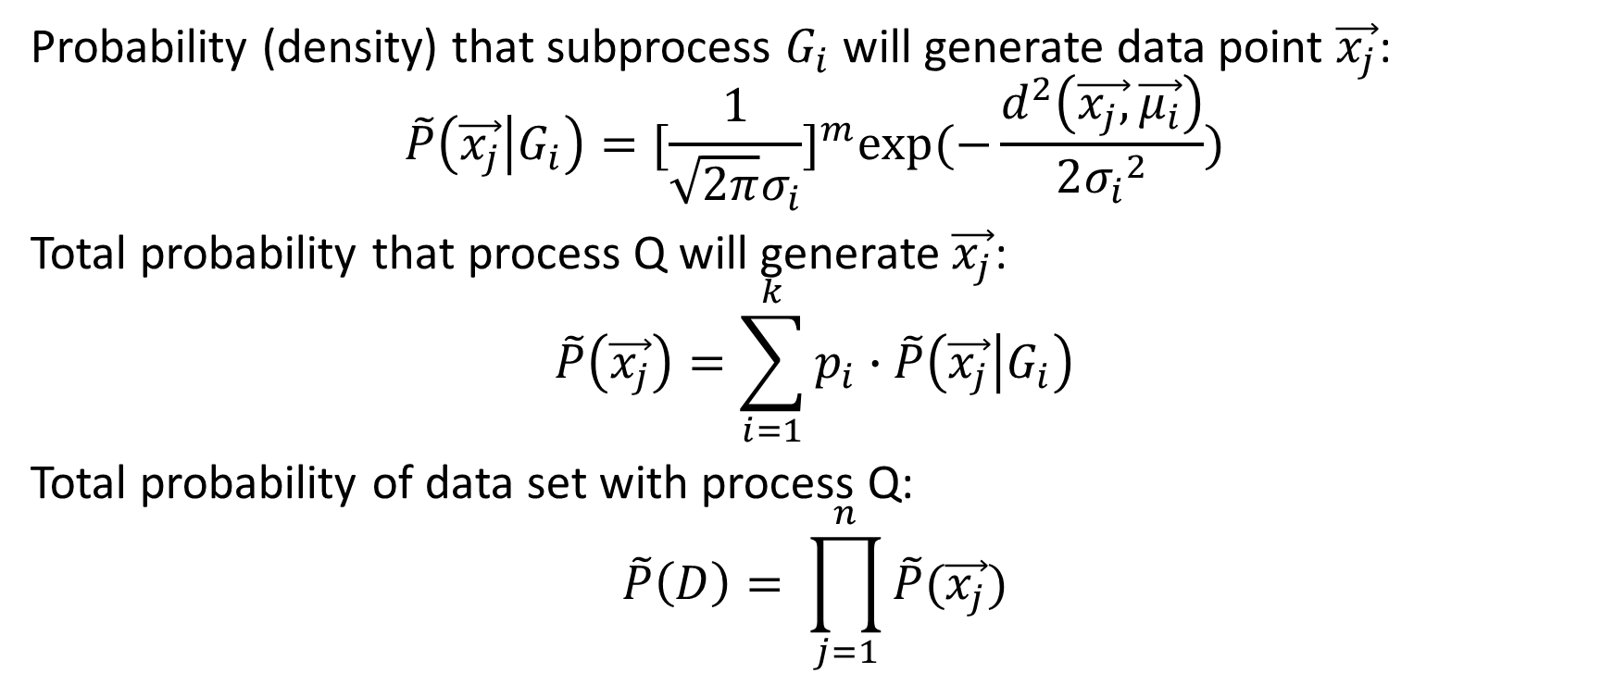
Probability (density) that subprocess $G_{i}$ will generate data point $\vec{x_{j}}$:
$$\tilde{P}\left(\vec{x_{j}} | G_{i}\right)=[\frac{1}{\sqrt{2π}σ_{i}}]^{m}exp⁡(−\frac{d^{2}\left(\vec{x_{j},}\vec{μ_{i}}\right)}{2{σ_{i}}^{2}})$$
Total probability that process Q will generate $\vec{x_{j}}$:
$$\tilde{P}\left(\vec{x_{j}}\right)=\sum_{i=1}^{k}{p_{i}∙\tilde{P}\left(\vec{x_{j}} | G_{i}\right)}$$
Total probability of data set with process Q:
$$\tilde{P}\left(D\right)= \prod_{j=1}^{n}{\tilde{P}(\vec{x_{j}})}$$

Slide 21
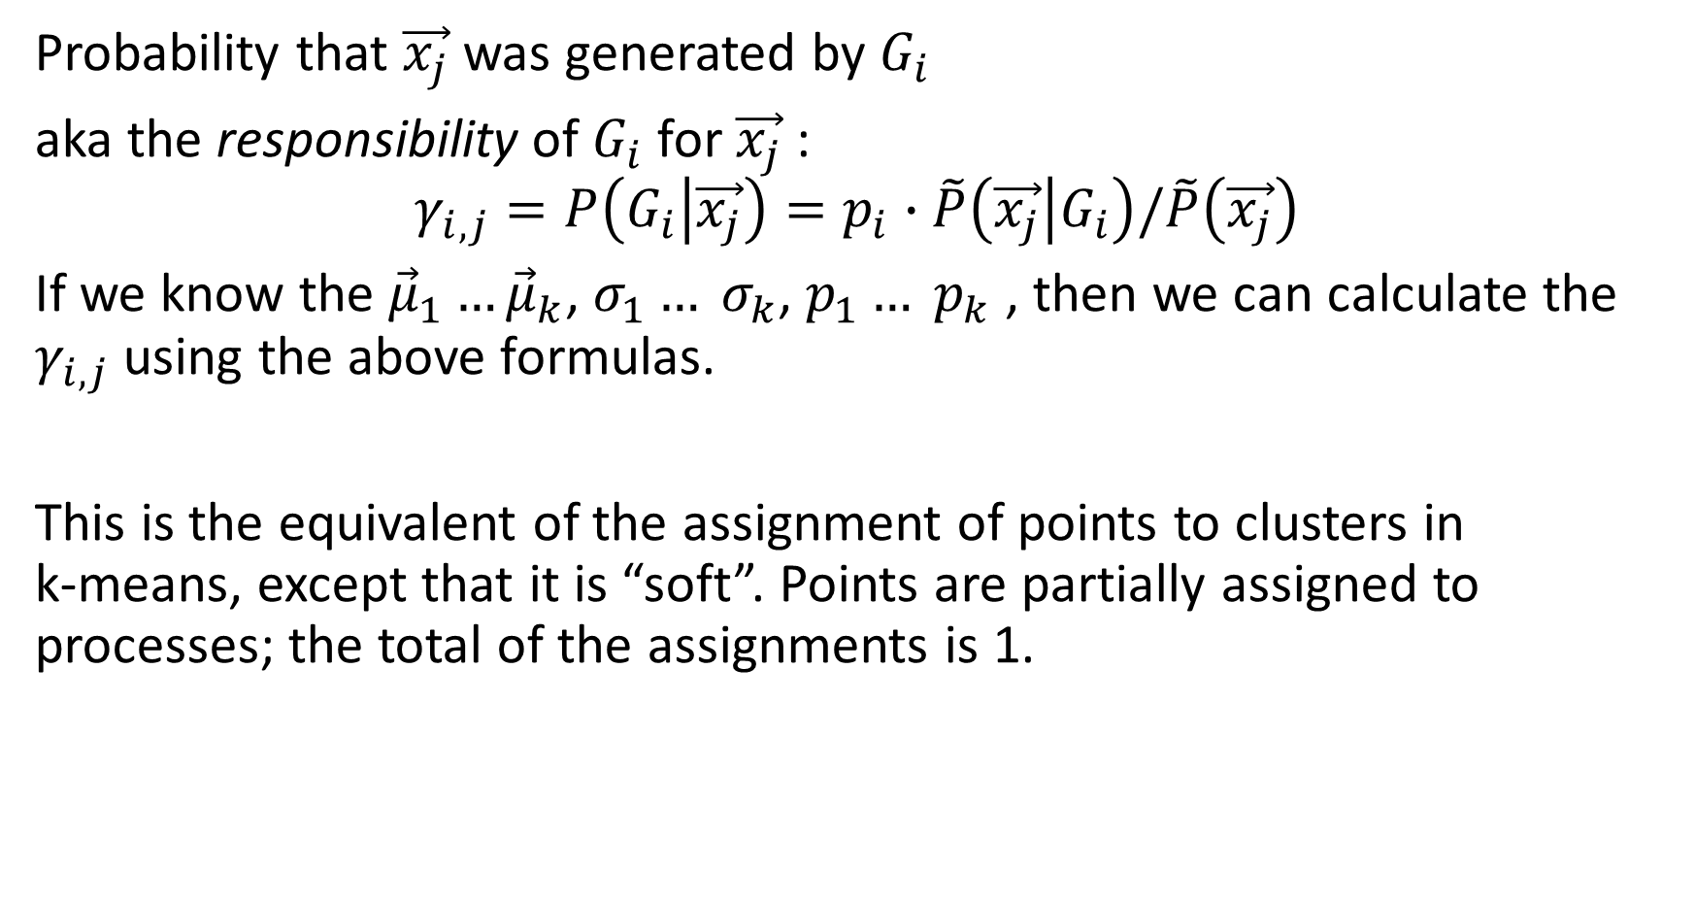
Probability that $\vec{x_{j}}$ was generated by $G_{i}$
aka the responsibility of $G_{i}$ for $\vec{x_{j}}$ :
$$γ_{i,j}=P\left(G_{i} | \vec{x_{j}}\right)=p_{i}∙\tilde{P}\left(\vec{x_{j}} | G_{i}\right)/\tilde{P}\left(\vec{x_{j}}\right)$$
If we know the ${\vec{μ}}_{1}…{\vec{μ}}_{k}$, $σ_{1}… σ_{k}$, $p_{1}… p_{k}$ , then we can calculate the $γ_{i,j}$ using the above formulas.
This is the equivalent of the assignment of points to clusters in
k-means, except that it is “soft”. Points are partially assigned to processes; the total of the assignments is 1.

Slide 22
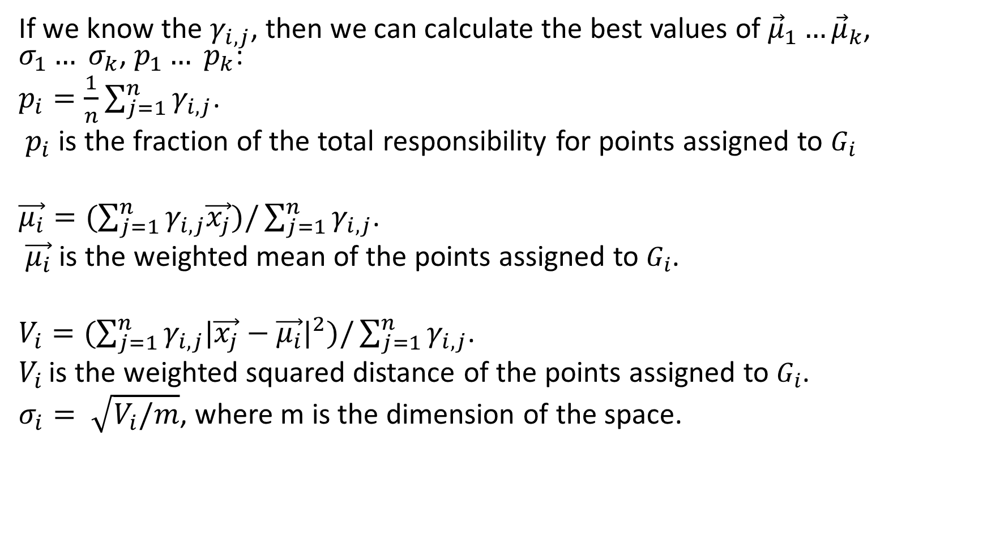
If we know the $γ_{i,j}$, then we can calculate the best values of ${\vec{μ}}_{1}…{\vec{μ}}_{k}$, $σ_{1}… σ_{k}$, $p_{1}… p_{k}$:
$p_{i}=\frac{1}{n}\sum_{j=1}^{n}{γ_{i,j}}$.
$p_{i}$ is the fraction of the total responsibility for points assigned to $G_{i}$
$\vec{μ_{i}}=(\sum_{j=1}^{n}{γ_{i,j}\vec{x_{j}})/\sum_{j=1}^{n}{γ_{i,j}}}$.
$\vec{μ_{i}}$ is the weighted mean of the points assigned to $G_{i}$.
$V_{i}=(\sum_{j=1}^{n}{γ_{i,j}|\vec{x_{j}}−\vec{μ_{i}}|^{2})/\sum_{j=1}^{n}{γ_{i,j}}}$.
$V_{i }$is the weighted squared distance of the points assigned to $G_{i}$.
$σ_{i}= \sqrt{V_{i}/m}$, where m is the dimension of the space.

Slide 23
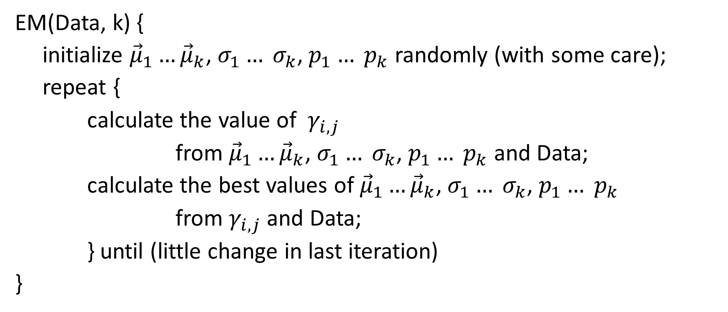
EM algorithm
EM(Data, k) {
initialize ${\vec{μ}}_{1}…{\vec{μ}}_{k}$, $σ_{1}… σ_{k}$, $p_{1}… p_{k}$ randomly (with some care);
repeat {
calculate the value of $γ_{i,j}$
from ${\vec{μ}}_{1}…{\vec{μ}}_{k}$, $σ_{1}… σ_{k}$, $p_{1}… p_{k}$ and Data;
calculate the best values of ${\vec{μ}}_{1}…{\vec{μ}}_{k}$, $σ_{1}… σ_{k}$, $p_{1}… p_{k}$
from $γ_{i,j}$ and Data;
} until (little change in last iteration)
}

Slide 24
EM algorithm
For most initializations, the probability P(Data|Q) steadily increases toward a local maximum.
No guarantee of a global maximum.
Example, again, in David Rosenberg's slides

Slide 25
Generalizing EM algorithm to other distributions
Instead of Gaussians, you can use any kind of parameterized distributions at the lower level as long as you can:
Calculate the probabilities of a given data point from the distribution (probability; easy). Same formula for responsibilities as above.
Given a set of data points and responsibilities, calculate the optimal values of the parameters (statistics; not so always easy).
I have no idea what kind of guarantees, if any, exist for the general case.

Slide 26
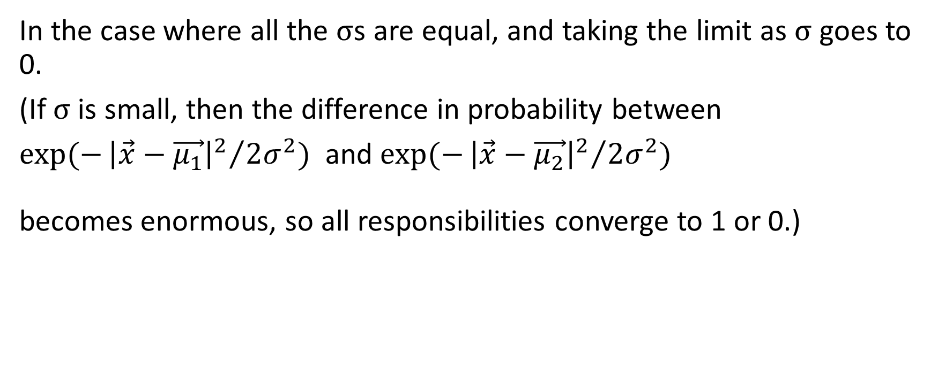
K-Means is a special case of EM
In the case where all the σs are equal, and taking the limit as σ goes to 0.
(If σ is small, then the difference in probability between
$exp⁡(−{{\left|\vec{x}−\vec{μ_{1}}\right|}^{2}}/{2σ^{2})}$ and $exp⁡(−{{\left|\vec{x}−\vec{μ_{2}}\right|}^{2}}/{2σ^{2})}$
becomes enormous, so all responsibilities converge to 1 or 0.)

Slide 27
Agglomerative clustering
Define a measure of “distance’’ d(C1,C2) between two clusters C1 and C2.
d(C1,C2) = max _{x ∊ C1, y ∊ C2} d(x,y)
d(C1,C2) = mean _{x ∊ C1, y ∊ C2} d(x,y)
d(C1,C2) = d(centerOf(C1),centerOf(C2))
(Using d(C1,C2) = min _{x ∊ C1, y ∊ C2} d(x,y) does not work well; the algorithm on the next slide turns into Kruskal’s algorithm for minimum spanning tree and does not give good clusters.)

Slide 28
Agglomerative clustering algorithm
clusters(T: training set) {
H = { {x} | x ∊ T}; % H is a forest of trees, where each node is a cluster
% initialize H so that each tree is a leaf with one element of T.
for (i=1 .. |T|-1) {
find C1, C2 roots of trees in H such that d(C1,C2) is minimal;
C = C1 ⋃ C2;
make C1 and C2 children of C in H;
}
return H;
}

Slide 29
Agglomerative clustering
Returns a binary hierarchy of clusters.
To get a flat set of k clusters, just halt when |H| = k.
Depending on the distance measure, it may not require that the data points are vectors, just that there is a distance between them. For instance, it may be easier to define how different two animals are than what their average is.
No stochastic model, AFAIK.
Various efficiency hacks to avoid repeated computation (these also exist for k-means).
It is debated whether these are better than k-means (not clear what is the gold standard for clustering).

Slide 30
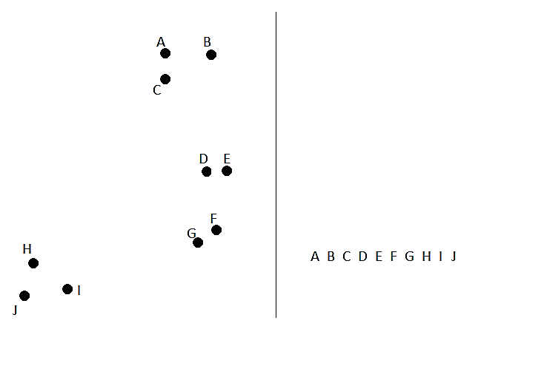

Slide 31
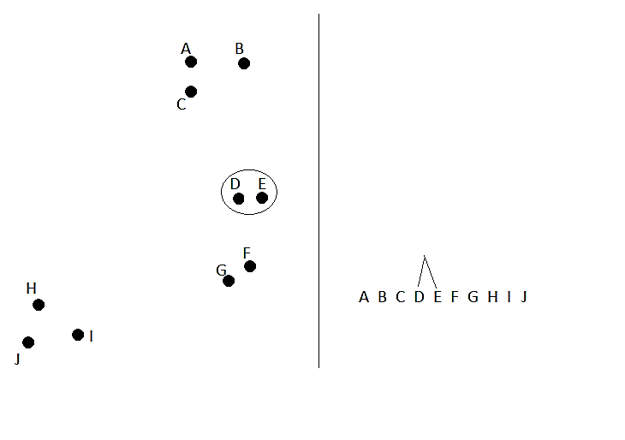

Slide 32
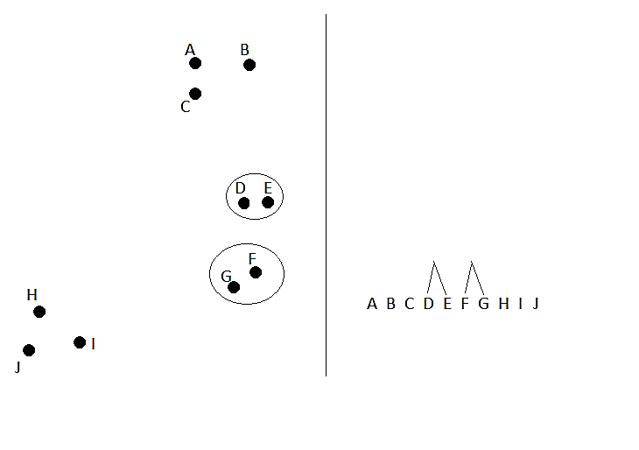

Slide 33
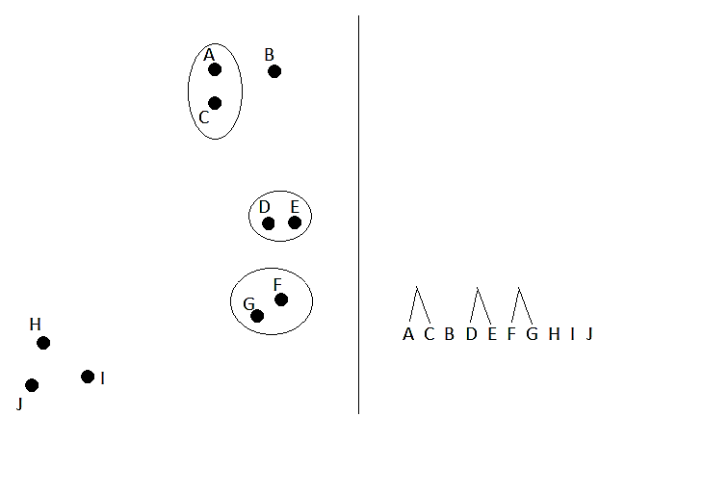

Slide 34
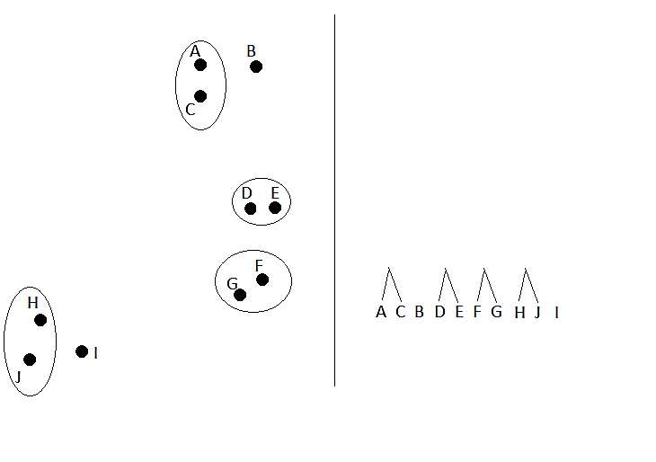

Slide 35
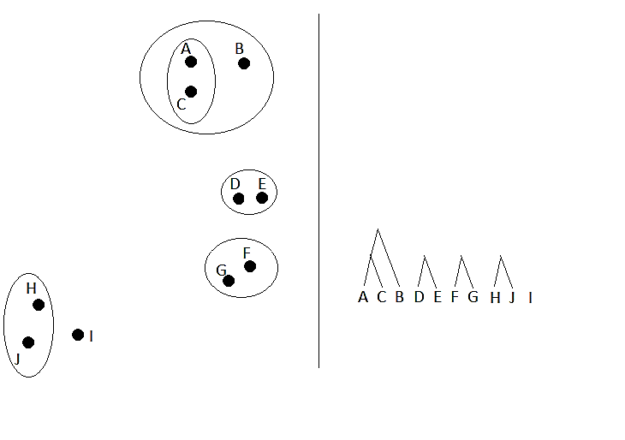

Slide 36
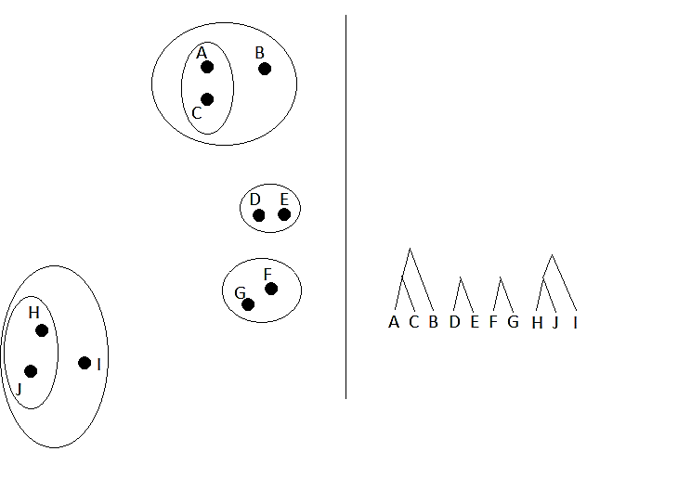

Slide 37
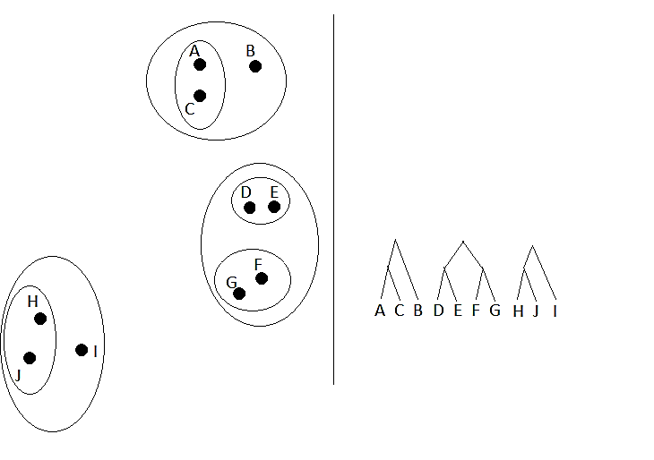

Slide 38
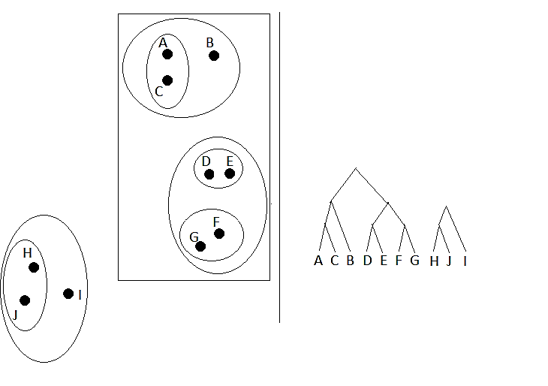

Slide 39
