Slide 1
K Nearest Neighbors

Slide 2
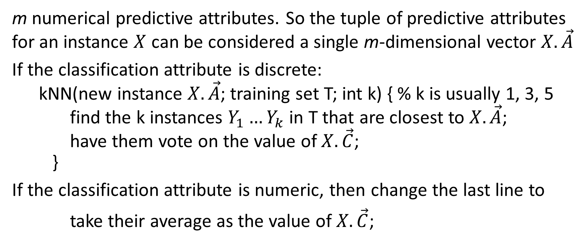
Conceptually the simplest form of classification learning
m numerical predictive attributes. So the tuple of predictive attributes for an instance $X$ can be considered a single m-dimensional vector $X.\vec{A}$
If the classification attribute is discrete: kNN(new instance $X.\vec{A}$; training set T; int k) { % k is usually 1, 3, 5 find the k instances $Y_{1}…Y_{k}$ in T that are closest to $X.\vec{A}$; have them vote on the value of $X.\vec{C}$; }
If the classification attribute is numeric, then change the last line to
take their average as the value of $X.\vec{C}$;

Slide 3
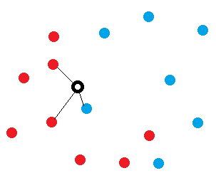
Example
Predictive attributes: Position in the plane. Classification attribute: Blue or red. New instance: Black dot
k=1: Predict blue. k=3: Predict red.

Slide 4
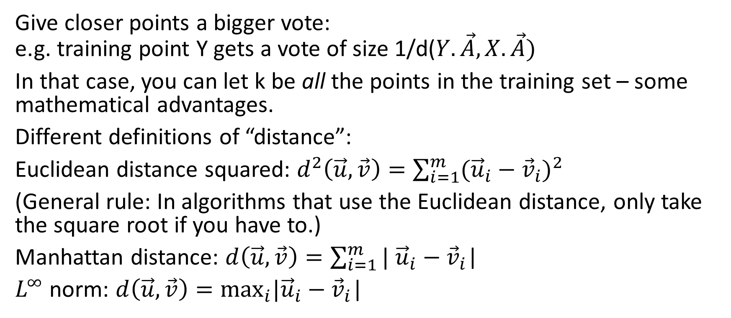
Variants
Give closer points a bigger vote: e.g. training point Y gets a vote of size 1/d($Y.\vec{A}, X.\vec{A})$
In that case, you can let k be all the points in the training set – some mathematical advantages.
Different definitions of “distance”:
Euclidean distance squared: $d^{2}\left(\vec{u},\vec{v}\right)=\sum_{i=1}^{m}{({\vec{u}}_{i}−{\vec{v}}_{i})^{2}}$
(General rule: In algorithms that use the Euclidean distance, only take the square root if you have to.)
Manhattan distance: $d\left(\vec{u},\vec{v}\right)=\sum_{i=1}^{m}{|}$ ${\vec{u}}_{i}−{\vec{v}}_{i}$|
$L^{∞}$ norm: $d\left(\vec{u},\vec{v}\right)=\max_{i}|{\vec{u}}_{i}−{\vec{v}}_{i}\text{|}$

Slide 5
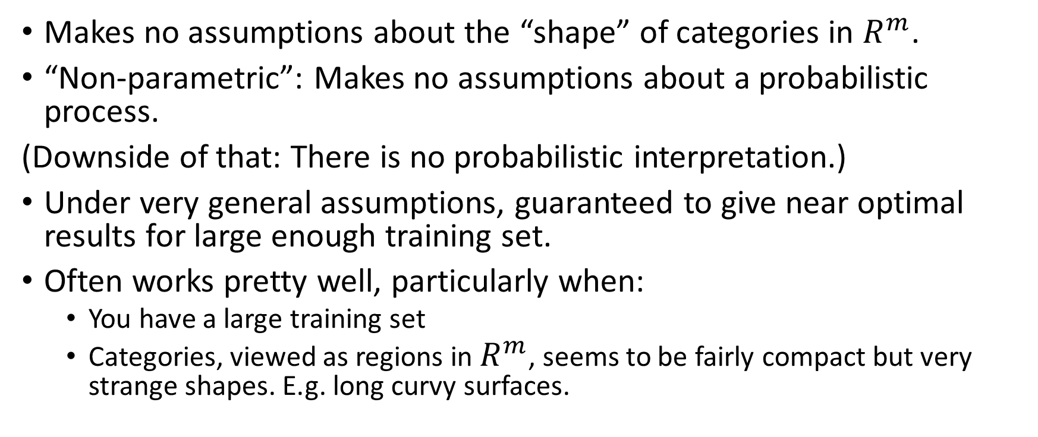
Strengths
Makes no assumptions about the “shape” of categories in $R^{m}$.
“Non-parametric”: Makes no assumptions about a probabilistic process.
(Downside of that: There is no probabilistic interpretation.)
Under very general assumptions, guaranteed to give near optimal results for large enough training set.
Often works pretty well, particularly when:
You have a large training set
Categories, viewed as regions in $R^{m}$, seems to be fairly compact but very strange shapes. E.g. long curvy surfaces.

Slide 6
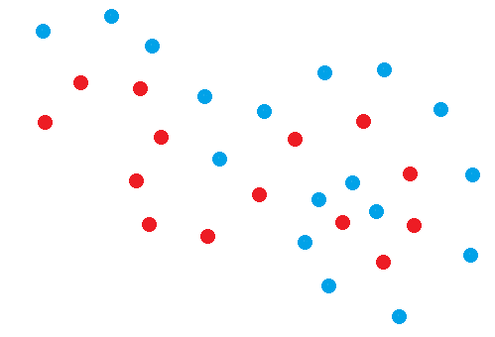

Slide 7
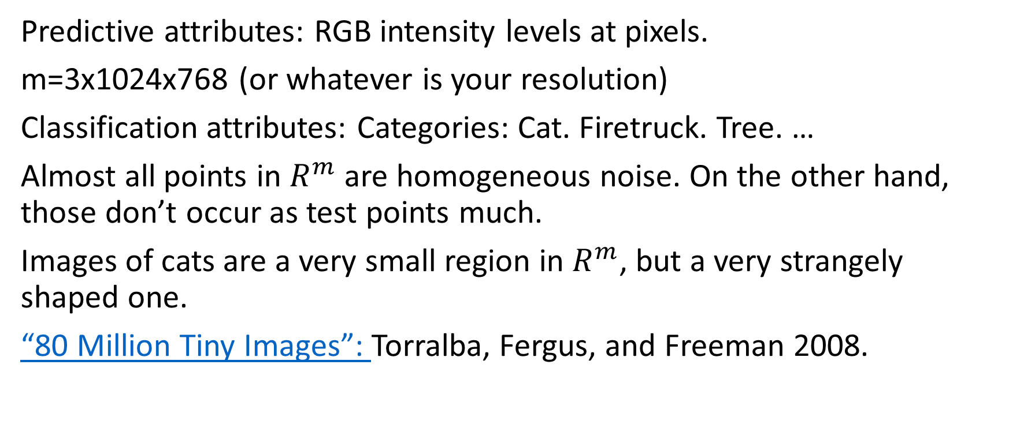
E.g. image labelling
Predictive attributes: RGB intensity levels at pixels.
m=3x1024x768 (or whatever is your resolution)
Classification attributes: Categories: Cat. Firetruck. Tree. …
Almost all points in $R^{m}$ are homogeneous noise. On the other hand, those don’t occur as test points much.
Images of cats are a very small region in $R^{m}$, but a very strangely shaped one.
“80 Million Tiny Images”: Torralba, Fergus, and Freeman 2008.

Slide 8
Limitations of kNN
Hypersensitive to noise. If the nearest points are mislabelled, then the answer is wrong. You can reduce sensitivity to noise by increasing k, but that costs in precision.
Can’t use training instances that have missing attributes, because you can’t compute a meaningful distance. (Rare exceptions.) Problematic to use with new examples missing attributes, for reasons below.
Brittle under repeated attributes.
Brittle under irrelevant attributes. All attributes are weighted equally.
Brittle under skewed class distribution. If one category is more common than another, then it is more likely to generate a close neighbor.

Slide 9
Issue with kNN: Not scale invariant
Example: Suppose that we are trying to characterize people’s body mass index (malnourished, thin, average, heavy, obese). We have a table that records their weight in grams and their height in meters.
Training examples
A: Weight=59000 gm. Height=1.5 m. Heavy. (130.1 lbs, 5 foot)
B: Weight=59100 gm. Height=1.8 m. Thin. (130.3 lbs, 6 foot)
New example
X: Weight=59075 gm. Height=1.55m
Obviously X is a lot more similar to A than to B. But
d(<59000,1.5>,<59075,1.55>) ≈ 75 d(<59100,1.8>,<59075,1.55>) ≈ 25

Slide 10
Solution to scale invariance
In each dimension, use a scale whose unit is the standard deviation.
Or use percentiles (A is in the 10th percentile of height; B is in the 80th percentile of height.)
How well this works depends on the distribution.

Slide 11
Running time
Straightforward/naïve implementation
Compute the distance from X to every point in the training set, choose the k smallest.
Time for training (offline time): Nothing to be done. O(0)
Time for inference: O(|Training set|)
That’s exactly the behavior we don’t want.

Slide 12
Can we do better for running time?
Yes, but not easily. Active area of research, technology is improving.
Deterministic algorithm for inference that takes time logarithmic in |T| but training is exponential in m.
Probabilistic algorithm for inference that are polynomial in m but have some probability of returning points that are not actually the closest.

Slide 13
Locality sensitive hashing
Define a hash function h(x) such that:
If x and y are close, then with high probability h(x) = h(y). (Or h(x) is close to h(y)). (Note that, unlike standard hashing, we are hoping for collisions.)
If x and y are far, then with high probability h(x) ≠ h(y).
Training time: Store training set T in a hash table using h.
Inference time: Given new example x, retrieve the example stored at h(x).
(Variant: retrieve examples stored at values close to h(x).)

Slide 14
Method of random projections
One approach to locality-preserving hashing.
Choose integer q. Generate q random directed half-planes P₁ … P_{q} in n-dimensional space (“directed” means that you specify which is the positive side of P and which is the negative side.)
For any example x, define the bit h_{i}(x) to be the side of P_{i} (positive or negative) containing x.
Define h(x) to be the bit vector of length q: < h₁(x), h₂(x) … h_{q}(x) >
So h(x) has 2^{q} different values (assuming q ≤ n).
Training time: O(|T|nq).
Inference time: O(nq).

Slide 15
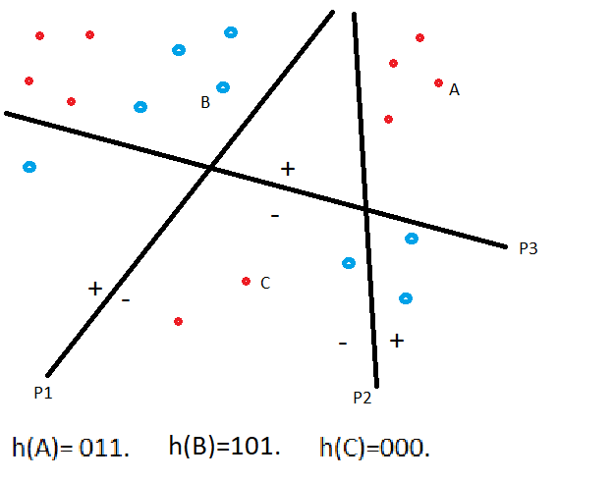
Method of random projections

Slide 16
Hyperparameters in machine learning
Machine learning algorithms tend to be full of hyperparameters:
We have already seen
δ in the Laplacian correction for Naïve Bayes
k in k-Nearest Neighbors
M controlling explore vs. exploit in reinforcement learning
We will soon see
Step size in gradient descent methods
k in k-means
Regularization coefficients
In complex methods there are often many fine-grained architectural decisions to make. E.g. termination condition in gradient descent,

Slide 17
How do you set hyperparameters?
Very occasionally there is some guidance from theory.
There is a body of informal knowledge: “folk wisdom”.
Practitioners get good from experience.
You may use one ML system to find hyperparameters for another ML.
But mostly: Empirical Experimentation.
Experimental design and analysis is a whole art in itself.

