Slide 1
Evaluation

Slide 2
Evaluating a classifier
You have learned a classifier. How good is it?
What is the relevant measure?
How can you estimate it from labeled corpus?
Note that there are three uses of a measure:
ML algorithm uses an evaluation measure as the thing to optimize e.g. by gradient descent. In that case, the measure has to be automatically computable, reasonably quickly.
Compare one classifier against another. Meta-analysis.
Predict the usefulness of your classifier in future.

Slide 3
What is the right measure?
For discrete classifiers, the standard measure is accuracy.
Accuracy = fraction of instances correctly classified.
But not always.

Slide 4
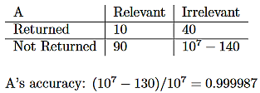
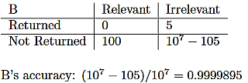
Why accuracy isn’t always the right measure
If you give a web search engine a query with a small number of results, you can consider it a classifier, where the category is “this page is relevant to my query”.
Now suppose we have two web search engines A and B. For some query, A returns 50 pages of which 10 are relevant. B returns 5 pages of which 0 are relevant. Suppose that the web has 10⁷ pages of which 100 are actually relevant to the query

Slide 5
Precision and Recall
C = the actual elements in the category in T.
Q = the elements labelled by the classifier as being in the category.
Precision = |C ∩ Q | / |Q| = Prob(C|Q)
Recall = |C ∩ Q | / |C| = Prob(Q|C)
For A, Precision = 10/50 = 0.2. Recall = 10/100 = 0.1.
For B, Precision = 0/5 = 0. Recall = 0/100 = 0.

Slide 6
F-Score combines precision and recall into one number.
Harmonic mean. 1/F = ((1/P)+(1/R))/2. F = 2PR/(P+R).
For P=1/5 and R=1/10, F = 1/((5+10)/2) = 1/7.5 = 0.13
Properties of harmonic mean:
Always less than the average, unless P=R.
If P and R are close then F is close to their average.
If P is substantial and R is close to zero, then F is about 2R; and vice versa.

Slide 7
Precision/Recall trade-off
Classifiers often compute, not a fixed set, but scores for each item X of how likely they think it is that X is in the category.
One can then define a set by deciding on a threshold τ and selecting all items whose score is greater than τ.
Let Q_{τ} be the set of items scored greater than τ. Obviously, if λ < τ, then
Q_{λ} ⊃ Q_{τ} , and C ∩ Q_{λ} ⊃ C ∩ Q_{τ}
So as τ decreases, recall steadily increases. Precision presumably tends to decrease --- if the classifier is any good at all, there are a higher fraction of actually relevant items among the high scores than among the low scores. But it has a jagged up-and-down pattern. Each time lowering τ adds another relevant item, the precision goes up a little; each time it add another irrelevant item, precision goes down a little.
So you can trade-off precision vs. recall by choosing the value of τ.

Slide 8
Precision vs. Recall Tradeoff.
Suppose that there are actually 10 examples of a category in a data set. The classifier returns the following results in ranked order.
1. Right. 2 Right. 3. Wrong. 4. Right. 5. Wrong. 6. Wrong. 7. Wrong. 8 Right. 9 Wrong. 10. Wrong.
Then the precision and recall after the first K element is
Precision: 1/1=1. 2/2=1. 2/3=.67. 3/4=.75. 3/5=.6. 3/6=.5 3/7=.42.
4/8=.5 4/9=.44. 4/10=.4
Recall: 1/10=.1. 2/10=.2. 2/10=.2. 3/10=.3 3/10=.3. 3/10=.3. 3/10=.3
4/10=.4. 4/10=.4. 4/10=.4

Slide 9
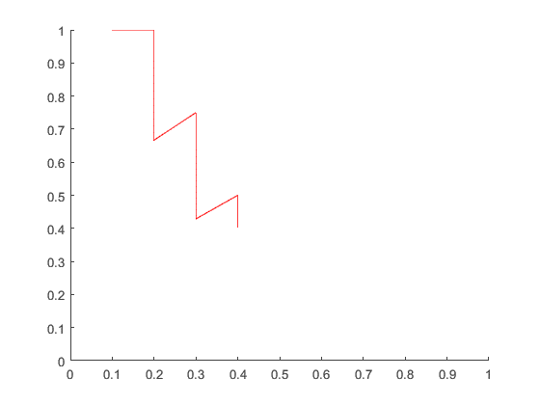
Precision vs. Recall plot

Slide 10
More generally
A “false positive” is an item that is not actually in the category, but the classifier (or test) reports to be in the category. (It is falsely reported to be positive.)
A “false negative” is an item that is in the category but the classifier reports is not in the category. (It is falsely reported to be negative.)

Slide 11
Specialized evaluation functions:
Machine translation
For AI tasks that are not simple classification, finding an effective, automatable evaluation metric can be challenging.
Machine translation. Many-to-many relation.
Gold standard: Ask bilingual speakers the quality of a proposed translation.
BLEU score. Measure based on the number of k-grams (sequences of k words) in common between the output translation and reference translations.
  Claim: Much of the progress in machine translation is a consequence of having the BLEU score as a metric to optimize.
  Anecdote: BLEU score becomes a fetish, with important papers being rejected because they don’t have a measurable impact on BLEU score.

Slide 12
Overfitting
The bane of ML: Once training is complete, inference works much better on examples in the training set then on examples not in the training set.
Trivial overfitting example:
Training: Save the training set in a hash table.
Inference: Look up the instance in the hash table. If it is there, return the recorded answer. If not, guess at random.
Accuracy on the training set: 100%.
Accuracy on new examples = the accuracy of random guessing.

Slide 13
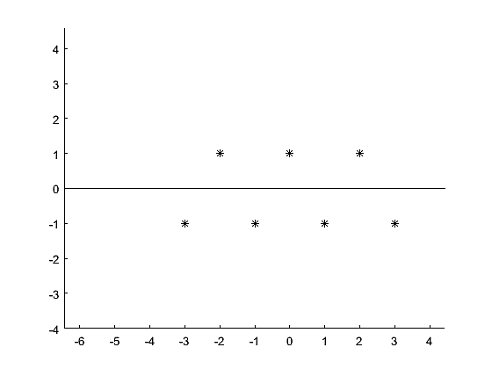
Somewhat unfair numerical example of overfitting
Any n points <x,y> can be fit to a unique n-1 degree polynomial.

Slide 14
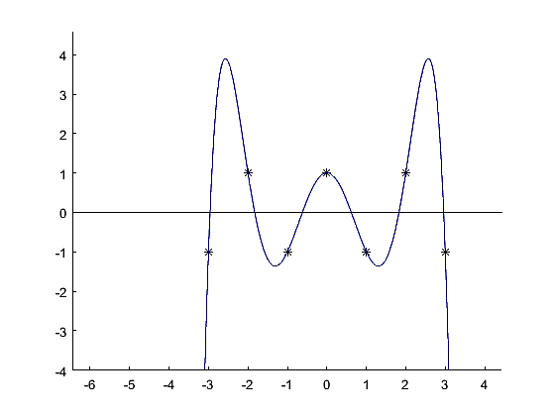
Somewhat unfair numerical example of overfitting
p(x) = -0.9x⁶ + 1.1x⁴ - 3 x² + 1
Unfair, because polynomial interpolation is known to be a particularly bad way to interpolate.

Slide 15
More serious examples of overfitting
Suppose you have a Boolean classification attribute C such that
C is True 70% of the time and F 30% of the time
C is independent of the predictive attributes
Then the optimal strategy is always to predict X.C=True, with an accuracy of 0.7.
If you look at enough classifiers, you will be able to find classifiers that do better than that, just by chance. But using these can only degrade performance on unseen examples.

Slide 16
Similar (fair) numerical example
Suppose that the data actually is generated by the stochastic process mentioned earlier: y = ax + b + ε where ε is a random variable following a Gaussian N_{μ,σ} corresponding to noise.
Then the best classifier is y=ax+b with a standard deviation of σ. Any kind of interpolation (not just polynomial interpolation) will degrade performance, because the noise at one point is not predictive of noise at another point.

Slide 17
Overfitting is a failure to generalize properly
The previous two examples are just illustrative, not typical. Because of the way we set them up, one can be sure that the training data cannot have more information than the very simple classifier. But, in general, it is possible that
The training data does not have the features needed to generalize.
The specific instances in the training corpus are misleading.
The class of inference engines does not include the proper generalization.
The learning algorithm does not find the proper generalization.
These can be hard to distinguish in practice.

Slide 18
Rule of thumb (useful, though not reliable)
If the number of parameters is equal to the number of training instances, then the ML system is prone to overfitting.
If the number of parameters is much less than the number of training instances, then the ML system is probably much more robust as regards overfitting.

Slide 19
How to use labelled corpus for evaluation
Idea 1: Train on entire corpus, and evaluate on entire corpus.
Problem: Does not detect overfitting. On the other hand:
  It gives an upper bound.
  If you are confident that you are not overfitting, (e.g. you are doing linear classification on a small number of parameters) it’s OK.

Slide 20
Training set and test set
Idea 2: Randomly divide the labelled corpus into a training set and a test set. Train on the training set. Evaluate on the test set.
Avoids problem with overfitting, since overfitting to the training set will not help on the test set.
This is so much the standard that, in discussing ML, “unseen examples” and “test set” are often conflated, as if they were the same thing.
Overfitting is defined as “significantly better performance on the training set than on the test set.”

Slide 21
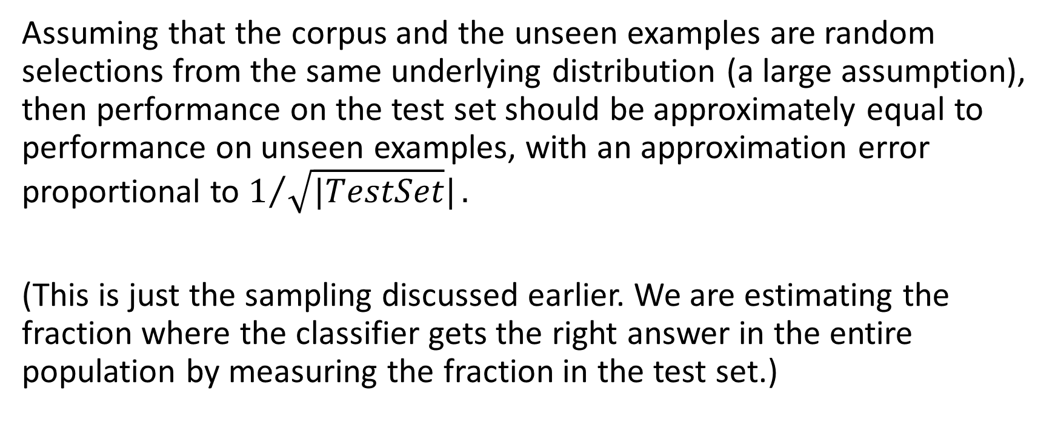
Training and test set
Assuming that the corpus and the unseen examples are random selections from the same underlying distribution (a large assumption), then performance on the test set should be approximately equal to performance on unseen examples, with an approximation error proportional to $1/{\sqrt{|TestSet}|}.$
(This is just the sampling discussed earlier. We are estimating the fraction where the classifier gets the right answer in the entire population by measuring the fraction in the test set.)

Slide 22
Problem
Suppose:
You have a task and a labelled corpus, which you have divided into a training and a test set.
You have run fifty different ML algorithms (or architectures), each with fifty different settings on meta-parameters. You train each of them on the training set and test each of them on the test set.
If you publish all 2500 results, reporting the results on the test set, that’s fine.
If you choose the best algorithm and the best setting and just report that, then the number you report is not reliable. Even though it’s the same number as in (a).

Slide 23
Explanation
There will be a certain amount of variance in performance, just due to chance. If you choose the best performing one, then you don’t know whether its performance was because it actually performs well, or was just lucky.
Extreme example: Suppose that the task is to predict a coin toss, and the test set has 10 coin flips. Suppose that with a training set of coin flips, all the ML algorithms end up effectively guessing at random. Since there are only 1024 possible outcomes, there is a .92 chance that one of the 2500 algorithms will score 100%. But, of course, on future flips, it will only score 0.5.

Slide 24
Serious problem in the scientific literature
A scientist has gotten some immense data set of information about diet and medical conditions.
They run a correlation of every possible medical condition against every possible dietary characteristic. One of them will come up large.
They publish the large result and put the rest in the “file drawer”.
“Why most published research findings are false”. John Ioannidis 2005
Some significant fraction of results in medicine and psychology could not be replicated, including some famous ones.

Slide 25
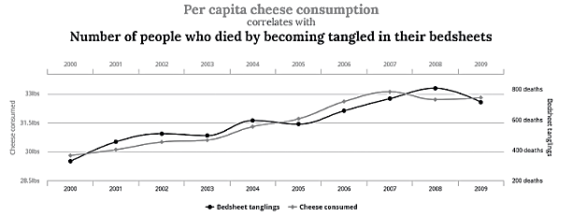
Tyler Vygen, Spurious Correlations

Slide 26
To avoid this problem
Divide the labelled corpus into a training set, a validation set, and a test set.
Train individual ML algorithms on the training set.
Use the validation set to choose between them.
When that’s all done, use the test set to evaluate the apparent winner.

Slide 27
Generalization to unseen examples
Then there is the question of whether the training corpus is actually representative of examples that come up in the future.
The training set may be assembled in a particular way. Autonomous vehicles trained in one city do badly in another.
The world may change.
The world may change in response to the existence of the AI program:
  People try to game the system.
  People try to break the system.
  People adapt to the system. (Learn how to use the tool.)
  AI programs interact in weird ways.
  One AI program create data that it then uses for training.
Measure robustness by training on one corpus and testing on a different one.

Slide 28
Reusing a test set
Once the results of a test set have been used in any way as a guide to action --- choosing an ML algorithm, setting metaparameters, guiding future research --- in principle, the test set is contaminated and a new test set should be chosen. In practice, it may not be a huge problem. But it is difficult to know how large a problem it is.
On the other hand, (a) large, high-quality test sets don’t come cheap; (b) if you don’t reuse the test set, it’s hard to measure progress over time.
If you do reuse the test set, then seeming progress may just be overfitting to the test set.
If you keep constructing new test sets, then you don’t have a standard measure.

Slide 29
Another issue
Often you have a small corpus, and cannot afford to hold back a large fraction for testing.
K-fold testing. Divide the corpus into k parts P₁ … P_{k}.
For i=1..k, train on T-P_{i}, and test on P_{i}. Average the test results.
Extreme version: “Leave one out”. Same thing, with k=N. So for each instance X in the training set, you train on everything except X then test on X and see the fraction correct overall.
Hard to justify theoretically. Often works well in practice.

Slide 30
Evaluating ML algorithm
Suppose that you have an ML algorithm that does a good job on classifying a number of different categories of images collected in a particular way.
Will it do well on classifying new categories?
Will it do well on classifying images collected or created in some different way?
E.g. if you train it on posed still photos that people upload to Instagram, will it do well on frames from a video? On images in a surveillance camera?

