Slide 1
Machine Learning

Slide 2
Corpus-based machine learning
The final general area of this course is corpus-based machine learning.
In its many different forms, this is currently by far the dominant approach to artificial intelligence −so much so, that there are those who define AI as machine learning. Not me.

Slide 3
Corpus-based machine learning
Broadly speaking machine learning involves the following:
You have:
A task to be carried out.
An evaluation metric that measures success on the task.
A corpus of training data that is relevant to the task.
Deliberately constructed e.g. a database.
Preexisting vs. created as training data.
Naturally evolving e.g. web pages.
Synthetically generated.

Slide 4
Examples
Image tagging. Task: Given an image, identify what it shows. Evaluation: Accuracy (fraction correct). Training corpus: Flickr images and user descriptions. ImageNet.
Sentiment analysis. Task: Given the text of a review, determine whether it is favorable. Evaluation: Accuracy. Training corpus: Online reviews with numbers of stars.
Machine Translation. Task: Translate a text from a source to a target language. Training corpus: Collection of bitexts. Evaluation: BLEU score (comparison of generated translation to recorded one.)

Slide 5
Types of learning (these are not mutually exclusive)
Supervised learning: Corpus of data labelled with output.
E.g. images with labels. Reviews with numeric rankings
Unsupervised learning. Corpus of unlabeled data. E.g. learning a first language.
Semi-supervised learning. A small corpus of labelled data and a large corpus of unlabelled data.
Active learning. Exploring or asking questions to facilitate learning.
Reinforcement learning. Learning how to act from success or failure. E.g. games playing programs.
End-to-end learning. Learning the relation of input to output with no intermediate structure. E.g. in an autonomous vehicle, mapping sensor readings directly to steering wheel, gas, and brake.

Slide 6
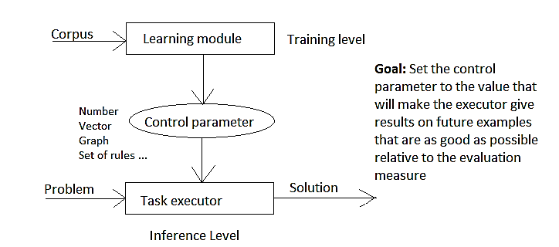
Architecture of ML system

Slide 7
Control parameter
Controls behavior of executor; set by learner. All the learner can do is to set the control parameter. The range of possible behaviors of the executor corresponds to the space of values of the control parameter.
Vector of numbers
More general data structure e.g. tree or graph.
Set of rules
Fragment of code

Slide 8
General limitations on ML
Inherent limitations of the executor: Is there any value of the control parameter for which the executor will work well?
Limits of the training algorithm: Can the learning algorithm find a good value for the control parameter?
Evaluation metric: Does the evaluation metric actually correspond to what you want from the system? Can the system “game” the metric?
Generalization: Will success on past examples carry over to success on future examples?
Bias: Is the executor biased in undesirable or unacceptable ways?

Slide 9
Running times for ML
Running time for inference (online). Generally you want this to be small. In some cases (e.g. self-driving cars) it is critical that it is very small. Generally, it should be a function (hopefully linear) of the size of the individual example, and independent of the size of the training corpus.
Running time for training (offline). This can usually be large, though not impossibly large. It is carried out once (conceptually), before the system is deployed. Always a function of the size of the training set. For high-powered systems, a single training regime can be months on supercomputers with hundred of GPUs.

Slide 10
Supervised, tabula rasa, classification learning
Task: To predict the classification of an instance from its features.
Training corpus: A relational database. A row is an instance. The columns are attributes. One of these is the classification attribute; the rest are the predictive attributes (= features).
Tabula rasa: Latin for “blank slate”. You don’t start with any prior knowledge of the domain (except as that is built into the choice of features – a significant exception); all that the learning algorithm has to work with is the training set.
(Note: In practice, it is often necessary to do “data cleaning” and “feature engineering” prior to running the learning algorithm. These can involve lots of domain knowledge on the part of whoever is doing these.)

Slide 11
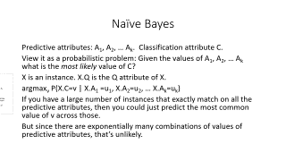
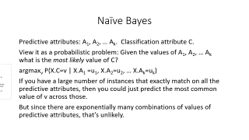
Naïve Bayes
Predictive attributes: A₁, A₂, … A_{k}. Classification attribute C.
View it as a probabilistic problem: Given the values of A₁, A₂, … A_{k} what is the most likely value of C?
X is an instance. X.Q is the Q attribute of X.
argmax_{v} P(X.C=v | X.A₁ =u₁, X.A₂=u₂, … X.A_{k}=u_{k})
If you have a large number of instances that exactly match on all the predictive attributes, then you could just predict the most common value of v across those.
But since there are exponentially many combinations of values of predictive attributes, that’s unlikely.

Slide 12
Naïve Bayes
argmax_{v} P(C=v | A₁ =u₁, A₂=u₂, … A_{k}=u_{k}) = (By Bayes’ law)
argmax_{v} P(A₁ =u₁, A₂=u₂, … A_{k}=u_{k} | C=v ) ∙ P(C=v)/ P(A₁ =u₁, A₂=u₂, … A_{k}=u_{k})
(since the denominator is the same for all values of v)
argmax_{v} P(A₁ =u₁, A₂=u₂, … A_{k}=u_{k} | C=v ) ∙ P(C=v)
Now assume (often implausibly) that the predictive attributes are conditionally independent given the classification attribute. Then this becomes argmax_{v} P(A₁ =u₁|C=v) ∙ P(A₂=u₂|C=v) ∙ … ∙ P(A_{k}=u_{k} | C=v ) ∙ P(C=v)

Slide 13
Naïve Bayes
argmax_{v} P(A₁ =u₁|C=v) ∙ P(A₂=u₂|C=v) ∙ … ∙ P(A_{k}=u_{k} | C=v ) ∙ P(X.C=v)
These are numbers we can estimate (hopefully) from the training data.
Notation: T is the training set. For attributes P,Q, values i,j #T is the number of instances (rows) in T. #_{T}(P=i) is the number of instances X in T such that X.P = i.
Freq_{T}(P=i) = #_{T}(P=i) /#T is the fraction of instances X in T such that X.P = i. Freq_{T}(P=i |Q=j) = #_{T}(P=i,Q=j)/#_{T}(Q=j) is the fraction of instances X in T such that X.P = i out of all the instances X in T where X.Q=j.

Slide 14
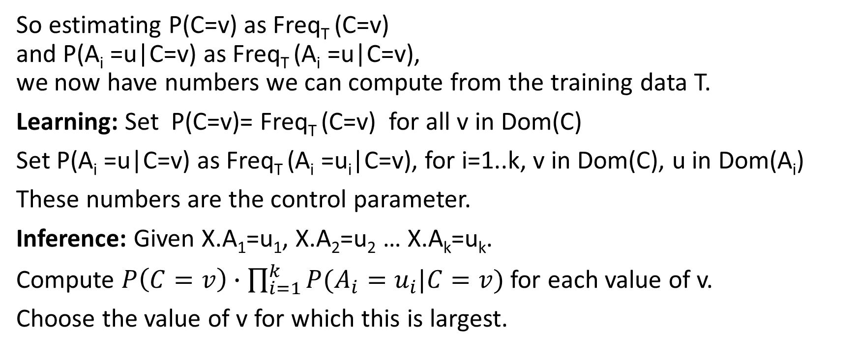
Naïve Bayes
So estimating P(C=v) as Freq_{T} (C=v) and P(A_{i} =u|C=v) as Freq_{T} (A_{i} =u|C=v), we now have numbers we can compute from the training data T.
Learning: Set P(C=v)= Freq_{T} (C=v) for all v in Dom(C)
Set P(A_{i} =u|C=v) as Freq_{T} (A_{i} =u_{i}|C=v), for i=1..k, v in Dom(C), u in Dom(A_{i})
These numbers are the control parameter.
Inference: Given X.A₁=u₁, X.A₂=u₂ … X.A_{k}=u_{k}.
Compute $P\left(C=v\right)∙\prod_{i=1}^{k}{P(A_{i}}=u_{i}|C=v)$ for each value of v.
Choose the value of v for which this is largest.

Slide 15
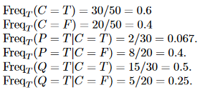
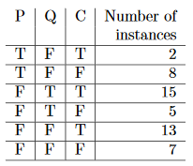
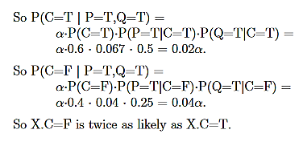
Example Suppose you have a new instance X where X.P=T, X.Q=T. What value should be predicted for X.C?

Slide 16
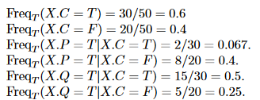
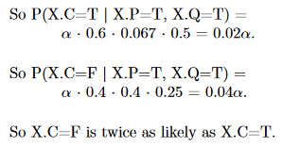
Example

Slide 17
Features of Naïve Bayes
Running time
Learning: (offline); O(|T|) (size of training set)
Inference (online): O(k ∙ |Dom(C)|)
Robust under noise (some mislabelled examples don’t change things much)
Robust under missing predictive attributes
Missing attributes in the test example: Just skip that attribute in computing the product.
Missing attributes in the training examples: Include example X in the tally for Freq_{T} (A_{i} =u|C=v), for attributes A_{i} where X.A_{i} is known, and skip it for the attributes where it is known.
Probabilistic model
Often used for text classification

Slide 18
Problems with Naïve Bayes
Assumes that all the predictive attributes are independent. The significance for C=v of A=u is always the same regardless of any of the other attributes.
Repeated attributes are overweighted. If attributes A, B, C are all identical or highly correlated, then they get multiplied in three times.
Often gives a fairly good answer, but the probability estimates tend to be way overconfident.

Slide 19
Variants: Smoothing
Sometimes #_{T}(X.C=v, X.A_{j}=u) = 0. In that case Freq_{T}(X.A_{j}=u | X.C=v) = 0. So you have a 0 entering into the product, which means that the product is 0. So this one attribute X.A_{j}=u vetoes the value X.C=v, no matter how strongly any other attributes favor it.

Slide 20
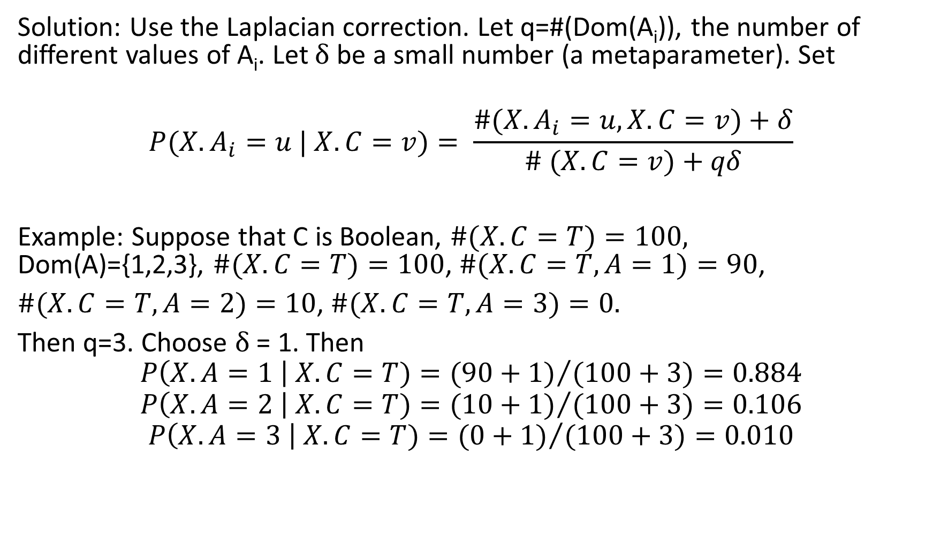
Laplacian correction
Solution: Use the Laplacian correction. Let q=#(Dom(A_{i})), the number of different values of A_{i}. Let δ be a small number (a metaparameter). Set
$$P(X.A_{i}=u | X.C=v)= \frac{\#(X.A_{i}=u, X.C=v)+δ}{\# (X.C=v)+qδ}$$
Example: Suppose that C is Boolean, $\#(X.C=T)=100,$ Dom(A)={1,2,3}, $\#(X.C=T)=100$, $\#(X.C=T,A=1)=90$,
$\#(X.C=T,A=2)=10$, $\#(X.C=T,A=3)=0.$
Then q=3. Choose δ = 1. Then
$$P\left(X.A=1 \right| X.C=T)={(90+1)}/{(100+3)}=0.884$$
$$P\left(X.A=2 \right| X.C=T)={(10+1)}/{(100+3)}=0.106$$
$$P\left(X.A=3 \right| X.C=T)={(0+1)}/{(100+3)}=0.010$$

Slide 21
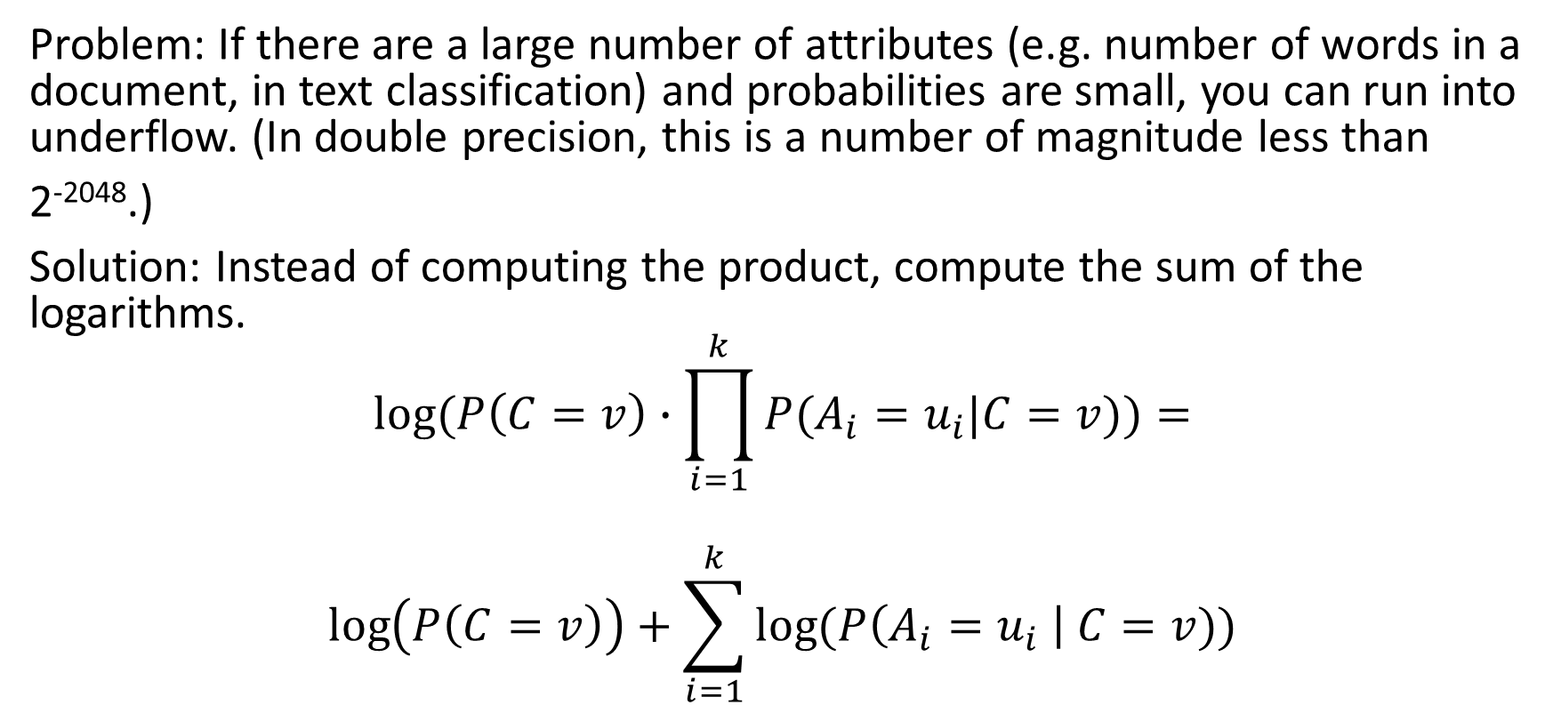
Logarithm
Problem: If there are a large number of attributes (e.g. number of words in a document, in text classification) and probabilities are small, you can run into underflow. (In double precision, this is a number of magnitude less than
2⁻²⁰⁴⁸.)
Solution: Instead of computing the product, compute the sum of the logarithms.
$$log⁡(P\left(C=v\right)∙\prod_{i=1}^{k}{P(A_{i}}=u_{i}|C=v))=$$
$$\log\left(P\left(C=v\right)\right)+\sum_{i=1}^{k}{\log{(P\left(A_{i}=u_{i} \right| C=v))}}$$

