Slide 1
Information Theory and Minimum Description Length Learning
Ernest Davis
April 27, 2020

Slide 2
Information Theory
The information Inf(E) of a probabilistic event E is the information gained in finding out that E occurred. It is measured in bits.
Definition: Inf(E) = −log₂P(E). (P(E) is a number between 0 and 1, so log₂P(E) is negative, so Inf(E) is positive.)
Why? Well, suppose that you flip a fair coin N times. Any particular outcome – TTHHTTTHTHHHHTHTHTTTHHT – has probability 2^{-N}, and it obviously takes N bits to specify. So the number of bits is −log₂P(E)
(You might reasonably wonder: Suppose that you flip an unfair coin N times? Then the probability is different, but it still takes N bits to specify. The answer is, as we will see, that on average you can represent the outcome in fewer than N bits.)

Slide 3
Information
The information of a pair of events Inf(E,F) = −log₂P(E,F).
The conditional information of E given F, Inf(E|F) is the information gained if you already know F and then find out E. So
Inf(E|F) = Inf(E,F) − Inf(F) = −log₂P(E,F) − (−log₂P(F)) =
−log₂ (P(E,F)/P(F)) = −log₂P(E|F)
So it works out very nicely.

Slide 4
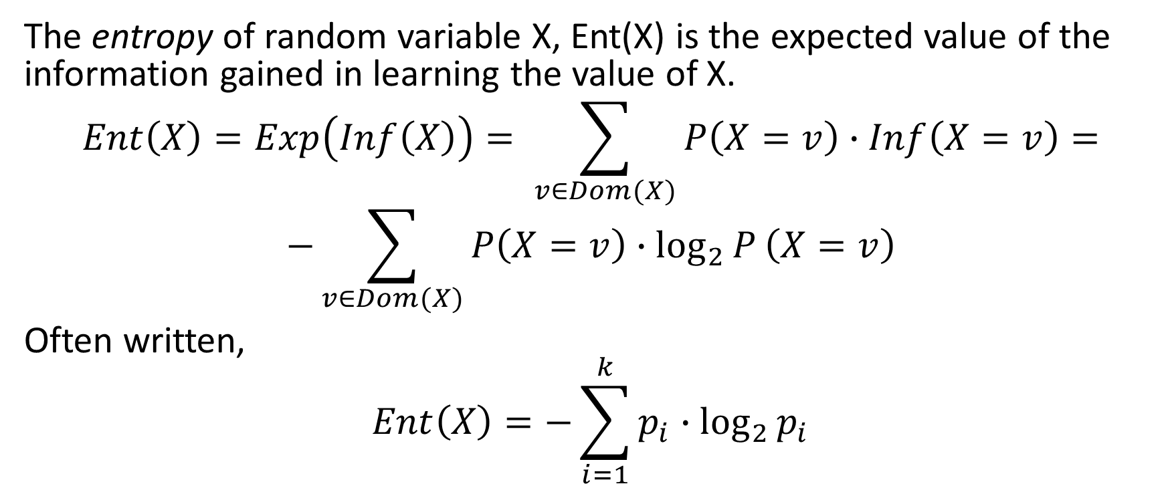
Entropy
The entropy of random variable X, Ent(X) is the expected value of the information gained in learning the value of X.
$$Ent\left(X\right)=Exp\left(Inf\left(X\right)\right)= \sum_{v∈Dom(X)}{P\left(X=v\right)∙Inf\left(X=v\right)=}$$
$$−\sum_{v∈Dom(X)}{P\left(X=v\right)∙\log_{2}{P}\left(X=v\right)}$$
Often written,
$$Ent\left(X\right)=−\sum_{i=1}^{k}{p_{i}∙\log_{2}{p_{i}}}$$

Slide 5
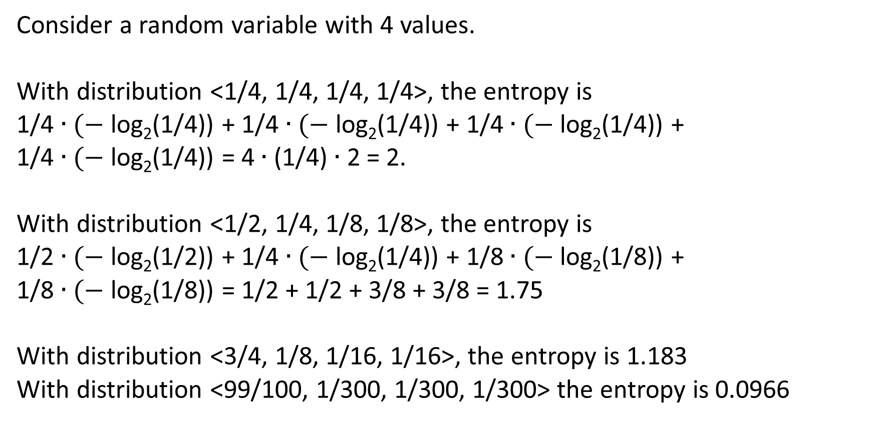
Example
Consider a random variable with 4 values.
With distribution <1/4, 1/4, 1/4, 1/4>, the entropy is
1/4 ∙ ($−$ log₂(1/4)) + 1/4 ∙ ($−$ log₂(1/4)) + 1/4 ∙ ($−$ log₂(1/4)) +
1/4 ∙ ($−$ log₂(1/4)) = 4 ∙ (1/4) ∙ 2 = 2.
With distribution <1/2, 1/4, 1/8, 1/8>, the entropy is
1/2 ∙ ($−$ log₂(1/2)) + 1/4 ∙ ($−$ log₂(1/4)) + 1/8 ∙ ($−$ log₂(1/8)) +
1/8 ∙ ($−$ log₂(1/8)) = 1/2 + 1/2 + 3/8 + 3/8 = 1.75
With distribution <3/4, 1/8, 1/16, 1/16>, the entropy is 1.183
With distribution <99/100, 1/300, 1/300, 1/300> the entropy is 0.0966

Slide 6
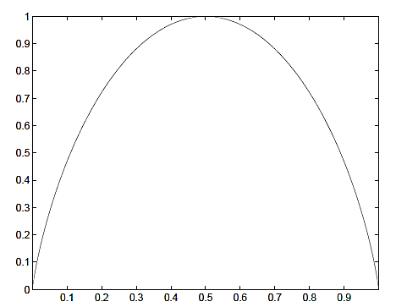
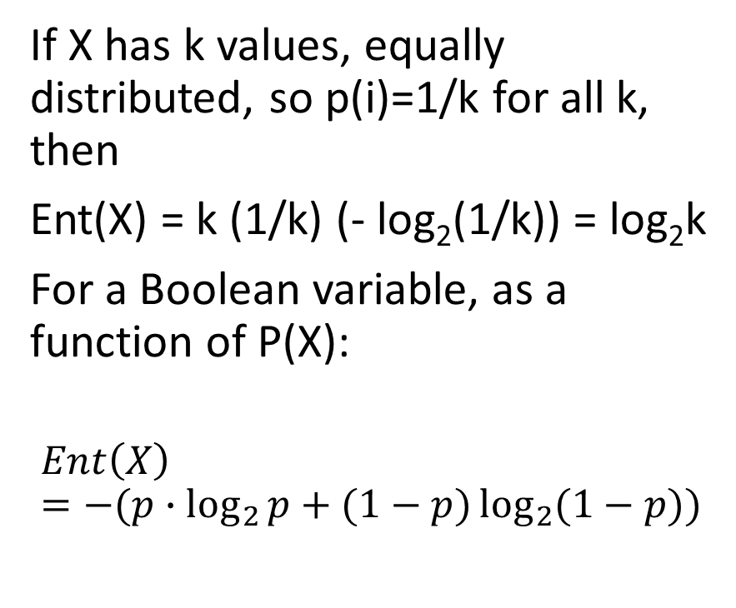
Example
If X has k values, equally distributed, so p(i)=1/k for all k, then
Ent(X) = k (1/k) (- log₂(1/k)) = log₂k
For a Boolean variable, as a function of P(X):
$$Ent\left(X\right)=−(p∙\log_{2}{p+(1−p)\log_{2}{(1−p))}}$$

Slide 7
Entropy is a measure of ignorance
Suppose that you have a random variable X with a particular distribution.
Ent(X) is the expected amount of information you will gain if you find out the value.
So it is a measure of the amount of information that you lack, not knowing the value.
So it measures your ignorance.

Slide 8
Numeric random variables
Entropy has no relation to the value of the random variable, only how to the probabilities is spread around among different values.
So if you have two random variables X and Y
P(X=4) = 1/2. P(X=5)=1/2.
P(Y=0) = 1/2. P(Y=1000)=1/2
Then Ent(X) = Ent(Y) = 1.
So “measure of ignorance” has to be taken with a grain of salt. There are two measures – the standard deviation and the entropy – which measure different kinds of ignorance.

Slide 9
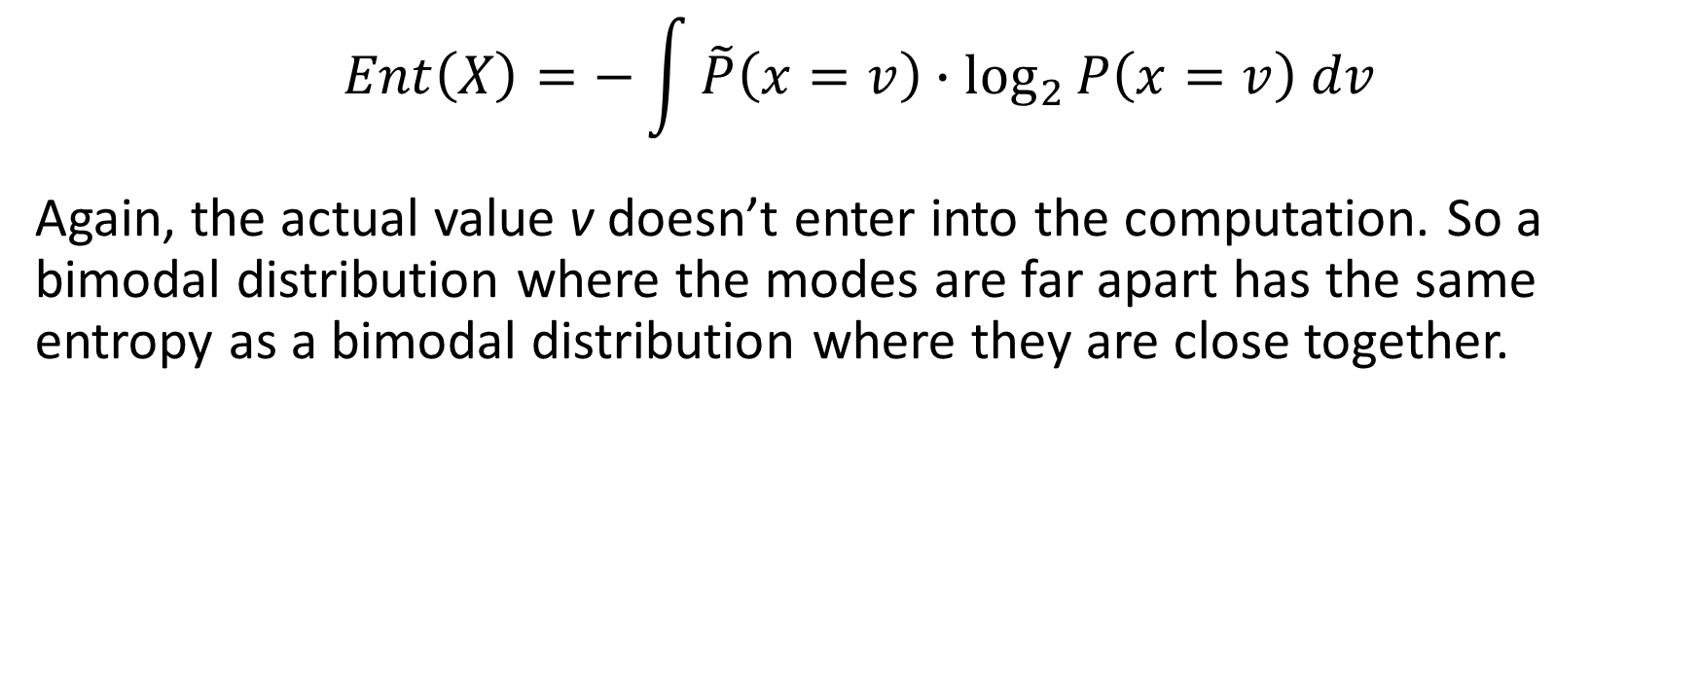
Entropy of continuous random variable
$$Ent\left(X\right)=−\int{\tilde{P}\left(x=v\right)∙\log_{2}{P\left(x=v\right) dv}}$$
Again, the actual value v doesn’t enter into the computation. So a bimodal distribution where the modes are far apart has the same entropy as a bimodal distribution where they are close together.

Slide 10
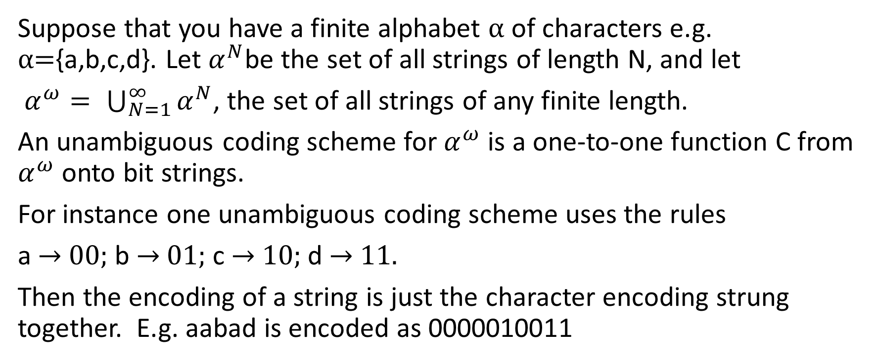
Coding
Suppose that you have a finite alphabet α of characters e.g. α={a,b,c,d}. Let $α^{N}$be the set of all strings of length N, and let
$α^{ω}= \bigcup_{N=1}^{∞}{α^{N}}$, the set of all strings of any finite length.
An unambiguous coding scheme for $α^{ω}$ is a one-to-one function C from $α^{ω}$onto bit strings.
For instance one unambiguous coding scheme uses the rules
a → 00; b → 01; c → 10; d → 11.
Then the encoding of a string is just the character encoding strung together. E.g. aabad is encoded as 0000010011

Slide 11
Prefix-free codes
One way to make sure that a code is unambiguous is to have the codes be prefix free --- that is, no bit string on the right side of a rule is a prefix of another bit string on a right side. For instance
a → 0; b → 10; c → 110; d → 111.
Then if you have a bit string, you can read off the encoding left to right, in only one way. For instance if you have the bit string
01101000011100
The leftmost 0 must be a. Then 110 must be c. Then 10 must be b. and so on
0 | 110 | 10 | 0 | 0 | 0 | 111 | 0 | 0 = acbaaadaa

Slide 12
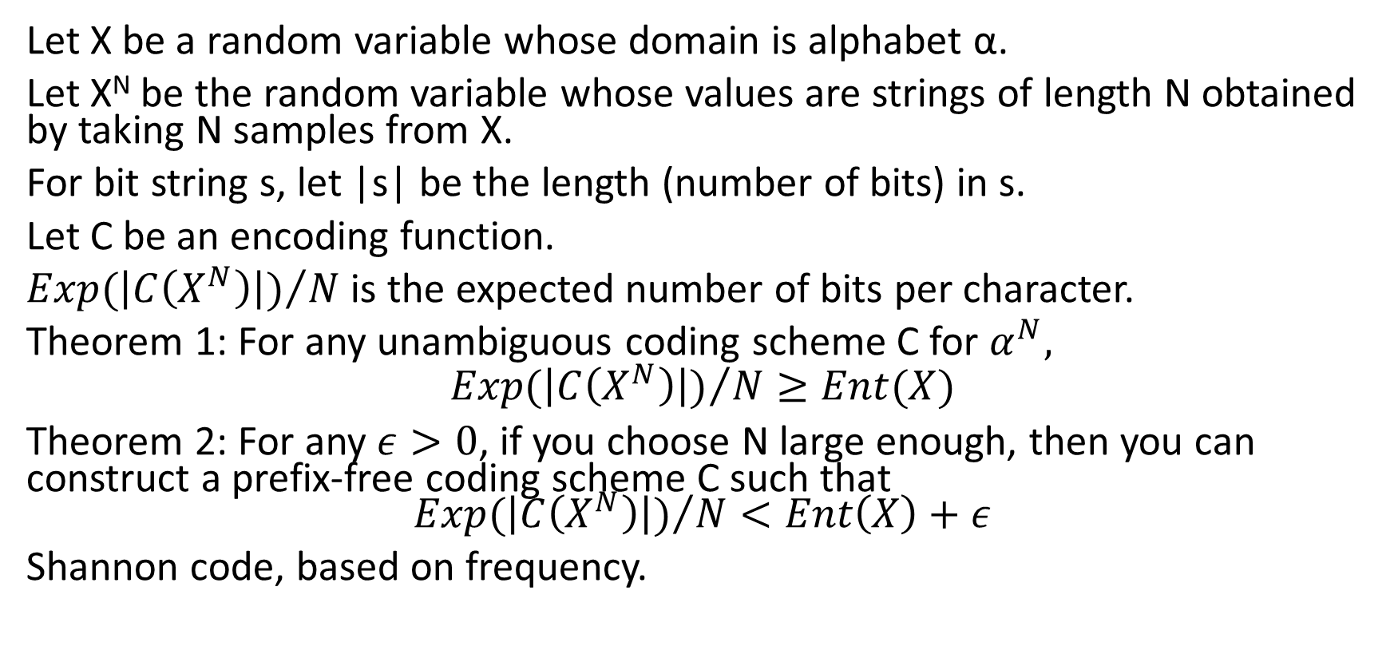
Coding theorems (Claude Shannon, 1948)
Let X be a random variable whose domain is alphabet α.
Let X^{N} be the random variable whose values are strings of length N obtained by taking N samples from X.
For bit string s, let |s| be the length (number of bits) in s.
Let C be an encoding function.
${Exp(\left|C\left(X^{N}\right)\right|)}/N$ is the expected number of bits per character.
Theorem 1: For any unambiguous coding scheme C for $α^{N},$
$${Exp(\left|C\left(X^{N}\right)\right|)}/N≥Ent(X)$$
Theorem 2: For any $ε>0$, if you choose N large enough, then you can construct a prefix-free coding scheme C such that $${Exp(\left|C\left(X^{N}\right)\right|)}/N<Ent\left(X\right)+ε$$
Shannon code, based on frequency.

Slide 13
Example:
Suppose P(X=a) = 1/2, P(X=b) = 1/4, P(X=c) = 1/8, P(X=d) = 1/8.
As we saw, Ent(X) = 1.75.
Use the code a → 0; b → 10; c → 110; d → 111.
Then for large N a string generated by X^{N} will with high probability have
About N/2 a’s costing a total of N/2 bits
About N/4 b’s costing a total of 2*N/4 = N/2 bits
About N/8 c’s costing a total of 3*N/8 = 3N/8 bits
About N/8 d’s costing a total of 3*N/8 = 3N/8 bits.
Total: 1.75N bits.

Slide 14
Example
Suppose we have two characters {a,b}, P(X=a)=127/128, P(X=b)=1/128.
Ent(X) = 0.0435
How can you have less than 1 bit per character?
Answer: Encode groups of characters. We’ll break the string into N/128 sequences of 128 characters, and we provide a code for strings of length 128.

Slide 15
Example cntd.
(To illustrate how you can get under 1, not anything like the optimal solution.)
Of the N/128 substrings,
N/(128*e) will be all a’s. We’ll code a string of 128 a’s as ‘0’. Total cost: N/(128*e)
N/(128*e) will have a single ’b’. We’ll use a code where the first two bits are ’10’, then the index of the position of the ‘b’ (7 bits) = 9 bits. Total cost. 9N/(128*e)
The rest we’ll code starting ’11’ then the ordinary one-bit encoding of the string = 130 bits. Total cost: (N/128)(1-2/e)*130
Total cost: 0.2971N

Slide 16
Maximum Entropy Principle
Principle: If you know constraints on a probability distribution of random variable X, you should assume that you are as ignorant as possible about its value.
Since entropy measures ignorance, assuming you are as ignorant as possible amounts to assuming that X follows the distribution of maximum entropy that follows those constraints.

Slide 17
Examples of Maximum Entropy Principle
Constraint: You know that X has k possible values. Consequence of ME: Assume that X is equidistributed: P(X=v)=1/k for all v.
Constraint: You know the probability distributions of X and of Y but not the joint distribution of X,Y. Consequence of ME: Assume that X and Y are independent.
Constraint: You know the joint distributions of X,Y and of X,Z but not the complete joint distribution X,Y,Z. Consequence of ME: Assume that Y and Z are conditionally independent given X.

Slide 18
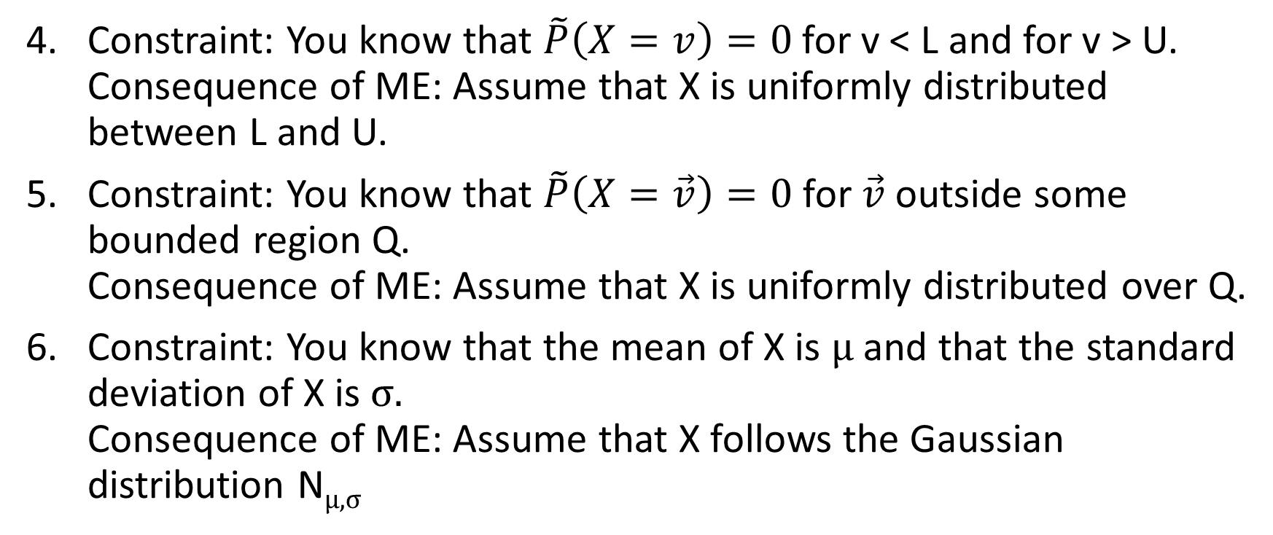
Examples of Maximum Entropy Principle: Real- or vector-valued variables
Constraint: You know that $\tilde{P}\left(X=v\right)=0$for v < L and for v > U. Consequence of ME: Assume that X is uniformly distributed between L and U.
Constraint: You know that $\tilde{P}\left(X=\vec{v}\right)=0$ for $\vec{v}$outside some bounded region Q. Consequence of ME: Assume that X is uniformly distributed over Q.
Constraint: You know that the mean of X is μ and that the standard deviation of X is σ. Consequence of ME: Assume that X follows the Gaussian distribution N_{μ,σ}

Slide 19
Minimum Description Length Learning A very broad framework of learning
Occam’s razor: Given two theories that explain the same data equally well, prefer the simpler of the two.
Computational interpretation of “simpler”: The more compact representation.
General idea. You have in mind a fixed decoding function θ. You are given raw data D. “Learning” consists in finding an encoding E of D where |E| < |D| and where θ(E)=D. Thus, you can reconstruct D from E. The quality of learning carried out is |D| − |E|, where these lengths are measured in bits – the more bits you save, the better you have learned.

Slide 20
MDL for a perfect discrete classifier
Suppose that you have a classification problem, with predictive attributes A₁ … A_{k} and classification attribute C. And suppose that you have found a perfect classifier for the training data D: With the control parameter value α, inference procedure I_{α}(X.A₁ … X.A_{k}) is always equal to X.C, for all X∊D. (Note: I, with different values of α, applies to a class of ML problems, not to a single problem.)
Then the encoded form of the data, E, consists of [a table of the values of X.A₁ … X.A_{k} for all X∊D, together with the control parameter α. The decoder is the inference procedure I. Then you can reconstruct the original data by computing the values of X.C. The saving in bits is
[the memory required by the C column in T] − | α |.

Slide 21
Note:
Unlike algorithmic analysis, we’re not talking about order-of-magnitude savings. The size of the representation is still O(N). We’re saving comparatively small number of bits, and we are working with exact counts of bits. As we’ll see, there’s a good reason for that.

Slide 22
MDL for an imperfect classifier
Suppose that C is a Boolean attribute.
Suppose that the situation is as on the previous slide, but
I_{α}(X.A₁ … X.A_{k}) is equal to X.C only most of the time, not all the time.
We can use this to construct an encoding E of D as follows:
Replace the C column in D with a new attribute C’ where:
If X.C== I_{α}(X.A₁ … X.A_{k}) then X.C’ = Yes
Else X.C’ = ‘No’
Encode C’ using the Shannon encoding.

Slide 23
MDL for an imperfect classifier cntd.
The encoding E is now [the table of the values of X.A₁ … X.A_{k}, X.C’ for all X∊D] together with α. The decoding procedure θ(E) is
for (X in E) {
v = I_{α}(X.A₁ … X.A_{k}) ;
if (X.C’ == Yes) then X.C = v else X.C=~v; }
Assuming that the original D uses Shannon coding for C, the C column required N∙Ent(C) bits. In E, the C’ column requires N∙Ent(C’) bits. The saving in bits is therefore N∙(Ent(C) − Ent(C’)) − | α | bits.

Slide 24
MDL for an imperfect classifier example
Suppose that C is a Boolean attribute which is equally often T or F.
Then Ent(C) = Ent(<1/2, 1/2>) = 1.
Suppose that I_{α} guesses randomly, so guesses right half the time.
Then Ent(C’) = Ent(<1/2, 1/2>) = 1 so no gain. Net loss of |α|.
But now suppose that I_{α} gets the right answer 3/4 of the time (equally for T and F). Then Ent(C’) = Ent(<3/4, 1/4>) = .8113
So you save N ∙ (1-.8113) - | α | bits
So as long as N > | α | /(1-.8113) there is a net gain in bits.
For any discrete C, if I_{α} does better than random guessing, you can use this method to decrease entropy and thus shorten the encoding.

Slide 25
Imperfect classifier: More complex example
Suppose that there is an attribute where the classification attribute has 3 values {a,b,c} with frequencies <1/4,1/2, 1/4>. You have a table with 10,000 rows. The naïve encoding, with 2 bits per value, is 20,000 bits
If you use the Shannon encoding b->0, a->10, c->11 then the representation of the classification column uses 5000*1+2500*2+2500*2 = 15,000 bits.

Slide 26
Encoding of the table
You also have to encode the table --- if you are encoding lots of different data sets, then each has a different system of frequencies, and will have a different code. Suppose that, in all your tables, the values of the classification attributes are a,b,c. Then you have to encode the sequence of codes in standard order unambiguously e.g. “10.0.11”
If you now use a second code where symbols ‘1’, ‘0’, ‘.’ are each 2 bits, then this table is 14 bits.
Total length of encoding: 15,014 bits.

Slide 27
Imperfect classifier example continued.
Now suppose that you have a classifier of some kind, determined by a 200 bit parameter. This classifier is perfect on values ‘b’ but guesses randomly on values ‘a’ and ‘c’.
Now consider the following code
Classifier gives correct value. Code 0. 7500 rows. Classifier gives incorrect value and true value is ‘a’. Code 10. 1250 rows Classifier gives incorrect value and true value is ‘c’. Code 11. 1250 rows Total length of the classification column: 7500*1+1250*2+1250*2 = 12,500 bits.

Slide 28
Encoding of table.
In the new system, considering all possible imperfect classifiers and tables, there are four possible values on the left side: Classifier works correctly, classifier works incorrectly and true value is ‘a’, etc.
So you can encode this sequence in a sequence of four codes. In this case. ‘0.10..11’. Using a two-bit encoding for each symbol, this is 16 bits.
Total length of encoding: 12,500+200+16 = 12,716 bits
Total savings: 15,014 – 12,716 = 2,298 bits.

Slide 29
| α | when α is a sequence of natural numbers
The obvious encoding for a number N is its encoding in binary.
→ 1001. 12 → 1010. 19 → 10011.
But this is not a prefix code, so if you want to represent a series of numbers 12,9,19 you can’t just string them together as 10101001100011
We need a prefix-free code for natural numbers.

Slide 30
Prefix-free code for natural numbers
Level 1: Take N. Turn it into a binary string B. Let K=|B|. Encode N as K 1’s, followed by 0, followed by B. This is prefix free. If you have a sequence of these, left to right, you read K till you hit 0, then you read K bits and that’s N.
Examples:
N=4. B=100. K=3. Code = 1110100
N=12. B=1010. K=4 . Code = 111101010
Length: 1+2*cl(N) where cl(N) = ceiling(log₂(N+1)) = K
Level 2: Take N. Turn it into a binary string B. Let K=|B|. Encode N as the level 1 encoding of K followed B.
Example: 12=11101001010
Length: 1+cl(N)+2*cl(cl(N))

Slide 31
Prefix-free code for natural numbers
You can obviously keep doing this to level 3, level 4, etc.
But:
Beyond level 2, this only pays for truly enormous numbers.
There is no coding scheme that is asymptotically optimal.
There is no way to achieve a prefix-free representation with only cl(N) bits.
(In the homework assignment, I instructed you to use a length of 1+cl(N) (the extra bit for the sign). That’s optimistic, but it doesn’t matter much.)

Slide 32
Representing real numbers
Real numbers can be represented either:
As fractions (pair of numbers)
As fixed precision numbers (e.g. 4 digits of accuracy). In practice in ML applications, using more than a few digits is almost always pointless, or even counter-productive.
If the numbers are being generated by a random process e.g. a Gaussian, then it is much more effective to use the information theory encoding based on frequency. Thus, values close to the mean get short representations; those far from the mean get long representations.
(There is also a way of doing this with continuous densities, but I distrust that.)

Slide 33
| α | when α is a data structure
You have to go back to basics, and find some way of encoding the data structure as a bit string.

Slide 34
MDL for an approximate classifier
Suppose that the predictive and classification attributes are numeric.
E.g. you have found by linear regression that y ≈ 5x+2.
Data D: Table of values (to some fixed precision).
Encoding E: Replace column C by C’ which is actual value minus the predicted value. The point is that that in general this will be a much smaller number so fewer bits are required.
Savings: N*(the average number of bits saved going from C to C’)

Slide 35
MDL for approximate classifier: Example
Data D
x y
0.1 2.3
0.2 3.1
0.6 5.2
1.1 7.2
1.5 9.7
If y ranges from 23/10 to 97/10 then naively 7 bits are needed for each.
Encoding E: y = 5.0x+2.0+ε
x ε
0.1 -0.2
0.2 0.1
0.6 0.2
1.1 -0.3
1.5 0.2
If ε takes on only the 7 values -0.3 .. 0.3, then only 3 bits are needed for each, plus 13 bits for 5.0 and 2.0. The control parameter α is the pair <5.0, 2.0>

Slide 36
MDL explains overfitting
In MDL theory, overfitting occurs when |α| is nearly as large as |D|−|E|, so no actual compression occurs.

Slide 37
MDL for statistical inference
D is a set of strings over an alphabet, and there are significant differences in the frequency of one character over another.
MDL representation: E is the Shannon encoding. The control parameter here is the table of encodings; e.g. a → 0; b → 10; c → 110; d → 111
In fact, if there is any statistically significant pattern that can be characterized by a parameter α, then there will be a shortening encoding. Sketch of proof: Use a Shannon-like encoding that makes strings that conform to the pattern short and those that don’t long.

Slide 38
Three learning methods that do not correspond to MDL
Exact k-nearest neighbors. The only compression you can do is to get rid of unnecessary training points.
Agglomerative clustering (AFAIK) for non-vectors.
Deep learning where the number of parameters is comparable to the size of the training set (such things exist currently).

Slide 39
MDL for Clustering
Discussed in problem 6 of the problem set.

Slide 40
MDL for Stochastic Generative Models (sketch)
A stochastic generative model is a program P that generates output by generating random bits from time to time, incorporating various parameters.
The decoding procedure is P. The control parameter α is the collection of parameters of P. The encoding of a given output is the sequence of bits that were generated randomly.

Slide 41
Is there a most general MDL model?
In the discussion of MDL so far, each different application had a different decoding function.
Is there a single decoding function that subsumes them all and therefore allows us to do any kind of learning?

Slide 42
Is there a most general MDL model?
In the discussion of MDL so far, each different application had a different decoding function.
Is there a single decoding function that subsumes them all and therefore allows us to do any kind of learning?
The answer is Yes! And a very familiar one. The most general decoding function is:

Slide 43
Is there a most general MDL model?
In the discussion of MDL so far, each different application had a different decoding function.
Is there a single decoding function that subsumes them all and therefore allows us to do any kind of learning?
The answer is Yes! And a very familiar one. The most general decoding function is:
A programming language (any of them).
The control parameter is a decoding program to execute.

Slide 44
Most general MDL model
Definition: For any decoding function I and data D, let c(I,D) be the maximal compression that I_{α} can achieve for data set D for any value of the parameter α (i.e. the number of bits saved)
Theorem: Let I be any computable decoding function and let P be a programming language. Then there exist a constant f(I,P) such that for every data set D, c(P, D) ≥ c(I,D) − f(I,P). That is, P achieves almost as much compression as I on every data set, by a constant difference. The size of the difference depends on I and P but not at all on D.

Slide 45
Proof
Let Q(α,E) be a program written in programming language P that executes I_{α} on E.
Set f(I,P) = |Q|, the length of program Q.
Now choose a data set D.
Let α be the particular parameter value that achieves maximal compression on D for I with encoding E. So I_{α}(E) = D and c(I,D) = |D| − (|E|+|α|)
Let parameter β be the pair <Q, α >. So |β| = |Q|+|α|
Now P_{β}(E) = Q(α,E) = I_{α}(E) = D
So c(P,D) ≥ |D| − (|E|+|β|) = c(I,D) – f(I,P).

Slide 46
What is the maximum compression possible for a data set D?
What is the program Q, parameter α and encoding E, where Q(α,E)=D such that |Q|+ |α| + |E| is minimal? We can make α and E part of Q, and so rephrase this:
What is the shortest inputless program Q that outputs D?
The length of the shortest program that outputs D is called the Kolmogorov complexity of D, K(D). (Andrei Kolmogorov, 1903-1987).
A string is h-random if it cannot be compressed by more than h bits:
K(D) ≥ |D|-h

Slide 47
Theorems
Theorem: For any N, the fraction of bit strings of length N that are not h-random is less than 2^{-h}.
Proof: There are 2^{N} bit strings of length N and fewer than 2^{N-h} bit programs of length less than N-h.
So saving, say, 100 bits is a real accomplishment. With a random string, the probability that you can save 100 bits is at most 2⁻¹⁰⁰.
Theorem: There are only finitely many strings that can be proved h-random. There are only finitely many strings whose Kolmogorov complexity can be calculated.

Slide 48
So in practice
We can’t actually use a programming language as the decoder; we have to use more limited classes of decoders.

Slide 49
The ultimate ML theory
Let D be all the data that we have about the world, expressed as a bit string.
Assign to program G the prior probability P(G) = c∙2^{-|G|} c is just a normalization constant. Assuming that programs are encoded in an unambiguous coding, this is a valid probability distribution.
Compute the posterior probability of all programs G: By Bayes’ law, P(G|D) = P(G)∙ P(D|G)/P(D)
The most probable G is the best possible scientific theory.
(I don’t, myself, put much stock in this; but people actually have proposed it as an idealized model and have studied its properties, some of which are mathematically interesting.)

