Slide 1
CROWDFUNDING PROJECT (Group-4)

Slide 2
Names of Participants :
1. K. Vigneshwar Reddy
2. Jyotsna Nagvekar
3. Tushar Kadam
4. Chilamkuri Suprajitha Reddy
5. Sachin Nare
6. Ande Usha Sree

Slide 3

What is Crowdfunding ?
Crowdfunding is the practice of funding a project or venture by raising small amounts of money from a large number of people, typically via the Internet.
Crowdfunding is a form of crowdsourcing and alternative finance. In 2015, over US$34 billion was raised worldwide by crowdfunding.

Slide 4
Tools And Technologies:
Microsoft Excel
Power BI
Tableau
MySQL

Slide 5
Crowdfunding Data Analysis in Excel:
Data Cleaning & Transformation:
Processed raw data by converting date fields into a readable/natural time format.
Standardized financial data by converting goal amounts to USD for accurate comparison and analysis.
Data Modeling:
Built a robust data model using Power Pivot.
Created a Calendar table to support time-based analysis and enable period filtering.
KPI Development:
Designed key performance indicators (KPIs) including:
Projects Overview
Successful Projects
Top Successful Projects by Category or Country
Visualization:
Used PivotTables and Pivot Charts for interactive reporting.
Implemented multiple chart types like Bar Graphs, Column Charts, and Pie Charts.
Added Slicers for intuitive filtering by status, category, and time period.

Slide 6
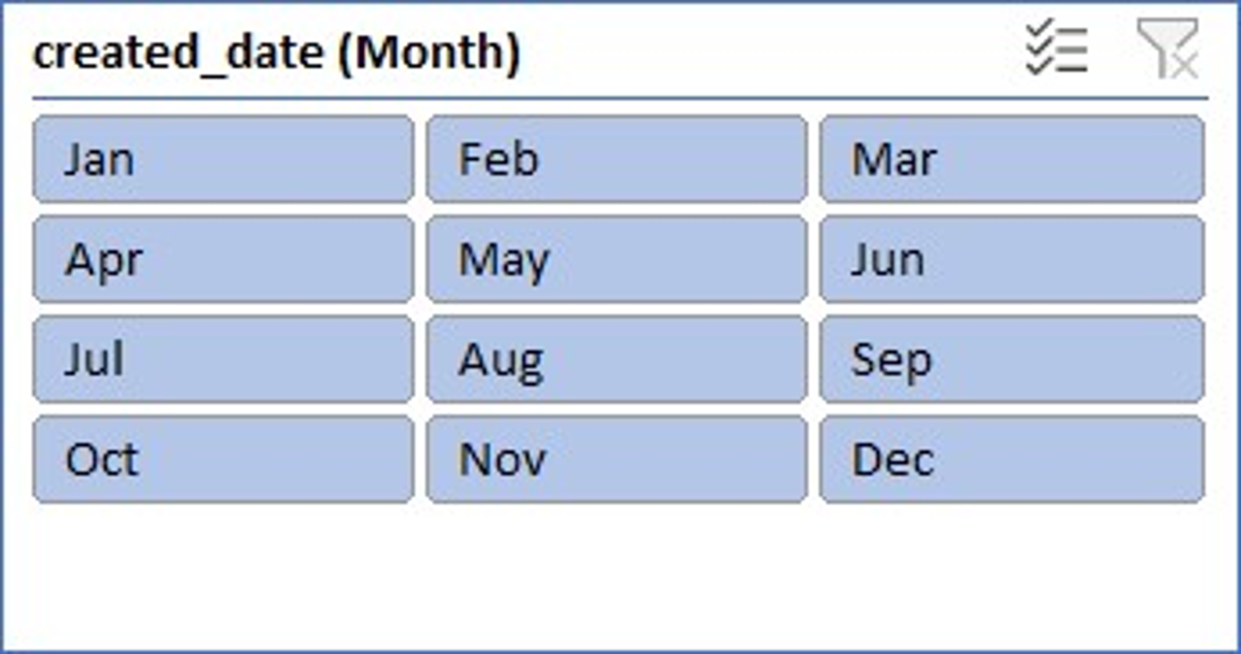
Snapshots of some charts used in Excel

Slide 7
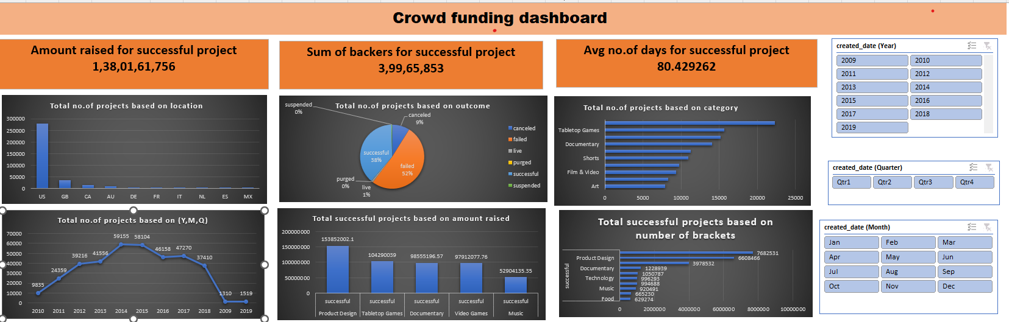
Dashboard By Using Excel:

Slide 8
Crowdfunding Data Analysis in Power BI
Data Cleaning & Transformation:
Performed data preprocessing in Power Query including date conversion into natural time format for improved readability.
Converted goal amounts into USD to ensure consistency and accuracy in financial analysis.
Data Modeling:
Created a Calendar table to enable time intelligence functions.
Built an efficient data model using Power BI’s data view, defining relationships between multiple tables for seamless analysis.
KPI Development:
Developed dynamic KPIs such as:
Projects Overview
Successful Projects Count
Top Successful Projects by Category or Country
Data Visualization:
Designed interactive dashboards using visuals like bar charts, column charts, and pie charts.
Implemented slicers and filters to enable user-driven exploration and drill-down capabilities.

Slide 9
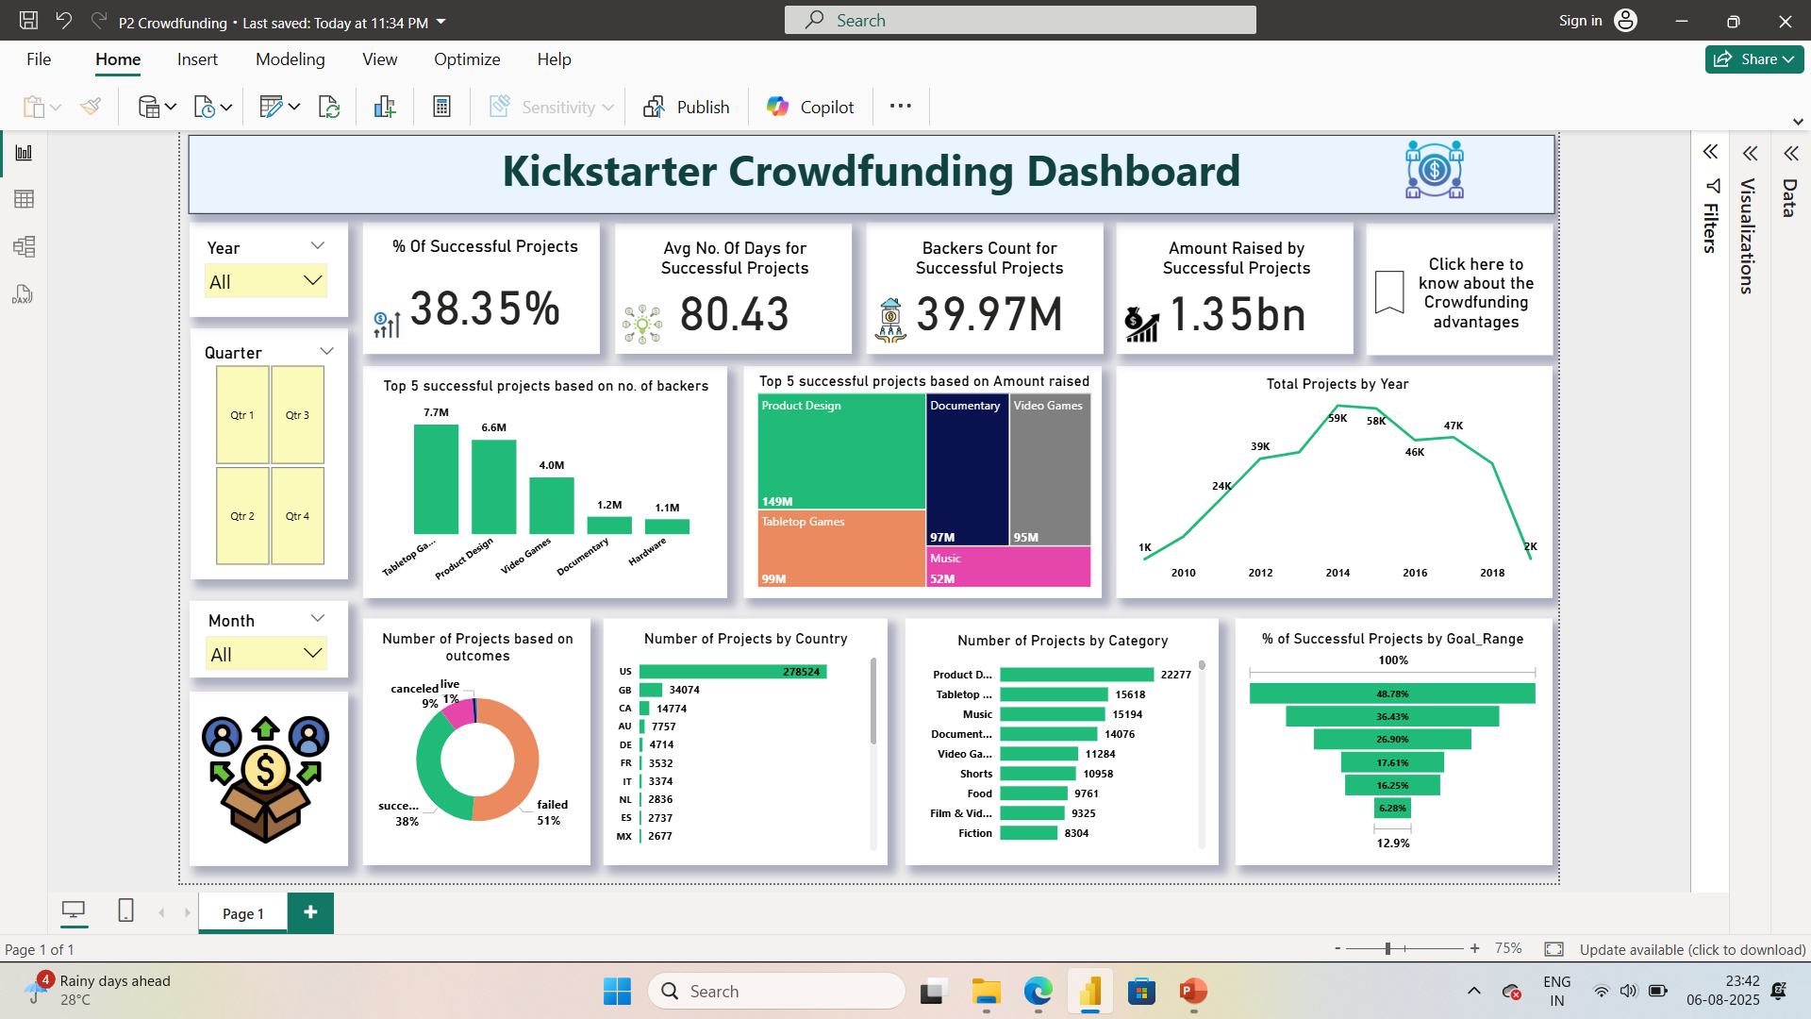
Dashboard by using Power BI:

Slide 10
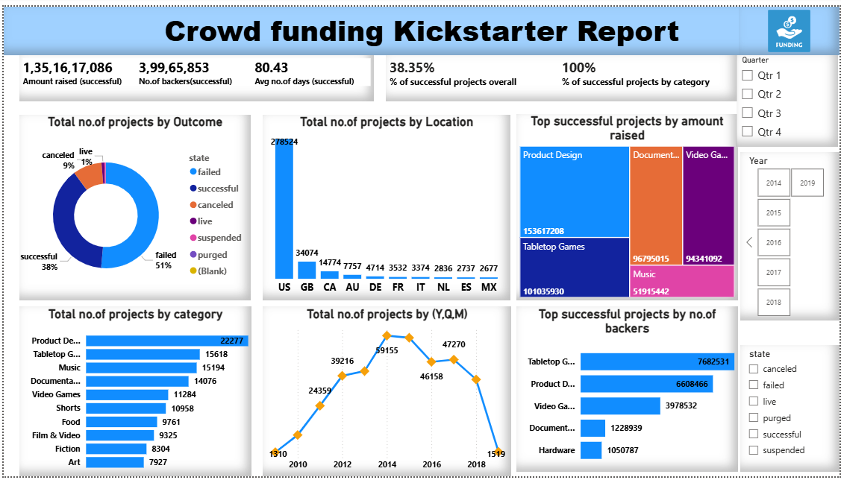
Dashboard by using Power BI:

Slide 11
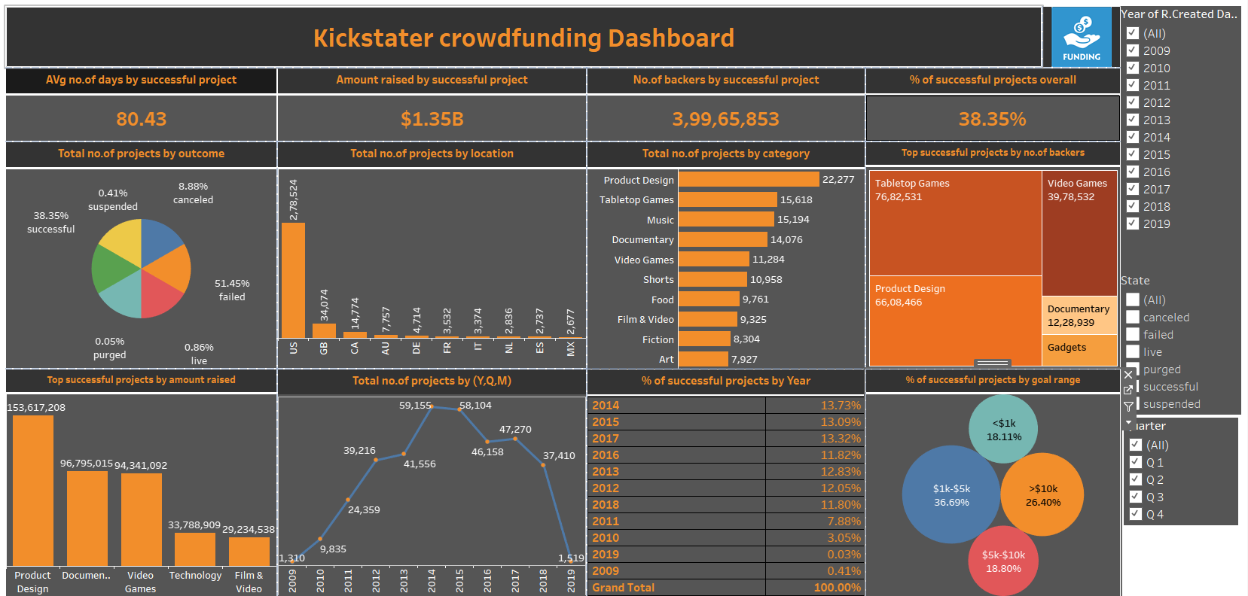
Dashboard By Using Tableau:

Slide 12
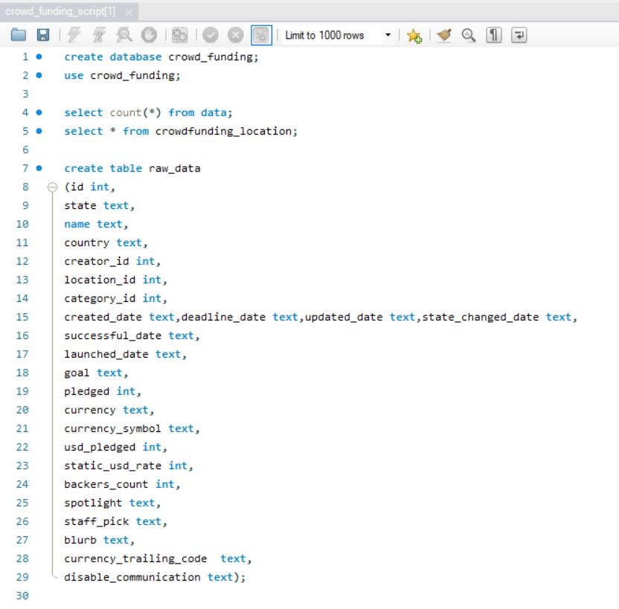
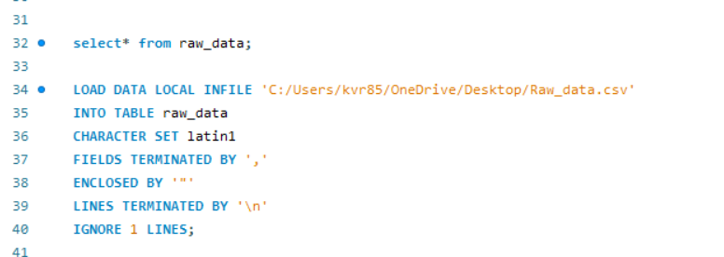
Extracting various KPI’s from raw data by using MySQL:

Slide 13
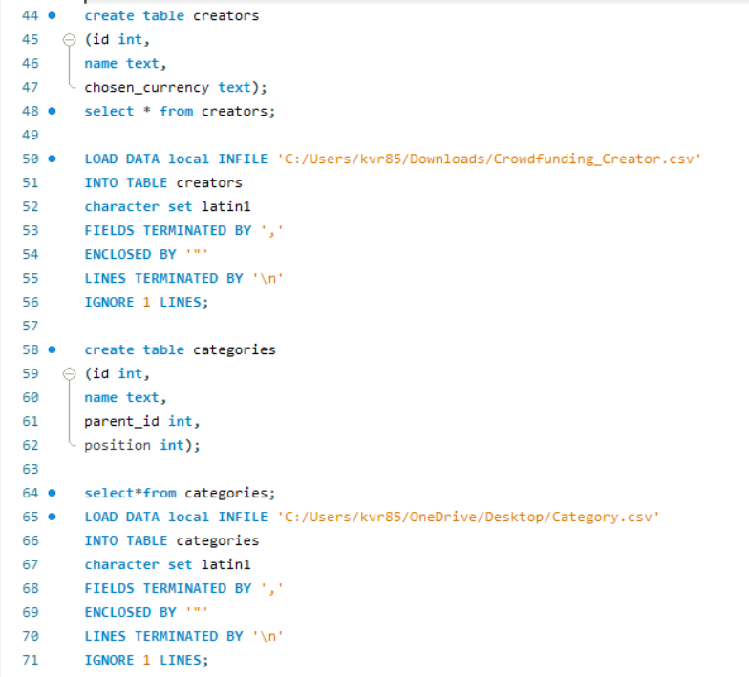

Slide 14
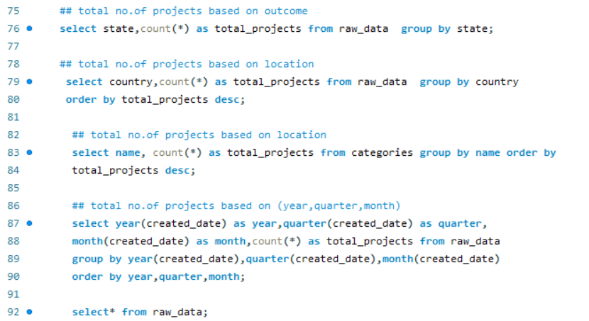
Total number of projects based on various factors:

Slide 15
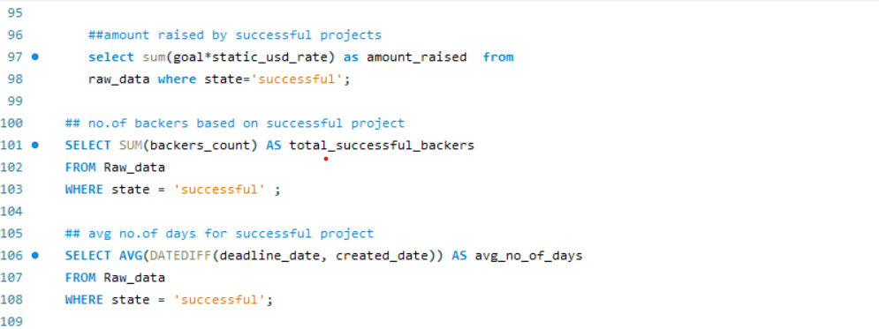
Amount, No. of backers, no. of days by successful projects:

Slide 16
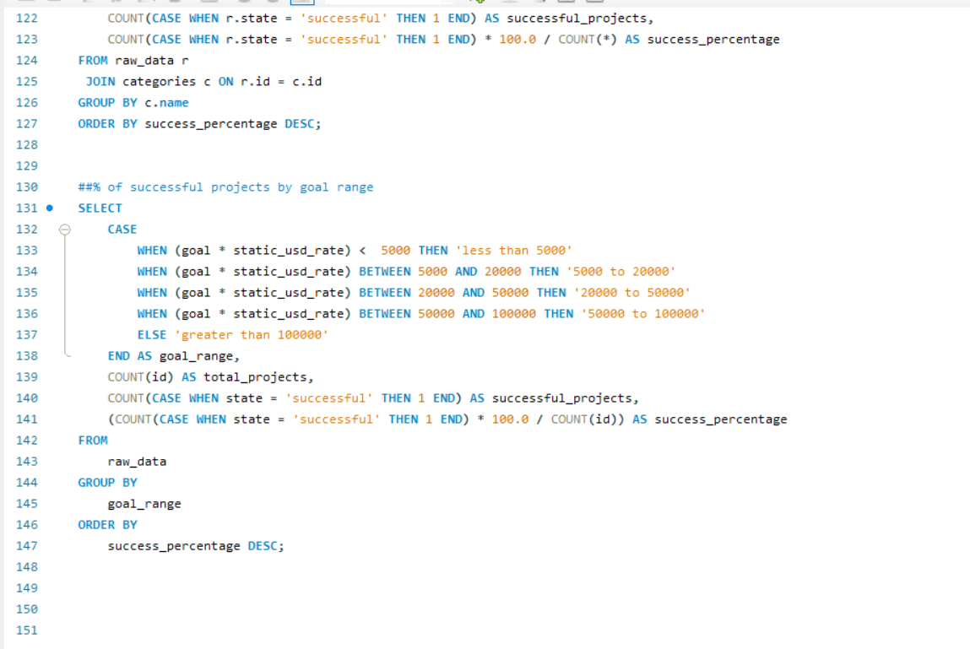
Percentage of successful projects:

Slide 17
References or Sources:
https://en.wikipedia.org/wiki/Crowdfunding
https://www.investopedia.com/terms/c/crowdfunding.asp
https://mode.com/sql-tutorial/
https://learn.microsoft.com/en-us/training/powerplatform/power-bi/
https://community.powerbi.com/t5/Data-Stories-Gallery/bd-p/DataStoriesGallery
https://github.com/search?q=crowdfunding+dashboard

Slide 18
Thank You!

