Slide 1

EngineeringCollege Department Management System
Software Engineering Project Presentation
Django-based academic department management system
Prepared for project documentation, testing, deployment, and demonstration
Modules: Admin, Faculty, Student, Project Domains, Certificates, PDFs, Gallery, Exam Branch
Prepared for Software Engineering Project Presentation
01

Slide 2
Project Overview
Overview
What the system delivers
Central platform for department-level academic data management
Maintains faculty and student profiles with certificates and research details
Generates profile PDFs and organizes project materials by domain
Includes receipt-based project download workflow and deployed demo pages
EngineeringCollege Department Management System
2

Slide 3
Problem Statement
Problem Statement
Need for a unified academic management system
Department data is often spread across files, forms, and manual registers
Faculty, student, certificate, and research details are difficult to update consistently
Manual PDF/profile preparation takes time and introduces errors
Project resources, payment receipts, and downloads need a controlled workflow
EngineeringCollege Department Management System
3

Slide 4
Problem Impact
Problem Statement
Operational issues in the current workflow
Repeated manual data entry across student and faculty records
Delayed access to certificates, project details, and academic reports
Limited traceability for project folder payment and delivery confirmation
Harder deployment and sharing of executable academic software projects
EngineeringCollege Department Management System
4

Slide 5
Objectives
Objectives
Primary project goals
Digitize faculty and student profile management
Enable certificate upload, storage, and profile PDF generation
Organize academic projects by domain with documentation and assets
Support project download confirmation through PhonePe receipt submission
Deploy the project on Render for live access
EngineeringCollege Department Management System
5

Slide 6
Specific Objectives
Objectives
Implementation-focused goals
Provide separate workflows for Admin, Faculty, and Student users
Store structured academic data in relational database tables
Integrate static/media handling for images, certificates, QR code, and video
Create UML diagrams, test cases, presentation, and demo video for submission
EngineeringCollege Department Management System
6

Slide 7
Existing System
Existing System
Manual and fragmented process
Student and faculty details are commonly maintained in spreadsheets or paper files
Certificates and proofs may be stored without a single searchable structure
Profile reports are generated manually or through repeated formatting work
Project delivery and payment confirmation rely on informal communication
EngineeringCollege Department Management System
7

Slide 8
Existing System Drawbacks
Existing System
Limitations of the old approach
Low consistency across records and documents
More time required for verification and report preparation
Difficult access control for role-specific information
Limited readiness for cloud deployment and public project showcase
EngineeringCollege Department Management System
8

Slide 9
Proposed System
Proposed System
Django-based department platform
Web application with role-oriented dashboards and academic data workflows
Database-backed faculty, student, certificate, research, and project information
Automated PDF generation and organized project folder packaging
Deployed application with Render, Cloudinary-ready media handling, and project support form
EngineeringCollege Department Management System
9

Slide 10
Proposed System Modules
Proposed System
Major functional areas
Admin dashboard and project management
Faculty profile, research, FDP, certificate, BTech project, and exam branch management
Student profile, certificate, academic, and research publication management
Project domain showcase, paid ZIP/receipt workflow, gallery, syllabus, and live demo assets
EngineeringCollege Department Management System
10

Slide 11
System Architecture
Architecture
High-level request flow
Browser sends requests to Django URL routes
Views apply business logic, authentication, validation, and database access
Templates render dashboards, project pages, forms, tables, and video players
Static/media services deliver CSS, images, certificates, QR code, and demo video
EngineeringCollege Department Management System
11

Slide 12
Architecture Layers
Architecture
Application structure
Presentation layer: HTML templates, CSS, JavaScript, and responsive UI
Controller layer: Django views, URL routing, forms, and session handling
Data layer: Django ORM models, migrations, PostgreSQL/SQLite tables
Integration layer: Cloudinary, Render deployment, email, QR/payment receipt workflow
EngineeringCollege Department Management System
12

Slide 13
Technology Stack
Technology Stack
Core technologies
Backend: Python and Django
Database: PostgreSQL on Render; SQLite supported locally
Frontend: HTML, CSS, JavaScript, Django templates
Media/Files: Cloudinary-ready media handling and local static files
Deployment: Render with build and start scripts
EngineeringCollege Department Management System
13

Slide 14
Django Stack Usage
Technology Stack
How Django is used
URL patterns map public pages, dashboards, downloads, payments, and media routes
Views handle login, dashboards, project pages, receipt submission, PDF generation, and file streaming
Models represent academic records, users, payments, receipts, and related data
Templates provide reusable UI for project details, dashboards, forms, and support chatbot
EngineeringCollege Department Management System
14

Slide 15
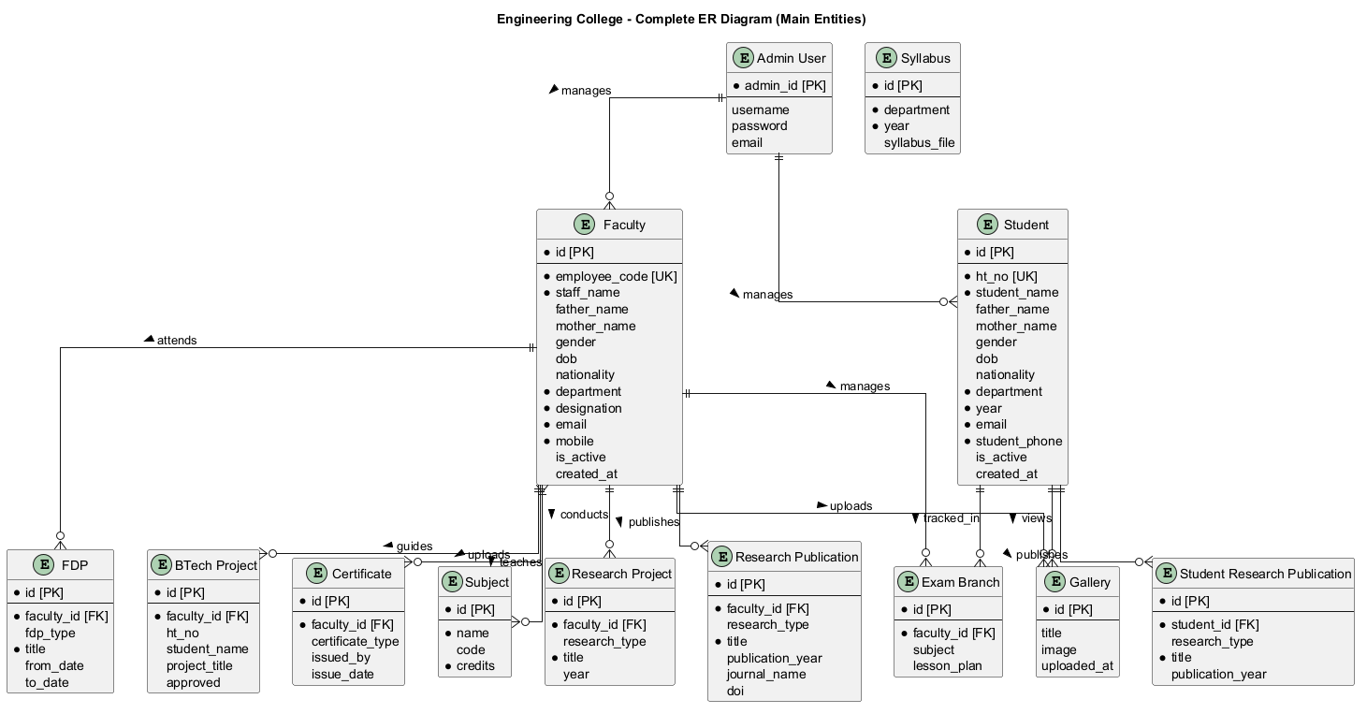
Database Design
Database Design
Main entities
Admin User manages faculty and student records
Faculty stores staff identity, department, designation, contact, active status, and related academic data
Student stores HT number, name, department, year, contact, active status, and academic data
Related tables cover certificates, research, FDP, BTech projects, subjects, syllabus, gallery, and exam branch
EngineeringCollege Department Management System
15

Slide 16
ER Diagram
ER Diagram
Complete entity relationship view
Primary keys identify all major records
Unique keys protect employee_code and ht_no
Foreign keys connect faculty/student records to certificates, research, projects, and exam branch data
Relationships support ownership-based dashboard filtering
EngineeringCollege Department Management System
16

Slide 17
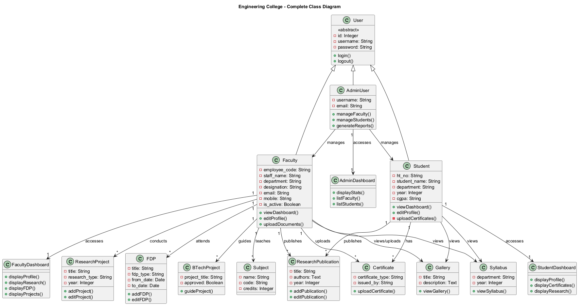
Class Diagram
Class Diagram
Object-oriented system view
User is represented as a common abstract concept for Admin, Faculty, and Student
Dashboard classes display role-specific data
Academic classes represent research, FDP, BTech projects, certificates, subjects, syllabus, and gallery
Associations show which role manages, uploads, views, or owns each record
EngineeringCollege Department Management System
17

Slide 18
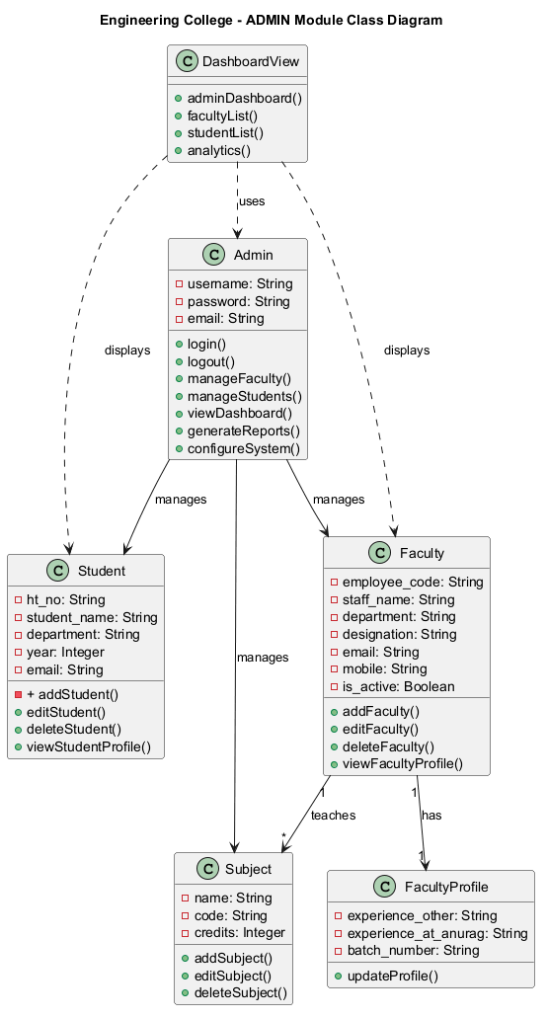
Admin Class View
Class Diagram
Admin responsibilities
Admin manages faculty records, student records, subjects, reports, and dashboard statistics
Admin dashboard lists records and summarizes system activity
Admin workflows support data maintenance and export/report preparation
EngineeringCollege Department Management System
18

Slide 19
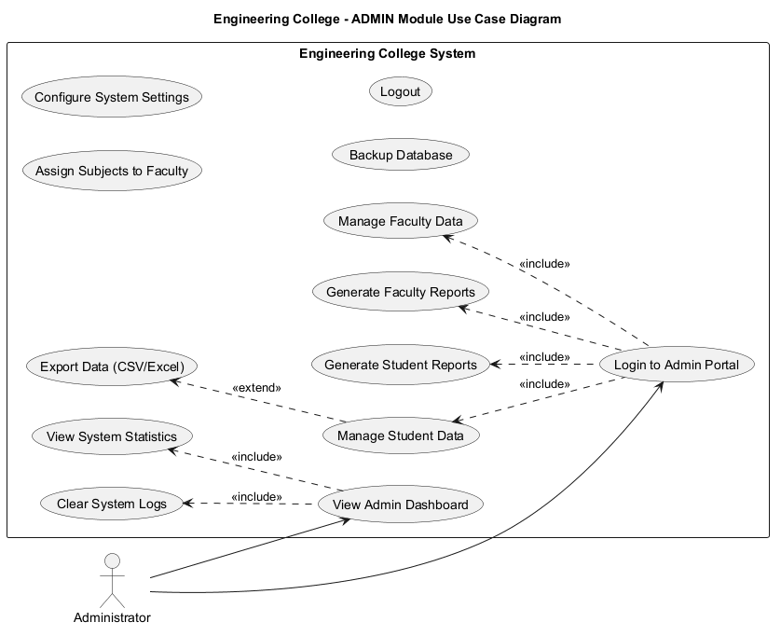
Use Case Diagram
Use Case Diagram
Role interactions
Admin logs in, views dashboard, manages faculty/students, assigns subjects, generates reports, exports data, and logs out
Student logs in, views profile, academic data, syllabus, gallery, certificates, publications, and profile PDF
Faculty logs in, manages profile, research, FDP, projects, certificates, exam branch, attendance, reports, and logout
EngineeringCollege Department Management System
19

Slide 20
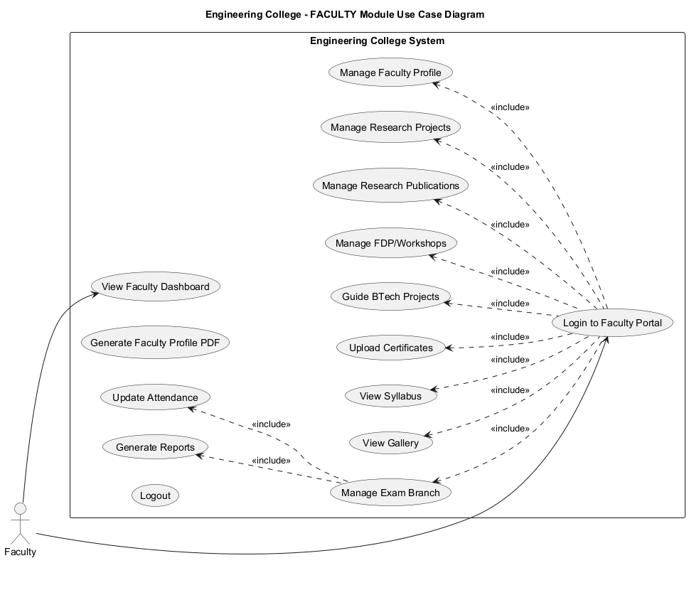
Student and Faculty Use Cases
Use Case Diagram
User-facing services
Student services focus on personal profile, certificates, research, syllabus, gallery, and PDF generation
Faculty services focus on academic contribution, teaching records, exam branch, certificates, and reports
Use cases validate that each role has a clear permission boundary
EngineeringCollege Department Management System
20

Slide 21
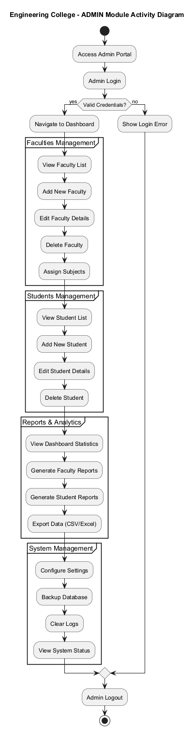
Activity Diagram
Activity Diagram
Workflow behavior
Login begins with input validation and user lookup
Valid users move into role dashboards and selected management actions
Invalid input returns controlled error messages
Logout clears the user session and returns to the login/public page
EngineeringCollege Department Management System
21

Slide 22
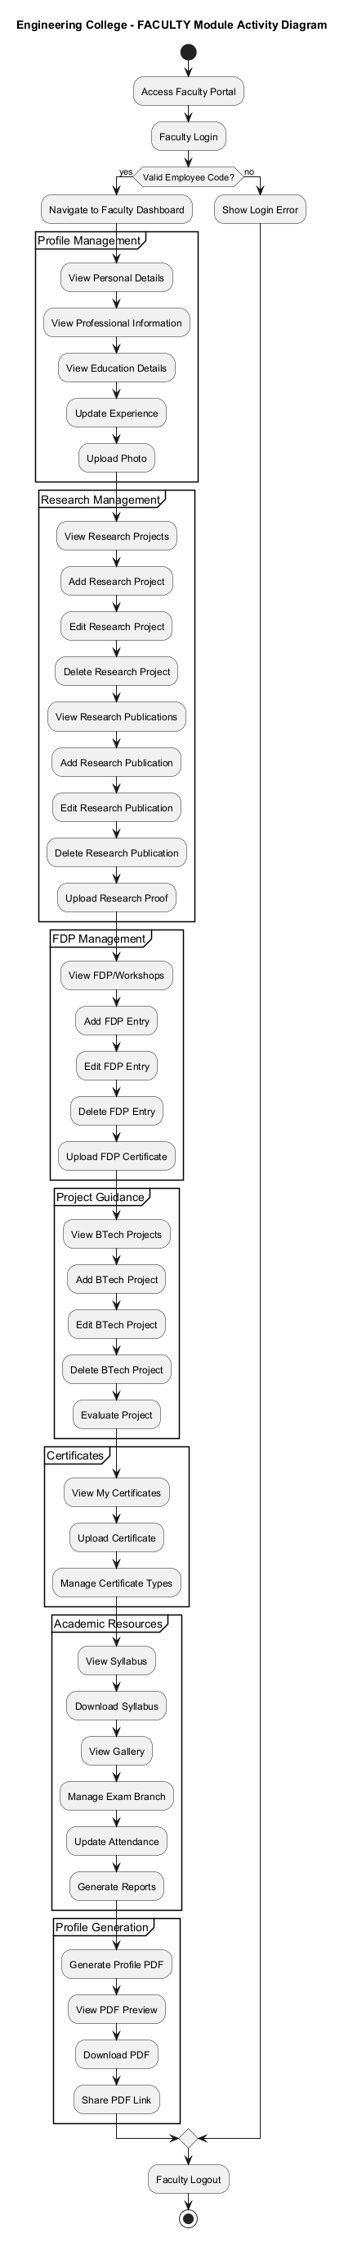
Faculty Activity Flow
Activity Diagram
Faculty module activities
Faculty logs in with employee code
Dashboard loads profile, research, FDP, BTech projects, certificates, syllabus, gallery, and exam branch
Faculty updates records and generates reports/PDF context
Session terminates on logout
EngineeringCollege Department Management System
22

Slide 23
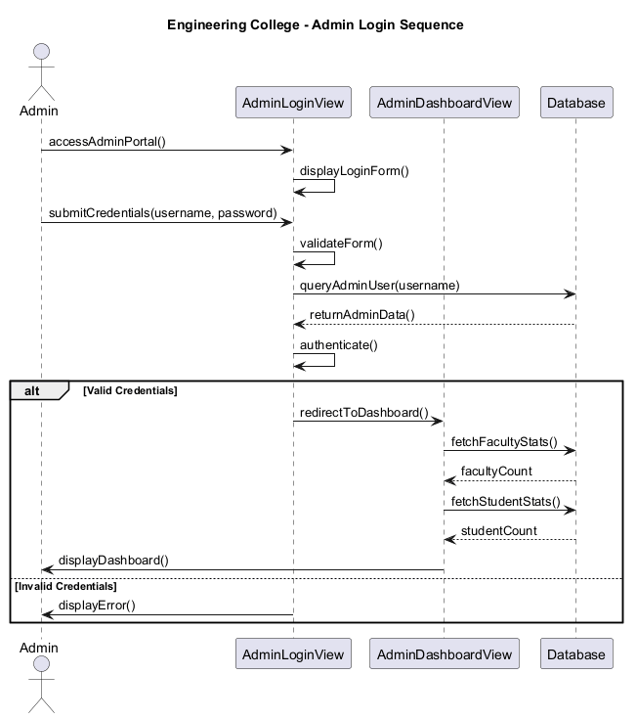
Sequence Diagram
Sequence Diagram
Login interaction flow
Actor opens portal and submits credentials or role identifier
View validates form input and queries database
Valid result creates session and redirects to dashboard
Dashboard fetches related records before rendering the page
EngineeringCollege Department Management System
23

Slide 24
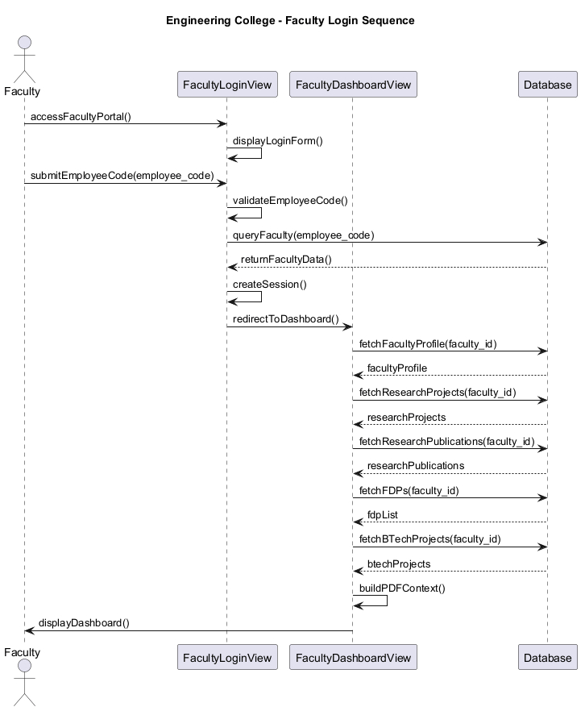
Faculty Sequence Flow
Sequence Diagram
Dashboard loading sequence
Faculty submits employee_code
System validates and fetches faculty profile
Dashboard loads research projects, publications, FDPs, and BTech projects
PDF context is built from the same related data
EngineeringCollege Department Management System
24

Slide 25
Component Diagram
Component Diagram
Logical components
Authentication component handles login, logout, sessions, and access checks
Dashboard component renders Admin, Faculty, and Student pages
Certificate/PDF component manages uploads and generated documents
Project Domain component handles project folders, downloads, QR receipt flow, and live demo video
EngineeringCollege Department Management System
25

Slide 26
Component Responsibilities
Component Diagram
Internal services
Database layer stores users, profiles, certificates, publications, payments, and project metadata
Static/media layer stores CSS, QR code, demo video, certificates, and generated files
Email/support layer sends receipt confirmation details to project support
Deployment layer uses Render build/start scripts and environment variables
EngineeringCollege Department Management System
26

Slide 27
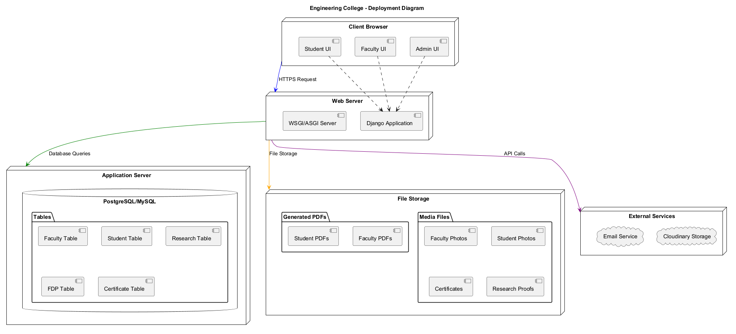
Deployment Diagram
Deployment Diagram
Production environment
User browser accesses the Render-hosted Django application
Gunicorn runs the Django WSGI app
Render PostgreSQL provides production database storage
Static/media assets are served through configured Django/static handling and Cloudinary when available
EngineeringCollege Department Management System
27

Slide 28
Deployment Workflow
Deployment
From GitHub to Render
Code is committed and pushed to GitHub
Render build script installs dependencies and collects static files
Database migrations run during build/start process
Application starts with Gunicorn and serves public project URLs
EngineeringCollege Department Management System
28

Slide 29
Testing and Validation
Testing
Testing types covered
Unit Testing validates forms, views, and isolated model behavior
Integration Testing checks login, dashboard, database, PDF, upload, and download interactions
Functional Testing validates user-facing workflows
Validation Testing checks required fields, formats, duplicates, file types, and date/year rules
EngineeringCollege Department Management System
29

Slide 30
Advanced Testing Coverage
Testing
System, UAT, black box, and white box
System Testing verifies end-to-end Admin, Faculty, Student, and deployment flows
User Acceptance Testing confirms workflows from real user roles
Black Box Testing validates visible inputs and outputs without code knowledge
White Box Testing covers sessions, branches, ownership queries, and database relationships
EngineeringCollege Department Management System
30

Slide 31
Validation Results
Testing
Checks performed
Django system checks completed without issues
Migrations verified with no pending model changes
UML diagrams rendered to PNG format
Test-case Word document created from UML flows
Demo video endpoint supports MP4 browser range playback
EngineeringCollege Department Management System
31

Slide 32
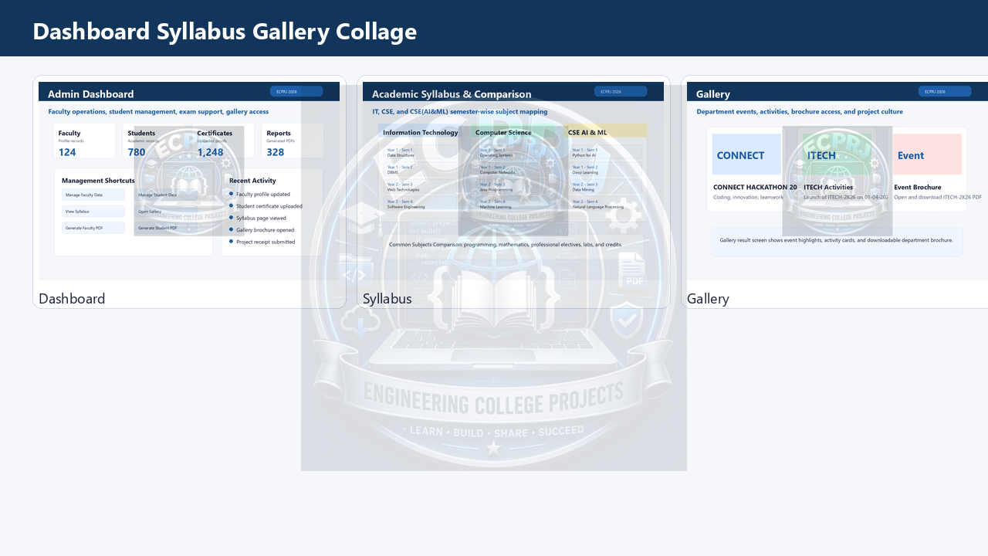
Results and Screenshots
Results
Project page result
EngineeringCollege project page displays project folder structure
Live Demo section plays the generated project demo video
Receipt form supports student name, email, phone, note, and PhonePe acknowledgement upload
Project folders list Source Code, Modules, Documentation, PPT, Video, Test Cases, UML Diagrams, and Databases
EngineeringCollege Department Management System
32

Slide 33
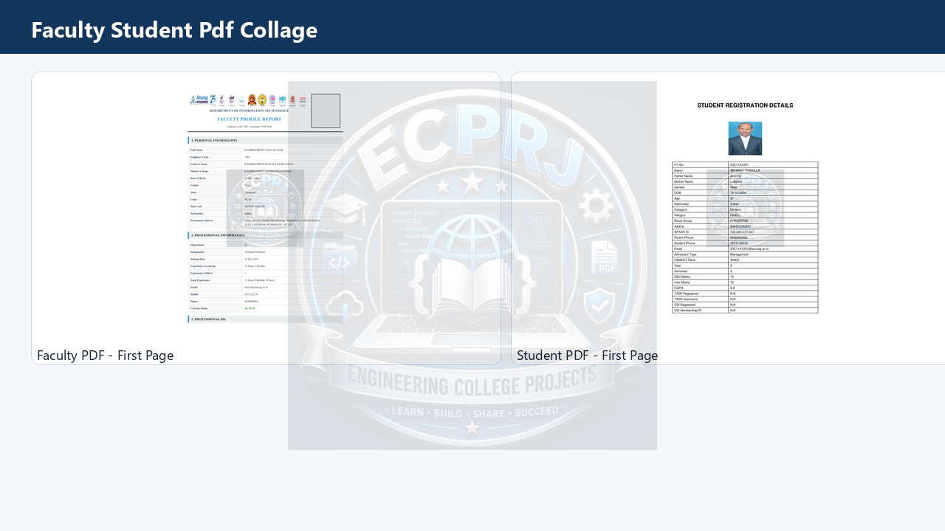
Results and Screenshots
Results
Dashboard and document outputs
Admin dashboard supports faculty/student management and reports
Faculty dashboard displays profile, research, FDP, projects, certificates, and PDF output
Student dashboard displays profile, certificates, research, and generated profile PDF
Static assets include QR code, UML PNGs, PowerPoint, test cases, and demo video
EngineeringCollege Department Management System
33

Slide 34
Advantages
Advantages
Benefits of the proposed system
Centralized academic data management
Role-based workflows for Admin, Faculty, and Student users
Reduced manual effort through PDF generation and structured forms
Organized project submission package with UML, testing, documentation, PPT, and video
Cloud-ready deployment workflow
EngineeringCollege Department Management System
34

Slide 35
Additional Advantages
Advantages
Operational improvements
Improves data consistency and retrieval
Supports project showcase and controlled project folder delivery
Provides reusable local execution steps for students
Improves presentation readiness through diagrams, test cases, and live demo assets
EngineeringCollege Department Management System
35

Slide 36
Limitations
Limitations
Current constraints
Some workflows depend on correct environment variables and deployment configuration
Cloudinary and PostgreSQL require valid production credentials
Receipt-based project delivery still needs manual admin verification
Further role-level permission hardening can improve access control
Large media files may require external storage for long-term scalability
EngineeringCollege Department Management System
36

Slide 37
Future Scope
Future Scope
Possible enhancements
Add stronger role-based permission groups and audit logs
Provide REST API endpoints for mobile apps
Add analytics dashboards and automated reports
Automate payment verification and project delivery status
Improve notification workflow through email/SMS/WhatsApp integration
EngineeringCollege Department Management System
37

Slide 38
Future Technical Scope
Future Scope
Engineering improvements
Add CI checks for migrations, tests, static assets, and PDF generation
Add automated screenshot testing for key dashboards
Move larger videos/media to Cloudinary or object storage
Expand project-domain system for more departments and domains
Improve accessibility and responsive UI coverage
EngineeringCollege Department Management System
38

Slide 39
Conclusion
Conclusion
Project summary
EngineeringCollege is a complete Django-based department management system
It digitizes academic records, certificates, PDFs, project pages, receipt workflow, and deployment
The project includes implementation, UML diagrams, test cases, PPT, documentation, database notes, and demo video
The system is suitable for academic submission, local execution, and cloud deployment
EngineeringCollege Department Management System
39

