Slide 1


Home Credit Risk Analysis
by Chaitanya Madduri,
Diego Zucchino,
Kartik Vijay

Slide 2
Agenda
1. Business Case Introduction
3. Data Interpretation and Pattern Findings
4. Applied Machine Learning Models
5. Conclusion
6. Next Steps
2. Data Transformation
7. Q&A Feedback

Slide 3

Business Case Introduction
Home Credit B.v
Objective: Provide safe and positive borrowing experience
Dilemma: Clients have little to none previous credit history

Slide 4
Motivation
Status Quo
Process
Goal
Already existing statistical methods aiming to predict defaulters.
Exploratory Data Analysis into previous client's information.
Detecting the most important features from possible loan takers.

Slide 5

2. Data Transformation

Slide 6
Raw Table Scheme
User Application Data (307.511, 22)
Bureau Information (1.716.428, 22)
Previous Application Data (1.670.214, 37)
32.000.000 data entries.
User POS Cash (10.001.358, 8)
User Credit Card Balance (3.840.312, 23)
User Installments Payments (13.605.401, 8)

Slide 7
Analysis on Credit Card balance
Description:
Description: Summary of monthly balance snapshots of previous credit cards that the applicant has with Home Credit.
Missing values were filled with 0 as default.
Multiple columns being count related are summed up to one column.
Highly correlated columns were dropped.

Slide 8
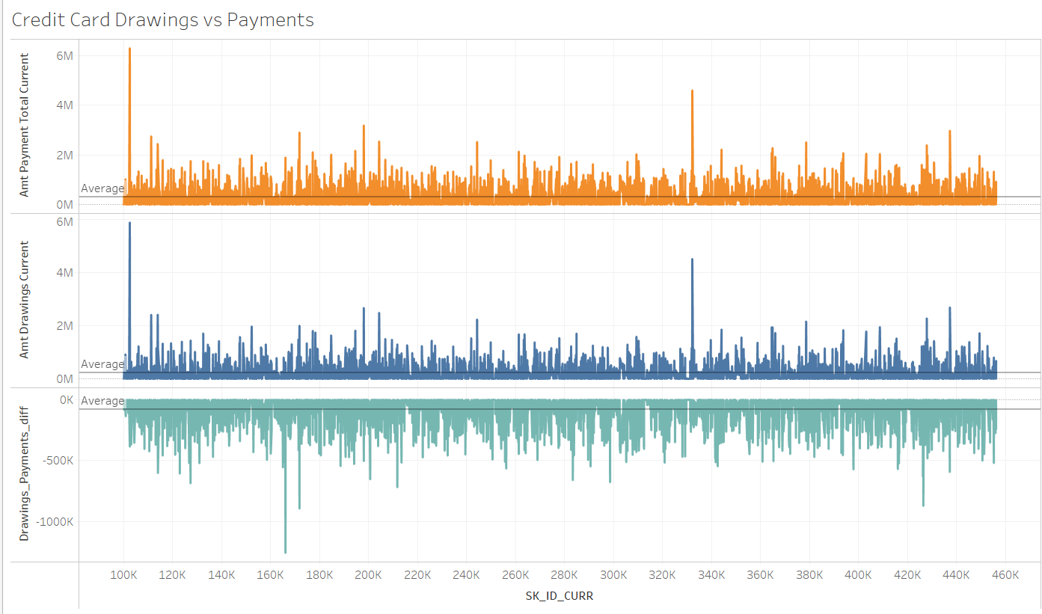
Analysis on Credit Card balance
Average Drawings 3.00.055,00
Average Payments 2.19.482,00
Average Difference -80.573,00

Slide 9
Analysis on Previous Application
Description:
Description: Summary of all previous applications for loans from current Home Credit Clients
Few date columns have a max value of 356.243 which is a default value. These values are replaced with zero as we .
Columns with values Yes & No (or similar) were replaced by 1 or 0 respectively.
One hot encoding was applied to categorical variables for conversion into a form that can be provided to ML algorithms to do a better job in prediction.

Slide 10
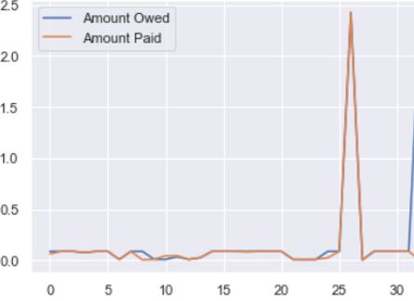
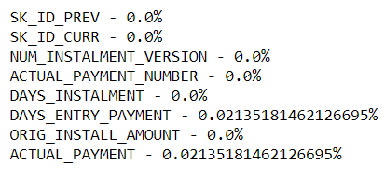
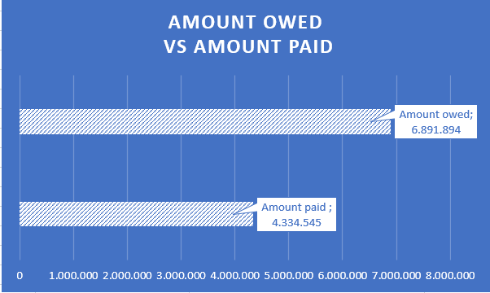
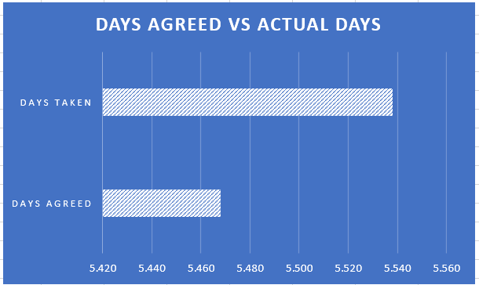
Installment Payments & Cash Balance
The devil is in the details
Credit History
Client’s ID: 111148
Client 111148 – Credit History
Installment Amount
Missing Data
Installment Number
15,17 Years
14.98 Years

Slide 11
Analysis on Bureau Data
Description: All clients previous credits provided by other financial institutions that were reported to Credit Bureau
For every loan in our sample, there are as many rows as number of credits the client had in Credit Bureau before the application date
Missing value treatment for columns – ‘AMT_ANNUITY’ and ‘AMT_CREDIT_MAX_OVERDUE’
Variable reduction for columns – CREDIT_ACTIVE and CREDIT_TYPE

Slide 12
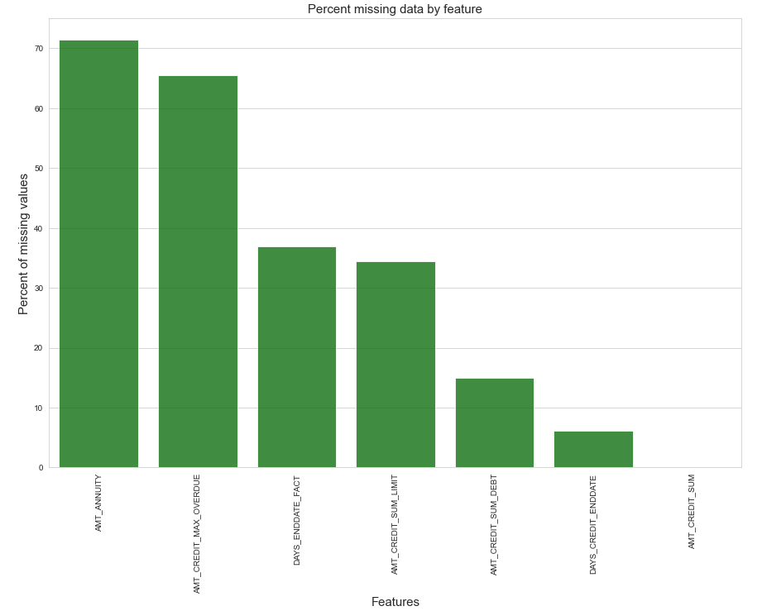
Bureau Data Transformation
Column: CREDIT_ACTIVE
Variables | %
Closed | 63%
Active | 37%
Sold | 0.380%
Bad debt | 0.001%
Column: CREDIT_ACTIVE
Variables | %
Closed | 63%
Active | 37%
Sold_Bad_debt | 0.382%

Slide 13
Processed Table Scheme
Master Table (307.511, 251)
User Application Data (307.511, 251)
Bureau Information (305.811, 17)
Previous Application Data (307.511, 123)
User POS Cash (337.252, 7)
User Credit Card Balance (103.558, 23)
User Installment Payments (339.587, 8)
After data cleaning and extraction, the volume of the raw data was reduced by almost 6 times.

Slide 14
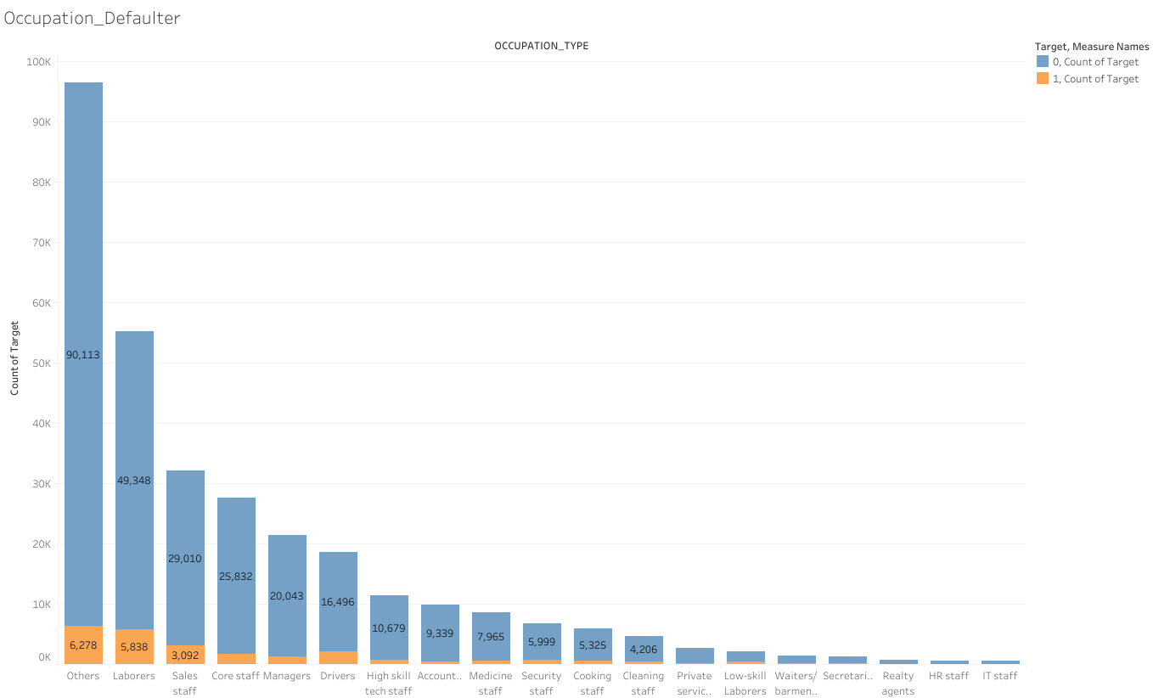
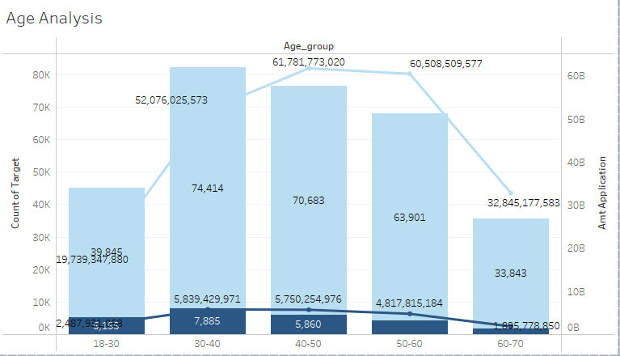
3. Data Interpretation and Pattern Findings
Amongst all occupations, laborers and “others”, accounted for the most loan applications and most defaulters.
While the 40-50 age group has applied for the highest amount of loans, the 30-40 age group has the highest number of defaulters.
Link:https://public.tableau.com/app/profile/mvs.chaitanya/viz/CreditRiskAnalysis_16362852398140/Analysis_2#1

Slide 15
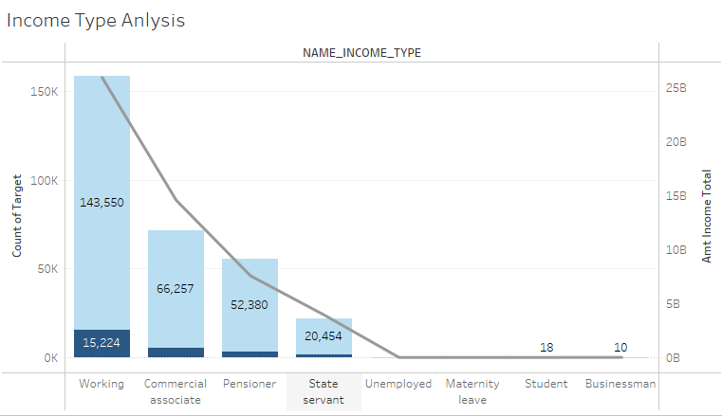
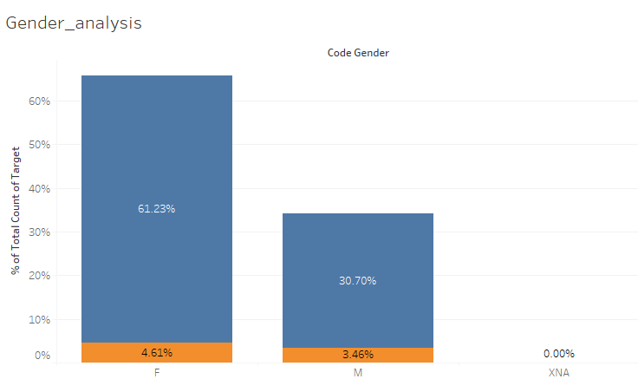
3. Data Interpretation and Pattern Findings
Having a stable jobs doesn't necessarily result in fewer defaulters.
The proportion of women is much higher compared to the Men's proportion. Though the defaulter percentage is not much different.
Link:https://public.tableau.com/app/profile/mvs.chaitanya/viz/CreditRiskAnalysis_16362852398140/Analysis_2#1

Slide 16
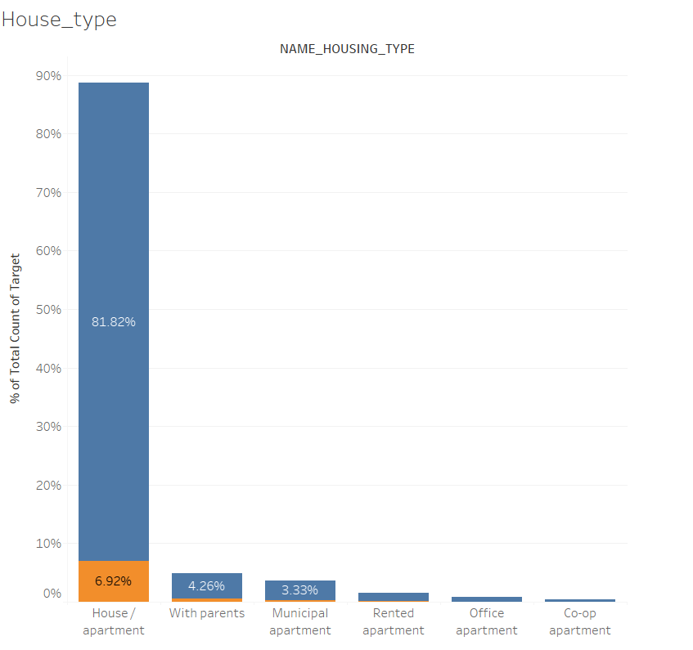
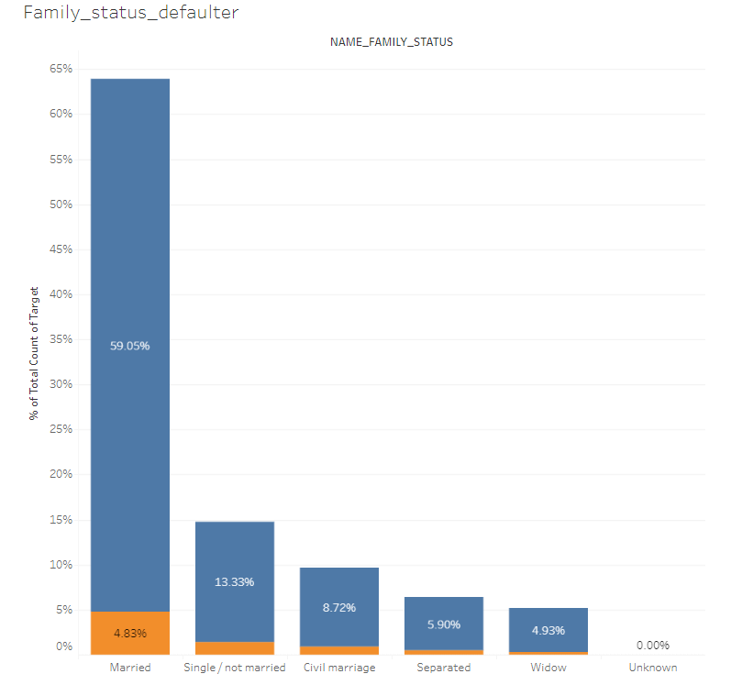
3. Data Interpretation and Pattern Findings
Most of the applications own a or House/Apartment.
1.45%
In absolute numbers the majority of defaulters are married.
Link:https://public.tableau.com/app/profile/mvs.chaitanya/viz/CreditRiskAnalysis_16362852398140/Analysis_2#1

Slide 17
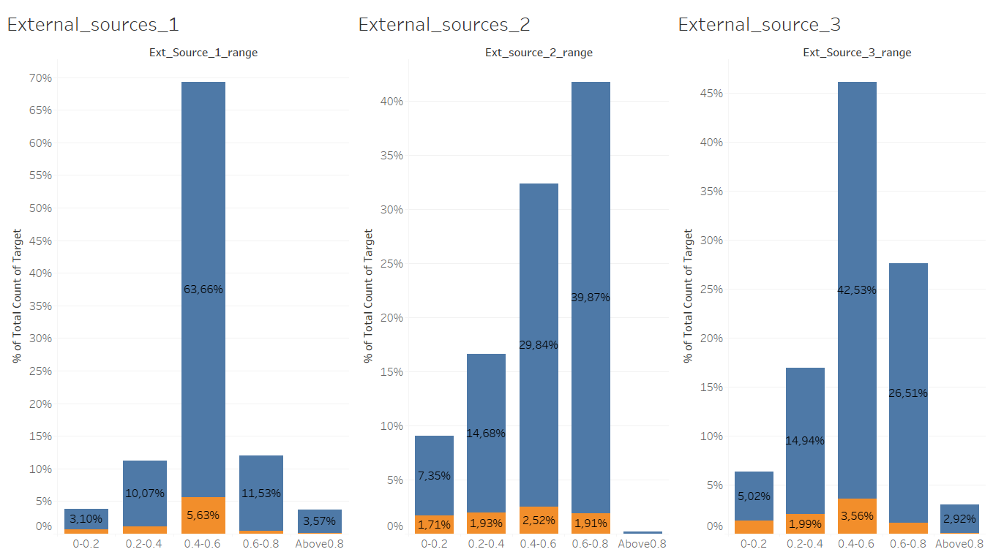
3. Data Interpretation and Pattern Findings
Assumptions:
If the external credit score is greater than 0.8, then the are low chances of default payments.
After the analysis external Source 1 is more reliable.
External sources scores cannot be used as sole criteria for defaulter estimation.
Link:https://public.tableau.com/app/profile/mvs.chaitanya/viz/CreditRiskAnalysis_16362852398140/Analysis_2#1

Slide 18
4. Applied Machine Learning Model
Created a Train and Test Data with 80-20 Split
Smote model is applied to handle the class imbalance. The minority class i.e the defaulter is increased by 300%.
Random Forest Algorithm is used for the model building.

Slide 19
Metrics
Accuracy = 0.91920
Precision = 0.34000
Recall = 0.00013
F1 Score = 0.00026

Slide 20
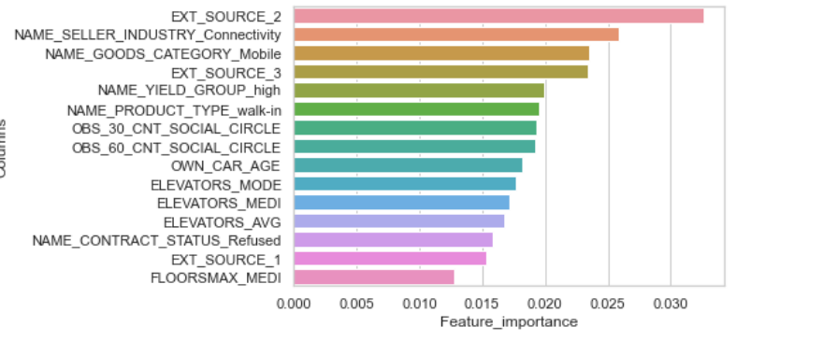
Features Importance based on ML Model

Slide 21
Top 20 Features
User Application Data
(13)
Bureau Information (0)
Previous Application Data (7)
User POS Cash
(0)
User Credit Card Balance
(0)
User Installments Payments
(0)
The model is unable to extract key insights from the all the additional data.
The similar pattern is observed for top 50 as well.

Slide 22
4. Applied Machine Learning Model - 2
Selected all the User IDs who has all details in all the tables
Created a Train and Test Data with 80-20 Split
Smote model is applied to handle the class imbalance. The minority class i.e the defaulter is increased by 300%.
Random Forest Algorithm is used for the model building.
Non defaulter: 66.695
Defaulter: 6.098

Slide 23
Metrics
Accuracy = 0.91920 -> 0.916
Recall = 0.00013 -> 0.00273
F1 Score = 0.00026 -> 0.00544
Precision = 0.34000 ->0.625

Slide 24
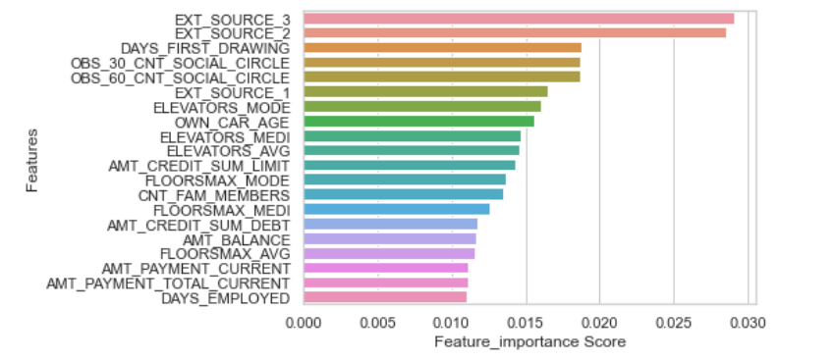
Features Importance based on ML Model-2

Slide 25
Top 20 Features model-2
User Application Data
(12)
Bureau Information (2)
Previous Application Data (2)
User POS Cash
(2)
User Credit Card Balance
(1)
User Installments Payments
(1)
The model 2 is to extract key insights from the all the additional data provided.
The similar pattern is observed for top 50 as well.

Slide 26
5. Conclusion
Single data details cannot infer over default or no default.
External credit scores play vital roles in the defaulter analysis, but it always good to consider the user transaction history.
Additional user details add value in better understanding the chances of default.
Machine Learning Models can be optimized if we can provide the user personal details and transaction histories.

Slide 27

Next Steps
User transaction anomalies vs default rate.
Advanced ML algorithms for model development.

Slide 28

6. Q&A

Slide 29
Appendix
https://public.tableau.com/app/profile/mvs.chaitanya/viz/CreditRiskAnalysis_16362852398140/External_sources_1
https://www.kaggle.com/c/home-credit-default-risk
https://www.homecredit.net/about-us.aspx
Github:: https://github.com/Chaitanya2593/home_credit_risk_analysis

Slide 30
Thank You

