Slide 1

Channel Estimation using PARAFAC and Sum-Rate Maximization for STAR-RIS
Vinay Kusumanchi (IMT2023608)
Rajdeep Alapati (IMT2023592)

Slide 2
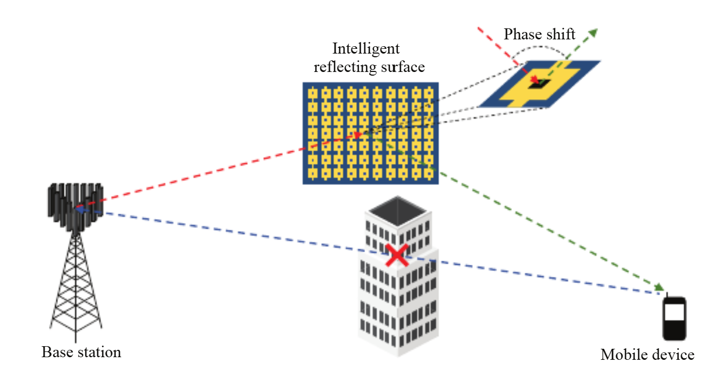
Why RIS?
6G and beyond demand for spectrum efficiency & energy efficiency
Traditional solutions: Large antenna arrays at BS → costly, high power consumption. Limited coverage in blocked areas.
Reconfigurable Intelligent Surfaces (RIS): Low-cost meta-surfaces with passive elements. Shape the wireless channel itself (not just adapt to it). Reduces coverage holes and improves spectral efficiency

Slide 3
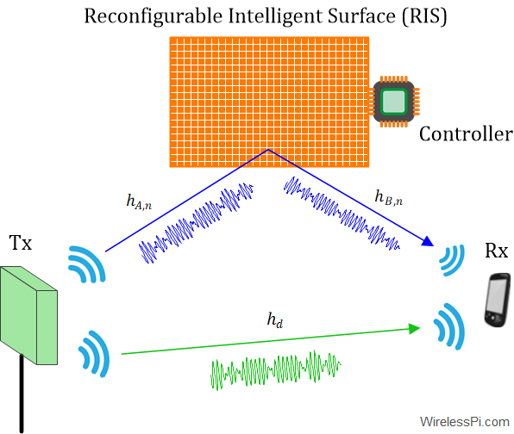
What is RIS?
A 2D metasurface made of many programmable passive elements.
Each element applies a controllable phase shift to the incident wave.
Works as a passive reflector.
No RF chains, no mixers, no ADCs → extremely low-cost & low-power.
Can redirect signals toward desired users by controlling phases.
Improves SNR, coverage, and spectral efficiency.
Channel estimation is challenging because RIS is passive (no receive chain)

Slide 4
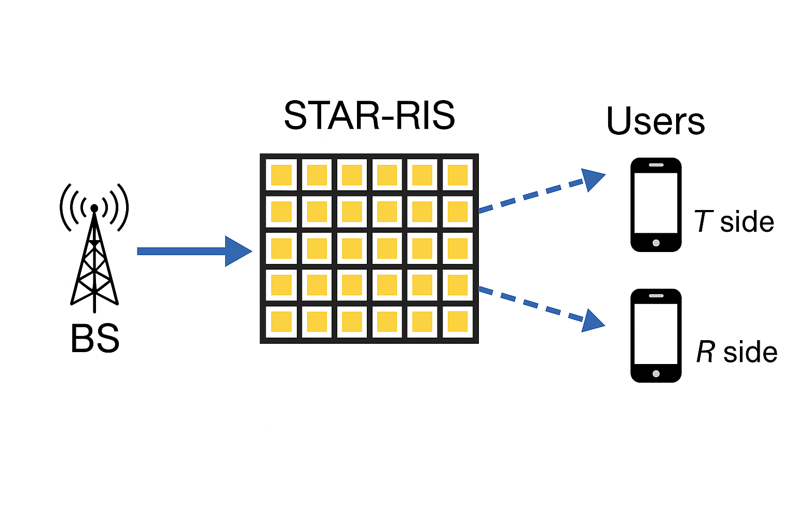
What is STAR-RIS?
STAR-RIS (Simultaneous Transmission And Reflection RIS)
Upgraded version of RIS that can transmit and reflect signals at the same time.
Supports users on both sides of the panel (front & back).
Enables full-space coverage (360°).
Each element intelligently controls how much signal goes through (transmission) or bounces back (reflection).
Why it matters: Traditional RIS → only reflects → cannot help users behind the panel. STAR-RIS → solves this limitation → improves coverage & throughput.

Slide 5
System Model for STAR-RIS Assisted mmWave Communication
Consider a Base Station with M antennas assisting K users via a STAR-RIS with N elements.
Users are divided into: Transmission users (Kt), Reflection users (Kr)
STAR-RIS simultaneously: Reflects towards one side and transmits towards the opposite side
All users communicate with the BS only through STAR-RIS (direct link blocked).
G ∈ ℂ^{M×N} = BS → STAR-RIS channel hᵗₖ, hʳₖ ∈ ℂ^{N×1} = STAR-RIS → user channels

Slide 6


Transmission and Reflection Coefficients
Each RIS element has two adjustable coefficients:
Transmission:
Reflection:
Energy conservation constraint:
Common setting used in paper (equal splitting):
STAR-RIS can direct signals toward both sides of the surface by tuning phases and amplitudes.
Phases 𝜃𝑡,𝜃𝑟​ determine the beam directions for transmission & reflection.
Amplitudes 𝛽𝑡,𝛽𝑟​ determine how much energy goes to each side.

Slide 7


Saleh–Valenzuela mmWave Channel Model
mmWave channels modeled as sparse multipath (LoS + few NLoS paths).
BS → RIS channel:
RIS → User channels:
Steering vectors correspond to RIS UPA and BS ULA
Steering vectors specify how signals arrive/depart based on angle of arrival (AoA) and angle of departure (AoD).
Key properties:
Sparse
Low-rank
Highly directional
→ exploited later in estimation.

Slide 8
Received Signal Model (Pilots + STAR-RIS Phases)
During pilot transmission, the BS receives signals through the STAR-RIS only (direct path blocked).
Received signal at time slot i:
Components:
G ∈ C^{M×N}: BS → STAR-RIS channel
𝐻𝑟, 𝐻𝑡 ∈ 𝐶^{𝑁×𝐾}: RIS → users (Reflection / Transmission)
𝛩𝑟(𝑖), 𝛩𝑡(𝑖): RIS reflection & transmission phase matrices at slot i
𝑠𝑟(𝑖), 𝑠𝑡(𝑖): pilot symbols
𝑛(𝑖) ∼ 𝐶𝑁(0, (𝜎^2)𝐼): noise
Key idea: RIS phases Θ𝑡(𝑖), Θ𝑟(𝑖) are changed every pilot slot introduces diversity needed for PARAFAC.
Goal: Collect received pilot signals to form a 3D tensor, enabling joint estimation of 𝐺, 𝐻𝑟​, and 𝐻𝑡​.

Slide 9

Why PARAFAC?
The received pilots naturally form a 3-way tensor (BS antennas × pilot symbols × RIS phase patterns).
The three unknown channels G, Hr, Ht appear as three tensor factors.
RIS phase changes across pilot slots create a trilinear model:
PARAFAC/CP decomposition is built exactly for such trilinear tensors.
Identifiability: PARAFAC guarantees unique recovery of 𝐺,𝐻𝑟,𝐻𝑡 under mild conditions unlike matrix LS/MMSE.
Pilot-efficient: Needs far fewer pilots since it uses the tensor structure.
Joint estimation: Estimates all channels simultaneously (BS → RIS and RIS → Users).
Structure-exploiting: Works because RIS phases create rank-1 components in each mode.

Slide 10
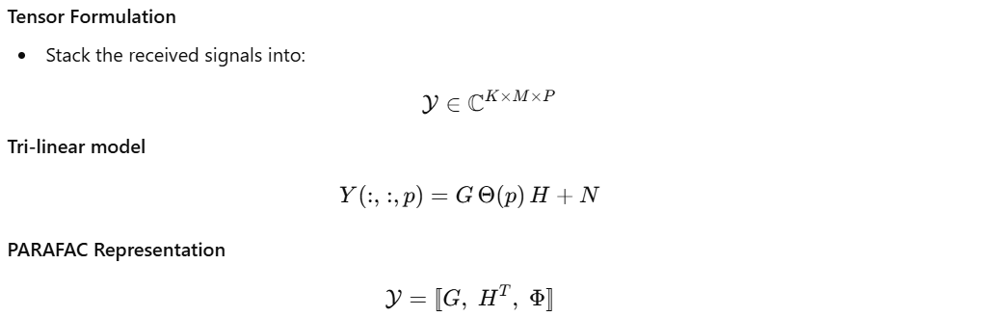
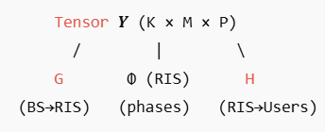
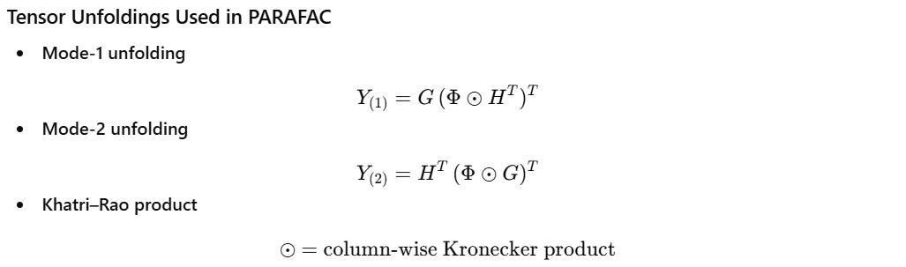
PARAFAC Tensor Model

Slide 11



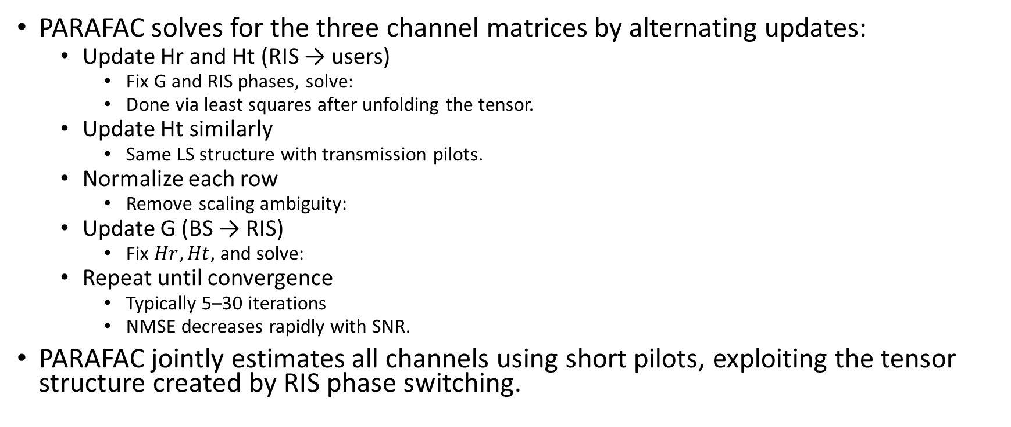
PARAFAC Algorithm (ALS Updates)
PARAFAC solves for the three channel matrices by alternating updates:
Update Hr and Ht (RIS → users)
Fix G and RIS phases, solve:
Done via least squares after unfolding the tensor.
Update Ht similarly
Same LS structure with transmission pilots.
Normalize each row
Remove scaling ambiguity:
Update G (BS → RIS)
Fix $Hr,Ht$, and solve:
Repeat until convergence
Typically 5–30 iterations
NMSE decreases rapidly with SNR.
PARAFAC jointly estimates all channels using short pilots, exploiting the tensor structure created by RIS phase switching.

Slide 12
PARAFAC Simulation Setup
Parameters used in simulation:
BS antennas: K = 16
RIS elements: N = 16
Reflection users: M = 6
Transmission users: M₁ = 6
Pilots per user: T = 30
RIS phase patterns (slots): P = 16
Training procedure:
Users transmit pilots
RIS phases change every slot
Received signals form a K × T × P tensor
PARAFAC decomposes tensor to estimate:
G (BS→RIS)
Hr (RIS → Reflection users)
Ht (RIS → Transmission users)
Baselines compared:
PARAFAC (our method)
Oracle LS → Least squares using true channels (ideal but unrealistic baseline)

Slide 13
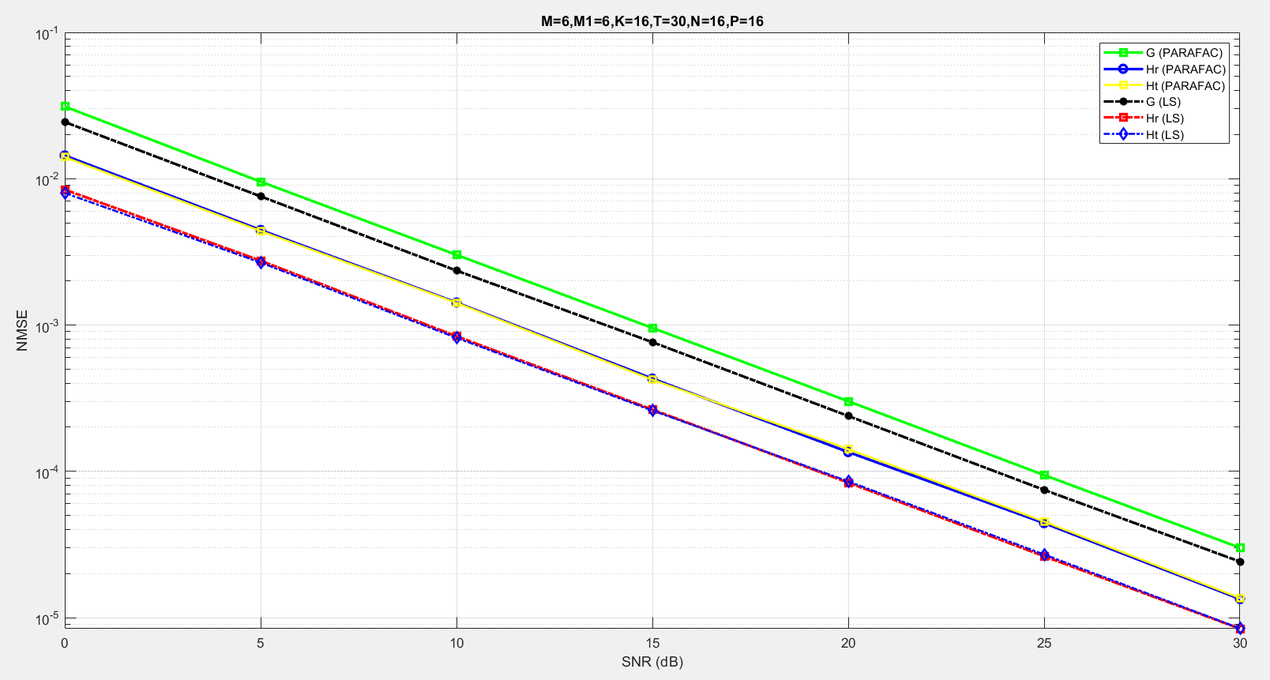
PARAFAC Channel Estimation Results (NMSE vs SNR)
Observations:
PARAFAC NMSE decreases significantly with SNR
Oracle LS slightly better (as it knows true channels)
Hr and Ht have lower NMSE since RIS-user links have fewer unknowns
G (BS→RIS) has slightly higher NMSE because it has larger dimension (16×16) and more multipath uncertainty
PARAFAC successfully recovers all channels using short pilots and no LS overhead

Slide 14
Why Optimization After PARAFAC?
PARAFAC only gives channel estimates (G, Hr, Ht)
But STAR-RIS has:
Amplitude coupling: βₜ,n² + βᵣ,n² = 1
Phase coupling: cos(φₜ,n − φᵣ,n) = 0 ⇒ |φₜ − φᵣ| = π/2 or 3π/2
This makes STAR-RIS design a non-convex optimization problem
Need to jointly optimize:
BS beamforming (W)
STAR-RIS transmission coefficients (θₜ)
STAR-RIS reflection coefficients (θᵣ)
Notes:
BS beamforming matrix $W$controls how the base station weights and combines its antennas to transmit data streams toward users, and it is optimized jointly with STAR-RIS coefficients to maximize the system sum-rate.

Slide 15
General Optimization Framework for STAR-RIS (PDD + BCD)
Original problem has non-convex constraints due to coupling.
Convert to Augmented Lagrangian form.
Apply alternating updates:
Update beamforming + phases + amplitudes
Update auxiliary variables
Update penalty and Lagrange multipliers
PDD introduces:
θ̃ₜ, θ̃ᵣ : auxiliary variables (decouple constraints)
λₜ, λᵣ : Lagrange multipliers (dual variables)
ρ : penalty factor (controls constraint enforcement)
Proved to converge to KKT optimal solution under mild conditions.
(KKT optimal solution -> mathematically guaranteed best feasible solution for non-convex problems.)

Slide 16

Throughput Maximization Problem
Objective:
​Constraints:
BS transmit power
STAR-RIS amplitude coupling: βₜ,n² + βᵣ,n² = 1
STAR-RIS phase coupling: cos(φₜ,n − φᵣ,n) = 0
Solved using:
WMMSE transformation → block-wise convex
PDD (Penalty Dual Decomposition) → handles equality constraints
BCD (Block Coordinate Descent) → solves each block efficiently

Slide 17
Combined Workflow: PARAFAC + PDD
Step 1: Use PARAFAC to estimate (G, Hr, Ht)
Step 2: Convert PARAFAC outputs into PDD-compatible format
G_pdd = Gᵀ
h_pdd = [Hr_final, Ht_final]
Step 3: Initialize PDD using para_init()
Step 4: Solve:
BS beamforming vector W
STAR-RIS amplitudes βₜ, βᵣ
STAR-RIS phases φₜ, φᵣ
Step 5: Obtain:
Optimal W
Optimal θₜ, θᵣ
Convergence curves
Final sum rate

Slide 18
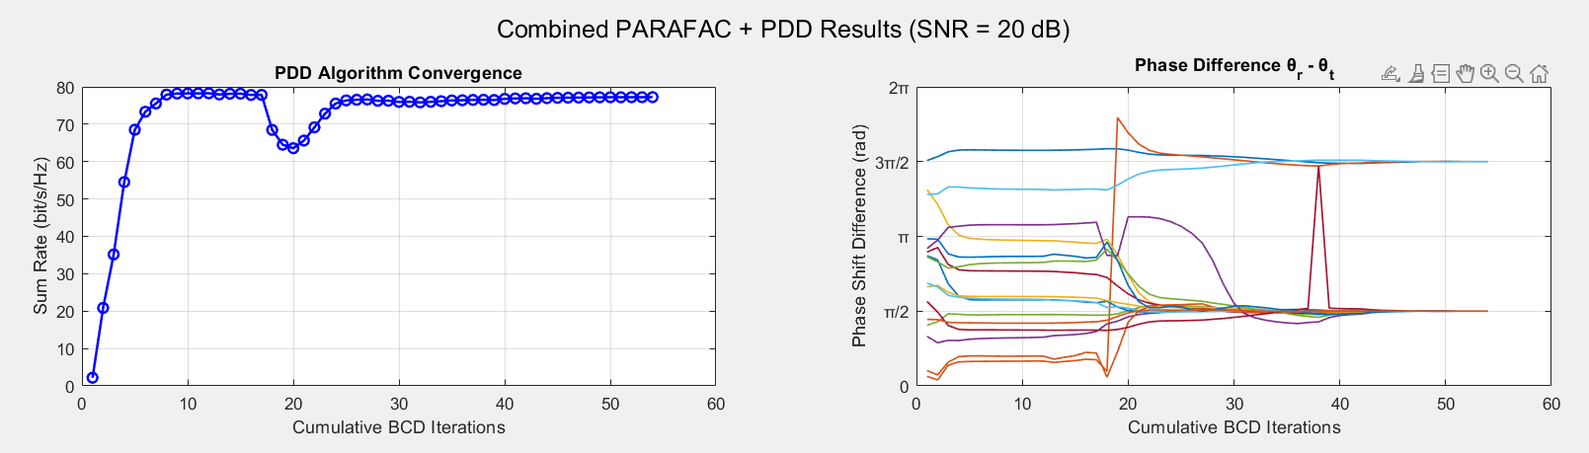
PDD Optimization Results: SNR = 20 dB
PDD algorithm steadily increases the sum-rate and converges near 77bit/s/Hz.
Small dip around iteration ~18 occurs due to penalty-factor update in PDD.
Phase difference curves stabilize, confirming STAR-RIS coupling constraints are satisfied.
Shows that PARAFAC-estimated channels are successfully used for sum-rate maximization.

Slide 19
Final Observations & Key Takeaways
PARAFAC-Based Channel Estimation
Successfully estimates all three channels (G, Hr, Ht) using short pilots.
Achieves low NMSE, close to oracle LS performance.
Exploits the tensor structure created by STAR-RIS phase switching.
PDD + BCD Sum-Rate Optimization
Rapid convergence to ~80 bit/s/Hz at SNR = 20 dB.
Handles coupled transmission–reflection constraints of STAR-RIS.
Beamforming matrix W, amplitudes βₜ/βᵣ, and phases θₜ/θᵣ all converge smoothly.
Overall Workflow Achieved
Channel Estimation (PARAFAC) → Channel Optimization (PDD) → Max Sum-Rate
Shows compatibility between the two papers and correctness of implementation.

Slide 20
References
M. Di Renzo et al., “Reconfigurable Intelligent Surfaces: Fundamentals, Solutions, and Opportunities,” arXiv, 2020.
Z. Wan, Z. Gao, F. Gao, M. D. Renzo, and M. Alouini, “Channel Estimation for RIS-Assisted Wireless Communications: Part I — Fundamentals, Solutions, and Future Opportunities,” IEEE Communications Letters, 2021.
H. Zhang et al., “Channel Estimation for STAR-RIS Assisted Multi-User Communications,” IEEE Transactions on Wireless Communications, 2022.
A. Pal, V. Yajnanarayana, and K. V. S. Hari, “Power Allocation for STAR-RIS Assisted C-V2X Systems with Discrete Phase Shifts,” IEEE VTC, 2023.
T. Hou, Y. Liu, Z. Song, X. Sun, and Y. Chen, “Coupled Phase-Shift STAR-RISs: A General Optimization Framework,” IEEE Transactions on Wireless Communications, 2023.

