Slide 1
Non-Terrestrial Networks (in 6G)
Vinay Kusumanchi IMT2023608

Slide 2
What are NTNs?
Definition: Networks that use space-based or aerial platforms instead of (or along with) traditional ground-based cell towers.
Operate above 8 km altitude up to geostationary orbit (~36,000 km)
Supported in 3GPP Release 17 → integrated into 5G/6G
Goal: Provide connectivity anywhere (oceans, mountains, rural areas, and disaster zones) where terrestrial networks can’t reach

Slide 3
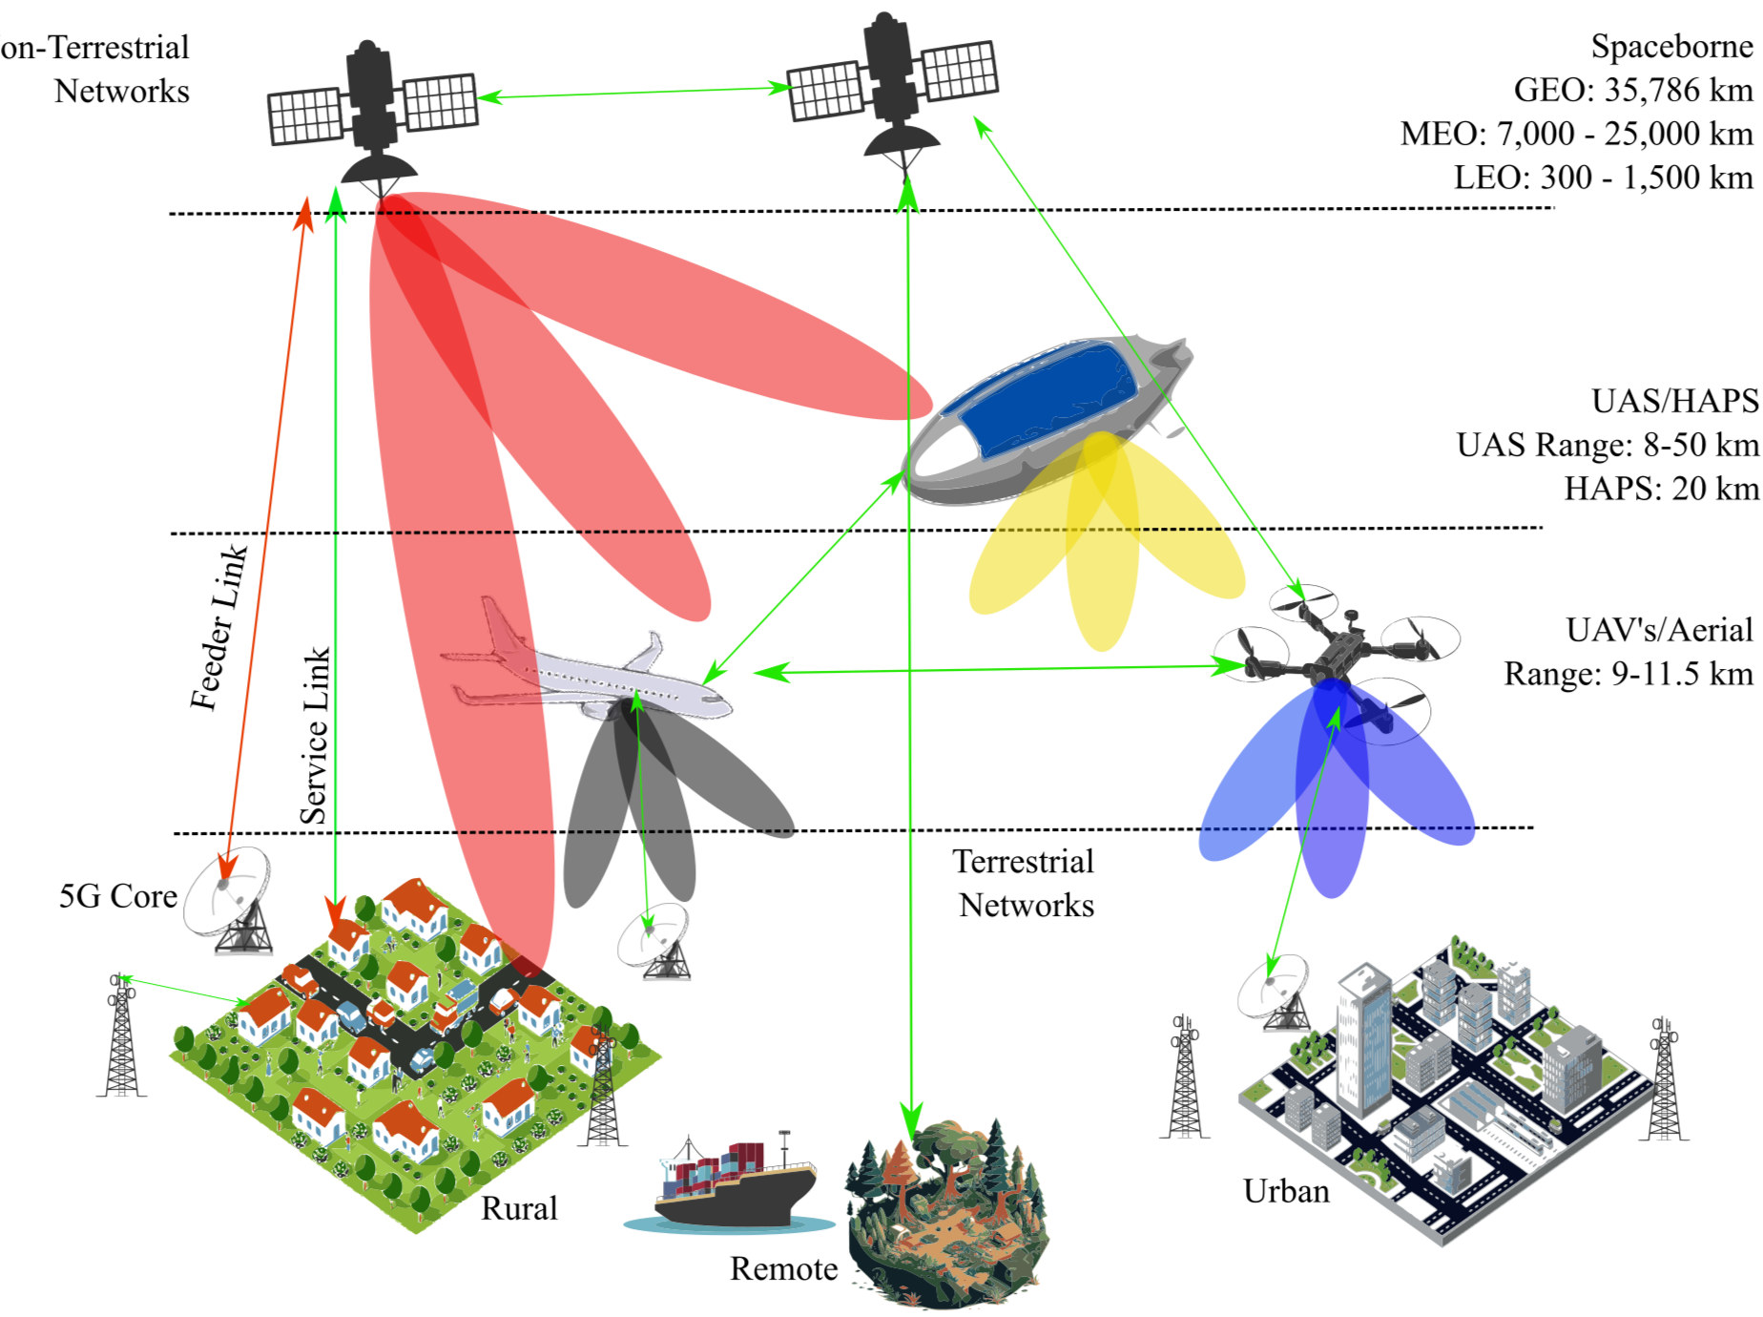
Why NTNs?
Global Coverage - Reach 100% of the population, including remote, rural areas, oceans, disaster zones
Terrestrial networks (5G towers) → limited reach, costly to expand globally
Disaster Recovery: Provide connectivity when ground towers are down
Maritime & Aviation Connectivity: Internet on ships and airplanes
Military & Emergency Comms: Secure, independent communication lines

Slide 4
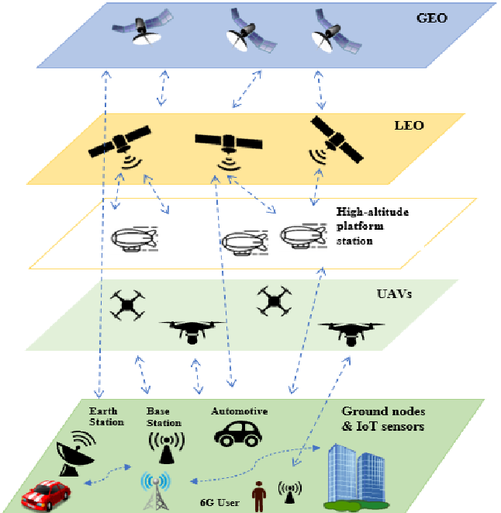
NTN Platforms
1. Satellites
GEO (Geostationary Earth Orbit, 35800km altitude) - Fixed satellites with large coverage area High latency
MEO (Medium Earth Orbit, 2,000-35,000km altitude) - Lower latency than GEO
LEO (Low Earth Orbit, 200-2,000 km altitude) - Low latency and high speed Needs many satellites in a constellation for full coverage Examples: Starlink, OneWeb, Amazon Kuiper

Slide 5
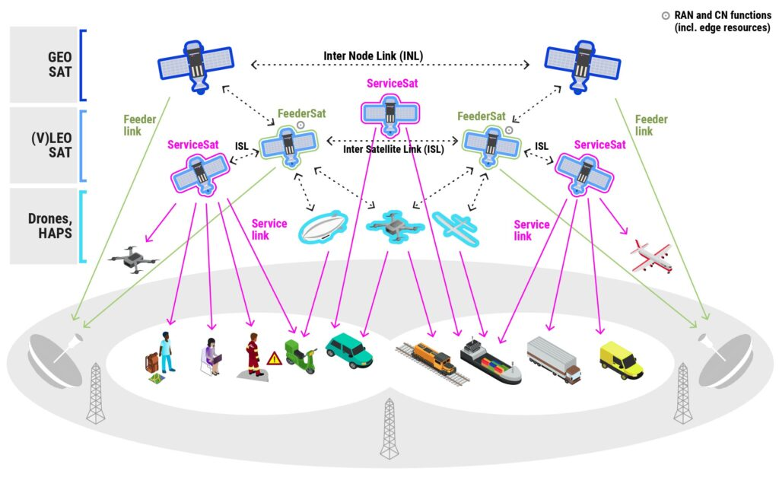
NTN Platforms
2. High Altitude Platforms (HAPs, 20km altitude)
Balloons, airships, or solar planes
Quick deployment for events or disaster relief
3. Unmanned Aerial Vehicles (UAVs / Drones)
Fly a few hundred meters to a few kilometres
Provide temporary on-demand coverage (concerts, sports, emergency)

Slide 6
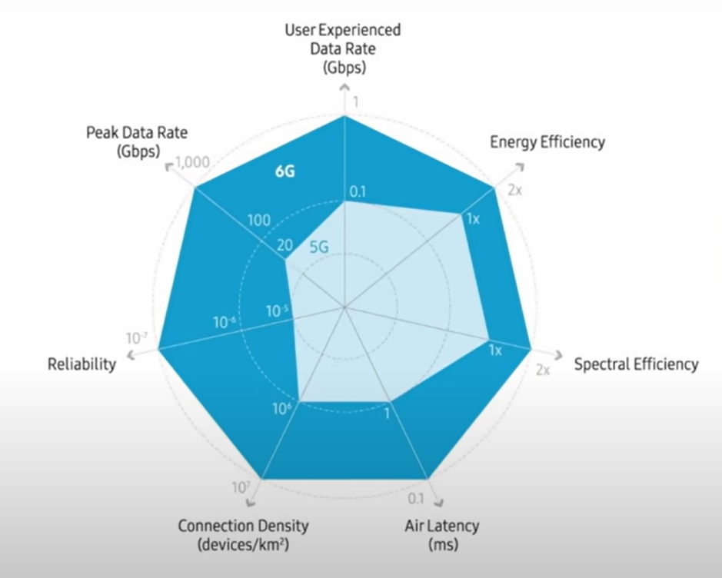
Requirements of NTNs
Throughput: High data rates for video/IoT
Latency: Signal travel time is longer than on land. LEO ~20-40 ms, GEO ~600 ms (too high for real-time apps)
Interference Management: Integrating efficiently with terrestrial networks and avoiding signal clash
Spectrum efficiency: Coordinating frequency use globally, avoid interference (frequency reuse, beamforming)
Energy efficiency: Limited power on UAVs/satellites
6G → Terrestrial + Non-Terrestrial seamless integration

Slide 7
Research Areas in NTNs
Resource Allocation
Beamforming - user-centric beams for higher capacity
Network Routing
AI Integration - predicting traffic, optimizing routing, anomaly detection
Inter-Satellite Links (ISL) – enabling satellite swarms to work as one
Security & Privacy – secure data transmission across space & ground

Slide 8
Resource Allocation
Efficient use of spectrum, power, and time slots in NTNs
Why? Satellites, UAVs, and HAPS have limited bandwidth, power, and coverage. Thousands of UEs (user devices) may compete for the same resources. Incorrect allocation → congestion, wasted energy, poor QoS.
Fairness vs Efficiency trade-off: need to balance between maximizing throughput and serving all users fairly.
Research directions AI/ML-based allocation: predict traffic demand and allocate proactively. Non-Orthogonal Multiple Access (NOMA) in NTNs: multiple users share same frequency with power-domain separation. Dynamic Spectrum Sharing between terrestrial and non-terrestrial networks.

Slide 9
Network Routing
Choosing the best path for data in a dynamic space-air-ground network
Why?
Unlike terrestrial networks, NTNs are constantly moving (LEO satellites, UAVs).
Data may need to hop across multiple satellites, HAPS, or UAVs before reaching the ground.
Efficient routing = lower latency + higher reliability.
Energy constraints: UAVs and satellites cannot afford energy-heavy routing protocols.
Delay-sensitive applications: need routing that minimizes propagation + queuing delay.
Research directions
AI-driven routing: predict mobility and select best future path.
Cluster-based routing: group nearby satellites (swarm intelligence).
Multi-Connectivity Routing: simultaneous use of terrestrial + NTN paths for reliability.
Energy-aware routing: reduce load on UAVs/satellites with limited onboard power

Slide 10
Routing in 6G NTN
Why Routing: Efficient path selection reduces delay, packet loss, and congestion.
Challenges: Dynamic satellite topologies Link failures & congestion Multi-layer orbit planes
Categories of Routing: Centralized – global optimization Distributed – local adaptability Hybrid – combines both

Slide 11
Centralized Routing
Definition: Routes are computed by a global controller (e.g., Ground Control Centre, GEO/MEO nodes with SDN).
Features: Global view of the network Optimized paths (Dijkstra, RL, etc.) High complexity & signalling overhead
Pros: Better fault tolerance, optimized delay & throughput
Cons: Latency in large networks, reliance on control centres

Slide 12
Distributed Routing
Definition: Each satellite computes and updates routes locally using onboard processing.
Features: Adaptive to dynamic conditions Uses protocols like LCO-RIP, ADR, AODV
Pros: Quick response, scalable, no single point of failure
Cons: Lacks global optimization -> may create bottlenecks
Use Case: Highly dynamic LEO constellations

Slide 13
Hybrid Routing
Definition: Integrates centralized global planning with distributed local decisions.
Features: SDN + MEC support (MaCRo, SDMCN with OGDR algorithm) Local adaptation + global optimization
Pros: Balances performance, reliability, and flexibility
Cons: Still complex, research ongoing
Use Case: Mega-constellations like Starlink, Kuiper

Slide 14
 | Centralized | Distributed | Hybrid
Definition | Global controller computes routes (ground station, SDN) | Each satellite makes local routing decisions | Combines global planning + local adaptation
View of Network | Global, complete view | Local, partial view | Global + local
Pros | Optimized paths Efficient resource use High reliability | Fast response Scalable No single point of failure | Balance between optimization and adaptability
Cons | High overhead Slower updates Central point of failure risk | Suboptimal routes Risk of congestion | More complex, requires coordination
Best Suited For | Smaller constellations, stable GEO/MEO | Large dynamic LEO constellations | Mega-constellations (Starlink, Kuiper), 6G NTN

Slide 15
 | Paper Title | ML Model | Optimization Strategy | Objectives | NTN Platform
1 | Enhancing Resource Utilization of Non-Terrestrial Networks Using Temporal Graph-Based Deterministic Routing | None | Integer Linear Programming (ILP) 2. Extended Time-Expanded Graph (ETEG) Algorithm | Improve resource utilization Ensure deterministic delay/jitter guarantees | LEO satellites
2 | Centralized Versus Distributed Routing for Large-Scale Satellite Networks | Graph Neural Network Reinforcement Learning | RL optimization with reward shaping (compared against Dijkstra, Q-routing) | Enable adaptive, low-delay, high-throughput routing in dynamic integrated NTN | LEO satellites integrated with terrestrial 5G
3 | Distributed On-Demand Routing for LEO Mega-Constellations: A Starlink Case Study | Reinforcement Learning (Q-learning / Deep RL) | RL optimization (policy learning) | Adaptive routing for dynamic LEO topologies, reduce delay & packet loss, improve throughput | LEO satellites
4 | A path selection method based on rule prediction in non-terrestrial networks | Multi-Agent Reinforcement Learning (Q-routing) | Q-routing optimization in MARL framework | Adaptive routing in dynamic LEO, reduce delay & packet loss, improve throughput & load balancing | LEO satellites
5 | A Routing Method with Link Information-based Rule Selection in Non-Terrestrial Networks | Random Forest (classification model) | Rule-based optimization (maximize Eb/N0, minimize BER, minimize distance, etc.) | Improve packet delivery under dynamic topology & weather; achieved ~93% delivery vs 67–79% for AODV/OLSR | LEO satellites + ISLs + Ground Stations

Slide 16
Routing Parameters in NetSim
Routing Protocol Selection
Let’s us choose which routing algorithm the node will use
AODV, OLSR, DSR, RIP, Static
Protocol-Specific Parameters
AODV: Hello Interval, Active Route Timeout
OLSR: Hello Interval, TC Interval
RIP: Update Time
Hello Interval: Time between “hello” messages used to check if neighbors are alive. Active Route Timeout: How long an unused route is kept in the routing table before being deleted TC Interval (Topology Control Interval): Frequency of topology update messages to inform the network about reachable nodes. Update Timer: Interval at which the routing table is broadcast to neighbors.

Slide 17
Random Forest
Start with a dataset, each record has features (inputs) and a label (output).
Example in NTN: link delay, SNR, bandwidth → classify as good or bad link.
Create multiple decision trees: Each tree is trained on a different random sample of the data. Each tree also sees only some of the features. So, every tree learns slightly different patterns.
Each tree makes its own prediction
For example:
Tree 1 → Good link
Tree 2 → Bad link
Tree 3 → Good link
Forest combines the votes: The final decision is based on the majority vote.
This reduces errors because not all trees make the same mistake.
Model learns the most important features that is it also shows which features (delay, SNR, etc.) most affect the final decision.

Slide 18
Random Forest (Our example Model)
Used a public satellite dataset (satimage from OpenML). Each record had several features describing satellite surface data.
We trained a Random Forest Classifier with 100 trees. The model learned patterns between input features and output classes.
It predicted the correct class with ~92% accuracy, meaning it predicted correctly most of the time.
It also showed which features were most important for decisions.
Similar approach can be used in NTN routing to classify good or bad links based on delay, SNR, etc.
Output
Accuracy: 0.916 → very high performance.
Confusion Matrix: showed few misclassifications.
Showed which features mattered most for the decision.
Model saved as rf_model.pkl (can be re-used later).

Slide 19
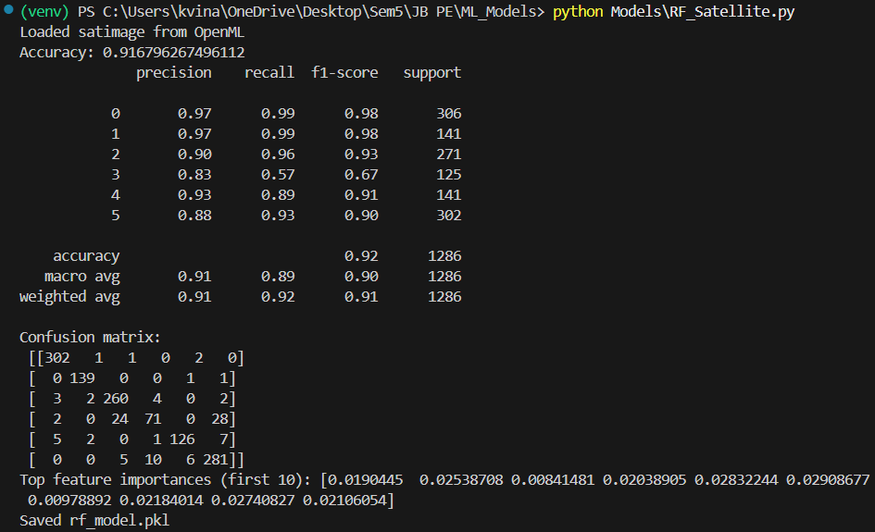
Generated Results

Slide 20
Understanding Random Forest Results
Public dataset: “satimage” from OpenML.
Real satellite images: each data sample describes one small region of Earth’s surface, with various numerical features extracted from the image
Random Forest learned to classify what kind of surface that region is (for example, soil, vegetation, water, etc.).
Class Label | Type of Surface (example meaning)
0 | Red soil
1 | Cotton crop
2 | Grey soil
3 | Damp grey soil
4 | Soil with vegetation stubble
5 | Very damp grey soil

Slide 21
Understanding Random Forest Results
Each input row contained 36 numerical features, like:
Average intensity in different spectral bands (Red, Green, Blue, NIR)
Ratios between color bands
Statistical measures (mean, variance, etc.)
“Here are 36 features of many samples, and their correct classes. Learn the pattern so you can predict the class for new samples.”
Metric | Meaning
Precision | Out of all samples the model predicted as this class, how many were actually correct?
Recall | Out of all samples that actually belonged to this class, how many did the model find correctly?
F1-score | Combines precision and recall into one value (the balance between them).
Support | Number of actual test samples for that class.

Slide 22
Understanding Random Forest Results
Confusion Matrix: A simple table that shows what the model predicted vs what was actually correct.
Each row = actual class, Each column = predicted class.
First row (Class 0): [302 1 1 0 2 0]
302 were correctly predicted as Class 0
1 was wrongly predicted as Class 1
1 was wrongly predicted as Class 2
2 were wrongly predicted as Class 4
Total = 306 (same as support)
Feature Importances: These numbers show how much each input feature influenced the final decision.
Higher number = that feature helped the model split the data better in the trees.
The output shows the first 10 importance values. But, we’re only seeing numbers, their corresponding feature names can be printed by adding a small code.

Slide 23
Reinforcement Learning
RL is like trial and error learning where the system teaches itself what to do by interacting with its environment, it learns from experience and reward signals.
The agent starts with no knowledge. It doesn’t know which actions are good or bad.
Agent takes an action, environment gives feedback: The agent receives a reward (positive or negative). Example: Low delay = +1 reward, Link failure = −1 reward
Agent learns from that feedback: It updates what it “believes” about that action in that situation.
Good actions get higher value, bad ones get lower value.
Agent repeats this process thousands of times. Finally, it forms a policy
“If I’m in this state, this action gives me the best long-term reward.”

Slide 24
Q-Learning
Q-Learning is a type of RL that uses a Q-table.
The Q-table stores the quality of each action.
The agent updates these values based on the reward it gets.
Formula: new value = current reward + expected future best reward
Slowly, the Q-table becomes stable. The agent can now choose the best action in any situation.
It doesn’t need to know how the environment works: only the results of its actions.
RL in NTN Routing:
The satellite (agent) can learn which neighbor link (action) gives the best result.
Reward = lower delay, fewer losses, or higher throughput.
After many transmissions, it learns optimal routing paths automatically.

Slide 25
Q-Learning (Our example Model)
Used a small grid world (Frozen Lake) as our environment.
Each tile = a state. Actions = move up, down, left, right.
Goal tile = reward = +1, holes = reward = 0 or −1.
The agent starts exploring randomly (no knowledge). After each move, it updates its Q-table: Each entry in the table stores how good a specific action is in a given state.
Formula : Q(state, action) ← reward + future best reward
Over time, the Q-table fills with values showing which move is best from each position.
The agent starts choosing the best actions instead of random ones.
After enough training, it always reaches the goal (win rate = 1.0).
This shows how RL can be used in routing, learning by trial and reward.

Slide 26
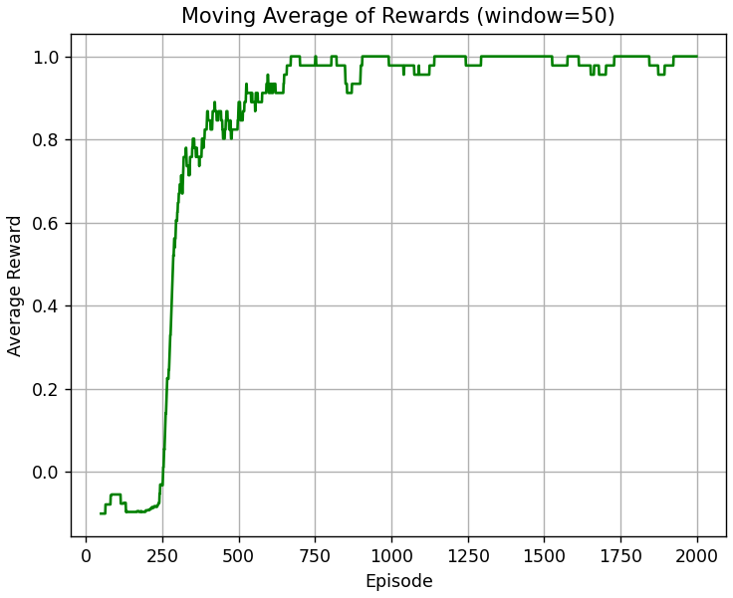
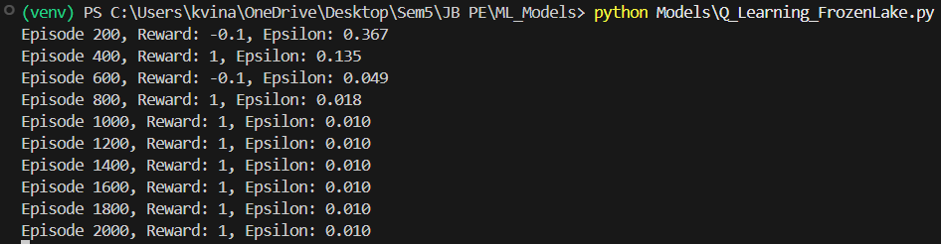
Understanding Q-Learning Results
Graph shows a smooth curve rising as agent learns. from 0 → 1
Early episodes: moving average is low because most rewards are failures.
Later episodes: moving average approaches 1 as agent consistently reaches goal.
Reward = 1 → agent reached the goal in that episode. Reward = -0.1 → agent fell into a hole before reaching goal (penalty we added).
So early on (like Episode 200), the agent is mostly exploring randomly. Sometimes it reaches the goal, sometimes it falls into a hole → reward varies.
Epsilon is your exploration rate: Probability of choosing a random action.
By Episode 1000+, epsilon ≈ 0.01 → agent almost always follows learned Q-values (greedy). This is why after Episode 1000, the agent consistently gets Reward = 1: it has learned the correct path to the goal.

Slide 27
Q-Routing
Q-Routing is Q-Learning applied to a network.
Each node (satellite) acts as an agent. It learns which neighbor gives the best route to a destination.
Each node keeps a small Q-table:
Rows = possible destinations.
Columns = neighboring nodes.
Value = estimated delay or cost of sending through that neighbor.
When a packet is sent: The node picks the neighbor with the lowest Q-value (fastest route).
After receiving feedback: It updates the Q-table based on actual delay or success.
Over time: Each node’s Q-values improve as it sees more results.
The network self-learns optimal routes without a central controller.
If a link fails or congestion happens: The Q-values update automatically → nodes adapt to new paths quickly.
Over time, all nodes learn the fastest or most reliable routes.

Slide 28
Q-Routing (Our example Model)
We simulated a multi-node network where each node updates its Q-table.
Each node initially guesses delays to reach a destination through neighbors.
As packets are sent and acknowledged, actual delays are used to correct those guesses.
Eventually, each node learns:
“Neighbor X → faster route to destination Y.”
The network becomes self-optimizing: no global routing table needed.
In NTN Routing:
In LEO or UAV constellations, links change constantly. Centralized control is difficult.
Q-Routing allows each node to autonomously adapt to link changes.
Reduces delay, avoids congestion, and improves reliability.

Slide 29
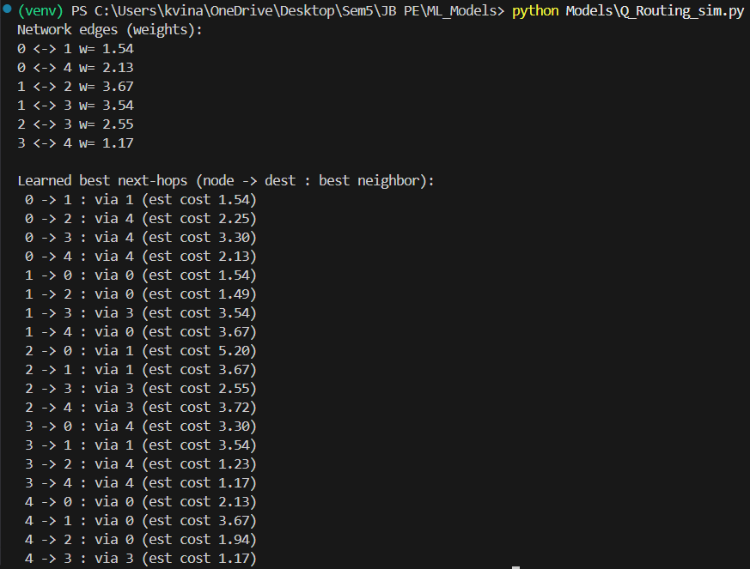
Understanding Q-Routing Results
Network edges: Shows the initial random link weights (delays) between nodes.
Each number is like the cost of sending data through that link.
Learned best next-hops: This is the main result.
Each line means: “From node X, to reach destination Y, send via neighbor Z.”
The “est cost” is the learned (predicted) minimum delay or hop cost.
In simple words, every node has learned the best neighbor to forward packets to each destination.

