Slide 1
Chapter 1
File Systems and Databases

Slide 2
In this chapter, you will learn:
What a database is, what it does, and why database design is important
How modern databases evolved from files and file systems
About flaws in file system data management
What a DBMS is, what it does, and how it fits into the database system
About types of database systems and database models

Slide 3
Introducing the Database
Data versus Information
  Data constitute building blocks of information
  Information produced by processing data
  Information reveals meaning of data
  Good, timely, relevant information key to decision making
  Good decision making key to organizational survival

Slide 4
Database Management
Database is shared, integrated computer structure housing:
  End user data
  Metadata
Database Management System (DBMS)
  Manages Database structure
  Controls access to data
  Contains query language

Slide 5
Importance of DBMS
  Makes data management more efficient and effective
  Query language allows quick answers to ad hoc queries
  Provides better access to more and better-managed data
  Promotes integrated view of organization’s operations
  Reduces the probability of inconsistent data

Slide 6
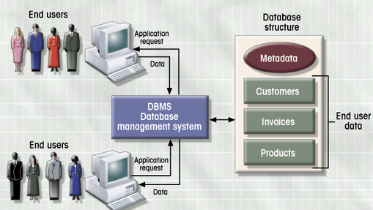
DBMS Manages Interaction
Figure 1.2

Slide 7
Database Design
Importance of Good Design
  Poor design results in unwanted data redundancy
  Poor design generates errors leading to bad decisions
Practical Approach
  Focus on principles and concepts of database design
  Importance of logical design

Slide 8
Historical Roots of Database
First applications focused on clerical tasks
Requests for information quickly followed
File systems developed to address needs
  Data organized according to expected use
  Data Processing (DP) specialists computerized manual file systems

Slide 9
File Terminology
Data
  Raw Facts
Field
  Group of characters with specific meaning
Record
  Logically connected fields that describe a person, place, or thing
File
  Collection of related records

Slide 10
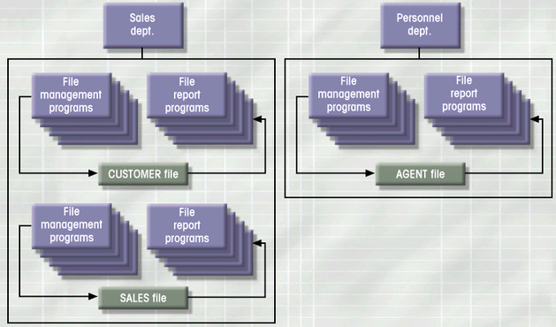
Simple File System
Figure 1.5

Slide 11
File System Critique
File System Data Management
  Requires extensive programming in third-generation language (3GL)
  Time consuming
  Makes ad hoc queries impossible
  Leads to islands of information

Slide 12
File System Critique (con’t.)
Data Dependence
  Change in file’s data characteristics requires modification of data access programs
  Must tell program what to do and how
  Makes file systems cumbersome from programming and data management views
Structural Dependence
  Change in file structure requires modification of related programs

Slide 13
File System Critique (con’t.)
Field Definitions and Naming Conventions
  Flexible record definition anticipates reporting requirements
  Selection of proper field names important
  Attention to length of field names
  Use of unique record identifiers

Slide 14
File System Critique (con’t.)
Data Redundancy
  Different and conflicting versions of same data
  Results of uncontrolled data redundancy
    Data anomalies
      Modification
      Insertion
      Deletion
    Data inconsistency
      Lack of data integrity

Slide 15
Database Systems
Database consists of logically related data stored in a single repository
Provides advantages over file system management approach
  Eliminates inconsistency, data anomalies, data dependency, and structural dependency problems
  Stores data structures, relationships, and access paths

Slide 16
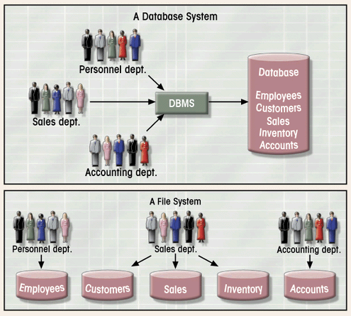
Database vs. File Systems
Figure 1.6

Slide 17
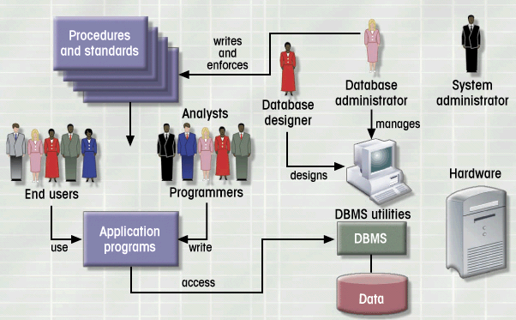
Database System Environment
Figure 1.7

Slide 18
Database System Types
Single-user vs. Multiuser Database
  Desktop
  Workgroup
  Enterprise
Centralized vs. Distributed
Use
  Production or transactional
  Decision support or data warehouse

Slide 19
DBMS Functions
Data dictionary management
Data storage management
Data transformation and presentation
Security management
Multiuser access control
Backup and recovery management
Data integrity management
Database language and application programming interfaces
Database communication interfaces

Slide 20
Database Models
Collection of logical constructs used to represent data structure and relationships within the database
  Conceptual models: logical nature of data representation
  Implementation models: emphasis on how the data are represented in the database

Slide 21
Database Models (con’t.)
Relationships in Conceptual Models
  One-to-one (1:1)
  One-to-many (1:M)
  Many-to-many (M:N)
Implementation Database Models
  Hierarchical
  Network
  Relational
Notes:
31

Slide 22
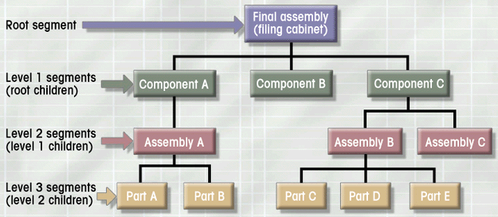
Hierarchical Database Model
Logically represented by an upside down tree
  Each parent can have many children
  Each child has only one parent
Figure 1.8

Slide 23
Hierarchical Database Model
Advantages
  Conceptual simplicity
  Database security and integrity
  Data independence
  Efficiency
Disadvantages
  Complex implementation
  Difficult to manage and lack of standards
  Lacks structural independence
  Applications programming and use complexity
  Implementation limitations

Slide 24
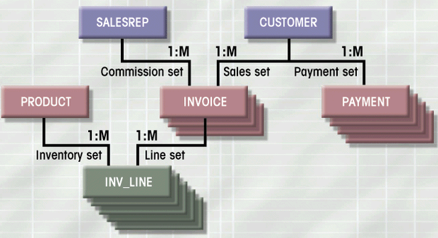
Network Database Model
Each record can have multiple parents
  Composed of sets
  Each set has owner record and member record
  Member may have several owners
Figure 1.10

Slide 25
Network Database Model
Advantages
  Conceptual simplicity
  Handles more relationship types
  Data access flexibility
  Promotes database integrity
  Data independence
  Conformance to standards
Disadvantages
  System complexity
  Lack of structural independence

Slide 26
Relational Database Model
Perceived by user as a collection of tables for data storage
Tables are a series of row/column intersections
Tables related by sharing common entity characteristic(s)

Slide 27
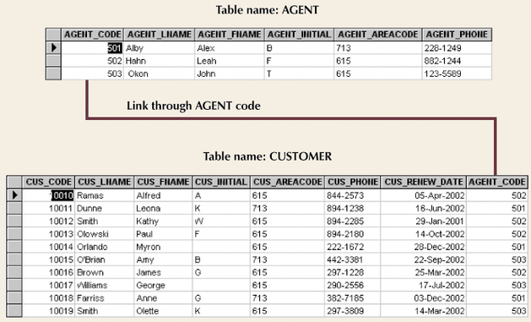
Relational Database Model (con’t.)
Figure 1.11

Slide 28
Relational Database Model
Advantages
  Structural independence
  Improved conceptual simplicity
  Easier database design, implementation, management, and use
  Ad hoc query capability with SQL
  Powerful database management system

Slide 29
Relational Database Model
Disadvantages
  Substantial hardware and system software overhead
  Poor design and implementation is made easy
  May promote “islands of information” problems

Slide 30
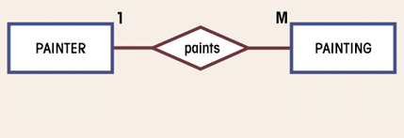
Entity Relationship Database Model
Complements the relational data model concepts
Represented in an entity relationship diagram (ERD)
Based on entities, attributes, and relationships
Figure 1.13

Slide 31
Entity Relationship Database Model
Advantages
  Exceptional conceptual simplicity
  Visual representation
  Effective communication tool
  Integrated with the relational database model
Disadvantages
  Limited constraint representation
  Limited relationship representation
  No data manipulation language
  Loss of information content

Slide 32
Object-Oriented Database Model
Objects or abstractions of real-world entities are stored
  Attributes describe properties
  Collection of similar objects is a class
    Methods represent real world actions of classes
    Classes are organized in a class hierarchy
  Inheritance is ability of object to inherit attributes and methods of classes above it

Slide 33
OO Data Model
Advantages
  Adds semantic content
  Visual presentation includes semantic content
  Database integrity
  Both structural and data independence
Disadvantages
  Lack of OODM
  Complex navigational data access
  Steep learning curve
  High system overhead slows transactions

Slide 34
Database Models and the Internet
Characteristics of “Internet age” databases
  Flexible, efficient, and secure Internet access
  Easily used, developed, and supported
  Supports complex data types and relationships
  Seamless interfaces with multiple data sources and structures
  Simplicity of conceptual database model
  Many database design, implementation, and application development tools
  Powerful DBMS GUI make DBA job easier

