Slide 1
Chapter 2
The Relational Database Model

Slide 2
In this chapter, you will learn:
That the relational database model takes a logical view of data
That the relational database model’s basic components are entities and their attributes, and relationships among entities
How entities and their attributes are organized into tables
About relational database operators, the data dictionary, and the system catalog
How data redundancy is handled in the relational database model
Why indexing is important

Slide 3
Logical View of Data
Relational Database
  Designer focuses on logical representation rather than physical
  Use of table advantageous
    Structural and data independence
    Related records stored in independent tables
    Logical simplicity
  Allows for more effective design strategies

Slide 4
Logical View of Data (con’t.)
Entities and Attributes
  Entity is a person, place, event, or thing about which data is collected
  Attributes are characteristics of the entity
Tables
  Holds related entities or entity set
  Also called relations
  Comprised of rows and columns

Slide 5
Table Characteristics
  Two-dimensional structure with rows and columns
  Rows (tuples) represent single entity
  Columns represent attributes
  Row/column intersection represents single value
  Tables must have an attribute to uniquely identify each row

Slide 6
Table Characteristics (con’t.)
  Column values all have same data format
  Each column has range of values called attribute domain
  Order of the rows and columns is immaterial to the DBMS

Slide 7
Keys
One or more attributes that
determine other attributes
  Key attribute
  Composite key
Full functional dependence
Entity integrity
  Uniqueness
  No ‘null’ value in key

Slide 8
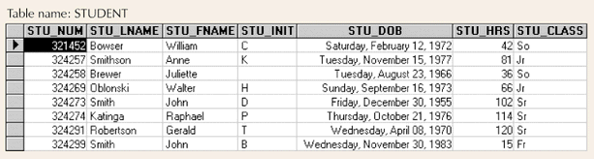
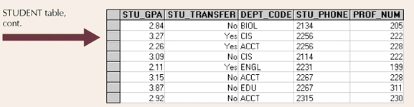
Example Tables
Figure 2.1

Slide 9
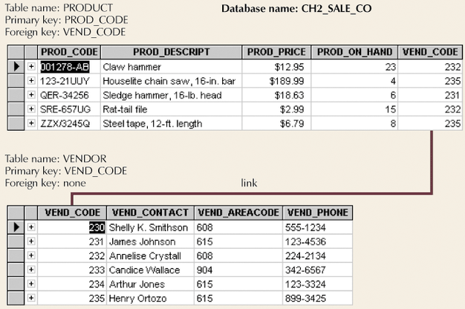
Simple Relational Database
Figure 2.2

Slide 10
Keys (con’t.)
Superkey
  Uniquely identifies each entity
Candidate key
  Minimal superkey
Primary key
  Candidate key to uniquely identify all other attributes in a given row
Secondary key
  Used only for data retrieval
Foreign key
  Values must match primary key in another table

Slide 11
Integrity Rules
Entity integrity
  Ensures all entities are unique
  Each entity has unique key
Referential integrity
  Foreign key must have null value or match primary key values
  Makes it impossible to delete row whose primary key has mandatory matching foreign key values in another table

Slide 12
Relational Database Operators
Relational algebra determines
table manipulations
Key operators
  SELECT
  PROJECT
  JOIN
Other operators
  INTERSECT
  UNION
  DIFFERENCE
  PRODUCT

Slide 13
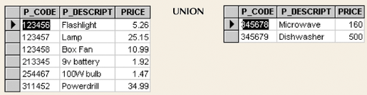
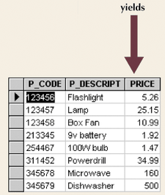
Union
Combines all rows
Figure 2.5

Slide 14
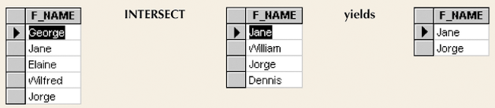
Intersect
Yields rows that appear in both tables
Figure 2.6

Slide 15
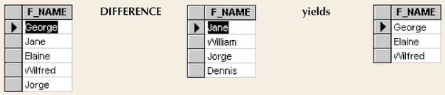
Difference
Yields rows not found in other tables
Figure 2.7

Slide 16
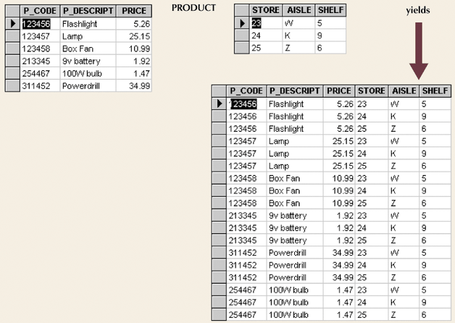
Product
Yields all possible pairs from two tables
Figure 2.8

Slide 17
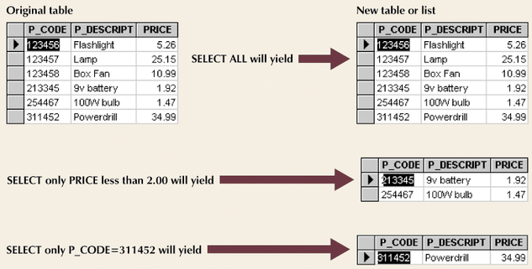
Select
Yields a subset of rows based on specified criterion
Figure 2.9

Slide 18
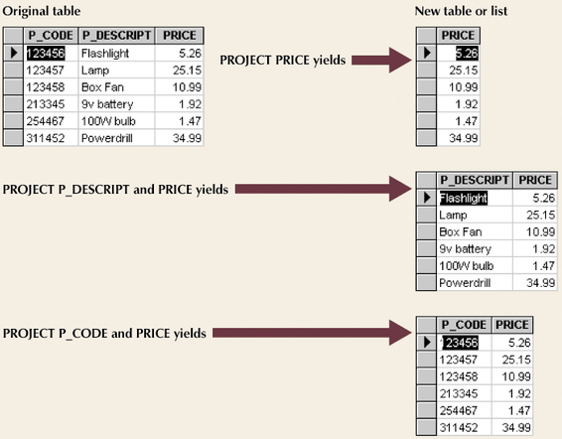
Project
Yields all values for selected attributes
Figure 2.10

Slide 19
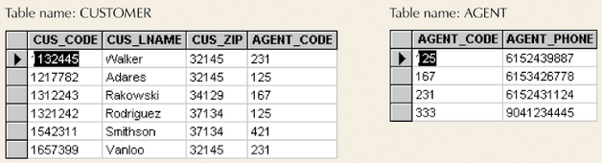
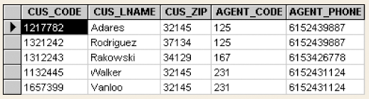
Join
Information from two or more tables is combined
Figure 2.11
Figure 2.14

Slide 20
Data Dictionary and System Catalog
Data dictionary
  Provides detailed account of all tables found within database
  Metadata
  Attribute names and characteristics
System catalog
  Detailed data dictionary
  System-created database
  Stores database characteristics and contents
  Tables can be queried just like any other tables
  Automatically produces database documentation

Slide 21
Relationships within Relational Database
Relationship classifications
  1:1
  1:M
  M:N
E-R Model
  ERD Maps E-R model
  Chen
  Crow’s Feet

Slide 22
ERD Symbols
  Rectangles represent entities
  Diamonds represent the relationship(s) between the entities
  “1” side of relationship
    Number 1 in Chen Model
    Bar crossing line in Crow’s Feet Model
  “Many” relationships
    Letter “M” and “N” in Chen Model
    Three pronged “Crow’s foot” in Crow’s Feet Model

Slide 23
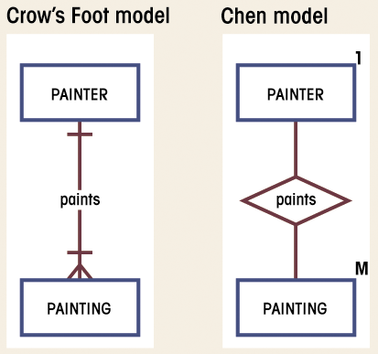
Example 1:M Relationship
Figure 2.18

Slide 24
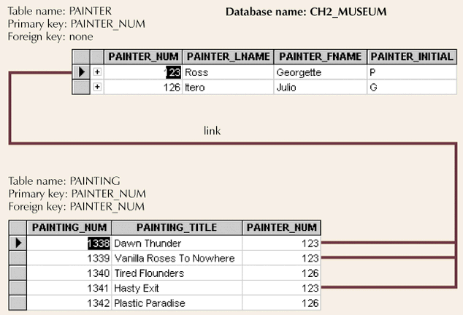
Example 1:M Relationship
Figure 2.20

Slide 25
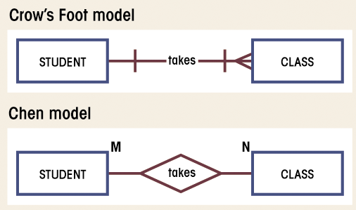
Example M:N Relationship
Figure 2.23

Slide 26
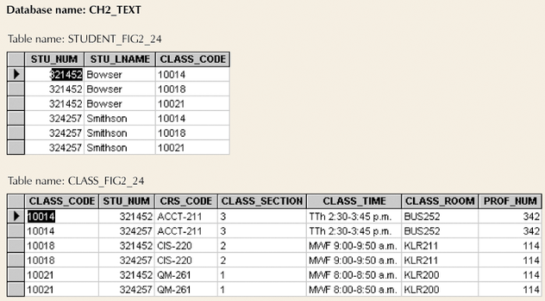
Example M:N Relationship
Figure 2.24

Slide 27
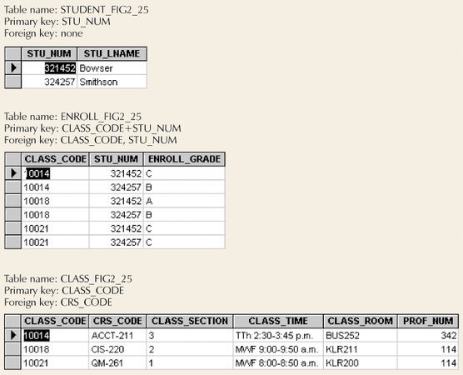
Converting M:N Relationship to Two 1:M Relationships
Figure 2.25

Slide 28
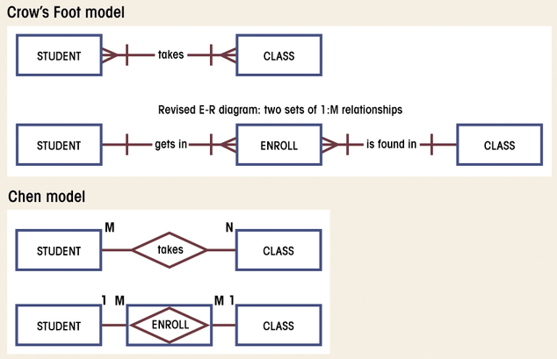
Converting M:N Relationship to Two 1:M Relationships (con’t.)
Figure 2.26

Slide 29
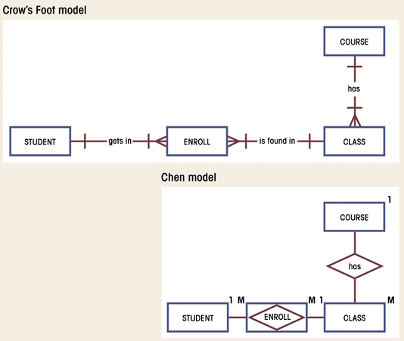
Converting M:N Relationship to Two 1:M Relationships (con’t.)
Figure 2.27

Slide 30
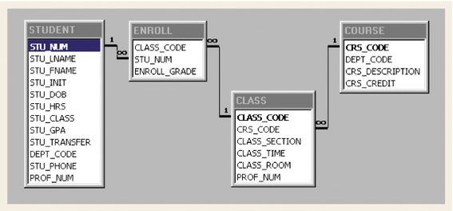
Converting M:N Relationship to Two 1:M Relationships (con’t.)
Figure 2.28

Slide 31
Data Redundancy Revisited
Foreign keys can reduce redundancy
Some redundancy is desirable
  Called controlled redundancy
  Speed
  Information requirements

Slide 32
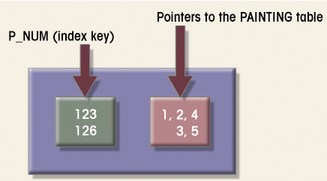
Indexes
Points to location
Makes retrieval of data faster
Figure 2.31

