Slide 1
Chapter 3
Entity Relationship (E-R) Modeling

Slide 2
In this chapter, you will learn:
What a conceptual model is and what its purpose is
The difference between internal and external models
How internal and external models serve the database design process
How relationships between entities are defined and refined, and how such relationships are incorporated into the database design process
How ERD components affect database design and implementation
How to interpret the modeling symbols for the four most popular E-R modeling tools
That real-world database design often requires you to reconcile conflicting goals

Slide 3
Basic Modeling Concepts
Art and science
Good judgment coupled with powerful design tools
Models
  “Description or analogy used to visualize something that cannot be directly observed” Webster’s Dictionary
Data Model
  Relatively simple representation of complex real-world data structures

Slide 4
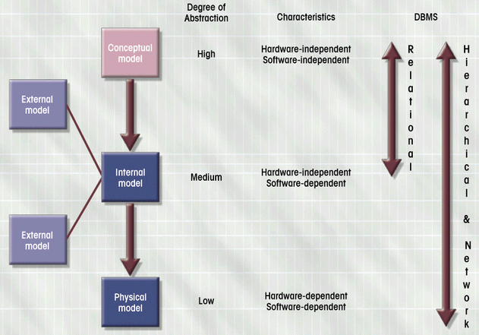
Data Models: Degrees of Data Abstraction
Figure 3.1

Slide 5
Degrees of Abstraction
Conceptual
  Global view of data
  Basis for identification and description of main data items
  ERD used to represent conceptual data model
  Hardware and software independent
Internal
  Representation of database as seen by DBMS
  Adapts conceptual model to specific DBMS
  Software dependent

Slide 6
Degrees of Abstraction (con’t.)
External
  Users’ views of data environment
  Provides subsets of internal view
  Makes application program development easier
  Facilitates designers’ tasks
  Ensures adequacy of conceptual model
  Ensures security constraints in design
Physical
  Lowest level of abstraction
  Software and hardware dependent
  Requires definition of physical storage devices and access methods

Slide 7
The Entity Relationship (E-R) Model
Represents conceptual view
Main Components
  Entities
    Corresponds to entire table, not row
    Represented by rectangle
  Attributes
  Relationships

Slide 8
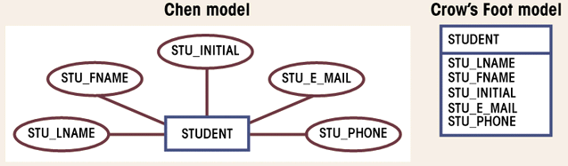
Attributes
Characteristics of entities
Domain is set of possible values
Primary keys underlined
Figure 3.6

Slide 9
Attributes (con’t.)
Simple
  Cannot be subdivided
  Age, sex, marital status
Composite
  Can be subdivided into additional attributes
  Address into street, city, zip
Single-valued
  Can have only a single value
  Person has one social security number
Multi-valued
  Can have many values
  Person may have several college degrees
Derived
  Can be derived with algorithm
  Age can be derived from date of birth

Slide 10
Relationships
Association between entities
Connected entities are called participants
Operate in both directions
Connectivity describes relationship classification
  1:1, 1:M, M:N
Cardinality
  Expresses number of entity occurrences associated with one occurrence of related entity

Slide 11
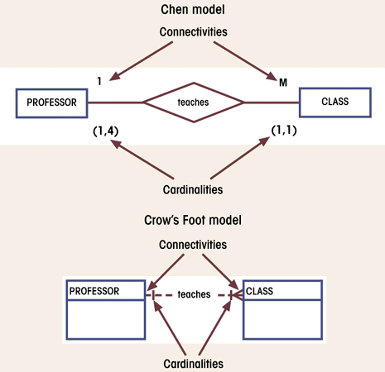
Connectivity and Cardinality in an ERD
Figure 3.12

Slide 12
Relationship Strength
Existence dependence
  Entity’s existence depends on existence of related entities
  Existence-independent entities can exist apart from related entities
  EMPLOYEE claims DEPENDENT
Strong (identifying) Relationship
  One entity is existence-independent on another
  PK of related entity doesn’t contain PK component of parent entity
Weak (non-identifying) Relationship
  One weak entity is existence-dependent on another
  PK of related entity contains PK component of parent entity

Slide 13
Relationship Participation
Optional
  Entity occurrence does not require a corresponding occurrence in related entity
  Shown by drawing a small circle on side of optional entity on ERD
Mandatory
  Entity occurrence requires corresponding occurrence in related entity
  If no optionality symbol is shown on ERD, it is mandatory

Slide 14
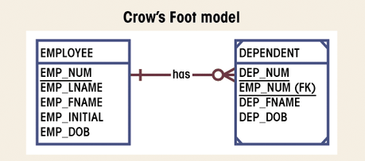
Weak Entity
Existence-dependent on another entity
Has primary key that is partially or totally
derived from parent entity
Figure 3.19

Slide 15
Relationship Degree
Indicates number of associated entities
Unary
  Single entity
  Recursive
  Exists between occurrences of same entity set
Binary
  Two entities associated
Ternary
  Three entities associated

Slide 16
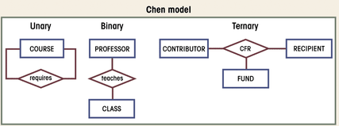
Three Types of Relationships
Figure 3.21

Slide 17
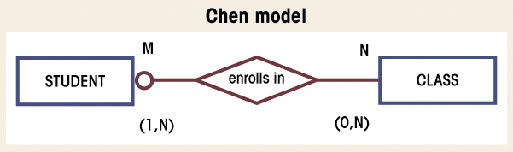
Composite Entities
Used to ‘bridge’ between M:N relationships
Bridge entities composed of primary keys of each entity needing connection
Figure 3.30

Slide 18
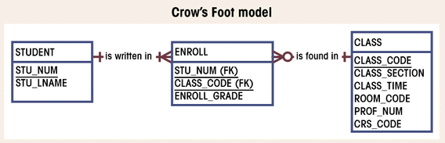
Composite Entities (con’t.)
Figure 3.31

Slide 19
Comparison of E-R Modeling Symbols
Alternate styles developed to enable easier use of CASE tools
Chen
  Moved conceptual design into practical database design arena
Crow’s Foot
  Cannot detail all cardinalities
Rein85
  Similar to Crow’s Foot
  Operates at higher level of abstraction
IDEF1X
  Derivative of ICAM studies in the late 1970’s
  Uses fewer symbols

Slide 20
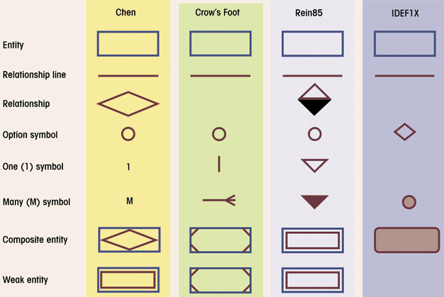
Comparison of E-R Modeling Symbols
Figure 3.36

Slide 21
Developing an E-R Diagram
Iterative Process
  Step1: General narrative of organizational operations developed
  Step2: Basic E-R Model graphically depicted and reviewed
  Step3: Modifications made to incorporate newly discovered E-R components
Repeat process until designers and users agree E-R Diagram complete

Slide 22
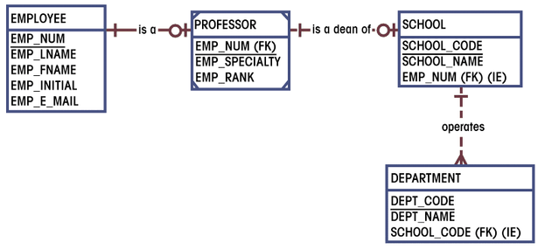
First ERD Segment Established
Figure 3.43

Slide 23
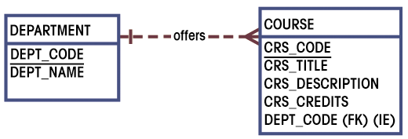
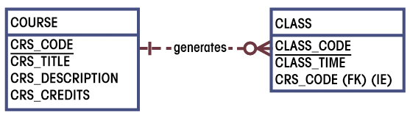
Second and Third ERD
Segments Established
Figures 3.44 & 3.45

Slide 24
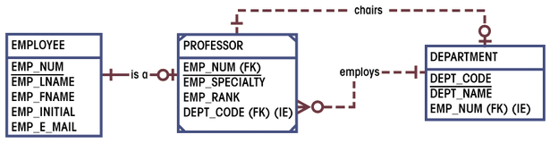
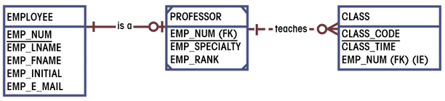
Fourth and Fifth ERD
Segments Established
Figures 3.46 & 3.47

Slide 25
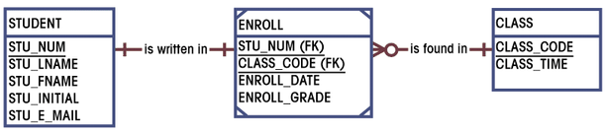
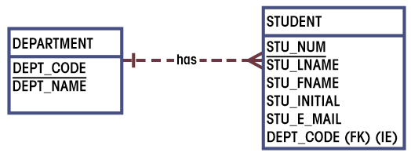
Sixth and Seventh ERD
Segments Established
Figures 3.48 & 3.49

Slide 26
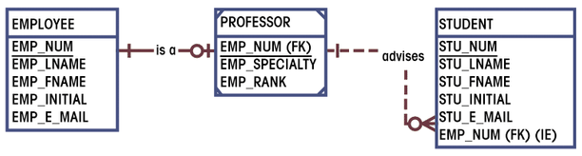
Eighth ERD
Segment Established
Figures 3.50

Slide 27
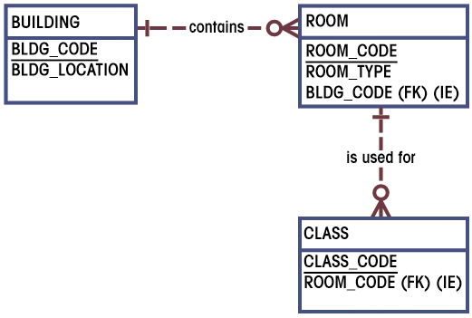
Ninth ERD
Segment Established
Figures 3.51

Slide 28
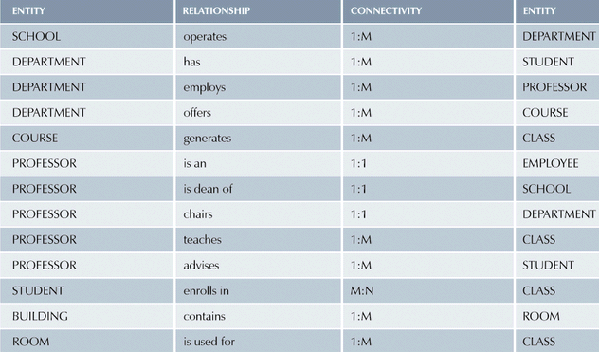
Components of E-R Model
Table 3.2

Slide 29
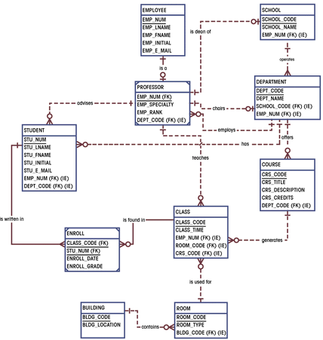
Completed ERD
Figure 3.52

Slide 30
Challenge of Database Design: Conflicting Goals
Database must be designed to conform to design standards
High-speed processing may require design compromises
Quest for timely information may be the focus of database design
Other concerns
  Security
  Performance
  Shared access
  Integrity

