Slide 1
Chapter 4
Normalization of Database Tables

Slide 2
In this chapter, you will learn:
What normalization is and what role it plays in database design
About the normal forms 1NF, 2NF, 3NF, BCNF, and 4NF
How normal forms can be transformed from lower normal forms to higher normal forms
That normalization and E-R modeling are used concurrently to produce a good database design
That some situations require denormalization to generate information efficiently

Slide 3
Database Tables and Normalization
Table is basic building block in database design
Normalization is process for assigning attributes to entities
  Reduces data redundancies
  Helps eliminate data anomalies
  Produces controlled redundancies to link tables
Normalization stages
  1NF - First normal form
  2NF - Second normal form
  3NF - Third normal form
  4NF - Fourth normal form

Slide 4
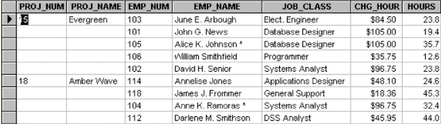
Need for Normalization
Figure 4.1

Slide 5
Figure 4.1 Observations
PRO_NUM intended to be primary key
Table entries invite data inconsistencies
Table displays data anomalies
  Update
    Modifying JOB_CLASS
  Insertion
    New employee must be assigned project
  Deletion
    If employee deleted, other vital data lost

Slide 6
Conversion to 1NF
Repeating groups must be eliminated
  Proper primary key developed
    Uniquely identifies attribute values (rows)
    Combination of PROJ_NUM and EMP_NUM
  Dependencies can be identified
    Desirable dependencies based on primary key
    Less desirable dependencies
      Partial
        based on part of composite primary key
      Transitive
        one nonprime attribute depends on another nonprime attribute

Slide 7
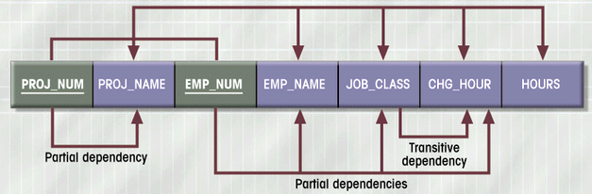
Dependency Diagram (1NF)
Figure 4.4

Slide 8
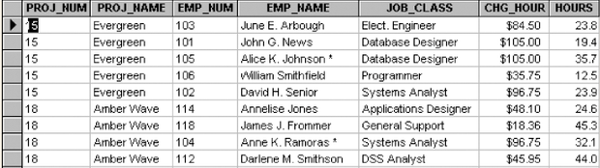
Data Organization: 1NF
Figure 4.3

Slide 9
1NF Summarized
All key attributes defined
No repeating groups in table
All attributes dependent on
primary key

Slide 10
Conversion to 2NF
Start with 1NF format:
Write each key component on separate line
Write original key on last line
Each component is new table
Write dependent attributes after each key
PROJECT (PROJ_NUM, PROJ_NAME)
EMPLOYEE (EMP_NUM, EMP_NAME, JOB_CLASS, CHG_HOUR)
ASSIGN (PROJ_NUM, EMP_NUM, HOURS)

Slide 11
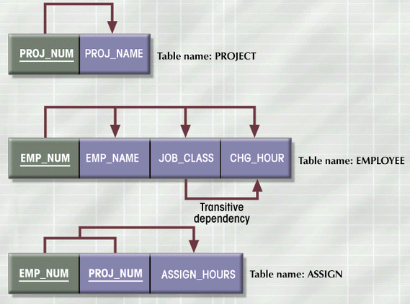
2NF Conversion Results
Figure 4.5

Slide 12
2NF Summarized
In 1NF
Includes no partial dependencies
  No attribute dependent on a portion of primary key
Still possible to exhibit transitive dependency
  Attributes may be functionally dependent on nonkey attributes

Slide 13
Conversion to 3NF
Create separate table(s) to eliminate transitive functional dependencies
PROJECT (PROJ_NUM, PROJ_NAME)
ASSIGN (PROJ_NUM, EMP_NUM, HOURS)
EMPLOYEE (EMP_NUM, EMP_NAME, JOB_CLASS)
JOB (JOB_CLASS, CHG_HOUR)

Slide 14
3NF Summarized
In 2NF
Contains no transitive dependencies

Slide 15
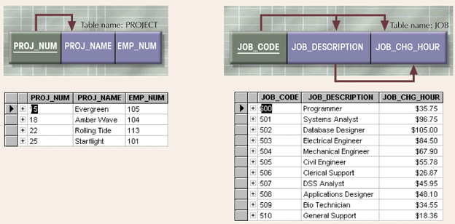
Additional DB Enhancements
Figure 4.6

Slide 16
Boyce-Codd Normal Form (BCNF)
Every determinant in the table is a candidate key
  Determinant is attribute whose value determines other values in row
  3NF table with one candidate key is already in BCNF

Slide 17
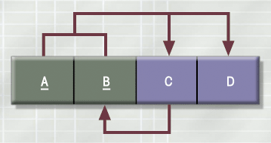
3NF Table Not in BCNF
Figure 4.7

Slide 18
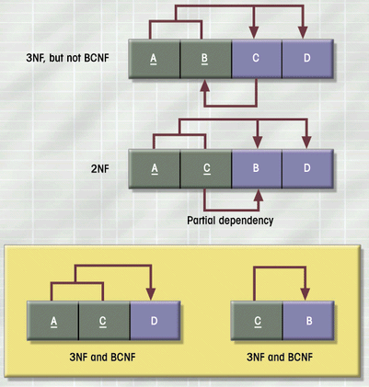
Decomposition of Table
Structure to Meet BCNF
Figure 4.8

Slide 19
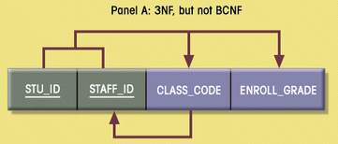
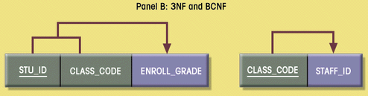
Decomposition into BCNF
Figure 4.9

Slide 20
Normalization and Database Design
Normalization should be part of the design process
E-R Diagram provides macro view
Normalization provides micro view of entities
  Focuses on characteristics of specific entities
  May yield additional entities
Difficult to separate normalization from E-R diagramming
Business rules must be determined

Slide 21
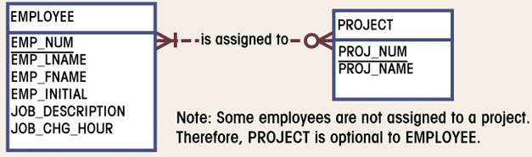
Initial ERD for Contracting Company
Figure 4.10

Slide 22
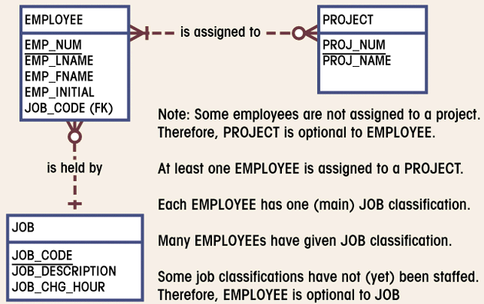
Modified ERD for
Contracting Company
Figure 4.11

Slide 23
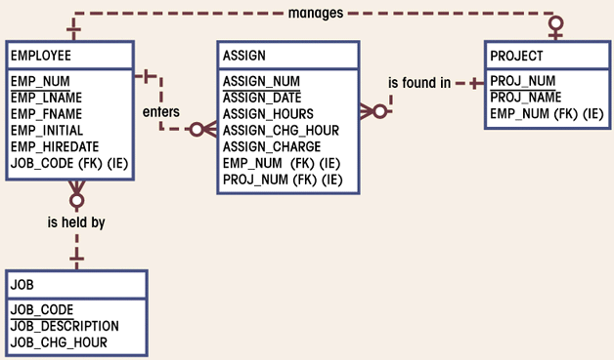
Final ERD for
Contracting Company
Figure 4.12

Slide 24
Higher-Level Normal Forms
Fourth Normal Form (4NF)
  Table is in 3NF
  Has no multiple sets of multivalued dependencies

Slide 25
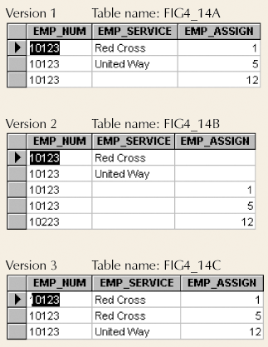
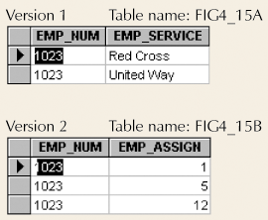
Conversion to 4NF
Figure 4.15
Set of Tables in 4NF
Figure 4.14
Multivalued Dependencies

Slide 26
Denormalization
Normalization is one of many database design goals
Normalized table requirements
  Additional processing
  Loss of system speed
Normalization purity is difficult to sustain due to conflict in:
  Design efficiency
  Information requirements
  Processing

Slide 27
Unnormalized Table Defects
Data updates less efficient
Indexing more cumbersome
No simple strategies for creating views

