Slide 1
Introduction

Slide 2
Objectives
After completing this lesson, you should be able to do the following:
  Describe the course organization
  Describe the sample HR schema
  List the available development environments
  Review the basic features of SQL Developer
Notes:
Oracle Database 11g: PL/SQL Fundamentals I - <number>
Lesson Aim
This lesson gives you a high-level overview of the course and its flow. You learn about the database schema and the tables that the course uses. You are also introduced to different products in the Oracle 10g grid infrastructure.

Slide 3
Course Objectives
After completing this course, you should be able to do the following:
  Identify the programming extensions that PL/SQL provides to SQL
  Write PL/SQL code to interface with the database
  Design PL/SQL anonymous blocks that execute efficiently
  Use PL/SQL programming constructs and conditional control statements
  Handle run-time errors
  Describe stored procedures and functions
Notes:
Oracle Database 11g: PL/SQL Fundamentals I - <number>
Course Objectives
This course presents the basics of PL/SQL. You learn about PL/SQL syntax, blocks, and programming constructs and about the advantages of integrating SQL with those constructs. You learn how to write PL/SQL program units and execute them efficiently. In addition, you learn how to use SQL Developer as a development environment for PL/SQL. You also learn how to design reusable program units, such as procedures and functions.

Slide 4
Course Agenda
Lessons for the first day:
  I. Introduction
  Introduction to PL/SQL
  Declaring PL/SQL Variables
  Writing Executable Statements
  Interacting with the Oracle Database Server
  Writing Control Structures
Notes:
Oracle Database 11g: PL/SQL Fundamentals I - <number>

Slide 5
Course Agenda
Lessons for the second day:
  Working with Composite Data Types
  Using Explicit Cursors
  Handling Exceptions
  Creating Stored Procedures and Functions
Notes:
Oracle Database 11g: PL/SQL Fundamentals I - <number>

Slide 6
Human Resources (HR) Schema for This Course
DEPARTMENTS
department_id
department_name
manager_id
location_id
LOCATIONS
location_id
street_address
postal_code
city
state_province
country_id
JOB_HISTORY
employee_id
start_date
end_date
job_id
department_id
EMPLOYEES
employee_id
first_name
last_name
email
phone_number
hire_date
job_id
salary
commission_pct
manager_id
department_id
COUNTRIES
country_id
country_name
region_id
JOBS
job_id
job_title
min_salary
max_salary
REGIONS
region_id
region_name
Notes:
Human Resources (HR) Schema Description
The Human Resources (HR) schema is part of the Oracle Sample Schemas that can be installed in an Oracle database. The practice sessions in this course use data from the HR schema.
Table Descriptions
REGIONS contains rows that represent a region such as Americas, Asia, and so on.
COUNTRIES contains rows for countries, each of which is associated with a region.
LOCATIONS contains the specific address of a specific office, warehouse, or production site of a company in a particular country.
DEPARTMENTS shows details about the departments in which employees work. Each department may have a relationship representing the department manager in the EMPLOYEES table.
EMPLOYEES contains details about each employee working for a department. Some employees may not be assigned to any department.
JOBS contains the job types that can be held by each employee.
JOB_HISTORY contains the job history of the employees. If an employee changes departments within a job or changes jobs within a department, then a new row is inserted into this table with the old job information of the employee.

Slide 7
PL/SQL Development Environments
This course provides the following tools for developing PL/SQL code:
  Oracle SQL Developer (used in this course)
  Oracle SQL*Plus
  Oracle JDeveloper IDE
Notes:
PL/SQL Development Environments
There are many tools that provide an environment for developing PL/SQL code. Oracle provides several tools that can be used to write PL/SQL code. Some of the development tools that are available for use in this course are:
Oracle SQL Developer: A graphical tool
Oracle SQL*Plus: A window or command-line application
Oracle JDeveloper: A window-based integrated development environment (IDE)
Note: The code and screen examples in the course notes were generated from output in the SQL Developer environment.

Slide 8

Coding PL/SQL in Oracle SQL Developer
  Oracle SQL Developer is a free graphical tool that enhances productivity and simplifies database development tasks.
  You can connect to any target Oracle database schema by using standard Oracle database authentication.
  You will use SQL Developer in this course.
SQL Developer
Notes:
Oracle Database 11g: PL/SQL Fundamentals I - <number>
What Is Oracle SQL Developer?
Oracle SQL Developer is a free graphical tool designed to improve your productivity and simplify the development of everyday database tasks. With just a few clicks, you can easily create and debug stored procedures, test SQL statements, and view optimizer plans.
SQL Developer, the visual tool for database development, simplifies the following tasks:
Browsing and managing database objects
Executing SQL statements and scripts
Editing and debugging PL/SQL statements
Creating reports
You can connect to any target Oracle database schema by using standard Oracle database authentication. When connected, you can perform operations on objects in the database.

Slide 9

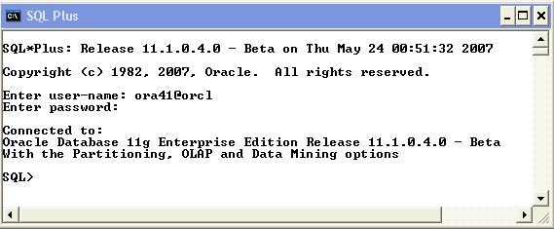
Coding PL/SQL in SQL*Plus
Notes:
Coding PL/SQL in SQL*Plus
Oracle SQL*Plus is a command-line application that enables you to submit SQL statements and PL/SQL blocks for execution and receive the results in an application or command window.
SQL*Plus is:
Shipped with the database
Installed on a client and on the database server system
Accessed from an icon or the command line

Slide 10

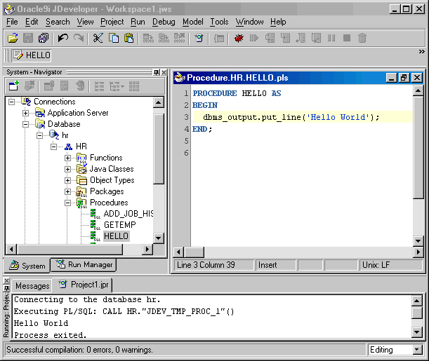
Coding PL/SQL in Oracle JDeveloper
Edit
Run
Notes:
Coding PL/SQL in Oracle JDeveloper
Oracle JDeveloper allows developers to create, edit, test, and debug PL/SQL code by using a sophisticated graphical user interface (GUI). Oracle JDeveloper is a part of Oracle Developer Suite and is also available as a separate product.
When coding PL/SQL in JDeveloper, consider the following:
You first create a database connection to enable JDeveloper to access a database schema owner for the subprograms.
You can then use the JDeveloper shortcut menus on the database connection to create a new subprogram construct using the built-in JDeveloper Code Editor. The JDeveloper Code Editor provides an excellent environment for PL/SQL development, with features such as the following:
Different colors for syntactical components of the PL/SQL language
Code insight to rapidly locate procedures and functions in supplied packages
You invoke a subprogram by using a Run command on the shortcut menu for the named subprogram. The output appears in the JDeveloper Log Message window, as shown in the lower portion of the screenshot.
Note: JDeveloper provides color-coding syntax in the JDeveloper Code Editor and is sensitive to PL/SQL language constructs and statements.

Slide 11

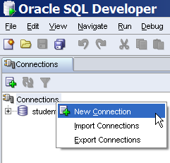
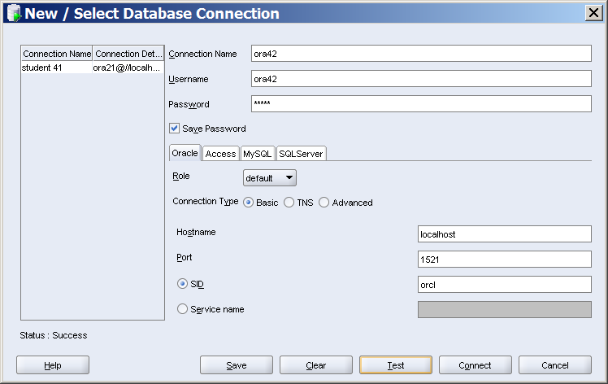
Starting SQL Developer and
Creating a Database Connection
Notes:
Creating a Database Connection
To create a database connection, perform the following steps:
1. Double-click <your_path>\sqldeveloper\sqldeveloper.exe.
2. On the Connections tabbed page, right-click Connections and select New Connection.
3. Enter the connection name, username, password, host name, and SID for the database you want to connect to.
4. Click Test to make sure that the connection has been set correctly.
5. Click Connect.
On the tabbed page that appears at the bottom of the window, enter the following options:
Hostname: Host system for the Oracle database
Port: Listener port
SID: Database name
Service Name: Network service name for a remote database connection
If you select the Save Password check box, the password is saved to an XML file. As a result, you are not prompted for the password after you close the SQL Developer connection and open it again.

Slide 12
Creating Schema Objects
  You can create any schema object in SQL Developer by using one of the following methods:
    Executing a SQL statement in the SQL Worksheet
    Using the shortcut menu
  Edit the objects by using an edit dialog box or one of the many context-sensitive menus.
  View the data definition language (DDL) for adjustments such as creating a new object or editing an existing schema object.

Slide 13
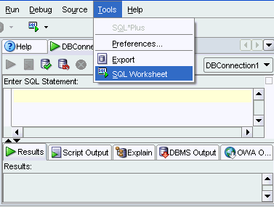
Using the SQL Worksheet
  Use the SQL Worksheet to enter and execute SQL, PL/SQL, and SQL*Plus statements.
  Specify any actions that can be processed by the database connection associated with the worksheet.
Notes:
Using the SQL Worksheet
When you connect to a database, a SQL Worksheet window for that connection is automatically opened. You can use the SQL Worksheet to enter and execute SQL, PL/SQL, and SQL*Plus statements. The SQL Worksheet supports SQL*Plus statements to a certain extent. SQL*Plus statements that are not supported by the SQL Worksheet are ignored and not passed to the database.
Within a worksheet, you can specify various database manipulation and definition connection actions, such as:
Creating a table
Inserting data
Creating and editing a trigger
Selecting data from a table
Saving the selected data to a file
You can display a SQL Worksheet by using either of the following options:
Select Tools > SQL Worksheet.
Click the Open SQL Worksheet icon.

Slide 14
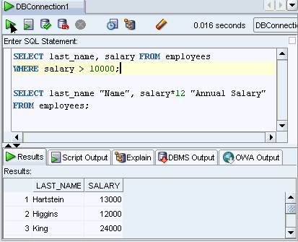
Executing SQL Statements
Use the Enter SQL Statement box to enter single or multiple SQL statements.
Notes:
Executing SQL Statements
In the SQL Worksheet, you can use the Enter SQL Statement box to enter a single or multiple SQL statements. For a single statement, the semicolon at the end is optional.
When you enter the statement, the SQL keywords are automatically highlighted. To execute a SQL statement, ensure that your cursor is within the statement and then click the Execute Statement button. Alternatively, you can press the [F9] key.
To execute multiple SQL statements and see the results, click the Run Script button. Alternatively, you can press the [F5] key.
In the example in the slide, the first statement is terminated with a semicolon because there are multiple SQL statements. The cursor is in the first statement, and so, when the statement is executed, results corresponding to the first statement are displayed in the Results box.

Slide 15
Summary
In this lesson, you should have learned how to:
  Describe the course organization
  Describe the sample HR schema
  List the available development environments
  Review the basic features of SQL Developer
Notes:
Oracle Database 11g: PL/SQL Fundamentals I - <number>

Slide 16
Notes:
Oracle Database 11g: PL/SQL Fundamentals I - <number>
Course Practices
In the practices for this course, you develop a simple application by using anonymous blocks that cover the following:
Writing a declarative section
Declaring variables of scalar types
Declaring variables using the %TYPE attribute
Writing an executable section
Accepting user inputs for variables
Retrieving the values from the database and storing the values in the variables by using the INTO clause
Writing a nested block within the executable section
Using the control structures in the executable section to perform business logic
Using the INDEX BY table to store values and print them
Handling exceptions

