Slide 1
Content
Movie mention
Sentiment
Geographical analysis
Word cloud
Movie Comparison
Conclusion

Slide 2
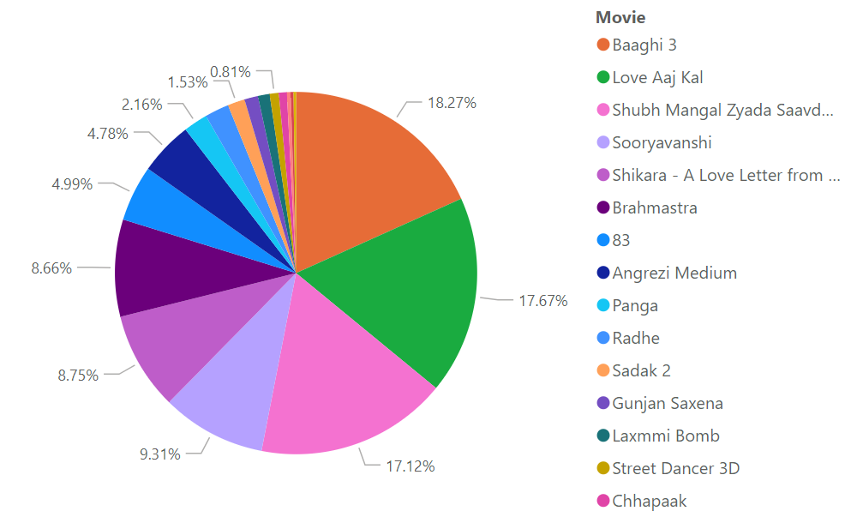
1. Movie mention
﻿
Baaghi 3 had the highest Movie mention at 2,894, Baaghi 3 accounted for 18.27% of Movie count. followed by Love Aaj Kal with 17.67% and Shubh Mangal Zyada with Saavdhan with 17.12%.

Slide 3
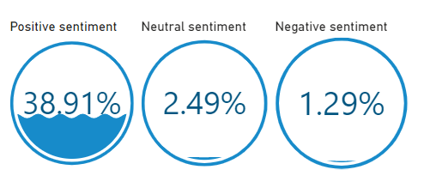
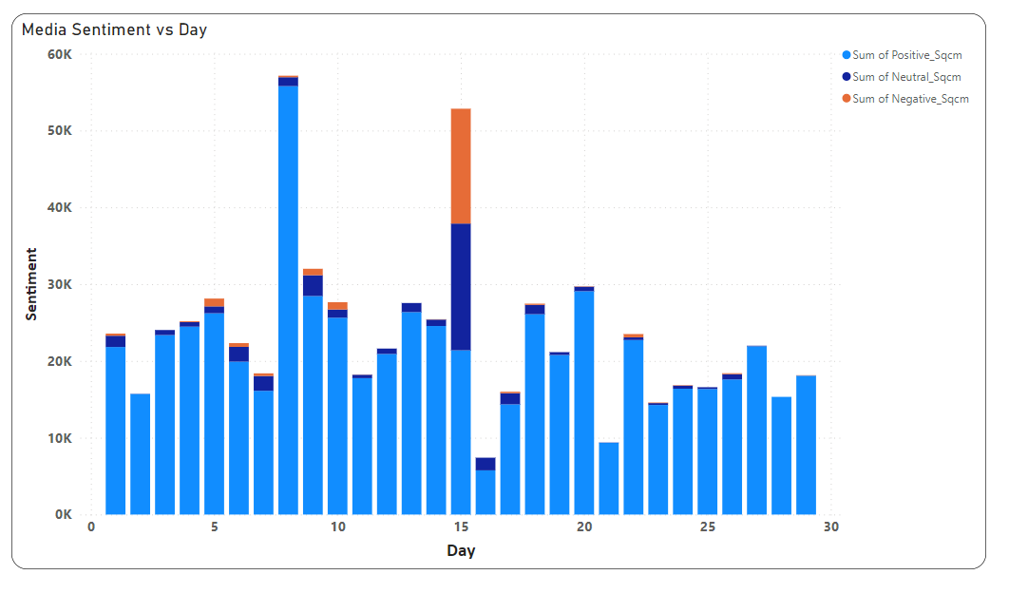
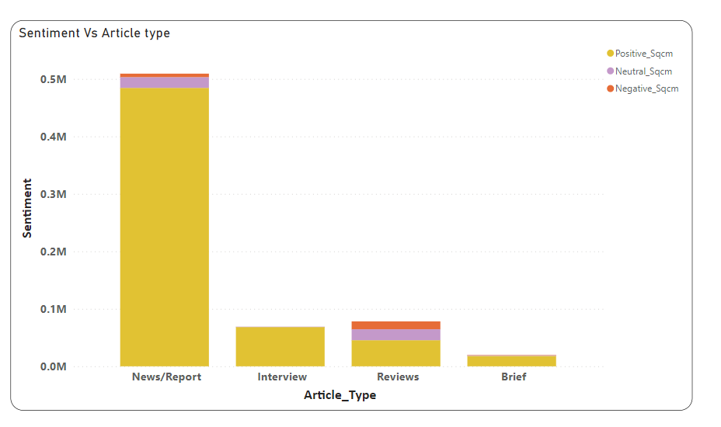
2. Sentiment

Slide 4
Insights
From the visuals, we can figure out that positive sentiment is highest in the article, followed by neutral and negative respectively. Journalist has used more positive attribute in their article regarding Bollywood movies and less negative sentiment for the february coverage.
Comparing day wise, February 8th 2020 has highest mention of positive, neutral and negative sentiment. 16th February 2020 had least mention of sentiment in the February media coverage.
News report media type used more sentiment for Bollywood news coverage, followed by interview and reviews. Least sentiment is covered by brief media coverage.
We can conclude that news media is the platform which people use the most as it has maximum mention. Media platform use maximum positive sentiment in their article and less negative sentiment.

Slide 5
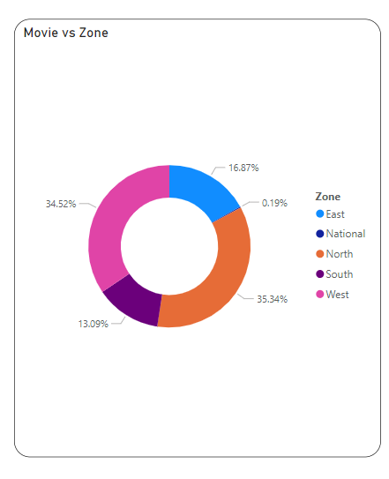
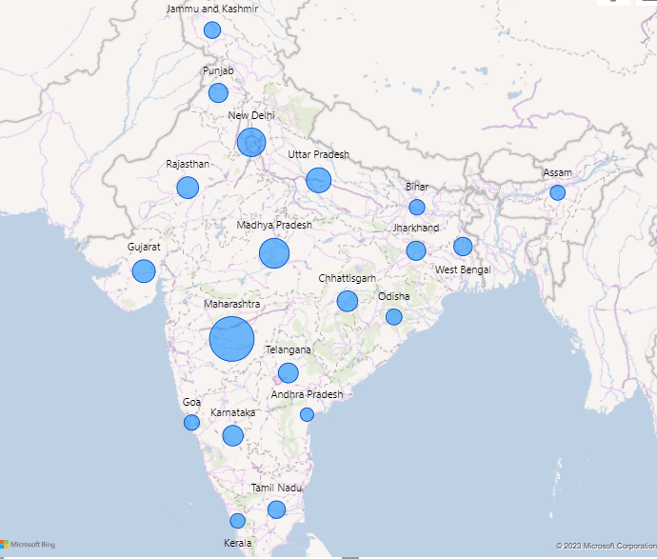
3. Geographical analysis

Slide 6
Insights
Maharashtra had the highest Count of Movie and was higher than Andhra Pradesh and AP which had the lowest Count of Movie. Maharashtra accounted for 21.08% of Count of Movie. Followed by Madhya Pradesh with 11.16% and New Delhi with 10.18% and least is Kerala with 0.92%.
Northern regions has maximum audience for Bollywood movie with 35.34%, followed by west region with 34.52% and followed by east with 16% of audience for Bollywood movie.
We can conclude that North-easthen and western region is popular for Bollywood movie and south region except Maharashtra are less likely prefer hindi movie because they have their own regional language and have difficulty in understanding the language.
Hindi language barrier has developed less occupancy in southern states like Andra Pradesh, Tamil Nadu, Karnataka and Kerala also south Indian movies are popular in these zones.

Slide 7
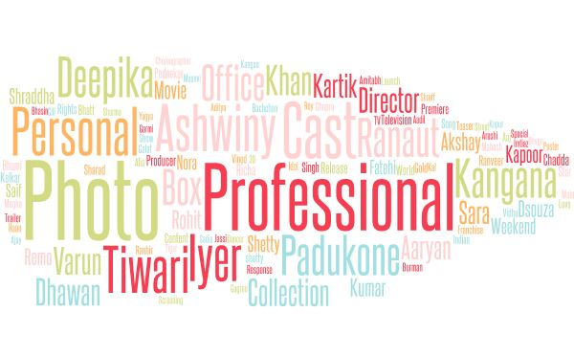
4. Word cloud
Photo,Personel,Professional,Iyer,Tiwari.. Etc are the keywords which are highly used in February media coverage. These are the hot keywords and these are trending across the media platform.

Slide 8
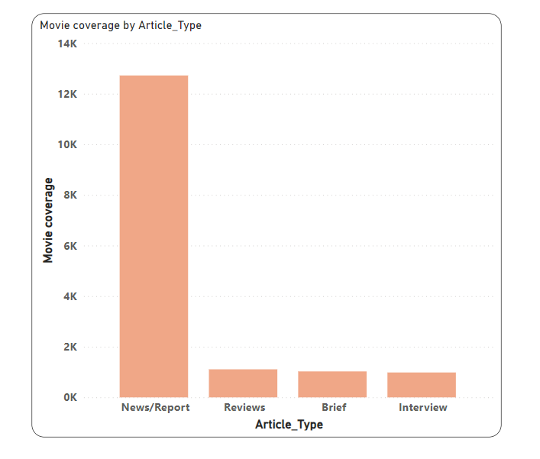
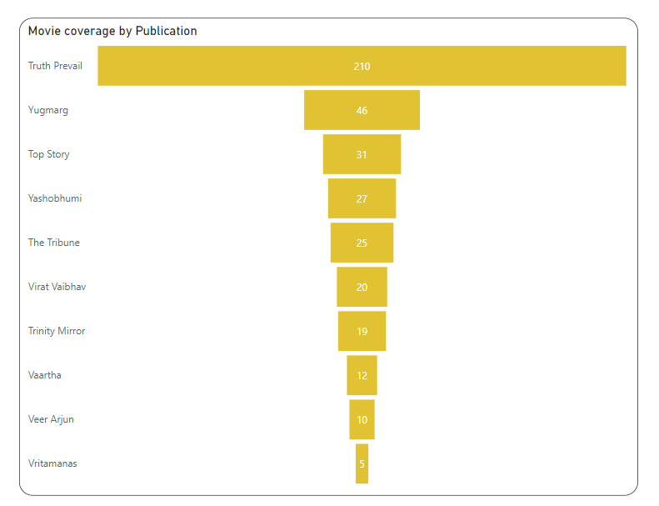
5. Movie Comparison

Slide 9
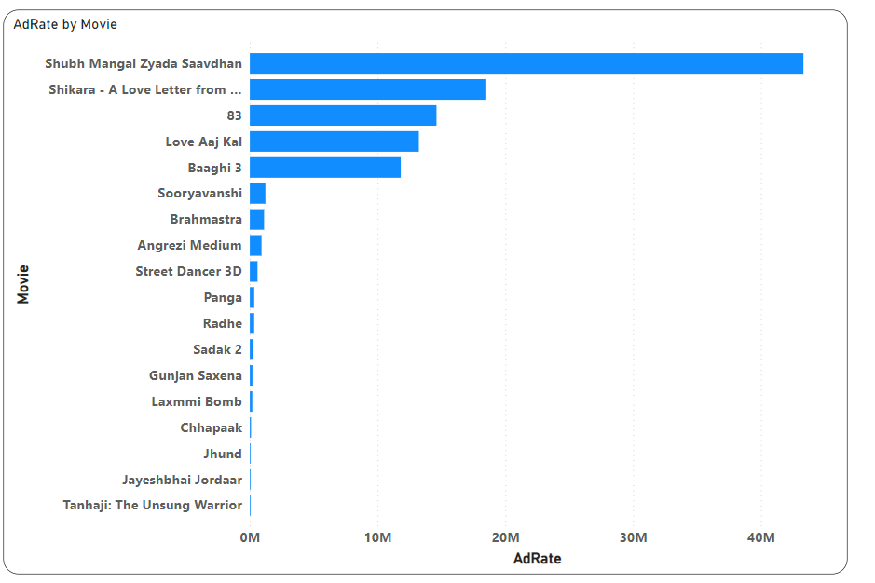
From the visuals, we can notice that News report has maximum coverage of Bollywood movie and interview has least coverage of movies.
Truth Prevail publication has highest coverage of Bollywood news article and Vritamanas publication includes least Bollywood news coverage.
Subh Mangal Zyada Savadhan movie has the highest adrate.

Slide 10
6. Conclusion
From the analysis, we can conclude that audience from north-westhern part of India prefer watching Bollywood movie as they speak and understand the language very well. Comparing it with southern part, proportion of people watching movie is less excluding Maharashtra state .
As recommendation, there is requirement to promote Bollywood in southern part as we can notice that AP has least audience. AP is a state which promotes good movies and has good movie audience. Capturing this state can help not only to enlarge audience but also in revenue.

