Slide 1
ERD Assignment 1 Solution

Slide 2
Q1: Each classroom has one projector or none. Each projector could be in a classroom or not.
:
Notes:
We see a 1:1 relationship because one projector can be in at most one classroom and one classroom can have at most one projector. Therefore we do not use any crow-feet.
We also note that a classroom is allowed not to have a projector and a projector is allowed not to be associated with a classroom. Therefore both halves are dashed.

Slide 3
Q2: Each actor stars in one or more movies. Each movie has one or more actors starring in it.
:
Notes:
Recall that while trying to identify the degree of a relationship we take one instance∫ of one entity type and see how many instances of the other entity type it can be related to – at least and at most. The upper limit determines whether or not we place a crow-foot on the opposite side, and the lower limit determines whether the line on its own side is dashed or not.
We see a m:n relationship because an actor can star in many movies and a move can also have many actors – upper limit. Thus we have a crow-foot on either end.
From the description we also see that every actor has to star in at least one movie and each movie must have at least one actor – hence the solid line at both ends.

Slide 4
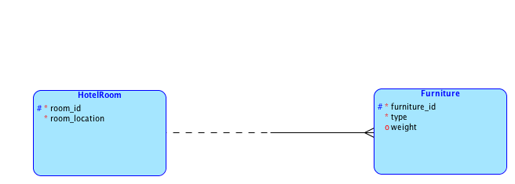
Q3: A hotel has many rooms and many pieces of furniture. Each room could have many pieces of furniture or none. Every piece of furniture has to be in one room.
Notes:
Hotel does not have to be an entity type in the diagram – we have just one hotel and no more instances. We are doing the modeling for a specific hotel’s situation and hence do not need an entity type for it.
Room and Furniture then emerge as the entity types of interest.
Each room is allowed to have many pieces of furniture, but a piece of furniture can only be in one room at most. We thus have a 1:n relationship.
A room need not have any piece of furniture, but a piece of furniture must be in one room. Thus Furniture has obligatory participation and Room has optional or non-obligatory participation. So we have a dashed line near Room and a solid line near Furniture.

Slide 5
Q4: A company has many machines. A machine requires many spare parts or none. Each spare part is meant for a specific machine. Each employee is assigned to maintain many machines or none. Each machine is assigned a specific employee for its maintenance.
Notes:
Company does not need to be an entity type here because it only sets the context where everything is happening. We do not have interesting instances of company that participate in relationships.
Machines and spare parts have a 1:n relationship and employees and machines also have a 1:n relationships – hence the crow-feet.
Every machine need not have a spare part, but every spare part is associated with exactly one machine – hence the dashed line near Machine and a solid line near Spare Part.
Every employee need not be responsible for a machine, but every machine has an employee associated with it. Hence the the solid line near Machine and the dashed line near Employee.

Slide 6
Q5: A company sells many products. Each product belongs to one product line, but each product line could have many products or none. Each product line has an employee assigned as its product manager. Each employee could be the product manager for many product lines or none.
Notes:
Company does not need to be an entity type here because it only sets the context where everything is happening. We do not have interesting instances of company that participate in relationships.
Product line and Product have a 1:n relationship and Employee and Product Line also have a 1:n relationship.
Since every product must belong to one product line, we have a solid line near Product. Every product line need not have a product in it and hence we have a dashed line near Product Line.
Every product line has to have an employee responsible for it. And so Product Line has a solid line in this relationship. Every employee need not be the manager of a product line and hence Employee has a dashed line in this relationship.

