Slide 1
Database Design: Part 1

Slide 2






Database
Database design
Database designer
Based on business needs
Data on:
Books
Users
Authors
Purchases
…
Based on design
SQL – Structured Query Language
Internet
User
Server computer
Notes:
We have seen this figure before. Thus far we have looked at how enterprise data stored in a relational database using SQL.
By now you must be convinced that we can get out pretty much any information we need by using SQL.
As I have said a few times before, I find this all the more fascinating because at the time we design the database, we do not have to ever consider what retrieval requirements we might have .. And yet, we can easily get whatever we want from the database.
Little wonder then that relational databases have served as the backbone of IT systems for over three decades now. Without this technology, IT applications might not have developed to the extent they have.
With increased volumes of data – like those that companies like Google and Facebook handle, we need different technologies – but that has to wait for another course …
We now trun out attention to database design. We have seen several (small, to be sure) relational databases – Suppliers-parts, SBA basketball, College, Sakila and classicmodels. Each had a set of tables and we enjoyed waving our SQL wand at these to get information.
How did whoever desinged these databases decide exactly what tables to have and what fields to keep in each table. After all they could have done things in so many different ways. Why did they choose to do it exactly like they did?
Enter “Database Design” using “Entity Relationship Diargrams” or ERD.

Slide 3
SPJ Database

Slide 4
College Database

Slide 5
SBA – Basketball Database

Slide 6
SBA – Basketball Database
Redundancy – one of these two will do
Redundancy – can be calculated from players’ points scored

Slide 7
Business rules
Systematic procedure
Database Design
Notes:
We will learn a structured process to understand a business situation and convert that understanding into a relational database design that can support almost any queries that would likely arise in managing operations.
AT this stage we do not need to explicitly consider what information might need to be retrieved. Just represent some kinds of business rules in a rigorous diagrammatic notation and the database design automatically pops out of the process. Cool stuff indeed!
Business knowledge plays a key role in this process.

Slide 8
Primary key or identifier – unique. Two different rows cannot have the same value for primary ley
Attributes
Course
# course_id
course_name
o credits
*
Courses table
Note: Singular
Course entity

Slide 9
#
Identifier attribute
Course
# course_id
course_name
o credits
*
Required attribute
*
*
o
Optional attribute
Course entity

Slide 10
Course
Sometimes we do not show the attributes

Slide 11
Entity Type
Entity Instance
Course
# course_id
* course_name
o credits

Slide 12
Entity Relationship Diagrams
refers to
Entity Type

Slide 13
Your turn: Draw the entity corresponding to the parts table shown below. Pause the video, do the work and only then proceed. (Make your own assumptions regarding required and optional attributes.)
Part
# pno
* pname
o color
* weight
o city
Parts table
Part entity

Slide 14
Instructors table
Instructor entity
Instructor
# instructor_id
* firstname
* lastname
o dob

Slide 15
Entity Type
Category of things about which an organization wants to store data.
Notes:
An entity type represents a category or concept. You should pay special attention to this fact. Entity types differ from entity instances.
The concept “Person” is an entity type. Specific persons like you and I are instances of this concept.
In this sense an entity type is abstract and instances are concrete.

Slide 16
Entity Type
Can potentially have instances
Always has attributes
Notes:
If you come across something that cannot have instances, then it cannot be an entity type – it could be an entity instance.
For example, consider a specific customer like customer A. Can we have instances of customer A? No. Customer A is customer A and does not represent a concept. Customer A is a specific, concrete customer.
On the other hand “Customer” is a concept and we could have several instances of the concept.
Entity types can have attributes. Each instance of an entity type will have its own values for each of the attributes.
In this sense you can also see an entity type as a template describing whatever is common to a family of objects or things.

Slide 17
Entity Type
Each instance has its own value for each attribute
Instructor
Instructor
# instructor_id
* firstname
* lastname
o dob
Instances
Notes:
The slide shows the entity type “Instructor” on the left.
On the right we see a table containing data about four instances of the entity type.
Note how each instance has its own values for each of the attributes like instructor_id, firstname, lastname and dob.

Slide 18
Entity Type
Singular noun
Notes:
Since an entity type represents a category or concept, it is always expressed as a singular noun.
Do not think of an entity type as a collection of instances. That misunderstanding can hamper you a lot as you try to learn ER diagramming.

Slide 19
Entity Type
usually
has
is a
is a
has
Category
Singular Noun
Attributes
Instances

Slide 20
Entity Type?
Customer
Notes:
Represents a category and can have instances, for example, customer A, customer B, etc.
Can have attributes like name, address, etc.
Can be an entity type.

Slide 21
Entity Type?
Vendor
Notes:
Represents a category and can have instances like vendor A, vendor B, etc.
Can have attributes like name, address, etc.
Can be an entity type.

Slide 22
Entity Type?
Seton Hall University
Notes:
Does not represent a category because it cannot have its own instances.
Looks like an instance of an entity type like University, or Organization or some such.

Slide 23
Entity Type?
Person
Notes:
Represents a category and can have instances which would be specific persons like you and me.
Can have attributes like name, address, etc.
Can be an entity type.

Slide 24
Entity Type?
Person with SSN 111-11-1111
Notes:
Does not represent a category and hence cannot be an entity type.
Could be an instance of an entity type like Person.

Slide 25
Entity Type
usually
has
is a
is a
has
Category
Singular Noun
Attributes
Instances
Notes:
In any given situation, we can identify infinitely many entity types. Which ones should we actually model?
For example, while studying an organization, we will surely come across entity types like chair, table, insect, light and so on. Whether we include these in our model or not depends on whether the business wants to track these as part of its operations. While mostly quite clear, we will encounter situations where this decision could be subjective.

Slide 26

Business Rules
A student might be assigned a laptop and each laptop might be assigned to a student.
Jill Jones
Laptop 1
Robert Yu
Laptop 2
Vladimir Khalifman
Laptop 3
George Ramos
Notes:
Figure shows instances of entity type student and shows possible relationships between those and instances of entity type laptop.
The above is not an ER diagram. It does not show entity types, instead it deals with entity instances.

Slide 27
Relationship
Notes:
Relationships capture the various ways in which entities could be related in the situation under consideration.
As with entity types, we can potentially identify infinitely many relationships. Which ones we include in our model depends on what the organization considers significant.

Slide 28

Jill Jones
Note that we do have students without laptops and laptops not assigned to students.
Laptop 1
Robert Yu
Laptop 2
Vladimir Khalifman
Laptop 3
George Ramos
Student
# student_id
* first_name
* last_name
….
Laptop
# laptop_id
* make
o model
….
Relationship
1:1
We will refine relationship notation – notation shown above is incomplete
Notes:
Note the correspondence between the figure showing connections between entity instances and the more general ER diagram showing the generic relationship between the two entity types.

Slide 29
Student
# student_id
* first_name
* last_name
….
Laptop
# laptop_id
* make
o model
….
1:1 Relationship
Notes:
Since a student can have at most one laptop and a laptop can be assigned to at most one student, this is a 1:1 relationship.
In determining the degree of a relationship, we consider each entity type in turn and ask at most how many instances of the other entity type the first one can be related to. We are concerned only with whether the answer is “one” or “many” – if the answer is more than 1, then the specific number does not matter, it is just “many.”
In the above situation we ask:
Each student can be associated with at most how many laptops? Our earlier description indicated that a student might be assigned a laptop. Thus the upper limit is 1.
Each laptop can be assigned to at most how many students? Again we see that the description indicates that this is also 1.
Therefore the relationship is 1:1.

Slide 30

Jill Jones
Laptop 1
Robert Yu
Laptop 2
Vladimir Khalifman
Laptop 3
George Ramos
Shows entity instances
Notes:
The above figure represents instances. It is not an ER diagram and I have shown it only to clarify the difference between ER diagrams and those that show specific instances.
ER diagrams show only entity types. As an enterprise operates, specific instances come and go – new customers are added, old ones are removed and so on – but the entity type “customer” stays on.

Slide 31
Student
# student_id
* first_name
* last_name
….
Laptop
# laptop_id
* make
o model
….
ER Diagram: Shows entity types
We will refine relationship notation – notation shown above is incomplete
Notes:
The above is an ER diagram – although the relationship notation has not yet been refined. We will discuss additional nuances of the notation shortly.

Slide 32


Your turn: A professor might be assigned an office; each office might be assigned to a professor.
Example: Prof X -> office 101, Prof Y → office 201. Prof Z → none. Offices 302 and 747 have not been assigned to any professors.
Show the instances and how they are related and also show the ERD. Is this a 1:1 relationship?
Prof. X
Office101
Prof. Y
Office 201
Prof. Z
Office 302
Office 747
Professor
# prof_id
* first_name
* last_name
….
Office
# office_id
* …
o ….
Another 1:1 relationship
We will refine relationship notation – notation shown above is incomplete
Notes:
ERDs show relationships between entity types by connecting related entity types by a line. The above slide does not show the full picture yet. We will refine the notation as we progress.

Slide 33
A student might be assigned a laptop and each laptop might be assigned to a student. Each student is assigned a dorm room and each dorm room might be assigned to a student.
Student
# student_id
* first_name
* last_name
….
Laptop
# laptop_id
* make
o model
….
ER diagrams can show many entities and their relationships
Dorm_room
# dorm_room_id
* …
* ….
We will refine relationship notation – notation shown above is incomplete
Notes:
An ERD shows many entity types of interest to an organization, and depicts their relationships.
You can therefore expect to see that many entity types have relationships with many others, as with Student above, which relates to Laptop and Dormroom.

Slide 34
Each laptop might be assigned to an employee for maintenance and each employee might be assigned to maintain many laptops.
Employee
# employee_id
* first_name
* last_name
o office_location
Laptop
# laptop_id
* make
o serial_no
* model
1:many or 1:n relationship
We will refine relationship notation – notation shown above is incomplete
Notes:
In the above, we see that each laptop might be assigned to at most one employee, but that each employee might be responsible for many laptops – we thus have a relationship of degree 1:n.

Slide 35
Employee
# employee_id
* first_name
* last_name
o office_location
Laptop
# laptop_id
* make
o serial_no
* model
Crow-foot notation used on the “many” side of a 1:n relationship
Notes:
We use the crow-foot notation on the “many” side of the 1:n relationship.
Since one employee can be associated with many laptops, we have the crow-foot on the side of Laptop.
Since each laptop can be associated with at most one employee, we do not have a crow-foot on Employee.
Be sure you get the logic of the placement of the crow-foot.

Slide 36
Relationship degree
One instance of each entity type can be associated with at most how many of the other – is upper limit 1 or many?
Notes:
In determining the degree of relationship between entity types A and B, we are concerned with the following two questions:
One instance of A can be related to at most how many of B: 1 or n?
One instance of B can be related to at most how many of A: 1 or n?
If both are 1, then we have a 1:1 relationship.
If one is 1 and the other is n then we have a 1:n relationship.
If both or n, then we have a m:n relationship.

Slide 37
A
B
Degree?
One instance of A can be related to at most how many instances of B (1 or n)?
One instance of B can be related to at most how many instances of A (1 or n)?
Both 1
1:1
One to one
One 1
1:n
One to many
Both n
m:n
Many to many
Notes:
Look at the relationship from both ends to determine the degree.

Slide 38
Relationship degree
1:1
1:n
m:n
Notes:
We will say more about m:n relationships later.

Slide 39
Business Rules
A student might be assigned a laptop and each laptop might be assigned to a student.
Each student is assigned a dorm room and each dorm room might be assigned to a student.
Each laptop must be assigned to an employee for maintenance and each employee might be assigned to maintain zero or more laptops.
Corresponding ERD
Student
# student_id
* first_name
* last_name
….
Laptop
# laptop_id
* make
o model
….
Employee
# employee_id
* first_name
* last_name
o office_location
Dorm_room
# dorm_room_id
* …
* ….
We will refine relationship notation – notation shown above is incomplete
Notes:
Database design involves identifying the various entity types involved in a business situation and capturing the relationships.
During this process we do not explicitly consider data retrieval requirements. We only try to unearth entities and relationships of interest. The sheer beauty of the relational database concept allows us to then use SQL to retrieve pretty much anything we need.
We first understand the business rules by talking to people who run the business and then convert these into ERDs.

Slide 40
A student might be assigned a laptop and each laptop might be assigned to a student.
Vs.
Every student is assigned a laptop and each laptop might be assigned to a student.
Vs.
Every student is assigned a laptop and each laptop must be assigned to a student.
Notes:
We now look at another aspect of relationships – whether or not an entity type has optional or mandatory or obligatory participation in a relationship. The three situations presented above bring out the main issue.
In the first sentence, we see that students and laptops have a relationship, but that the business rules allow for some students to not be related to any laptops and some laptops to not be related to any students. This means that all students and all laptops are not obliged to participate in the relationship.
That is, in general students and laptops re related, but not all students and laptops need to participate – participation is optional.
In the third sentence we see that all students and all laptops must participate – participation is obligatory or mandatory.
In the second sentence, we see that students must participate but laptops need not.

Slide 41
Note: Will not show attributes in some of the following few ERDs

Slide 42
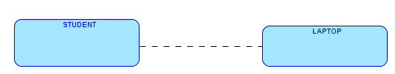
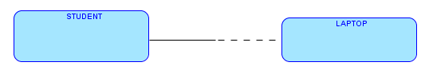
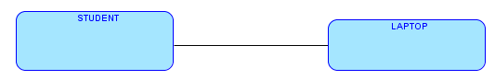
A student might be assigned a laptop and each laptop might be assigned to a student.
Every student is assigned a laptop and each laptop might be assigned to a student.
Every student is assigned a laptop and each laptop must be assigned to a student.
Notes:
The relationship line connecting two entity types can be seen as comprising two halves – one half close to each entity type.
If an entity type has obligatory participation (that is, it must participate and cannot remain unassociated with the other entity type) on a relationship then the half line close to it on that relationship is solid. Otherwise that half line is dashed.
We look at each of the above three examples in the following slides.
When we say that a student need not necessarily be related to a laptop, we are really answering the question: “is it possible that at some point in time w could have an instance of student that is unrelated to any instance of laptop?” If this is true, we have optional participation.
On the other hand, if at no point in time were it allowed for a student instance to be unrelated to a laptop instance, then we have obligatory participation.

Slide 43
A student might be assigned a laptop and each laptop might be assigned to a student.
Allows for a student with no laptop and for laptop that is not assigned to any student.
Non-OBLIGATORY participation
Notes:
When we have two entity types that have a relationship – like student and laptop above, we have many possibilities for business rules controlling their participation in the relationship.
The business rule on this slide says that although some instances of student and laptop might be associated, we could still have instances of both of these entity types which are not associated with any instance of the other. That is, these entity types have NON-OBLIGATORY participation in this relationship.

Slide 44
A student might be assigned a laptop and each laptop might be assigned to a student.
Neither entity type is obligated to participate in the relationship. Dashed line near both entities.
Notes:
In practice this means that in our database we can have instances of either entity type that has no associated instance of the other entity type.
This allows us to have instances of student and laptop that are related and also allows us to have instances of either that are unrelated to the other type.

Slide 45
Every student is assigned a laptop and each laptop might be assigned to a student.
Every student has obligatory participation. Solid line near Student.
Every laptop need not necessarily participate in the relationship. Dashed line near Laptop.
Notes:
In practice this means that we are not allowed to create a student instance without specifying a laptop for that student. Each and every student must at all times be associated to a laptop instance. However, we could create laptop instances that have no associated student.

Slide 46
Every student is assigned a laptop and each laptop must be assigned to a student.
Since both entity types have to participate in the relationship, both halves are solid.
Notes:
In practice this means that we cannot create a student without a laptop nor can we create a laptop without assigning it to a student.

Slide 47

Your turn: Each student is assigned one dorm room and each dorm room might be assigned to one student.
Students must have dorm rooms assigned -- OBLIGATORY participation. Hence solid near student.
A dorm room might not necessarily be assigned to a student. Every dorm room need not participate. Hence dashed.

Slide 48
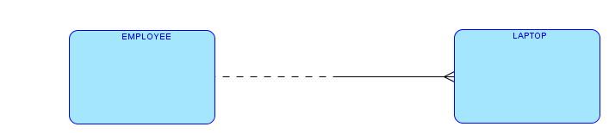
Your turn: Each laptop must be assigned to an employee for maintenance and each employee might be assigned to maintain zero or more laptops.
Every laptop must have an employee assigned for maintenance – solid line.
Can have employees without laptops assigned to them for maintenance – dashed line.

Slide 49
Player
Team
Degree
Each player can belong to at most how many teams?
1
Each team can have at most how many players?
n
1:n
Notes:
While drawing ERDs we first identify the entity types of interest. In doing this we apply the what we learned earlier about the properties of entity types.
Once we have the various entity types, we need to consider the relationships.
Properly representing a relationship requires us to identify the degree of a relationship and also the participation rules.
Together they determine the proper cardinality notation.

Slide 50
Player
Team
Obligatory?
No – free agents don’t
Does each player have to belong to a team?
Does each team have to have at least one player?
No – might not have purchased any players yet

Slide 51
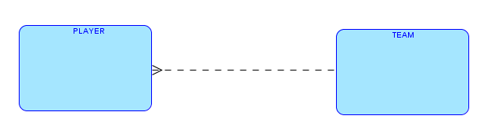

Slide 52
ERD
Relational database
Entity type
Table
Relationship
???
Notes:
We have already seen that an entity type on the ERD corresponds to a table on the relational database schema.
What does a relationship on the ERD connote in a relational database schema?

Slide 53
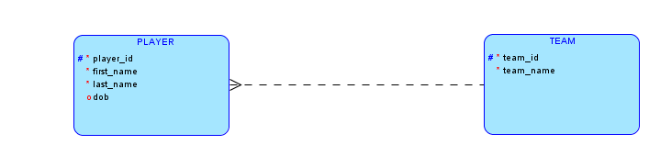
Notes:
From the databases that we have already seen, we know that we can show connections between various tables by adding the primary key of one table as a field or column in another. The slide shows how the connection between players and teams (that is, which team a player belongs to) is represented by adding the team_id to the players table.
In fact this is exactly how we represent relationships in schema.
The added column to represent a relationship is called a foreign key. The term makes sense because the field is not a primary key in the table where it is added – like the team_id in the players table, but it is a primary key elsewhere (in the players table); it is the key of some other table.
We will see later that the primary key of a table can sometimes be added to that same table as a foreign key.

Slide 54
Foreign key column
Relationships represented by adding primary key of a table as FOREIGN KEY column

Slide 55
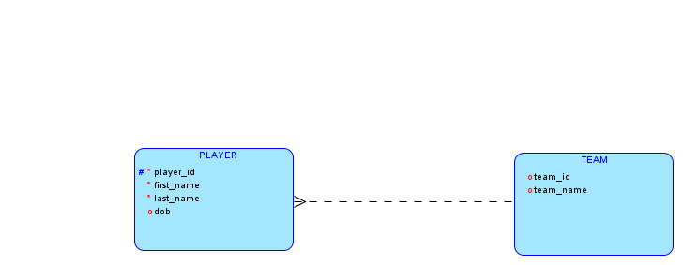
Team_id not shown as attribute in ERD …
Primary key of entity on the 1 side is always a column of the table on the n side of the relationship.
Redundant to repeat this on the diagram. Avoids clutter.
Notes:
ERDs can get pretty complex and we want to avoid clutter and redundancy where possible.
Generalizing from the teams-players example, we can see that to represent a i:n relationship, we add the primary key of the entity type in the “1” side as a foreign key to the entity type on the “n” side of the relationship. This is always true and therefore when we see a 1:n relationship on an ERD, we can always infer this. Therefore there is no need to redundantly show the foreign key attribute on the ERD and add clutter and redundancy.
This is why the above ERD does not show team_id as an attribute in the Player entity type. The ERD on the prior page implies this and so we need not repeat this by showing team_id as an attribute.

Slide 56
ERD
Relational database
Entity type
Table
Relationship
Foreign key
Notes:
From the earlier discussion, we see that a relationship on the ERD is represented through a foreign key on the database schema.

Slide 57
Courses table
Sections table
We know that course_id in the sections table refers to the id of a course on the courses table
Relationship
Notes:
We have several courses and for some courses we have multiple sections. We now go on to look at the issue of a primary key for the sections table.

Slide 58
Course
Section
Degree: How many sections can a course have? One or many?
A course can possibly have many sections. Each section is related to one course.
1:n

Slide 59
Obligatory Participation?
Course
Section
Does every course need to have at least one section?
No
Does every section need to be associated with at least one course?
Yes

Slide 60
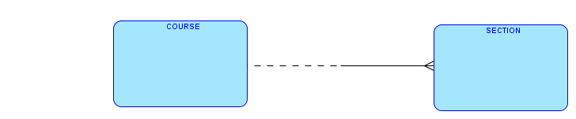
Obligatory Participation?
Every course need not have a section – non-obligatory
Every section must be of some course or other – section cannot exist without an associated course -- obligatory
Diagram is still incomplete

Slide 61
Two sections of course 10
Sections table
Three sections of course 30
No unique field
One section of course 40
Primary key for section?
Notes:
We can see that none of the columns in the sections table can be the primary key for the table. We need to think carefully about what uniquely identifies a section. Clearly a course has many sections. To distinguish between the different sections of the same course, we have the section name.
Since the combination of course_id and section_name will surely be unique, we can use this combination as the primary key.

Slide 62
Combination is unique -- can be the primary key

Slide 63
Course_id
Section_name

Slide 64
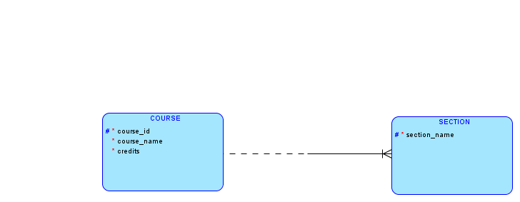
Why no course_id, instructor_id?
Course_id is implicitly an attribute because of 1:n relationship
Notes:
Because of the 1:n relationship between Course and Section, course_id is implicitly an attribute (as a foreign key) in Section. Thus, we do not need to show it as an attribute on the Section entity in the ERD.
However, this poses a problem because course_id is one of the columns in the primary key of Section. How can we show that the primary key for Section is course_id+section_id without being ale to put course_id as an attribute in Section?
The small vertical bar near the crow-foot is called as the key migration notation and it is used to solve this problem. The key migration notation tells us that the primary key of the entity type on the opposite side of the relationship is part of the primary key of this entity type.
Specifically, because of the key migration notation above, we know that the primary key of Section is not section_id alone, which is all that is shown inside the Section entity type, but that course_id is also a part of the primary key for Section.

Slide 65
Shows that primary key of entity on the other side is part of the primary key of this entity – key migration

Slide 66
When foreign key is part of the primary key of a table
Use key migration notation
Notes:
Whenever a situation arises that the foreign key is also part of the primary key we should use the key migration notation.

Slide 67
Figure out the primary key for SECTION just by looking at the figure?
Key migration notation tells us that course_id is also part of the primary key
# tells us that section_name is part of the primary key
Course_id+section_name

Slide 68
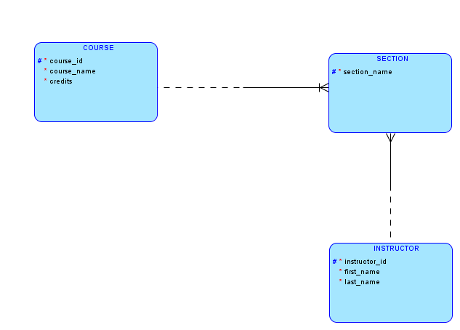
One instructor can teach many sections and each section is taught by exactly one instructor – 1:n relationship, hence instructor_id is a foreign key and is implicit
Instructor_id – just column, not part of primary key – unlike course_id which is a foreign key as well as part of the primary key of section.
Notes:
Instructor_id in the sections table is also a foreign key and hence it is not explicitly shown in the Section entity type. However, the mere presence of a 1:n relationship automatically tells us that instructor_id is a foreign key attribute and does not need to be redundantly specified on the entity type.

Slide 69
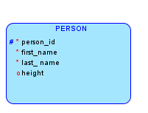
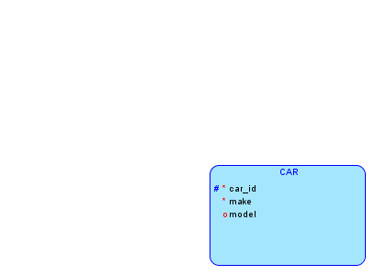
Practice 1: A person might own several cars or no cars (car_id is the primary key). Each car is owned by exactly one person (person_id is primary key). Make up two or three attributes other than the indicated primary key.
Step 1: Identify the entity types and their primary keys

Slide 70
Practice 2 (continued): A person might own several cars or no cars (car_id is the primary key). Each car is owned by exactly one person (person_id is primary key). Make up two or three attributes other than the indicated primary key.
Step 2: Identify the degree of the relationship
1:n
Each person can own several cars (upper limit)
Each car can belong to exactly one person (upper limit)

Slide 71
Practice 2 (continued): A person might own several cars or no cars (car_id is the primary key). Each car is owned by exactly one person (person_id is primary key). Make up two or three attributes other than the indicated primary key.
Step 3: Identify participation
Each person can own zero or more cars – Non obligatory
Each car must belong to exactly one person – Obligatory

Slide 72
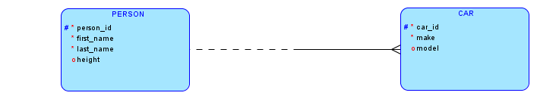
Practice 2 (continued): A person might own several cars or no cars (car_id is the primary key). Each car is owned by exactly one person (person_id is primary key). Make up two or three attributes other than the indicated primary key.
One person can own many cars
A person need not own a car
Each car must be owned by some person

Slide 73
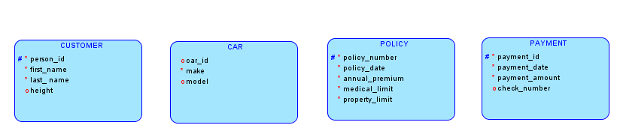
Practice 2: Construct an ER diagram for a car insurance company whose customers own one or more cars each. Each insurance policy covers one or more cars, and has zero or more premium payments associated with it. Each payment is for a particular policy and for a period of time and has an associated due date and the date when payment was received.
Step 1: Identify the entity types and their primary keys

Slide 74
Practice 2 (continued): Construct an ER diagram for a car insurance company whose customers own one or more cars each. Each insurance policy covers one or more cars, and has zero or more premium payments associated with it. Each payment is for a particular policy and for a period of time and has an associated due date and the date when payment was received.
Step 2: Identify relationship degrees
Step 3: Identify participation rules
Customer -- Car
1:n
Customer, Car: Obligatory
Policy -- Car
1:n
Car, Policy: Obligatory
Policy -- Payment
1:n
Policy: Non-obligatory; Payment: Obligatory

Slide 75
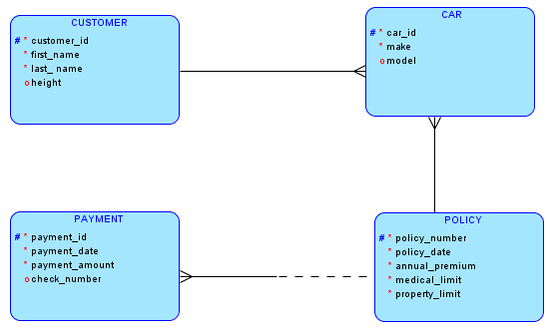
Customer -- Car
1:n
Customer, Car: Obligatory
Car -- Policy
1:n
Car, Policy: Obligatory
Policy -- Payment
1:n
Policy: Non-obligatory; Payment: Obligatory

Slide 76
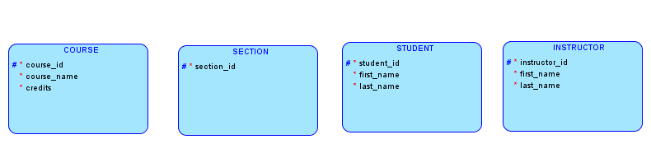
Practice 3: A course can have many sections or none. Each section is of exactly one course. A student can be registered for several sections or none. A section could have many students or none and a section must have exactly one instructor. An instructor could be teaching many sections or none. Each student has an instructor as advisor. Each instructor might be the advisor for many students or none.
Step 1: Identify the entity types and their primary keys

Slide 77
Practice 3 (continued): A course can have many sections or none. Each section is of exactly one course. A student can be registered for several sections or none. A section could have many students or none and a section must have exactly one instructor. An instructor could be teaching many sections or none.
Step 2: Identify relationship degrees
Step 3: Identify participation rules
Course -- Section
1:n
Course: Optional; Section: Obligatory
Student -- Section
m:n
Student: Optional; Section; Optional
Instructor – Section
1:n
Section: Obligatory; Instructor : Optional
Instructor -- Student
1:n
Student: Obligatory; Instructor : Optional

Slide 78
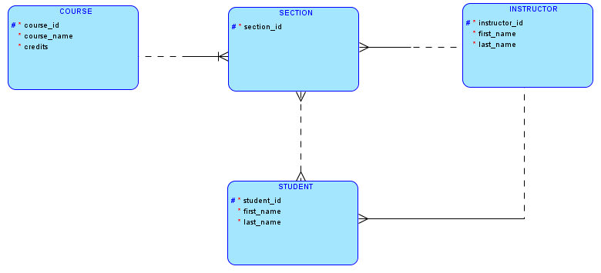
Course -- Section
1:n
Course: Optional; Section: Obligatory
Student -- Section
m:n
Student: Optional; Section; Optional
Section -- Instructor
1:n
Section: Obligatory; Instructor : Optional
Instructor -- Student
1:n
Student: Obligatory; Instructor : Optional

