Slide 1
Database Design: Part 2

Slide 2






Database
Database design
Database designer
Based on business needs
Data on:
Books
Users
Authors
Purchases
…
Based on design
SQL – Structured Query Language
Internet
User
Server computer
Notes:
We have already looked at how SQL can help us to retrieve almost any information we need from a relational database.
We have started looking at how we can arrive at a database design in the form of an Entity Relationship Diagram for a given business situation.

Slide 3
Cardinality Notation
Degree
Participation
Key migration
1:1
1:n
m:n
Obligatory
Non-obligatory

Slide 4
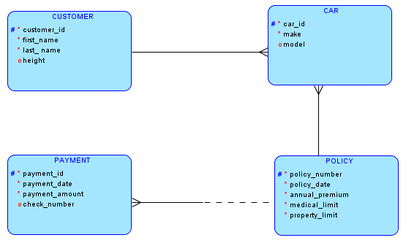
Recap 1 -- Basics
Entity type
Relationship
Primary key
Required attribute
Optional attribute
Many
Obligatory participation
Non-obligatory participation

Slide 5
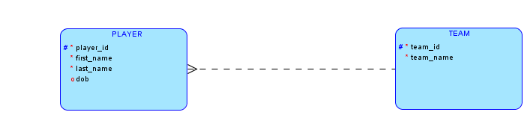
Recap 2 -- Implicit Foreign Key in 1:n Relationship
1:n relationship -- primary key of entity type on the 1 side is implicitly a FOREIGN KEY attribute of the entity type on the n side.
Notes:
Whenever we have a 1:n relationship, we can see that representing the relationship in tables requires adding the primary key of the entity type on the 1 side as a foreign key to the entity type on the n side.
You can easily convince yourself that adding the foreign key to the entity type on the 1 side will not work.
For example, in the above case, adding player_id as a foreign key to the teams table will not work, because a team could have many players and adding a foreign key will allow us to only show one player per team.
However, adding the team_id to the players table works because each player can belong to at most one team and adding a foreign key column allows this.

Slide 6
ODM Demo

Slide 7
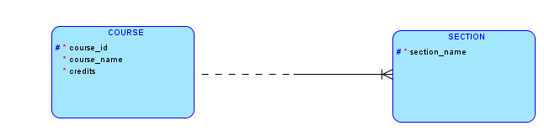
Recap 3 – Key Migration
Course_id is part of primary key of Section … shown with KEY MIGRATION notation
Course_id implicit foreign key attribute -- hence not shown
Notes:
Don’t confuse the implicit foreign key attribute with the key migration notation.
The implicit foreign key attribute always arises in all 1:n relationships.
We use the key migration notation only when the foreign key also happens to be part of the primary key in the table on the n side of the relationship. Be sure to understand this from the many examples provided earlier.

Slide 8
A company has many buildings and each has many rooms. To track the assets installed in each room, the company needs to track all rooms. The company has assigned each building a unique building_id and stores the square footage, GPS coordinate and height of each building.
Each building has many rooms and each room has a room number. Room numbers are unique within a building, but not across buildings. Thus building 200 could have a room 103 and building 300 could also have a room 103.
To uniquely identify a room across the company we have to use both the building id and the room number.
Notes:
A company wants to track the assets installed in various rooms of its office buildings. Hence it needs to have a way to store information about buildings and rooms.

Slide 9

Building 200 – Room 501
Building 300 – Room 501
501
501
501
301
301
301
Building 200
Building 300
Building 500
Room 501?
Notes:
The same room number can occur in several buildings and hence the room number alone does not suffice to uniquely identify a room across all the buildings.

Slide 10
Building_id
Room_number
Room
Notes:
The combination of room number and building number provides a unique identifier for a room. The combination will be unique across all roooms of all buildings.

Slide 11
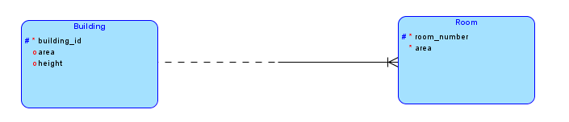
501
501
501
301
301
301
Building 200
Building 300
Building 500
Key migration notation
Primary key is room_number + building_id

Slide 12
Key Migration Demo in ODM

Slide 13
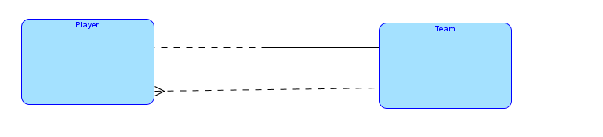
Relationship Naming
Two relationships? What do they stand for?
Notes:
In situations where we know the application domain very well, we might not need to be told what each relationship represents. However, in unfamiliar domains and sometimes even in familiar domains, we might not understand what a relationship signifies. In the above ERD, we might ve a little confused by the two relationships between Player and Team.
To clarify the meaning of relationships, we need to name them.

Slide 14
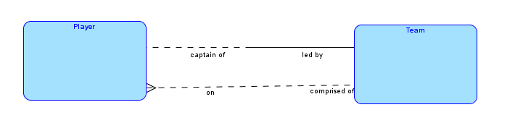
Now we see why we have two relationships
Need names to clarify ERDs
Notes:
The names on the relationships tell us what each relationship signifies from the viewpoint of the application domain.
One shows that a player is a regular player on a team and the other tells us that each team has one player as captain.
We place names on relationship lines to indicate the role that each entity type plays in the relationship.

Slide 15
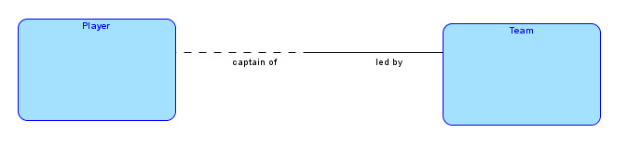
Reading Relationships
Reading from left …
Each
PLAYER
MIGHT BE
CAPTAIN OF
ONE
TEAM

Slide 16
Reading Relationships
Reading from right …
Each
TEAM
MUST BE
LED BY
ONE
PLAYER

Slide 17
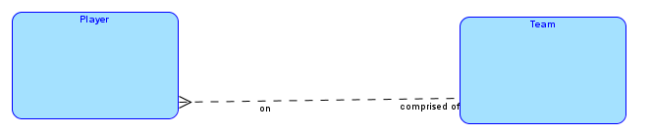
Reading Relationships
Reading from left …
Each PLAYER MIGHT BE ON ONE TEAM
Reading from right …
Each TEAM MIGHT BE COMPRISED OF ONE OR MORE PLAYERS

Slide 18
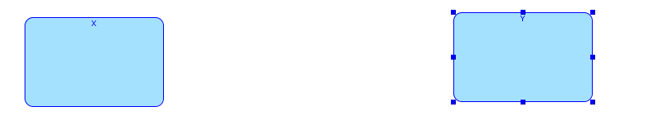
Naming Relationships
Reading from left to right – name the relationship on the left side so as to properly complete the following sentence:
must be
one or many
Each X
Name-1
Y(s)
might be
one
Solid or dashed on left
Crow-foot or not on right
Name-1

Slide 19
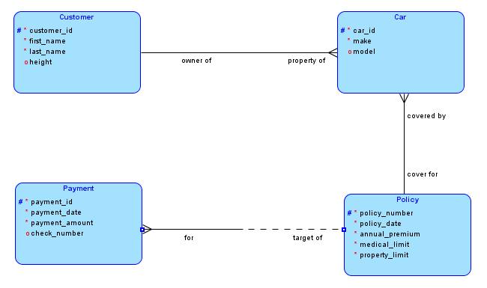
Reading Relationships – Your turn

Slide 20
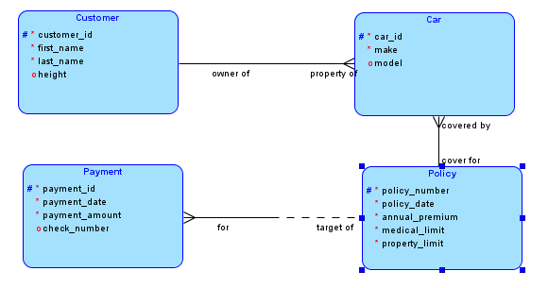
Reading Relationships – Your turn
Each customer must be owner of one or many cars
Each car must be property of one customer
Each car must be covered by one policy
Each policy must be the cover for one or more cars
Each policy might be the target of one or more payments
Each payment must be for one policy

Slide 21
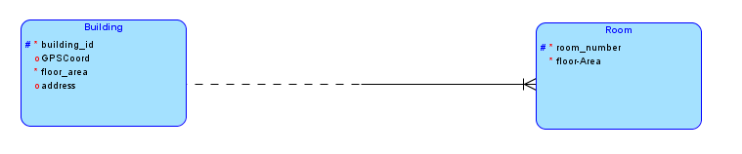
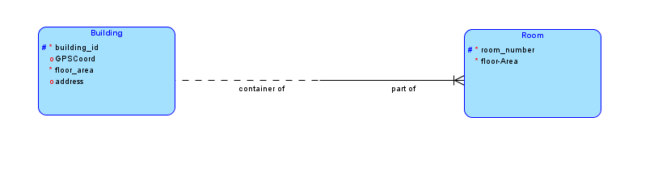
Naming Relationships – Your Turn: Find suitable names for the relationship – you need two names, one on each side.

Slide 22
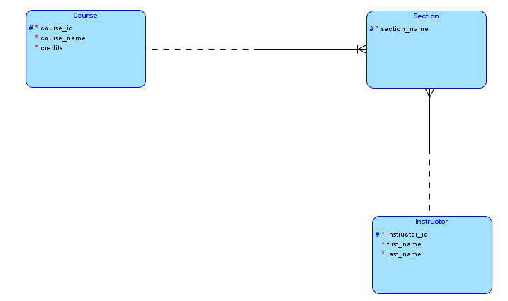
Naming Relationships – Your Turn (continued): Find suitable names for the relationships – you need two names per relationship.

Slide 23
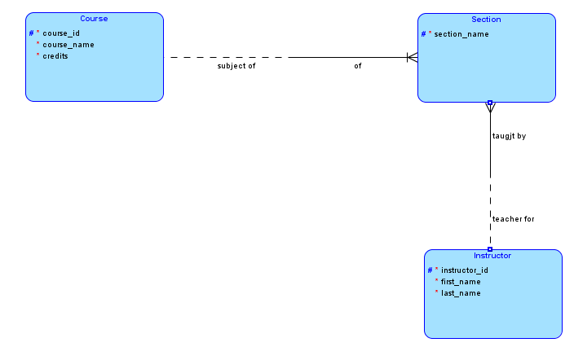
Naming Relationships – Your Turn (continued): Find suitable names for the relationships – you need two names per relationship.

Slide 24
Naming Relationships – Your Turn (continued): Find suitable names for the relationships – you need two names per relationship.

Slide 25
Relationship Naming Demo in ODM

Slide 26
ERD Ninjahood
Master m:n Relationships

Slide 27
Inventory management scenario:
A company keeps many products in stock.
The company has many warehouses and stores many products in each warehouse.
Each product could also be stored in several warehouses.
At various points in time the company could run out of stock of some products.
At various points in time, some warehouses could be empty.

Slide 28
Inventory management scenario
Products
Quantities
Warehouses
Keyboard
W1
200
Disk drive
W2
100
150
Monitor
W3
Memory
250
Webcam

Slide 29
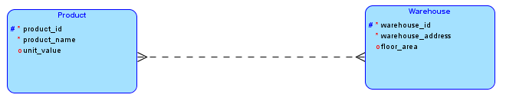
Attribute quantity?

Slide 30
Attribute values
Atomic
Entity instances must have indivisible values for each attribute

Slide 31
Non-atomic values in column – not allowed in a relational design

Slide 32
Products
Quantities
Warehouses
Keyboard
W1
Where does attribute quantity belong? Product or Warehouse?
200
Disk drive
100
W2
150
Monitor
W3
Memory
250
Webcam

Slide 33
Because a product can be in many warehouses, placing quantity in Product makes it non-atomic
Because a warehouse can have stocks of many products, placing quantity in Warehouse makes it non-atomic
Disk drive is in W1 and W2
W2 has both Disk drives and Webcams

Slide 34
Where does attribute quantity belong? Product or Warehouse?

Slide 35
Products
Quantities
Warehouses
Keyboard
W1
200
Disk drive
100
W2
150
Monitor
W3
Memory
250
Webcam
Quantity is an attribute of the relationship between Product and Warehouse

Slide 36
Duck test
If it swims like a duck and quacks like a duck it must be a duck
If a relationship has its own attribute, then it must be an entity type

Slide 37
New entity type that has quantity as an attribute
ALWAYS create new entity type for m:n relationship

Slide 38
ALWAYS create new entity type for m:n relationship …

Slide 39
Even if it does not seem to have an attribute.

Slide 40
Inventory management scenario
Products
Warehouses
Keyboard
W1
200
Disk drive
W2
100
150
Monitor
W3
Memory
250
Webcam
Think of each line as an instance of the new entity type.

Slide 41
Products
Quantities
Warehouses
Keyboard
W1
200
Disk drive
100
W2
150
Monitor
W3
Memory
250
Webcam
Each instance represents the storage of a certain quantity of a product at a warehouse – Stock

Slide 42
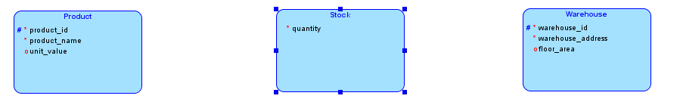

Slide 43
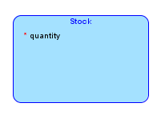
Products
Warehouses
Keyboard
W1
200
Disk drive
100
W2
150
Monitor
W3
Memory
250
Webcam
Stock instance: of a particular product at a particular warehouse
product_id + warehouse_id can be primary key for Stock

Slide 44
Cardinality notation?

Slide 45
Relationship Degree
n
At most how many stocks can a product have?
1
At most how many products can a stock be related to?
1:n

Slide 46
0
At least how many stocks must a product have?
1
At least how many products must a sock be related to?
Product – Non-obligatory
Stock – Obligatory

Slide 47
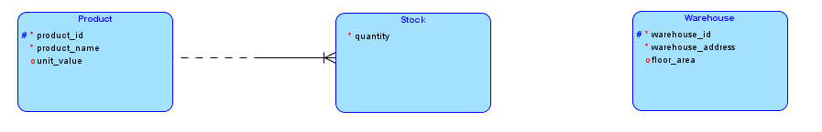
1:n
Stock – Obligatory
Product – Non-obligatory

Slide 48
Relationship Degree
n
At most how many stocks can a warehouse have?
1
At most how many warehouses can a stock be related to?
1:n

Slide 49
0
At least how many stocks must a warehouse have?
1
At least how many warehouses must a sock be related to?
Warehouse– Non-obligatory
Stock – Obligatory

Slide 50
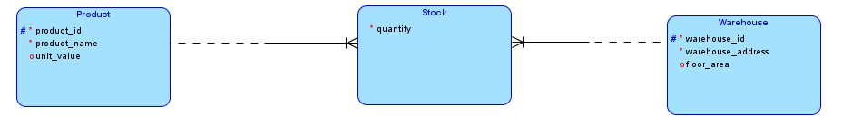
1:n
Stock – Obligatory
Warehouse– Non-obligatory

Slide 51
Primary Key for Stock?
From key migrations: product_id + warehouse_id

Slide 52
Entity type created to replace m:n relationship: Associative Entity

Slide 53
Cardinality notation on associative entities always the same: crow-feet and solid half-lines on both sides.
Key migrations from both ends – if we do not give it its own primary key

Slide 54
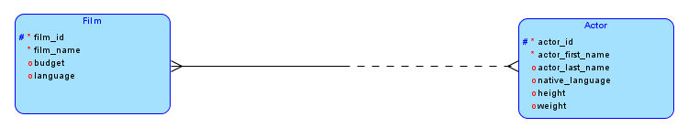
Hollywood scenario:
A film studio produces many films.
The studio has signed on many actors.
Each actor might have a role on several films.
Each film must involve one or more actors playing roles.
Some actors might not yet have acted in any films.

Slide 55
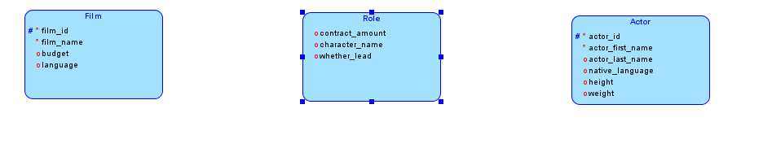

Slide 56
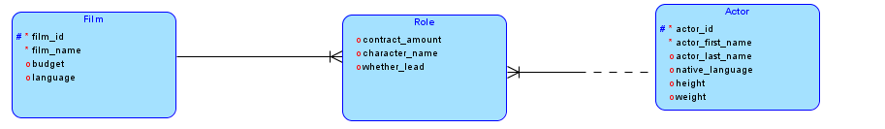
Each film must have at least one actor
An actor might not have any roles yet

Slide 57
Each role must be in some film
Each role must involve an actor

Slide 58
Primary key for Role: film_id + actor_id

