Slide 1
Input data frame
Pipe operator
price_demand |>
point_plot(sales_qty ~ price)
Function
Tilde expression for the plot
sales_qty ~ price
Y-axis variable
tilde
X-axis variable

Slide 2
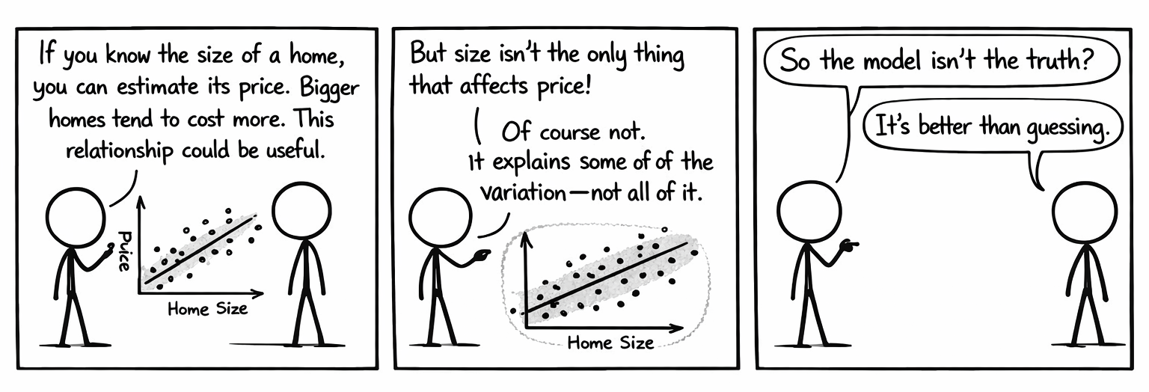


Slide 3
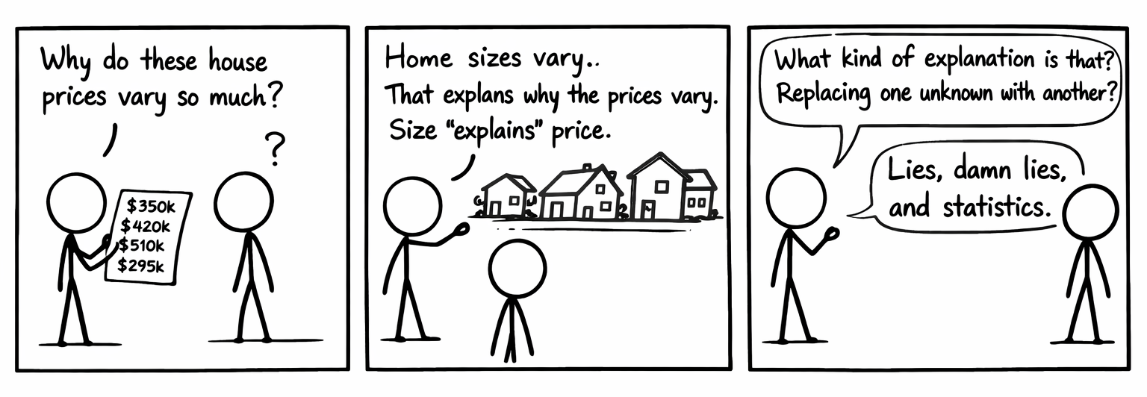

Slide 4
weekly_sales_k ~ advertising_spend_k + color
Y-axis variable
tilde
X-axis variable
Variable for color of points

Slide 5
Boston_marathon |>
point_plot(minutes ~ 1, annot = ”violin”)
Tilde expression for the plot
Adding an “annotation”
minutes ~ 1
Y-axis variable
”1” because there is no x-axis variable

Slide 6
annot = ”violin”
We want an annotation
… specifically, a “violin”

Slide 7
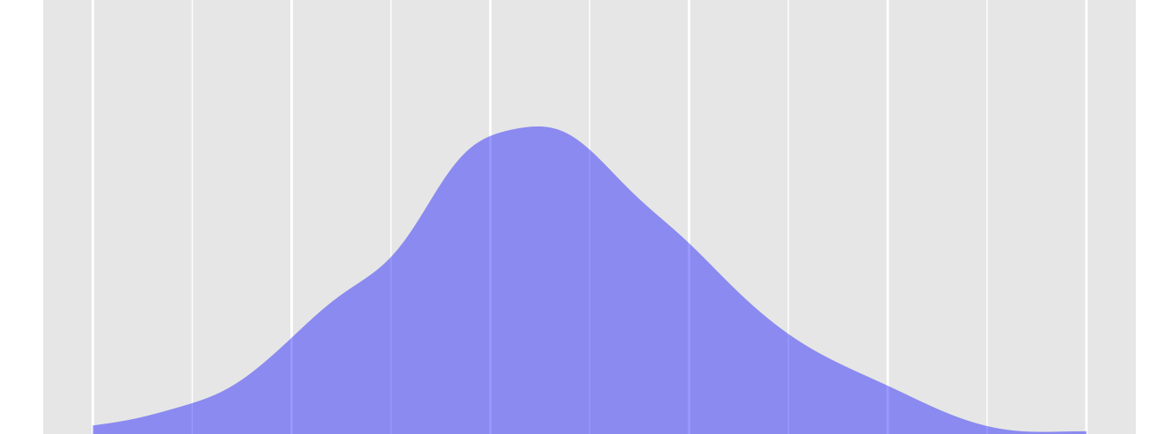

Slide 8
4, 2, 6, 1, 8, 1, 3, 9, 2, 4
4

Slide 9
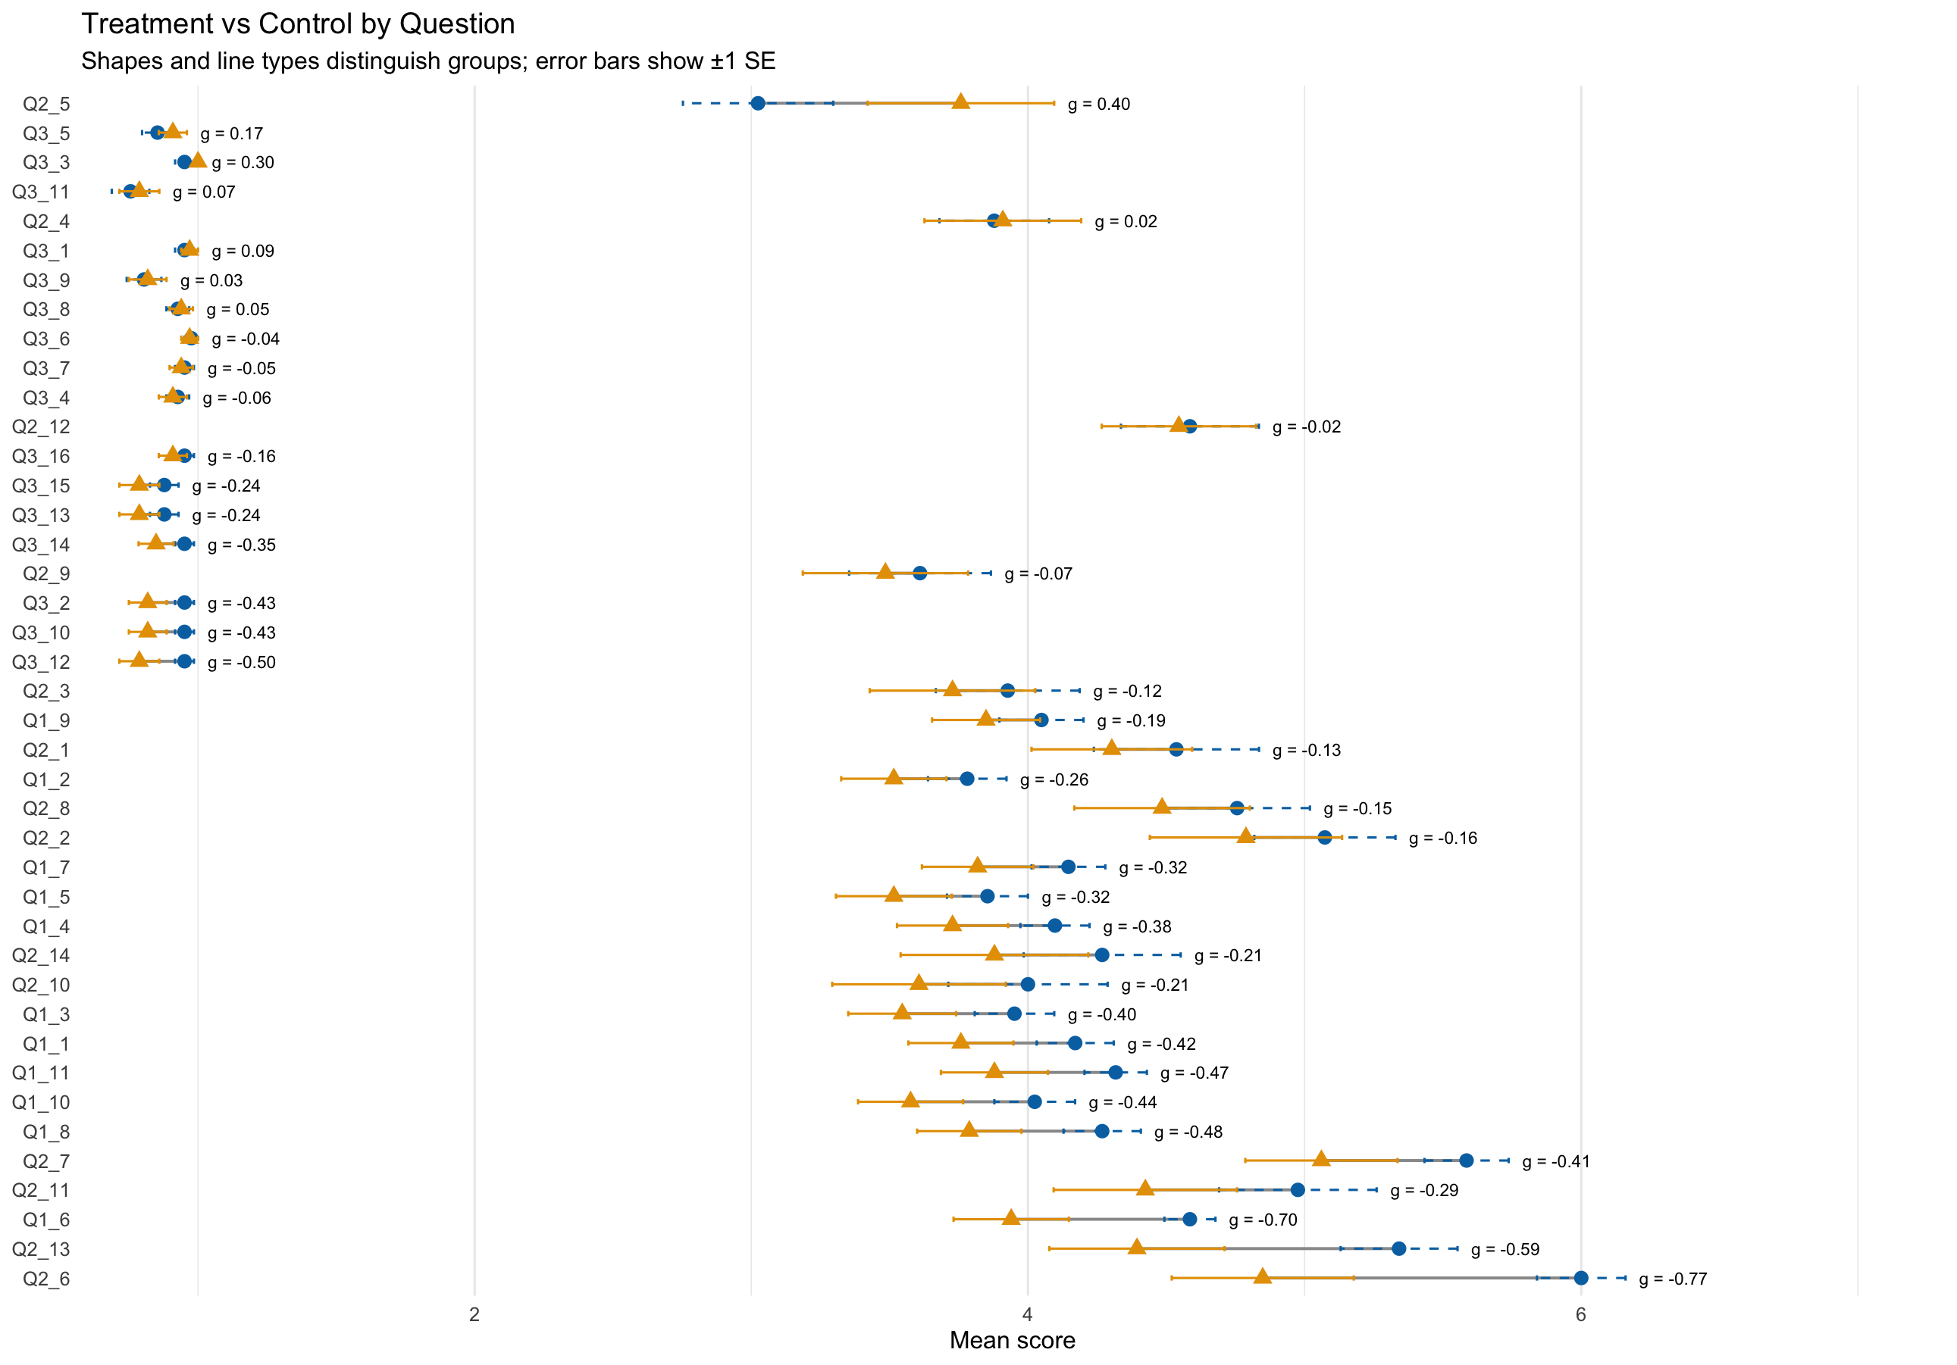

Slide 10
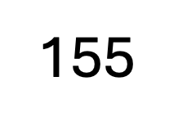





Beach kiosk model
Predicted number of customers
temperature
$$a+b∗temperature$$
$$temperature$$
$$\hat{customers}$$
$$15+2∗temperature$$
$$70$$
155

Slide 11
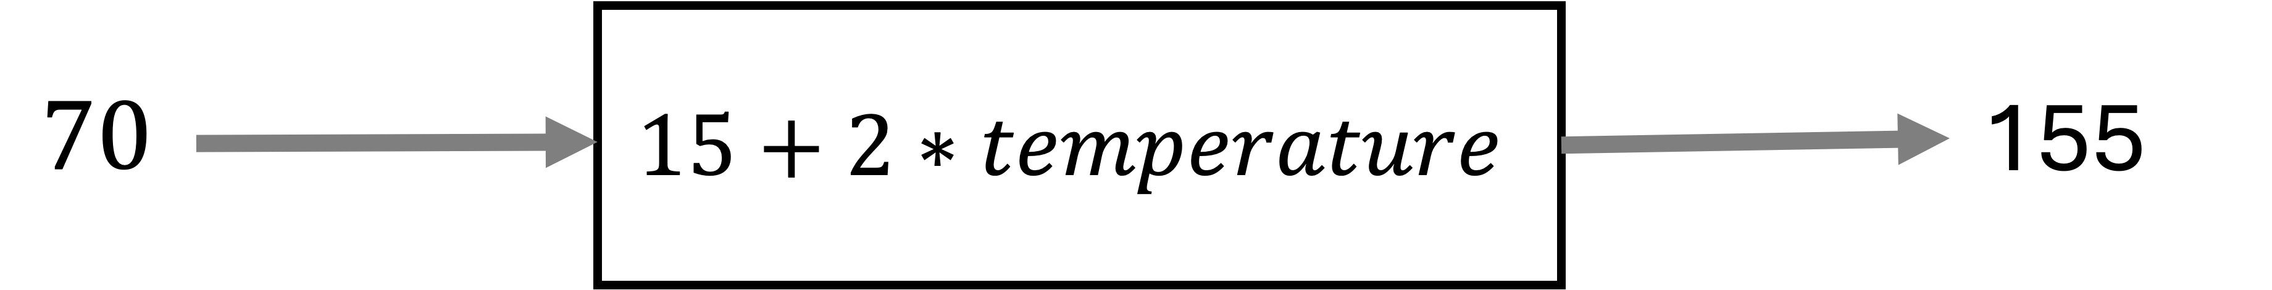


Slide 12

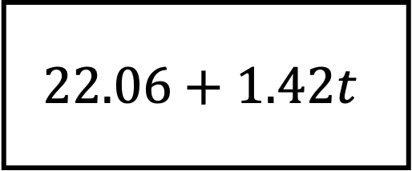

$$22.06+1.42t$$
$$t$$
$$\hat{cust}$$

