Slide 1


3D Haralick texture feature for cell phase classification
Weekly meeting
Du Tiehua
2 Jul 2008

Slide 2













Texture of cell phases
1 | early interphase
2 | late Interphase
3 | later Interphase
4 | Prophase
5 | Prometaphase
6 | Metaphase
7 | Anaphase A
8 | Anaphase B
9 | Telophase

Slide 3
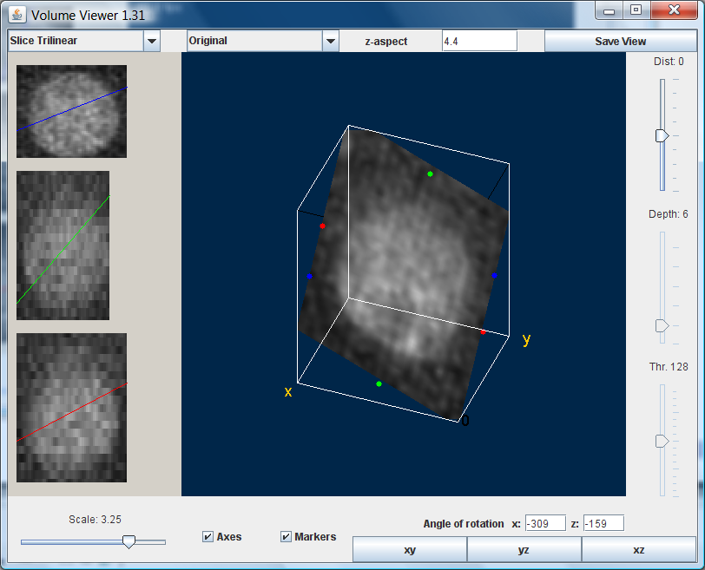
How to quantify texture of 3D image stack?

Slide 4
2D Haralick textural feature
R.M. Haralick, et. al. Texture feature for image classification, IEEE Transaction on Systems, Man and Cybernetics, Vol. MSC-3, 1973
Haralick texture features are based on statistics which summarize the relative frequency distribution. ( how often one gray tone will appear in a specified spatial relationship to another gray tone on the image).

Slide 5
Calculation of Haralick feature
Gray-tone dependence matrix
Texture feature calculation

Slide 6
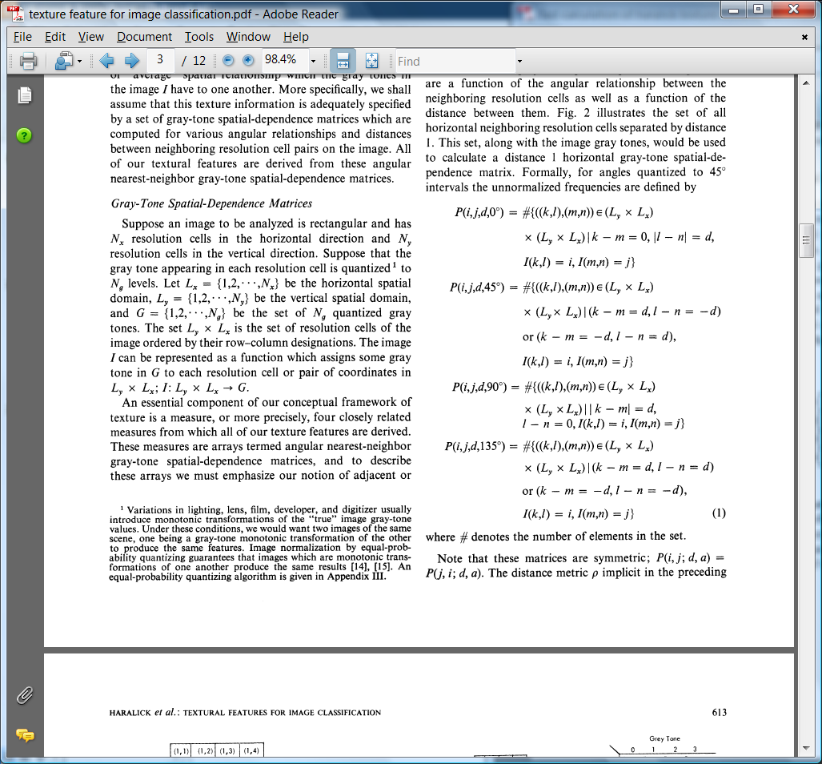
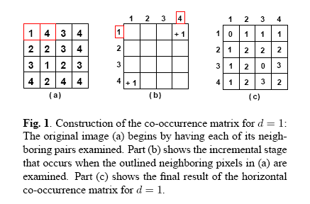
Gray-tone dependence matrix
90
135
45
0

Slide 7
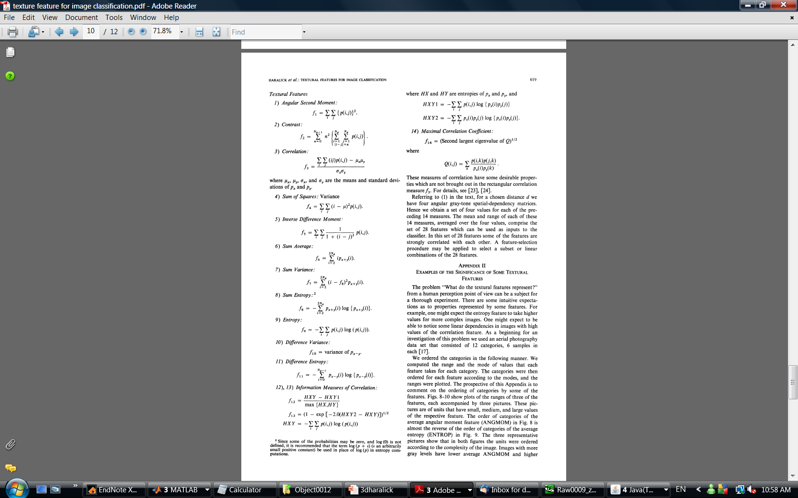
Texture feature calculation

Slide 8
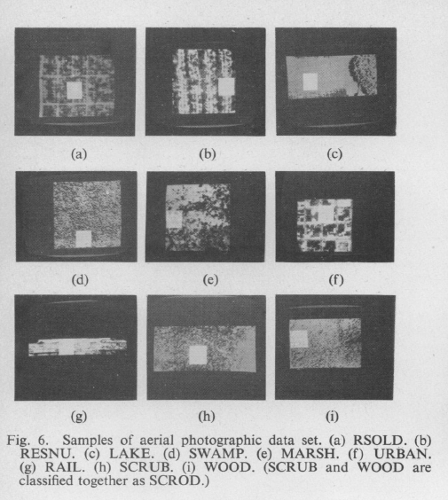
Successful applications of 2D Haralick feature

Slide 9
Literatures about “3D Haralick texture”
Ludvik T, et. al. 3D extension of Haralick texture features for medical image analysis. Proceedings of the Fourth conference on IASTED International Conference: Signal Processing, Pattern Recognition, and Applications. Innsbruck, Austria: ACTA Press; 2007.
Xiang Chen and Robert F. Murphy, Robust Classification of Subcellular Location Patterns in High Resolution 3D Fluorescence Microscope Images, Proceedings of the 26th Annual International Conference of the IEEE EMBS, San Francisco, CA, USA • September 1-5, 2004

Slide 10
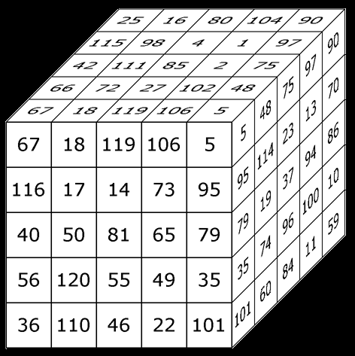

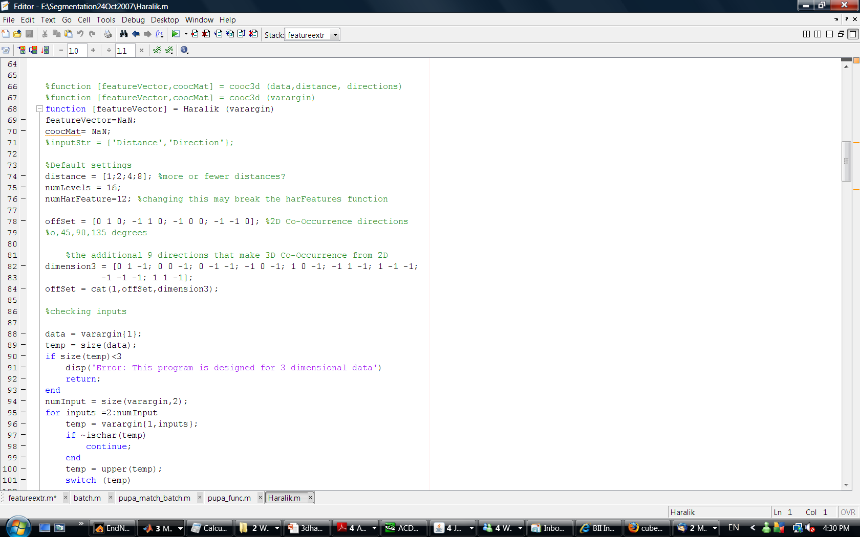



3D Haralick texture calculation
1. There are 13 Gray-tone dependence matrices for 3D image stack (13 directions). (Interpolate the image stack such that distance between image slices is equal to pixel size )
2. Calculate Haralick features for 13 directions

Slide 11
Step size
We choose step size d at 1, 2 ,4 and 8 to capture the texture at different scale

Slide 12
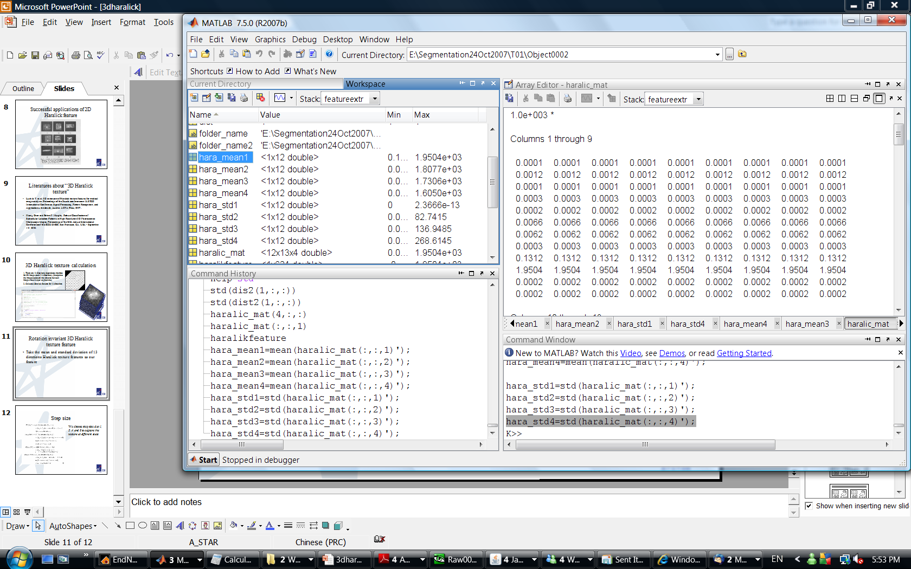
Rotation invariant 3D Haralick texture feature
Take the mean and standard deviation of 13 directions Haralick texture features as our feature
 | Energy | Entropy | Correlation | Contrast | Variance | SumMean | Inertia | Cluster Shade | Cluster tendency | Homogeneity | MaxProbability | Inverse Variance
Mean(d=1) | 0.106748 | 1.216471 | 0.147521 | 0.274341 | 0.189224 | 6.638649 | 6.173905 | 0.274341 | 131.2019 | 1950.414 | 0.223019 | 0.232507
Std(d=1) | 2.89E-17 | 2.31E-16 | 2.89E-17 | 5.78E-17 | 2.89E-17 | 0 | 1.85E-15 | 5.78E-17 | 2.96E-14 | 2.37E-13 | 5.78E-17 | 0
Mean(d=2) | 0.06549 | 1.44459 | 0.136338 | 1.056797 | 0.185535 | 6.773588 | 6.25785 | 1.056797 | 124.2524 | 1807.685 | 0.150424 | 0.427032
Std(d=2) | 0.023601 | 0.133768 | 0.007405 | 0.498525 | 0.002163 | 0.103494 | 0.049816 | 0.498525 | 4.278291 | 82.74145 | 0.04497 | 0.112587
Mean(d=4) | 0.058597 | 1.500142 | 0.129521 | 1.593661 | 0.183596 | 6.858073 | 6.311798 | 1.593661 | 117.3675 | 1730.587 | 0.138668 | 0.43412
Std(d=4) | 0.022342 | 0.140564 | 0.013021 | 0.971932 | 0.003722 | 0.186375 | 0.095563 | 0.971932 | 11.30717 | 136.9485 | 0.041606 | 0.092929
Mean(d=8) | 0.053481 | 1.554143 | 0.116147 | 2.847348 | 0.181185 | 7.04164 | 6.387158 | 2.847348 | 104.2822 | 1604.952 | 0.129526 | 0.411884
Std(d=8) | 0.023708 | 0.172289 | 0.028128 | 2.540861 | 0.005855 | 0.396854 | 0.170341 | 2.540861 | 26.43448 | 268.6145 | 0.045718 | 0.082934

Slide 13

Question?

