Slide 1
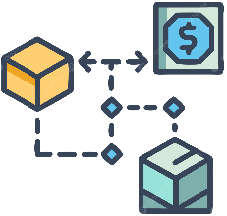



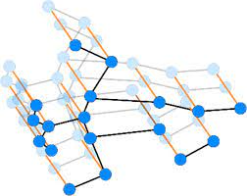



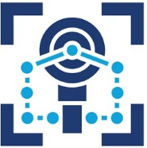
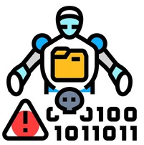





Streaming
Cryptocurrency
Transactions
572 tx/sec
Bitcoin/Ethereum
Real-time Stream
Transaction Attributes
Risk Assessment
with Confidence
Privacy Budget Tracker
Sliding Windows1-hour/1-min
Out-of-order Handling
Watermark
Management
𝜀 = 0.93
Budget Allocation
Noise Calibration
Composition Tracking
Window Info
< 4ms Latency
98.50% F1 Score
Temporal Window Manager
𝜀_{𝑐𝑜𝑛𝑠𝑢𝑚𝑒𝑑}
Node/Edge Creation
Temporal Indexing
GPU B+ Trees
Graph Partitioning
Cumulative Cost
Round Tracking
Sensitivity Analysis
Adaptive Thresholds
Graph Stats
Temporal Graph Construction
Privacy Accounting
$G_{t}^{short}$
$$G_{t}^{long}$$
$$G_{t}^{medium}$$
Daily/Weekly Trends
Account Profiles
Incremental Learning
Evolution Detection
Short-term Pattern Detection
Hourly Analysis
Behavioral Patterns
GNN Processing
Attention Mechanisms
Minute-level
Rapid Sequences
Immediate Alerts
𝑂(|𝐸 |_{𝑤𝑖𝑛𝑑𝑜𝑤})
𝜀_{𝑟𝑒𝑚𝑎𝑖𝑛𝑖𝑛𝑔}
Long-term Pattern Detection
Medium-term Pattern Detection
Fraud Score Computation
𝑃_{𝑚𝑒𝑑𝑖𝑢𝑚}
𝑃_{𝑙𝑜𝑛𝑔}
Risk Calculation
Threshold Application
Model Inference
Federated Weights
𝑃_{𝑠ℎ𝑜𝑟𝑡}
Adaptive Privacy
Control
Pattern Fusion
Noise
Hourly Analysis
Behavioral Patterns
GNN Processing
Attention Mechanisms
Pattern Complexity
Dynamic Adjustment
Remaining Budget
Utility Optimization
Early Stopping
𝜀 ≤ 1.0
𝑃_{𝑓𝑢𝑠𝑒𝑑}

Slide 2


Cryptographic
Attacks
Privacy
Attacks
Proof
Forgery:
2¹²⁸ ops
Commitment
Forgery:
2¹²⁸ ops
Membership
Inference:
51.3%
Model
Inversion:
8.2%
FORGE-AUTH
Attribute Inference: 54.7%
Key Recovery: HSM+Threshold
Behavioral
Attacks
Federated
Attacks
Replay
Detection:
97.6% acc
Takeover
Detection:
93.7% acc
Byzantine
Tolerance:
3/10 nodes
Sybil
Detection:
94.8% rate
Strong defense: >90%
Vulnerability: >50%
Spoofing Detection: 95.9% acc
Data Poisoning: 6.7% success

Slide 3
User Interactions
Credential Storage
Pedersen commits
Behavioral Monitor
147 features
Privacy Features
Noise: 0.01
Local Computation
Client-side
User Layer
Multi-Factor AuthEER: 2.1%
Auth Requests
Selective Disclosure 31.6ms
ZK Verification
8.3ms
Temporal Analysis
𝐺_{𝑡} = (𝑉_{𝑡} , 𝐸_{𝑡})
Authentication Layer
Differential Privacy
𝜖 = 0.93
Federated
Consensus
10 Organizations
Non-IID data
Secure Aggregation
3-of-5 threshold
Byzantine Tolerance
𝑓 < 𝑛/3 nodes
Federation Layer
Audit Logging
Immutable
Data Operations
Temporal Graph DB203M edges
Key Management
HSM storage
Privacy Tracker
𝜖_{𝑡𝑜𝑡𝑎𝑙} ≤ 0.93
Infrastructure Layer
Throughput: 8,760 req/s | Latency: 67.4ms | Accuracy: 97.8%

Slide 4
Federation
𝐹₁, ..., 𝐹₁₀
User (U)
Server (AS)
Compute 𝐶
𝐶 ← Com(c; 𝑟 )
Phase 1
⟨𝐶, reg_req⟩
𝑡 = 0ms
1.7ms
auth_request
Phase 2
𝑡 = 10ms
Generate 𝑐
Total: Latency 67.4ms
⟨𝑐, P ⟩
Phase 3
𝑡 = 15ms
Generate 𝜋
⟨𝑐, P ⟩
∀_{𝑖} : 𝑣_{𝑖} ←Verify_{𝑖} (𝜋 )
Phase 4
⟨𝜋, 𝐷_{P}⟩
⟨𝑐, P ⟩
31.6ms
8.3ms (parallel)
𝑡 = 47ms
Phase 5
⟨auth_result, 𝑑⟩
𝑑 ← Thresh_{6,10} ({𝑣1, . . . , 𝑣10 })
𝑡 = 67.4ms
Security Properties
Soundness: 𝜖_{𝑠} ≤ 2⁻¹²⁸| Zero-Knowledge: Perfect | Privacy: (𝜖 = 0.93, 𝛿 = 10⁻⁵)-DP

Slide 5





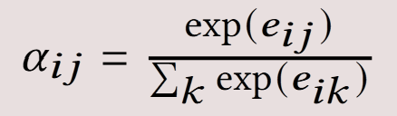
Transaction Stream
Feature Extraction
Graph Analysis
Stage 1
Stream Ingestion
8,760 req/s
𝑒 = (𝛼, 𝜏, 𝜇, ℓ, 𝛿 )
Stage 2
Temporal Window
𝑤 = 3600s
𝑠 = 1800s
(50% overlap)
Stage 3
Graph Mining
2-hop neighbors
𝑧𝑚 = (𝑓𝑚 −𝜇𝑚)\𝜎𝑚
Input
Deep Learning
Privacy
Stage 4
LSTM Encoding
ℎ = 512, 8 heads
Stage 5
Privacy Preserve
N (0, 0.01)|
|f | |2 ≤ 1.0
15% masking
128-dim
3.8 bits
Output Signature
Amount: 𝛼
Time: 𝜏
Category: 𝜇
Location: ℓ
Device: 𝛿
147 features
3600s window
50% overlap
Motif detection
Centrality
PageRank

