Slide 1
CSCI-455/552
Introduction to High Performance Computing
Lecture 22

Slide 2
Batcher’s Parallel Sorting Algorithms
• Odd-even Mergesort
• Bitonic Mergesort
Originally derived in terms of switching networks.
Both are well balanced and have parallel time complexity of O(log²n) with n processors.
Slides for Parallel Programming Techniques & Applications Using Networked Workstations & Parallel Computers 2nd ed., by B. Wilkinson & M. Allen, @ 2004 Pearson Education Inc. All rights reserved.

Slide 3
Odd-Even Mergesort
Odd-Even Merge Algorithm
Start with odd-even merge algorithm which will merge two sorted lists into one sorted list. Given two sorted lists a₁, a₂, a₃, …, a_{n} and b₁, b₂, b₃, …, b_{n} (where n is a power of 2).
Slides for Parallel Programming Techniques & Applications Using Networked Workstations & Parallel Computers 2nd ed., by B. Wilkinson & M. Allen, @ 2004 Pearson Education Inc. All rights reserved.

Slide 4
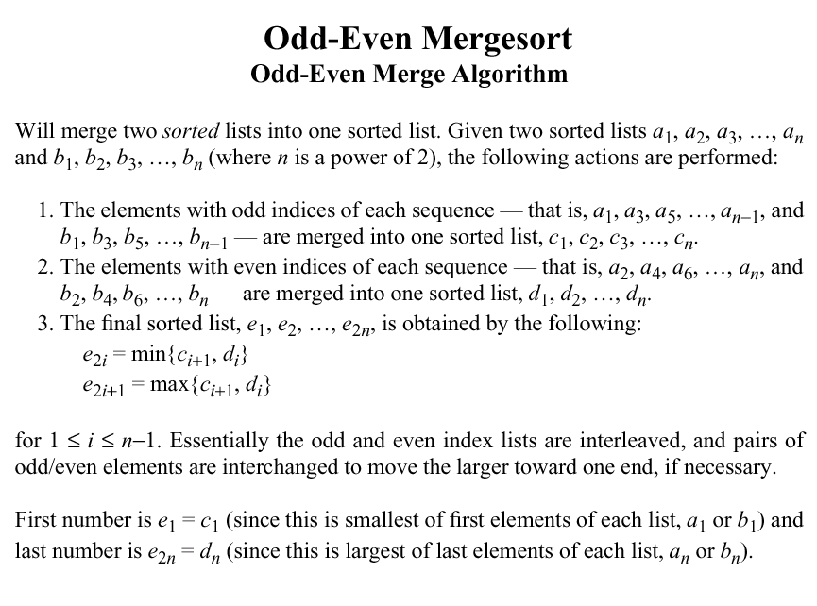

Slide 5
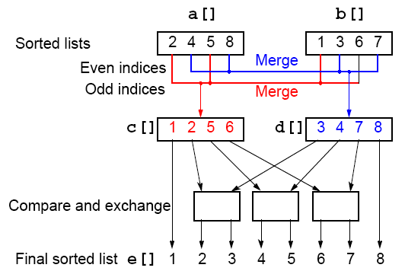
Odd-Even Merging of Two Sorted Lists
Slides for Parallel Programming Techniques & Applications Using Networked Workstations & Parallel Computers 2nd ed., by B. Wilkinson & M. Allen, @ 2004 Pearson Education Inc. All rights reserved.

Slide 6
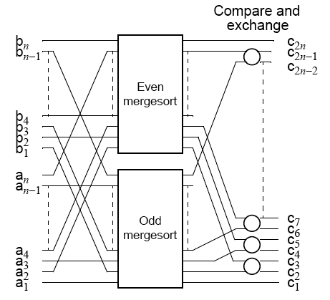
Odd-Even Mergesort
Apply odd-even merging recursively
Slides for Parallel Programming Techniques & Applications Using Networked Workstations & Parallel Computers 2nd ed., by B. Wilkinson & M. Allen, @ 2004 Pearson Education Inc. All rights reserved.

Slide 7
Bitonic Mergesort
Bitonic Sequence
A monotonic increasing sequence is a sequence of increasing numbers.
A bitonic sequence has two sequences, one increasing and one decreasing. e.g.
a₀ < a₁ < a₂, a₃, …, a_{i-1} < a_{i} > a_{i+1}, …, a_{n-2} > a_{n-1}
for some value of i (0 <= i < n).
A sequence is also bitonic if the preceding can be achieved by shifting the numbers cyclically (left or right).
Slides for Parallel Programming Techniques & Applications Using Networked Workstations & Parallel Computers 2nd ed., by B. Wilkinson & M. Allen, @ 2004 Pearson Education Inc. All rights reserved.

Slide 8
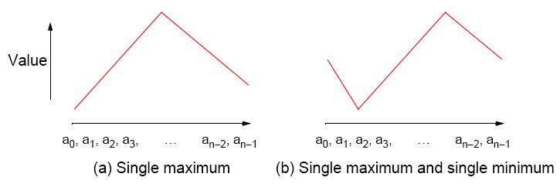
Bitonic Sequences
Slides for Parallel Programming Techniques & Applications Using Networked Workstations & Parallel Computers 2nd ed., by B. Wilkinson & M. Allen, @ 2004 Pearson Education Inc. All rights reserved.

Slide 9
“Special” Characteristic of Bitonic Sequences
If we perform a compare-and-exchange operation on a_{i} with a_{i+n/2} for all i, where there are n numbers in the sequence, get TWO bitonic sequences, where the numbers in one sequence are all less than the numbers in the other sequence.
Slides for Parallel Programming Techniques & Applications Using Networked Workstations & Parallel Computers 2nd ed., by B. Wilkinson & M. Allen, @ 2004 Pearson Education Inc. All rights reserved.

Slide 10
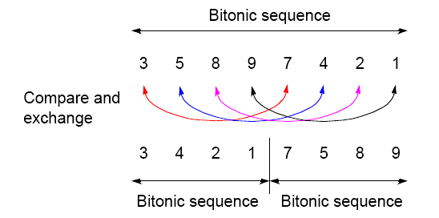
Creating two bitonic sequences from one bitonic sequence
Starting with the bitonic sequence
3, 5, 8, 9, 7, 4, 2, 1
we get:
Slides for Parallel Programming Techniques & Applications Using Networked Workstations & Parallel Computers 2nd ed., by B. Wilkinson & M. Allen, @ 2004 Pearson Education Inc. All rights reserved.

Slide 11
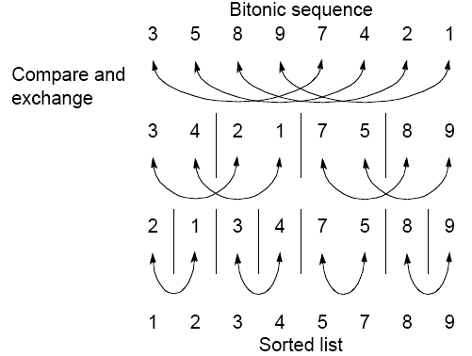
Sorting a bitonic sequence
Compare-and-exchange moves smaller numbers of each pair to left and larger numbers of pair to right. Given a bitonic sequence, recursively performing operations will sort the list.
Slides for Parallel Programming Techniques & Applications Using Networked Workstations & Parallel Computers 2nd ed., by B. Wilkinson & M. Allen, @ 2004 Pearson Education Inc. All rights reserved.

Slide 12
Sorting
To sort an unordered sequence, sequences are merged into larger bitonic sequences, starting with pairs of adjacent numbers.
By a compare-and-exchange operation, pairs of adjacent numbers formed into increasing sequences and decreasing sequences. Pairs form a bitonic sequence of twice size of each original sequences.
By repeating this process, bitonic sequences of larger and larger lengths obtained.
In the final step, a single bitonic sequence sorted into a single increasing sequence.
Slides for Parallel Programming Techniques & Applications Using Networked Workstations & Parallel Computers 2nd ed., by B. Wilkinson & M. Allen, @ 2004 Pearson Education Inc. All rights reserved.

Slide 13
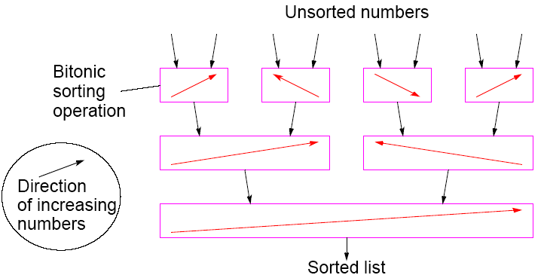
Bitonic Mergesort
Slides for Parallel Programming Techniques & Applications Using Networked Workstations & Parallel Computers 2nd ed., by B. Wilkinson & M. Allen, @ 2004 Pearson Education Inc. All rights reserved.

Slide 14
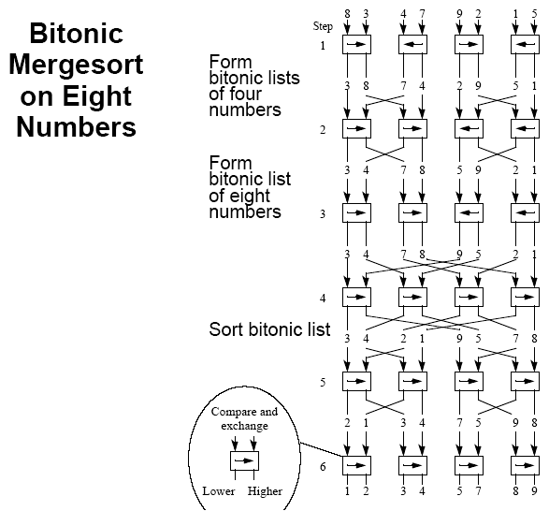
Slides for Parallel Programming Techniques & Applications Using Networked Workstations & Parallel Computers 2nd ed., by B. Wilkinson & M. Allen, @ 2004 Pearson Education Inc. All rights reserved.

Slide 15
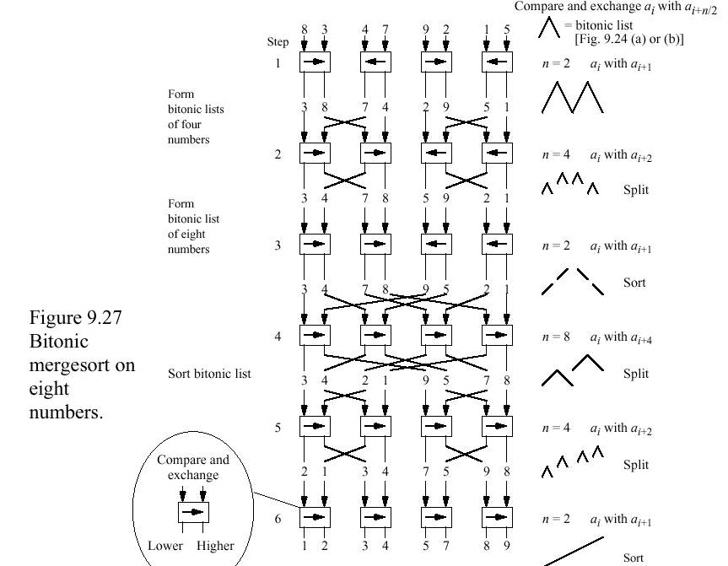

Slide 16
Phases
The six steps (for eight numbers) are divided into three phases:
Phase 1 (Step 1) Convert pairs of numbers into increasing/
decreasing sequences and into 4-bit
bitonic sequences.
Phase 2 (Steps 2/3) Split each 4-bit bitonic sequence into two
2-bit bitonic sequences, higher
sequences at center.
Sort each 4-bit bitonic sequence increasing/ decreasing sequences and merge into 8-bit bitonic sequence.
Phase 3 (Steps 4/5/6)Sort 8-bit bitonic sequence.
Slides for Parallel Programming Techniques & Applications Using Networked Workstations & Parallel Computers 2nd ed., by B. Wilkinson & M. Allen, @ 2004 Pearson Education Inc. All rights reserved.

Slide 17

Number of Steps
In general, with n = 2^{k}, there are k phases, each of 1, 2, 3, …, k steps. Hence the total number of steps is given by
Slides for Parallel Programming Techniques & Applications Using Networked Workstations & Parallel Computers 2nd ed., by B. Wilkinson & M. Allen, @ 2004 Pearson Education Inc. All rights reserved.

Slide 18
Sorting Conclusions so far
Computational time complexity using n processors
• Odd-even transposition sort - O(n)
• Parallel mergesort - O(n) but unbalanced processor load and Communication
• Parallel quicksort - O(n) but unbalanced processor load, and communication can generate to O(n²)
• Odd-even Mergesort and Bitonic Mergesort O(log²n)
Bitonic mergesort has been a popular choice for a parallel sorting.
Slides for Parallel Programming Techniques & Applications Using Networked Workstations & Parallel Computers 2nd ed., by B. Wilkinson & M. Allen, @ 2004 Pearson Education Inc. All rights reserved.

Slide 19
Sorting on Specific Networks
Algorithms can take advantage of the underlying interconnection network of the parallel computer.
Two network structures have received specific attention: the mesh and hypercube because parallel computers have been built with these networks.
Of less interest nowadays because underlying architecture often hidden from user - We will describe a couple of representative algorithms.
MPI features for mapping algorithms onto meshes, and one can always use a mesh or hypercube algorithm even if the underlying architecture is not the same.
Slides for Parallel Programming Techniques & Applications Using Networked Workstations & Parallel Computers 2nd ed., by B. Wilkinson & M. Allen, @ 2004 Pearson Education Inc. All rights reserved.

Slide 20
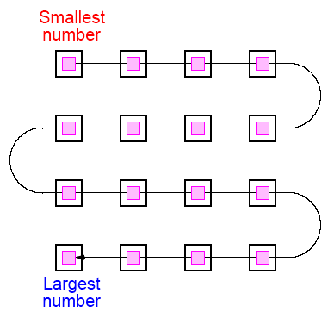
Mesh - Two-Dimensional Sorting
The layout of a sorted sequence on a mesh could be row by row or snakelike. Snakelike:
Slides for Parallel Programming Techniques & Applications Using Networked Workstations & Parallel Computers 2nd ed., by B. Wilkinson & M. Allen, @ 2004 Pearson Education Inc. All rights reserved.

Slide 21
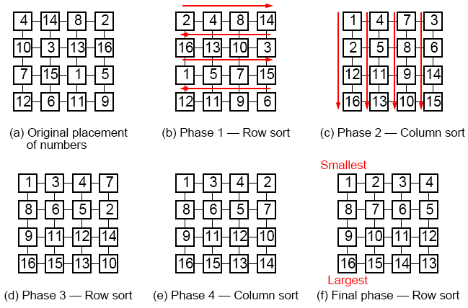
Shearsort
Alternate row and column sorting until list fully sorted. Row sorting
alternative directions to get snake-like sorting:
Slides for Parallel Programming Techniques & Applications Using Networked Workstations & Parallel Computers 2nd ed., by B. Wilkinson & M. Allen, @ 2004 Pearson Education Inc. All rights reserved.

Slide 22
Shearsort
Slides for Parallel Programming Techniques & Applications Using Networked Workstations & Parallel Computers 2nd ed., by B. Wilkinson & M. Allen, @ 2004 Pearson Education Inc. All rights reserved.

Slide 23
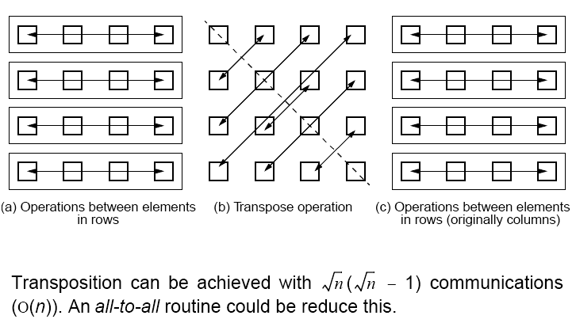
Using Transposition
Causes the elements in each column to be in positions in a row.
Can be placed between the row operations and column operations
Slides for Parallel Programming Techniques & Applications Using Networked Workstations & Parallel Computers 2nd ed., by B. Wilkinson & M. Allen, @ 2004 Pearson Education Inc. All rights reserved.

