Slide 1
Dhcp, dns, ftp et ssh

Slide 2
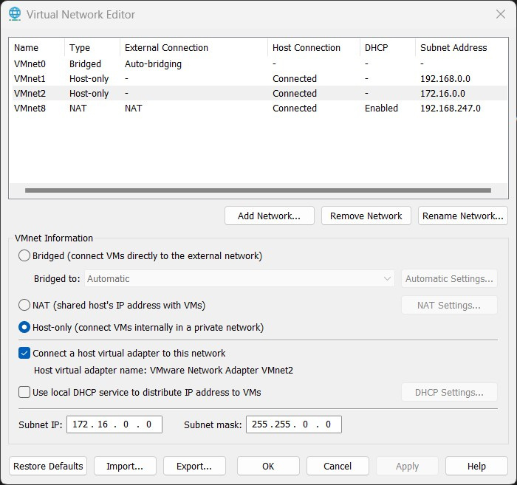
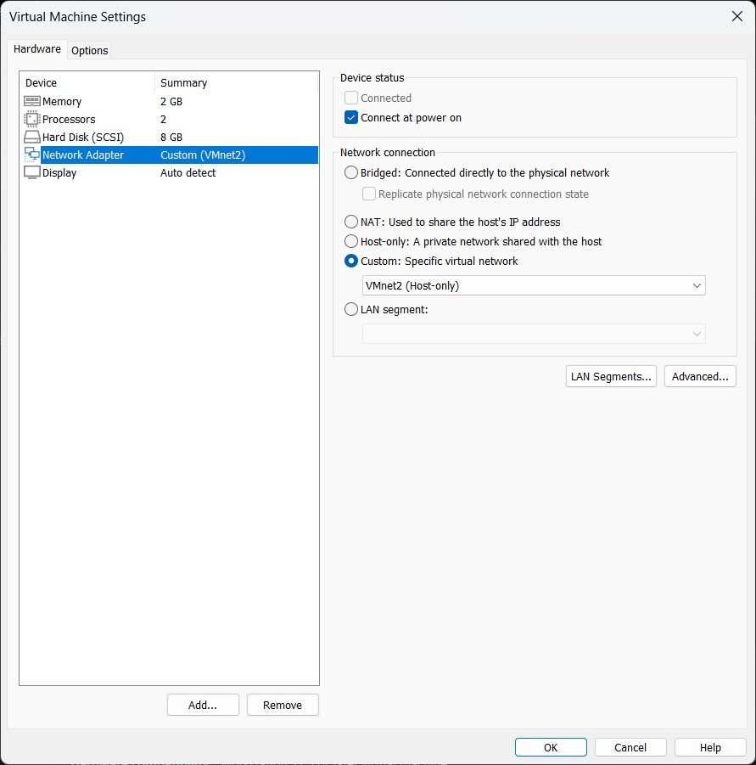
“prerequis”
add VMnet2
decocher” use local DHCP”
config subnet ip
VMnet2 : carte reseau pour le serveur
VMnet8 : carte reseau pour les installations

Slide 3
isc-dhcp-server

Slide 4
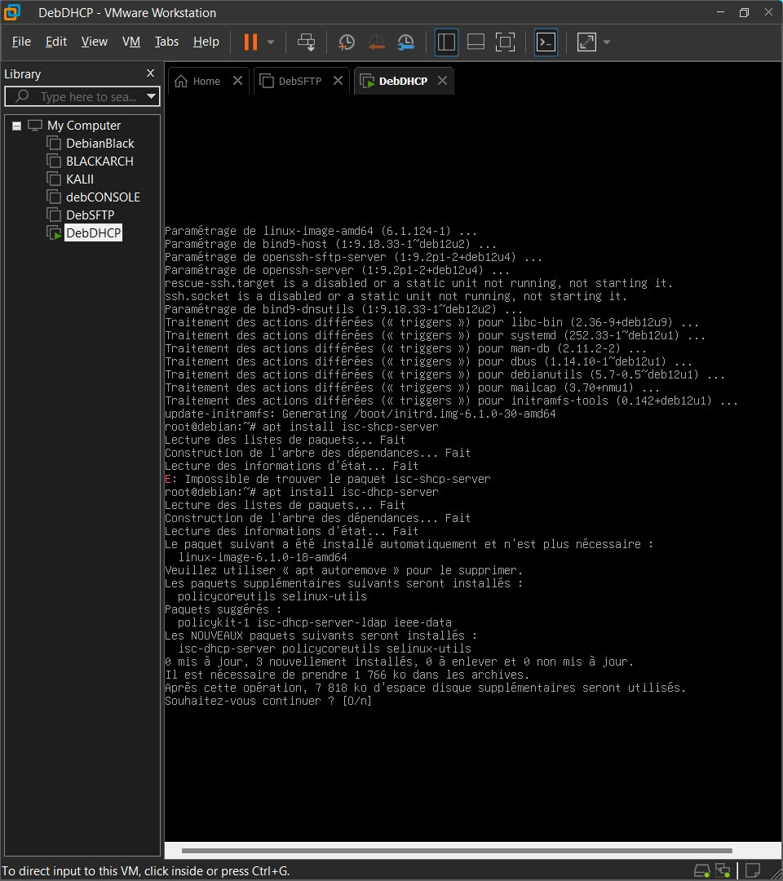
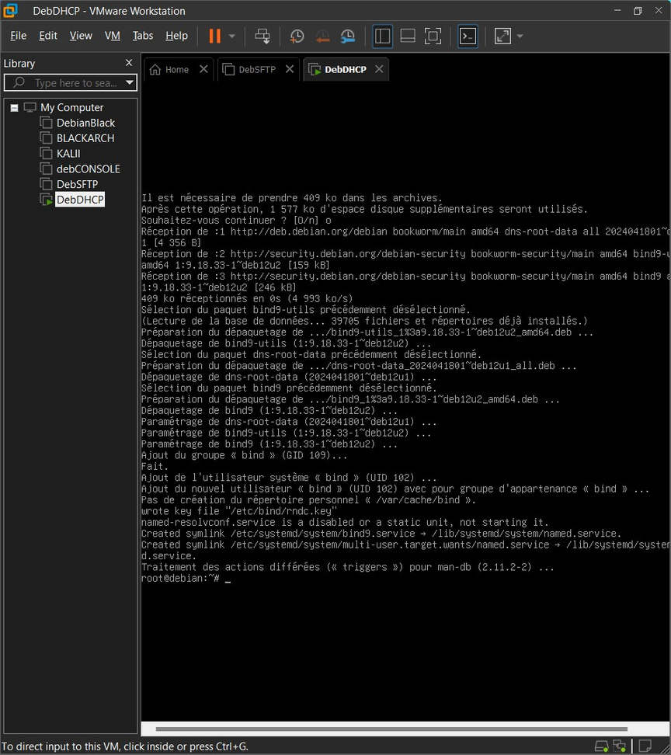
sudo apt install isc-dhcp-server
Install isc-dhcp-server
sudo apt install bind9

Slide 5
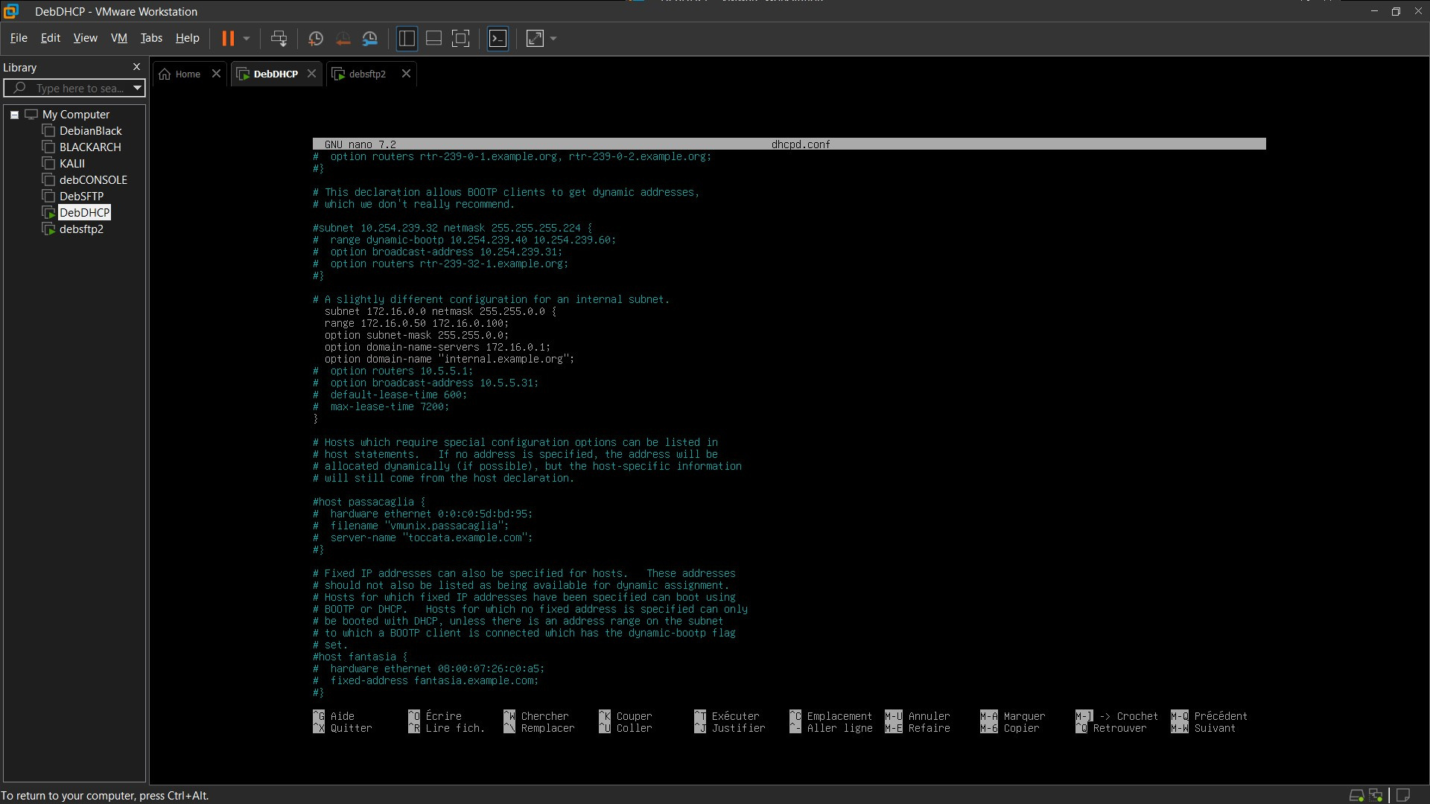
Configure isc-dhcp-server
/etc/dhcp/dhcpd.conf

Slide 6
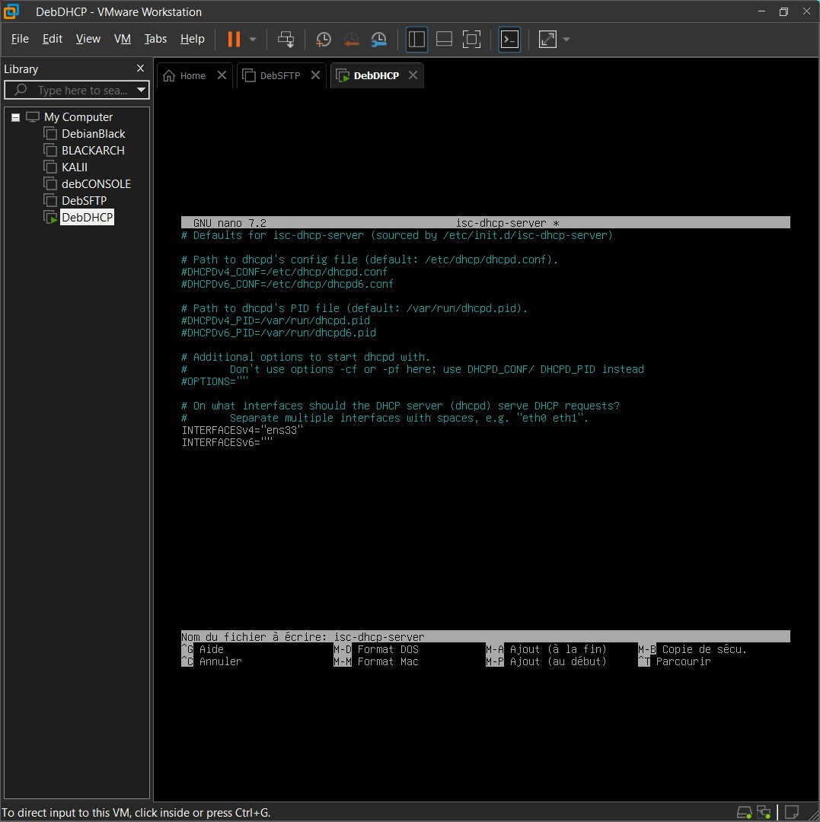
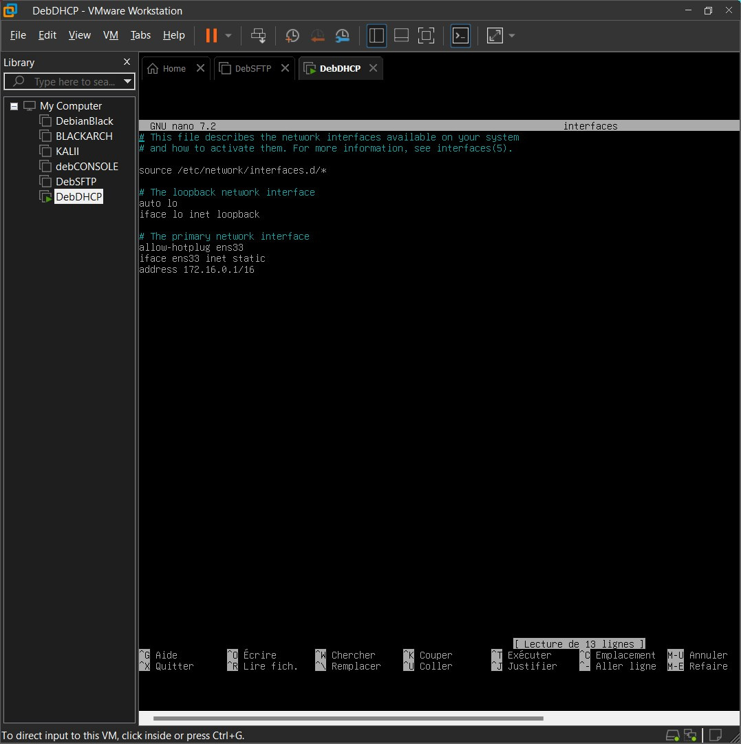
/etc/default/isc-dhcp-server
/etc/network/interface.d

Slide 7
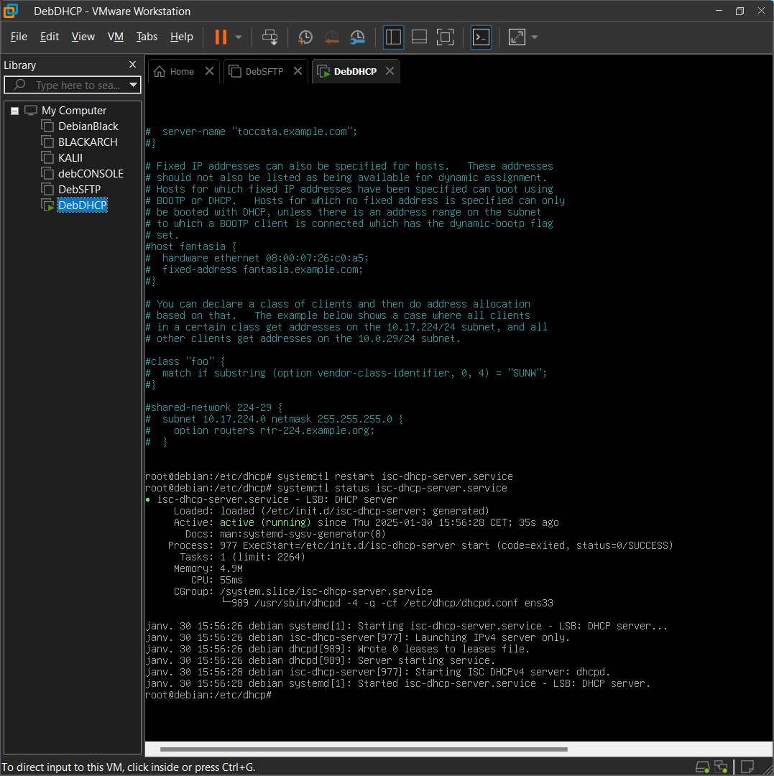
sudo systemctl RESTART isc-dhcp-server.service
sudo systemctl STATUS isc-dhcp-server.service

Slide 8
SFTP Server

Slide 9
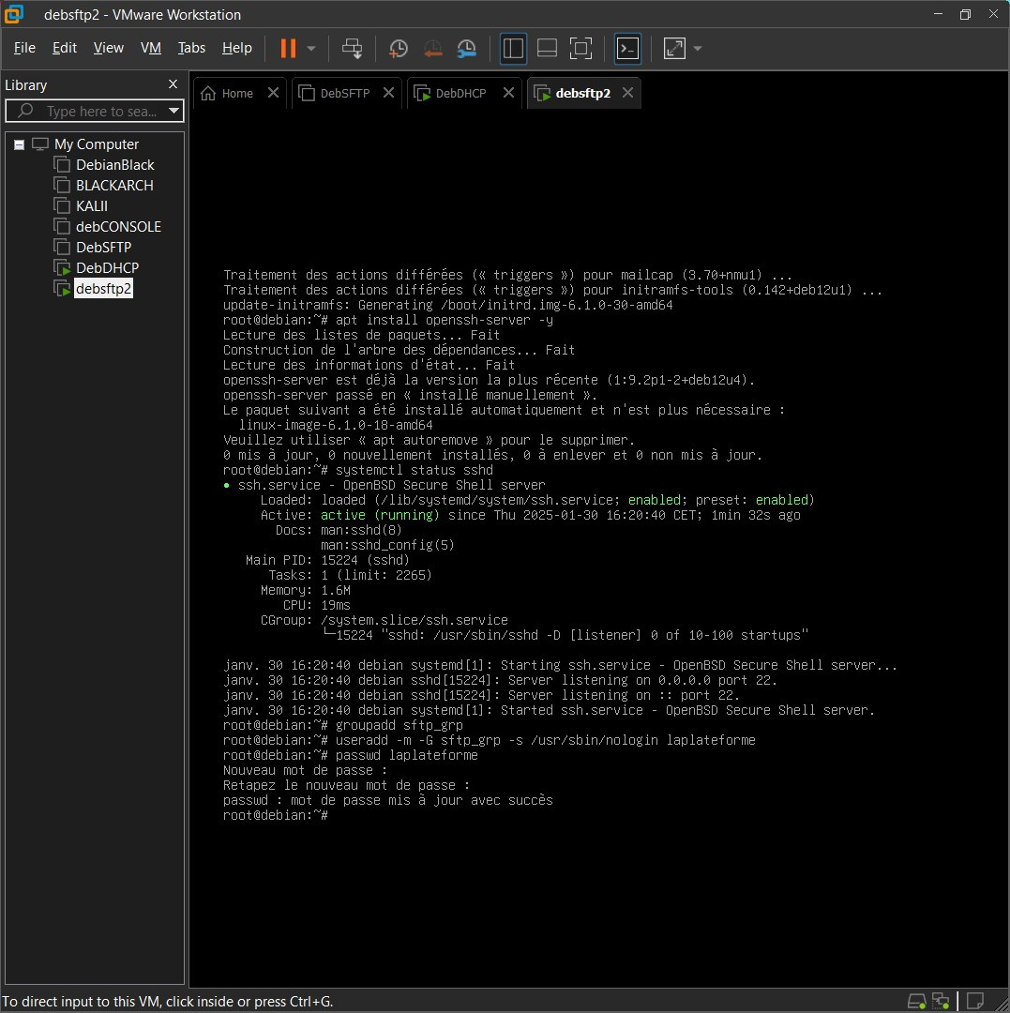
Install OpenSSH Server Package
sudo apt install openssh-server -y
sudo systemctl STATUS sshd
Create a Group and User for sftp

Slide 10
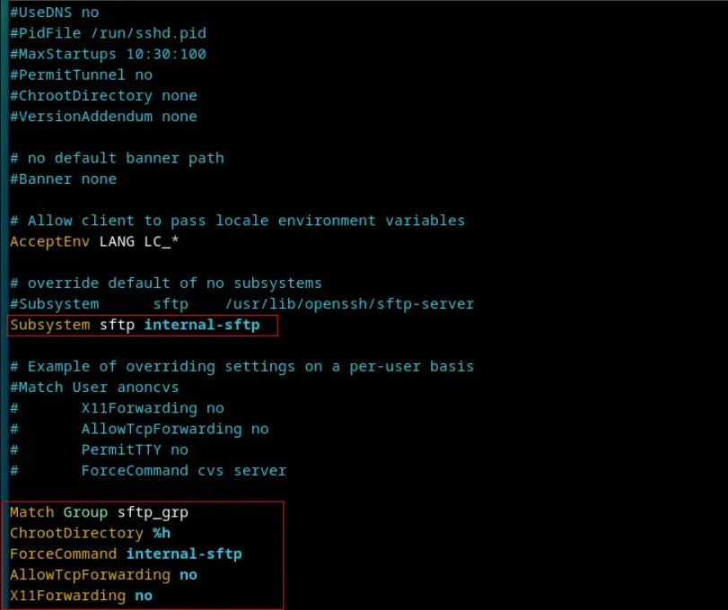
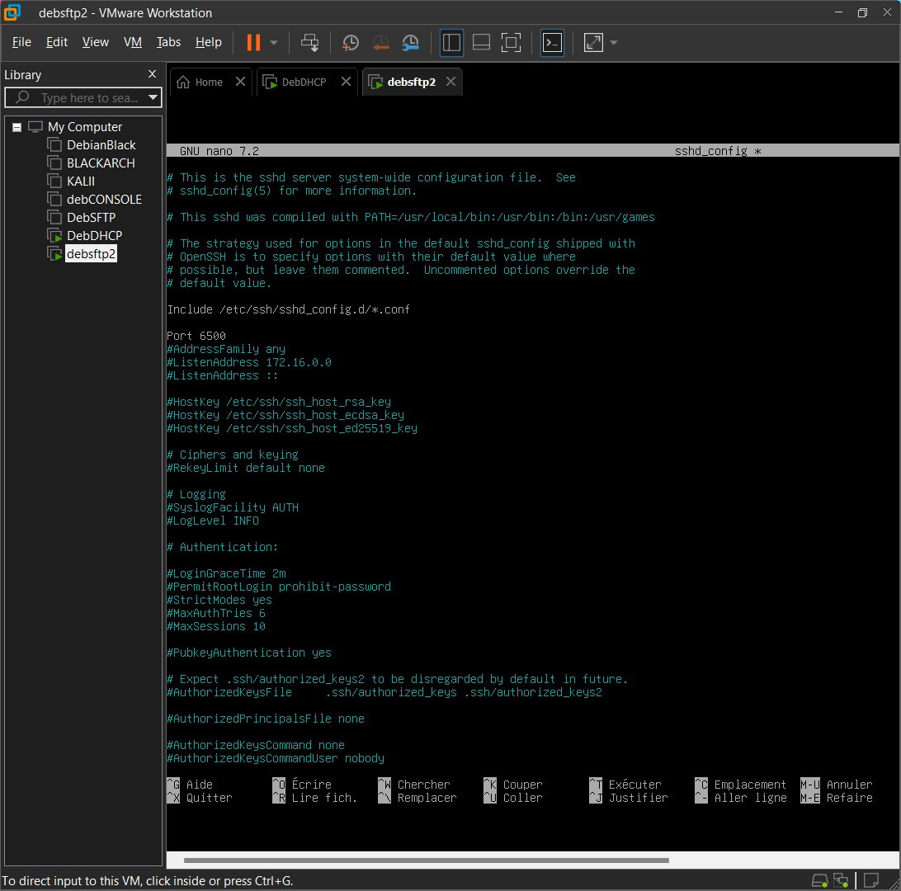
Setup SFTP Server
“/etc/ssh/sshd_config“

Slide 11
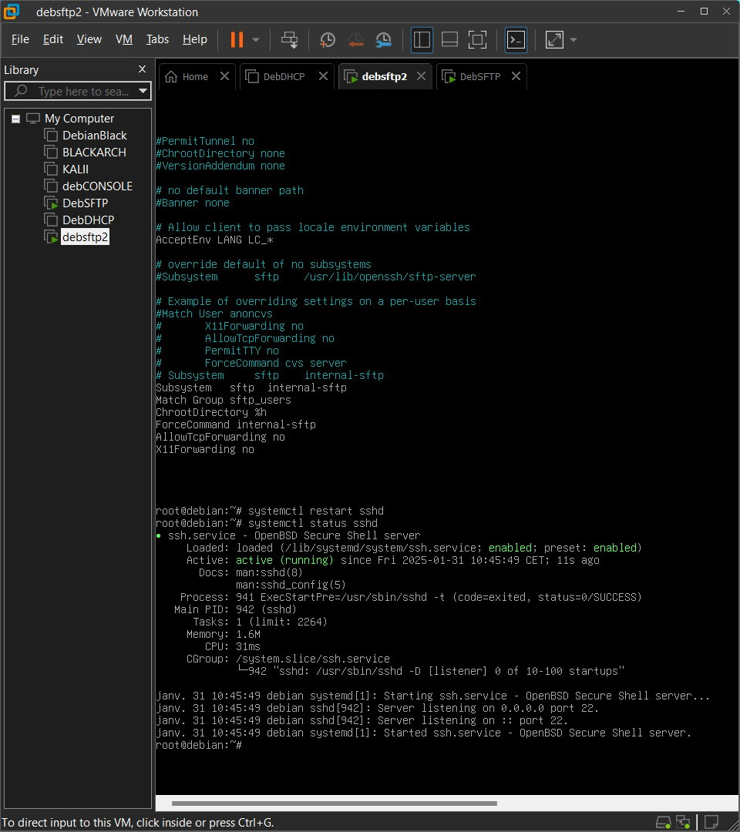
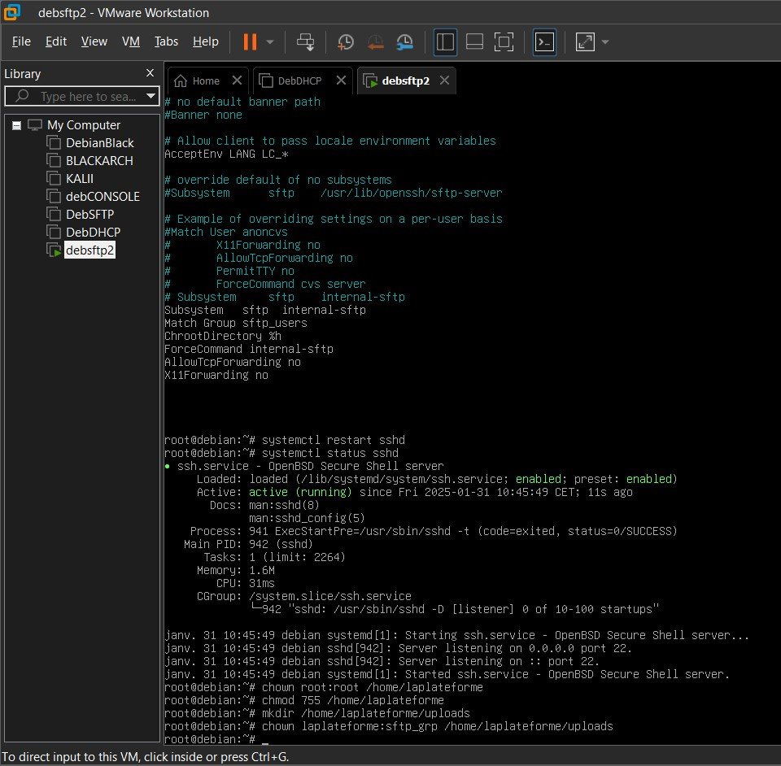
sudo systemctl restart sshd
Create Uploads Folder and Set Permissions

Slide 12
TEST

Slide 13
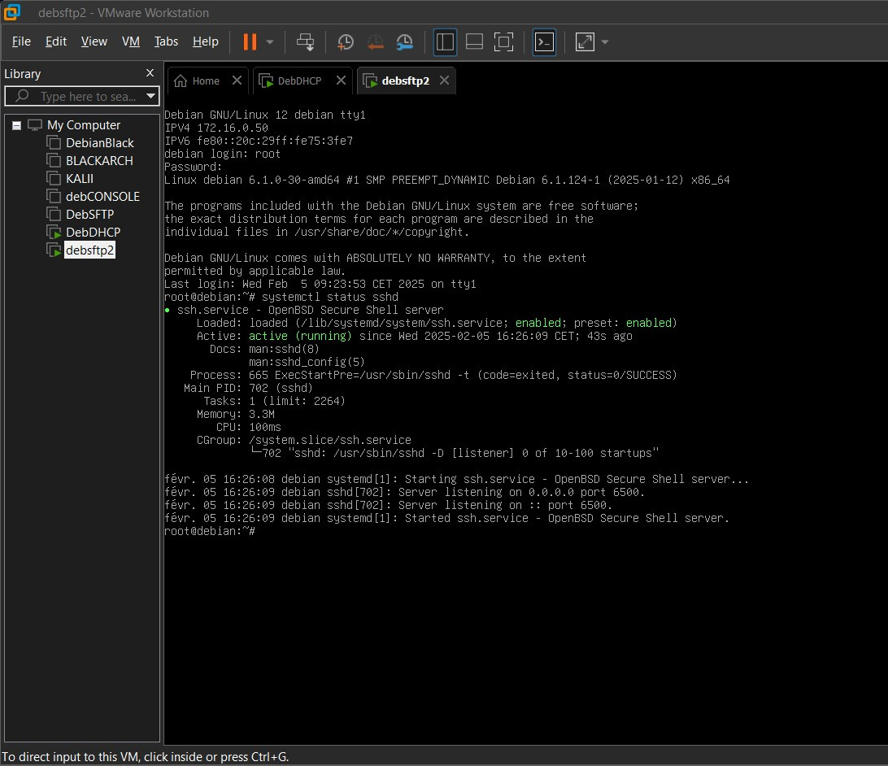
serveur sftp
172.16.0.50
port 6500

Slide 14
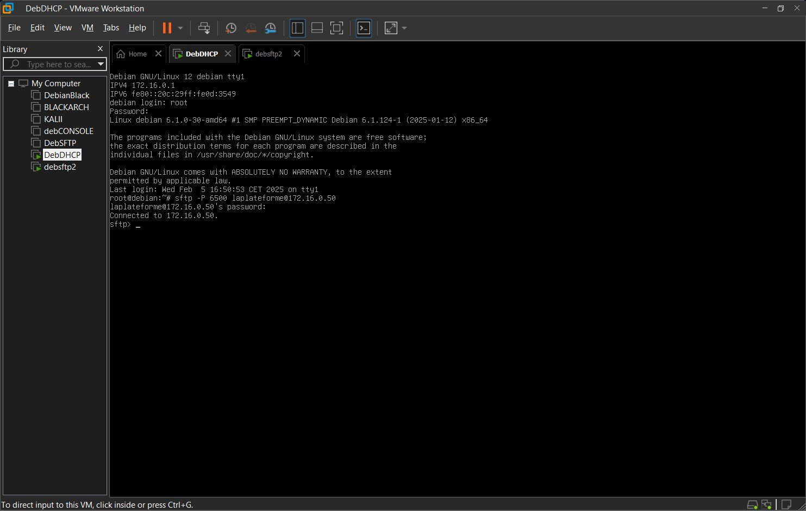
Serveur DHCP
172.16.0.1
CONNECT

Slide 15
