Slide 1
AIT ASM Yassine
LDAP
sudo apt install slapd ldap-utils

Slide 2
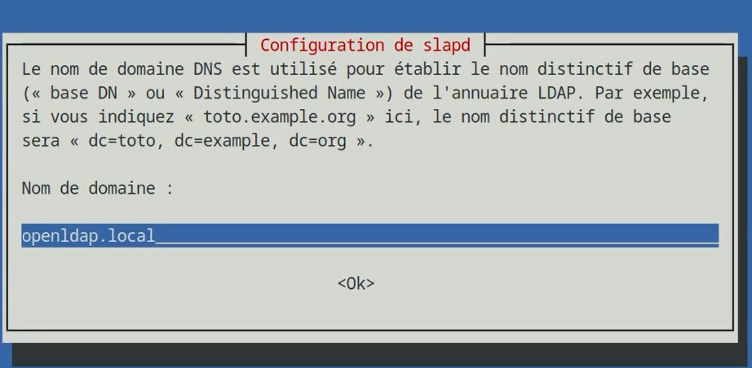
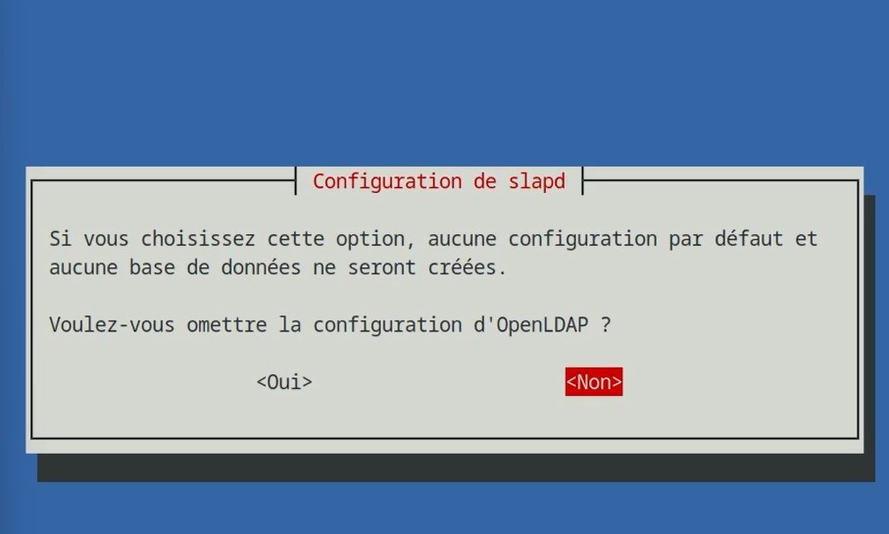
“prerequis”
dpkg-reconfigure slapd

Slide 3
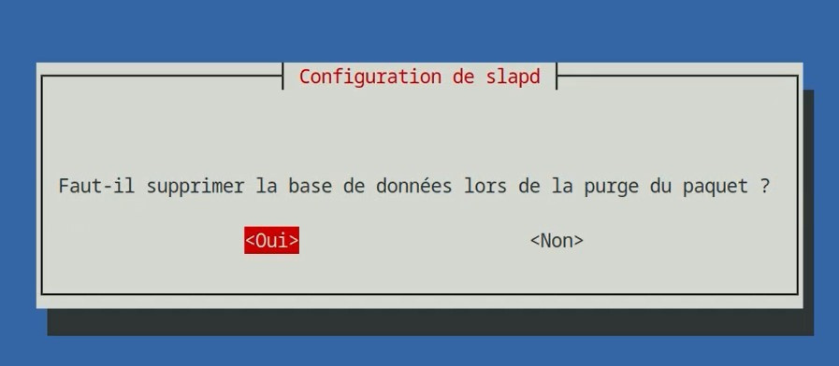
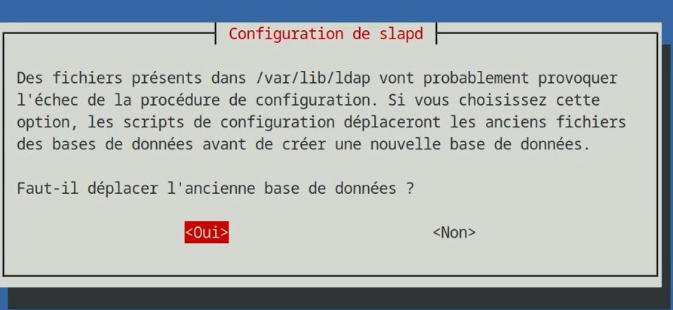

Slide 4
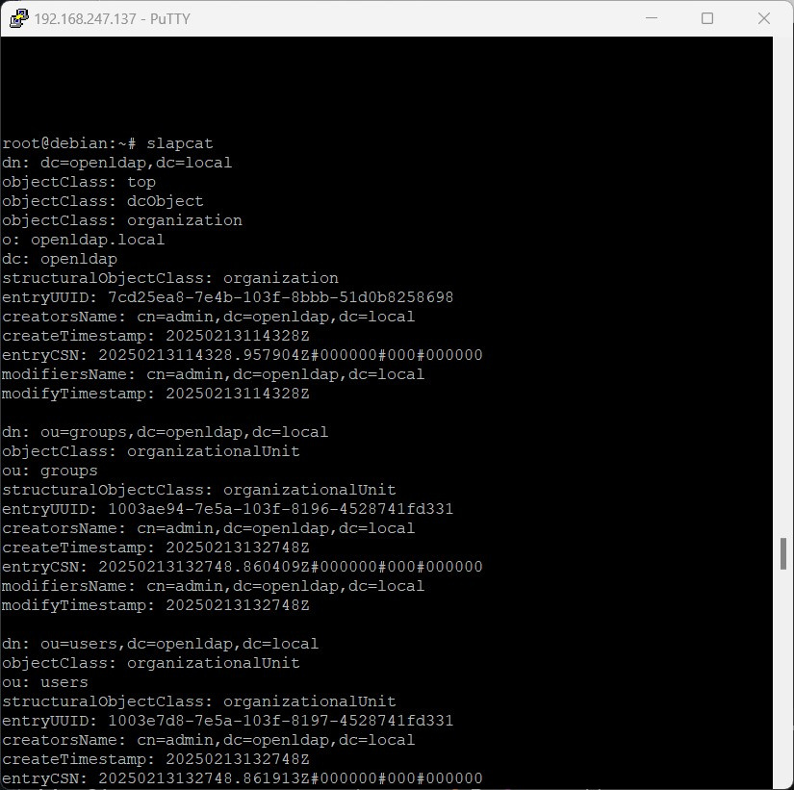
slapcat

Slide 5
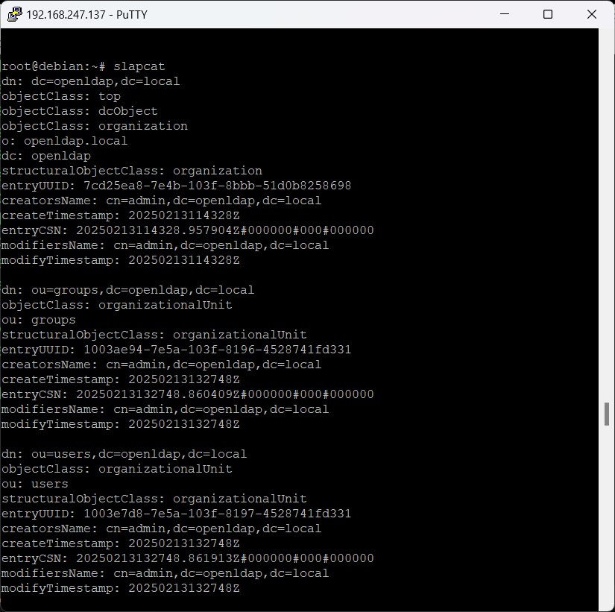
“test.ldif”
base ,users et groupes

Slide 6
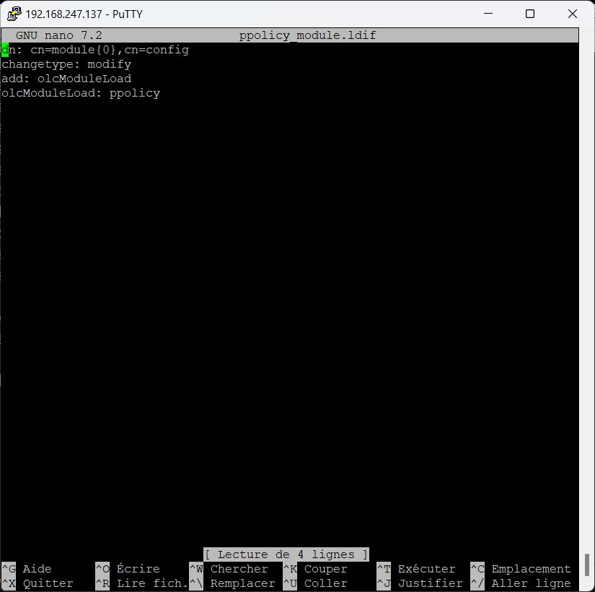
ppolicy modules.ldif

Slide 7
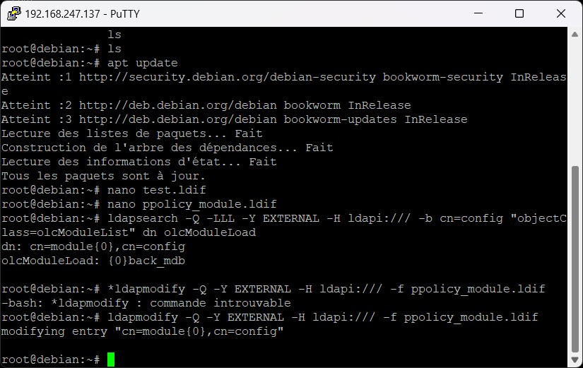
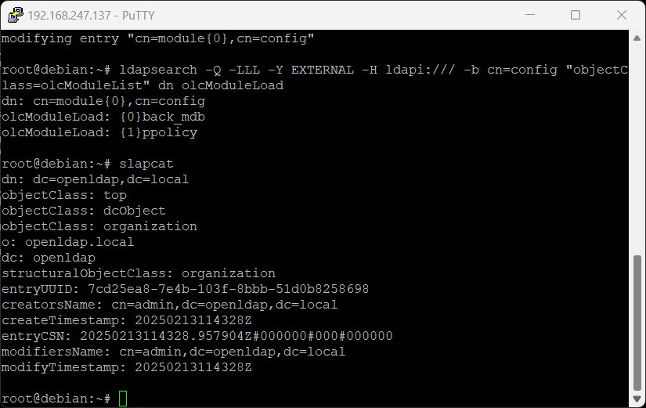
ldapsearch -Q -LLL -Y EXTERNAL -H ldapi:/// -b cn=config "objectClass=olcModuleList" dn olcModuleLoad
ldapmodify -Q -Y EXTERNAL -H ldapi:/// -f ppolicy_module.ldif
ldapsearch -Q -LLL -Y EXTERNAL -H ldapi:/// -b cn=config "objectClass=olcModuleList" dn olcModuleLoad
ppolicy implanter

Slide 8
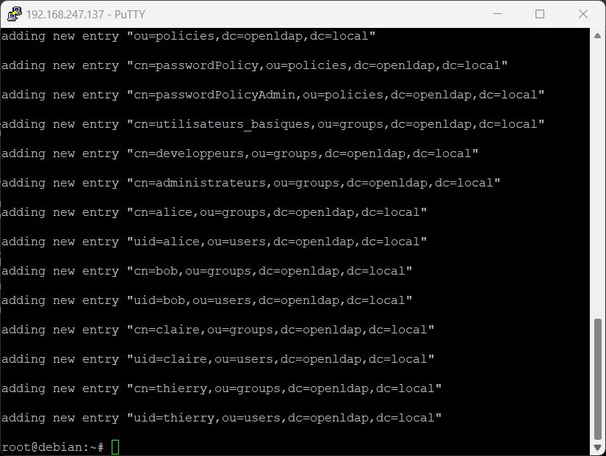
ldapadd -x -D "cn=admin,dc=openldap,dc=local" -w root -H ldap:// -f test.ldif

Slide 9
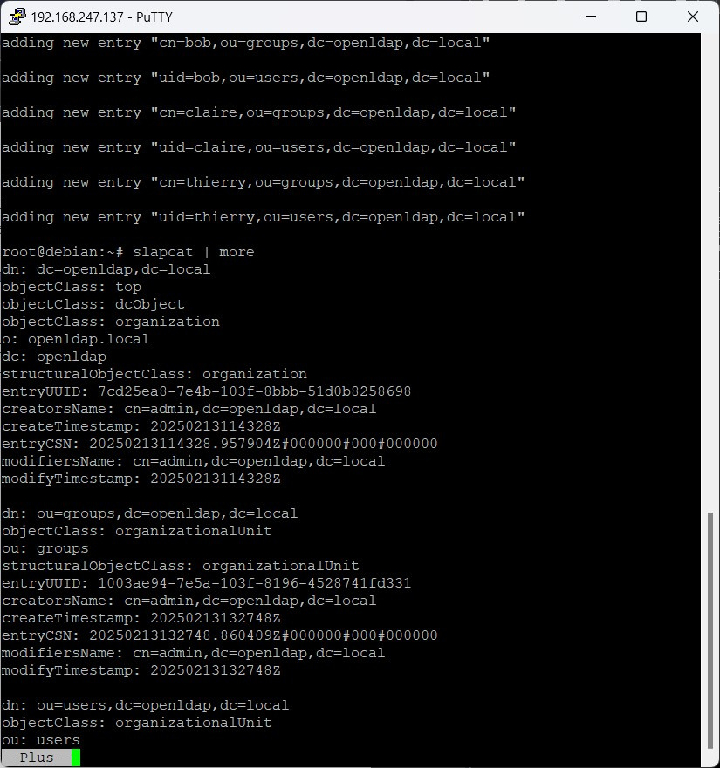
slapcat | more

