Slide 2
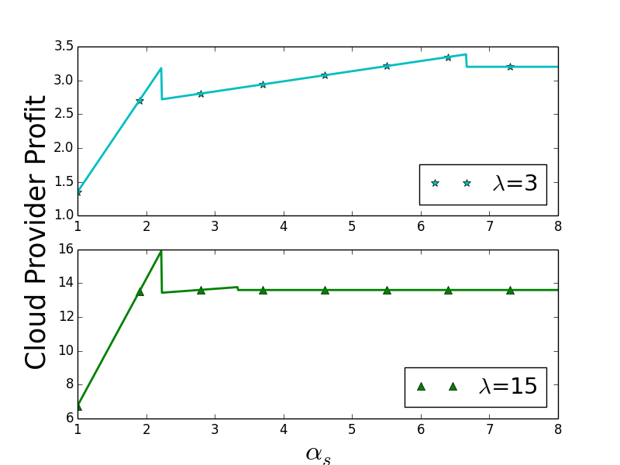
VM
only
SC + VM
SC
only
VM
only
SC
only
SC + VM

