Slide 1
The Age of Impatience
Optimal P2P Schemes in Opportunistic Networks,
        Joshua Reich & Augustin Chaintreau
        Columbia University, NY & Thomson, Paris

Slide 2

How Many Slides Before You’re Reading Email?
Impatience is fundamental
  If I deliver quickly -> you listen
  If I don’t -> I lose you
  (I also have to stay interesting)
But delay is as well
  Can be controlled somewhat in infrastructure (though still a problem)
  In opportunistic protocols, it’s a fact of life
This talk is about satisfying impatience in a delayed environment.

Slide 3
Content Dissemination in Mobile Networks
The Problem: Infrastructure
  Expensive
  Not always available
  Demand grows faster than infrastructure [1]
The Solution: Use opportunistic content dissemination
  Each meeting of mobiles is a chance to transfer data
  Huge quantity of untapped bandwidth
The Challenges:
  Potentially much slower
  Unstructured & unpredictable
  Limited memory on devices
  Energy constraints
[1] “Customers Angered as iPhones Overload AT&T”, NY Times, Sept. 3rd, 2009

Slide 4






Application: Mobile P2P Content Distribution
We’d like to distribute a set of content items
  Some items are more popular
  Some less so
  And to varying degrees

Slide 5






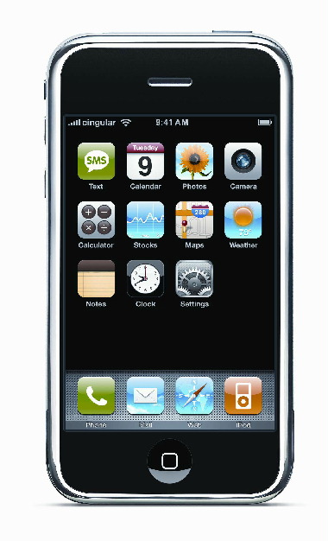


Application: Mobile P2P Distribution
Popular
?
…
!
…
Rare
+

Slide 6
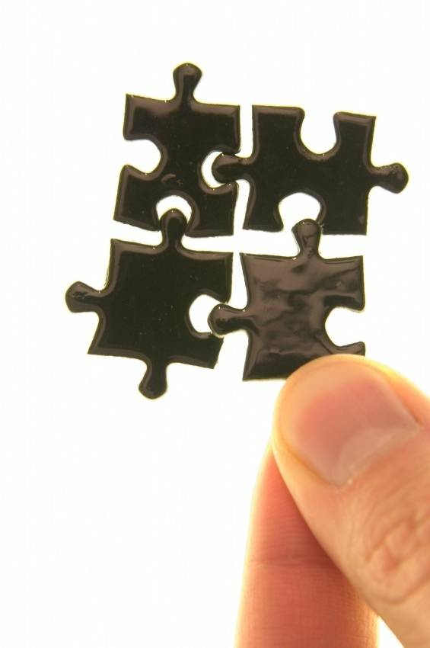
Contributions
Q: What is the right way to allocate cache content?
  User impatience
  Content popularity
  Memory constraints
A: There exists an ideal allocation, characterized as the solution of “convex” optimization taking all these into account.
Q: Can we find efficient distributed algorithms
A: Yes, we show a simple reactive mechanism can drive the global allocation of content towards the optimal.

Slide 7
Structure of This Talk
Motivation
Optimal cache allocation with impatient users
  Analytic model & objective
  Main results & intuition
Distributed replication schemes
  Building distributed schemes to exploit analytic results
  Validating performance under real-world mobility
Concluding remarks

Slide 8
Talk Structure
Motivation
Optimal cache allocation with impatient users
Distributed replication schemes
Concluding remarks

Slide 9
System Model
Network Composed of:
  Clients: Servers:
  Some nodes may be both client and server
    Ex.: Dedicated nodes: , Pure P2P:
Demand: total request rate for item is
  It may originate from client n w.p.
Let be 1 if item i is present in cache m
  The total number of replicas is
  We refer to x as the allocation
Rate of contacts between devices is constant
  Continuous time: contacts follow Poisson process
  We relax this assumption when validating

Slide 10
Modeling Users Impatience
We represent the effects of user impatience using delay-utility functions
  : gain (loss) when a request for item i is fulfilled t time units after being made
We assume
  h is a non-increasing function (one never gets less impatient as time increases)
  It admits a limit when t goes to 0, (for simplicity, although all results generalize)
  A separate h is not needed for each user

Slide 11


Modeling User Impatience: Ad Revenue
Embedded commercials provide revenue
Probability [0,1] of user watching content declines over time

Slide 12

Modeling User Impatience: Time-Critical
Delay utility declines very quickly
Convergent only when server’s can be clients

Slide 13

Modeling User Impatience: Waiting Penalty
Delay - most intuitive
Global Fairness
  penalizing unpopular content overmuch much has very adverse effect

Slide 14
Defining Our Objective Function
Let be the time spent requesting
  Exponential with rate
Our objective function is the expected social welfare
  For a given allocation x
  We take the expected delay utility for fulfilling node n’s demand for message i
  Multiplied by the relatively likelihood of n demanding i
  Summed over all nodes and multiplied by the popularity of message i
  Summed over all messages

Slide 15
Maximizing Our Objective
We desire an allocation x that maximizes the social welfare
Such that every node has
  Either 0 or 1 copies of any particular content item
  No more than p content items

Slide 16
Main Analytic Results
THM1: U submodular in x
  Decreasing gains as replicas of i are added
  Centralized algorithm provides a 1-1/e approximation.
THM2: In a homogeneous network U is concave
  Optimal reached in steps
  Relaxation solved by gradient descent, and optimal satisfies a balance condition

Slide 17
Sketch of Theorem 2 Proof
We introduce the differential impatience cost
  added loss incurred per unit of time
  always positive
Then the expected gain when n requests i is
We can make this simplification because
  All nodes are equally likely to demand and given message
  All nodes pairs meet w/ the same poisson rate

Slide 18

Sketch of Theorem 2 Proof (cont.)
The optimal satisfies balance condition:
  Let
  Then
  This result becomes precise as the cache becomes large
In other words, for the optimal allocation:
  The marginal benefit to increasing i’s share of the cache must equal the marginal benefit to increasing j’s share
  Otherwise, a better allocation could be produced by increasing i’s share and decreasing j’s (or vice-versa)
Therefore, the optimal can be found using gradient descent

Slide 19
Structure of this talk
Motivation
Optimal cache allocation with impatient users
Distributed replication schemes
Concluding remarks

Slide 20
How Do We Exploit These Results?
Our analysis determines centralized mechanisms
But our target application environment is messy
  Demand rarely known in advance
  Contact patterns are unpredictable
  Current cache allocation
    Difficult to follow
    Even harder to adjust
Previous work is highly heuristic
  Passive replication (+ public buffer) [7DS01, Podnet07]
  Social overlay and utility [Yoneki07, Boldrini08]
  Recently, Metropolis with fraction of disseminating nodes [HuLeBoudecVojnovic09]

Slide 21
Query-Counting Replication (QCR)
1) When a request is created
  Counter initialized, qctr:= 0
  Incremented for each request, qctr++
2) When the demand is fulfilled
  Counter stopped
  A number ψ(qctr) replica are made and distributed
Generalizes Path replication [CohenShenker02]
  Has been shown to minimize search overhead
  With a few important differences

Slide 22
Tuning Query Counting Replication
Approximate evolution of cache
  Net increase of replica for item I
  Demand for item i fulfilled w. p.
  For any replica created, replace item I w. p.
Steady state satisfies balance equation iff

Slide 23
Tuning Query Counting Replication
Example: characterization of Power impatience
  α=1.5 (sqrt repl.), α=1 (passive repl.), α=0 (~ path repl.)
Opt. allocation
Repl.

Slide 24
Conclusions
Can p2p make the right content available?
  Yes, (with homogeneous popularity and mobility), replication adapts to serve requests timely.
  Warning: Impatience matters!
  The homogeneous assumption can be relaxed
This is tractable (optimal, predictable)
  Promising to design new schemes
  Applications:
    Recommendation, Incentive.

Slide 25

Thank you!
Companion papers:
- J. Reich, A. Chaintreau, “The age of impatience: optimal replication schemes for opportunistic networks” In Proc. of ACM CoNEXT, 2009 (Thomson TR CR-PRL-2009-06-0001).
In preparation:
- S. Ioannidis, A. Chaintreau, L. Massoulié, “Optimal replication in diverse mobile population”, 2009. special thanks to:
N. Ristanovic, A-K. Pietilainen, J. Lebrun, E. Oliver, C. Diot, M. May, Di Niu and to Nitin for organizing this session!
Notes:
Mobility of anticipated users movement and actual traces.

Slide 26
BACK-UP SLIDES
Notes:
Mobility of anticipated users movement and actual traces.

Slide 27
Issue #2: Mandate routing
Wired p2p: data replicated along the search path
Mobile p2p: replica are created in two steps
  1) create set of instructions (mandates) for replication.
  2) execute mandate
  However, step 2 relies on data availability.
Solutions: Keep mandate near replicas
  Exchange instructions with preference to node with replica.

Slide 28
Illustration on homogeneous networks
Homogeneous network
  Power imp. α=0
  Pop. Pareto(1)
  ρ=5
  QCR vs. alloc.
Need mandate routing to converge

Slide 29
Structure of this talk
Opportunistic P2P Networking
P2P caching with impatient users
Performance of distributed replication
The next frontier
Future steps / concluding remarks

Slide 30


The new CTR (Click-Through-Rate)
In online advertising, CTR is the probability of a click given an impression.
  Heavily used for sponsored search
  Generally used in an auction mechanism
In delay tolerant network, time between a click and an impression is not negligible
  Delay incurs loss of revenue
  because of impatient users

Slide 31
Conclusion
For a general model of impatience (which may be compared to the CTR of online advertising)
  Network revenue maximization is submodular
In addition, for homogeneous networks
  A unique optimal exists, satisfying balance condition

Slide 32
Reality test
How does QCR (and others) accommodate:
  Heterogeneous contacts
  Other time statistics
Traces:
  INFOCOM06, 50 out of 68 mobile nodes, 3 days
  Cabspotting, 50 out of 500 cabs, 1 typical day
Comparison with perfect information channel
(UNI, SQRT, PROP, DOM) and OPT

Slide 33
Infocom06
Synthetic heterogeneity & Real trace

Slide 34
Cabspotting
Synthetic heterogeneous traces + real trace

Slide 35
Conclusion
QCR generalizes passive and path replication
  can be tuned to cope with any impatience function
  requires mandate routing to ensure fast convergence.
QCR approaches the performance of allocation built with perfect information (PROP, SQRT)

Slide 36
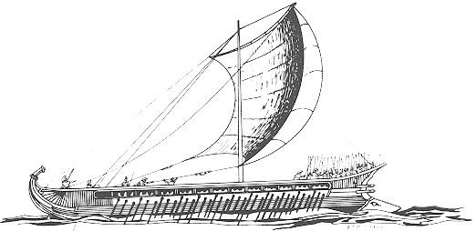
How do you imagine the future Internet? (bis)
Most users access content through …
  (1) social networking applications (2) on a mobile device.
  Location Location Location:
  “Offering a social network service that ignores location
  is like selling an apartment without telling where it is.”
  Infrastructure remains limited/expensive, while opportunistic contacts explode (BT, WiFi APs).
In this talk
  1 opportunistic application and some early results
  3 sides: Theoretical goal, Alg. design, Practical lessons

Slide 37
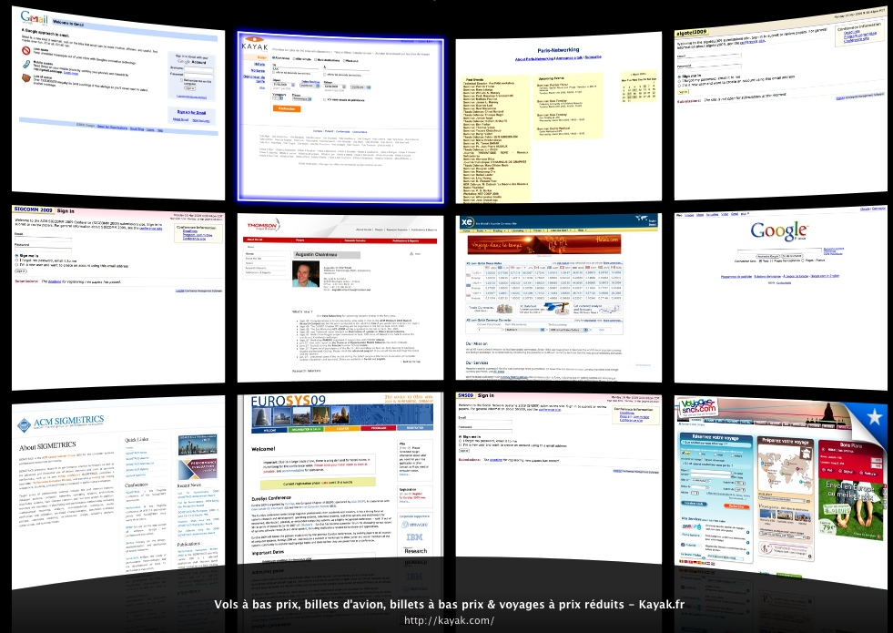
Several challenges ahead!
Can opportunistic contacts cope with update?
  Not for today (50 back-up slides available on request :) )
Can we make the right content available?
  Popularity profile
  Mobility/proximity encounters
  Impatience of user
Can we account for impatience? Optimally?
How does simple replication perform?

Slide 38


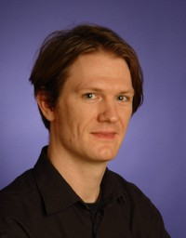
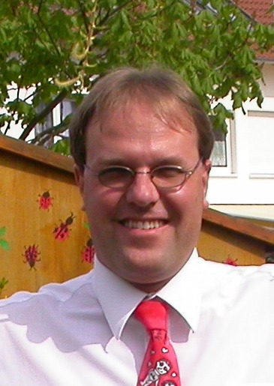
Answer to pessimists:
“There is no useful cellphone DTN app!”
  Except that current social networking is limited.
“Forget it, operators will block it.”
  Really (android, WiMo)? reason to stop research?
“Why bother, you can do it with 3G!”
  Perhaps, but this is cheaper. Not worth checking?
“Users do not tolerate delay.”
  True but interface is everything
  BTW hard to tell (e.g., privacy)

Slide 39





How do you imagine the future Internet?
Based on a vision …
  Interplanetary/rural/challenging environments
  Using all cell phones as scientific instruments
  Towards minimum joule per bits
or Based on a true story …
Social Networking
Enriched Media experience
Relatively short-lived content

