Slide 1
Deterministic Identification of A, B from Mixed EBSD Pattern C
Non-ML baseline for pair discovery and mixing-fraction inversion
Objective: From candidate bank {P_k} and observed mixed pattern C, find the contributing pair (A,B) and fraction x.
Model: C_hat_ij(x) = x P_i + (1-x) P_j, with x in [0,1].
Primary score: NCC; tie-break: minimum L2.
Search strategy: two-stage (coarse all-pairs screening + refined top-M evaluation).
DeepImageDeconvolution | Deterministic baseline (lab meeting draft)

Slide 2
Problem Formulation
Candidate bank: {P_k}, k = 1..n
Unique unordered pair set: U = {(i,j) | i < j}, |U| = n(n-1)/2
Per pair inversion: x*_ij = argmax_x NCC(C_hat_ij(x), C)
Global selection: (i*,j*) = argmax_(i,j in U_M) S_ij
Score: S_ij = NCC(T*_ij(C_hat_ij(x*_ij)), C)
C_hat_ij(x) = x P_i + (1-x) P_j
x in [0,1]
NCC(U,V) =
sum[(U-mean(U))(V-mean(V))] /
(||U-mean(U)|| ||V-mean(V)||)
L2(U,V) = (1/|M|) sum_{p in M}(U_p - V_p)^2

Slide 3
Algorithm (Implemented Workflow)
1) Enumerate all unique unordered pairs (i,j), i<j.
2) Stage-1 coarse search: fast x-grid for every pair; rank by NCC (L2 tie-break).
3) Keep top-M pairs (configurable, e.g., M=20).
4) Stage-2 refine: fine x-search + optional rigid alignment T(theta, dy, dx).
5) Re-estimate x with alignment fixed and compute final scores.
6) Return winner pair (A*,B*), x*, top-k list, alignment parameters, confidence margin.

Slide 4
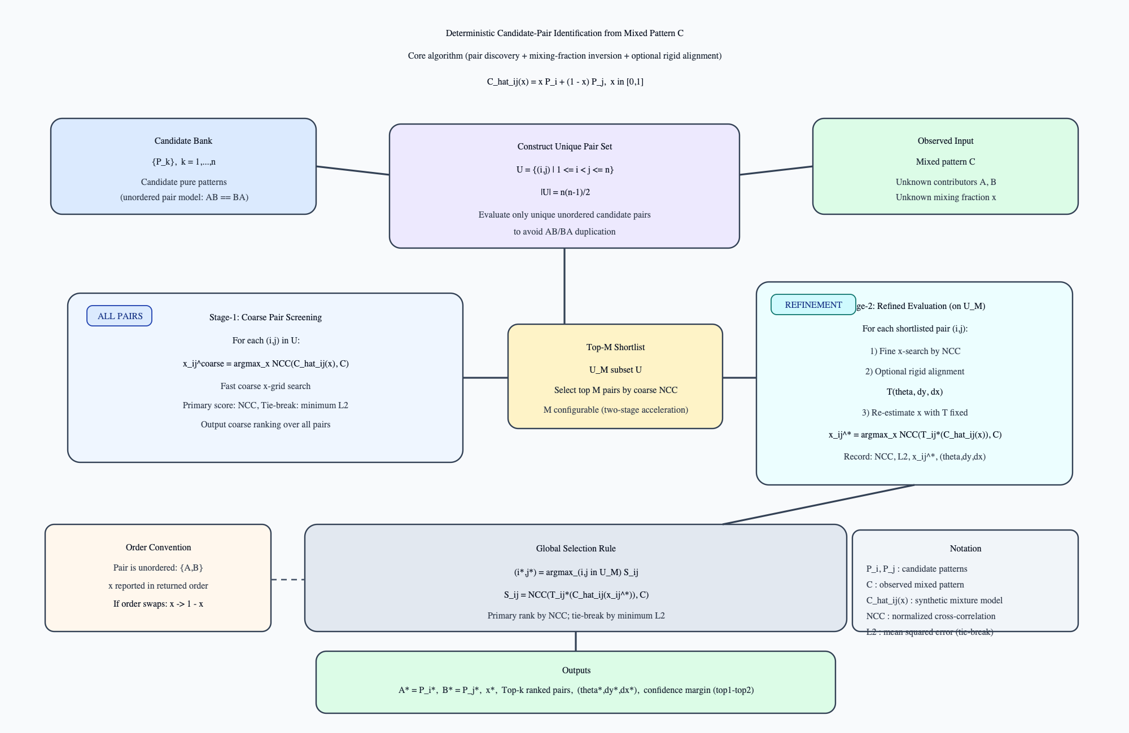
Publication Schematic of Core Algorithm
Figure: candidate pair generation, two-stage scoring, rigid alignment refinement, and final (A,B,x) decision.

Slide 5
Current Conclusions from Deterministic Baseline
The inverse problem is tractable with explicit physics-style mixing C_hat(x)=xA+(1-x)B.
NCC is robust as primary ranking metric; L2 improves deterministic tie resolution.
Two-stage search reduces runtime while preserving ranking quality.
Rigid alignment (small rotation + translation) improves resilience to geometric mismatch.
Outputs are explainable: winner pair, x*, top-k alternatives, and confidence margins.

Slide 6
Work Ahead
A) Validate on real convoluted EBSD patterns (not only synthetic mixtures).
B) Automate candidate-bank selection for arbitrary pattern locations in a full EBSD scan.
Target capability: given any scan pixel C(x,y), auto-propose local physically-plausible candidates.
Then run the same deterministic ranking pipeline to estimate pair identity and mixing fraction map.
Integrate confidence-aware outputs for boundary-region interpretation and downstream analysis.

