Slide 1
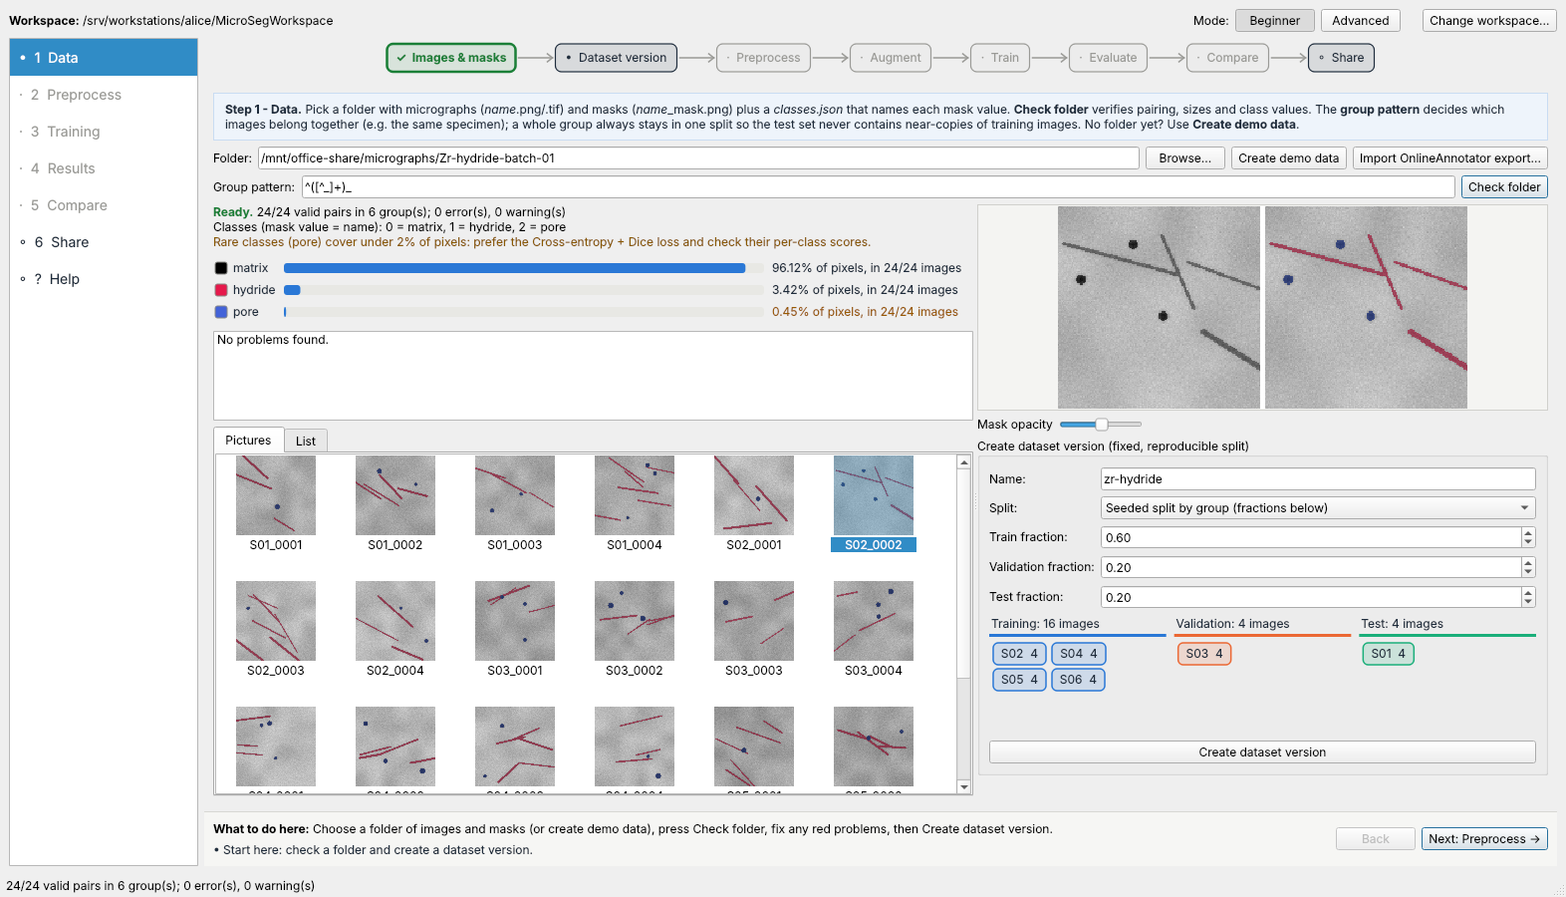
MicroSegWorkbench: a beginner's guide
Train, check, compare and share microstructure segmentation models
For researchers with no programming background
Version 1.0 release candidate · November 2026
About the screenshots
Real app, real training on CPU. Images are synthetic; a local folder (/mnt/office-share) stands in for the office network drive.
Simulated data and network drive
Six guided steps; the app checks your work at every step
Notes:
Use this deck next to the in-app Help page. Each slide is one step; numbered markers on the screenshot match the numbered statements on the left. Boxes marked ATTENTION are the points where beginners most often go wrong.

Slide 2
What the workbench does
Trains segmentation networks
on your annotated micrographs, on a GPU or the CPU
1
1
2
2
Images & masks
check folder
Dataset version
frozen split
Preprocess
border, size
Augment
visual pipeline
Keeps every result traceable
to exact images, settings, network and software
Checks your work at each step
data, settings, training and results, in plain words
Shares through the office drive
a colleague reviews before a model counts as approved
6
5
4
3
Share
publish, review
Compare
runs, same image
Evaluate
test scores, notes
Train
live curves
Numbers = steps in the app's left-hand list
Help (?) explains every step
One guided path from annotated micrographs to an approved model

Slide 3
Where your files live
Network drive: the authoritative copy
micrographs, dataset versions, published models, reviews
Office network drive
(S:\ or \\server\share)
micrographs and masks
MicroSegWorkbench shared folder:
dataset versions
published models + notes
reviews
Your Windows PC
local workspace
working copies (verified)
training runs, checkpoints
predictions
uses NVIDIA GPU or CPU
download
Your PC: the workspace
verified local copies, runs in progress, caches
publish
Publishing is checked
files are fingerprinted, never overwritten, never half-written
In these screenshots
/mnt/office-share = network drive
alice, bob, carol, dave =
four colleagues' PCs (simulated)
Ubuntu VM (optional)
small index for search and
review status; no images
!
ATTENTION
Never move, rename or edit files inside the workspace or the shared folder by hand. Use the app.
Originals stay on the network drive; your PC works on verified copies

Slide 4
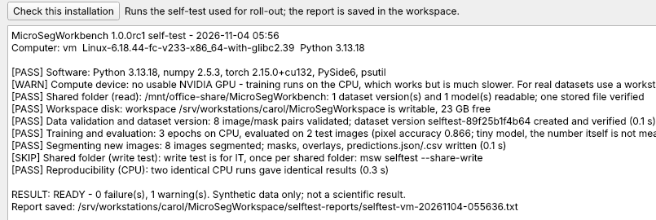
Check the installation first
1
Help -> Check this installation
or msw selftest; about a minute
2
Real training on tiny synthetic data
GPU, disk, data, training, evaluation, segmentation, reproducibility
1
3
Shared folder: read check
nothing is written; IT tests publishing once per share (--share-write)
3
2
Report saved for sign-off
workspace\selftest-reports
CPU-only sandbox: the GPU check shows WARN
!
ATTENTION
NOT READY? Each FAIL line names the step and the reason; send the report to IT.
A READY self-test on every workstation before real work

Slide 5
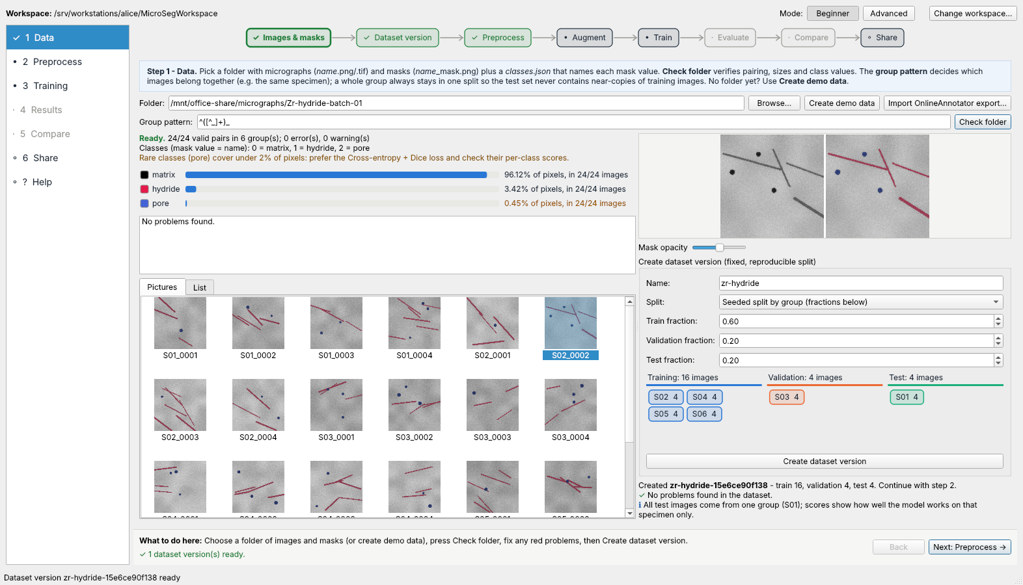
Finding your way around
1
Steps 1-6 on the left
a tick when done, ! when something needs a look
5
2
1
3
2
Workflow map on top
click a stage to jump there
3
Blue box explains the step
4
Footer: what to do here
plus Back and Next
5
Beginner / Advanced mode
Beginner shows only what you need
4
Simulated data and network drive
Follow the map left to right; the footer always says what to do next

Slide 6
Step 1 · Prepare the image folder
One mask per image
S01_0001.png with S01_0001_mask.png
Zr-hydride-batch-01\
classes.json
0 = matrix
1 = hydride
2 = pore
Mask pixel value = class number
classes.json names every value
classes.json
S01_0001.png
S01_0001_mask.png
Name starts with the specimen
S01_... keeps a specimen's images together
S01_0002.png
S01_0002_mask.png
Or import an OnlineAnnotator export
approved annotations, provenance kept
...
S01_0001
^ specimen (group)
Group pattern ^([^_]+)_ takes the text before the first _ as the specimen.
All images of one specimen go to the same split.
S06_0004.png
S06_0004_mask.png
0
0
0
1
1
0
!
ATTENTION
Save masks as PNG. JPEG and resizing change pixel values and silently create wrong classes.
0
0
1
1
0
0
A mask is an image of class numbers, one per pixel
0
1
1
0
0
0
1
1
0
0
2
0
1
0
0
2
2
2
0
0
0
0
2
0
Correct names and exact mask values are the foundation of every result

Slide 7
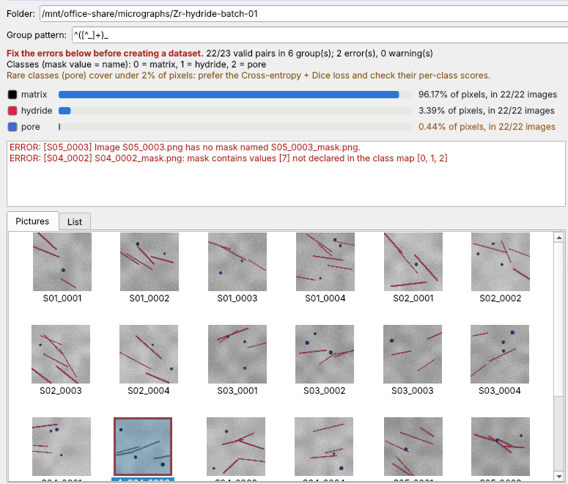
Step 1 · Check the folder
1
Browse to the folder, press Check folder
1
2
Errors listed in plain words
here: a missing mask and an undeclared value 7
4
2
3
Problem pictures framed red
click one to see it
4
Class balance
rare classes flagged in amber
!
ATTENTION
Fix problems in the original files, then press Check folder again.
3
Simulated data and network drive
Fix every red problem; the app will not build a dataset from a broken folder

Slide 8
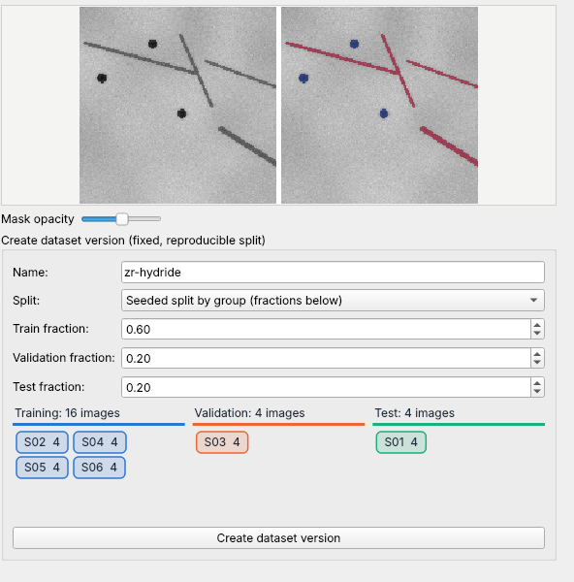
Step 1 · Split by specimen
1
Image and mask side by side
click any picture in the gallery
1
2
Mask opacity slider
check that masks sit exactly on the features
3
Whole specimens per split
Training learns, Validation picks the best epoch, Test is scored once
2
!
ATTENTION
With one test specimen, test scores describe only that specimen. Use more specimens where you can.
3
Simulated data and network drive
Splitting by specimen keeps the test honest

Slide 9
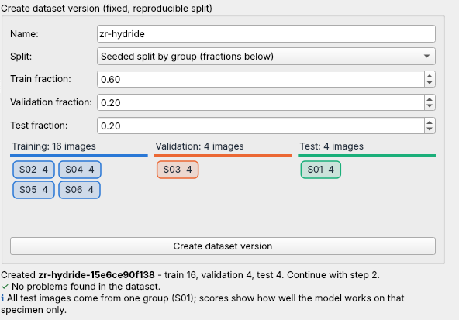
Step 1 · Create the dataset version
1
Give the version a name
2
Create dataset version
a frozen copy with fingerprints; the same version always gives the same split
1
3
Dataset check runs automatically
green tick, blue note, amber warning or red block
2
!
ATTENTION
Adding or fixing images later? Create a new version; old results keep pointing to the old one.
3
Simulated data and network drive
A dataset version is frozen: every result points to exactly these files

Slide 10
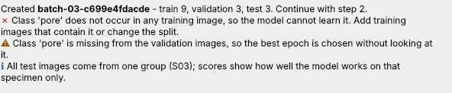
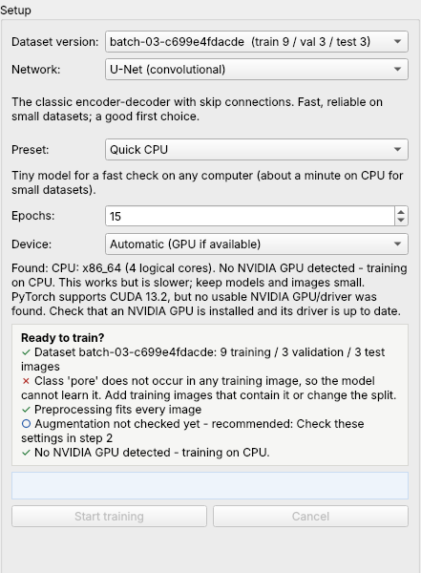
When the dataset check stops you
1
Class missing from training
pores occur only in specimen S03, which went to the test split
1
2
Start training stays disabled
the checklist says why
Fix the data, not the check
annotate pores in more specimens, then create a new version
1
!
ATTENTION
Amber warnings need a look; red blocks need a fix before training.
2
Simulated example: dave's dataset
A blocked start saves hours of training a useless model

Slide 11
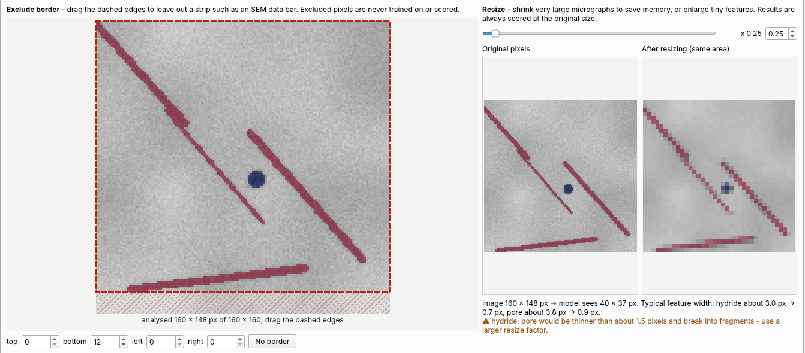
Step 2A · Preprocessing
1
Drag the dashed edges
to leave out data bars or labels; excluded pixels are never trained or scored
2
Resize only for very large images
before/after at true pixel size
2
3
Feature-width warning
hydrides 3 px wide become 0.7 px at x0.25
1
3
!
ATTENTION
Keep resize at x1 unless memory forces it. Features thinner than ~1.5 px break apart.
Simulated data and network drive
Preprocess as little as possible; never shrink features away

Slide 12
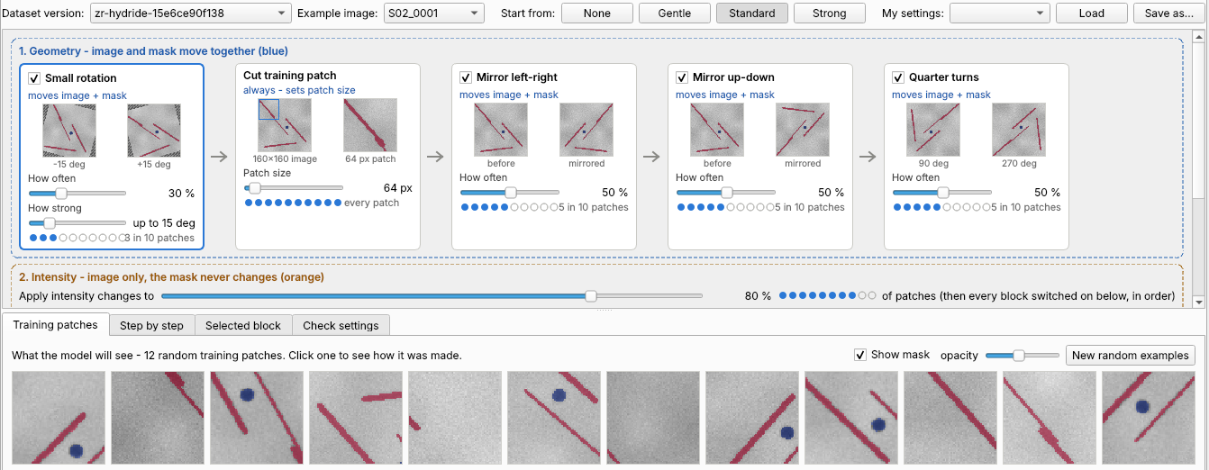
Step 2B · The augmentation pipeline
1
Start from a preset
Standard suits most data
2
Blocks run left to right
blue: image and mask move together; orange: image only
1
2
3
Dots = how often a block fires
slider sets probability, thumbnails show weakest and strongest
3
4
Real training patches
exactly what the model will see
4
Simulated data and network drive
Start from a preset; change a block only for a reason you can name

Slide 13
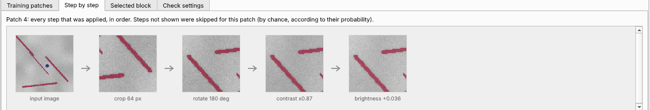
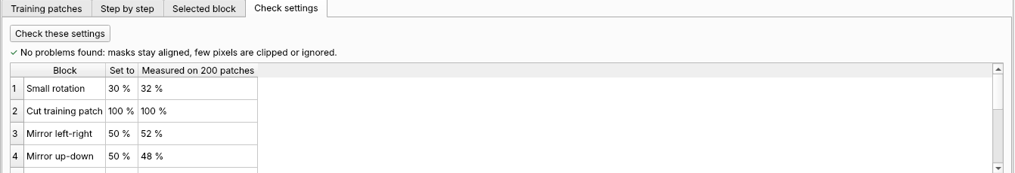
Step 2B · Check before you train
1
Step by step
one patch followed through every block
2
Check these settings
runs the real pipeline on your images
1
3
Findings in plain words
clipping, ignored pixels, blur against feature width, fire rates
2
3
!
ATTENTION
Strong blur or contrast changes can erase thin features. Read every finding.
Simulated data and network drive
Run 'Check these settings' after every change

Slide 14
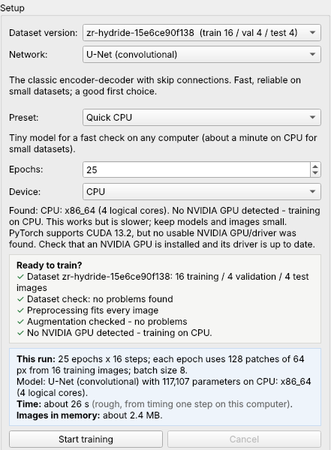
Step 3 · Set up a training run
1
Dataset version and network
1
2
Preset
Quick CPU for a first try; Standard or Large GPU for real runs
2
3
Ready to train?
all ticks, or amber items you have read
4
This run
epochs, model size, time and memory, measured on this PC
3
4
!
ATTENTION
No NVIDIA GPU found means training runs on the CPU: slower, but it works.
Simulated data and network drive
Read the checklist and the run card before pressing Start

Slide 15
Choosing a network
U-Net: first choice
convolutional, fast, reliable on small datasets
 | U-Net | SegFormer-lite
Type | Convolutional encoder-decoder | Vision transformer, MLP decoder
Strength | Fine detail, small data | Long-range context
Needs | Few images, short training | More images, more epochs
Patch size | multiple of 2^depth | multiple of 32
Parameters (quick preset) | 117,107 | 462,211
Demo test feature IoU | 0.995 | 0.860
Epochs in the demo | 25 | 40
SegFormer-lite: transformer
sees wider context; needs more images and epochs
Train both on the same dataset version
then compare them in step 5
More networks can be added later
as plugins, without changing the app
Demo: synthetic data, 16 training images, CPU; U-Net 25 epochs, SegFormer-lite 40 epochs. Your numbers will differ.
Start with U-Net; try the transformer when you have more data

Slide 16
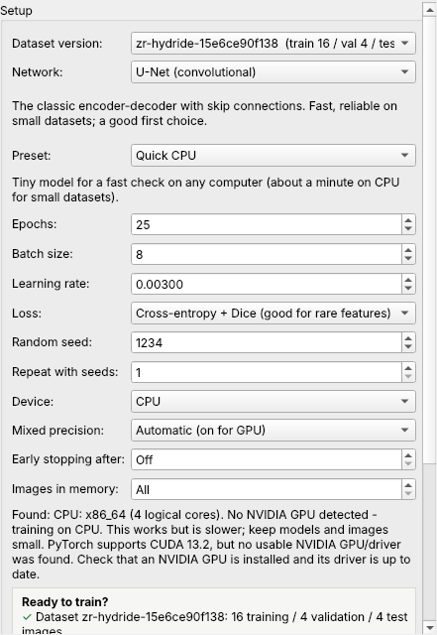
Beginner and Advanced mode
Switch at the top right
remembered for your workspace
2
Advanced adds expert settings
batch, learning rate, loss, seed, repeats, precision, early stopping
Beginner keeps the essentials
dataset, network, preset, epochs, device
2
!
ATTENTION
Change one expert setting at a time, and compare the runs in step 5.
Simulated data and network drive
Stay in Beginner mode until a result tells you what to change

Slide 17
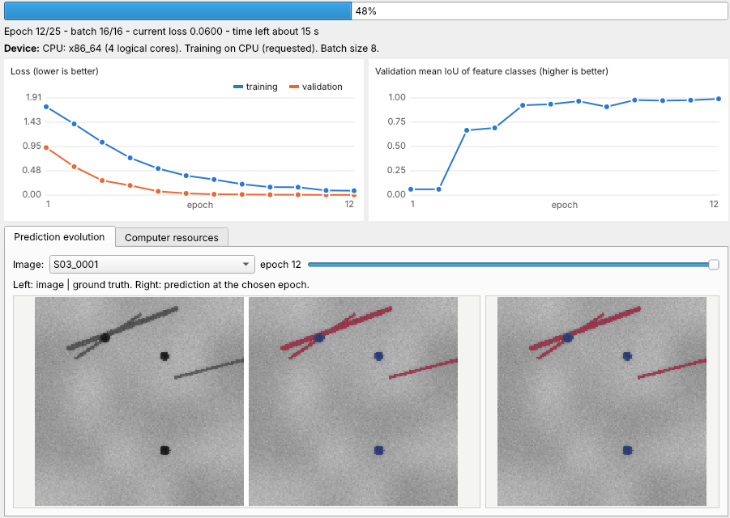
Step 3 · Watching training
1
Progress and time left
1
2
Loss falls
training (blue) and validation (orange)
2
3
Validation IoU rises, then levels off
the best epoch is kept automatically
3
4
4
Prediction evolution
the same image, epoch by epoch
!
ATTENTION
Training loss falling while validation IoU drops = overfitting. Cancel is safe; resume later in step 4.
Simulated data and network drive
Judge training by validation curves and images, not by loss alone

Slide 18
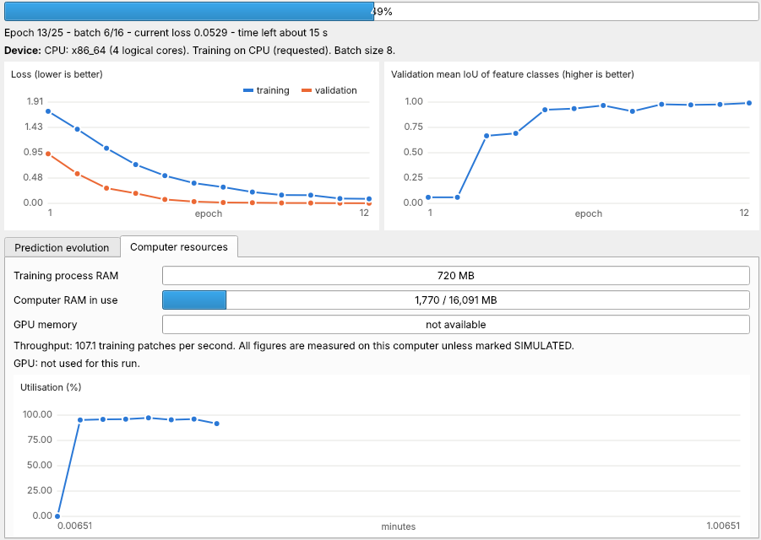
Step 3 · Computer resources
1
Memory of the run and the PC
and GPU memory when an NVIDIA GPU is used
2
Measured speed
3
Utilisation over time
Out of memory?
the run stops cleanly and suggests a smaller batch or patch
1
2
3
CPU-only sandbox: GPU memory not available
Know whether you are on the GPU or the CPU before a long run

Slide 19
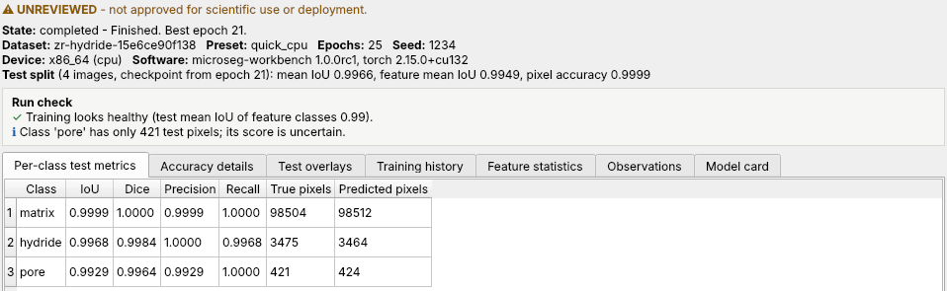
Step 4 · Results and run check
1
Status banner: UNREVIEWED
2
Run check in plain words
overfitting, under-training, missed classes, thin evidence
1
3
Per-class test scores
on the test split, never used for training
2
3
Simulated data and network drive
!
ATTENTION
Judge by the feature classes (hydride, pore). Matrix dominates the pixels, so overall accuracy flatters.
Results stay unreviewed until a colleague approves them

Slide 20
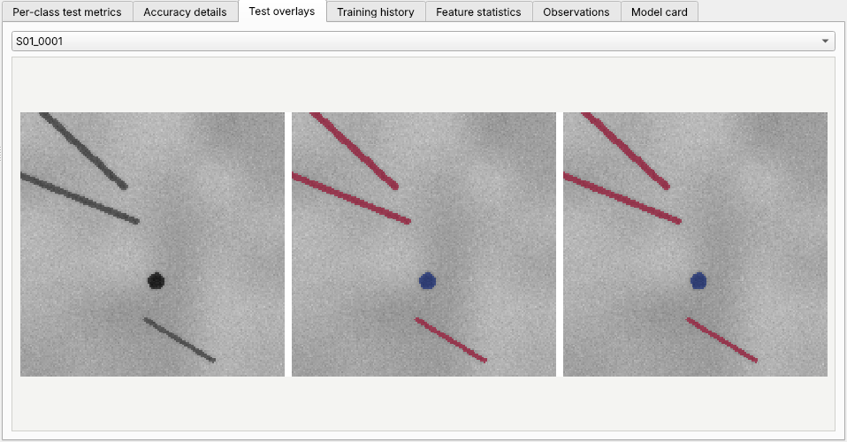
Step 4 · Look at the overlays
1
Every test image
ground truth next to prediction
Look for
broken thin hydrides, missed or merged pores, false edges at borders
1
Export report
one self-contained HTML file to attach or archive
Simulated data and network drive
A good score can hide systematic errors; always look

Slide 21
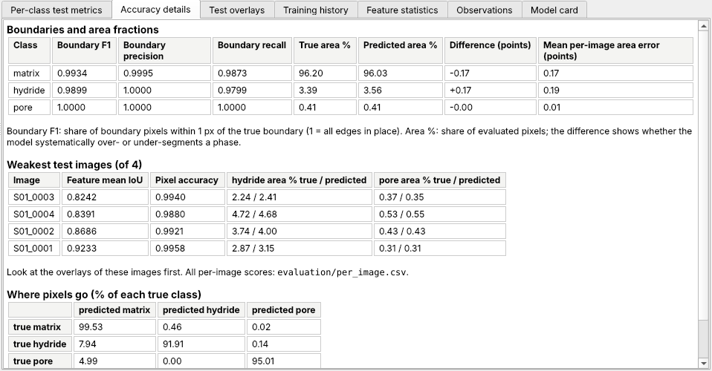
Step 4 · Accuracy details
1
Boundary F1
share of edges within 1 px of the true edge; 1 = every edge in place
2
True vs predicted area %
a clear difference means biased phase fractions
1
2
3
Weakest test images
look at their overlays first
3
4
Where pixels go
which classes are confused with which
4
!
ATTENTION
Before reporting area fractions, compare them with manual measurements on images not used for training.
Simulated data and network drive
Check boundaries and area fractions before you measure with a model

Slide 22
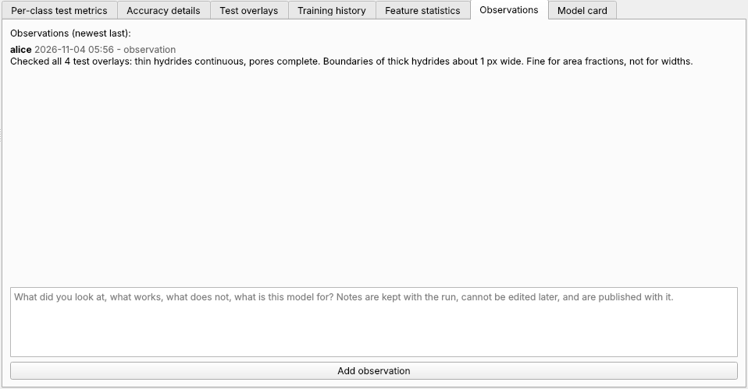
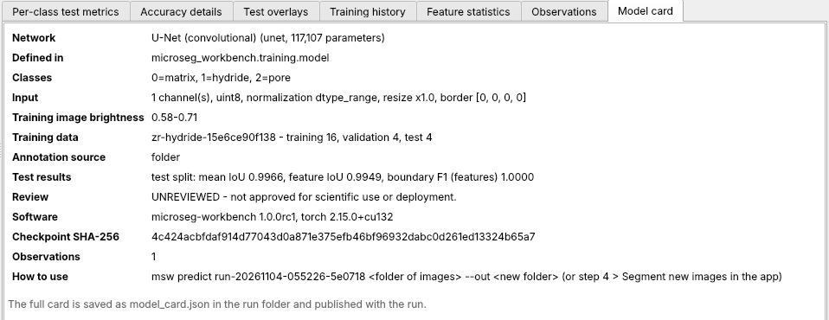
Step 4 · Observations and model card
1
Observations
what you checked, what the model is and is not good for
1
Notes cannot be edited
add a new note to correct one
2
Model card
network, classes, input, training data, scores, software, checkpoint fingerprint
2
!
ATTENTION
Publishing in step 6 needs at least one observation.
Simulated data and network drive
Write down what you checked; colleagues rely on it

Slide 23
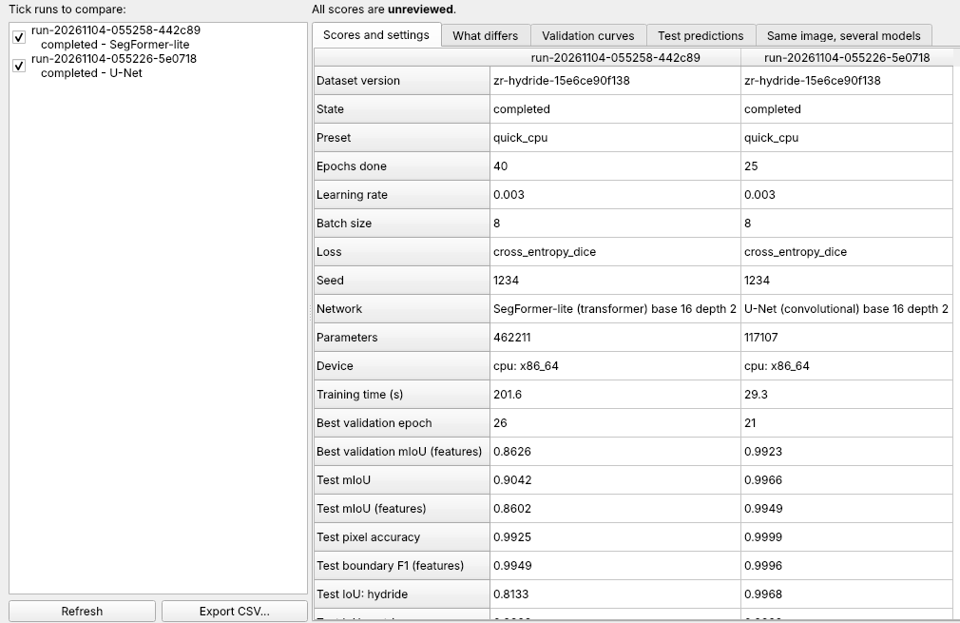
Step 5 · Compare runs
1
Tick the runs to compare
3
1
2
Scores and settings side by side
'What differs' lists only the changed settings
2
3
Validation curves, test predictions
!
ATTENTION
Rank runs only on the same dataset version. Repeat with seeds (Advanced) to see how much is luck.
Simulated data and network drive
Compare like with like: same dataset version, several seeds

Slide 24
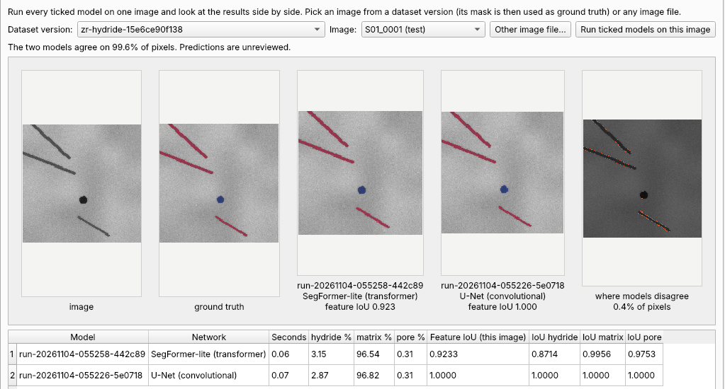
Step 5 · Same image, several models
1
Choose a dataset image or any file
dataset images bring their ground truth
2
Each model's segmentation
U-Net and SegFormer-lite side by side
1
2
3
3
Where models disagree
orange pixels
4
Scores, class fractions, time
4
Simulated data and network drive
Disagreement shows where to look more closely

Slide 25
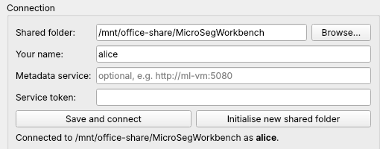
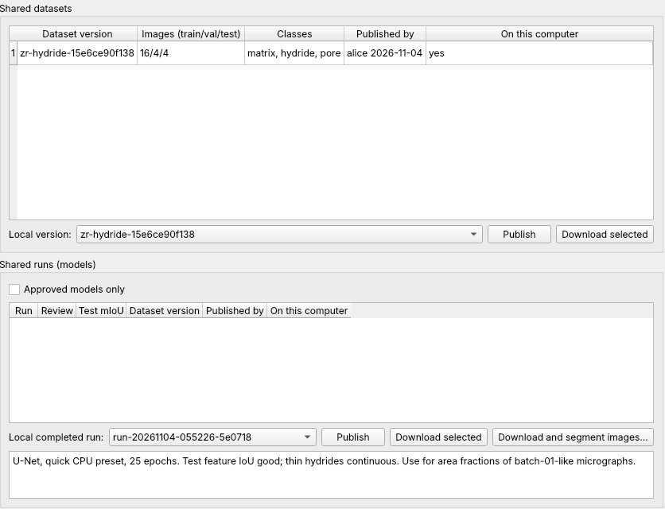
Step 6 · Connect and publish
1
Shared folder path and your name
once; Save and connect
1
2
Publish the dataset version first
3
Write observations, publish the run
files verified, deduplicated, immutable
2
!
ATTENTION
Published items are never overwritten. To improve a model, train and publish a new run.
3
Simulated data and network drive
Publishing makes your model available, with your notes attached

Slide 26
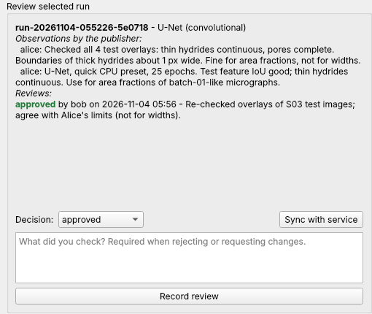
Step 6 · Review by a colleague
Download the run
with its dataset, verified
4
2
Read the observations, check the overlays
2
3
Decide and comment
approved, needs changes or rejected
4
Status for everyone
UNREVIEWED becomes APPROVED
3
Simulated data and network drive (bob's PC)
Approval must come from someone other than the publisher

Slide 27
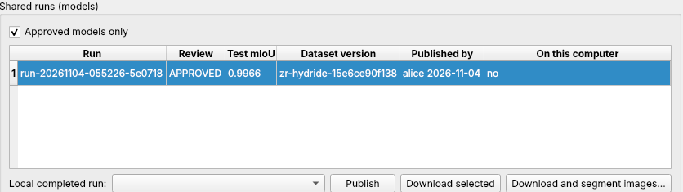
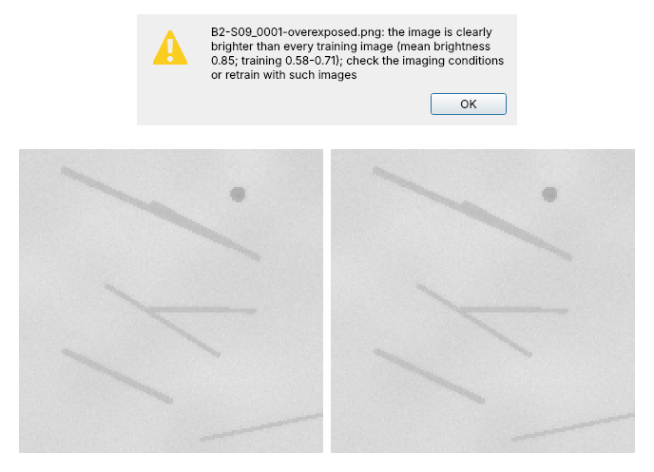
Fetch and use an approved model
1
Approved models only
1
2
Download and segment images
pick a folder; model and data are fetched, then applied
2
3
Warning for unlike images
here: an over-exposed micrograph, on which the model found no hydrides at all
3
!
ATTENTION
Predictions are unreviewed. Check images with warnings, or retrain with such images.
Warning, then the output overlay: image | prediction (nothing found)
Heed input warnings: a model knows only images like its training images

Slide 28
The same work from the command line
For repeat or batch work
same checks, same files, same provenance
> msw models
run-20261103-093320-629a63 [APPROVED] U-Net (convolutional)
data zr-hydride-15e6ce90f138 test feature IoU 0.9949
(here + shared)
> msw predict run-20261103-093320-629a63
S:\micrographs\Zr-hydride-batch-02-unlabelled
--out C:\Users\carol\results\batch-02
Downloading model ... (only if not here yet)
[1/9] B2-S01_0001.png
...
[9/9] B2-S09_0001-overexposed.png
WARNING B2-S09_0001-overexposed.png: the image is
clearly brighter than every training image (mean
brightness 0.85; training 0.58-0.71); check the
imaging conditions or retrain with such images
9 prediction(s) written to C:\Users\carol\results\
batch-02 [UNREVIEWED]
> msw compare-image IMAGE RUN RUN --out side.png
> msw check-run RUN > msw report RUN > msw selftest
msw models
every model here and on the shared folder
msw predict
downloads a shared model first
msw selftest
checks this computer and the shared folder
msw --help
lists every command
Everything in the app is also available as msw commands

Slide 29
Ten things that need your attention
Before you trust a result
Masks are PNG with exact class values; classes.json names every value
1
Before you share it
2
File names start with the specimen, so splits keep specimens together
Before you use someone else's model
3
Fix every red problem; read every amber warning
Print this page
and keep it next to the workstation
4
Never edit files inside the workspace or shared folder by hand
5
Do not resize features below ~1.5 px
6
Run 'Check these settings' after changing augmentation
7
Judge by feature IoU and the overlays, not overall accuracy
8
Compare runs only on the same dataset version (and several seeds)
9
Write observations before publishing; never approve your own run
10
Unreviewed is not approved; check images that raise input warnings
Most mistakes are caught by the app; the rest by your eyes

Slide 30
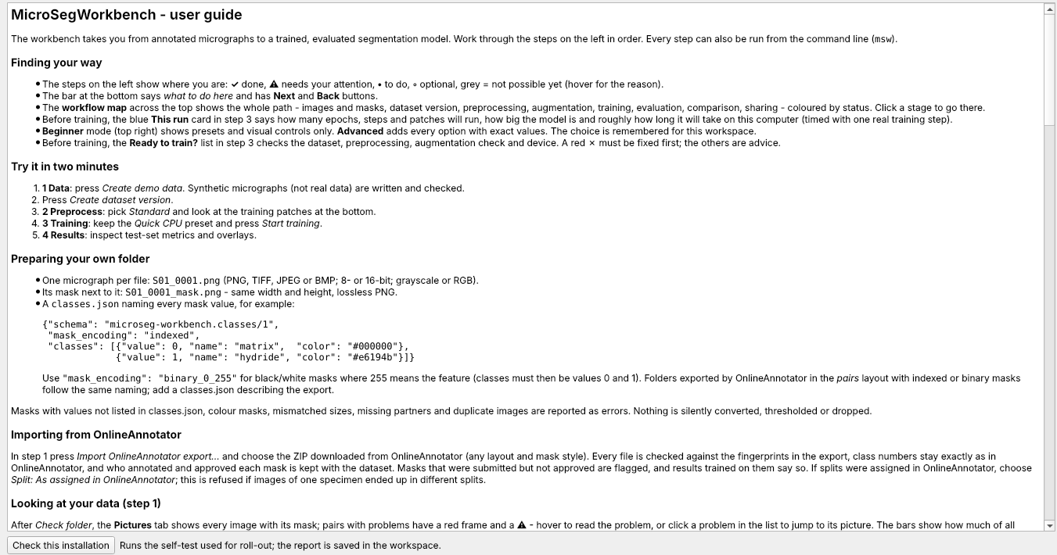
Getting help
1
? Help page
every step explained, with the matching commands
1
Hover for tooltips
on every button and setting
Error messages say what to do
not just what went wrong
Administrators
README, docs/DEPLOYMENT.md, docs/SPECIFICATION.md
Simulated data and network drive
When unsure: read the step's help, then ask a colleague

