Slide 1
Measurement conditions
Pattern center PCx and PCy: 0.457, 0.584
Resolution (Width): 141 pixels
Resolution (Height): 106 pixels
Step Size: 2μm
Field Width: 0.28mm
Field Height: 0.21mm
Number of Points: 14946
Hit Rate: 98.8 %
Accelerating Voltage: 25.00 kV
Working Distance: 18.0 mm
Detector Insertion Distance: 172.5 mm
Speed of Acquisition: 7.4 Hz
Tilt Axis: Parallel to X
Specimen Tilt (degrees): 70.0°
EBSD Camera Binning Mode: 1x1 (640x480 pixels)
EBSD Camera Exposure Time: 134.45 ms
EBSD Camera Gain: 9
Frame Averaging: 1 frames
Hough Resolution: 60
Number of Bands Detected: 8

Slide 2
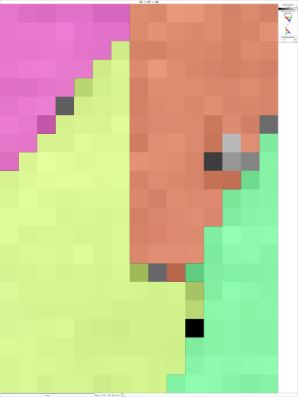
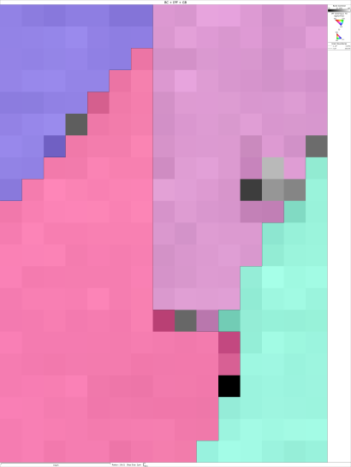
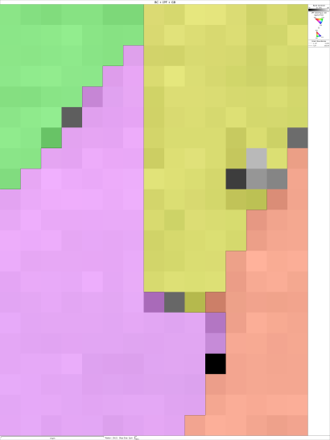
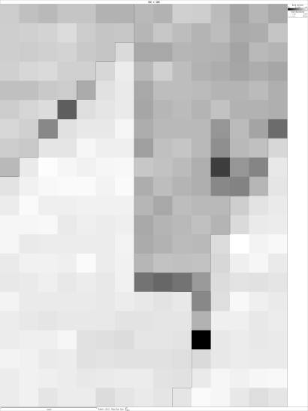
IPF X
IPF Y
IPF Z
BC

Slide 3
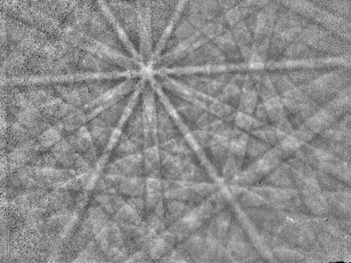
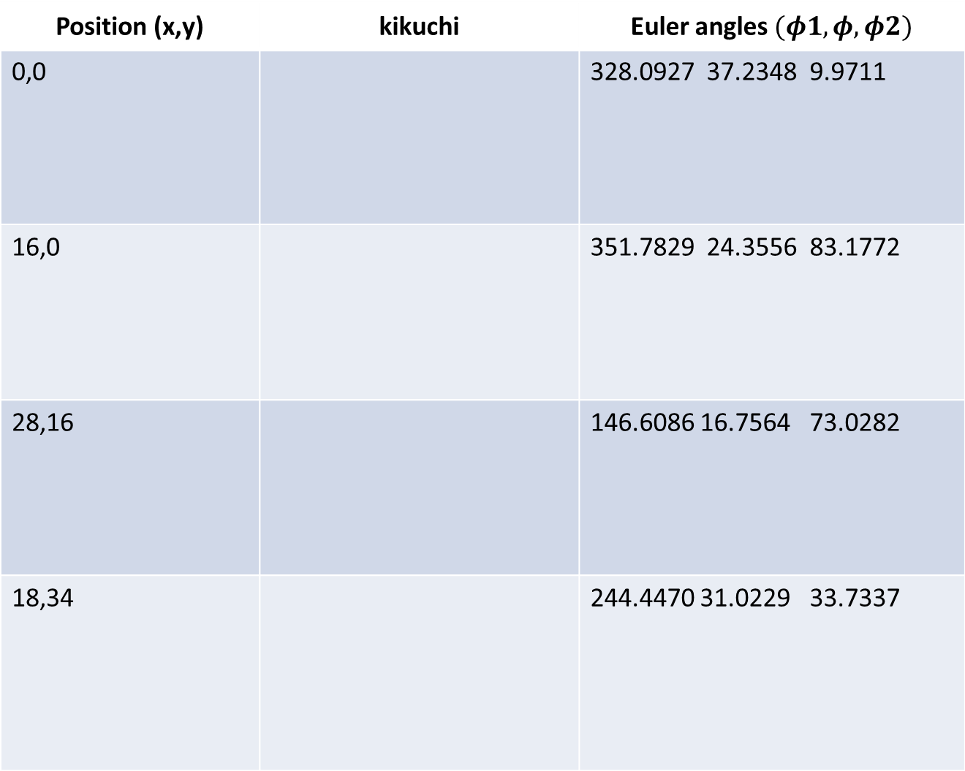
Position (x,y) | kikuchi | Euler angles $(φ1,φ, φ2)$
0,0 |  | 328.0927 37.2348 9.9711
16,0 |  | 351.7829 24.3556 83.1772
28,16 |  | 146.6086 16.7564 73.0282
18,34 |  | 244.4470 31.0229 33.7337

