Slide 1
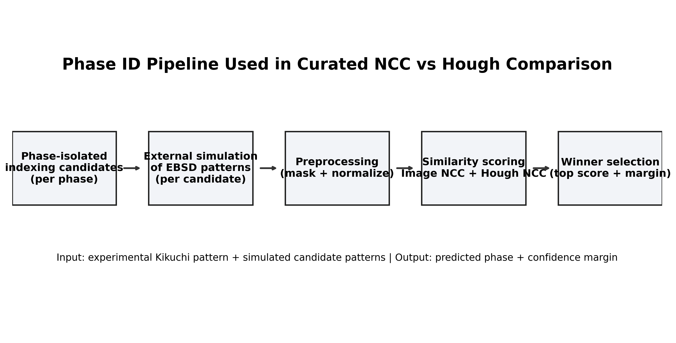
Objective and Scope
• Goal: improve phase ID among fe_bcc, fe3o4_magnetite, and feo_wustite.
• Compare masked image-space NCC vs KikuchiPy Hough-space NCC variants.
• Use latest result snapshot: reports/curated_hough_vs_ncc/summary.json (2026-02-21 09:41 UTC).
• Primary metric: top-1 phase accuracy on curated experimental patterns.
Bottom line: This comparison targets phase-correctness, not throughput, on curated benchmark evidence.

Slide 2
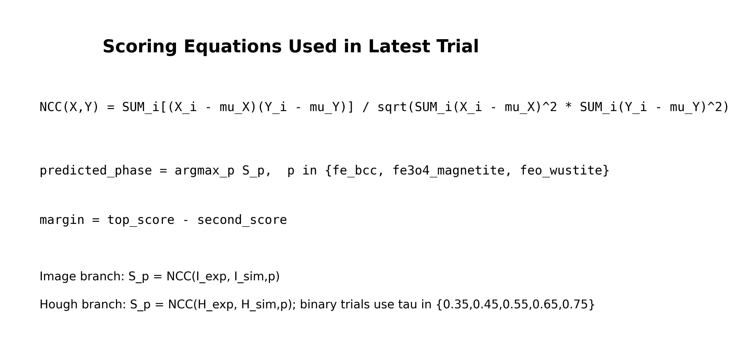
Data and Trial Configuration
• Curated cases: 3 (r001-r003), one experimental pattern per phase.
• Each case compares 3 simulated candidates from phase-isolated indexing assumptions.
• Hough config: n_theta=180, n_rho=90, n_bands=9, convolved-map=True.
• Binary Hough trials sweep tau = 0.35, 0.45, 0.55, 0.65, 0.75.
Bottom line: The experiment is controlled but very small, so conclusions are directional not final.

Slide 3
Methodology Pipeline
• Experimental pattern is compared against three phase-conditional simulated patterns.
• Common preprocessing: circular mask + minmax normalization inside mask.
• Compute image_ncc and hough_ncc scores per candidate; rank by top score.
• Decision evidence includes top score, second score, and margin = top-second.
Bottom line: Both branches use identical candidates; only similarity representation differs.

Slide 4
Scoring Equations and Decision Rule
• NCC is computed over masked pixels to reduce edge/background bias.
• Prediction uses argmax over candidate scores for the 3 phase hypotheses.
• Confidence proxy is margin (top score minus runner-up score).
• Hough trials evaluate raw map NCC and thresholded binary-map NCC.
Bottom line: Decision quality depends on separability of candidate scores, not just raw score magnitude.

Slide 5
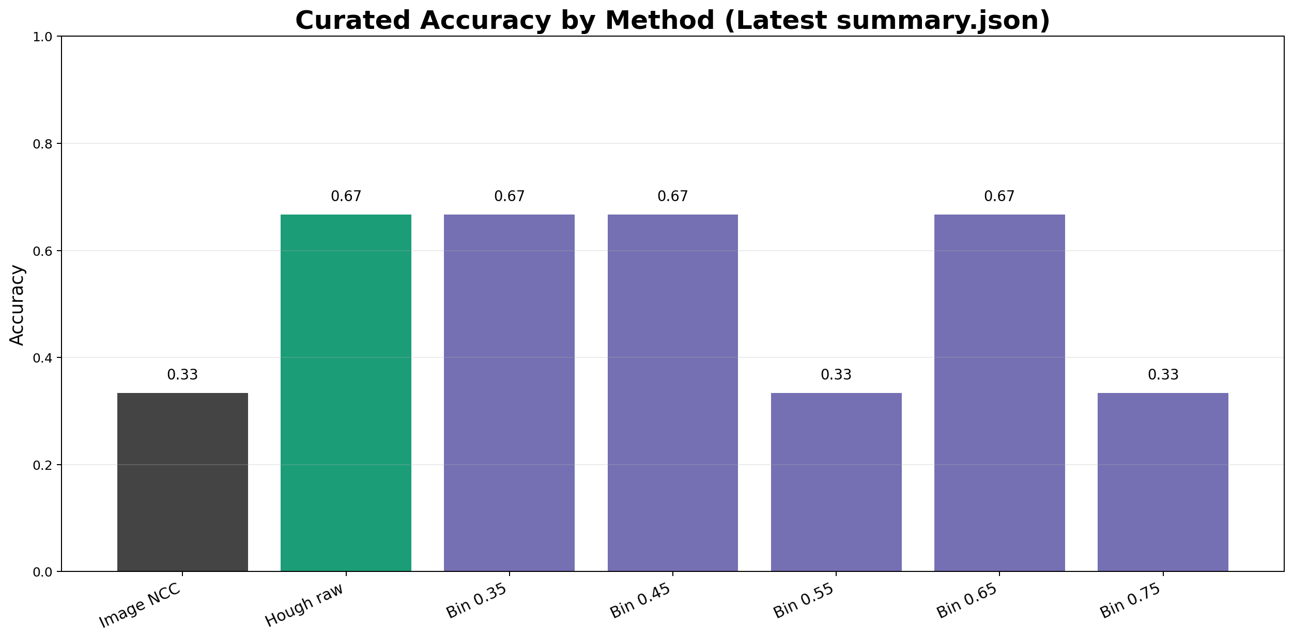
Headline Accuracy: NCC vs Hough-NCC
• Image NCC: 1/3 correct (33.3%).
• Hough raw NCC: 2/3 correct (66.7%).
• Best binary Hough method: hough_ncc_bin_t450 at 2/3 (66.7%).
• Absolute gain over image NCC: +33.3 percentage points on curated set.
Bottom line: Latest curated JSON indicates Hough-space scoring improves top-1 phase accuracy.

Slide 6
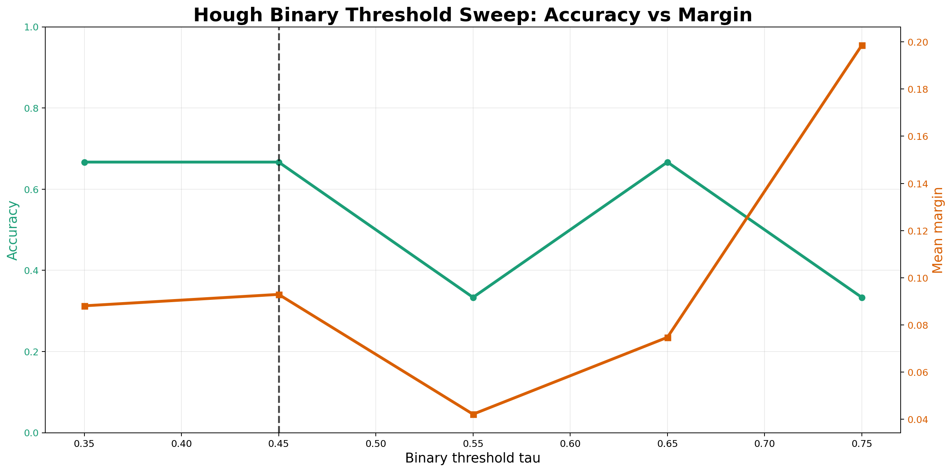
Binary Threshold Trials (Hough NCC)
• Thresholds 0.35, 0.45, and 0.65 each achieve 2/3 accuracy.
• Thresholds 0.55 and 0.75 fall to 1/3 accuracy.
• Best threshold in latest summary: tau=0.45 with strongest mean margin among 2/3 methods.
• Result confirms parameter sensitivity and need for robustness gating.
Bottom line: Tau=0.45 is a provisional best setting, not yet a frozen operating point.

Slide 7
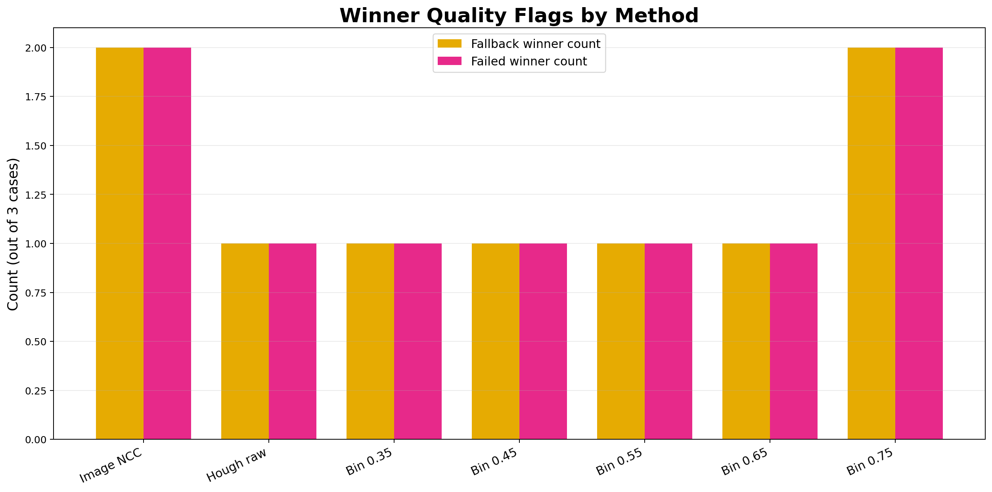
Winner Quality Flags and Fallback Impact
• Image NCC winners include failed/fallback orientations in 2 of 3 cases.
• Hough raw and hough_bin_t450 reduce failed/fallback winners to 1 of 3.
• The unresolved error case (r003) still tracks a failed/fallback bcc winner.
• Decision hygiene (penalty + uncertainty gate) is required before scale-up.
Bottom line: Reducing fallback-driven winners is central to reliable phase decisions.

Slide 8
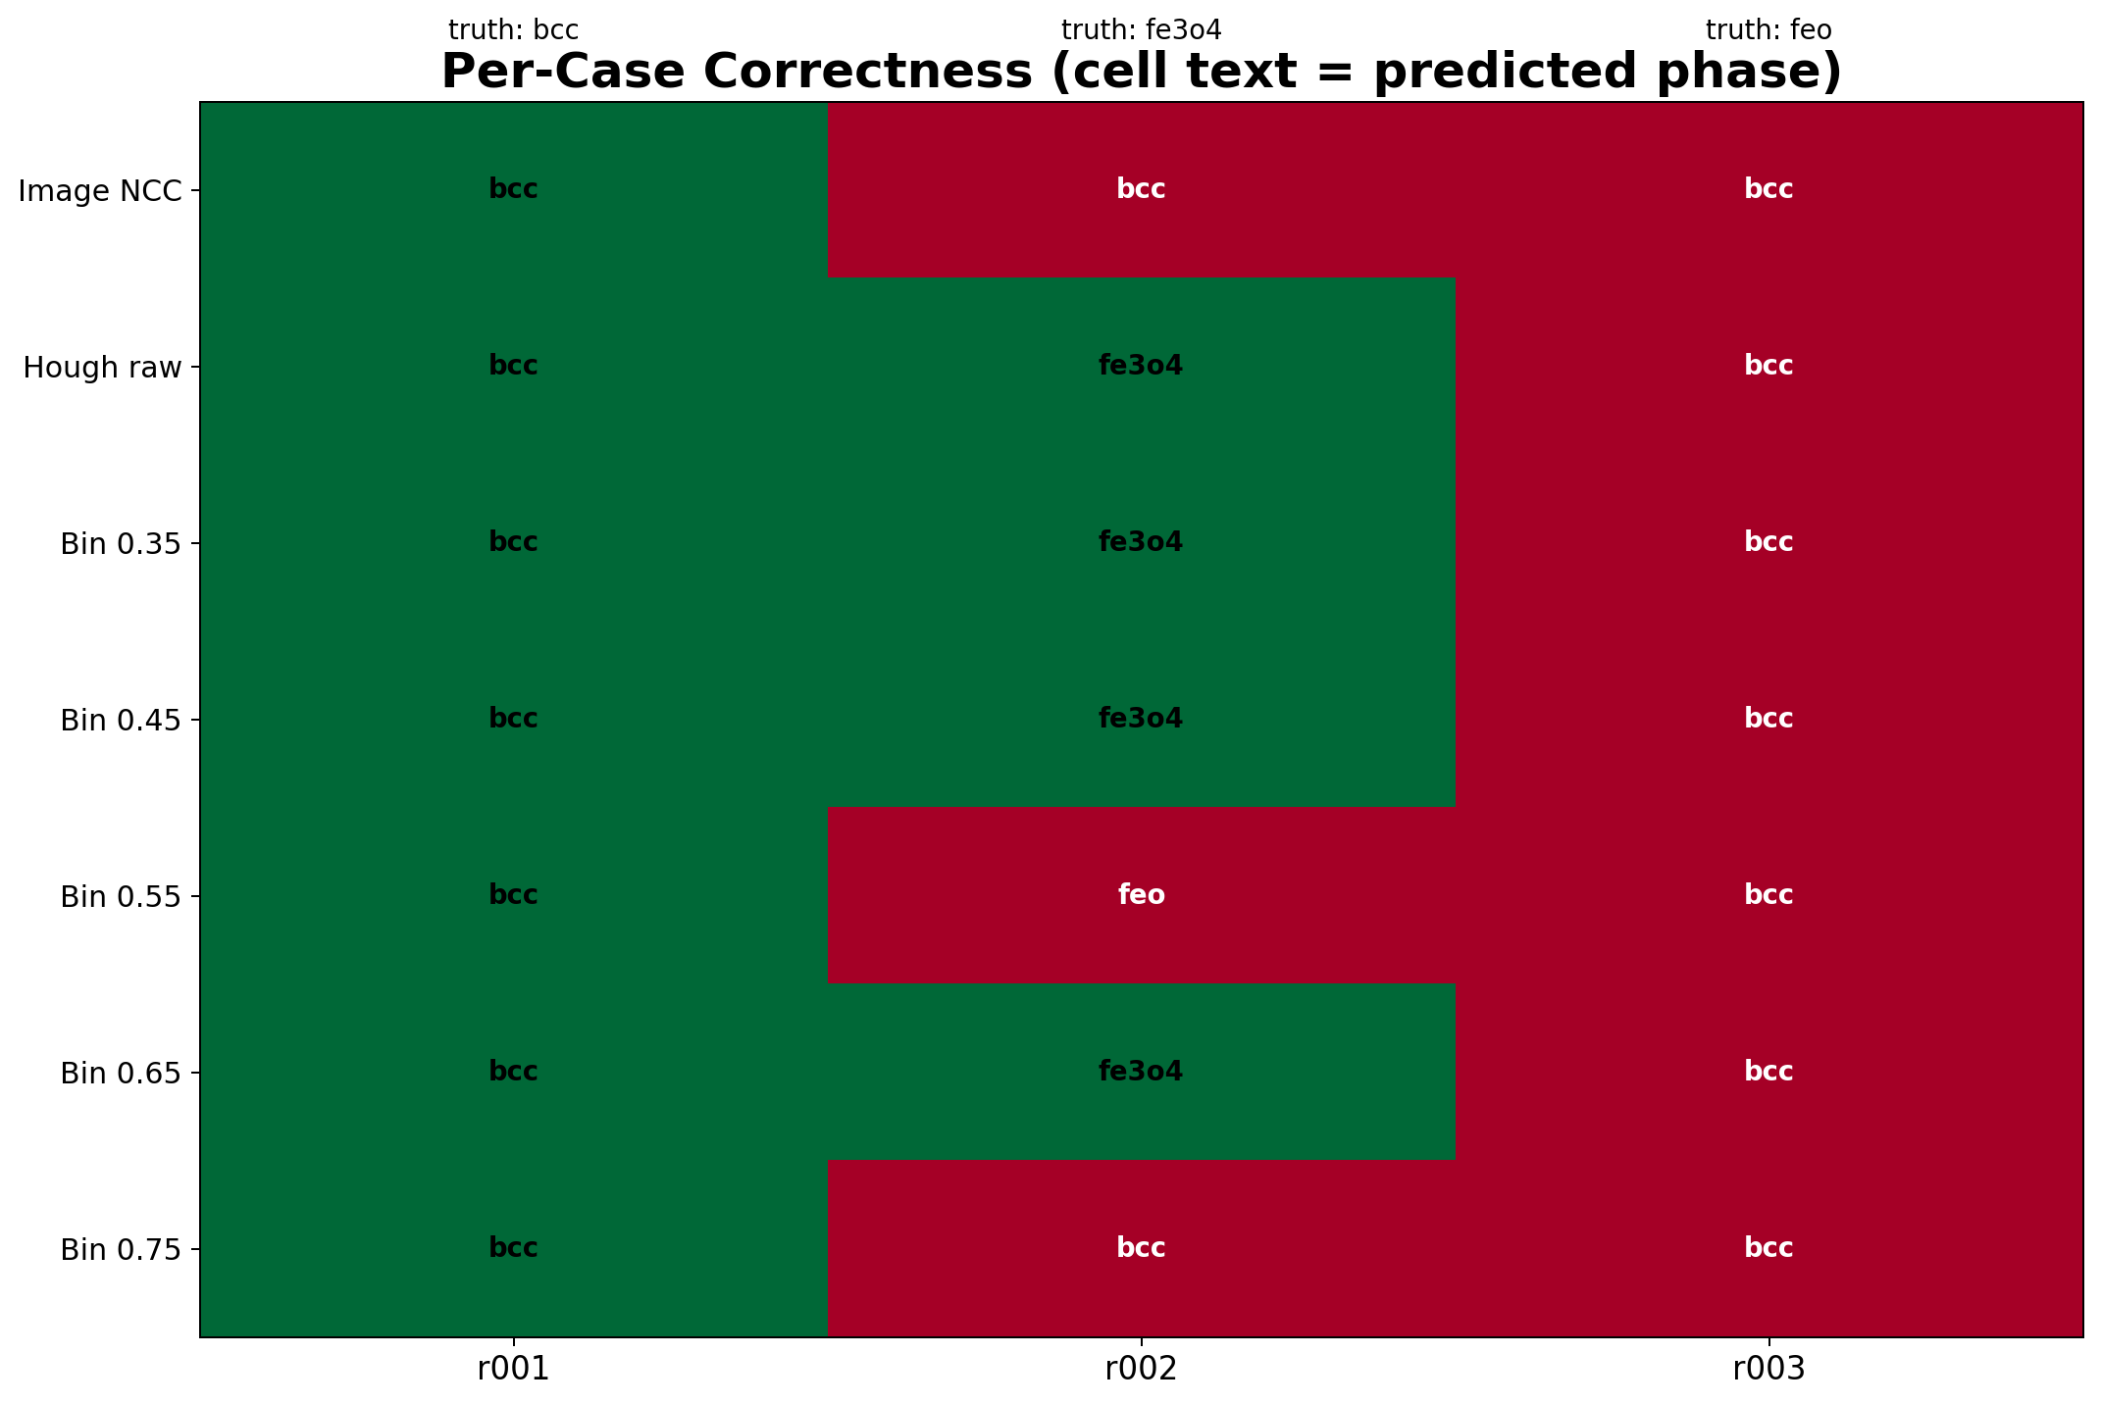
Per-Case Outcome Matrix
• r001 (truth bcc): all methods correct.
• r002 (truth fe3o4): image NCC fails, Hough raw/bin methods recover correct phase.
• r003 (truth feo): all methods predict bcc (persistent failure).
• Improvements are real but case-dependent; ambiguity remains on hard sample.
Bottom line: Hough branch fixes one key failure but does not solve all ambiguity cases.

Slide 9
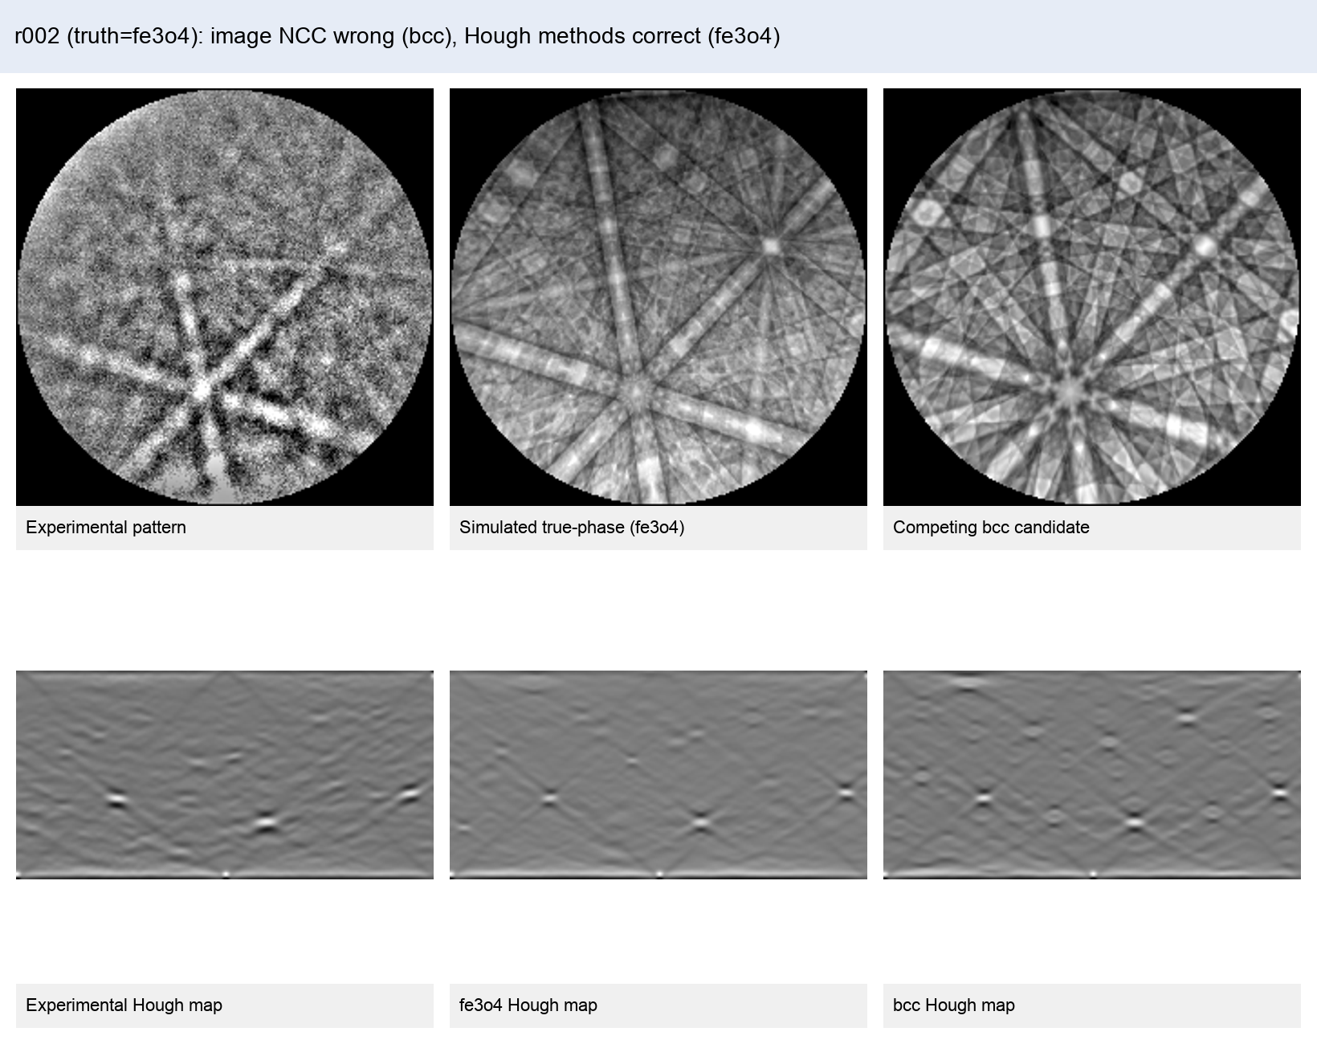
Qualitative Evidence: r002 Recovered by Hough
• Ground truth for r002 is fe3o4_magnetite.
• Image NCC selects bcc candidate (incorrect).
• Hough raw and binary (tau=0.45) select fe3o4 candidate (correct).
• Band-structure representation improves discrimination in this magnetite case.
Bottom line: For r002, Hough-space matching corrects the phase label missed by image NCC.

Slide 10
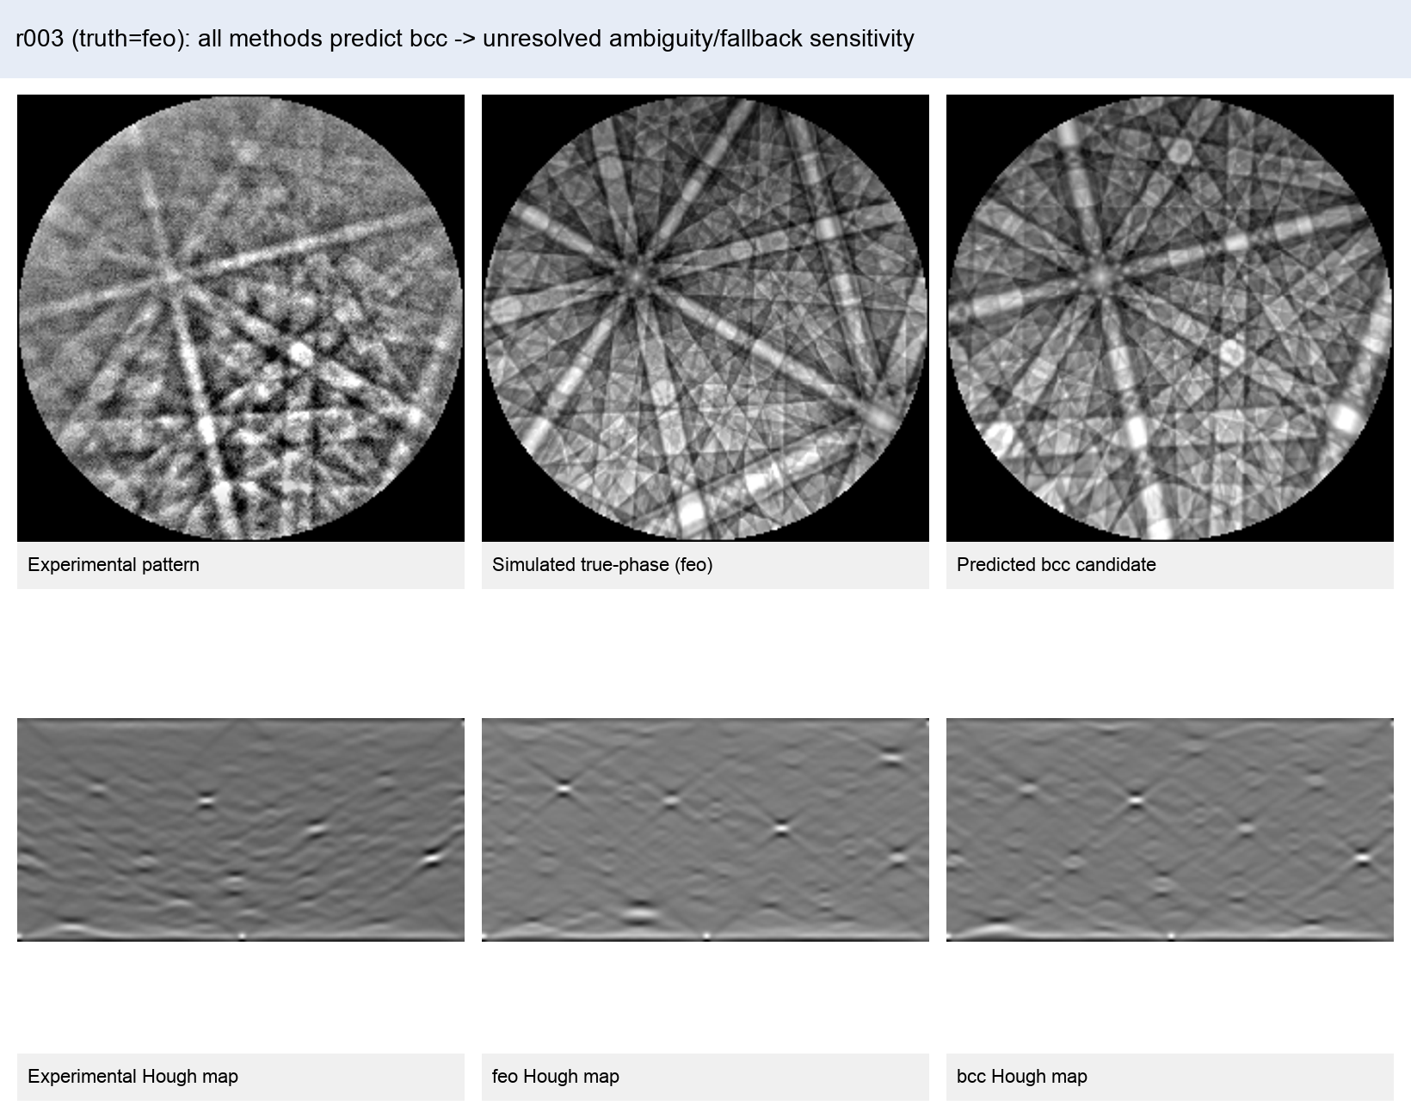
Conclusions and Next Steps
• Latest JSON comparison supports Hough-NCC as a stronger branch than image NCC on curated data.
• One hard case (r003) remains unresolved; all methods collapse to bcc.
• Immediate actions: fallback penalty, uncertainty output, and robustness-gated parameter lock.
• Expand curated orientations per phase before declaring default method for scan-wide runs.
Bottom line: Adopt Hough branch in parallel with strict decision guardrails before broader deployment.

