Slide 1
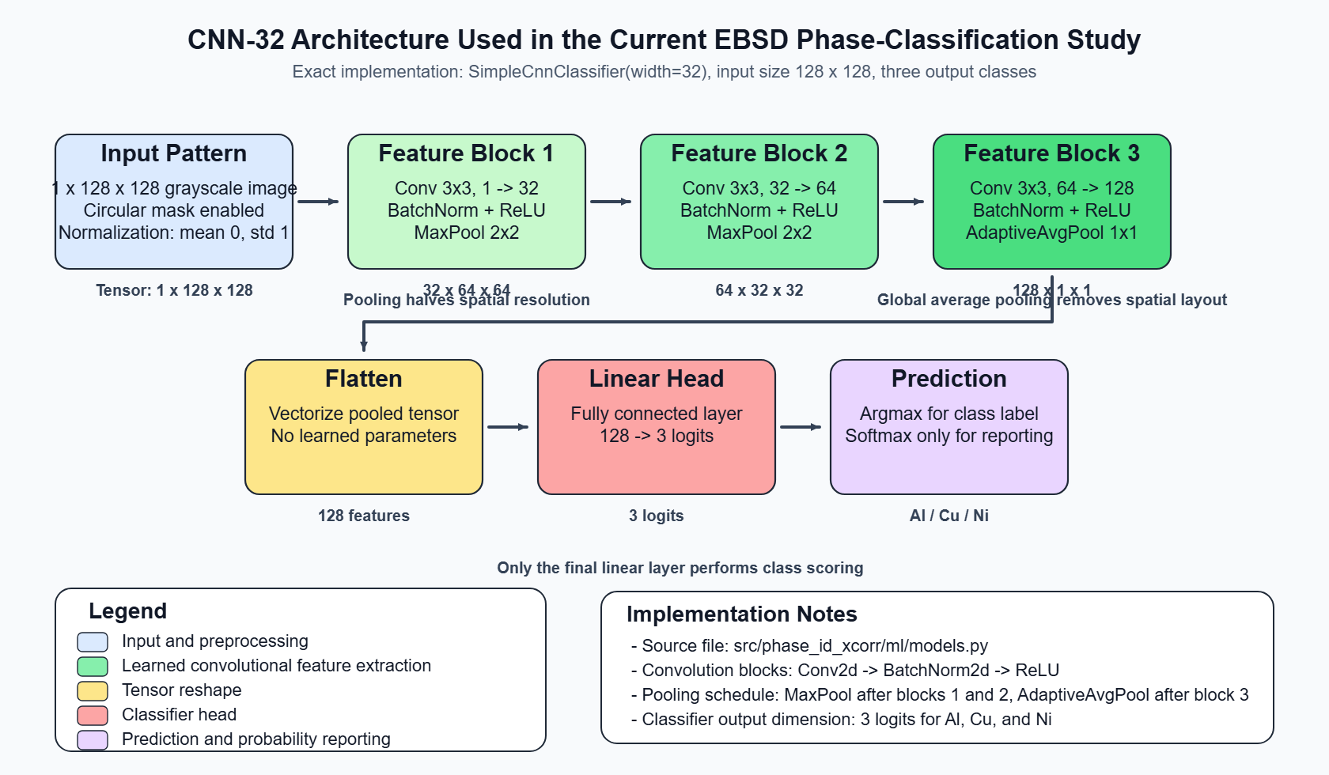
Title: Network Architecture
Pipeline
Pont 1 (some point) Unlike previous networks, out put is Point 2: very precise, minimal words.
Try to utilize space judiciously without overcrowding but at the same time make it legible.
Maintain this font for text inside the slides
Keep the caption of the figure legible ensure all inside text is also legible and unform in style and fonts. Where makes sense make .svg figure like above
Key take away: Custom network for our Kikuchi pattern processing

