Slide 1
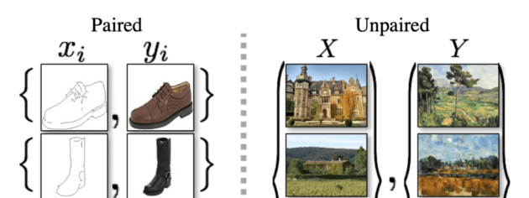
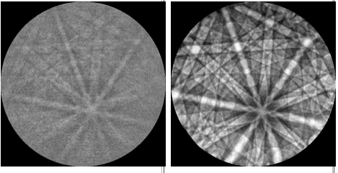
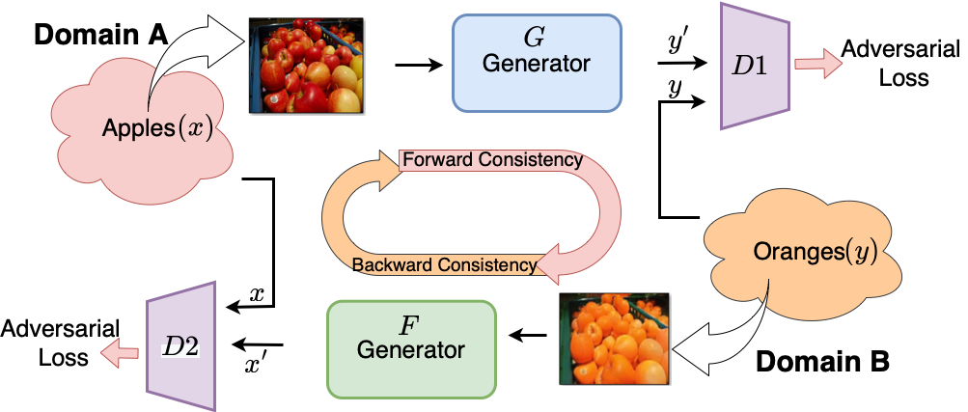
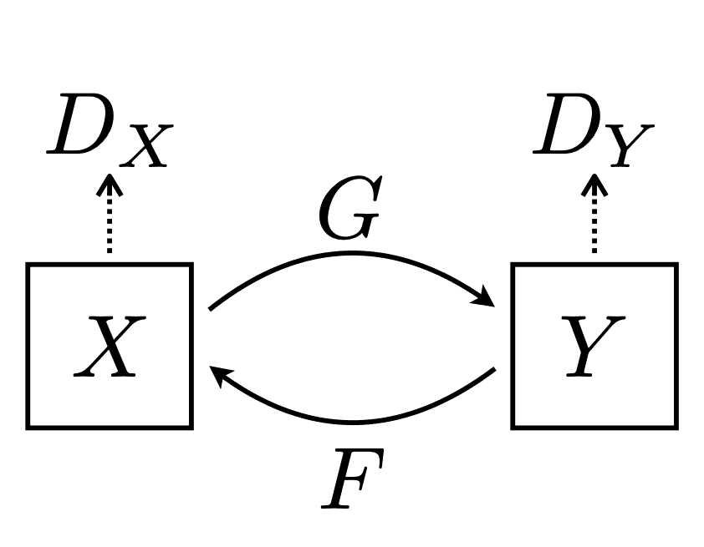
Data sets:
More than 8000 1X1 exp patterns
10,000 simulated HR patterns
Model: CycleGAN
Number of training runs: > 200 combinations with different hyper parameters (like beta, learning rate, number of epochs etc.)

Slide 2
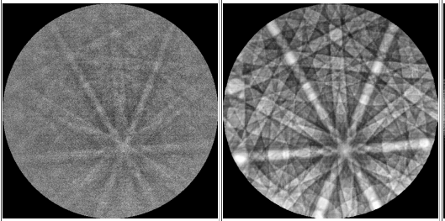
The best performing models:
Corrected_largeDataset_sim_kikuchi_lr2e-4_beta0.9
Corrected_largeDataset_sim_kikuchi_lr2e-4_beta0.9/epoch 100
Clear increase in the contrast.
Significant drop in noise.
Scale up by a factor of 4 is easily achievable.
Some hidden features in zone axis are brought out.
If the input image is of reasonable quality we have very good outcome.

Slide 3
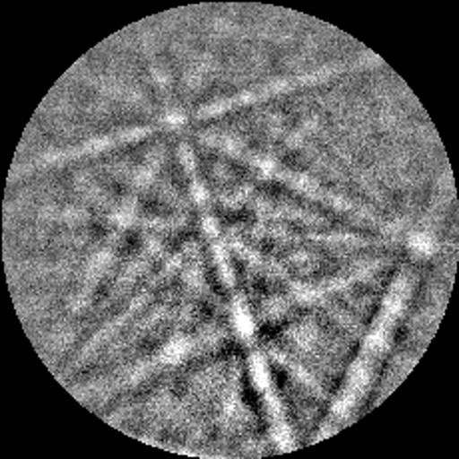
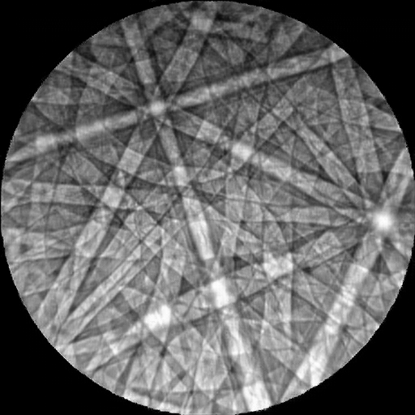
After incorporating the complete automation of inference script to export images, clean up results and resize images to required resolution

Slide 4
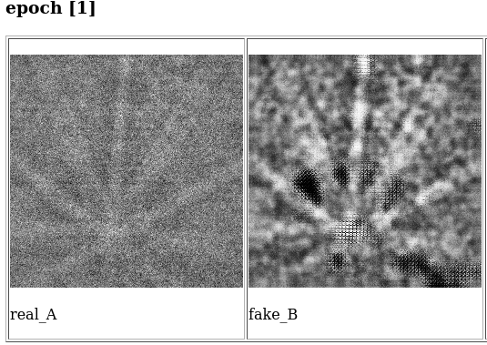
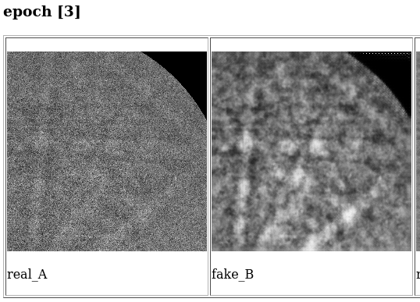
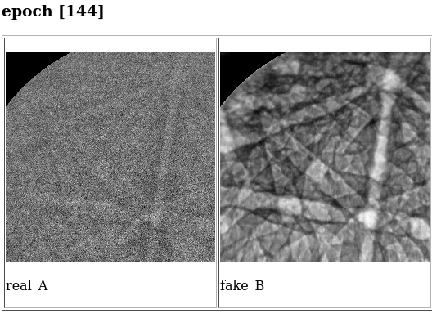
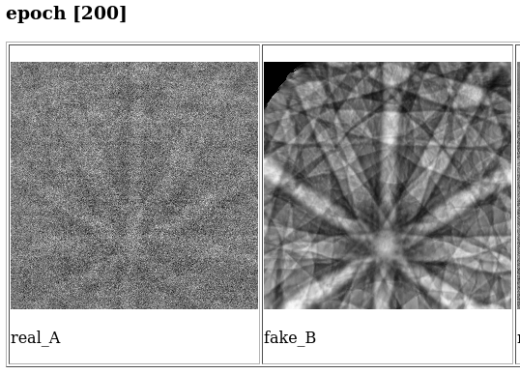
Progress of Training using Simulated patterns

Slide 5
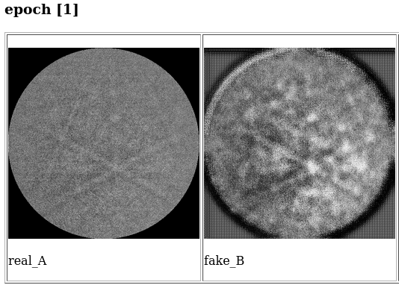
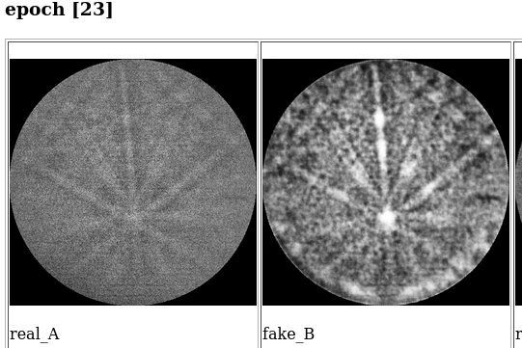
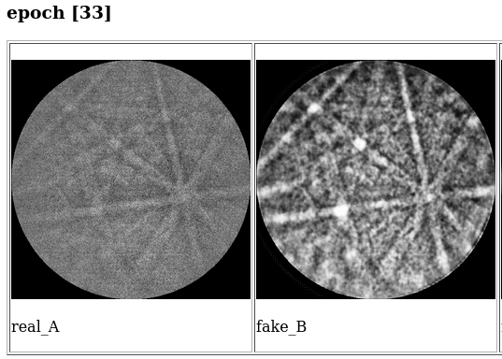
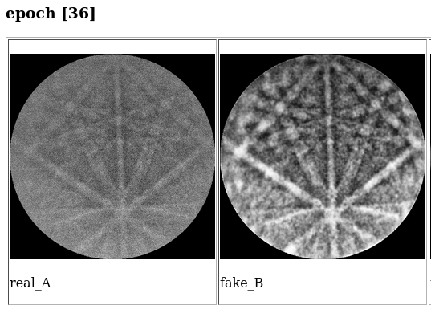

Slide 6
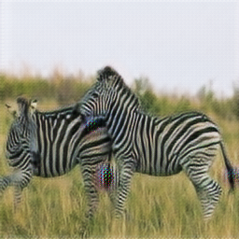
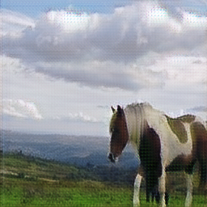
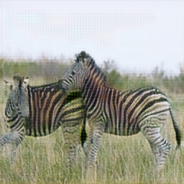
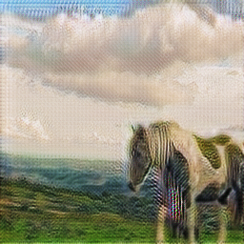
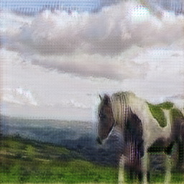
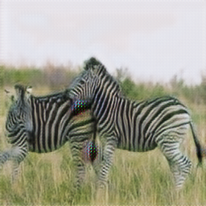
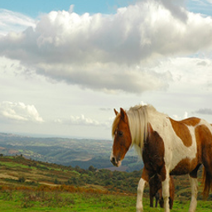
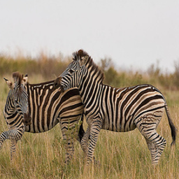
Epoch 10: idt_A
Epoch 10: idt_B
Epoch 10: fake_A
Epoch 10: fake_B
Epoch 10: rec_A
Epoch 10: rec_B
Epoch 10: real_A
Epoch 10: real_B

