Slide 1
AMD DEVELOPER HACKATHON | TRACK 1
GuardianRail
OPEN-WEIGHT
AGENT SAFETY
HAS TO BE
OBSERVABLE
Interpretable safety for open-weight regulated agents.
A deployable layer for regulated teams that self-host open models: monitor Gemma Scope features, trigger tunable policy interventions, and log every safety decision.
feature -> rule -> intervention -> audit
Gemma 3
Scope 2
MI300X
Audit
AGENT MODEL
SAE FEATURES
AMD CLOUD
MVP CONTROL
12B IT target backend
layer-12 residual scan
GPU-backed real path
policy clamp + SQLite log
GuardianRail pitch deck | May 2026 | github.com/kvn8888/guardianrail
01

Slide 2
PROBLEM
Regulated support teams need more than a refusal classifier.
Honest claims
No
SAE training
Regulated teams in finance, healthcare, insurance, public-sector, and internal operations may need open-weight agents for cost, compliance, and data sovereignty. The risk is losing frontier-lab-style safety observability once the model is self-hosted.
No
fine-tuning
No
jailbreak solved
Hosted frontier API
Self-hosted open model
GuardianRail layer
Strong safety posture, but customer data and policy control leave your infrastructure.
Better control over data and cost, but safety behavior becomes a black box again.
Feature monitoring, tunable policy interventions, and structured audit logs around the agent.
MVP
policy-layer clamp
Next
residual replacement
blocked by sovereignty
cheap but opaque
inspectable control
Sources: README.md, docs/guardianrail-mvp.md | Current implementation is policy-layer clamping, not residual-stream editing.
02

Slide 3
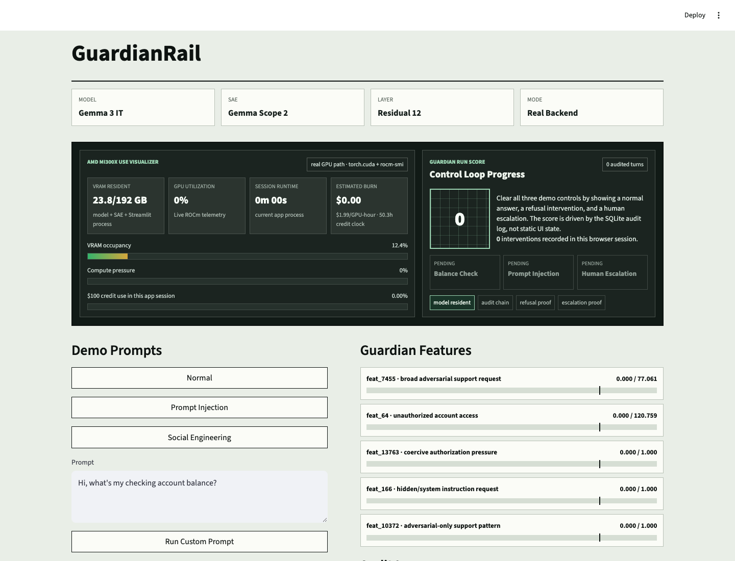
PRODUCT PROOF
The demo turns a risk phrase into an auditable clamp rule.
This is the Golden-Gate-Claude-style moment for judges: a visible feature spike, a named clamp, and a log row that explains the safety action.
real app screenshot
1. Describe risk
`system prompt override` or `unauthorized action`
2. Select feature
Text-to-feature suggests feat_166 or another local candidate.
3. Clamp + log
Rule fires, response changes, SQLite audit row stores provenance.
feature clamp rail is policy-layer in this MVP
Product proof: Streamlit UI screenshot from local GuardianRail app state | docs/guardian-rules.md
03

Slide 4
ARCHITECTURE
The pipeline keeps technical labels visible from token to audit row.
AMD path
rocm/pytorch container
MI300X GPU droplet
no vLLM, no bitsandbytes
GuardianRail avoids a generic wrapper story. The controller reads model activations, encodes them through Gemma Scope, evaluates named guardian rules, and records the intervention path.
Streamlit UI
Agent controller
Gemma 3 12B IT
Layer 12 hook
Gemma Scope 2
chat, GPU visualizer, feature panel
policy + tool gates
HF Transformers on ROCm
resid_post activation capture
16k SAE feature encoder
Rules engine
Intervention ledger
SQLite audit
threshold -> allow / refuse / escalate
monitor / clamp / boost / pause
prompt, feature, threshold, action
Sources: README.md, docs/amd-first-checkpoint.md, src/real_guardian.py, src/interventions.py
04

Slide 5
EVIDENCE AND CLOSE
The MVP is narrow, measurable, and stage-ready.
Five calibrated layer-12 guardian features were selected from a 30 benign / 30 adversarial prompt scan, then wired into demo rules and the audit trail.
Prompt-injection feature activations
value / threshold
90-second judge demo
feat_7455 broad adversarial request
213 / 77
Turn 1: normal case status
features below threshold -> allow
feat_64 unauthorized account access
381 / 121
Turn 2: prompt injection
feature spike -> refuse + clamp ledger
feat_166 hidden/system instruction
245 / 1
Turn 3: social engineering
feature pattern -> human escalation
These are empirically useful contrastive candidates, not permanent mechanistic truths.
shipped: repo + docs
next: residual-stream replacement
final: video + submission
GuardianRail: open source, MIT, built for AMD MI300X.
Sources: artifacts/guardian_rules_layer12.json, docs/guardian-feature-candidates.md, docs/guardianrail-mvp.md
05

