Slide 1
Streamly — Application UI Description
Streamly (iptvwebplayer.org)

Slide 2
Revision History
Version | Date | Description | Author
1.0 | 2026-06-24 | Initial Samsung TV certification submission Application package version 1.0.2 | Kevin Payoyo

Slide 3
Contents
UI Structure
Usage Scenario
Menu & function description
Key policy
How to change languages

Slide 4
UI Structure
Whole UI Structure (all screens — navigation flow) [Login Screen] ├─ Link with PIN (default on TV) ├─ Xtream tab └─ M3U URL tab ↓ (successful sign-in) [Home Screen] ├─ → [Live TV Screen] → [Player Overlay] → Return → back ├─ → [Movies Screen] → [Movie Detail Screen] → [Player Overlay] ├─ → [Series Screen] → [Series Detail Screen] → [Episode list] → [Player Overlay] ├─ → [Search Screen] → results → detail/play ├─ → [Settings Screen] └─ → [Continue Watching] → resume → [Player Overlay] [Player Overlay] — full-screen video; Return exits to previous screen

Slide 5
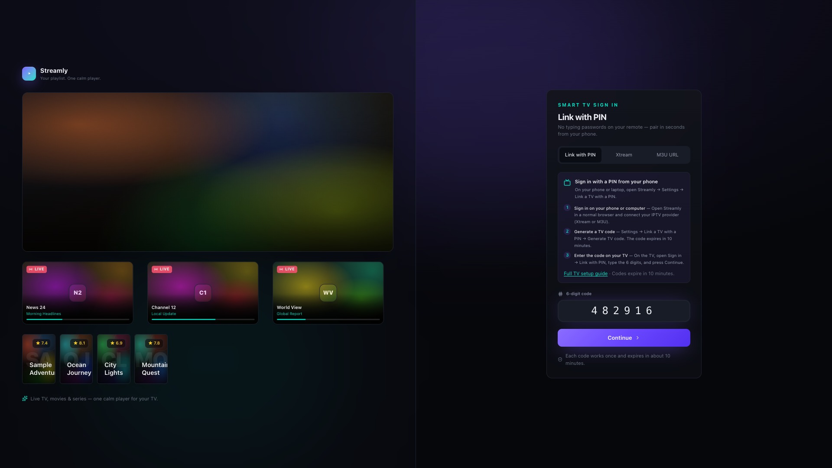
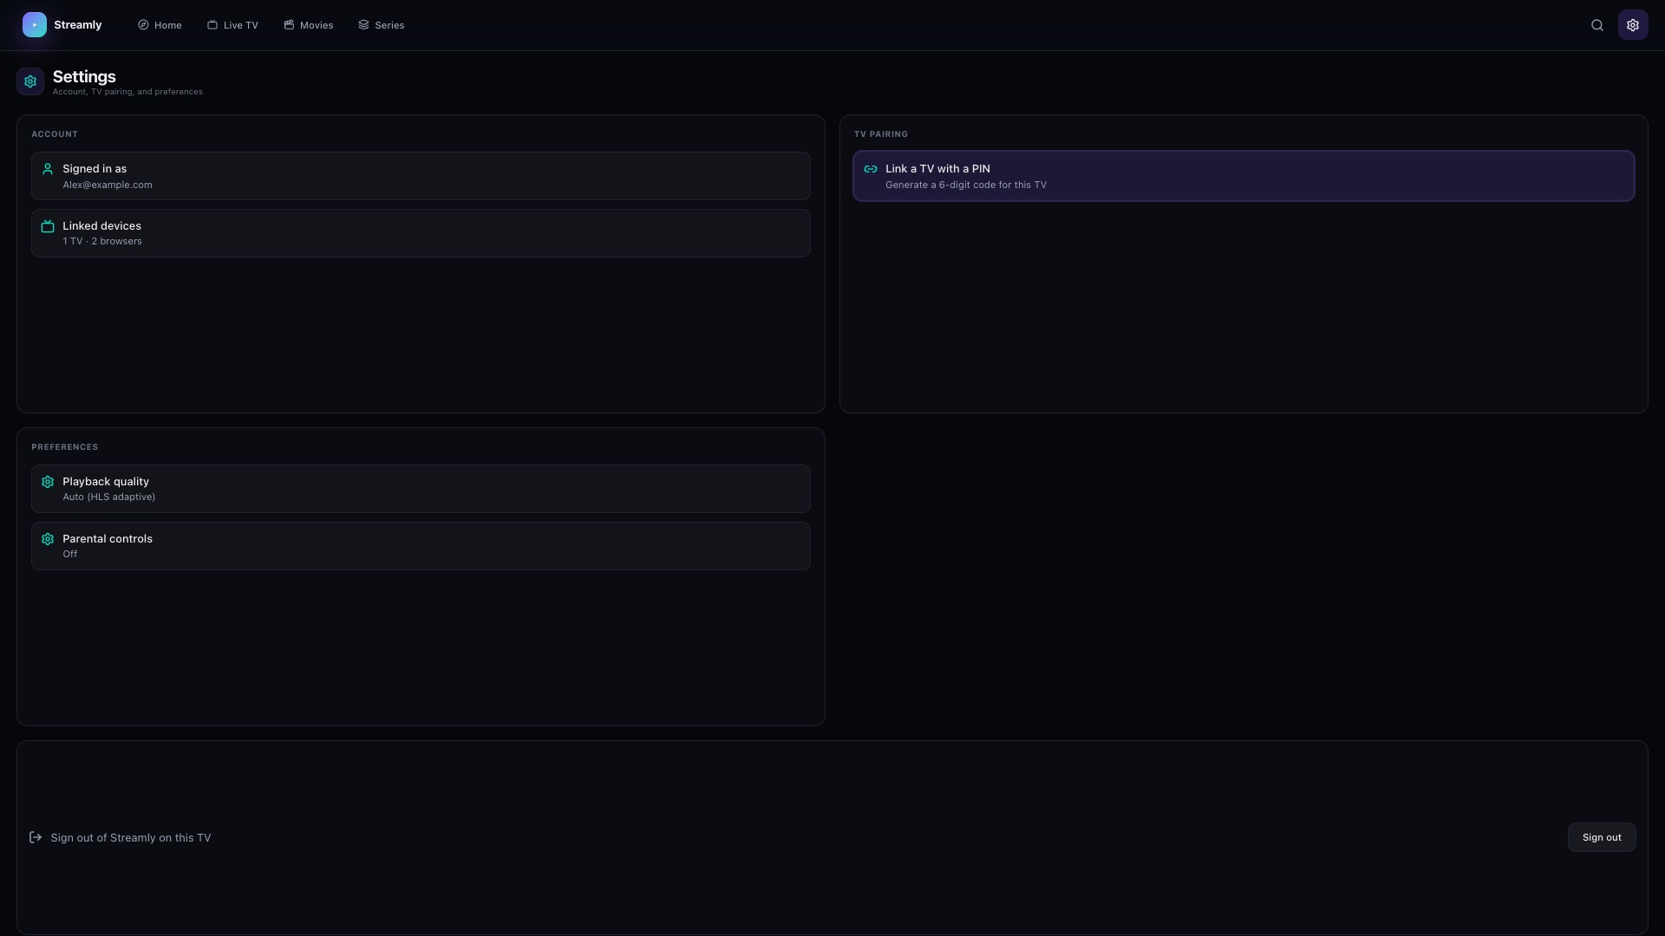
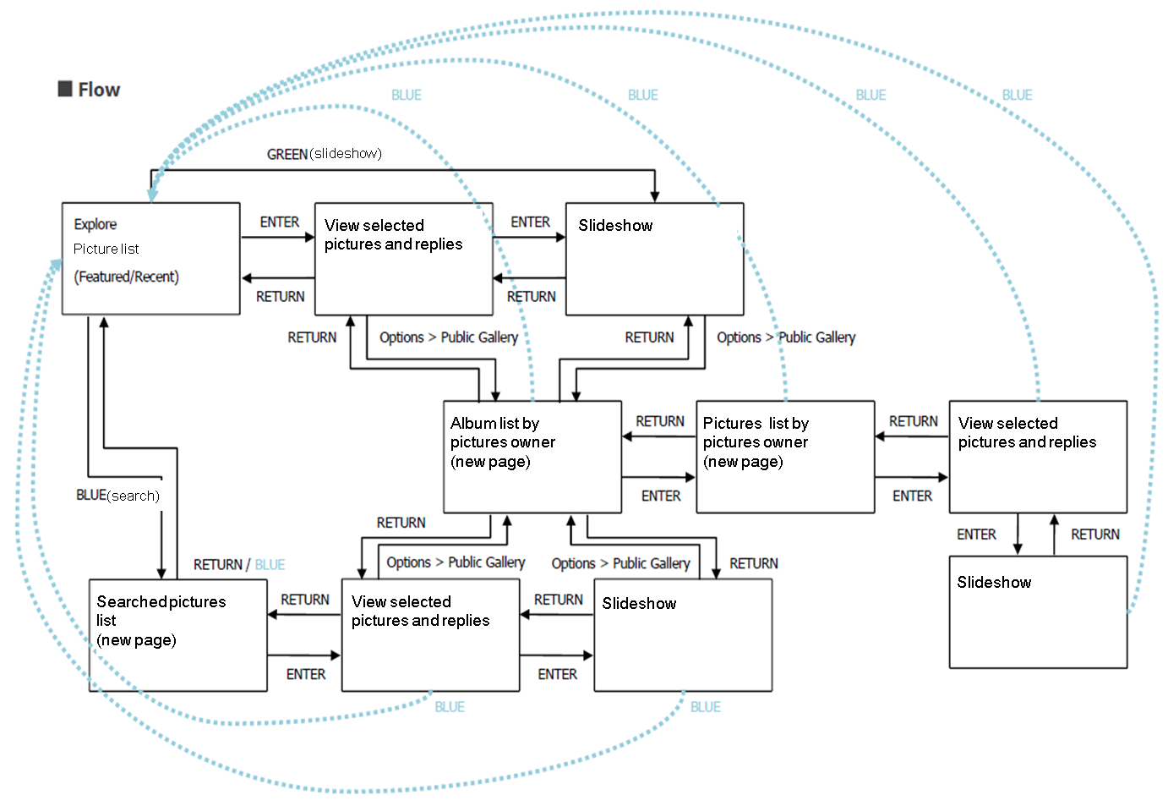
Menu & function — [Login Screen] + [Settings Screen]

Slide 6
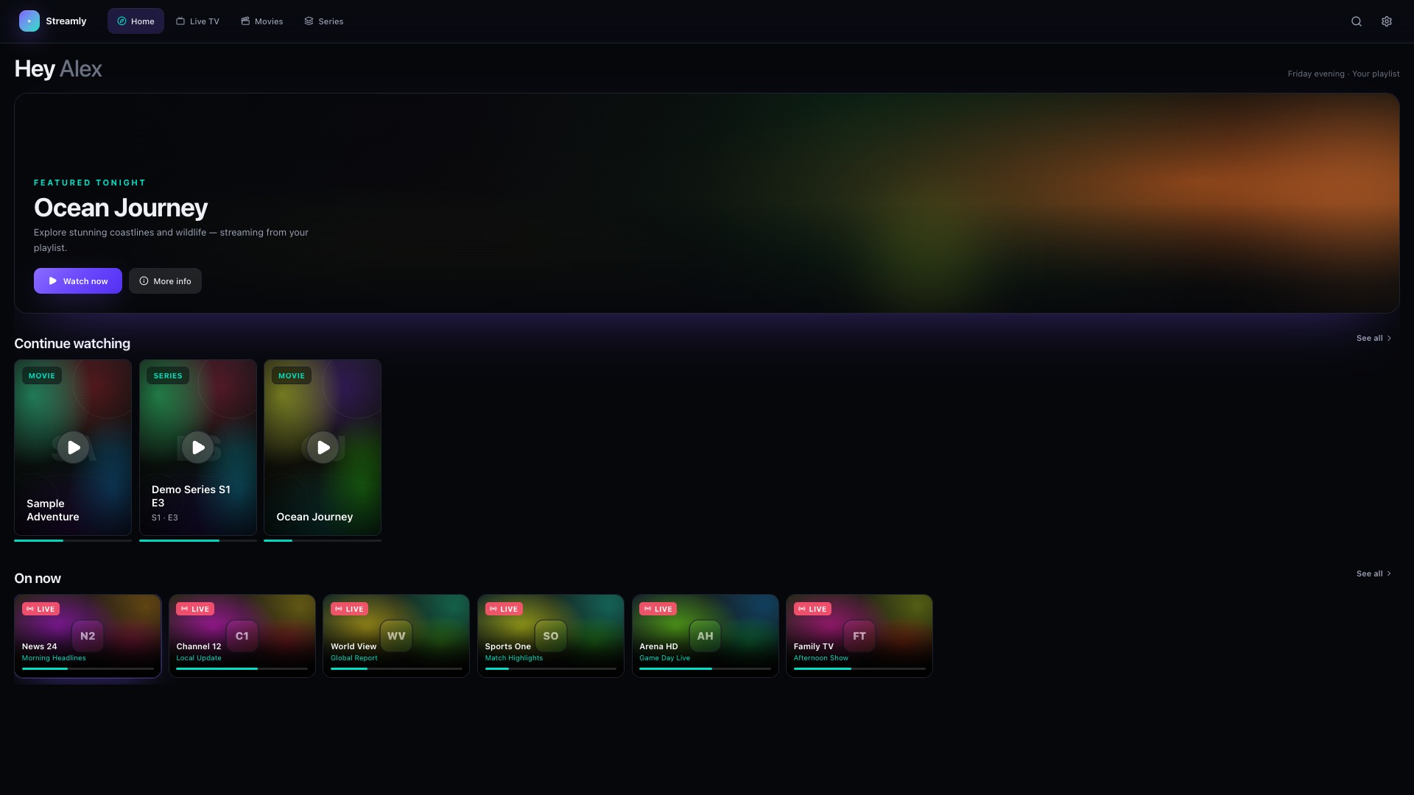
Menu & function — [Home Screen]

Slide 7
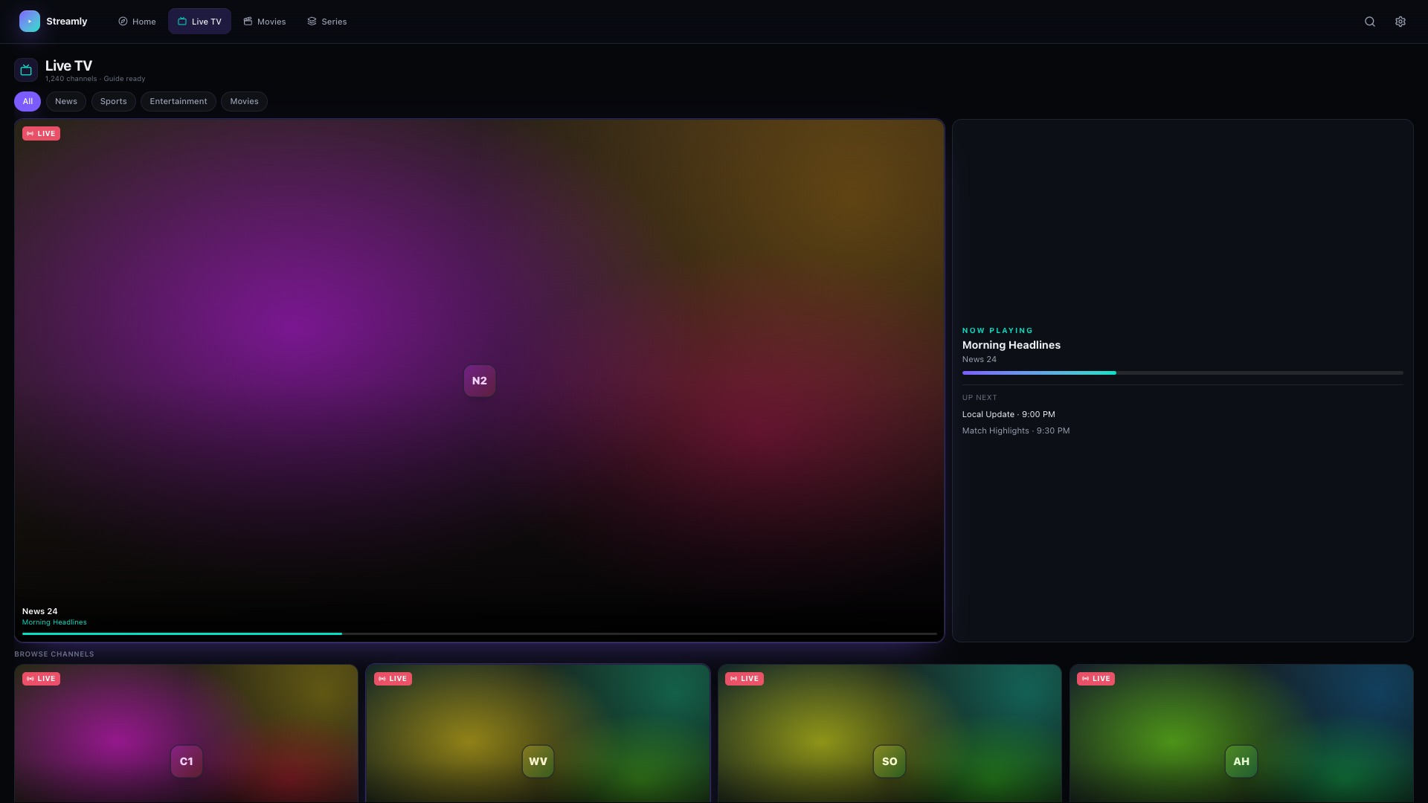
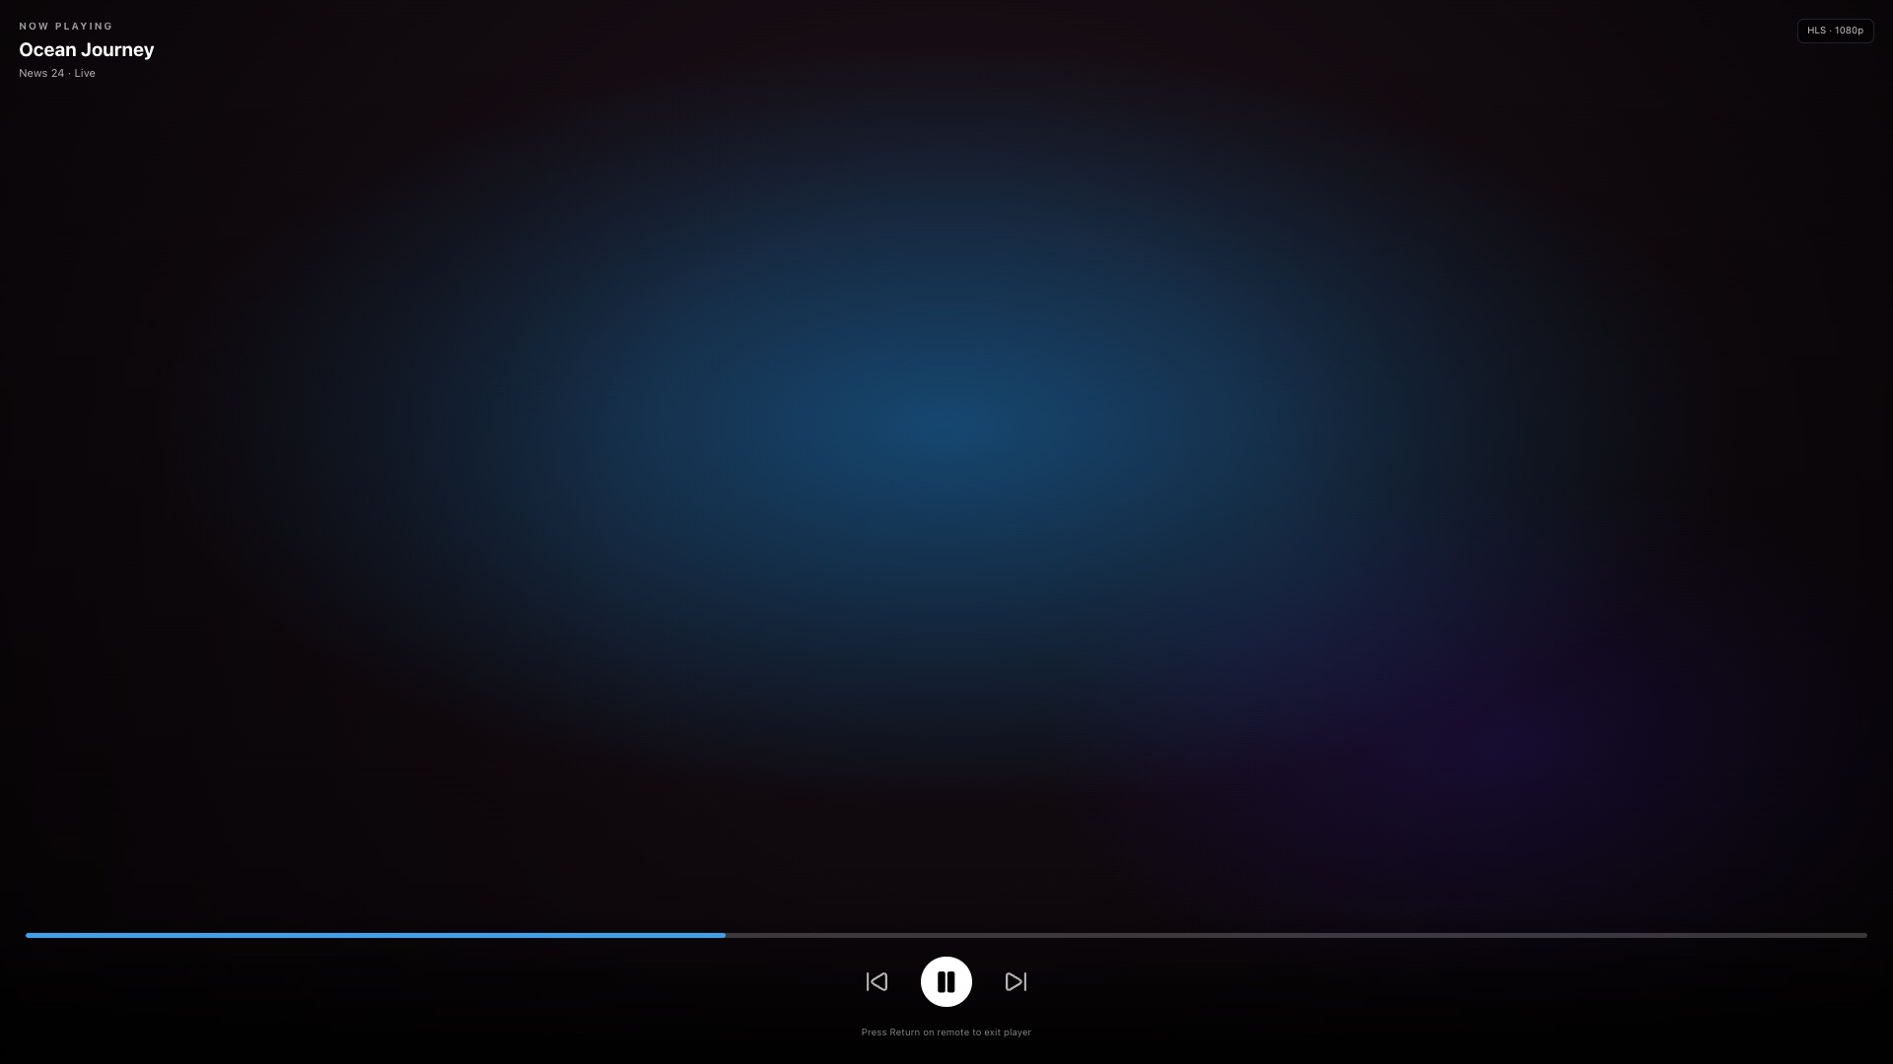
Menu & function — [Live TV Screen] + [Player Overlay]
[Live TV Screen] — screenshot 1 | # | Element | Action | | 1 | Category filter pill | Filter channel list | | 2 | Channel card | Play live → [Player Overlay] | | 3 | Now playing panel | Program info (read-only) | [Player Overlay] — screenshot 2 | # | Element | Action | | 1 | Progress bar | Seek position (VOD) | | 2 | Play / Pause | Toggle playback | | 3 | Return (remote) | Exit player to previous screen |

Slide 8
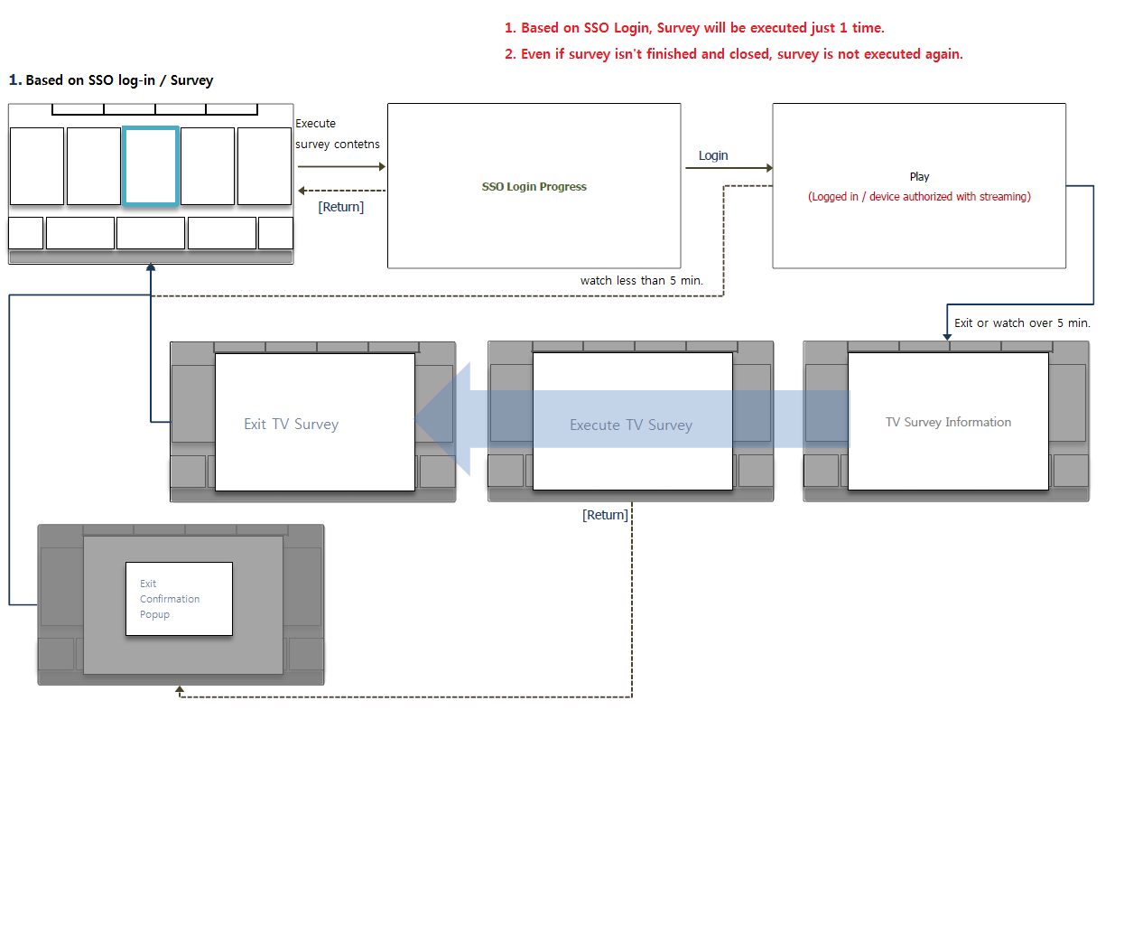
Usage Scenario — Streamly
UC1 — Sign in with PIN (recommended on Samsung TV) 1. On [Login Screen], focus is on Link with PIN tab. 2. On phone/PC: open https://iptvwebplayer.org/login → sign in (UC2 or UC3). 3. On phone/PC: [Settings Screen] → Link a TV with a PIN → copy 6-digit code. 4. On TV [Login Screen]: enter code → Continue → [Home Screen] loads. TEST ACCOUNT (required — login feature): Server URL (all): https://iptvwebplayer.org/api/review-panel Password (all): StreamlyReview2026 Parallel model-group testing — one username per TV (same playlist): MG1: samsung_review (or samsung_review_1) MG2: samsung_review_2 MG3: samsung_review_3 … through samsung_review_12 No ads, premium, or account-specific content — all QA logins are identical except username. Sample Live TV, Movies, Series (public test streams only). PIN alternative: PC login with any account above → Settings → Link TV PIN. App ID: 3202606046491 UC2 — Sign in with Xtream (direct on TV) 1. [Login Screen] → Xtream tab. 2. Enter Server URL, Username, Password. 3. Sign in → [Home Screen]. UC3 — Sign in with M3U URL 1. [Login Screen] → M3U URL tab. 2. Paste M3U playlist URL → Sign in → [Home Screen]. UC4 — Browse and play Live TV 1. [Home Screen] or top nav → [Live TV Screen]. 2. Optional: select category filter pill. 3. Focus channel card → OK → [Player Overlay] plays live stream. 4. Return → exits player to [Live TV Screen]. UC5 — Browse and play Movies 1. Top nav → [Movies Screen]. 2. Focus movie poster → OK → [Movie Detail Screen]. 3. Focus Play → OK → [Player Overlay]. 4. Return → back to detail or catalog. UC6 — Browse and play Series 1. Top nav → [Series Screen]. 2. Select series → [Series Detail Screen] → select episode → [Player Overlay]. UC7 — Search 1. Top nav → [Search Screen]. 2. Enter query → select result → play or open detail. UC8 — Settings / PIN pairing 1. Top nav → [Settings Screen]. 2. Link a TV with a PIN (for phone-to-TV pairing). 3. Account, preferences, sign out. UC9 — Exit player 1. While [Player Overlay] is visible, press Return → previous browse screen.

Slide 9
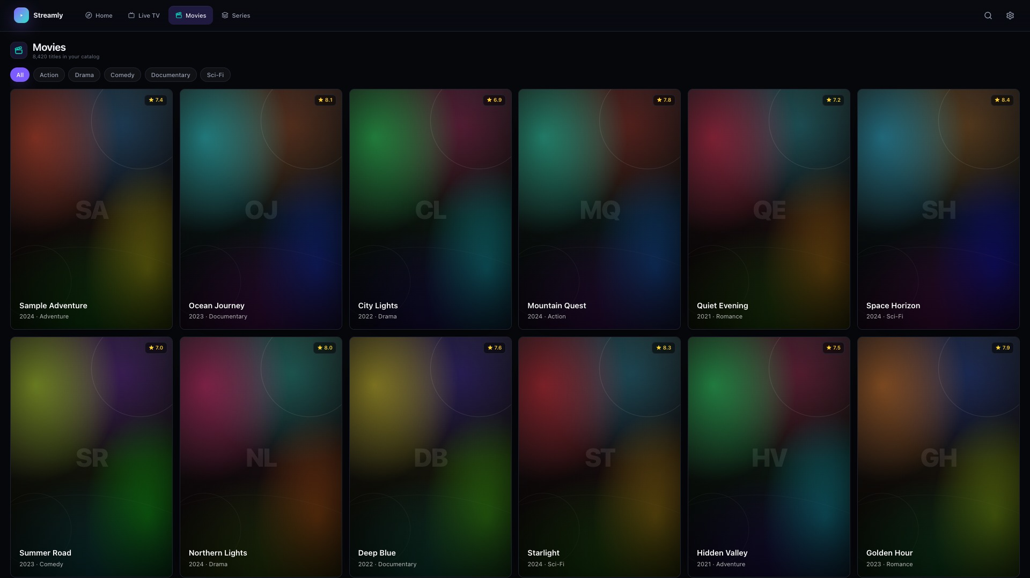
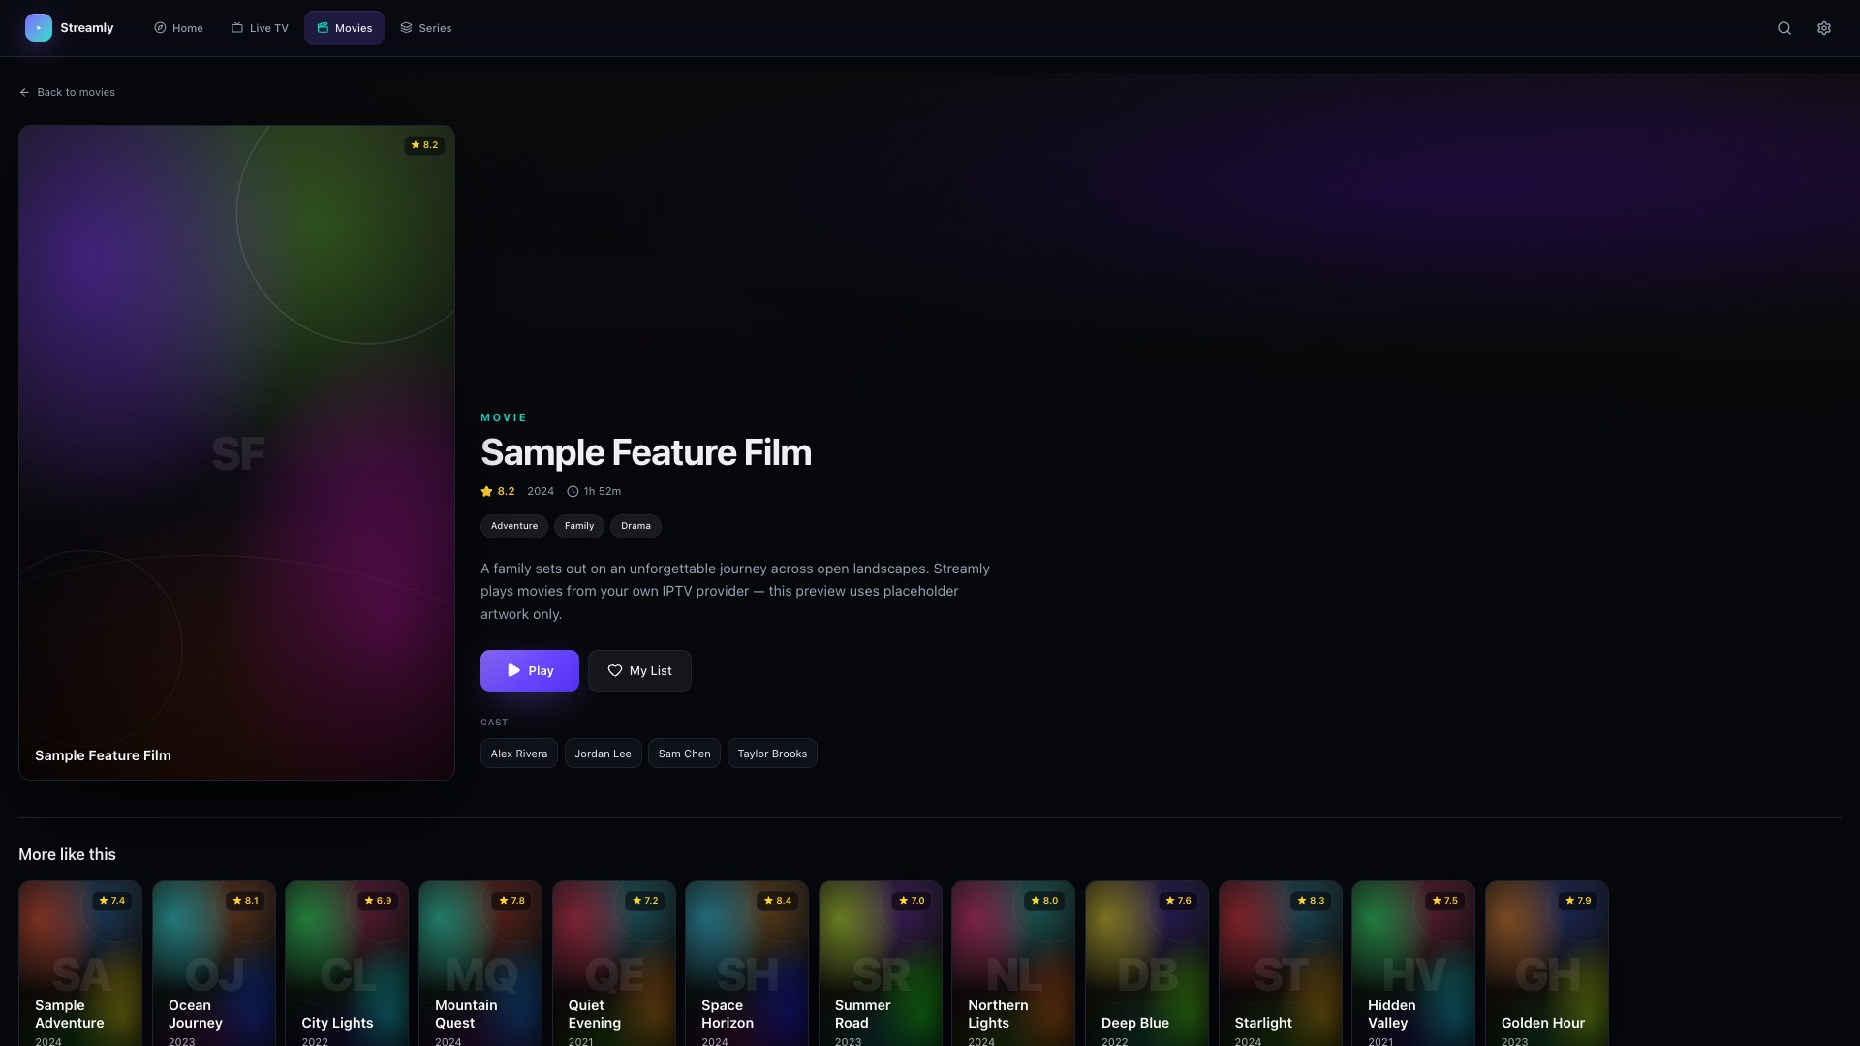
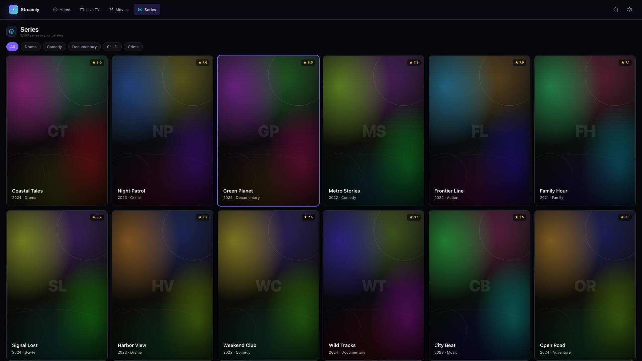
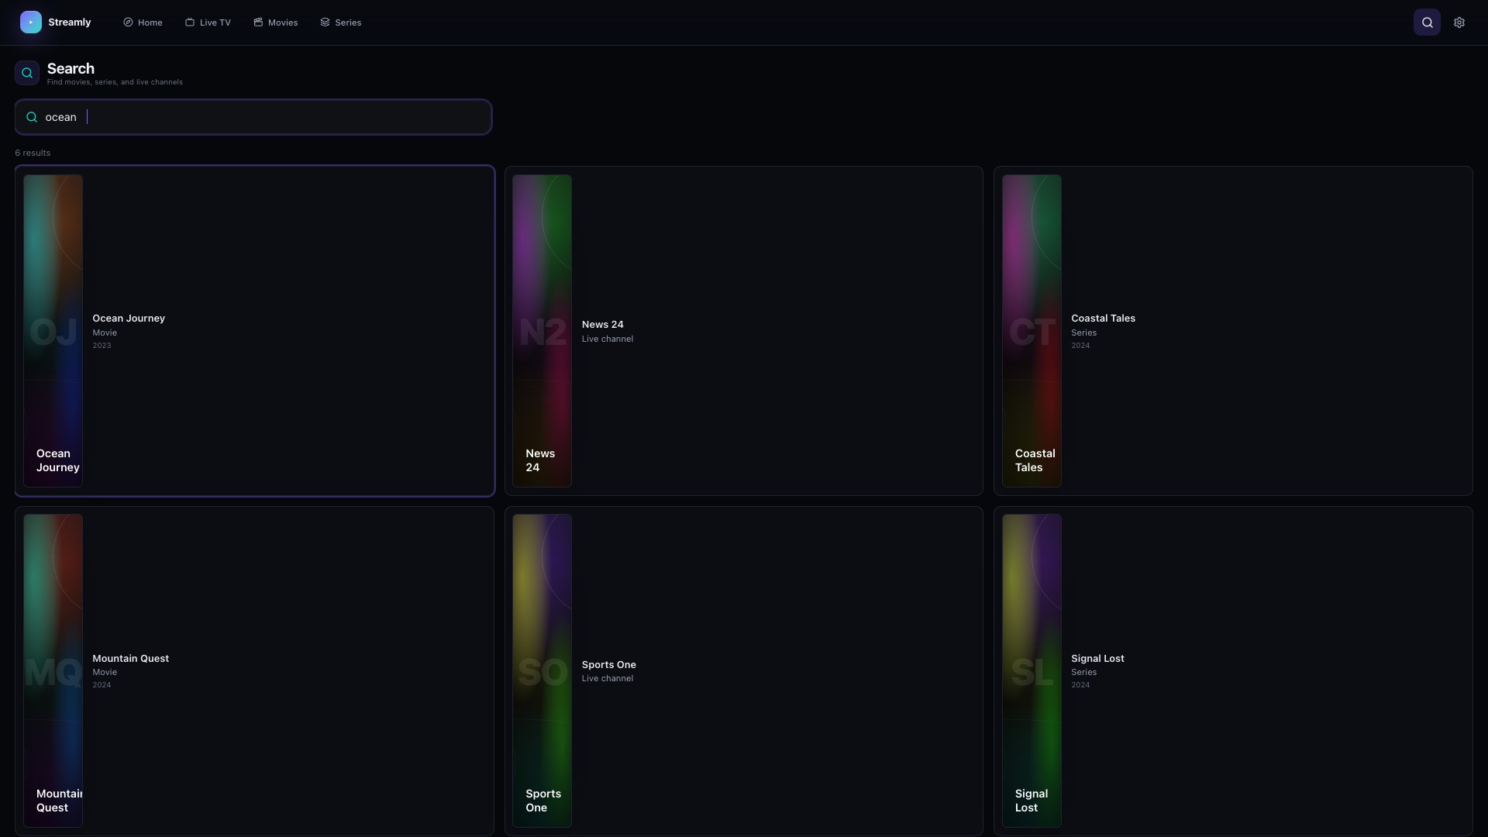
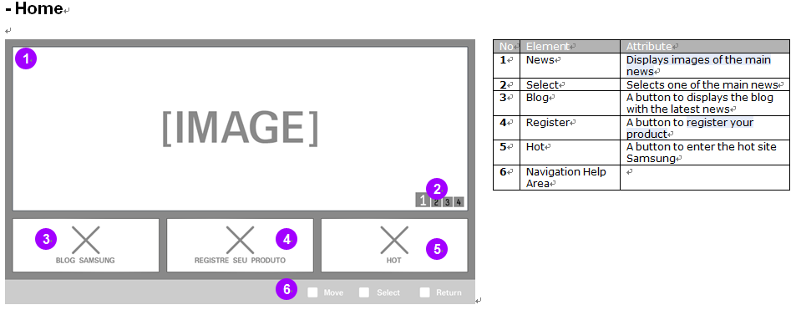
Menu & function — [Movies] [Movie Detail] [Series] [Search]
[Movies Screen] — top-left screenshot | # | Element | Action | | 1 | Genre filter | Filter movie grid | | 2 | Poster card | Open [Movie Detail Screen] | [Movie Detail Screen] — top-right | # | Element | Action | | 1 | Play | Start VOD → [Player Overlay] | | 2 | My List | Toggle favorite | | 3 | More like this | Open another title | [Series Screen] — bottom-left | # | Element | Action | | 1 | Genre filter | Filter series grid | | 2 | Series poster | Open series detail → episodes | [Search Screen] — bottom-right | # | Element | Action | | 1 | Search field | Enter query | | 2 | Result row | Play or open detail |

Slide 10
Key Policy — Streamly
Standard Tizen keys. Return/Exit not modified. Volume uses TV system.
Button | Action | Remarks
UP / DOWN / LEFT / RIGHT | Move focus between UI elements
OK / ENTER | Activate focused button; play content
Return | Back one screen; exit [Player Overlay] | Samsung Mandatory
Exit | Close application (system) | Samsung Mandatory
Play / Pause | Toggle playback in player when focused
Ch. Up/Down | Not used by app (N/R)
Color / Info / Tool keys | Not used by app (N/R)
Volume +/- | TV system volume — not overridden by app

Slide 11
How to change languages
Items | Contents
How to change languages | The application has no language options. English UI only. No in-app language selector. Content metadata language depends on the user's IPTV provider playlist.

