Slide 1
DATE: 15-06-2022
Heart disease detection using machine learning algorithms
123015126:Kanamarlapudi Venkata Naga Sreevalli
Guide Name: Dr. Rajkumar K, Senior Assistant Professor, SoC, SASTRA University

Slide 2
POINTS TO BE DISCUSSED
1. PROBLEM STATEMENT
2. EXISTING SOLUTION
3. AIM
4. WORKFLOW
5. DATA SET USED & ATTRIBUTES EXPLANATION
6. SAMPLE INPUT
7. RESULTS
8. METHEDOLOGY
9. REFERENCES

Slide 3
1. PROBLEM STATEMENT
Cardiovascular diseases (CVDs) are the leading cause of death globally.
An estimated 17.9 million people died from CVDs in 2019, representing 32% of all global deaths. Of these deaths, 85% were due to heart attack and stroke.
So, It is very important to prevent this. This can be possible by using machine learning algorithms.
Machine learning is crucial for determining whether anyone has suffered from heart disease.
In either case, if these are predicted ahead of time, doctors would have a much easier time gaining crucial information for treating and diagnosing patients and numbers of deaths will be reduced.
Currently, the health care sector is generating information from several facilities and patients.
By applying the best usage of this data, doctors can easily anticipate superior methods for treatment and enhance the complete delivery system of the health care sectors.

Slide 4
2. EXISTING SOLUTION
A data set with 14 different features/attributes taken and applied lot of different machine learning algorithms to find accuracy of each algorithm and correlation between each attribute.
Python dealing with HIPPA requirements is used as it is easy to establish tracking and health monitoring applications.
It is found that among all ML algorithms applied, A random forest classifier algorithm gave highest accuracy of approximately 83%.
Using this algorithm, when new data enters, this model will predict, to which group it belongs to.

Slide 5
3. AIM
To find different types of relations between each pair of attributes using python packages.
Highest ranked features are selected using feature selection
Splitting of data into training and testing and creating a prediction model using machine learning algorithms.
To find accuracy of different machine learning algorithms and selecting best algorithm among them.
To predict the output of the new data using trained model.

Slide 6
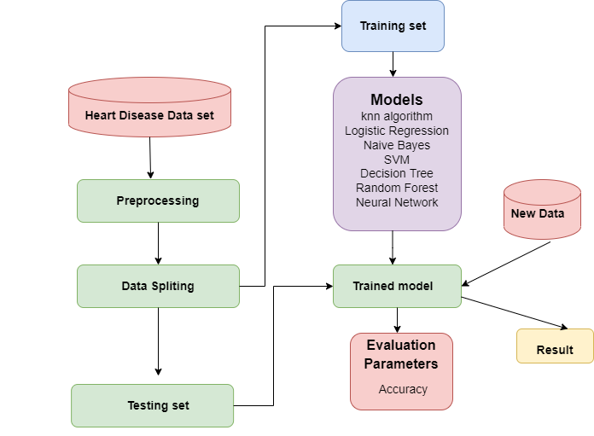
4. WORKFLOW

Slide 7
5. DATA SET USED & ATTRIBUTES EXPLANATION
Data set: https://archive.ics.uci.edu/ml/datasets/Heart+Disease
Number of Instances: 303
Attributes used: 14
age: age (numerical)
sex: 1: male, 0: female (categorial)
cp: cp(constrictive pericarditis)-A chronic inflammatory process (categorial)
chest pain type, 1: typical angina, 2: atypical angina, 3: non-anginal pain, 4: asymptomatic
trestbps: resting blood pressure (numerical)
chol: serum cholestoral in mg/dl (numerical)
fbs: fasting blood sugar > 120 mg/dl (categorial)
predicted attribut

Slide 8
ATTRIBUTES EXPLANATION CONT…
restecg: resting electrocardiographic results (values 0,1,2)
thalach: maximum heart rate achieved (numerical)
exang: exercise induced angina (categorial)
Oldpeak: ST depression induced by exercise relative to rest (numerical)
slope: the slope of the peak exercise ST segment (categorial)
ca: calcium particles enters the heart muscle cells during each heartbeat and contribute to the signal that coordinates the heart's function
number of major vessels (0-3) colored by flourosopy (categorial)
thal: thal: 3 = normal; 6 = fixed defect; 7 = reversable defect (categorial)
Target: It tells if heart disease is present or not (categorical)

Slide 9
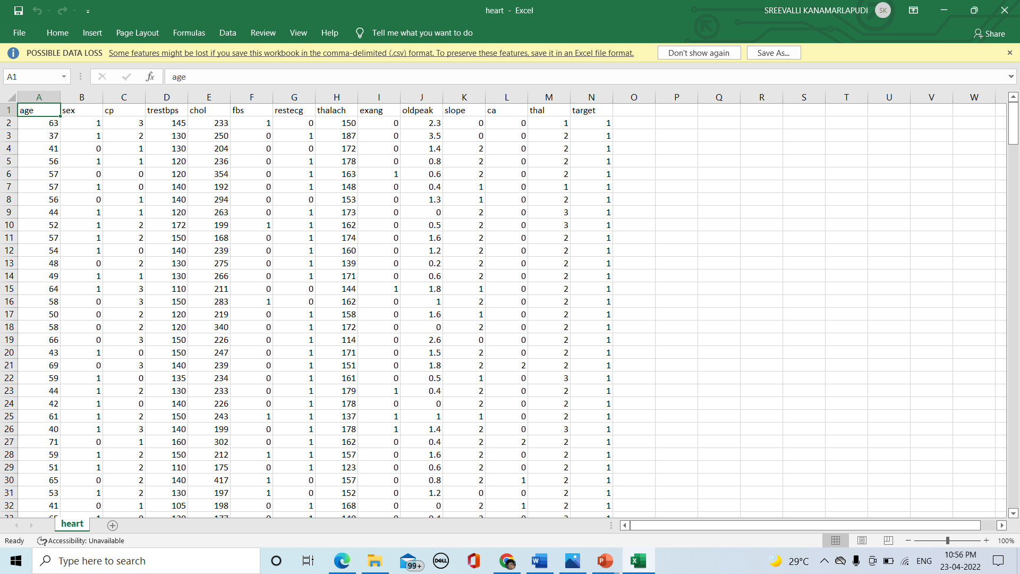
6. SAMPLE INPUT

Slide 10
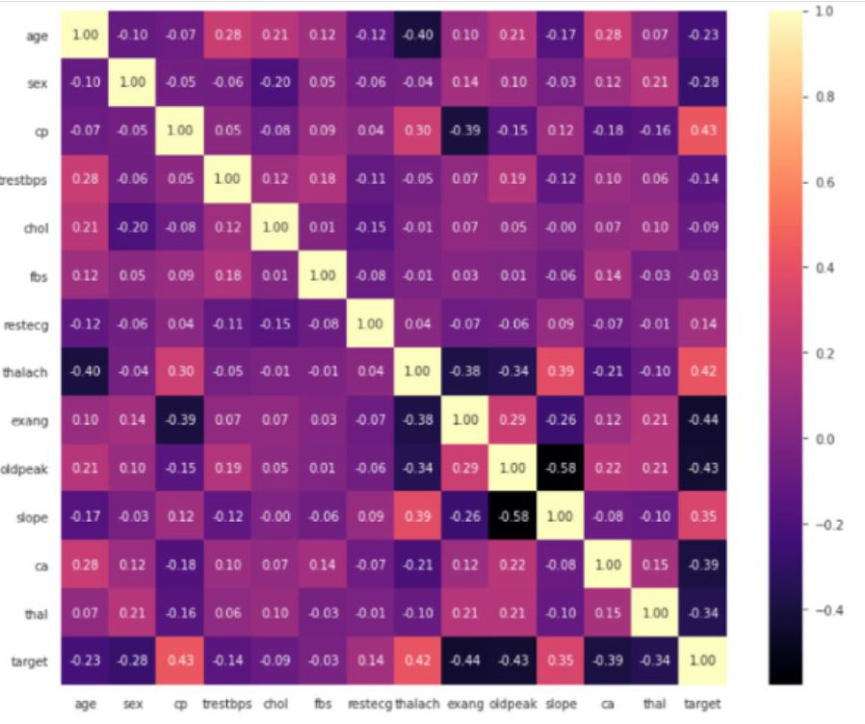
7. RESULTS - CORRELATION MATRIX

Slide 11
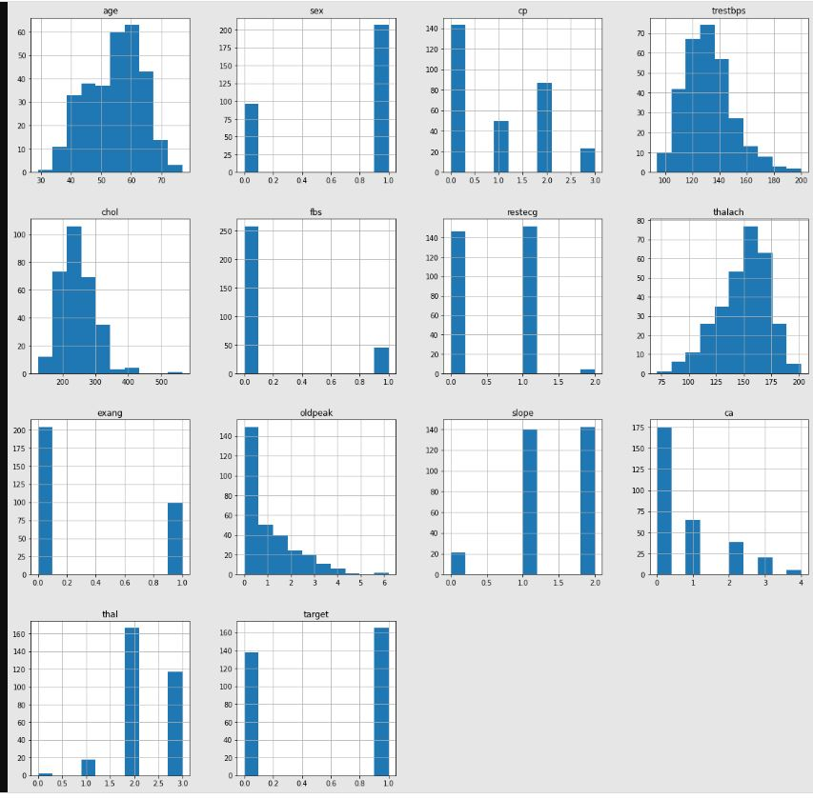
RESULTS – ATTRIBUTES VS COUNT

Slide 12
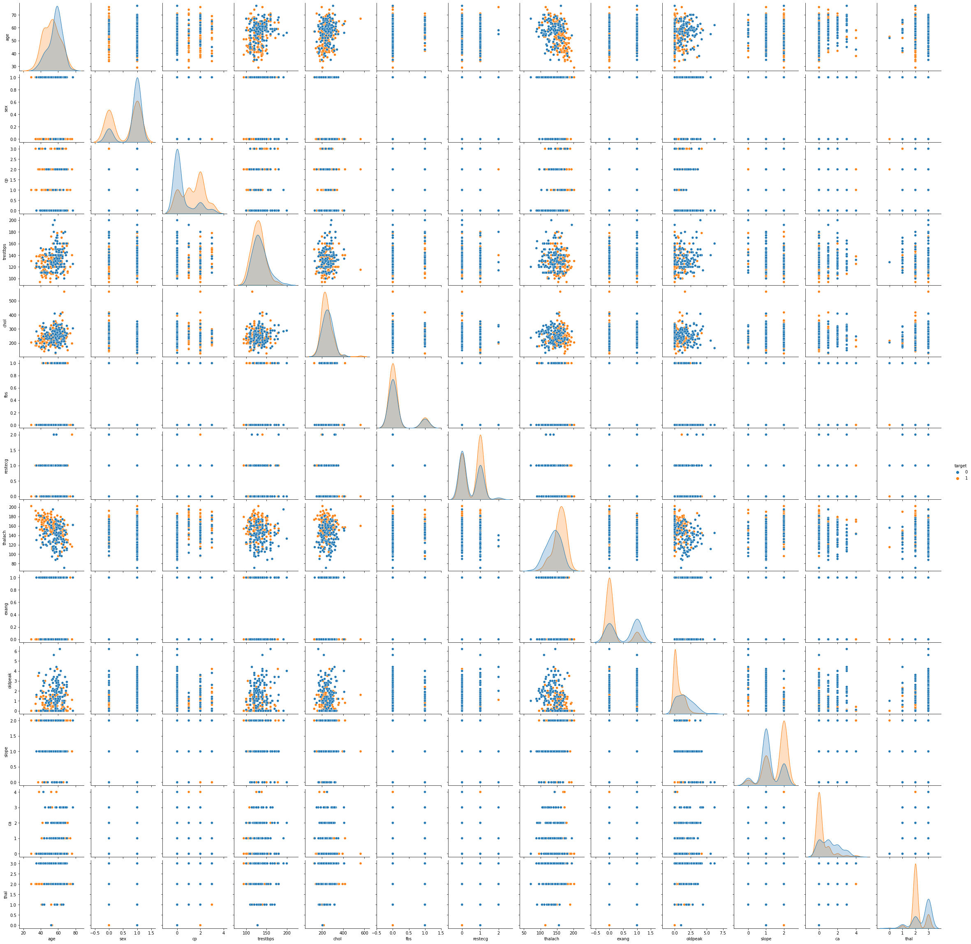
PAIR PLOT

Slide 14
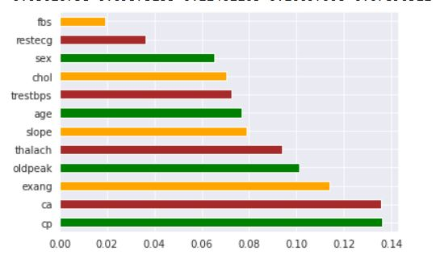
RESULTS - FEATURE SELECTION

Slide 15
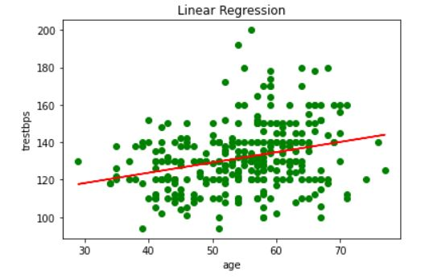
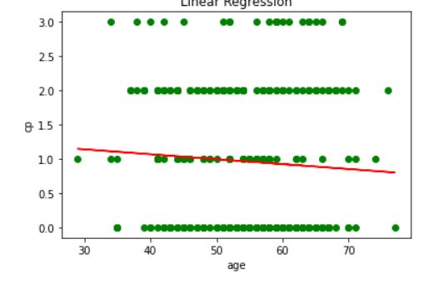
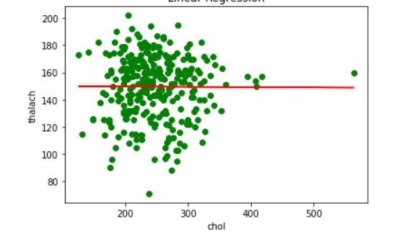
RESULTS – LINEAR REGRESSION (FINDING BEST FIT LINE)

Slide 16
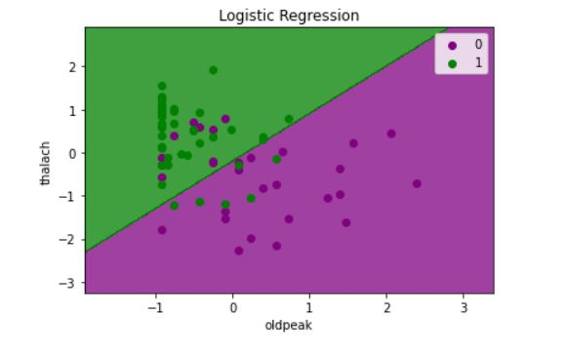
LOGISTIC REGRESSION

Slide 17
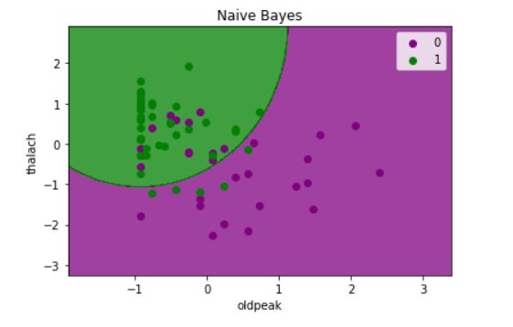
NAÏVE BAYES

Slide 18
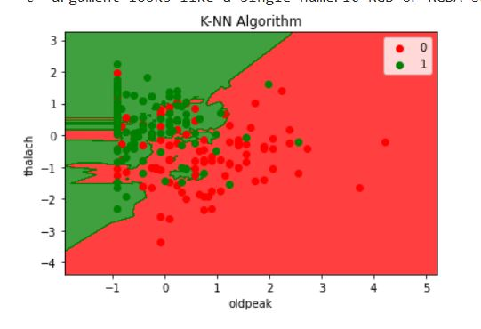
KNN ALGORITHM

Slide 19
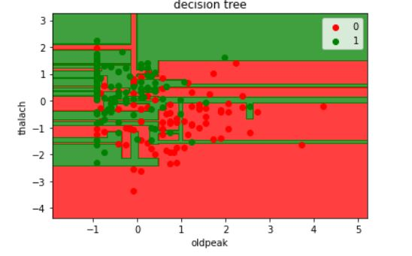
DECISION TREE

Slide 20
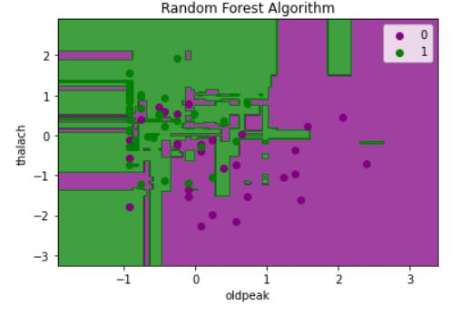
RANDOM FOREST

Slide 21
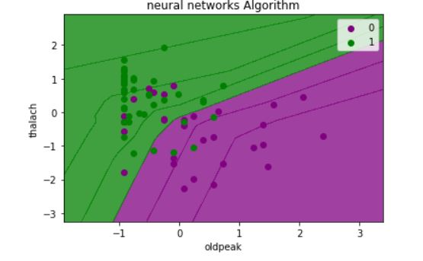
NEURAL NETWORKS

Slide 22
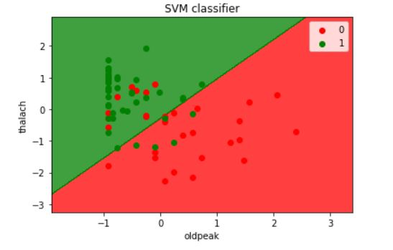
SVM

Slide 23
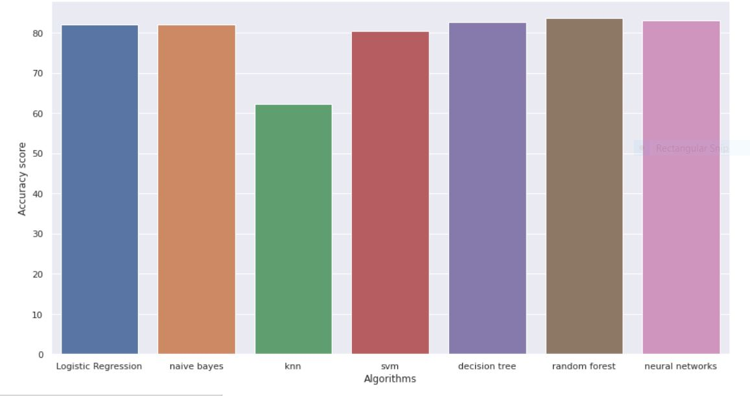

Slide 24
ACCURACY SCORE
ALGORITHM | ACCURACY
Logistic Regression | 81.97
Naïve Bayes | 81.97
KNN | 62.3
SVM | 80.33
Decision Tree | 82.61
Random Forest | 83.61
Neural Network | 82.97

Slide 25
9. REFERENCES
L. Loku, B. Fetaji, A. Krstev, M. Fetaji, Z. Zdravev, Using python programming for assessing and solving health management issues, South East Eur. J. Sustain. Dev. 4 (1) (2020).
P. Mathur, Overview of Machine Learning in healthcare, in: Machine Learning Applications using Python, A. Press, Berkeley, CA, 2019, pp. 1-11.
https://youtu.be/xtOg44r6dsE
https://youtu.be/gN1nQT-lA_k
https://www.javatpoint.com/machine-learning-random-forest-algorithm
https://archive.ics.uci.edu/ml/datasets/heart+disease

Slide 26


