Slide 1
Suicide, overdose, and worker exit
In a cohort of Michigan autoworkers
Ellen Eisen

Slide 2
Outline
Key Points
Background
Decline in US manufacturing
China Shock and the US automobile industry
United Autoworkers-General Motors (UAW-GM) Cohort
Methods
Results
Conclusions

Slide 3
Key Points
Question: Is risk of suicide or overdose among Michigan autoworkers associated with leaving work before retirement age during the period of decline in the domestic automobile industry?
Findings: In a longitudinal study of 26,890 autoworkers, risk of suicide was 17 times higher for those who left work than for those still employed. Workers who left work in their 20s or 30s had twice the risk of suicide or overdose relative to those who left for retirement.
Meaning: Most events occurred within five years of leaving work, suggesting that involuntary job loss may lead to suicide and fatal overdose.

Slide 4
Background
In the past 20 years, mortality due to drug overdose and suicide have increased in the US across all age groups and ethnicities (Hedegaard 2017, CDC 2014, Case 2015, Galea 2003, Keyes 2014)
Increase in so-called “deaths of despair” thought to be related to reduced economic opportunity, especially for those with lower levels of educational attainment
Involuntary worker exit found to have substantial effects on depressive symptoms, even after adjusting for baseline health (Burgard 2007)

Slide 5
Decline in US manufacturing
In the 1970s, 36% of all US male workers were employed in manufacturing
In 2018, only 15% of US male workers were employed in manufacturing (Rose 2018)
Good-paying jobs with strong employer-employee relationships and job security have declined while precarious work has increased (Kalleberg 2009)
China’s entry into the World Trade Organization in 2001 allowed Chinese imports to flood US markets, thereby contributing to industry contraction (Fort 2018)

Slide 6
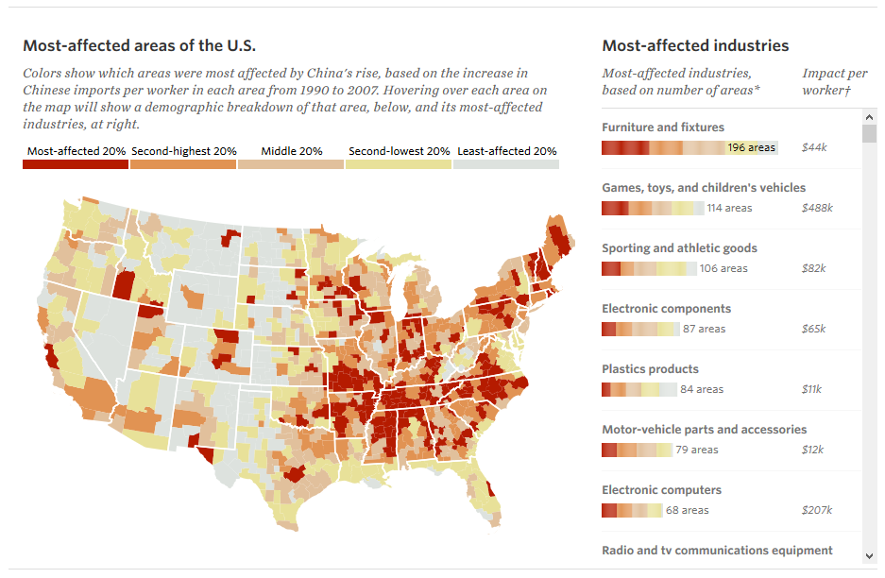
China Shock: All industries
Notes:
http://chinashock.info/

Slide 7
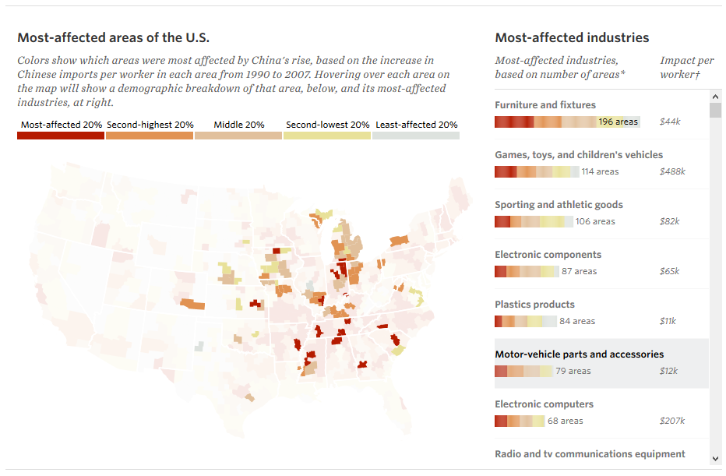
China Shock: Motor-vehicle parts & accessories
Notes:
http://chinashock.info/

Slide 8
US automobile industry
Striking case study of an impacted industry in decline
China shock
Oil embargo of 1979
Stronger vehicle safety regulations
Increasing oil prices
By 2008, Toyota became the largest automaker in the world, a title GM held for 77 years (Klier 2009)

Slide 9
United Autoworkers-General Motors Cohort (UAW-GM)
Large cohort of Michigan autoworkers with individual-level data
Cohort includes workers at 3 GM manufacturing facilities in Michigan
Urban center of Detroit
Willow Run, located 50 miles west of Detroit
Small city upstate, once a thriving lumber and manufacturing center
We focus on the period since the late 1970s, which captures a period of acceleration in the decline of the industry
By the end of follow-up in 2015, all three study plants had closed
We restricted our analyses to men due to the small number of cases observed among women in the cohort

Slide 10
Methods
Exposure: Worker exit measured in two ways
Time-varying employment status (active versus inactive)
Age at worker exit, to distinguish retirement (left work at age 55 or older) from early worker exit
Outcome: vital status and cause of death obtained through the Social Security Administration, the National Death Index, company records, death certificates, and state mortality files
Suicide alone
Suicide and Fatal overdose combined

Slide 11
Analytic method
Adjusted hazard ratios estimated using Cox proportional hazards models
Controlled for age, race, plant, year of hire, and calendar year of follow-up
Depression, a possible time-varying confounder, was not measured
All analyses conducted in R (version 3.6.1)
Cox proportional hazards models fitted using the survival package (Therneau 2000, Therneau 2015)

Slide 12
Model 1: By binary employment status
Follow-up starts 3 years after hire or January 1, 1970, whichever came later
Follow-up ends at death, loss to follow-up, or administrative end of follow-up on December 31, 2015
Employment records end on December 31, 1994; we censor subjects still employed at that time
Risk sets were indexed by age
Included covariates: race, plant, year of hire, and a time-dependent penalized spline function of calendar year of follow-up

Slide 13
Model 2: By categorical age at worker exit
Follow-up starts the day after worker exit
Follow-up ends at death, loss to follow-up, or administrative end of follow-up on December 31, 2015
Employment records end on December 31, 1994; we exclude subjects still employed at that time
Risk sets were indexed by time since worker exit
Included covariates: race, plant, and a time-dependent penalized spline function of calendar year of worker exit

Slide 14
Sensitivity analyses
Assumed that those who died of suicide within a week after the recorded worker exit date died while still employed
Account for possible “back-coding” of worker exit dates for those who died suddenly
Limited follow-up to no more than 5 years after the worker exit date
Account for confounding by age and the potential for competing risks

Slide 15
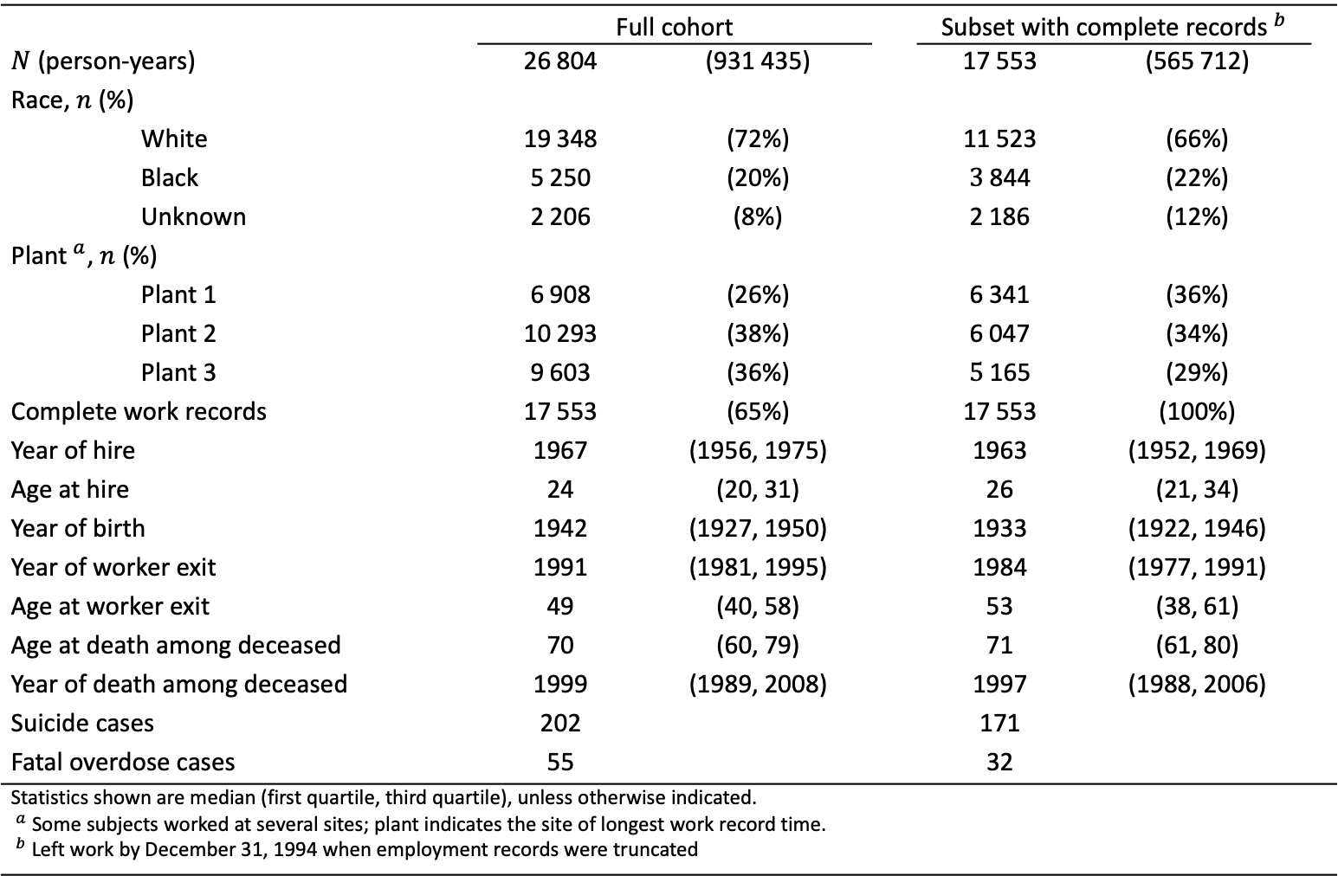
Table 1. Summary of the UAW-GM Cohort restricted to men employed in or after 1970.
 | Full cohort |  |  | Subset with complete records${​ }^{b}$
$N$ (person-years) | $$\text{26 8}\text{04}$$ | $$\text{(93}\text{1 435}\text{)}$$ |  | $$\text{1}\text{7 553}$$ | $$\text{(}\text{565} \text{712}\text{)}$$
Race, $n$ (%)
White | $$\text{19 3}\text{48}$$ | $$\text{(72\%)}$$ |  | $$\text{1}\text{1} \text{523}$$ | $$\text{(6}\text{6}\text{\%)}$$
Black | $$\text{5 2}\text{50}$$ | $$\text{(20\%)}$$ |  | $$\text{3} \text{844}$$ | $$\text{(2}\text{2}\text{\%)}$$
Unknown | $$\text{2 2}\text{06}$$ | $$\text{(8\%)}$$ |  | $$\text{2 }\text{186}$$ | $$\text{(1}\text{2}\text{\%)}$$
Plant${​ }^{a}$, $n$ (%)
Plant 1 | $$\text{6 9}\text{08}$$ | $$\text{(26\%)}$$ |  | $$\text{6 }\text{341}$$ | $$\text{(3}\text{6}\text{\%)}$$
Plant 2 | $$\text{10 }\text{293}$$ | $$\text{(38\%)}$$ |  | $$\text{6 }\text{047}$$ | $$\text{(3}\text{4}\text{\%)}$$
Plant 3 | $$\text{9 60}\text{3}$$ | $$\text{(36\%)}$$ |  | $$\text{5} \text{165}$$ | $$\text{(}\text{29}\text{\%)}$$
Complete work records | $$\text{1}\text{7} \text{55}\text{3}$$ | $$\text{(}\text{65}\text{\%)}$$ |  | $$\text{1}\text{7} \text{55}\text{3}$$ | $$\text{(100\%)}$$
Year of hire | $$\text{1967}$$ | $$\text{(1956, 1975)}$$ |  | $$\text{196}\text{3}$$ | $$\text{(195}\text{2}\text{, 19}\text{69}\text{)}$$
Age at hire | $$\text{24}$$ | $$\text{(20, 31)}$$ |  | $$\text{2}\text{6}$$ | $$\text{(2}\text{1}\text{, 3}\text{4}\text{)}$$
Year of birth | $$\text{1942}$$ | $$\text{(1927, 1950)}$$ |  | $$\text{193}\text{3}$$ | $$\text{(192}\text{2}\text{, 194}\text{6}\text{)}$$
Year of worker exit | $$\text{1991}$$ | $$\text{(198}\text{1}\text{, 1995)}$$ |  | $$\text{198}\text{4}$$ | $$\text{(197}\text{7}\text{, 199}\text{1}\text{)}$$
Age at worker exit | $$\text{49}$$ | $$\text{(40, 58)}$$ |  | $$\text{5}\text{3}$$ | $$\text{(3}\text{8}\text{, 61)}$$
Age at death among deceased | $$\text{70}$$ | $$\text{(60, 79)}$$ |  | $$\text{71}$$ | $$\text{(61, 80)}$$
Year of death among deceased | $$\text{1999}$$ | $$\text{(1989, 2008)}$$ |  | $$\text{1997}$$ | $$\text{(1988, 200}\text{6}\text{)}$$
Suicide cases | 202 |  |  | 171
Fatal overdose cases | 55 |  |  | 32
Statistics shown are median (first quartile, third quartile), unless otherwise indicated. ${​ }^{a}$ Some subjects worked at several sites; plant indicates the site of longest work record time. ${​ }^{b}$ Left work by December 31, 1994 when employment records were truncated

Slide 16
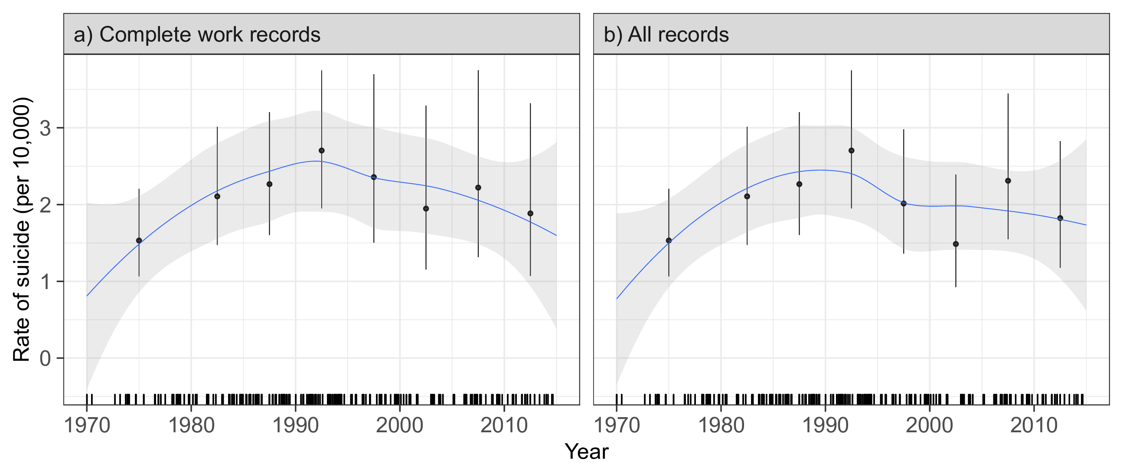
Results: Crude rate of suicide
Figure 1. Crude rate (per 10,000 person-years) of suicide by calendar year in the UAW-GM Cohort restricted to men employed in or after 1970.

Slide 17
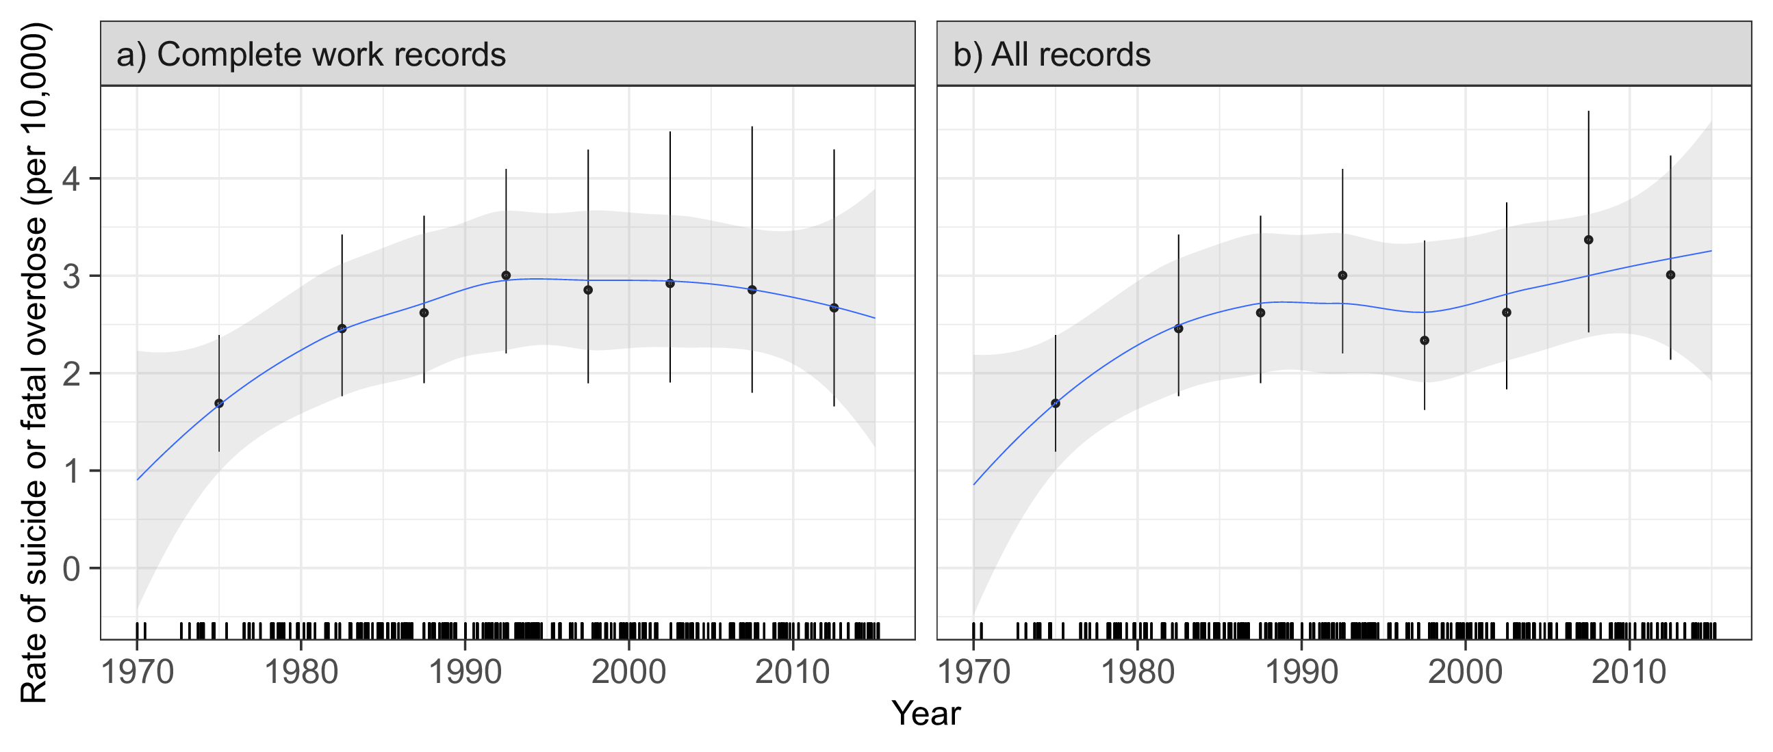
Results: Crude rate of suicide & fatal overdose
Figure 2. Crude rate (per 10,000 person-years) of the combined outcome of suicide and fatal overdose by calendar year in the UAW-GM Cohort restricted to men employed in or after 1970.

Slide 18
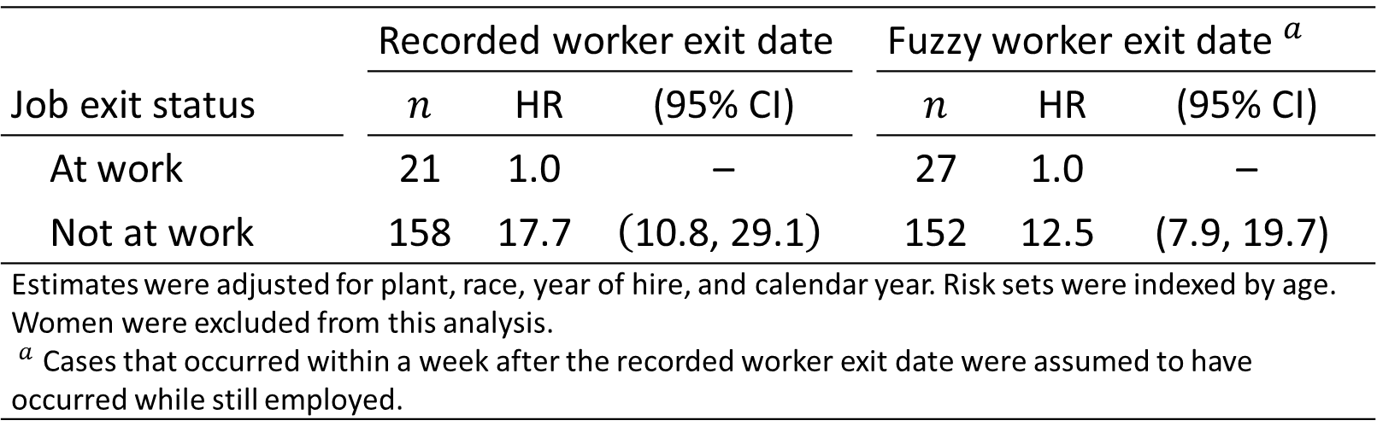
Results: By binary employment status
Table 2. Adjusted hazard ratio estimates for suicide by employment status in the UAW-GM Cohort restricted to men employed in or after 1970.
 |  | Recorded worker exit date |  |  |  | Fuzzy worker exit date${​ }^{a}$
Job exit status |  | $$n$$ | HR | (95% CI) |  | $$n$$ | HR | (95% CI)
At work |  | $$\text{21}$$ | $$\text{1.0}$$ | – |  | $$\text{27}$$ | $$\text{1.0}$$ | –
Not at work |  | $$\text{158}$$ | $$\text{17.7}$$ | $$\left(\text{10.8, 29.1}\right)$$ |  | $$\text{152}$$ | $$\text{12.5}$$ | $$\text{(7.9, 19.7)}$$
Estimates were adjusted for plant, race, year of hire, and calendar year. Risk sets were indexed by age. Women were excluded from this analysis. ${​ }^{a}$ Cases that occurred within a week after the recorded worker exit date were assumed to have occurred while still employed.

Slide 19
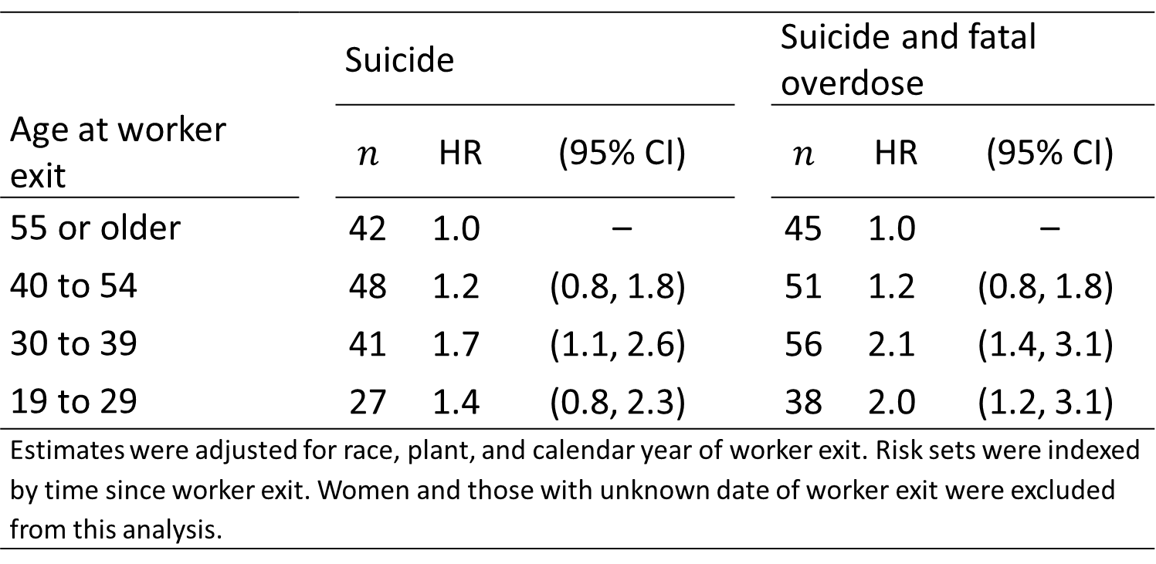
Results: By age at worker exit
Table 3. Adjusted hazard ratio estimates for suicide and the combined outcome of suicide and fatal overdose in the UAW-GM Cohort restricted to men employed in or after 1970.
 |  | Suicide |  |  |  | Suicide and fatal overdose
Age at worker exit |  | $$n$$ | HR | (95% CI) |  | $$n$$ | HR | (95% CI)
$\text{55}$ or older |  | $$\text{42}$$ | $$\text{1.0}$$ | – |  | $$\text{45}$$ | $$\text{1.0}$$ | –
$\text{40}$ to $\text{54}$ |  | $$\text{48}$$ | $$\text{1.2}$$ | $$\text{(0.8, 1.8)}$$ |  | $$\text{51}$$ | $$\text{1.2}$$ | $$\text{(0.8, 1.8)}$$
$\text{30}$ to $\text{39}$ |  | $$\text{41}$$ | $$\text{1.7}$$ | $$\text{(1.1, 2.6)}$$ |  | $$\text{56}$$ | $$\text{2.1}$$ | $$\text{(1.4, 3.1)}$$
$\text{19}$ to $\text{29}$ |  | $$\text{27}$$ | $$\text{1.4}$$ | $$\text{(0.8, 2.3)}$$ |  | $$\text{38}$$ | $$\text{2.0}$$ | $$\text{(1.2, 3.1)}$$
Estimates were adjusted for race, plant, and calendar year of worker exit. Risk sets were indexed by time since worker exit. Women and those with unknown date of worker exit were excluded from this analysis.

Slide 20
Conclusions
Michigan autoworkers who left work after 1970 had a higher risk of death from suicide or overdose than those who remained actively employed
Most events occurred within 5 years of leaving work among those who left before retirement age
These findings suggest that involuntary job loss may lead to suicide and fatal overdose

Slide 21
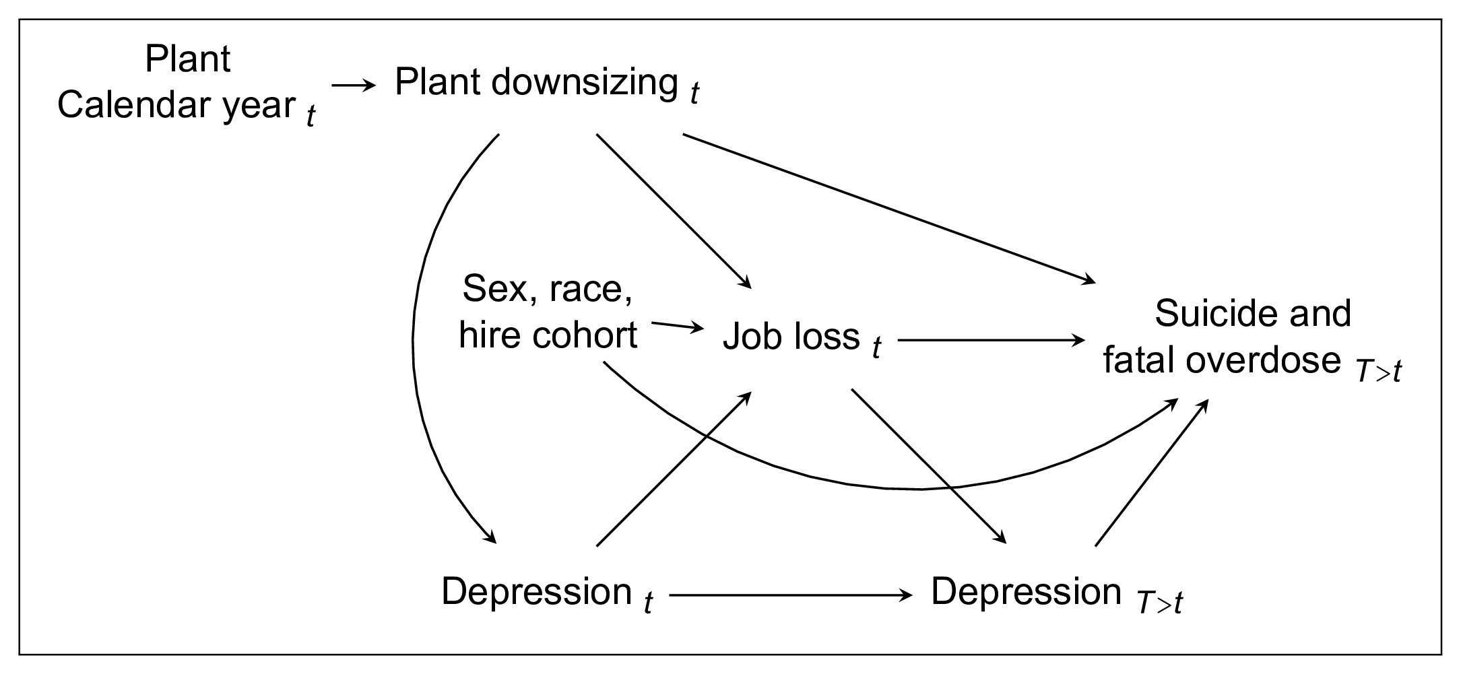
Additional materials: DAG
eFigure 1. Directed acyclic graph representing our working causal assumptions.

Slide 22
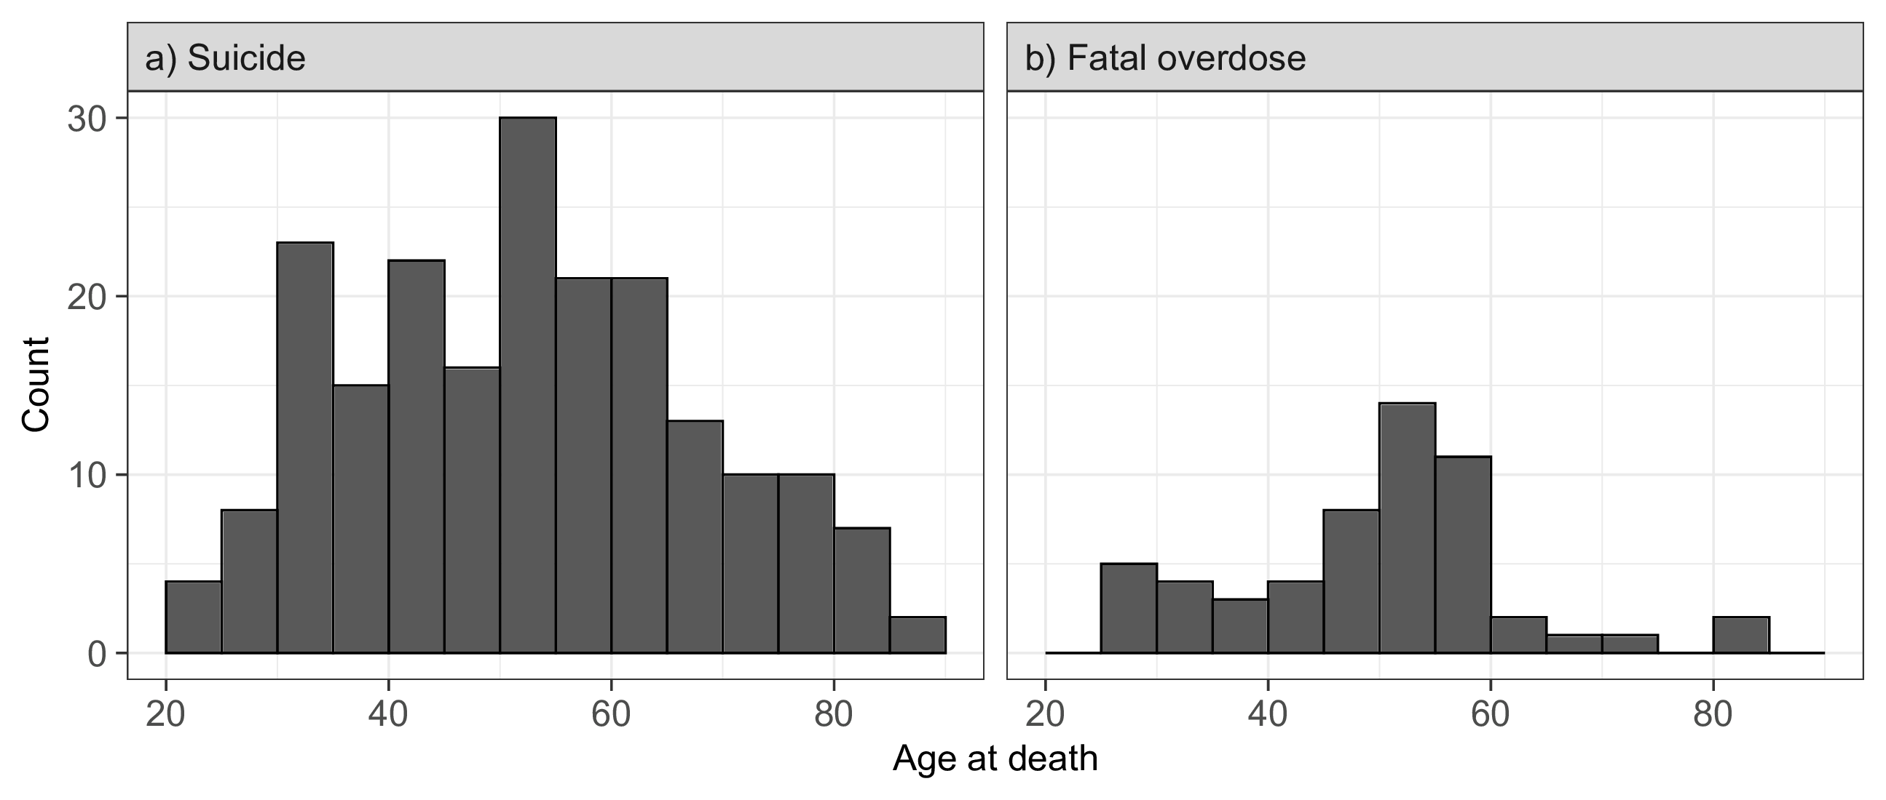
Additional materials: Age at death
eFigure 2. Histograms of age at death among suicide and fatal overdose cases in the UAW-GM Cohort restricted to men employed in or after 1970.

Slide 23
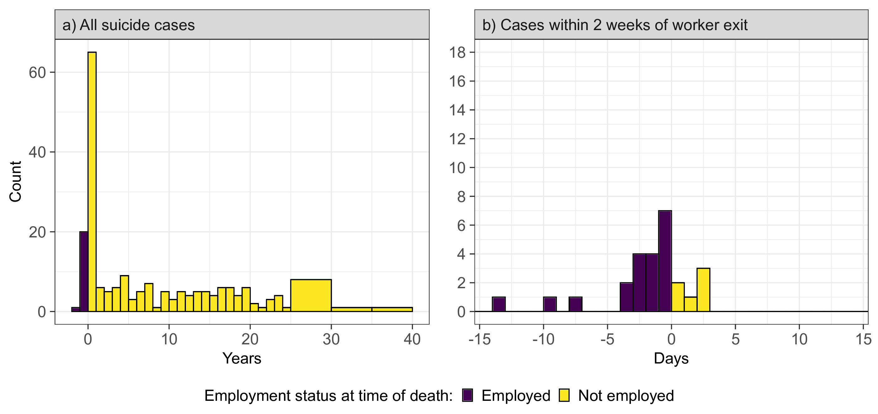
Additional materials: Fuzzy dates
eFigure 3. Histograms of time between worker exit date and date of suicide in the UAW-GM Cohort restricted to men employed in or after 1970. Bins corresponding to cases that occurred while employed are indicated in purple.

Slide 24
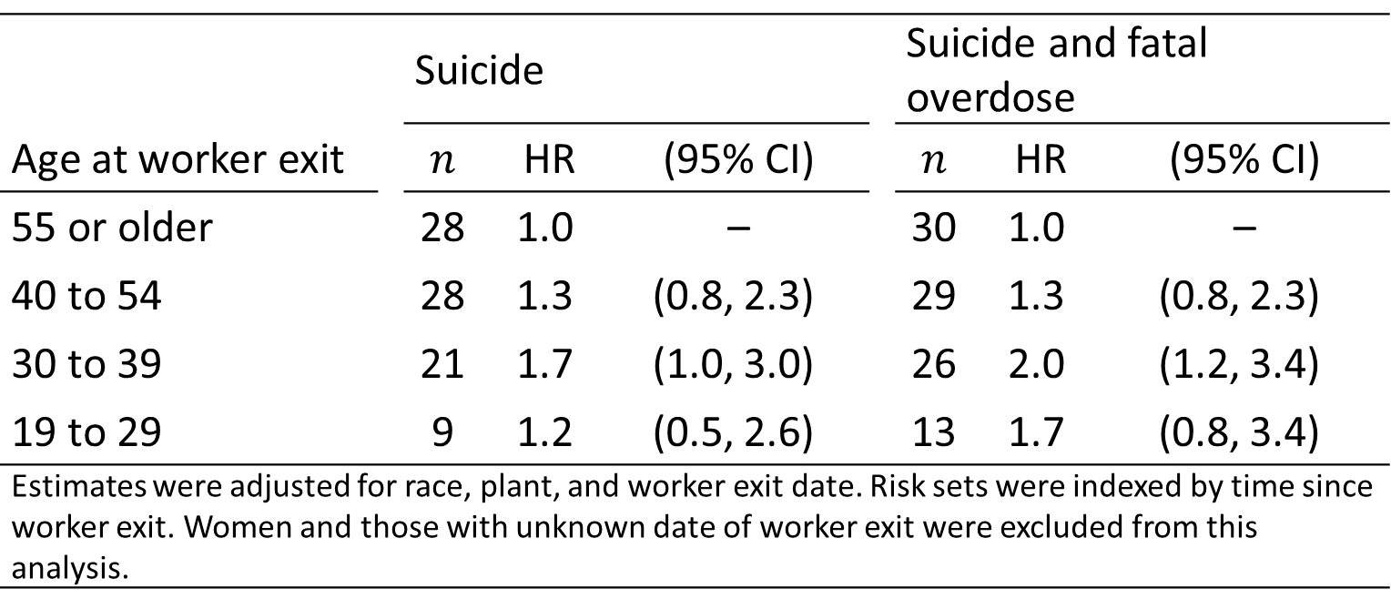
Additional materials: Restricted follow-up
eTable 1. Adjusted hazard ratio estimates for suicide and the combined outcome of suicide and fatal overdose in the UAW-GM Cohort, within five years of worker exit, restricted to men employed in or after 1970 who left work by December 31, 1994.
 |  | Suicide |  |  |  | Suicide and fatal overdose
Age at worker exit |  | $$n$$ | HR | (95% CI) |  | $$n$$ | HR | (95% CI)
$\text{55}$ or older |  | $$\text{28}$$ | $$\text{1.0}$$ | – |  | $$\text{30}$$ | $$\text{1.0}$$ | –
$\text{40}$ to $\text{54}$ |  | $$\text{28}$$ | $$\text{1.3}$$ | $$\text{(0.8, 2.3)}$$ |  | $$\text{29}$$ | $$\text{1.3}$$ | $$\text{(0.8, 2.3)}$$
$\text{30}$ to $\text{39}$ |  | $$\text{21}$$ | $$\text{1.7}$$ | $$\text{(1.0, 3.0)}$$ |  | $$\text{26}$$ | $$\text{2.0}$$ | $$\text{(1.2, 3.4)}$$
$\text{19}$ to $\text{29}$ |  | $$\text{9}$$ | $$\text{1.2}$$ | $$\text{(0.5, 2.6)}$$ |  | $$\text{13}$$ | $$\text{1.7}$$ | $$\text{(0.8, 3.4)}$$
Estimates were adjusted for race, plant, and worker exit date. Risk sets were indexed by time since worker exit. Women and those with unknown date of worker exit were excluded from this analysis.

Slide 25
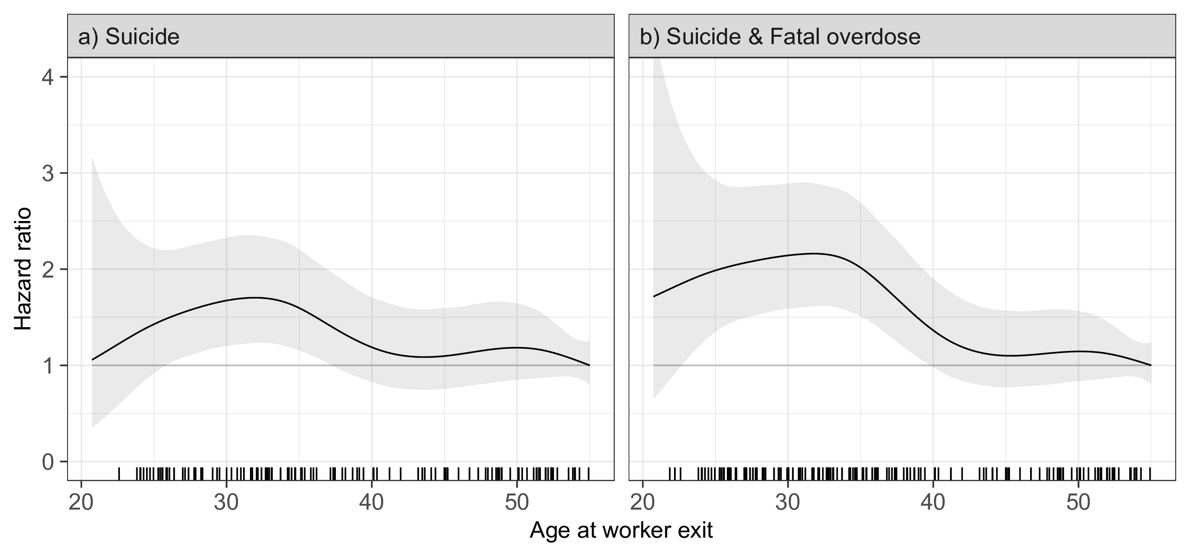
Additional materials: Spline fits
eFigure 4. Continuous adjusted hazard ratio estimates for suicide and the combined outcome of suicide and fatal overdose in the UAW-GM Cohort restricted to men employed in or after 1970.

