Slide 1
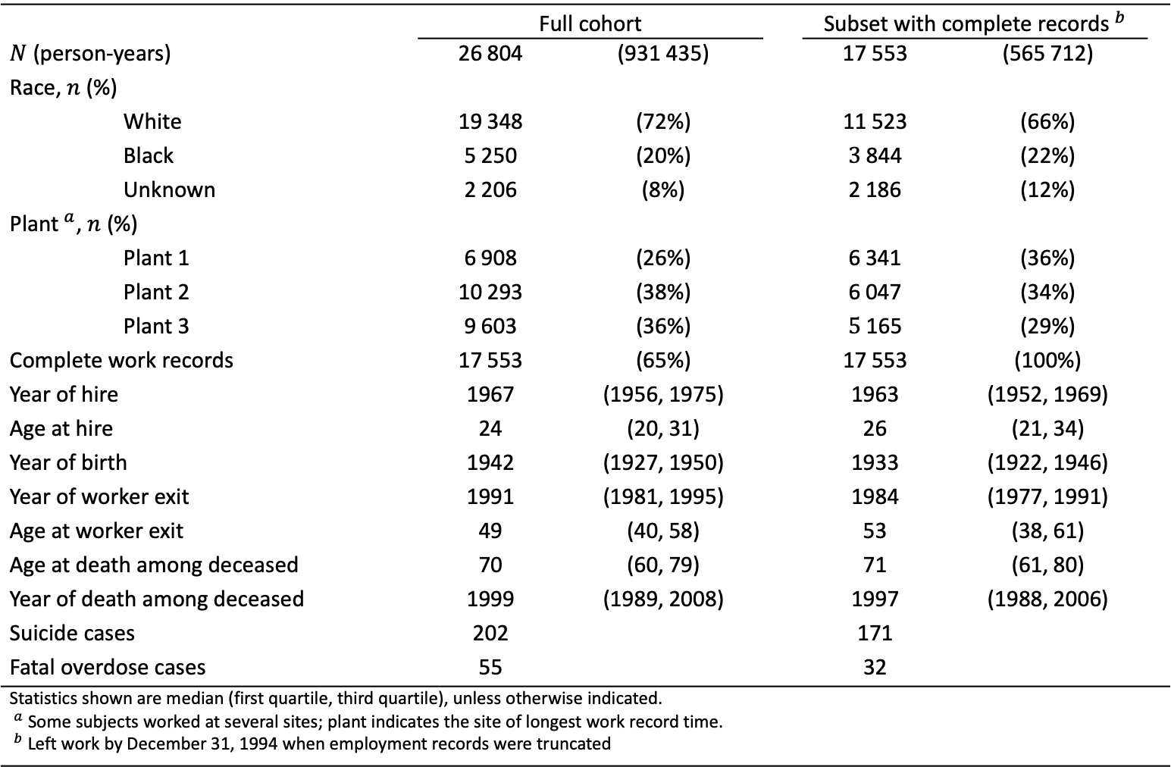
Table 1. Summary of the UAW-GM Cohort restricted to men employed in or after 1970.
 | Full cohort |  |  | Subset with complete records${​ }^{b}$
$N$ (person-years) | $$\text{26 8}\text{04}$$ | $$\text{(93}\text{1 435}\text{)}$$ |  | $$\text{1}\text{7 553}$$ | $$\text{(}\text{565} \text{712}\text{)}$$
Race, $n$ (%)
White | $$\text{19 3}\text{48}$$ | $$\text{(72\%)}$$ |  | $$\text{1}\text{1} \text{523}$$ | $$\text{(6}\text{6}\text{\%)}$$
Black | $$\text{5 2}\text{50}$$ | $$\text{(20\%)}$$ |  | $$\text{3} \text{844}$$ | $$\text{(2}\text{2}\text{\%)}$$
Unknown | $$\text{2 2}\text{06}$$ | $$\text{(8\%)}$$ |  | $$\text{2 }\text{186}$$ | $$\text{(1}\text{2}\text{\%)}$$
Plant${​ }^{a}$, $n$ (%)
Plant 1 | $$\text{6 9}\text{08}$$ | $$\text{(26\%)}$$ |  | $$\text{6 }\text{341}$$ | $$\text{(3}\text{6}\text{\%)}$$
Plant 2 | $$\text{10 }\text{293}$$ | $$\text{(38\%)}$$ |  | $$\text{6 }\text{047}$$ | $$\text{(3}\text{4}\text{\%)}$$
Plant 3 | $$\text{9 60}\text{3}$$ | $$\text{(36\%)}$$ |  | $$\text{5} \text{165}$$ | $$\text{(}\text{29}\text{\%)}$$
Complete work records | $$\text{1}\text{7} \text{55}\text{3}$$ | $$\text{(}\text{65}\text{\%)}$$ |  | $$\text{1}\text{7} \text{55}\text{3}$$ | $$\text{(100\%)}$$
Year of hire | $$\text{1967}$$ | $$\text{(1956, 1975)}$$ |  | $$\text{196}\text{3}$$ | $$\text{(195}\text{2}\text{, 19}\text{69}\text{)}$$
Age at hire | $$\text{24}$$ | $$\text{(20, 31)}$$ |  | $$\text{2}\text{6}$$ | $$\text{(2}\text{1}\text{, 3}\text{4}\text{)}$$
Year of birth | $$\text{1942}$$ | $$\text{(1927, 1950)}$$ |  | $$\text{193}\text{3}$$ | $$\text{(192}\text{2}\text{, 194}\text{6}\text{)}$$
Year of worker exit | $$\text{1991}$$ | $$\text{(198}\text{1}\text{, 1995)}$$ |  | $$\text{198}\text{4}$$ | $$\text{(197}\text{7}\text{, 199}\text{1}\text{)}$$
Age at worker exit | $$\text{49}$$ | $$\text{(40, 58)}$$ |  | $$\text{5}\text{3}$$ | $$\text{(3}\text{8}\text{, 61)}$$
Age at death among deceased | $$\text{70}$$ | $$\text{(60, 79)}$$ |  | $$\text{71}$$ | $$\text{(61, 80)}$$
Year of death among deceased | $$\text{1999}$$ | $$\text{(1989, 2008)}$$ |  | $$\text{1997}$$ | $$\text{(1988, 200}\text{6}\text{)}$$
Suicide cases | 202 |  |  | 171
Fatal overdose cases | 55 |  |  | 32
Statistics shown are median (first quartile, third quartile), unless otherwise indicated. ${​ }^{a}$ Some subjects worked at several sites; plant indicates the site of longest work record time. ${​ }^{b}$ Left work by December 31, 1994 when employment records were truncated

