Slide 1
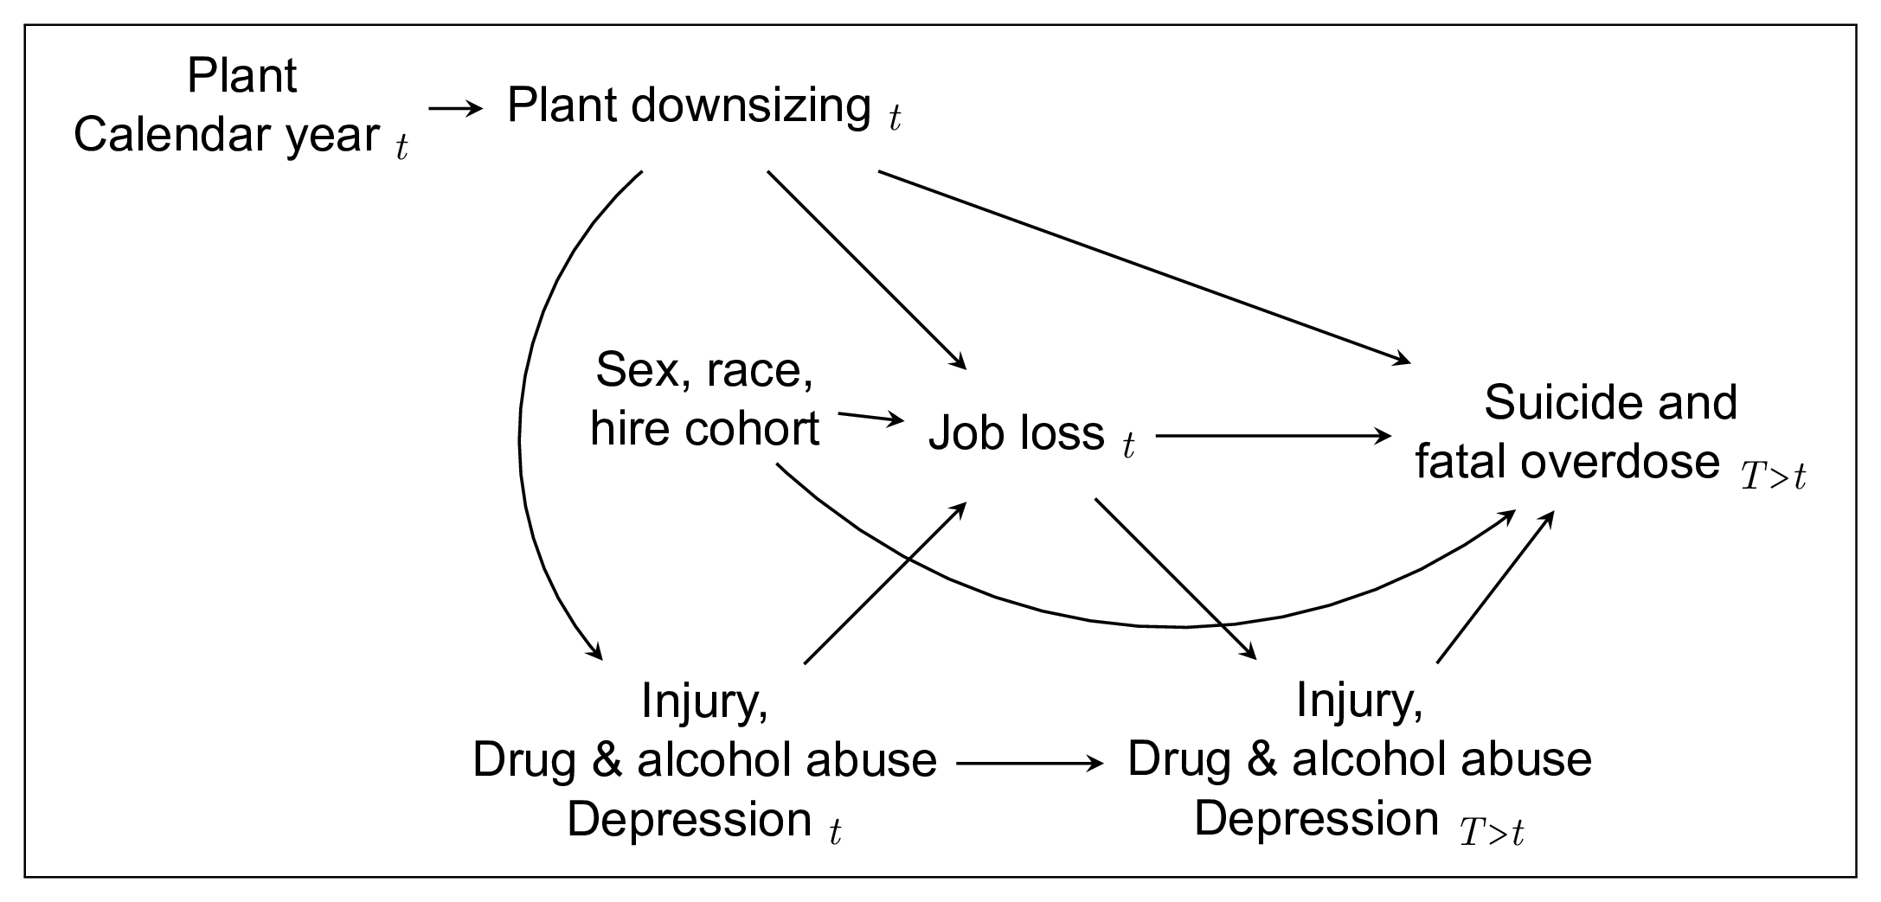

Additional materials: DAG
eFigure 1. Directed acyclic graph representing our working causal assumptions.

