Slide 1
Create An OpenCCC Account
How To…
First-Time User California Community Colleges

Slide 2
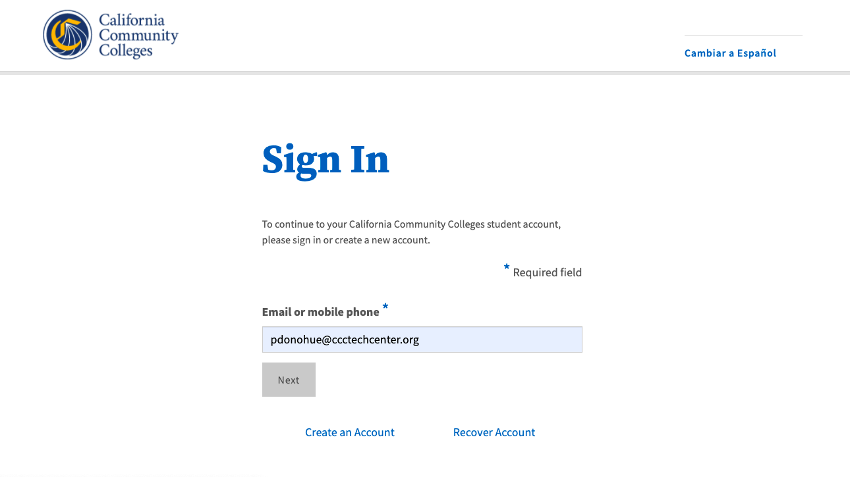
Why do you need an OpenCCC Account?
Step 1: Get Started
1. Click the Create An Account link on Sign In page
OpenCCC is the student account system for all 116 California Community Colleges.
Regardless of which college you are attending, OpenCCC generates a one-time CCC-ID for every student across the system.
The CCCID ensures all your applications and records are consolidated in one place throughout your college journey in the CCC system.
Reminder: If you already have an OpenCCC account, Sign In using your email address, or click the Recover Account link to reset your password.

Slide 3
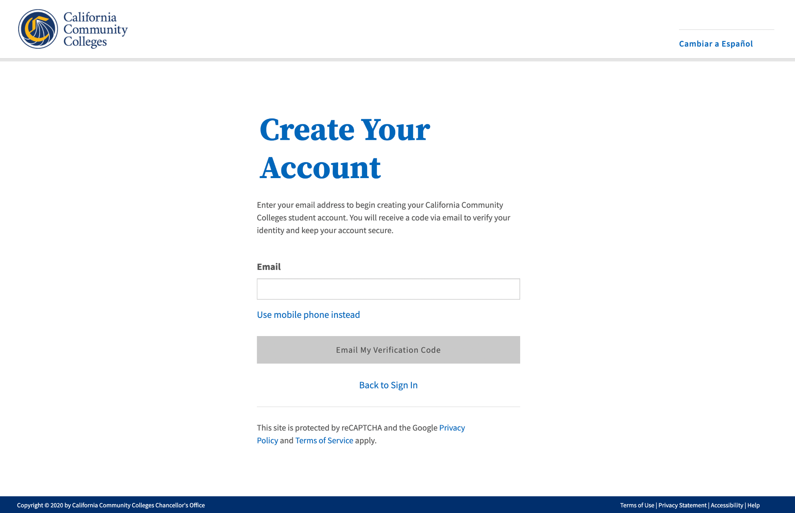
Here’s what you need to create your account
Step 2: Create Your Account
1. Enter your unique email address in Email field
A unique email address
Access to your email account
Chrome or Safari browser recommended
If you’re using a mobile device…
A unique, mobile phone number
Access to your mobile device
Email address to complete setting up your account
1
2
2. Click Email My Verification Code button

Slide 4
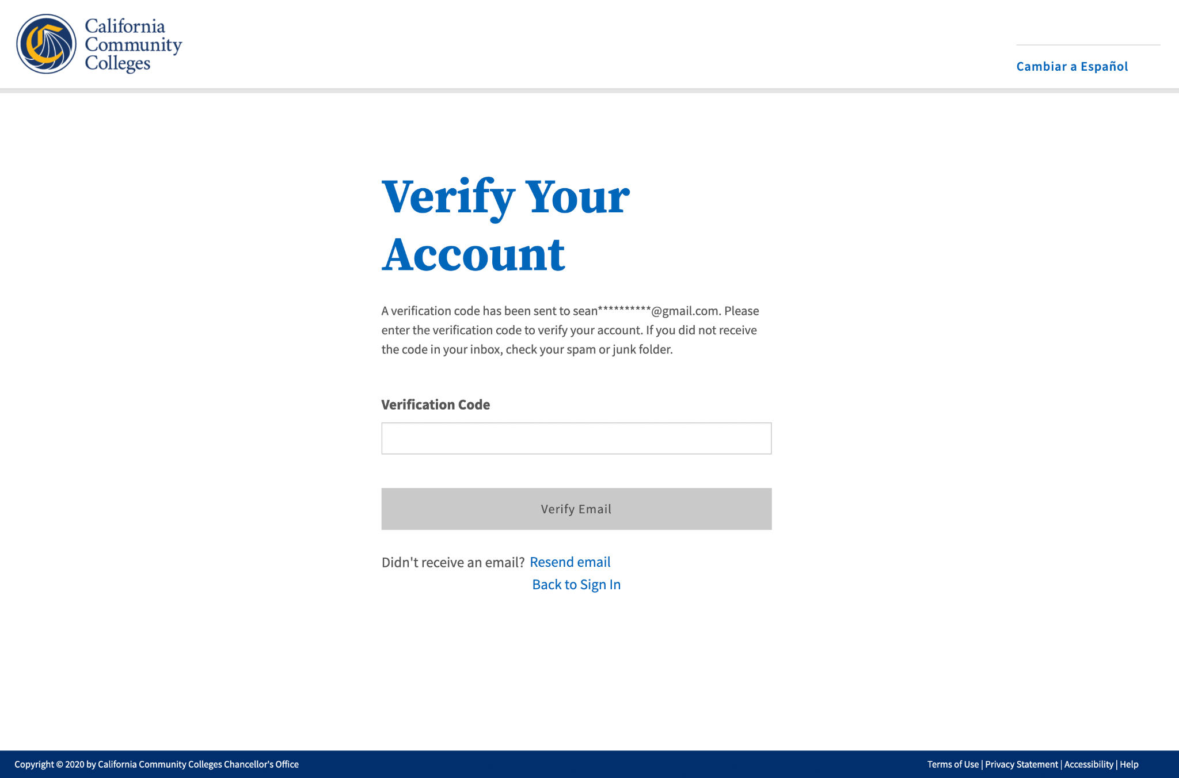
Retrieve your security code to verify your identity
Step 3: Verify Your Account
3. Enter security code in the Verification Code field
Access your email account and find the email from California Community Colleges
Copy the six-digit security code
Return to the Verify Your Account page and enter the code in the Verification Code field
Important Notes:
The security code is time-sensitive
Enter your code within 10 minutes
Three retries are allowed
Request a new code at any time
3
4
4. Click Verify Email button to verify your identity

Slide 5
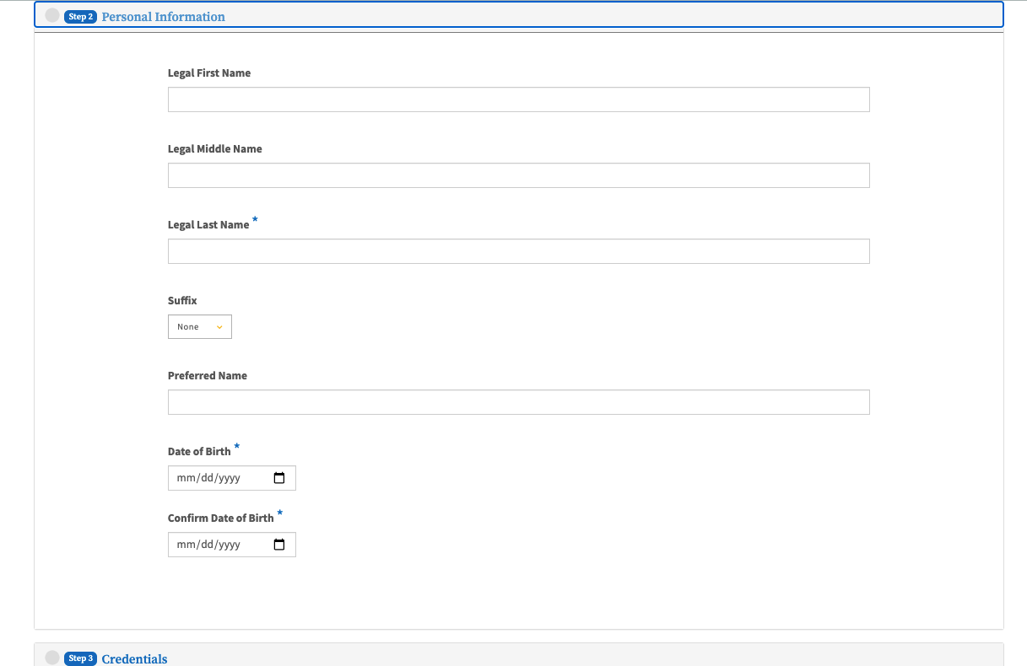
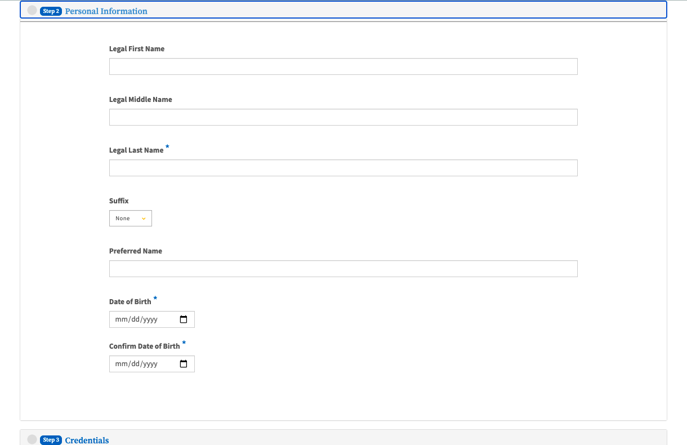
Basic Profile Information
Step 4: Complete Profile
5. Provide your Personal & Contact Information
5
Provide a phone number and indicate the type (mobile or landline)
Provide your permanent home address
Provide your full legal name
Enter and confirm your date of birth
6
6. Continue to Credentials screen to create password

Slide 6
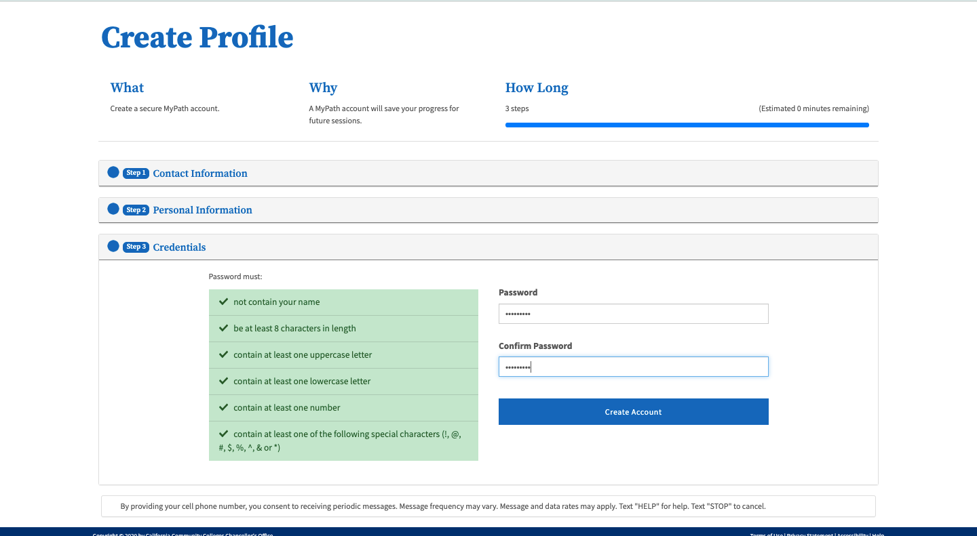
Our Commitment to Security & Privacy
Step 5: Create Password & Finish
7. Create and confirm your secure password
OpenCCC uses two-factor (2FA) authentication for identity security
Your personal information is secure
Your information is never sold or shared with third parties
Your data is encrypted in transit and at rest
7
8
8. Click Create Account button to finish

Slide 7

Congratulations!
Your account has been created and you’re on your way!

